Slide 1
IFMA Chapter Champions
Training Workshop
January 20, 2022

Slide 2

Agenda
Setting Expectations
Understanding Needs & Providing Solutions
Key Talking Points
Champion Toolkit
Q&A

Slide 3

About The IFMA Champions Program
Purpose
To improve support and resources to IFMA Chapters worldwide
Goals
Increase capacity of chapters
Improve the connection between IFMA and Chapters through direct engagement
Notes:
Description:
To improve the connection between IFMA HQ and IFMA chapters worldwide, IFMA volunteers and staff leaders (e.g., “Champions”) will provide information and targeted support to chapters utilizing a curated selection of IFMA resources (“Toolkit”). This Program and the Toolkit will be managed by the Director, Components and Membership.
Purpose:
IFMA has developed the Champions Program and Toolkit in an effort to improve support to and increase direct engagement with IFMA chapters. This Program directly supports the achievement of Strategic Theme 1, Objective 2, of IFMA’s Balanced Scorecard for 2020-2022.
Why did IFMA develop a ‘Champions’ Program?
IFMA is committed to supporting IFMA Chapters worldwide in meeting their goals and representing their members in the Build Environment. This program seeks to improve how IFMA supports and provides resources to IFMA Chapters. It also have the benefit of increasing the connection between IFMA and Chapters through direct engagement.
How does this Program work?
IFMA has recruited volunteers from the IFMA international board of directors, Fellows, and senior staff to serve as Champions. Champions will provide information and targeted support to chapters utilizing a curated selection of IFMA resources (“Toolkit”). This Program and the Toolkit will be managed by the Director, Components and Membership.
Which Chapters are getting a Champion?
In this first year of the Champions’ Program, IFMA International has assigned Champions to only a portion of all IFMA Chapters. Chapters are not able to request a Champion at this time. However, IFMA intends to expand the Program to include more Chapters in the future.
How do I respond if a Chapter reaches out to me requesting a Champion?
Please direct this contact to their Component Liaison. IFMA’s Components Team maintains a list of chapter requests for future consideration. In the meantime, IFMA staff will make all efforts to provide these chapters with direct support in lieu of a Champion.

Slide 4

Setting Expectations
IFMA’s Expectations of Champions
Participate in kickoff meeting
Receive training
At least two (2) contacts with adopted chapter(s) per term
Provide feedback to chapter liaisons
Notes:
Champion Responsibilities and Expectations
To participate in an initial kickoff meeting. Champions will only need to participate in this meeting once in the lifetime of their service as Champions;
To participate in a training workshop before making contact with their assigned chapter(s);
To engage with the board leaders of their adopted chapter(s) at least twice within the 18-month period of their term; and
Provide feedback to IFMA chapter liaisons on staff following each chapter contact.

Slide 5
How IFMA Champions Serve
Work with Chapter board leaders to understand their challenges, needs
Identify gaps in Chapter leadership’s knowledge about IFMA services and programs
Utilize resources from IFMA’s Champions Toolkit to develop solutions
Notes:
Champions are expected to have contact with board leaders (especially the President and 1st Vice Chair/President-elect) of their adopted chapter(s) at least twice within the 18-month period of their term.
Champions are expected to build a relationship with chapter leaders and identify/recommend the nature of their support to the chapter. IFMA HQ staff are available to provide suggestions for topics or areas for support and which IFMA resources to utilize.

Slide 6

Setting Expectations
What Chapters Can Expect From Champions
Guidance
Advice
Mentorship
Support and encouragement
Insight into ‘what’s new’
Notes:
Champions are to serve as resources to chapter leaders, providing guidance, advice, and mentorship. They should also share relevant news and updates from IFMA International with their Chapters.
Examples of the kinds of information Champions should share include but are not limited to: forwarding information about upcoming IFMA events and calls for presenters; sharing new tools and templates developed for Components; providing membership data reports developed by IFMA annually; etc.
Contacts can take many forms, including but not limited to phone calls; email exchanges; in-person meetings; and chapter events.

Slide 7
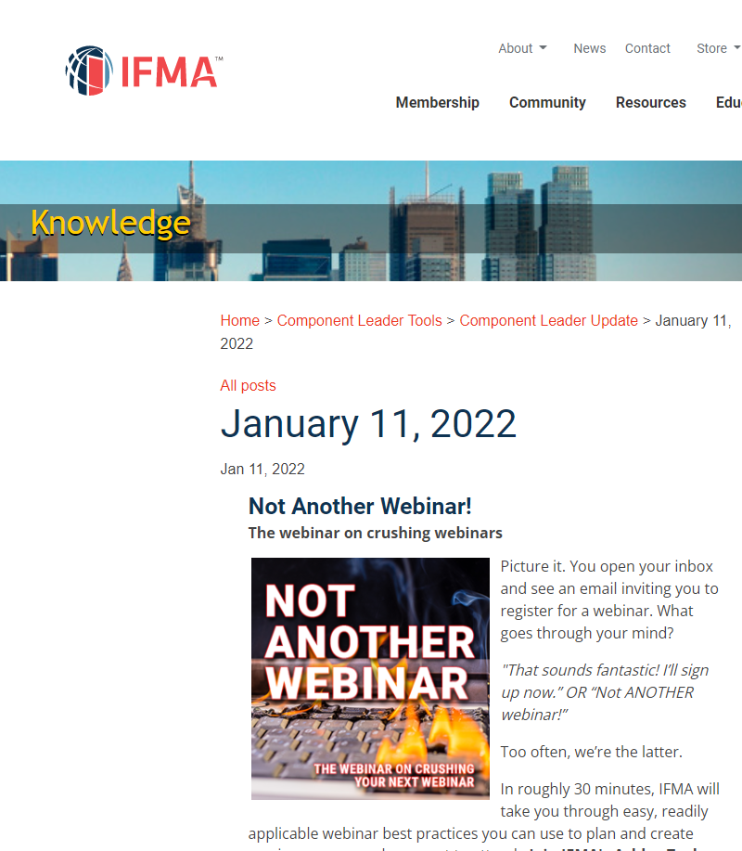
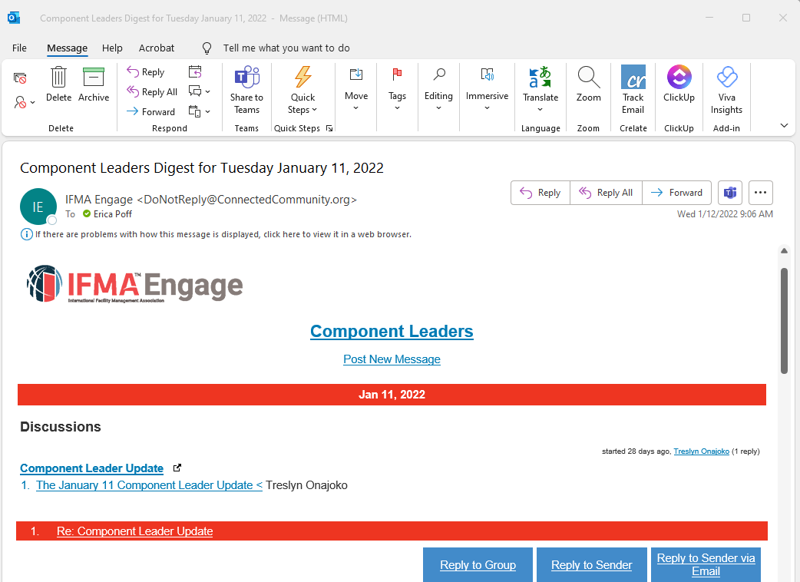
Notes:
Examples of the kinds of information Champions should be sharing

Slide 8
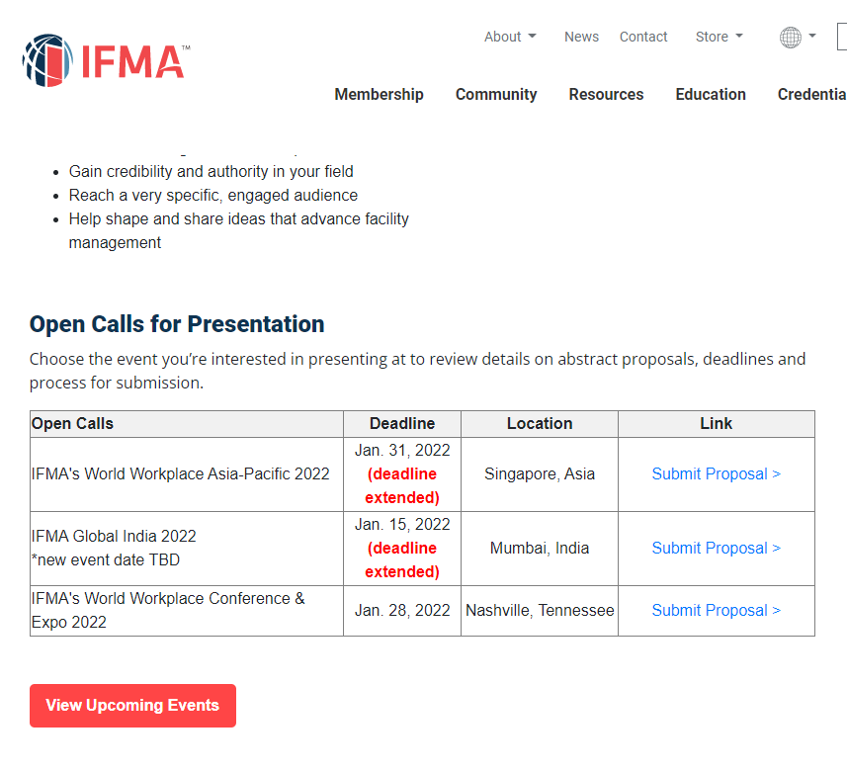
Notes:
More examples

Slide 9
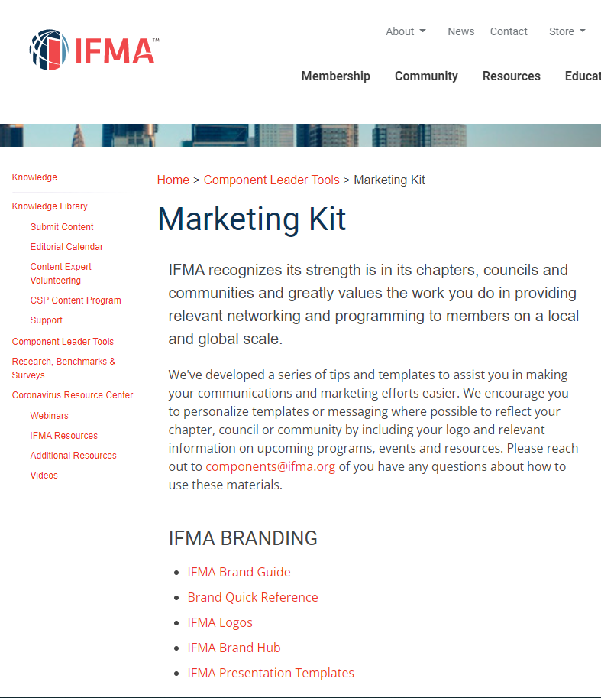
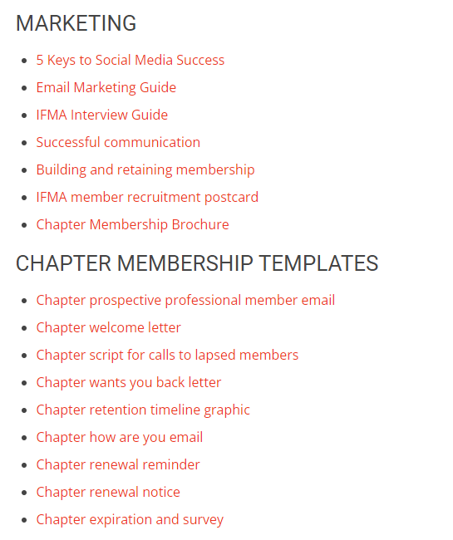
Notes:
More examples

Slide 10

Setting Expectations
What Champions Can Expect From IFMA
Resources
Support
Guidance
Recognition
Regular Communication
Notes:
The Champions’ Toolkit is the one-stop shop for Champions to find resources to share with their Chapters. This resource is only available to IFMA Champions and cannot be accessed through the IFMA main website.
IFMA Component Liaisons have been assigned to both Champions and Chapters, and they are your primary points of contact for questions, support, and guidance.
IFMA Champions are recognized at IFMA events and through IFMA marketing and communications

Slide 11
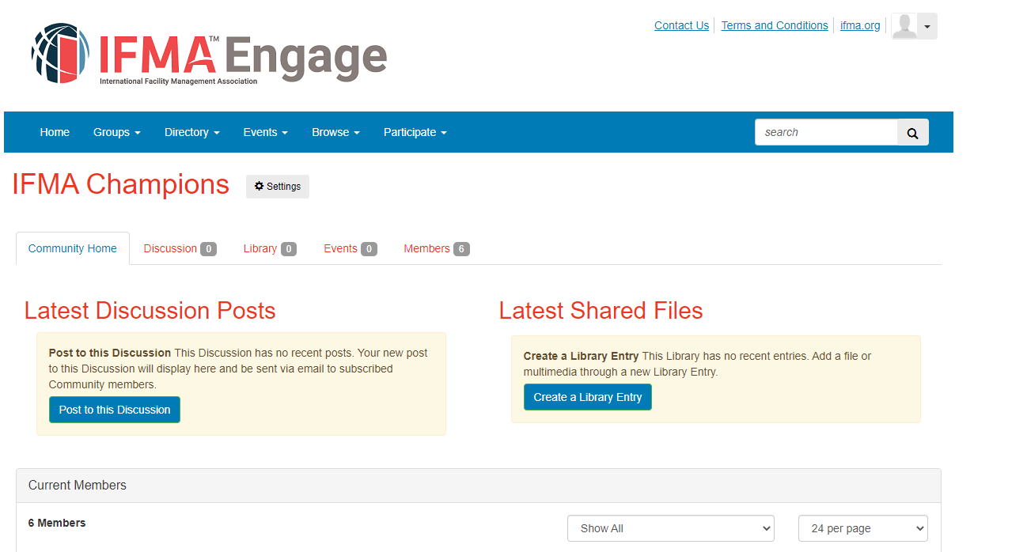
Notes:
The Champions Engage forum will be the primary means by which IFMA communicates updates and news out to Champions. Champions will also receive the Component Leaders e-newsletter (see example on slide 7)

Slide 12

Setting Limits
What Chapters Should NOT Expect of Champions
Administrative Support
Engagement with Chapter membership
Volunteerism to the Chapter
Notes:
While some Chapters have Administrators, many do not. Champions are not expected to conduct any administrative tasks and duties.
Champions provide support, guidance, advice and mentorship to the Chapter’s leadership. As such, Champions are not expected to provide training or give presentations to the Chapter’s membership.
Champions are not a part of the Chapter’s board of directors or on any Committees; as such, Champions are not expected to engage in any volunteer leadership on behalf of the Chapter

Slide 13


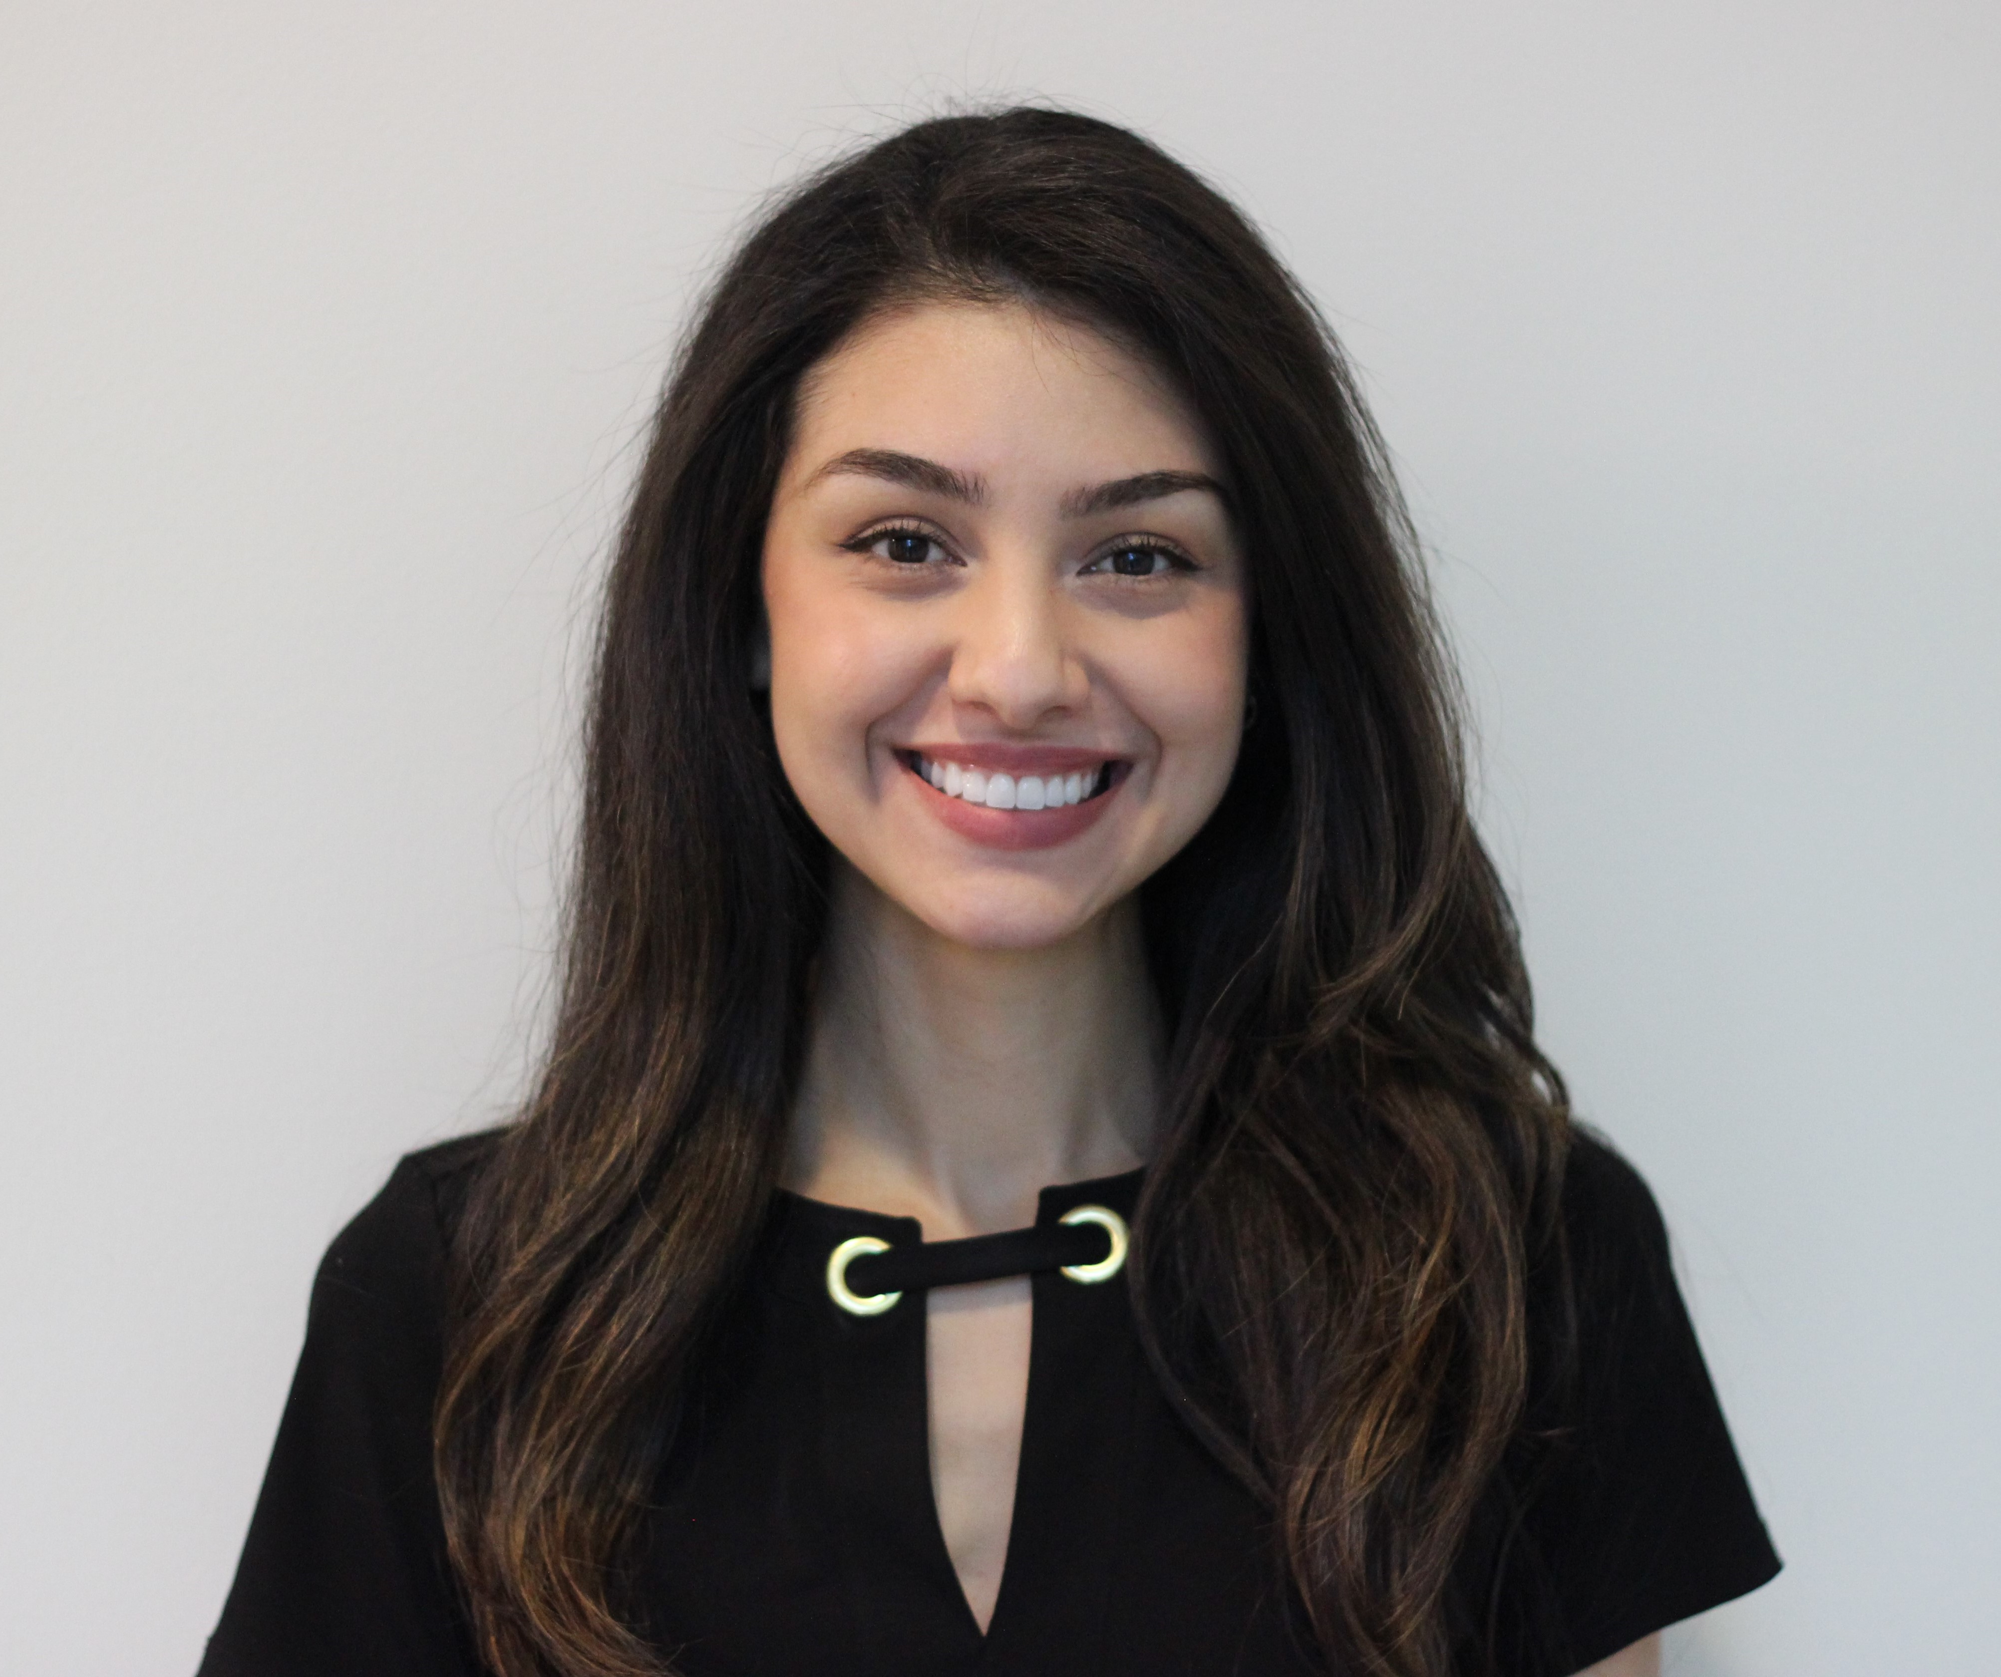
When In Doubt….
Joshua Amos, Components Liaison
Aniesha Hall, Components Liaison
Natalie Ortega,
Components Liaison
…Ask A Component Liaison!
Notes:
Component Liaisons are there for you, as a Champion, AND for Chapters.
The Liaison will be introducing the Champion to their Chapter next week
There will eventually be a spreadsheet showing which Liaison is to which Chapter

Slide 14

Understanding Our
Chapters
Notes:
In order to understand how we can best serve our adopted Chapters, it’s important to think from the Chapter’s perspective.

Slide 15
The Chapter Perspective
Largely volunteer-driven
Limited resources
Varying leadership skills/experience/training
Think and act locally
IFMA International- WIIFM?
Notes:
Most IFMA Chapters have little or no paid staff, meaning volunteers drive everything from strategy to conducting operations to taking care of administrative tasks
Chapter boards are highly dependent upon committees and other volunteers to realize the work of the Chapter
Our volunteer leaders come from the world of Facility Management, and they are not expected to have expertise in association management. As such, the level and quality of leadership skills, experiences, and training received to lead and govern an association will vary widely from Chapter to Chapter, person to person.
Chapter leaders are focused on serving their members locally. As such, they are not necessarily thinking about the larger world of IFMA and may not know about all the great offerings, resources, and services IFMA international has to offer them.
As their Champion, you can help to build that bridge- connecting Chapters to IFMA international and bringing the benefits and resources available directly to them.

Slide 16
Appreciative Inquiry (AI)
“Appreciative Inquiry is the discovery of the best in people, their organizations, and the relevant world around them. It is the art and practice of asking unconditional positive questions that anticipate and heighten potential”.
David Cooperrider & Diana Whitney,
IFMA AI Playbook, Version 1.0 2019
Strengths-based
Future-looking
Focused on Positives
Notes:
Appreciative Inquiry (AI) is a strengths-based, positive approach to leadership development and organizational change. AI can be used by individuals, teams, organizations, or at the societal level; in each case, it helps people move toward a shared vision for the future by engaging others in strategic innovation.
AI distinguishes itself from other organizational visioning and change models by focusing on the best of what is and using this as a platform to build future directions. While many traditional methods begin by focusing on pitfalls and problems, Appreciative Inquiry asks people to explore strengths and successes that already exist, both internally and externally. This positive approach leads to extraordinary performance by reinforcing relationships and culture, creating common vision and direction, promoting learning and innovation, and energizing collective action.
Source: https://cvdl.ben.edu/blog/what-is-appreciative-inquiry/#:~:text=Appreciative%20Inquiry%20(AI)%20is%20a,engaging%20others%20in%20strategic%20innovation.

Slide 17


Slide 18
- IFMA AI Playbook, Version 1.0 2019
Notes:
Why a positive approach is beneficial:
A problem-solving approach focuses on deficits, while an AI approach focuses on opportunities. It is the difference between a scarcity mindset and an abundance mindset.
This doesn’t mean that AI requires wearing “rose-tinted glasses”. AI is a rigorous approach that doesn’t gloss over problems, but rather uses them as learning opportunities.
AI is NOT about positive thinking (although positivity is important). AI accepts that there are problems but looks at them from a different viewpoint.

Slide 19
Problem Solving
Approach
Appreciative Inquiry
Approach
“What can we do to minimize membership losses?”
“What does your Chapter need to improve?”
“When have members been most pleased with their membership and what can we learn and apply from those moments of success?”
“What does your Chapter do exceptionally well?”
Notes:
Here are some examples of how to turn problem-focused questions into strengths-based, positives-focused questions.

Slide 20
Determine the Focus of Your Support
Sample Questions:
What do you value most about your Chapter?
What does your Chapter look like when it’s “at it’s best”?
What does your chapter’s ideal future look like?
What three wishes do you have now to enhance the health and vitality of your Chapter?
What would be your best aspirations for your chapter in five years?

Slide 21
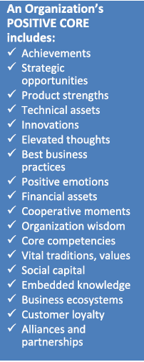
Discover Positive Core Strengths
Sample Questions:
Think of a time in your entire experience with your Chapter when you have felt the most excited, most engaged. What were the forces and factors that made it a great experience?
  What was it about you, others, and your Chapter that made it a peak experience for you?
What is it your chapter is doing, here and now, that makes you really proud?
What does your chapter do exceptionally well?
What are the core factors that “give life” to your Chapter, without which your Chapter would cease to exist?
Notes:
These kinds of questions help you to understand what the Chapter does really well, or what AI refers to as the “positive core strengths”. A list of positive core strengths common within organizations are listed in the blue column on the let.
IFMA AI playbook:
“AI assumes that every organization and community has many untapped and rich accounts of the positive- what people talk about as past, present, and future capacities or the positive core.
The Discovery phase is about appreciating the positive core. During this phase, participants ask questions that explore and identify strengths—of a team, organization, group, or individual. AI is concerned with using strengths to grow, change, adapt, and improve, so the more diverse a group, the more ground can be covered in the metaphorical search (Lewis et al., 2016).
https://positivepsychology.com/appreciative-inquiry-questions/
Succinctly put, an appreciative or positive question is:
“A question that seeks to uncover and bring out the best in a person, a situation or an organization.”

Slide 22
Example: ABC Chapter
Chapter value= high-level of commitment from long-time members
“At it’s best”= high turnout at events, widespread member engagement, high member satisfaction
Ideal future= Rapid growth of new members, YPs highly engaged in leadership positions, Chapter Of The Year Award recipient
FOCUS: MEMBERSHIP GROWTH & VOLUNTEER ENGAGEMENT
Exceptional at= making new members feel welcome; curating original content
“Core Factors”= publications, volunteers (small but dedicated group)
Points of pride= highly inclusive, “family” feeling among members
POSITIVE CORE STRENGTHS: PRODUCTS, ELEVATED THOUGHTS, POSITIVE EMOTIONS

Slide 23
Providing Solutions

Slide 24
Champion Support To ABC Chapter
Ideal future= Rapid growth of new members, YPs highly engaged in leadership positions, Chapter Of The Year Award recipient
APPROACH:
Share: relevant IFMA resources and tools on membership and volunteer engagement
Advise: Best practices for growing membership, highlighting your positive cores, how to model a “best Chapter” and apply for Award of Excellence
Mentor: How to motivate volunteerism
Connect: With other Component Leaders
IFMA TOOLS & RESOURCES:
Membership Benefits: Access The Value of IFMA
Membership Pricing Guide
ENGAGE Forums
Awards of Excellence
Regional Advisory Boards

Slide 25

Talking Points: Membership Benefits
How To Communicate the Value of Chapter Membership To Prospective Members
Meet and build relationships with fellow FM’s in your community
Access to high-quality, original content developed by your peers
Opportunities for recognition and leadership growth through volunteerism

Slide 26
Talking Points: Membership Benefits
How To Communicate the Value of IFMA International Membership To Prospective Members
Extensive Training & Professional Development Opportunities
Events held worldwide to help you develop personal and professional skills
Connect with FMs that share your specialized interests by joining an Industry Council and/or Community
Career Resources

Slide 27

Notes:
Many chapters have expressed concerns about the impact of the pandemic on their members; many have lost jobs (which has also impacted membership retention). So, highlight the career resources
Find your next job with JOBnet.
Receive career coaching, resume tips, and interview prep.
Discounts on exams for IFMA credentials.

Slide 28
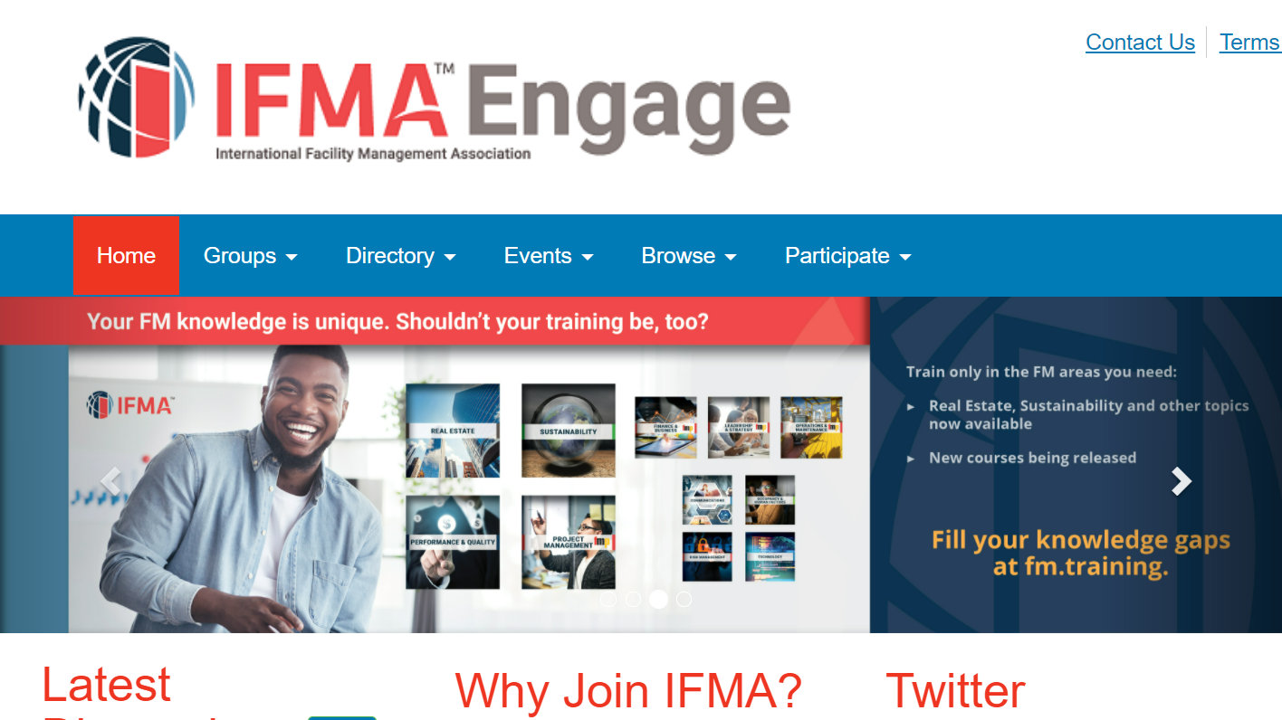
Talking Points: Membership Benefits
Notes:
The Engage Forum is the easiest way to connect with FM colleagues from around the world. IFMA Members can join the conversation to learn from the discussions – or post a question. Discussions cover the wide range of FM topics – everything from trash can placement to technology solutions to personnel best practices – members can learn from each other with the click of a button.
All-Members Forum:
Get answers and share resources with other FM professionals
Members-only access

Slide 29
Why Should My Chapter/Our Members Apply For An Award of Excellence?
Talking Points: Awards of Excellence
AOE winners are recognized on multiple platforms: social media; at World Workplace; in FMJ magazine
AOE individual winners receive a digital badge (great for self-promotion!)
An AOE can be a great tool for career advancement
IFMA’s Awards of Excellence recognize the outstanding achievements of individual members, chapters, councils, communities and partners.

Slide 30

Talking Points:
Awards of Excellence
Challenge your Chapters to push themselves to excellence
  Do you know about the AOEs?
  What would it take for your Chapter to be competitive for an AOE?
  What can we do right now?
  Is there an Associate member that has stood out that you can nominate? A young profession member?

Slide 31
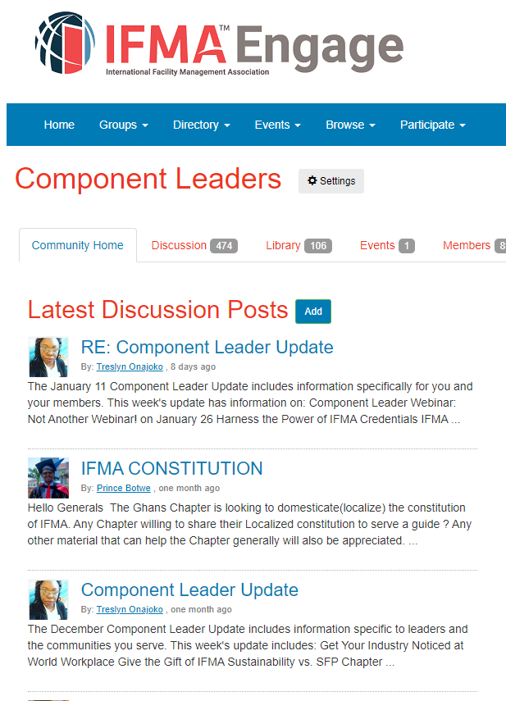
Talking Points: Connecting With Fellow Leaders
Discussion Forum
Monthly Webinars
Helpful Links

Slide 32
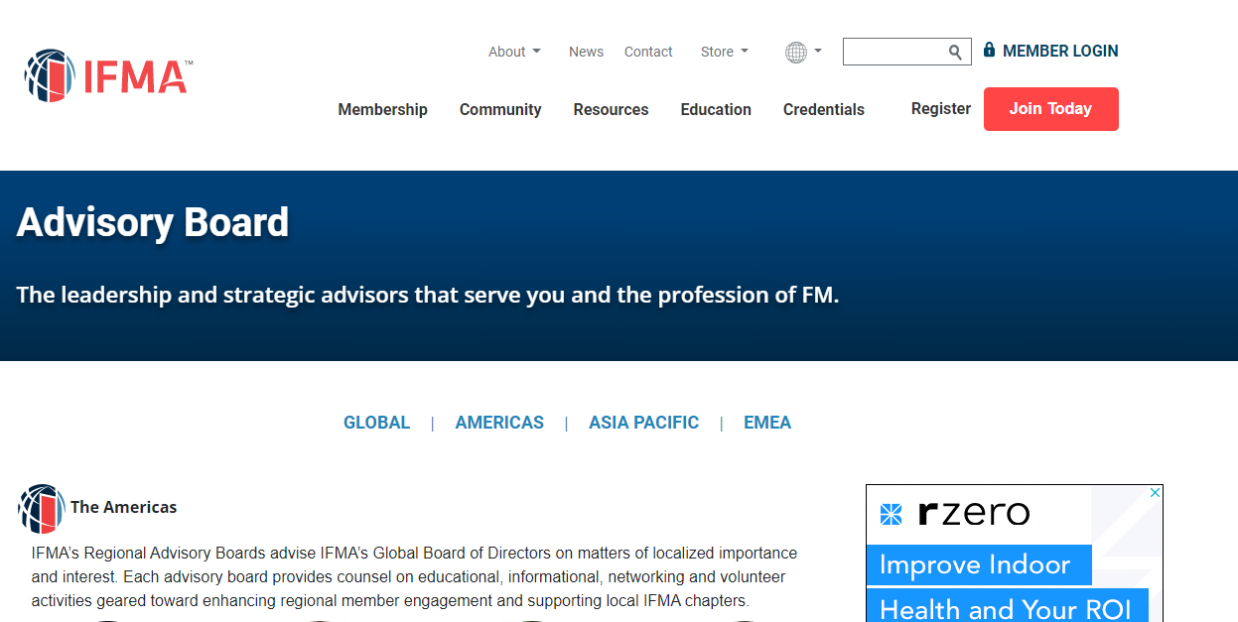
Talking Points:
Connecting With Fellow Leaders
Resource for Champions, too!

Slide 33
Common Topics of Interest For Chapters
Strategic Planning with the BSC coming soon!
Building relationships, connection with IFMA Components
Awards of Excellence
Succession Planning
IFMA Events
IFMA Foundation
  Workforce Development Program
  Local Scholarship Program
IFMA Fellows
IFMA professional development
IFMA credentials
Membership
Marketing & Communications
Templates

Slide 34
The Champions’ Toolkit

Slide 35
Launching the Program
Week of Jan 10: Notification to Chapters
Jan 20: Virtual Training for Champions
Week of Jan 24: Chapters introduced to Champions
Notes:
*After presentation, we will send out a link to the recording and a link to the Toolkit

Slide 36
Before We Go…
What is the most interesting thing you learned today?
What can you use immediately when working with your adopted Chapter?
Questions?
Knowledge
Idea
Learn

Slide 37
Thank you!
Erica Poff, PMP, CAE, IOM
Vice President, Nonprofit Effectiveness
Erica@TalbottTalent.com
(317)759-9595

