Slide 1
Welcome! Activity 2 Pre-decisional Application Assist
April 21 and 22, 2021
Notes:
35 Teams 40 Institutions and Counting Hit my goal35-40! Fund 20! 57% of success just by applying

Slide 2
Agenda - 2 parts
Part One-Overview
Objectives
Selection Rubric
RCA and Market Research
CDC Ideas and Learnings
Evaluation Overview
Application Document
Unique Value Proposition
Part Two-Team Working Session
Key Informants – You determine where you most need help on 2-3 key aspects of proposal

Slide 3
Goals of CDC/CES Partnership
Address barriers and concerns and increase acceptability about COVID-19, flu and other vaccinations among rural and medically underserved audiences.
Increase connection and communication between targeted communities and healthcare systems.
3. Increase accessibility of local COVID-19, flu and other adult vaccinations and vaccination clinics.
Inform CDC, USDA-NIFA, Cooperative Extension and health partners to implement public health programs to reduce health disparities.

Slide 4
Activity 2- Pilot Programs Ways that it is Different
2 years long
Immunization Education and COVID19
Competitive
Innovation-risk taking with new methodologies and delivery methods
Focus on market research-testing messages/process and repeat with learnings
Inform CDC and CES system of new messages, processes and partnerships for adult Immunization education

Slide 5
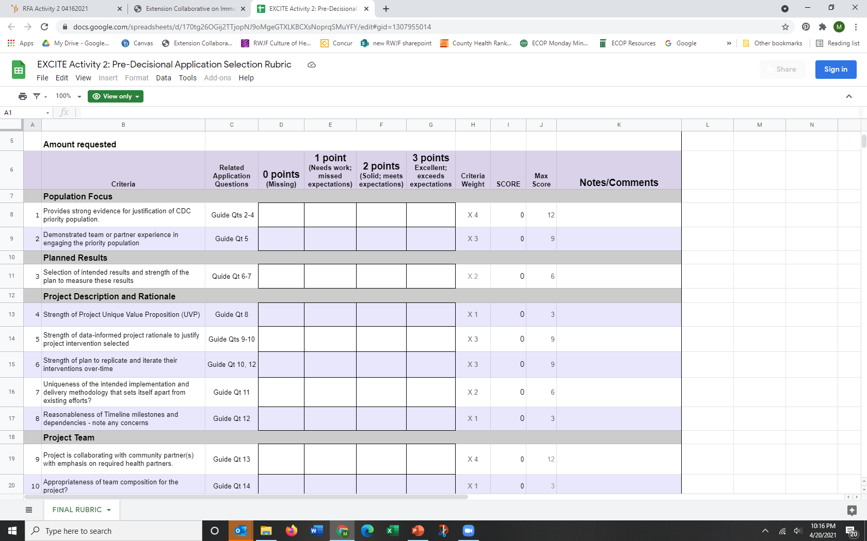
Rubric

Slide 6
Selection Process
Extension Foundation Review for Complete Application
3 CES Reviewers (Health Director,1862 Director, 1890 Administrator) and 3 CDC Reviewers independently complete rubric
Reviewer Meeting with summary outcome-Oversight with Carolyn Crocoll ECOP Executive Director –different methods, target audiences, large and small states etc. Final Decision

Slide 7
How To’s on the Rapid Community Assessment and Marketing Research
Lindsey Haynes-Maslow, PhD, MHA
Associate Professor & Extension Specialist
North Carolina State University
EXCITE Market Research Lead
Lhaynes-maslow@ncsu.edu

Slide 8
CDC’s Rapid Community Assessment (RCA)
RCA targets specific communities and is used to inform future project work phases on an issue
Generate a basic understanding of what communities think about an issue and plan for potential solutions to increase confidence/uptake
Need to identify community leaders, trusted messengers, and other important channels through which you can reach communities
RCA consists of 5 steps (CDC suggested time frame is 3 weeks)
https://www.cdc.gov/vaccines/covid-19/vaccinate-with-confidence/rca-guide/index.html

Slide 9
RCA Steps
Identify objectives and community(ies) of focus
Plan for the assessment
Collect and analyze data
Report findings and solutions
Evaluate your efforts

Slide 10
Marketing Research
Social marketing is the use of digital applications to plan, design, implement, and evaluate marketing campaigns to influence voluntary behavior change of target audiences to promote positive change
6 benchmarks for social marketing:
Having a behavioral objective to evaluate
Choosing a specific group of people as a target audience
Formative research with the target audience
Offering the exchange of short- or long-term benefits for the target audience
Using multiple marketing channels to deliver campaign messages
Knowing direct or in-direct campaign competition, such as those with competing or contradictory messages
Andreasen, Alan R. Marketing social change: Changing behavior to promote health, social development, and the environment. San Francisco: Jossey-Bass, 1995.

Slide 11
Formative Research
Interviews (telephone; virtual; in-person)
One-on-one; in-depth; semi-structured
Focus Groups (virtual; in-person)
6-10 individuals per focus group; semi-structured; play off dynamics of the group
Surveys (telephone-administered; online; paper-based)
Gather confidential data from individuals
TIP: Participants are the experts when conducting formative research; you are not there to educate, but to ask questions and listen.

Slide 12
How Can I Help You?
Existing resources – don’t reinvent the wheel!
Interview moderator guide
Focus group moderator guide
Survey design/language
Existing research
White papers
Private and public reports on immunization education
Peer-reviewed studies
Data analysis
Qualitative software programs
Coding formative research
Memo writing (summarizing key themes)

Slide 13
Questions?

Slide 14
CDC Program Examples and RCA Learnings Julie Zajac

Slide 15
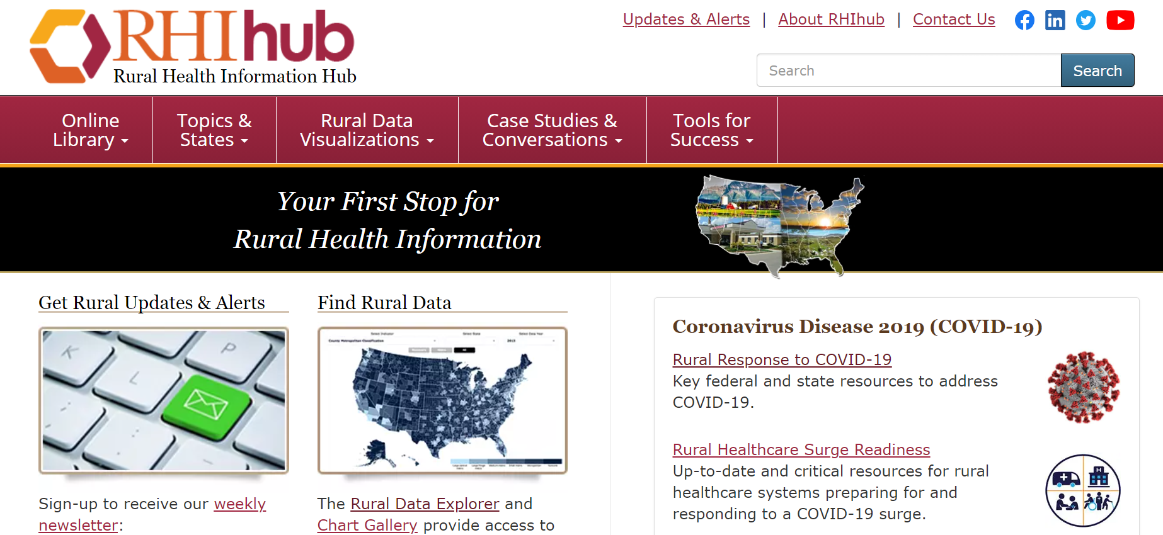
A great resource for innovative success stories:
ruralhealthinfo.org

Slide 16
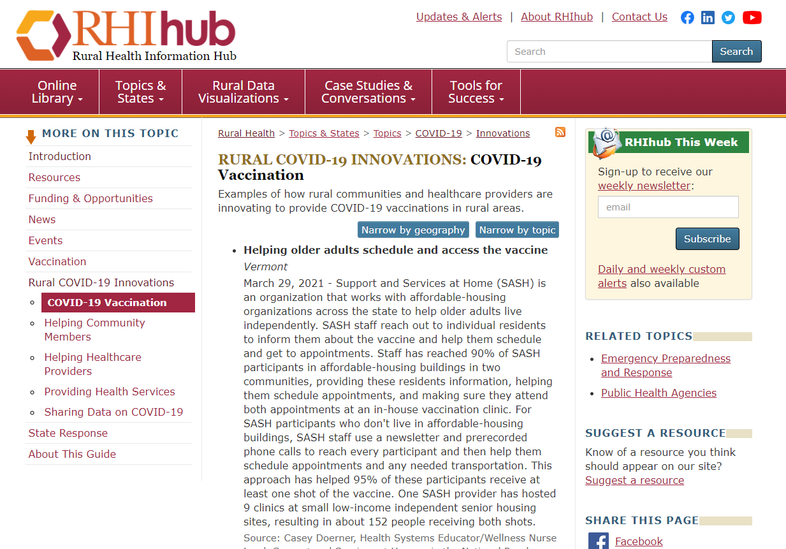
Specific COVID-19 and Rural Health examples: ruralhealthinfo.org/topics/covid-19/innovations/vaccination

Slide 17
EXCITE Portal – Reporting Laura Downey, Evaluation Specialist
The primary way to track pilot projects’ vaccination education outreach
Collectively document pilot project assets
Educational materials (for example, social media graphics, slide deck, or videos)
Evaluation tools
Centrally report pilot project activities and results
Reach
Major successes/challenges
Lessons learned
Progress towards intended results

Slide 18
Evaluation Support to Pilot Project Teams
Consult with pilot project teams (Q7 in Activity 2 Pre-Decisional Guide)
Measurement of intended results
Data collection approach (method)
Assessment tools
Offer training & tools to pilot project teams on reporting in the EXCITE portal
Provide technical assistance to pilot project leaders reporting in the EXCITE portal
Answer questions
Guide teams through reporting procedures

Slide 19
Evaluation of the EXCITE Initiative
Evaluate the overall EXCITE initiative
Facilitate “what’s working” share sessions among project teams and partners
Seek periodic feedback from project teams
Work with the EXCITE program team, the Extension Foundation, and CDC collaborators to document and report collective impact from EXCITE
Identify best or model practices for effective collaborative projects that can be adopted or adapted to increase immunization access in rural and other underserved areas.

Slide 20
Application Walk-through with Ashley Griffin
Notes:
https://use.vg/EgEcQ8

Slide 21
Unique Value Proposition
Molly Immendorf
Extension Foundation Design Strategist
Notes:
Hi, I’m Molly Immendorf, Design Strategist with the Extension Foundation. One question in your application that you might be wondering about is the Unique Value Proposition statement also known as the UVP statement. Your UVP is a quick way to communicate your project idea while also differentiating what makes it special or different, in other words… unique. So what goes into a UVP statement?

Slide 22
Unique Value Proposition
“A <program/project description> for <target community members/participants> that <key value> enabling <primary benefits> unlike <existing alternatives>.”
Notes:
As you can see here, it’s really a fill in the blank like MadLibs back in the day, except your team’s idea will shine through and be clear and concise. Let’s break down the parts of the UVP statement.

Slide 23
Unique Value Proposition
<program/project description> = Event, Activity, Method, Curriculum, etc.
<target community members/participants> = Who will benefit? Who is this for?
<key value> = How does it respect and show understanding/empathy of the community?
<primary benefits> = Outputs and Outcomes
<existing alternatives> = What’s already being done? Status quo
Notes:
<program/project description> = Event, Activity, Method, Curriculum, etc.
<target community members/participants> = Who will benefit? Who is this for?
<key value> = How does it respect and show understanding/empathy of the community?
<primary benefits> = Outputs and Outcomes
<existing alternatives> = What’s already being done? Status quo

Slide 24
Unique Value Proposition
A series of community listening sessions co-created with tribal partners followed by a vaccine mobile clinic for tribal elders that honors community values and traditions enabling influential and medically vulnerable elders to model willingness to be vaccinated unlike relying on vaccine clinics alone.
Notes:
Here’s an example from your application guide to show how this can describe a pilot idea succinctly. Now that you’ve seen all the parts of the application, let’s turn to the next portion of today’s workshop.

Slide 25
Hands-on Application Assistance
Breakout room by team until 4:20 pm ET
Use application guide
Focus on 2-3 questions
Request consultations from Key Informants
Notes:
You will be in breakout rooms by team. There are three main steps to guide your time together. First, use the application guide (link or file upload here). As Ashley mentioned in the video, it is a fillable PDF that has all of the questions that you can then copy and paste into the actual application in Survey Monkey apply. Second, use your time wisely, over the breakout time, focus on 2-3 questions tops - one at a time. Would you like some advice or help? Request a consultation from a Key Informant to come to your room for 10-15 min.

Slide 26
Key Informants on hand to help
Extension Foundation team
Beverly Coberly
Megan Hirschman
Karl Bradley
Tira Adelman
Aaron Weibe
Molly Immendorf
CDC team
Diane Hill
Scott Miller
Charleigh Granade
Sam Graitcer
EXCITE team
Michelle Rodgers
Katie Stofer
Lindsey Haynes-Maslow
Laura Downey
Notes:
We have many Key Informants on hand to help you. Whether you’d like advice on how innovative your pilot idea is, ideas for how to collect data, some feedback on your UVP statement, and so on, we are here to help.

Slide 27
Hands-on Application Assistance
Breakout room by team until 4:20 pm ET
Use application guide
Tip: one team member fills out while sharing screen
Notes:
I’ll share a few tips that might make this easier for you to focus. First - download the PDF and have one team member open it in Adobe Acrobat, share their screen and then fill out drafts live. - Decide who is going to do this.

Slide 28
Hands-on Application Assistance
Breakout room by team until 4:20 pm ET
Focus on 2-3 questions, one at a time
Tip: Key Informants are on hand to consult, but only have 10-15 minutes to spend with each team.
Notes:
It’s been mentioned to focus on 2-3 application questions - don’t do this all at once - do it one at a time, together. Would you like advice or guidance, ask but understand the Key Informants only have about 10-15 minutes with you so they can help other teams, too.

Slide 29
Hands-on Application Assistance
Breakout room by team until 4:20 pm ET
Request consultations from Key Informants
Tip: Use https://extension.org/form
Notes:
https://extension.org/form
When a key informant enters your breakout room, briefly share your project idea and which part of the application you are working on. They will ask clarifying questions and, if appropriate, provide advice and/or resources.
We are keeping track of what themes and questions are asked to create follow-up resources for you.

Slide 30
Breakout Rooms by Team
Until 4:20 PM ET
Notes:
We urge you to take a stretch break before the team time. Aaron will move you to your breakout rooms now. Aaron, any last minute tips?

Slide 31
Wrap-Up
Tuesdays 4-5 Application Consults
Email questions-respond or call
Timeline
Application Due May 15, 2021
Application Review May 17-21
Inform Selection May 24

