Slide 1
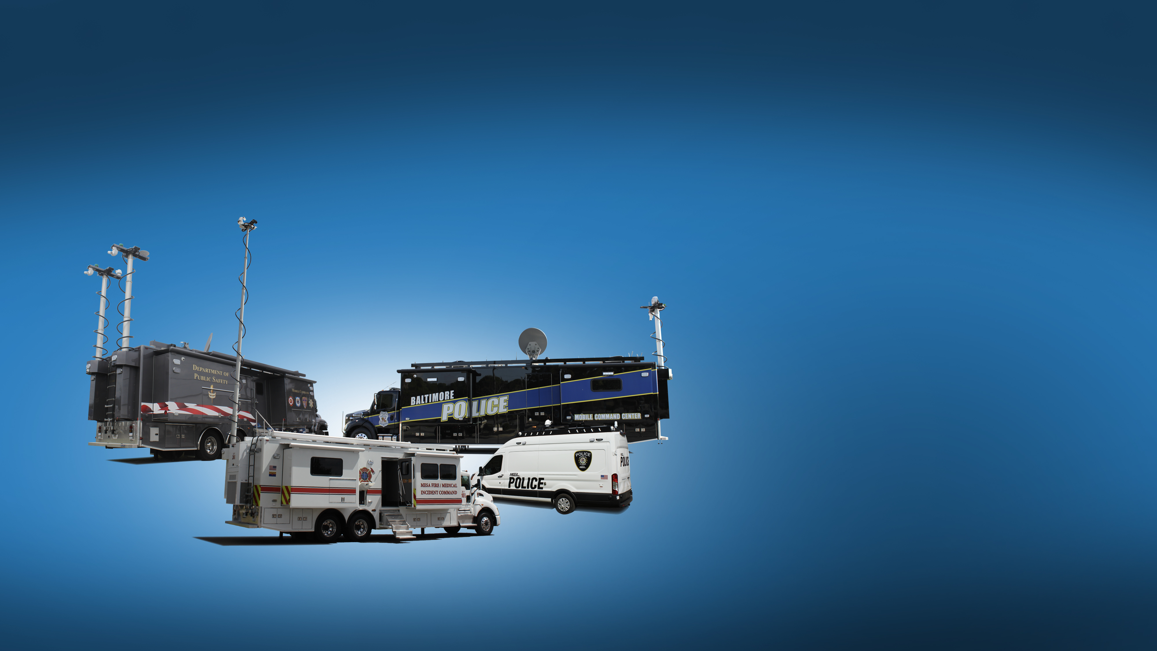
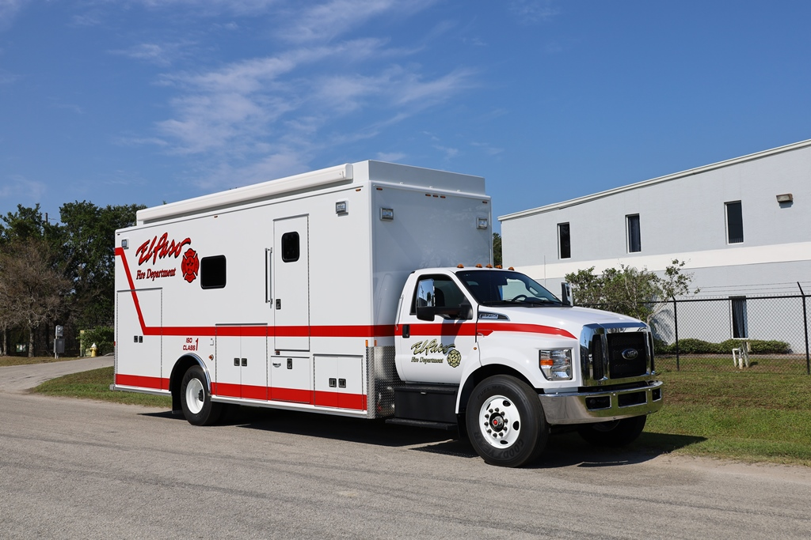
City of El Paso Fire Dept.
C-35 Rehab Unit

Slide 2
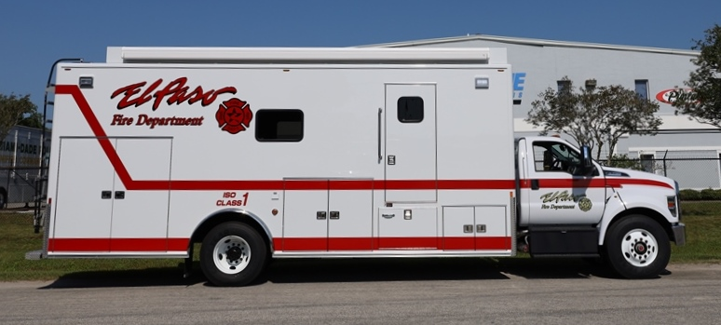
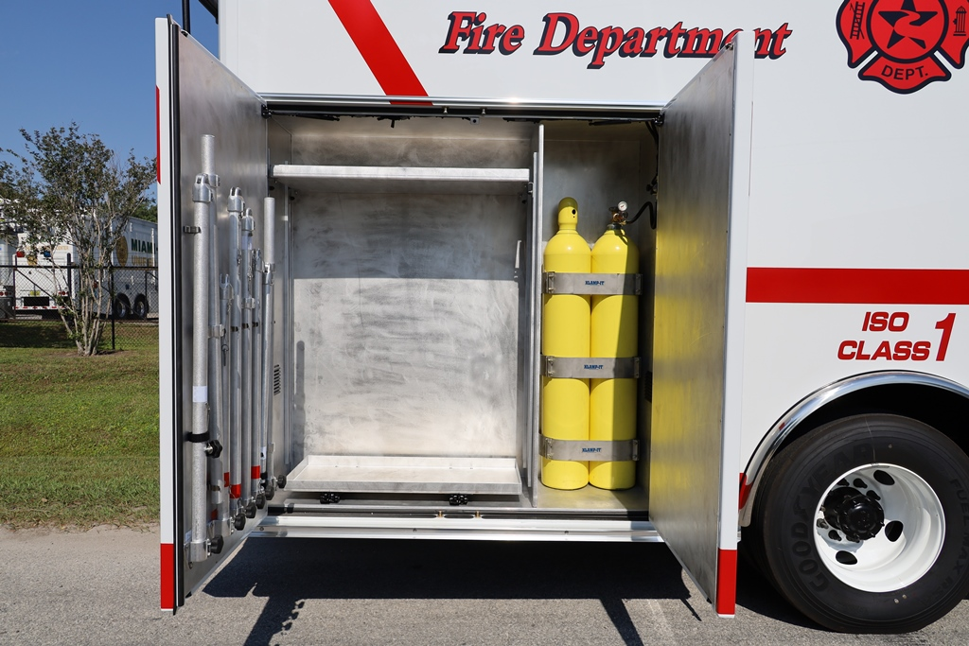
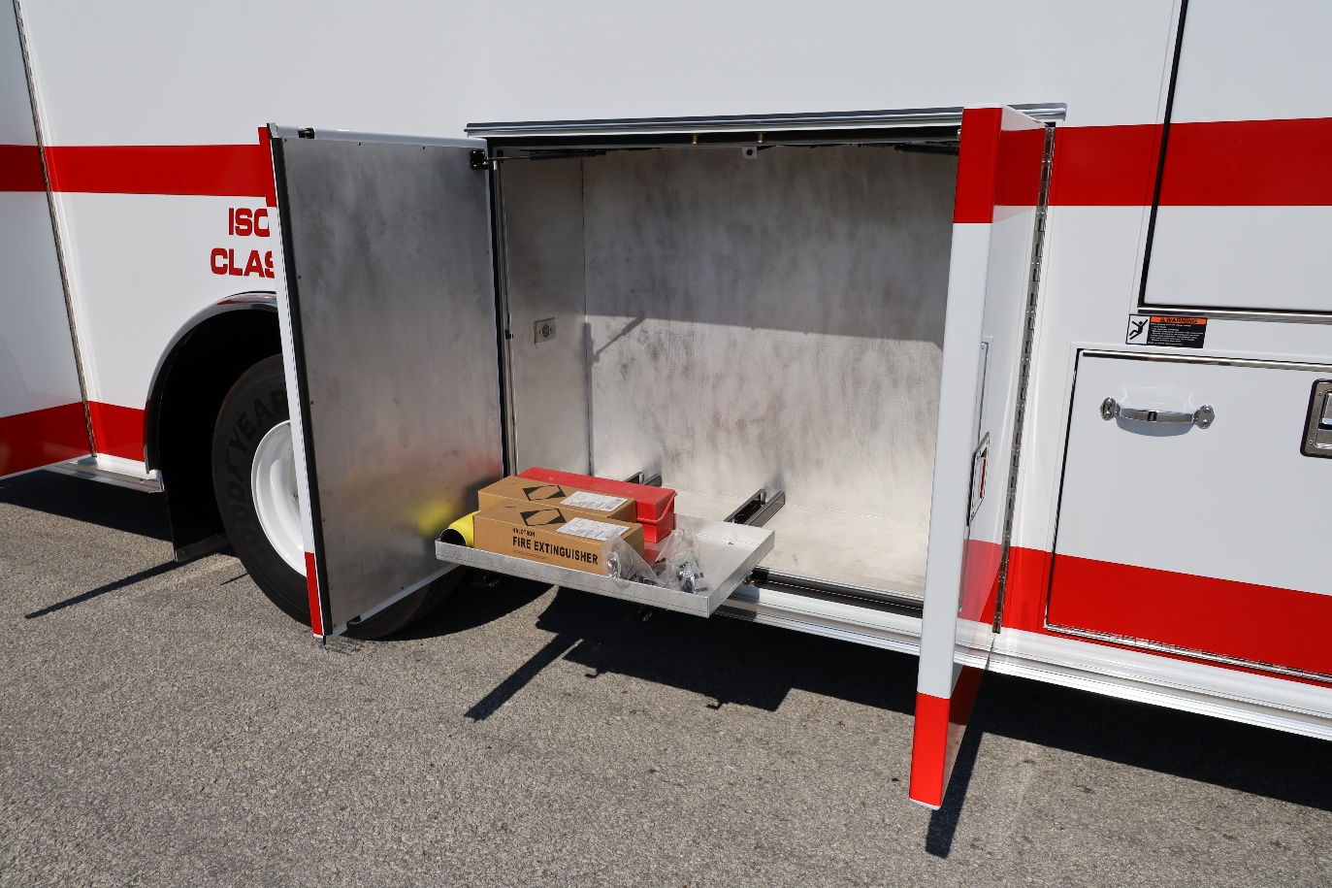
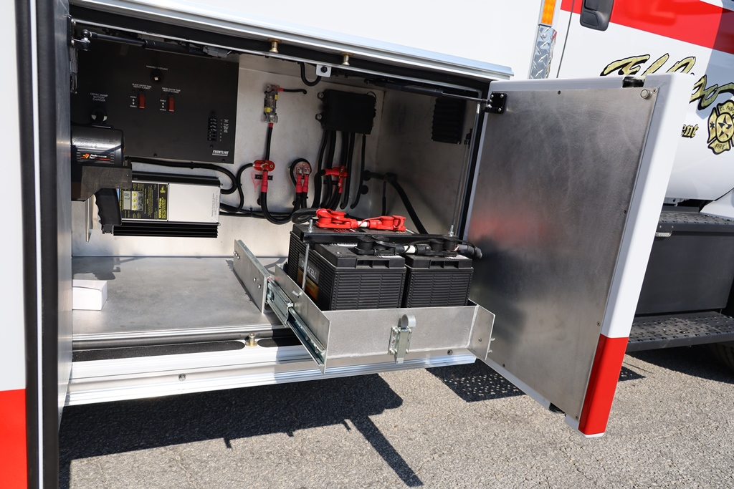
Battery & Charger Compartment
Batteries in Pull-out Tray for Accessible Service
On-board Oxygen & Storage Compartment
Curb Side Storage Compartment with Pull-out Tray

Slide 3
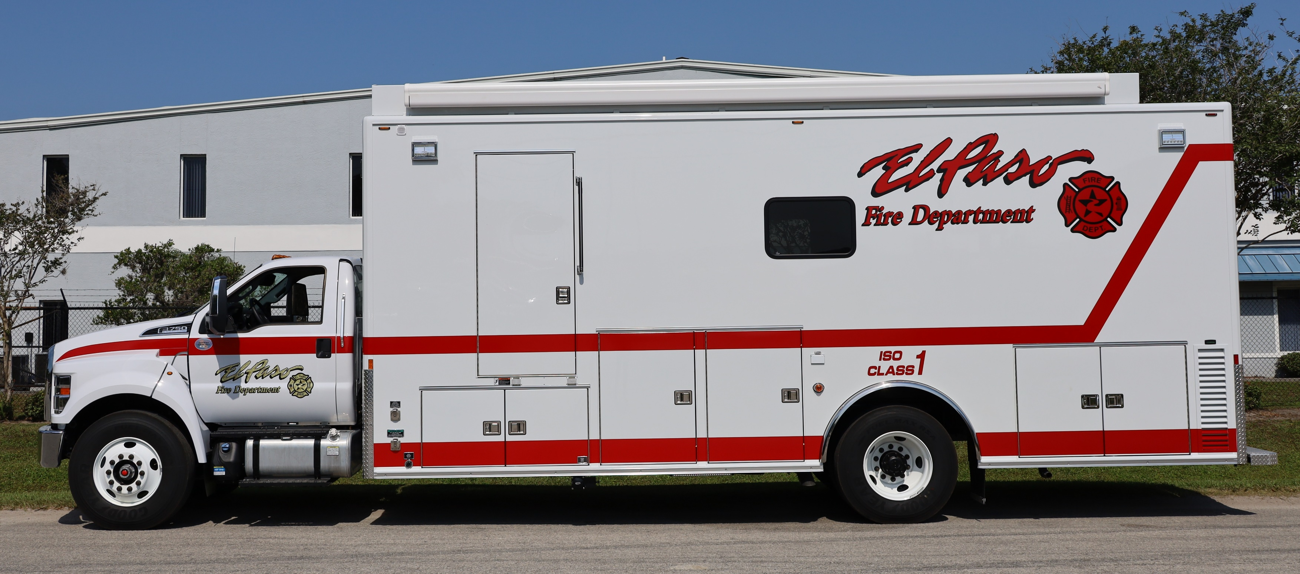
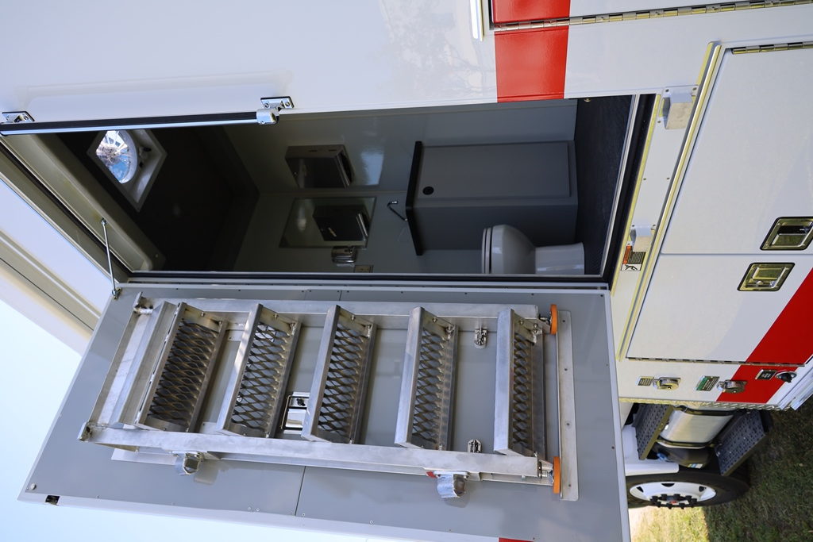
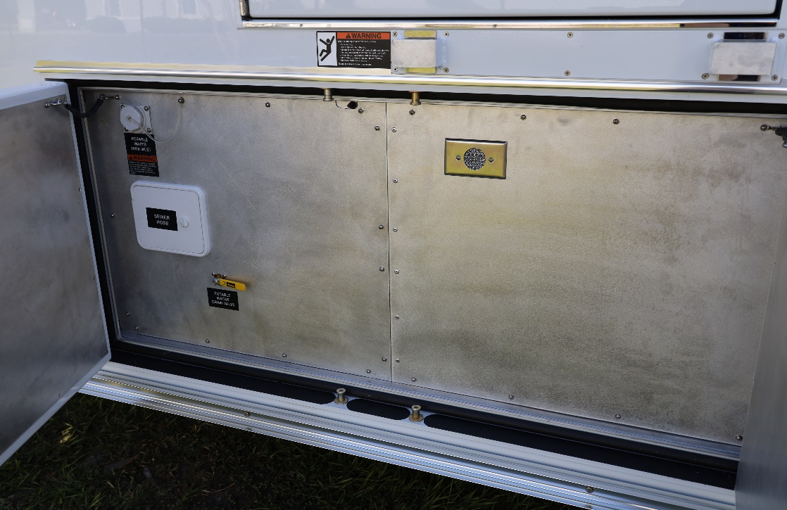
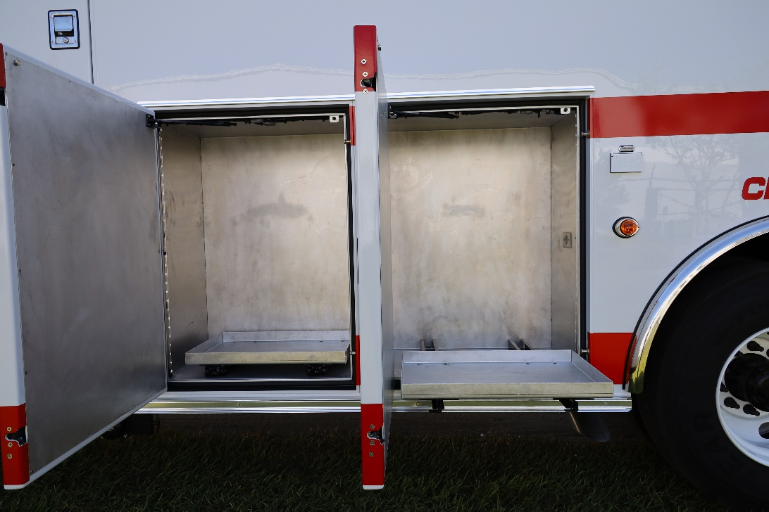
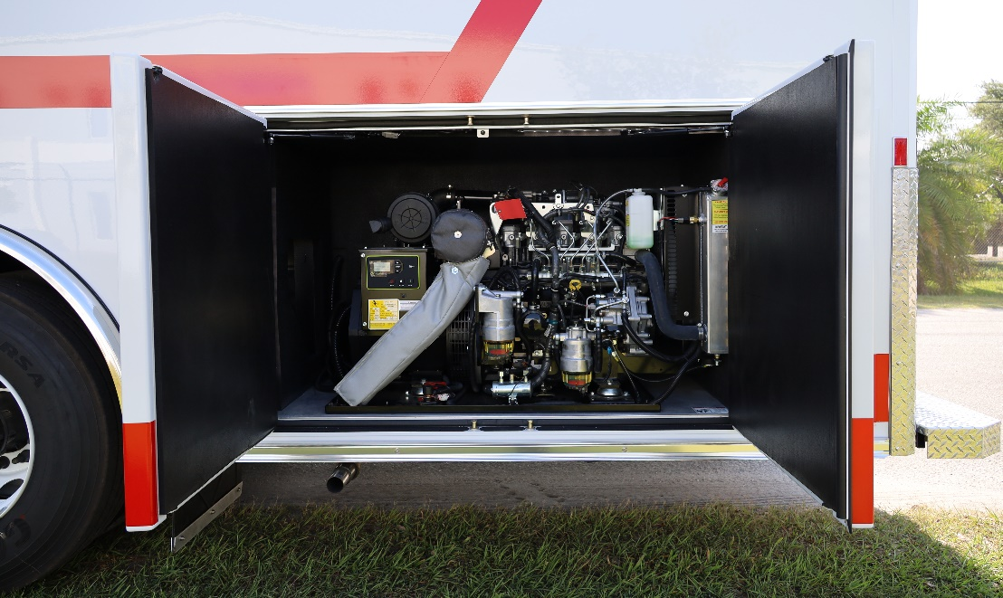
Street Side Storage with Pull-out Trays
Generator Compartment with Triple-Composite Insulation System for Noise Reduction
Exterior Entrance to Lavatory
Fresh Water & Black Water Tanks

Slide 4
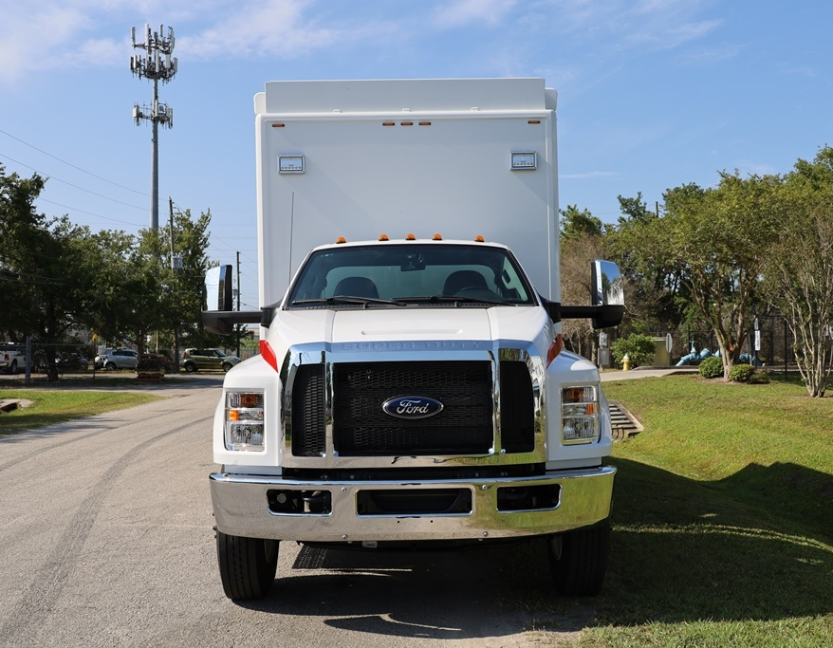
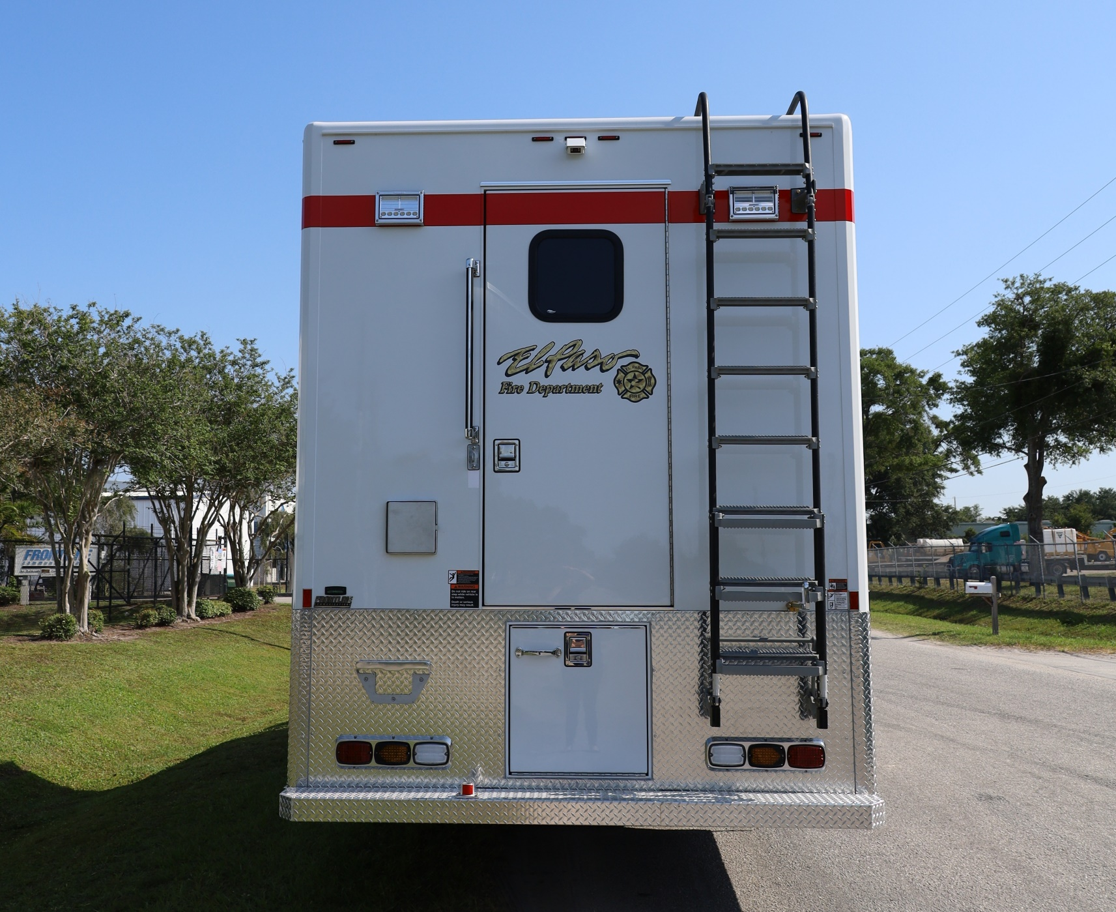
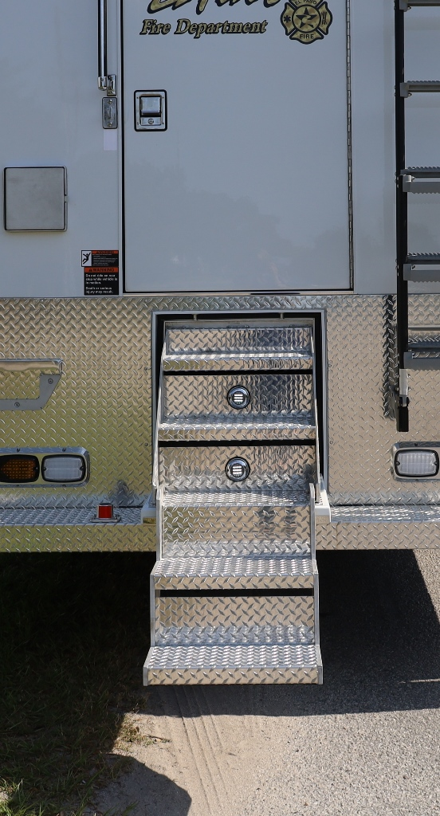
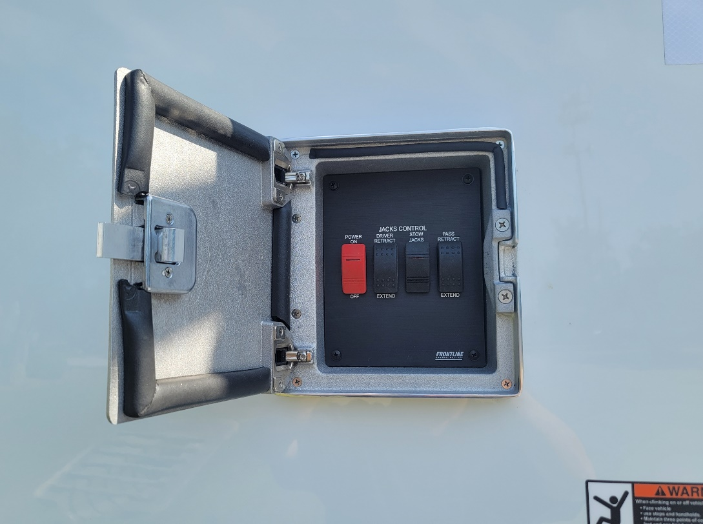
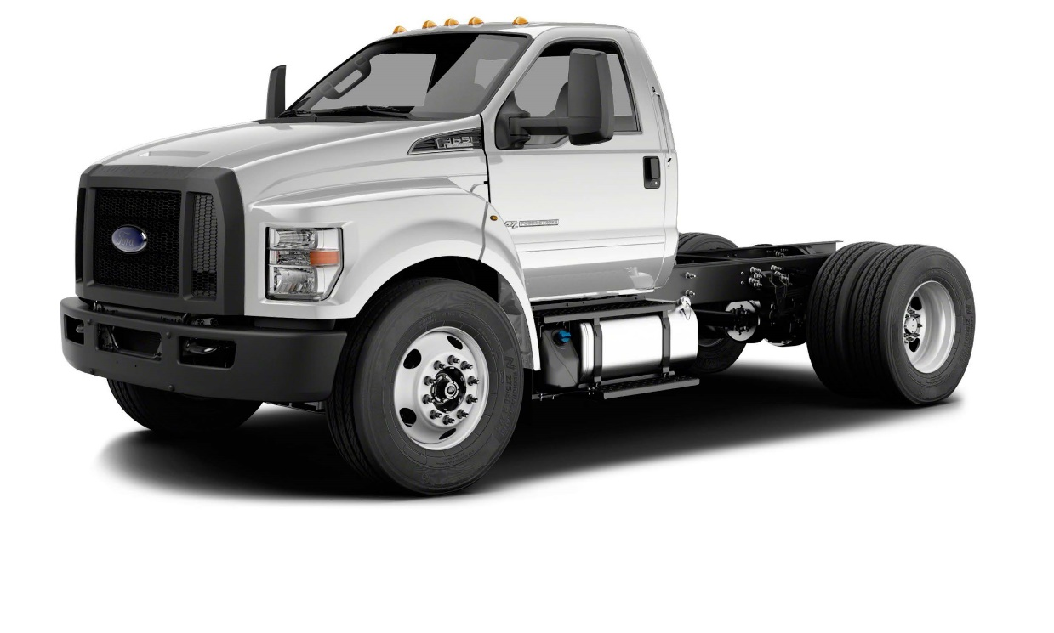
Rear Entry Fold-down Steps with Handrail (not shown) and LED Lighting
2021 Ford F-750 Diesel Regular Cab
“Bigfoot” Stabilizer Jack Controls

Slide 5
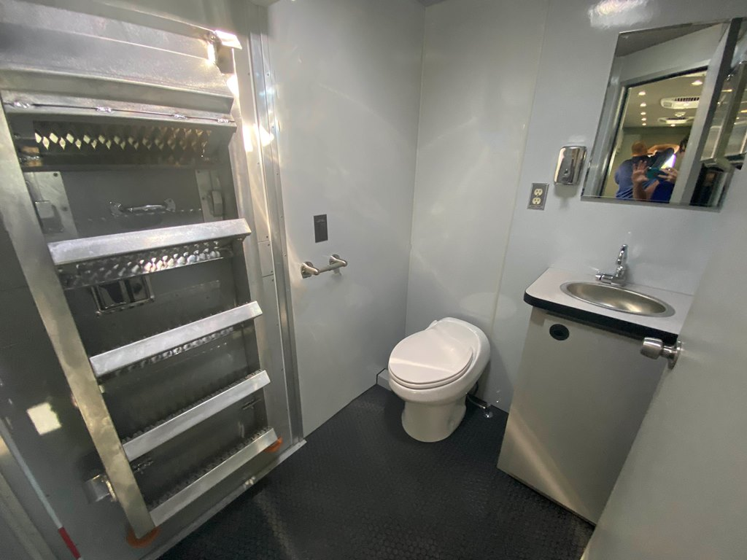
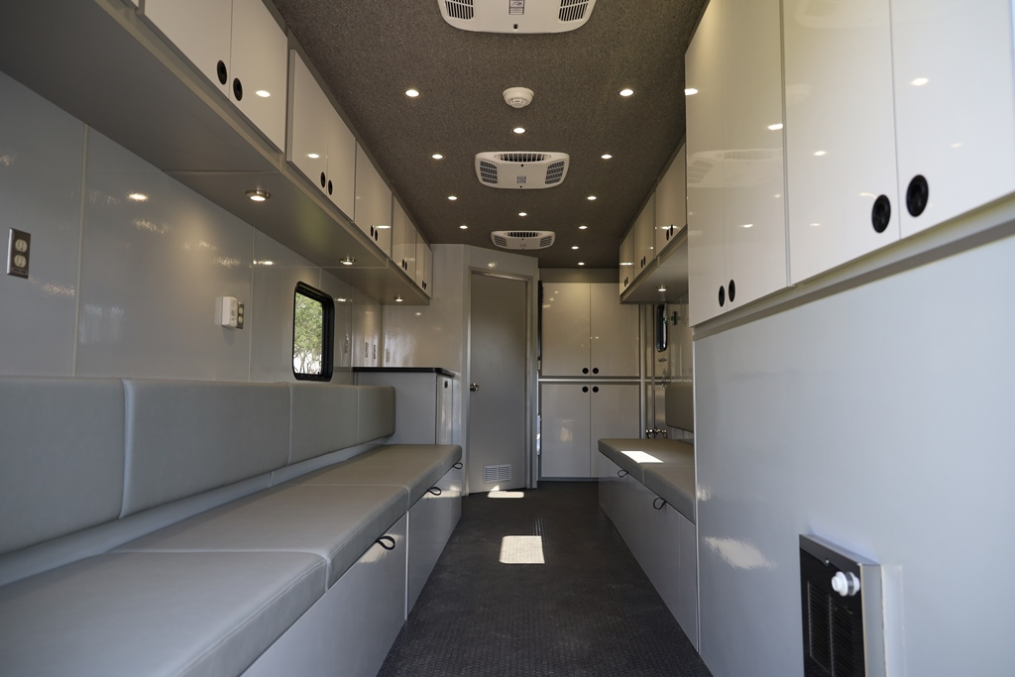
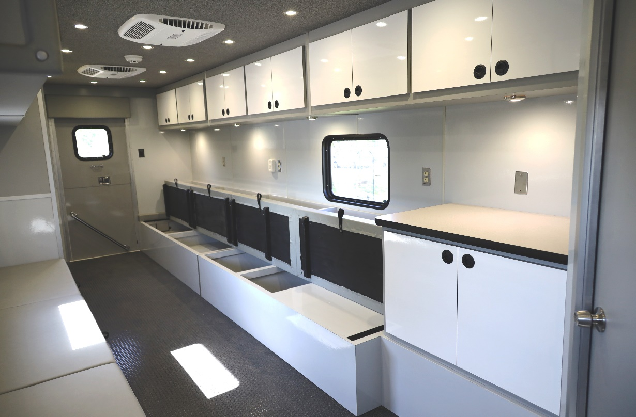
Lavatory with Interior and Exterior Entrances
Bench Seating with Storage Under Seat Cushions and Behind Seat Backs

Slide 6
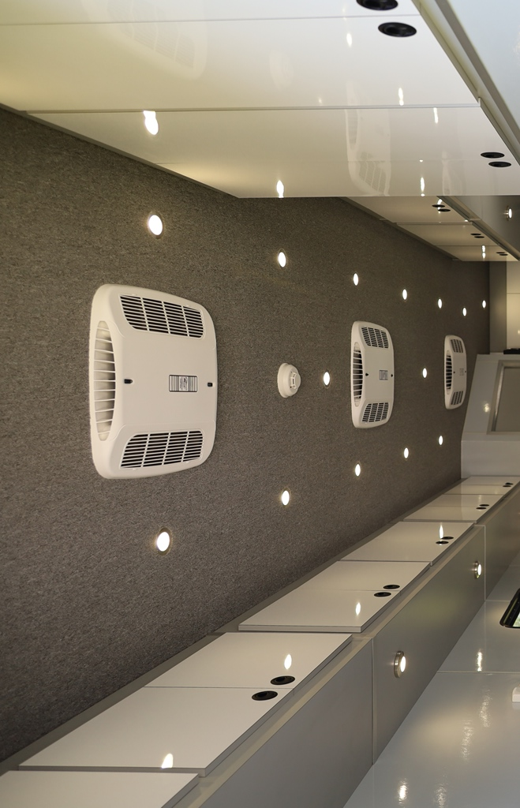
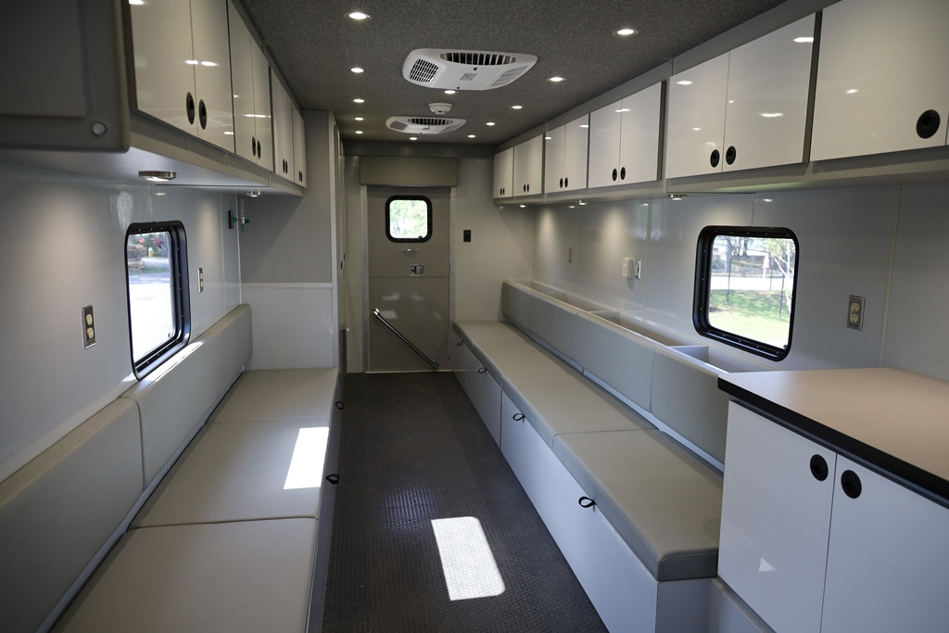
(3) 15,000 BTU Air Conditioners

Slide 7
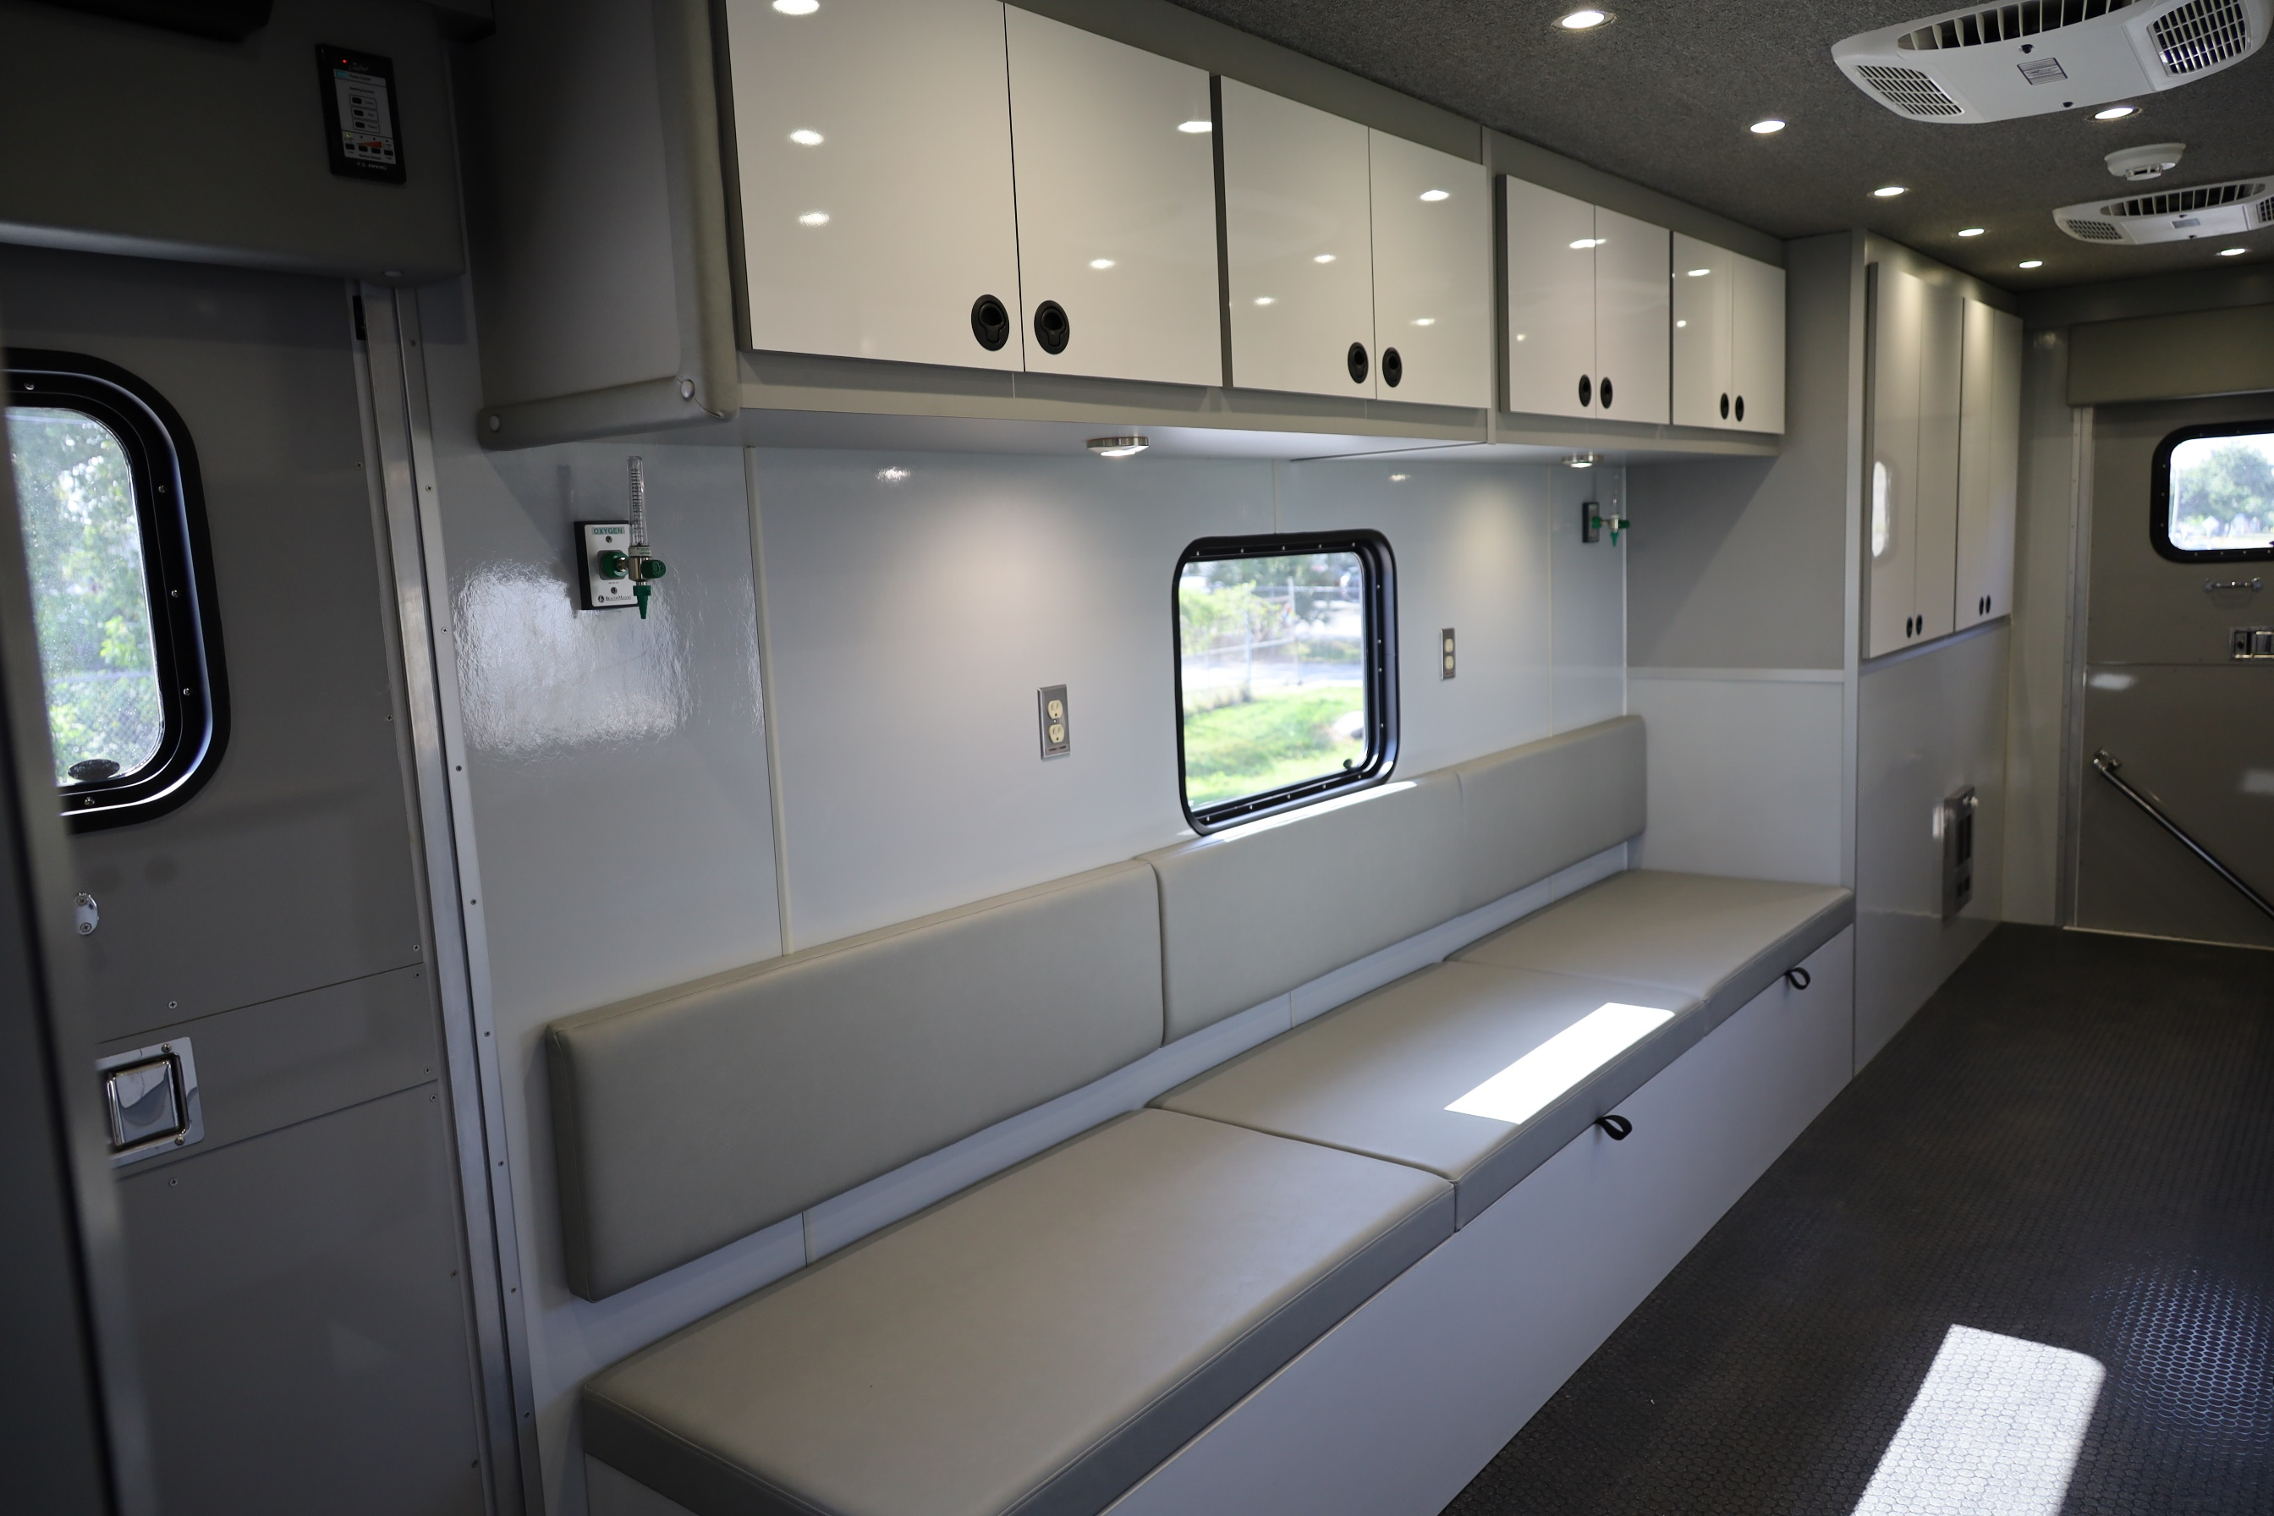
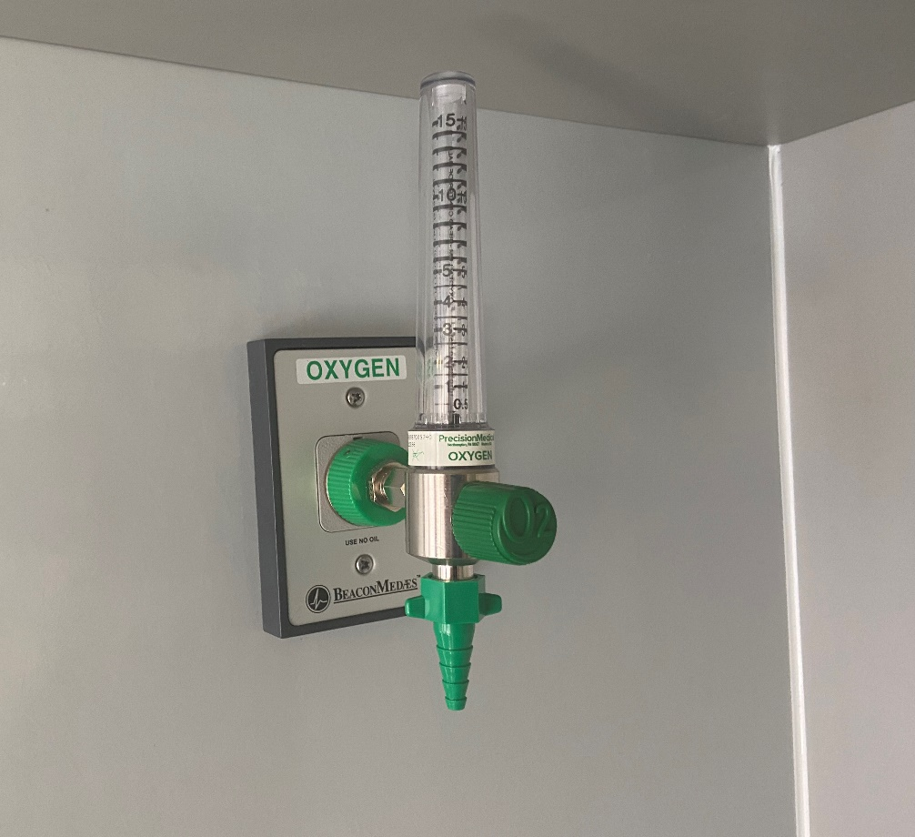
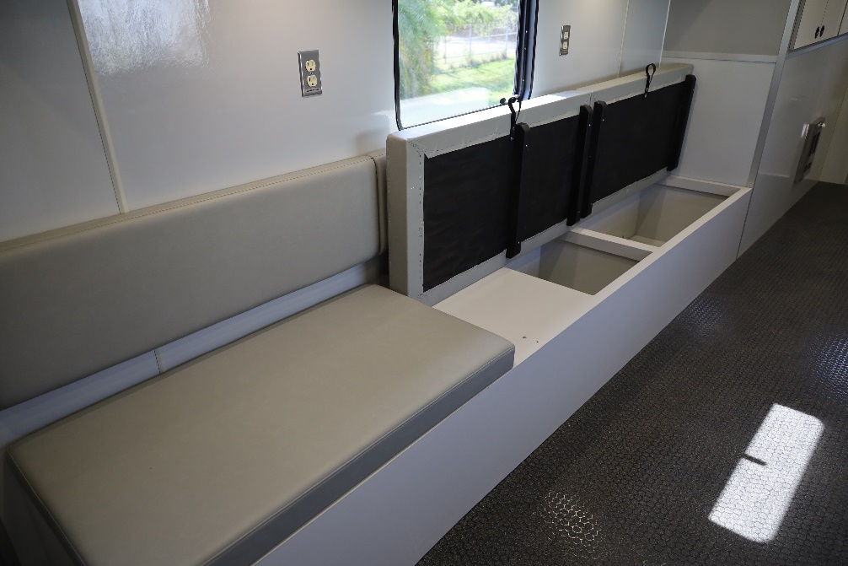
(2) Oxygen Supply Ports on Curbside Wall
Additional Storage Under Bench Seating

Slide 8
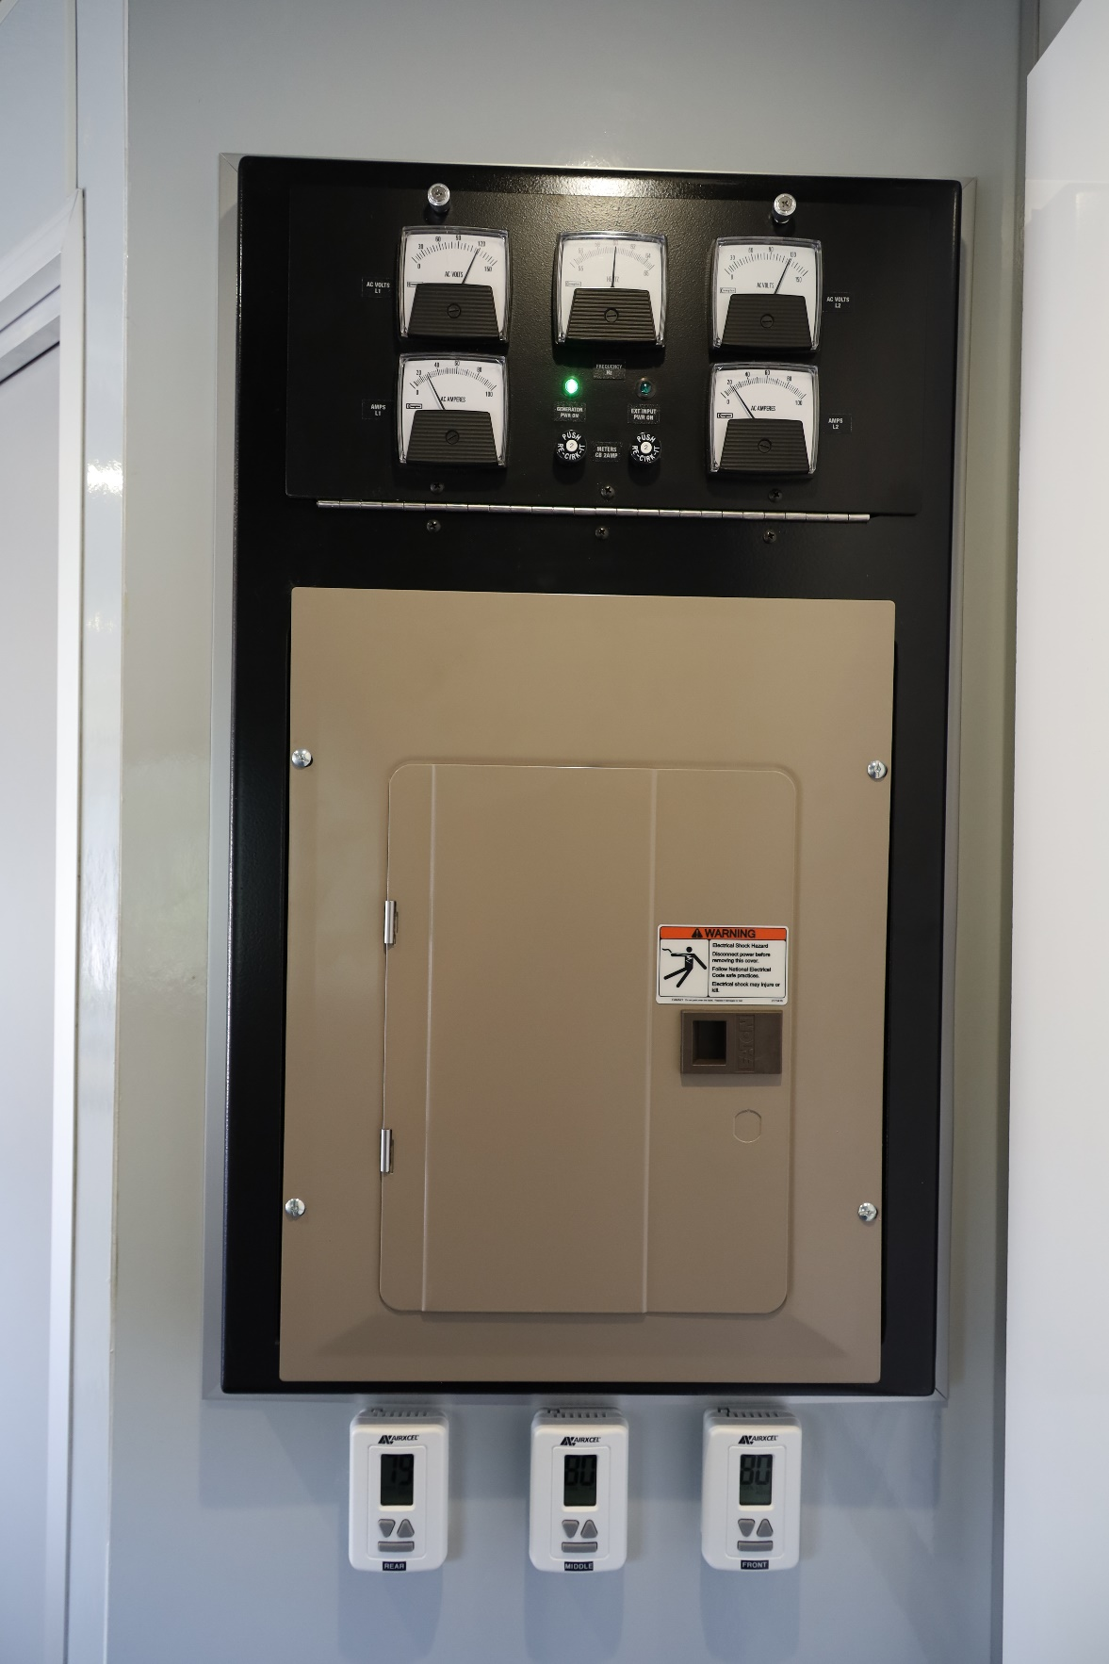
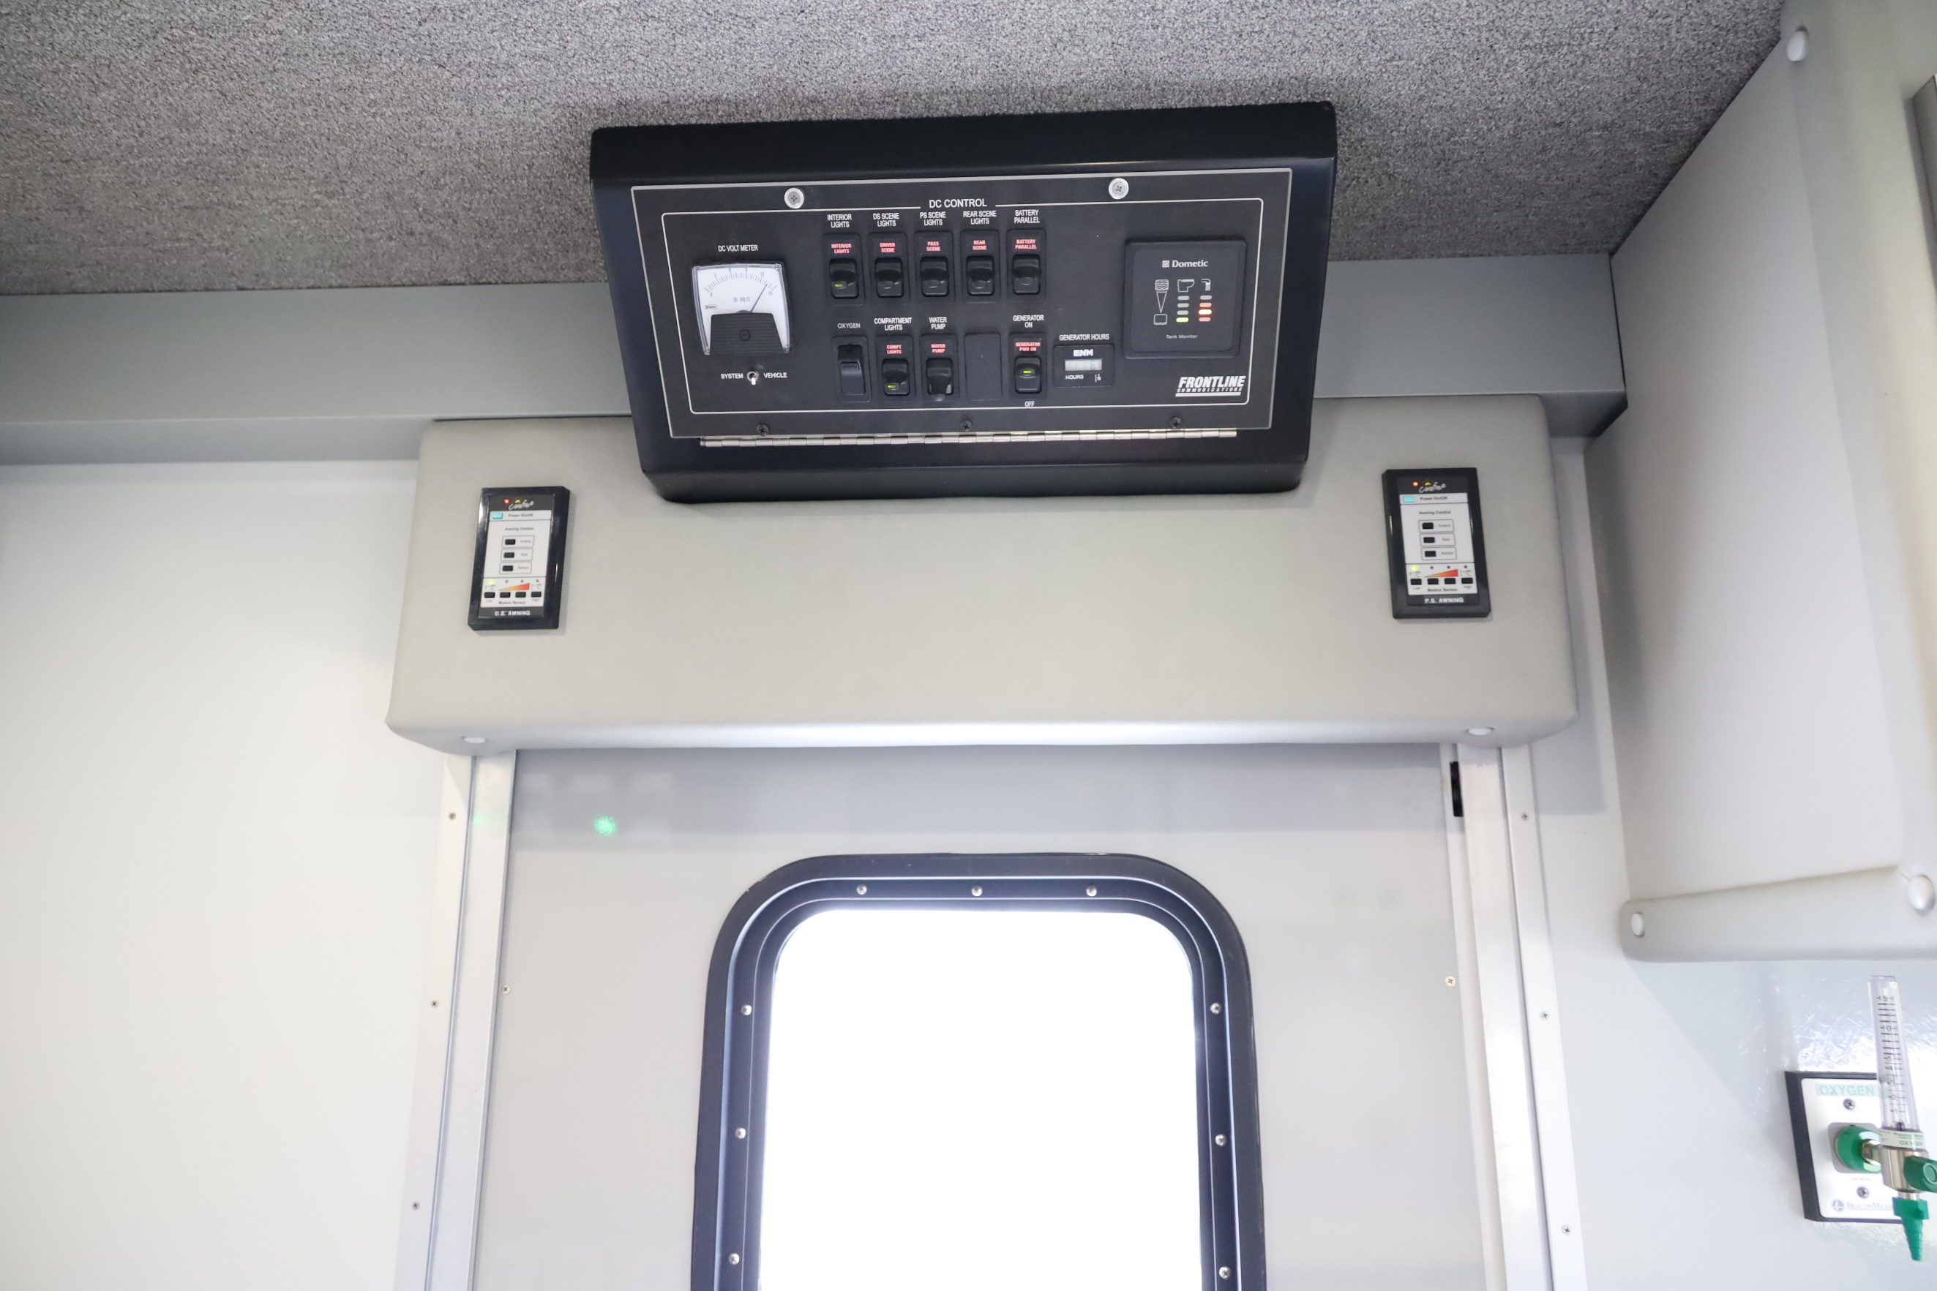
AC Power Panel, Fuse Box, A/C Thermostats
DC Power Control Panel Located at Main Entrance. Awning Controls for (2) 20-ft. Awnings

Slide 9
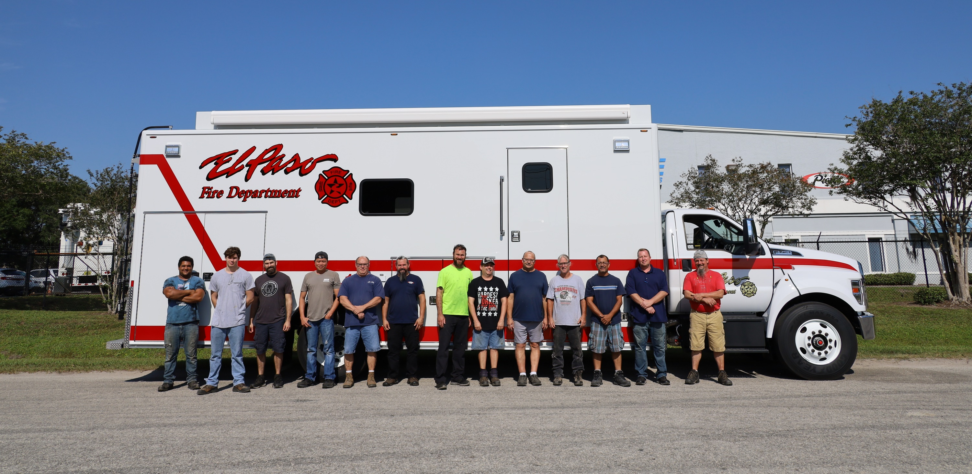
Thank You Siddons-Martin Emergency Group and the El Paso Fire Department for Choosing Frontline Communications
Frontline Communications’ Custom Modular Body Assembly Team

