Slide 1
Instructions for
Customizing Templates
To save a slide as an image:
Click File >> Export
Choose “PNG” from the file format dropdown box
Select “Save Current Slide Only”
Select where to save it and click “Export”
Questions?
Reach out to support@livesafemobile.com.

Slide 2
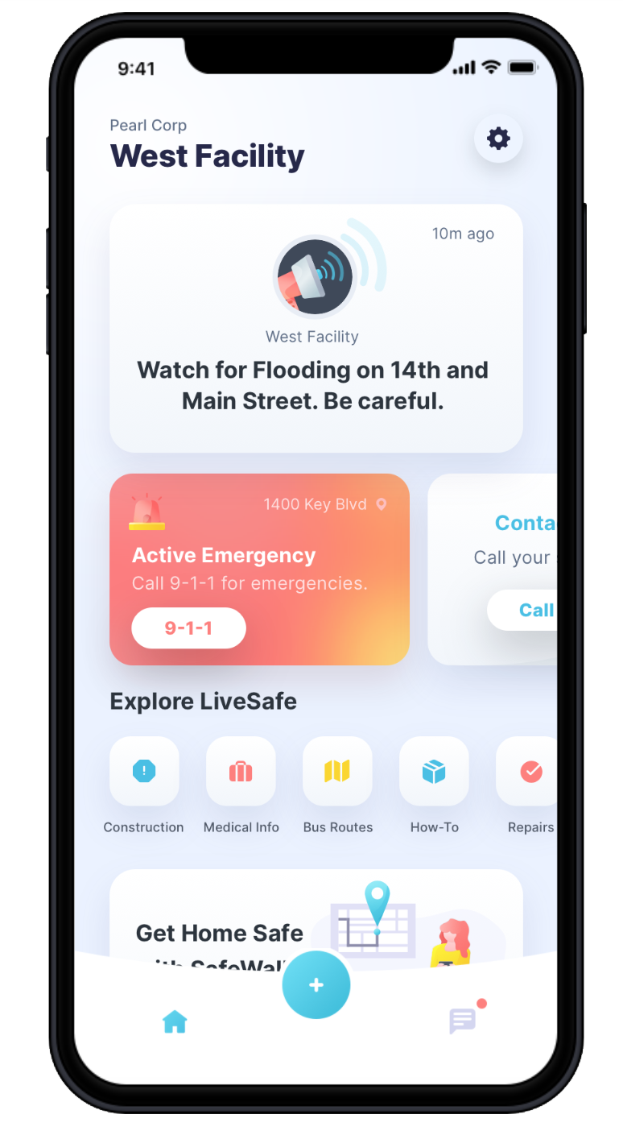
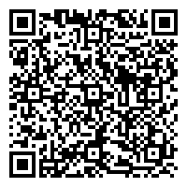
Download LiveSafe LiveSafe is a free benefit for your community
for
Get Instant Updates
Broadcast messages are displayed at the top of the home screen for quick access to information.
Settings
Access profile settings, manage your organizations, and get app help.
Request Help
Request help when you need it and quickly access emergency numbers specific to your campus.
Access Information and Emergency Procedures
Have fast access to information, emergency procedures, and local resources.
SafeWalk
Invite friends to virtually walk you to your destination.
Share Info with Safety & Security
If you see something suspicious, share it with security. You can anonymously submit text, files, or video.
Get the App:
Download LiveSafe from the App Store or Google Play or using the QR code
Register and complete your profile
Search for and select your organization
Notes:
To Replace “Fake Logo” With Your Organization’s Logo In The Header:
Right-click the middle of the “fake logo” image, to the right of the Live Safe logo
Select “Change Picture”
Select the light/white version of your organization’s logo (to be used on darker backgrounds). Make sure you are selecting a PNG for the file type.
TO UPDATE PHONE SCREEN: This is using an iPhone X for the base. Make sure you are replacing the app image with a screenshot taken from an iPhone X.
Right-click the iPhone X frame. Hover over “Send to Back” and select “Send Backward”. This will layer the app image above the phone frame so that you can easily select it and replace it with the updated image.
Right-click the app image. Select “Change Picture”.
Locate the screenshot you have already taken of the organization you are creating the launch kit for. Select it.
Right-click the updated screenshot you just dropped in. Hover over “Send to Back” and select “Send Backward”. This will layer the phone frame back on top of the app image.
TO UPDATE QR CODE: There are tons of options online for creating QR codes. One example is https://www.qr-code-generator.com/
Right-click the QR code. Select “Change Picture”
Locate the QR code you have generated for the organization you are creating a launch kit for. Select it.
To Change Color For Header and Footer Banners:
Click edge of blue box
Click “Shape Format” tab
Click “Shape Fill”
Choose a preset color or to select a custom color, click ”More Fill Colors” and enter in hex code

Slide 3
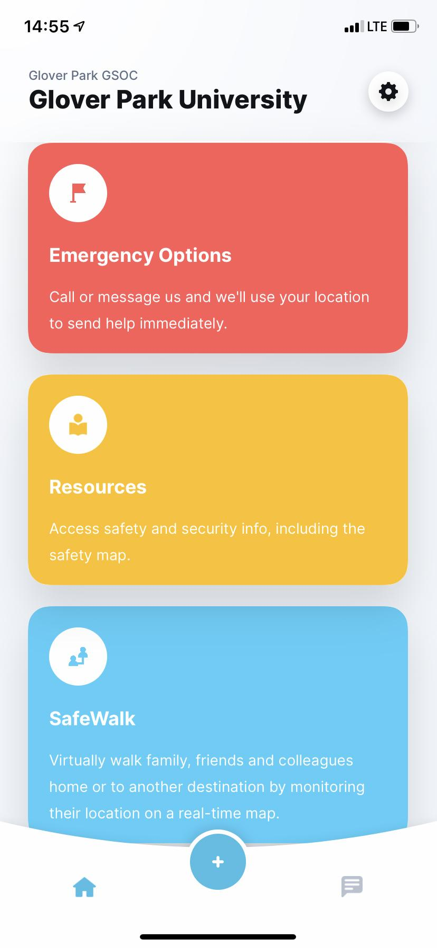
Download LiveSafe LiveSafe is a free benefit for your community
for
Request Help
Communicate with local emergency services and your school’s safety officials – no matter where you are.
Settings
Access profile settings, manage your community, and get app help.
Access Information and Emergency Procedures
View important information from your school, like emergency procedures and community resources.
SafeWalk
Invite friends to virtually walk you to your destination.
Tab Navigation: Home
See an overview of LiveSafe resources and updates from your school.
Tab Navigation: Activity
Access past broadcast messages, check-ins, and chat conversations.
Submit Tips to Safety & Security
If you see something suspicious, share it with security. You can anonymously submit text, files, or video.
Get the App:
Download LiveSafe from the App Store or Google Play or using the QR code
Register and complete your profile
Search for and select your organization
Notes:
TO UPDATE PHONE SCREEN: This is using an iPhone X for the base. Make sure you are replacing the app image with a screenshot taken from an iPhone X.
Right-click the iPhone X frame. Hover over “Send to Back” and select “Send Backward”. This will layer the app image above the phone frame so that you can easily select it and replace it with the updated image.
Right-click the app image. Select “Change Picture”.
Locate the screenshot you have already taken of the organization you are creating the launch kit for. Select it.
Right-click the updated screenshot you just dropped in. Hover over “Send to Back” and select “Send Backward”. This will layer the phone frame back on top of the app image.
TO UPDATE QR CODE: There are tons of options online for creating QR codes. One example is https://www.qr-code-generator.com/
Right-click the QR code. Select “Change Picture”
Locate the QR code you have generated for the organization you are creating a launch kit for. Select it.

Slide 4
Going Out? Keep yourself and your friends safe with LiveSafe.
for
Don’t let an unexpected accident ruin your fun. Use LiveSafe features like SafeWalk, Report Tips, and Emergency Options to stay safe while you’re out.
Download the LiveSafe Mobile App today and put safety in your own hands.
Get the App:
Download LiveSafe from the App Store or Google Play or using the QR code
Register and complete your profile
Search for and select your organization
Notes:
To Replace “Fake Logo” With Your Organization’s Logo In The Header:
Right-click the middle of the “fake logo” image, to the right of the Live Safe logo
Select “Change Picture”
Select the light/white version of your organization’s logo (to be used on darker backgrounds). Make sure you are selecting a PNG for the file type.
To Replace Phone Screen With Your Organization’s Configuration:
Right-click the middle of the home screen image
Select “Change Picture”
Select an image of your home screen configuration from your computer. Ideally, the screenshot was taken using an iPhone 6. If you don’t have access to an iPhone 6, reach out to support@livesafemobile.com.
To Change Color For Header and Footer Banners:
Click edge of blue box
Click “Shape Format” tab
Click “Shape Fill”
Choose a preset color or to select a custom color, click ”More Fill Colors” and enter in hex code

Slide 5
Know the Difference between having fun and abusing alcohol
for
Do you know what never takes a holiday?
Alcohol abuse can be a sign of a more serious issue like depression or suicide. Know the difference between having fun and needing alcohol to cope with something more significant.
With LiveSafe, you can report alcohol or substance abuse and other serious concerns anonymously to keep your friend safe and help them access resources and help.
Get the App:
Download LiveSafe from the App Store or Google Play or using the QR code
Register and complete your profile
Search for and select your organization
Notes:
To Replace “Fake Logo” With Your Organization’s Logo In The Header:
Right-click the middle of the “fake logo” image, to the right of the Live Safe logo
Select “Change Picture”
Select the light/white version of your organization’s logo (to be used on darker backgrounds). Make sure you are selecting a PNG for the file type.
To Replace Phone Screen With Your Organization’s Configuration:
Right-click the middle of the home screen image
Select “Change Picture”
Select an image of your home screen configuration from your computer. Ideally, the screenshot was taken using an iPhone 6. If you don’t have access to an iPhone 6, reach out to support@livesafemobile.com.
To Change Color For Header and Footer Banners:
Click edge of blue box
Click “Shape Format” tab
Click “Shape Fill”
Choose a preset color or to select a custom color, click ”More Fill Colors” and enter in hex code

Slide 6
Don’t Wait Until It’s Too Late
for
Frequent and excessive drinking can be a sign of a more serious problem. Don’t wait to report concerning alcohol behavior until it’s too late.
Be a good friend and report any concerning alcohol or substance use anonymously through LiveSafe to make your campus a safer place for all.
Get the App:
Download LiveSafe from the App Store or Google Play or using the QR code
Register and complete your profile
Search for and select your organization
Notes:
To Replace “Fake Logo” With Your Organization’s Logo In The Header:
Right-click the middle of the “fake logo” image, to the right of the Live Safe logo
Select “Change Picture”
Select the light/white version of your organization’s logo (to be used on darker backgrounds). Make sure you are selecting a PNG for the file type.
To Replace Phone Screen With Your Organization’s Configuration:
Right-click the middle of the home screen image
Select “Change Picture”
Select an image of your home screen configuration from your computer. Ideally, the screenshot was taken using an iPhone 6. If you don’t have access to an iPhone 6, reach out to support@livesafemobile.com.
To Change Color For Header and Footer Banners:
Click edge of blue box
Click “Shape Format” tab
Click “Shape Fill”
Choose a preset color or to select a custom color, click ”More Fill Colors” and enter in hex code

