Slide 1
Standard Config
Get the App
for Glover Park Corp
1
Download “LiveSafe” from Google Play or the App Store.
Register with your phone number & email.
Search for & select “Glover Park Corporation” & then choose your community.
2
3
Notes:
TO UPDATE PHONE SCREEN: This is using an iPhone X for the base. Make sure you are replacing the app image with a screenshot taken from an iPhone X.
Right-click the iPhone X frame. Hover over “Send to Back” and select “Send Backward”. This will layer the app image above the phone frame so that you can easily select it and replace it with the updated image.
Right-click the app image. Select “Change Picture”.
Locate the screenshot you have already taken of the organization you are creating the launch kit for. Select it.
Right-click the updated screenshot you just dropped in. Hover over “Send to Back” and select “Send Backward”. This will layer the phone frame back on top of the app image.

Slide 2
Standard Config
SAFETY STARTS WITH YOU

Slide 3
Export Instructions
1) Once both side options have been finalized, move them above this slide.
2) Move all other card sides not being used below this slide.
3) Double-check spelling, QR codes, download instructions, etc.
4) Delete this slide and all slides that follow.
5) In the menu bar, click File >> Export >> PDF.

Slide 4
Profile Question
Get the App
for Glover Park Corp
1
Download “LiveSafe” from Google Play or the App Store.
Register with your phone number & email.
Search for & select “Glover Park Corporation” & then choose your community.
Answer any additional profile questions.
2
3
4
Notes:
TO UPDATE PHONE SCREEN: This is using an iPhone X for the base. Make sure you are replacing the app image with a screenshot taken from an iPhone X.
Right-click the iPhone X frame. Hover over “Send to Back” and select “Send Backward”. This will layer the app image above the phone frame so that you can easily select it and replace it with the updated image.
Right-click the app image. Select “Change Picture”.
Locate the screenshot you have already taken of the organization you are creating the launch kit for. Select it.
Right-click the updated screenshot you just dropped in. Hover over “Send to Back” and select “Send Backward”. This will layer the phone frame back on top of the app image.

Slide 5
Pin
Get the App
for Glover Park Corp
1
Download “LiveSafe” from Google Play or the App Store.
Register with your phone number & email.
Search for & select “Glover Park Corporation” & then choose your community.
When prompted, enter in pin “XXXX”.
2
3
4
Notes:
TO UPDATE PHONE SCREEN: This is using an iPhone X for the base. Make sure you are replacing the app image with a screenshot taken from an iPhone X.
Right-click the iPhone X frame. Hover over “Send to Back” and select “Send Backward”. This will layer the app image above the phone frame so that you can easily select it and replace it with the updated image.
Right-click the app image. Select “Change Picture”.
Locate the screenshot you have already taken of the organization you are creating the launch kit for. Select it.
Right-click the updated screenshot you just dropped in. Hover over “Send to Back” and select “Send Backward”. This will layer the phone frame back on top of the app image.

Slide 6
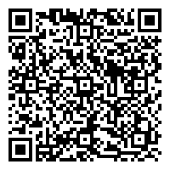
QR Code
Get the App
for Glover Park Corp
1
Scan the QR Code.
Download “LiveSafe,” then input & verify your mobile phone number.
If prompted, search for your organization.
2
3
Notes:
TO UPDATE PHONE SCREEN: This is using an iPhone X for the base. Make sure you are replacing the app image with a screenshot taken from an iPhone X.
Right-click the iPhone X frame. Hover over “Send to Back” and select “Send Backward”. This will layer the app image above the phone frame so that you can easily select it and replace it with the updated image.
Right-click the app image. Select “Change Picture”.
Locate the screenshot you have already taken of the organization you are creating the launch kit for. Select it.
Right-click the updated screenshot you just dropped in. Hover over “Send to Back” and select “Send Backward”. This will layer the phone frame back on top of the app image.
TO UPDATE QR CODE: There are tons of options online for creating QR codes. One example is https://www.qr-code-generator.com/
Right-click the QR code. Select “Change Picture”
Locate the QR code you have generated for the organization you are creating a launch kit for. Select it.

Slide 7
QR Code + Pin
Get the App
for Glover Park Corp
1
Scan the QR Code.
Download “LiveSafe,” then input & verify your mobile phone number.
Enter in “XXXX” when prompted for a pin.
2
3
Notes:
TO UPDATE PHONE SCREEN: This is using an iPhone X for the base. Make sure you are replacing the app image with a screenshot taken from an iPhone X.
Right-click the iPhone X frame. Hover over “Send to Back” and select “Send Backward”. This will layer the app image above the phone frame so that you can easily select it and replace it with the updated image.
Right-click the app image. Select “Change Picture”.
Locate the screenshot you have already taken of the organization you are creating the launch kit for. Select it.
Right-click the updated screenshot you just dropped in. Hover over “Send to Back” and select “Send Backward”. This will layer the phone frame back on top of the app image.
TO UPDATE QR CODE: There are tons of options online for creating QR codes. One example is https://www.qr-code-generator.com/
Right-click the QR code. Select “Change Picture”
Locate the QR code you have generated for the organization you are creating a launch kit for. Select it.

Slide 8
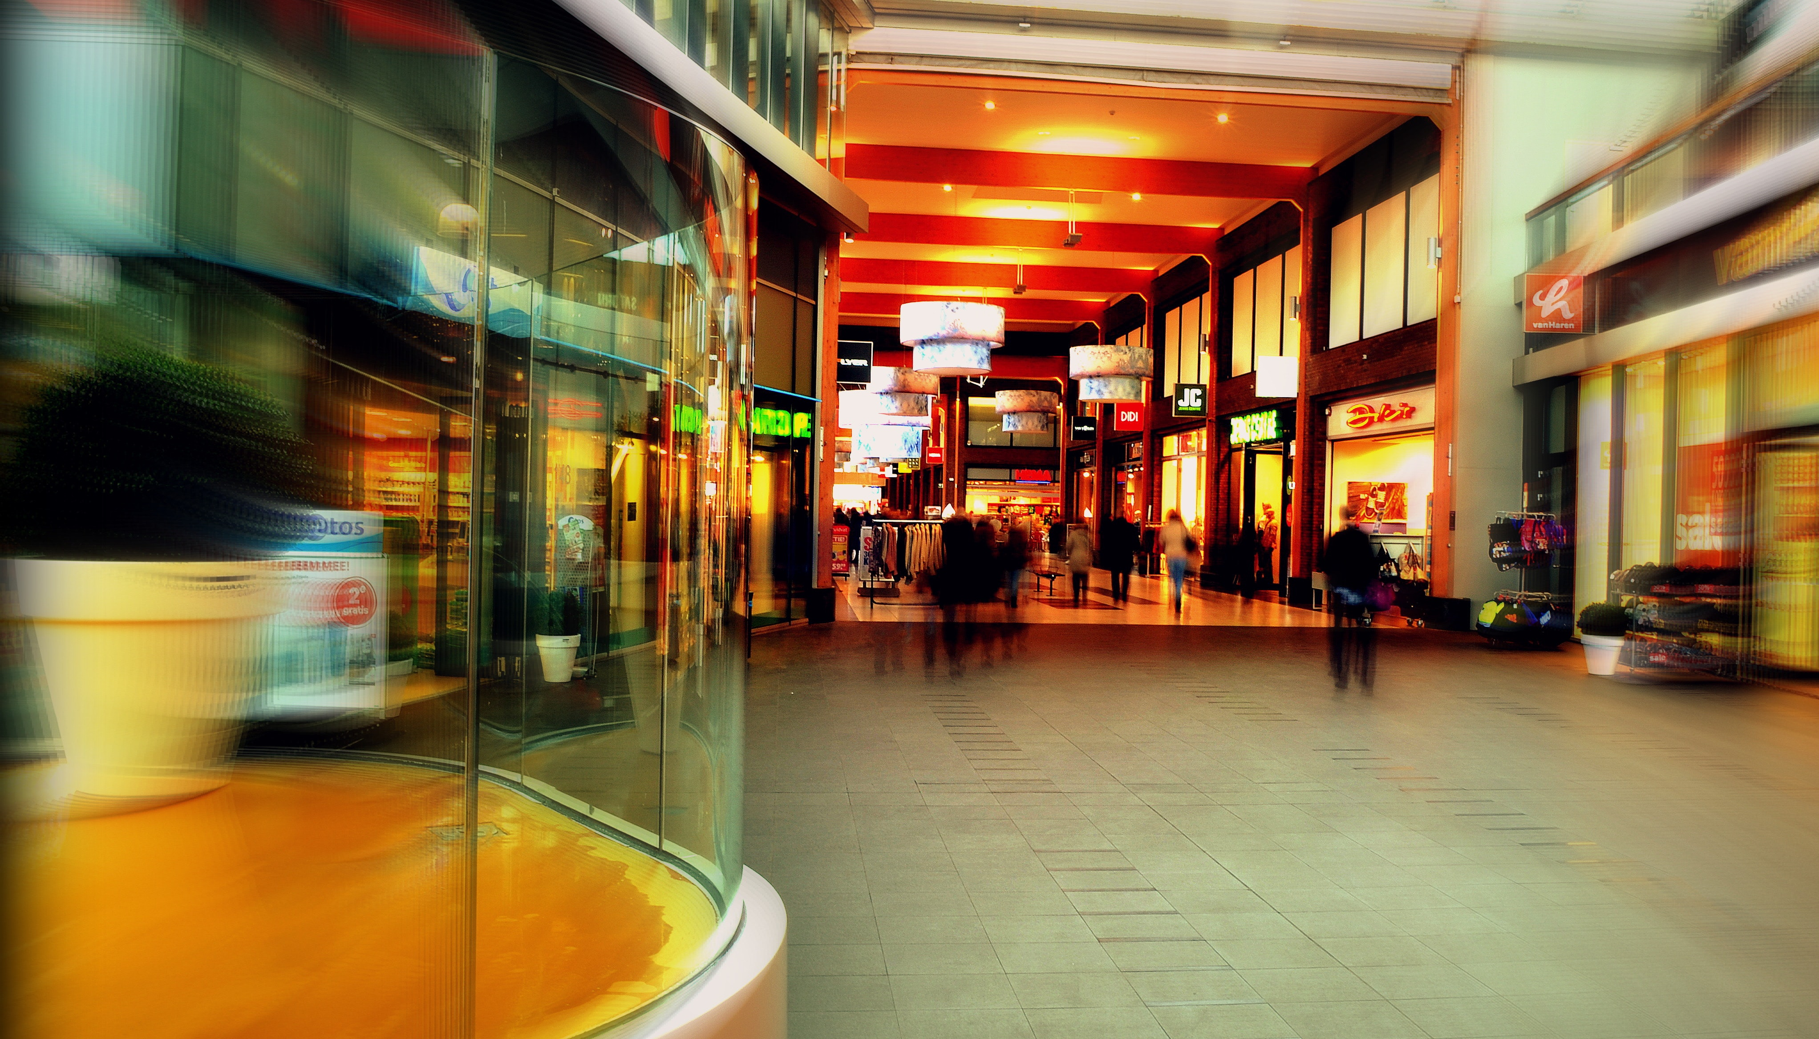
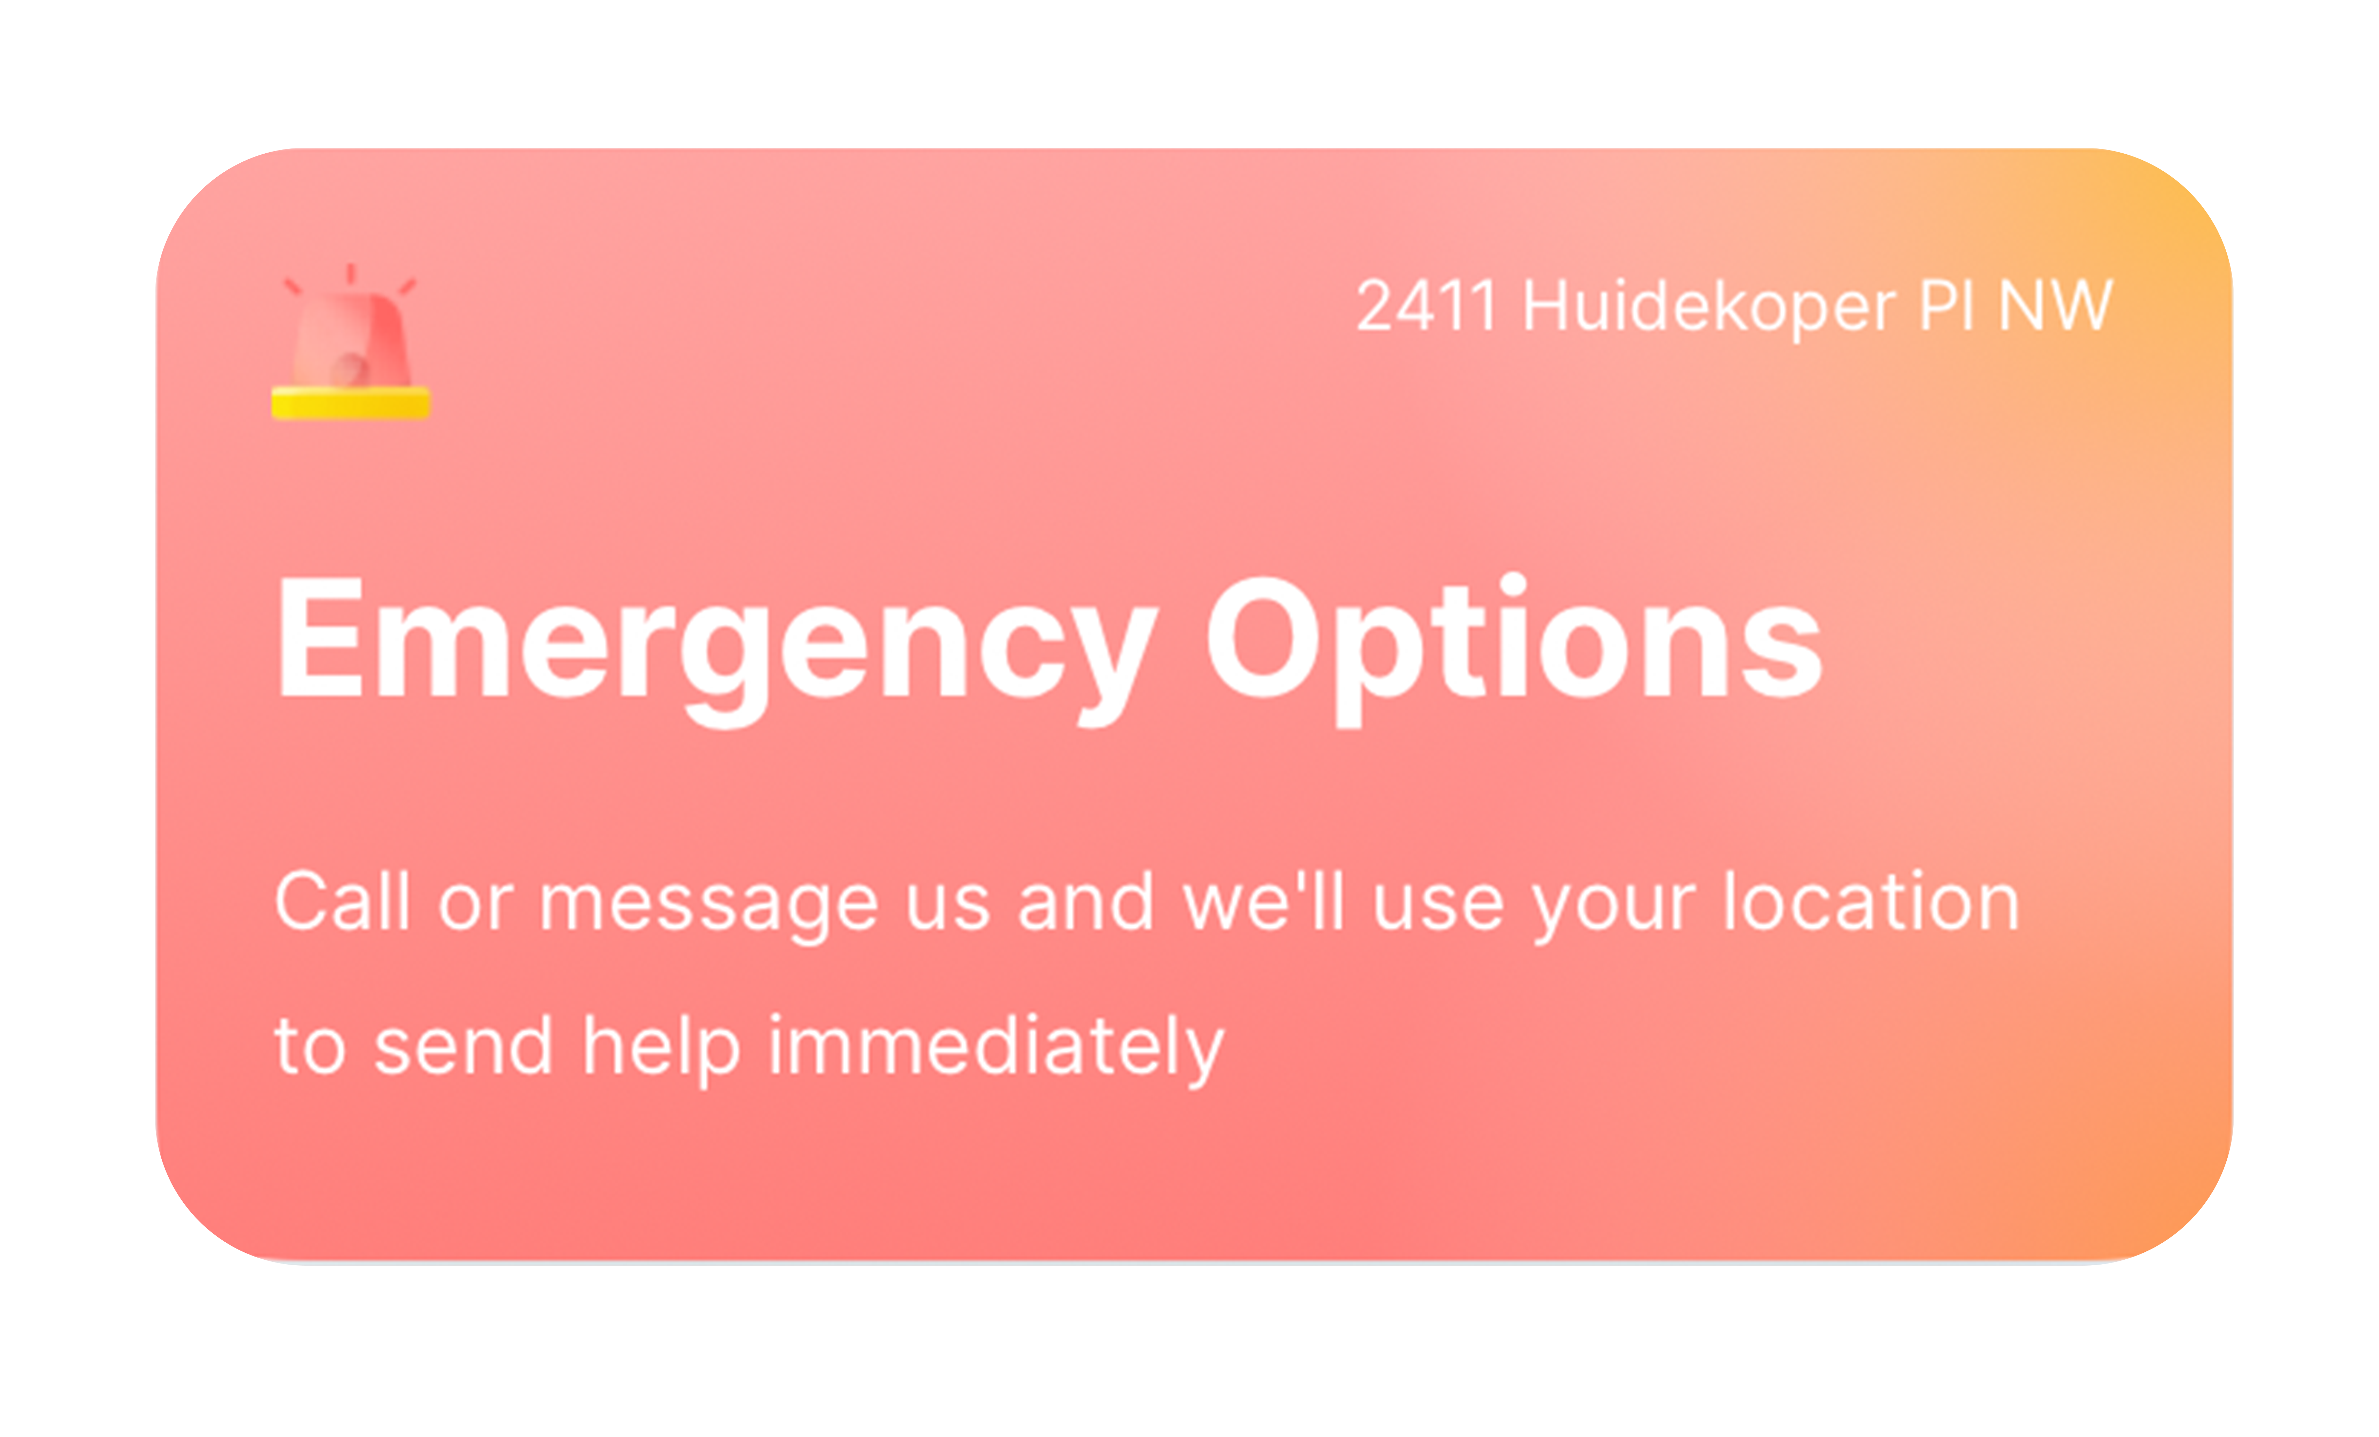
Old/Original Configuration
SAFETY STARTS WITH YOU

