Slide 1
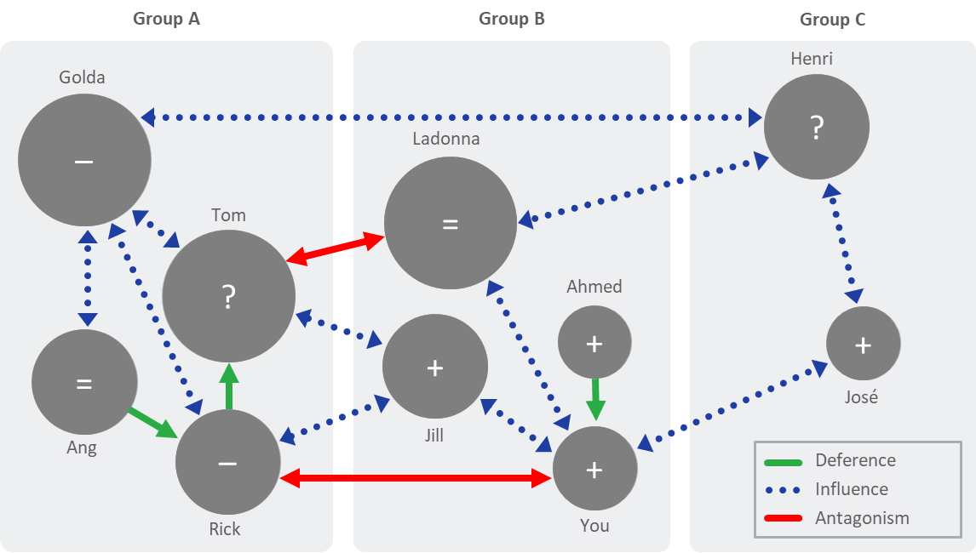
Stakeholder and Influence Mapping Tool
01-02
Sample Stakeholder and Influence Map

Slide 2
DEFERENCE
INFLUENCE
ANTAGONISM
Party A will almost certainly
Do what Party B does, or
Do what Party B advises, asks, or directs Party A to do
Sources of “deference”
Hierarchy, mentorship, sponsorship
Political power, seniority
Personal respect, admiration
Expertise, status, reputation, etc.
Watch for “patterns of deference” among the mapped players (i.e., who defers to whom?)
Represented as a green line on the stakeholder mapping diagram
Party A is likely to
Follow Party B’s lead, or
Do what Party B advises, asks, or directs Party A to do
Sources of “influence”
Trust of judgment, best intentions
Successful track record
Shared interests, common outlook, etc.
Watch for “patterns of influence” among the mapped players (i.e., who can help secure support from others?)
Represented as a blue dotted line on the stakeholder mapping diagram
Party A is unlikely to
Follow Party B’s lead, or
Do what Party B advises, asks, or directs Party A to do
Sources of “antagonism”
Political opposition, conflicting interests
Mistrust of judgment, intentions
Unsuccessful track record
Watch for “patterns of antagonism” among the mapped players (i.e., whose support would preclude agreement with others?)
Represented as a red line on the stakeholder mapping diagram

Slide 3
Stakeholder and Influence Mapping Tool (cont.)
02
Copy and Paste elements below to create your Influence Map
Arrows
Deference
Influence
Antagonism
Circles
Name
Name
Name

Slide 4
Stakeholder and Influence Mapping Tool (cont.)
02
Copy and Paste elements below to create your Influence Map
Arrows
Deference
Influence
Antagonism
Circles
Name
Name
Name

Slide 5
Stakeholder and Influence Mapping Tool (cont.)
03-04

