Slide 1
Mosaic NVMe for Oracle
High Performance Oracle RAC Cluster Powered by Dell

Slide 2

Introduction to Mosaic
Mosaic is an ultra-high performance, pre-calibrated data solution designed to be a superior alternative to Oracle Real Application Cluster (RAC).
  Faster: The sky-high performance and ultra-low latency is unparalleled for Oracle RAC workloads.
  Cheaper: Break the trend of increasingly expensive Oracle licensing – requires fewer licenses to run and scale
  Easier: Smaller footprint, off-the-shelf hardware, pre-configured and validated design. Take the guesswork out of RAC builds.

Slide 3



Mosaic NVMeoF Enabled by Dell
Oracle RAC cluster in a “box”
Pre Configured, Unparalleled Performance
Rack, Stacked and Wired
Ready to ship and plug into a data center
Start small and grow quickly
Calibrated & Scalable Configurations
Ultra High I/O Bandwidth
Combined with ultra low latency
Latest NVMe over Fabric technology
RoCEv2 (RDMA Over Converged Ethernet v2)
No Brainer Price/Performance
Cut Oracle licensing and reduce hardware footprint

Slide 4
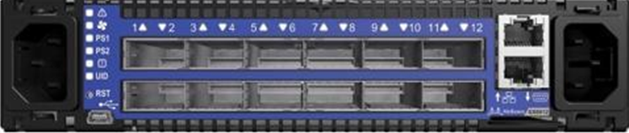
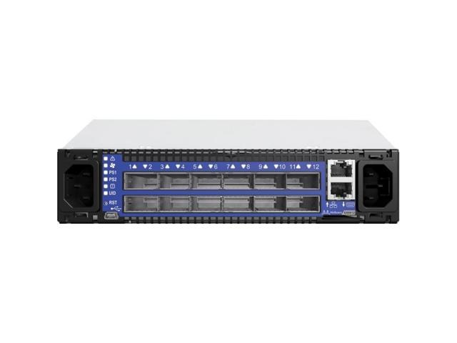
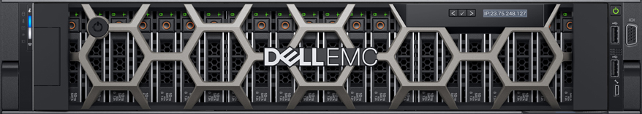

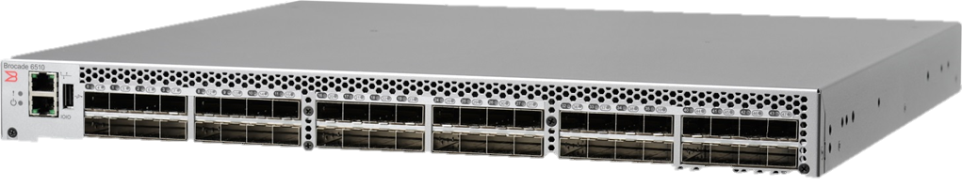
Mosaic on Dell PowerMax 8000
Oracle RAC Interconnect
2 x Mellanox SX6012
12-port
56Gb/s InfiniBand Switch
Oracle RAC Database Nodes
3x Dell R740
2x Intel Xeon Gold 6152 2.6GHz 22c
2x Dell QLogic 2692
Dual-Port 16Gbps FC HBA
Mellanox FDR Dual-Port
InfiniBand HCA (RAC)
Red Hat 7.5 (3.10.862.el7.x86_64)
MLNX OFED-4.3-3.0.2.1
Oracle RAC Clusterware 12.2
Oracle ASM 12.2
Oracle Database 12.2
FibreChannel Switches
up to 32Gbps
2x Brocade 6510
16Gbps FibreChannel Switch

Slide 5
Mosaic Benchmark Numbers
Benchmark | EMC 400K (Oracle 8 node RAC cluster with 4 engine EMC VMAX) | Excelero (Oracle 3 node RAC cluster with 4 Dell R740xd)
Create 10TB tablespace | 111 mins | 34 mins
Parallel direct path insert of 8 billion rows* | 156 mins | 83 mins
Create unique global partitioned index* | 11 mins | 6 mins
Create local bitmap index* | 92 mins | 21 mins
Query single table scan time* | 27 mins | 3 mins
Maximum sustainable scan rate per RAC node | 8 GB/Sec | 24 GB/Sec
Aggregate sustainable scan rate | 30 GB/Sec | 65 GB/Sec
* Operation performed on a 10TB partitioned table containing 8+ billion rows
** Join a 10TB 8+ billion row table with a 1.2TB 13+ billion row table

Slide 6
