Slide 1
NATIONAL CYBERSECURITY
AWARENESS MONTH (NCSAM)
Engage your team week-by-week leading up to October, and throughout the month.

Slide 2
TABLE OF CONTENTS
4-10
11-22
23-36
Pre-Launch Contact Plan
Post-Launch Contact Plan
Themed
Content

Slide 3
NCSAM MARKETING SCHEDULE CHECKLIST
Download one-pagers (Selected Series and CyberEscape Online)
Personalize one-pagers with organization logos and information
Select Weekly Security Concepts OR Themes
Schedule blog releases with your Communications Department
4 Weeks Pre-Launch Email
3 Weeks Pre-Launch Email
2 Weeks Pre-Launch Email
1 Weeks Pre-Launch Email
1st Week Post-Launch Email
2nd Week Post-Launch Email
3rd Week Post-Launch Email
4th Week Post-Launch Email
Post NCSAM Email

Slide 4
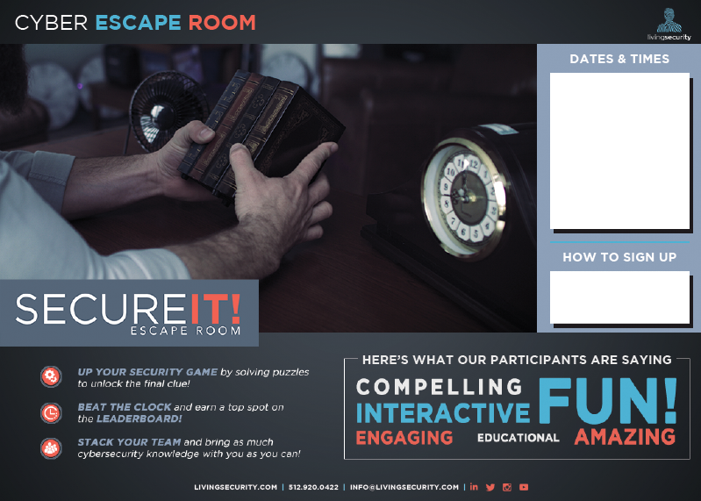
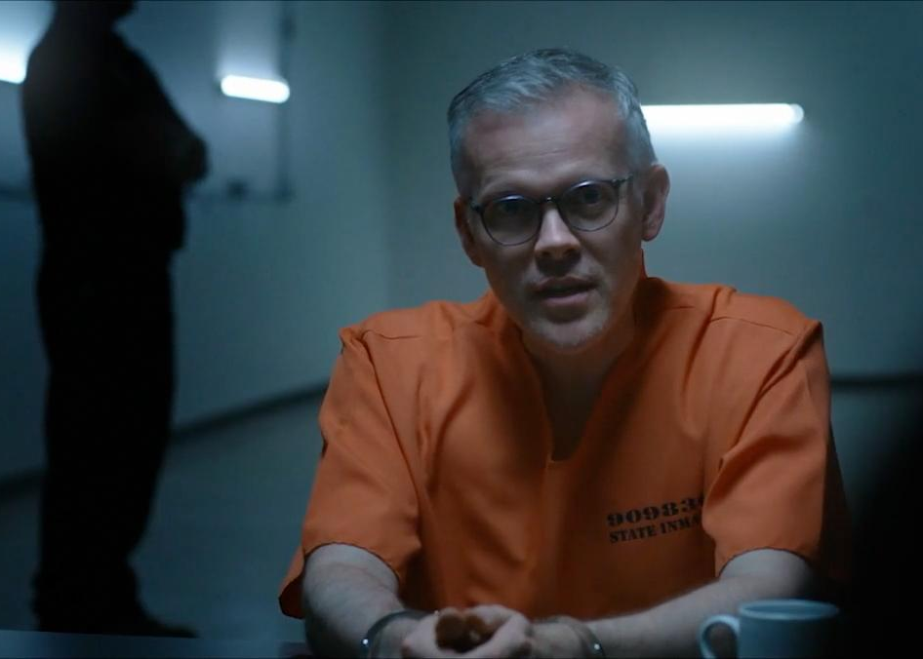
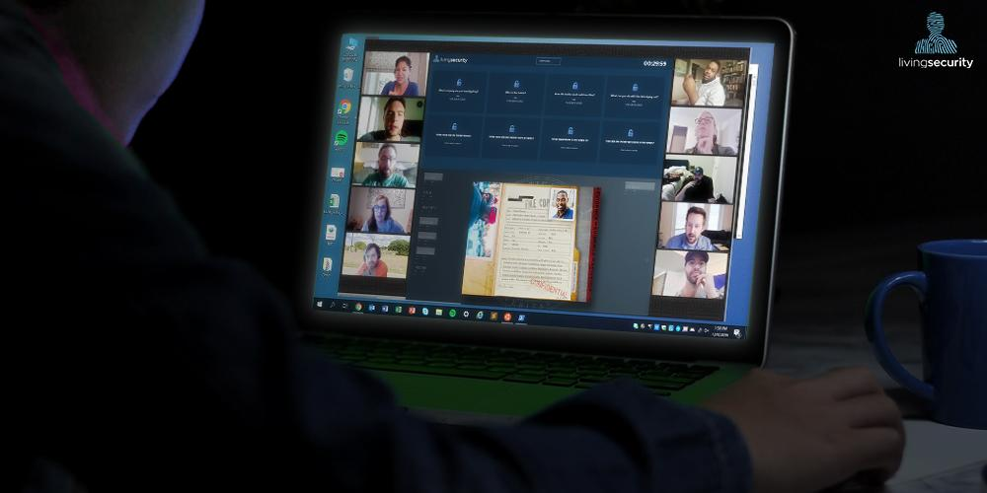
PRE-LAUNCH CONTACT PLAN
Weekly email content...PLUS:
Plug-in event one-pagers
Trailer videos
Security concept themed content

Slide 5
4 WEEKS
PRE-LAUNCH
[Your Greeting Here]
October is National Cyber Security Awareness Month, and we have partnered with Living Security to bring you Gone Virtual: an exciting 4 weeks of activities and awareness.
You can expect interactive and immersive experiences ranging from trainings to live events. Want a sneak peek? Check out one of the events you can look forward to below:
[Insert Event from Slides]
Keep your eyes peeled for more sneak peeks!
[Your Sign Off Here]

Slide 6
3 WEEKS
PRE-LAUNCH
[Your Greeting Here]
We’re excited about what we have in store for Cybersecurity Awareness Month, starting in just a few weeks. Featured next month are high-quality, immersive experiences to encourage habit-changing security awareness to keep our organization safe and secure. Living Security has helped us optimize security training and we think you’re going to like what you see; get ready to learn best practices and threats to look out for.
Curious about the trainings we’ll be apart of? Check out two of the events below:
[Insert Event from Slides]
[Insert Event from Slides]
[Your Sign Off Here]

Slide 7
2 WEEKS
PRE-LAUNCH
MODULES FOCUSED
Use this template or the Series-focused template on the previous slide to prepare your team for their cybersecurity awareness content on the Living Security Platform
[Your Greeting Here]
Living Security specializes in Hollywood-style, high quality content on their platform site. Get ready to be fully immersed in the world of cybersecurity. Move through the modules by answering questions and earning points to reach the top spot on the leaderboard. Each week, different modules with various highlighted security concepts will be released. Check out the related blog for more info!
[Insert related blog]
[Your Sign Off Here]

Slide 8
1 WEEK
PRE-LAUNCH
(security concept)
Use this template or the Themed Weeks-focused template on the next slide to prepare your team a week in advance
[Your Greeting Here]
National Cyber Security Awareness Month is just around the corner. With a month full of trainings and events...which you’ve already seen in our sneak peaks. Here is a taste of security concepts we’ll highlight over the next month:
Week 1: [Insert Security Concept Focus]
Week 2: [Insert Security Concept Focus]
Week 3: [Insert Security Concept Focus]
Week 4: [Insert Security Concept Focus]
You will begin to receive invitations in your email to Living Security’s platform site and to sign up for virtual Cybersecurity Escape Room sessions. Keep an eye out for those in your inbox over the next week from help@livingsecurity.com.
[Your Sign Off Here]

Slide 9
1 WEEK
PRE-LAUNCH
(themed weeks)
Use this template or the Security Concepts-focused template on the previous slide to prepare your team a week in advance
[Your Greeting Here]
National Cyber Security Awareness Month is just around the corner, with a month full of trainings and events...which you’ve already seen in our sneak peaks. Here is a taste of the weekly themes for the next month:
Week 1: [Insert Weekly Theme Focus from Slide]
Week 2: [Insert Weekly Theme Focus from Slide]
Week 3: [Insert Weekly Theme Focus from Slide]
Week 4: [Insert Weekly Theme Focus from Slide]
You will begin to receive invitations in your email to Living Security’s platform site and to sign up for virtual cybersecurity Escape Room sessions. Keep an eye out for those in your inboxes over the next week from help@livingsecurity.com.
[Your Sign Off Here]

Slide 10
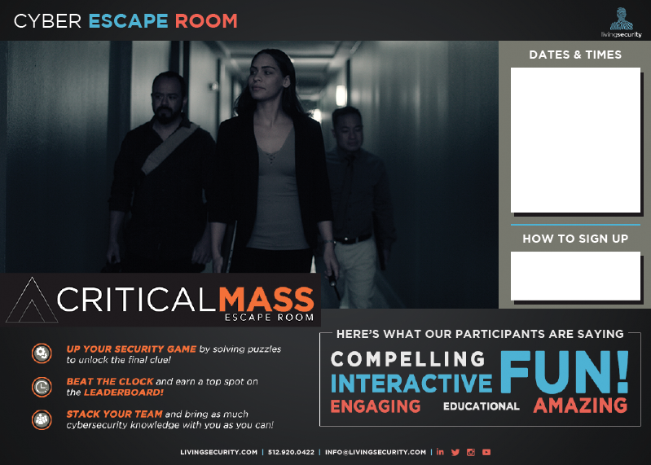
LAUNCHED CONTACT PLAN
BY SECURITY CONCEPTS
Weekly email content plus!
Plug-in event one-pagers
Trailer videos
Security concept themed content

Slide 11
WEEK 1
LAUNCHED
Security Concept
[Your Greeting Here]
It is here! National Cybersecurity Awareness month is officially kicking off and our first week of events will start us off right.
[Insert Security Concept Highlight]
[Insert Event]
Check out the attached fliers for more info!
[Your Sign Off Here]

Slide 12
WEEK 2
LAUNCHED
Security Concept
[Your Greeting Here]
Thanks for a great start to National Cyber Security Awareness Month. Let’s look ahead to the coming week:
[Insert Security Concept Highlight]
[Insert Event]
[Your Sign Off Here]

Slide 13
WEEK 3
LAUNCHED
Security Concept
[Your Greeting Here]
We’re entering into Week 3 for National Cybersecurity Awareness Month!
[Insert Security Concept Highlight]
Look forward to:
[Insert Event from Slides]
[Your Sign Off Here]

Slide 14
WEEK 4
LAUNCHED
Security Concept
[Your Greeting Here]
It is the last week for National Cyber Security Awareness Month and we plan to finish strong!
[Insert Security Concept Highlight]
[Insert Event from Slides]
Thank you for your participation, team! Your participation is making a real difference in protecting our organization from cybersecurity threats - nice job!
[Your Sign Off Here]

Slide 15
POST NCSAM
[Your Greeting Here]
We did it. Another Cybersecurity Awareness Month come and gone...and we covered A LOT! Thank you for your participation in the events over the last four weeks. Thanks to your strong participation, our company is in a stronger place. Nice work, team!
We hope you enjoyed this adventure just as much as we enjoyed providing it. As always, please contact us if you have any further questions or want to discover new ways to secure your digital life.
And if you have any feedback on the Living Security Platform or thoughts on how we can improve security training for you, please let us know. Be the next strong link in the chain!
[Your Sign Off Here]

Slide 16
THEMED CONTENT
Weekly Themes
Security Concepts
Events
Blogs

Slide 17
WEEKLY THEMES
Games Week
Let’s get ready to rumble! Rack up points during Game Week and earn bragging rights across your office. Starting stretching your hands in preparation for lightning-speed mouse clicking and ensure your hand/eye coordination is top notch. We can’t catch these security threats without you!
Cinema Week
Cybersecurity and hackers may seem like something straight out of the movies, but many threats you’re used to seeing on the big screen do have real life implications. Join us for Cinema Week to explore everyday threats you may face at work or at home.
Speaker Week
Security awareness takes a team. It’s important we learn from each other and continue to lean on others in the field to stay on top of the next threats. Join us for Speaker Week where our team will get personalized session and Q&A with famous hacker Christopher Hadnagy, as well as live webinars hosted by Living Security.
Touchdown Week
Are you eager to see where you placed on our company leaderboard throughout Cybersecurity Awareness Month? Touchdown Week will announce it all! We’ll wrap up NCSAM with a Cyber Hygiene webinar and a presentation featuring security’s 7 Deadly Sins.

Slide 18
Security Concepts
One-Liner
Messaging
Phishing
It just takes one click -- one click and you can put yourself and everyone around you at risk. Stay sharp and vigilant, always report it if something seems...phishy.
Social Media
It today’s world, we can hardly escape the grasp of social media. How safe are you in your online life?
Malware
Knowing what different kinds of malwares exist will help you recognize and avoid the threat no matter what form it comes in.
IoT
Technology is ever-changing, do you know how to keep yourself safe with all these new, connected devices?
Passwords
Passwords may seem like common sense, but there are new threats everyday. Ensure your password hygiene is squeaky clean.

Slide 19
PHISHING
WEEK BY WEEK
Week 1
Fishing is always a good time, but being “phished” is never fun. Phishing emails account for 90% of data breaches. So make sure to check for redflags on emails such as spoofed sender addresses and urgency so you don’t get hooked into a data breach.
Week 2
To pull off the best pranks on my siblings I would use their trust to make them lower their guard and then WHAM, water-balloon! The same goes for phishing emails that spoof trusted sources in order to trick you into clicking a link or downloading a file. You might think you can trust the sender but then WHAM, you’ve been pawned!
Week 3
“Quick! hurry! ASAP! Right now!” are examples of saying that make you snap into action and complete your task quickly. But when it comes to emails anytime someone is pressuring you to make a decision (especially involving $$$) make sure to take your time and double-check that you aren’t being tricked into send money or information to someone you shouldn’t.
Week 4
At this point in your training, you should be getting pretty good at identifying phishing attempts ... So would you click this link: dunkindonuts.com? Who doesn’t want to see what kinda deals dunkin’ has for us? WAIT! Before clicking a link, make sure to check the actual address by hovering over it with your mouse. Would you still click this link?

Slide 20
SOCIAL MEDIA
WEEK BY WEEK
Week 1
Social media is great for sharing with friends and family, but be careful not to share too much! You wouldn’t give your address to strangers so don’t put personal info out there for them to have!
Week 2
You cover your windows with blinds so that strangers can’t peak into your home. And the same should apply to your social media presence. Don’t invite people to peek into your personal life by accepting strangers’ friend requests.
Week 3
“Playing hooky from work for the next two weeks … Miami beaches here I come!” A post like this may seem like harmless sharing, but now everyone knows your home is vacant for the next two weeks! It would not be an ideal ending to your vacation to find out someone used the information you shared to rob your home while you were away :(
Week 4
Most people don’t leave their social security card out on the kitchen counter just because their front door locks. Normally people will add another layer of security by placing it inside a locked safe inside their already-locked home. Why don’t we treat our social media sites the same way?? Enable multi-factor authentication in your security settings to go the extra step so that your account is protected behind two layers of lock and key.

Slide 21
MALWARE
WEEK BY WEEK
Week 1
In the same way we practice good hygiene to avoid sickness you also need to develop good cyber hygiene to avoid getting malware on your machine! Malware is like an illness for your computer and can be a real drag to get over. Make sure to be observant about what links you click on and sites you visit so as to keep your computer healthy from any illnesses that it may contract.
Week 2
While most of us don’t enjoy going to our doctors for checkups and shots, we reluctantly do it because we know it is important to make sure we stay healthy. The same goes for updating your computer! While it may be annoying having to wait while your computer completes what seems like the fifth update this month, it will ensure that your computer has everything it needs to stay healthy from all the known malware strands that could infect your computer.
Week 3
Malware is like a box of chocolates, you never know what you're gonna get … This might not be the original saying but it does hold true! Malware can come in many different forms such as ransomware, spyware, adware, scareware, and others. Knowing what ‘wares’ exist will help you recognize and avoid malware no matter what form it comes in.
Week 4
Much like how security guards protect banks from robbers, antivirus software is designed to protect your computer from malware. But some robbers are so skilled they can sneak past the security without them ever knowing they were there until it's too late! Malware also has this ability, and it’s called obfuscation. This doesn’t mean your antivirus is pointless. I mean you wouldn’t want a bank without security, right? But to ensure you aren’t inviting robbers in be cautious what sites you visit and files you download!

Slide 22
IoT
WEEK BY WEEK
Week 1
Everybody wants the newest Internet of Things (IoT) devices because who doesn’t want a fridge that can tell you when you are running out of pizza rolls?! IoT devices provide greater convenience and connectivity, but they are also bringing more vulnerabilities. Consistently updating your IoT devices will help to protect from nosey cyber criminals … and make sure that you never run out of pizza rolls.
Week 2
You wouldn’t hand out a copy of your house key to anybody who asks, so why would you let strangers know your IoT devices password? By failing to change the default credentials on your IoT devices you are basically giving away the keys to the kingdom and allowing anyone to access your devices. Make sure to change the default credentials to ensure your password and username aren’t public knowledge and are only known by you.
Week 3
Bears love to eat the low hanging fruit from trees because it's easy to reach! For cyber criminals IoT devices are the ‘low hanging fruit. So make sure to read reviews on your devices before you purchase them and always change the default credentials and security settings! You don’t want to give the bears a reason to come poking around.
Week 4
BOGO sale deal buy one IoT device you are also getting one free vulnerability.

Slide 23
OTHER CONCEPTS
Never share your password:
You’d never share your toothbrush. So, why would you share your password? You may trust your friends intentions, but you may not be able to trust their hygiene. Always stay vigilant with who has access to your passwords…and toothbrush.
Password Managers:
We can all be picky with our clothes and some even try to never wear the same outfit more than once! We need to be this picky with our passwords. A password manager can create and store new strong passwords for us. Now you will never have to worry about creating a new password again! … needs work

Slide 24
Events One-Liner
Messaging
Living Security Hosted Live Webinar
Living Security’s live webinar will discuss the world’s latest security risks and vulnerabilities we are facing, featuring Kelley Bray.
Improv Group
Join Fish Sticks Comedy live for their interactive, hilarious improv show centered around cybersecurity concepts like how sharing a toothbrush is like sharing a password.
Speaker: Christopher Hadnagy
Ever wonder what it’s like to be a hacker? Join us for a live session with Social Engineering LLC’s Chris Hadnagy as he tells real-life stories, along with a Q&A.
Cyber Hygiene Recorded Webinar
Living Security’s Graham Westbrook, discusses what it means to know about your cyber hygiene -- how clean are you?
CyberEscape Online
Figure out what happened at Gizmo! An entirely virtual Escape Room will guide your team to uncover clues to identify and locate the insider threat.
True Eye Viewing Party
Grab your popcorn and watch Adrian, a new hire at a top AI firm, track an AI gone rogue and hopefully save a kidnapped co-worker!

Slide 25
Events One-Liner
Messaging
Zombie Hotspot Game
Search, click, and locate all of the security threats in today’s game...watch out for zombies!
Craft a Phish Game
Do you think you have a sharp eye? Can you spot a phishing email from a mile away? Let’s test that in Craft a Phish -- determine if an email is a phish or legit.
Rawfish/Sushi Game
Can you identify emails purely from the raw email log? Let’s put it to the test.
Security Feud
Are you a fan of game shows? Now you can play one! Join a team and come play Security Feud.
7 Deadly Sins Slide Deck
We all know a variety of security threats to watch out for, but what are security’s 7 Deadly Sins? Check out this presentation to find out if you’re guilty of one or more.

Slide 26
EVENTS
Living Security Hosted Live Webinar
A key factor of being secure is knowing the threats of today AND tomorrow. Join Living Security as they discusses latest vulnerabilities and threats in the security world.
Improv Group
Join us for this fun, interactive learning experience to take a look at security and threats in a different way. Fish Sticks Comedy will build hilarious scenarios and games off of YOUR suggestions.
Speaker: Chrisopher Hadnagy
Famous human hacker Christopher Hadnagy and his crew at Social-Engineer, LLC are booked to tell real-life hacker stories from the trenches - learn the risks (and consequences) that real companies have had to face
Cyber Hygiene Recorded Webinar
Living Security’s Graham Westbrook, Director of Intelligence and Content, and Ashley Rose, CEO, talk about the specifics of Cyber Hygiene and things to watch out for when working from home.
CyberEscape Online | One-Pager
CyberEscape Online is Living Security’s first entirely virtual escape room. This team building event is set at Gizmo Corp, where you and your team will help investigators follow an insider threat’s steps. See the attached one-pager for more info!
7 Deadly Sins Slide Deck
How secure are you? It’s easy to overlook everyday security violations at work or while in the comfort of your own home. Let’s explore the 7 Deadly Sins when it comes to working from home.

Slide 27
EVENTS
True Eye Viewing Party | One Pager
Follow Adrian through his first day at a global AI-technology firm. Adrian’s policy orientation and security training quickly spin into suspense and intrigue as his personal AI device, Guide, starts asking him to do unethical and even dangerous things with sensitive data. Grab some popcorn, sit back, and enjoy!
Zombie Hotspot Game
There are security violations everywhere. It’s up to you to find everything that can be a threat to your security safety. It’s a race against the clock, can you find the security violations in time?
Craft a Phish Game
Phishing can be obvious but it can also look and feel all-too-real. It’s easier to spot a phishing email when you think like an attacker and not like a victim. Locate the phishing indicators that are the most difficult to spot or least obvious to an average computer user
Rawfish/Sushi Game
Let’s test your security knowledge in this advanced game. Locate the malicious phishing emails using only the email raw logs in this game.
Security Feud
Quick on the buzzer? Join us for a fun, immersive security awareness training with 19 cybersecurity-themed crowdsourced question. May the best team win!

Slide 28
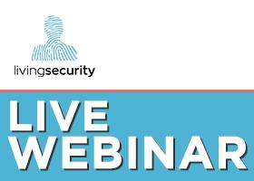
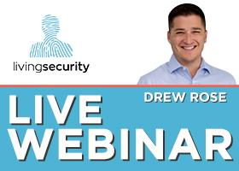
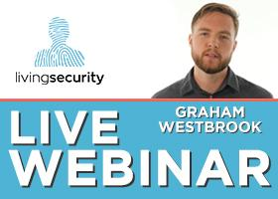
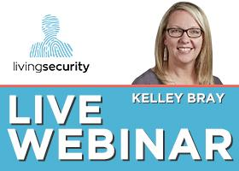
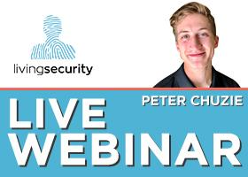
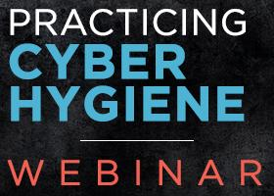
Event
Thumbnails
Right-click image to copy/save as image
UPGRADE
UPGRADE
UPGRADE

Slide 29
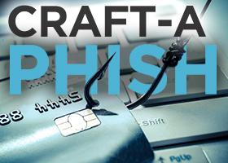
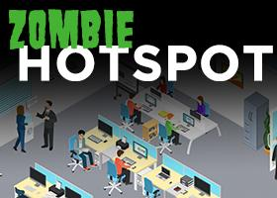
Event
Thumbnails
Right-click image to copy/save as image
UPGRADE
UPGRADE
UPGRADE

Slide 30
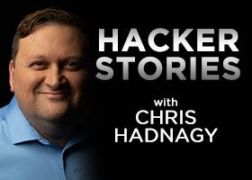
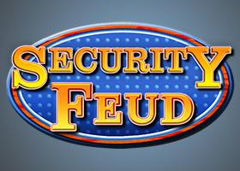
Event
Thumbnails
Right-click image to copy/save as image
UPGRADE
UPGRADE

Slide 31
BLOGS
Password Hygiene (related to Simon Says) People are more likely to learn when they feel like it addresses them personally. Check out Security guru, Melissa Plicque, explore real people's experiences with password strength and passphrases.
Phishing Awareness (related to Simon Says and Phishing IRL)
If you are in rural Oklahoma, the advice is simple. Keep your booger hook off the bang switch! In other words, keep in mind dangerous realities of phishing emails and the need to keep from clicking on links unless you are absolutely intent on launching a URL.
Default Credentials (related to Simon Says and Phishing IRL)
Smart gadgets aren’t just a fad, they are here to stay...and Siri, Alexa and GoogleHome are happy to join the family. Here’s the problem: they can store quite a bit of sensitive information and don’t always have your privacy top-of-mind.
Virtual Private Network (related to TGIS and Phishing IRL)
How often do you use a VPN? The recent popularity of VPNs has made us look at them with a bit more scrutiny: which VPN should we use, when should we use it, and, most importantly, is it really that secure?
Situational Awareness (related to True Eye)
There are implications for every person's actions. Let’s take a look at how to drive smart security awareness and how to inspire users to take advantage of the control they do have over their digital domain.

Slide 32
BLOGS
7 Deadly Cybersecurity Sins (related to True Eye)
Have you committed any of the 7 deadly cybersecurity sins? The key to sustaining culture change requires understanding not just your behavior, but also the identity and motivation behind each decision you make when it comes to security.
Policy Awareness (related to True Eye)
Too often we look at security awareness as a concept and not as behavior. Understanding awareness means understanding all the aspects of your life it can affect; at home, at work, and even on vacation.
Social Engineering (related to Phishing IRL)
You receive a message on Facebook from an old friend you haven’t kept in touch with. The message says: “I just saw this movie [URL link] and it made me think of you. I miss you! XOXO.” Would you click?
Secure WFH Workspace (related to Phishing IRL)
From a cybersecurity point of view, working remotely is a new playground for attackers. How secure is your workspace at home?
Ransomware & IoT (related to Phishing IRL)
With IoT devices making up a $50USD billion market, our everyday lives are becoming more connected to cyberspace. These devices can do A LOT--do you know how to keep yourself secure?
Cloud Security (related to Phishing IRL)
Every minute, millions of people around the world transfer their documents and files in the cloud. With so much sensitive data, it is also important to recognize that there are security threats associated with cloud computing that must be addressed.

