Slide 1
Hold for title slide
December 10, 2021

Slide 2
Housekeeping
We will record this webinar and post it on our website by end of day today (COVID-19 resource page)
Please submit questions via the Q&A function, not the Chat
OR submit to questions@dominionpayroll.com

Slide 3
Termination of the Employee Retention Credit Program
Per the Infrastructure Investment and Jobs Act, the Employee Retention Credit Program was retroactively suspended, effective 9/30/2021. The Act denies access to the employee retention tax credit in the fourth quarter of 2021 to employers other than those that qualify as “recovery startup businesses”
On Dec 6, 2021, the IRS has released guidance regarding the retroactive termination of the Employee Retention Credit.
For employers who Received ERC Advance Payments, that are not recovery startup businesses, for the fourth quarter wages of 2021, you can avoid failure to pay penalties if you repay those amounts by the due date of their applicable employment tax returns.
***failure to deposit penalties are not waived for employers if they reduce deposits after Dec. 20, 2021.

Slide 4
Path Out of the Pandemic Update

Slide 5
On September 9, 2021, President Biden announced a Covid-19 Action Plan, to include a directive to OSHA to develop a “Vaccine or Test” ETS. On November 4, 2021, OSHA published the ETS. But then…..
OSHA’s Emergency Temporary Standard (ETS)

Slide 6
Legal Challenges Abound!
November 6, 2021 - the 5th U.S. Circuit Court of Appeals in New Orleans issued an emergency stay, temporarily blocking the OSHA ETS “pending further action by this court.”
November 12, 2021 - the 5th U.S. Circuit Court of Appeals issued an order continuing its initial Nov. 6 stay of the ETS.
November 16, 2021 - the U.S. Judicial Panel on Multidistrict Litigation conducted a statutorily required random selection of circuit courts of appeal to hear the consolidated cases from around the country, with the 6th U.S. Circuit Court of Appeals, which covers Ohio, Michigan, Tennessee, and Kentucky, coming up as the selected court.
The 6th Circuit may end the stay or leave it in place. It’s not known yet when or how the Court will review the ETS, three-judge panel or en banc?
Then what?? U.S. Supreme Court???

Slide 7
Healthcare workers and federal contractors
Those vaccine mandates also are stayed and pending appeal…
Nov. 30th – the U.S. District Court for the Western District of Louisiana issued an injunction against the vaccine mandate for healthcare workers
Dec. 7th – the U.S. District Court for the Southern District of Georgia issued a stay on the vaccine requirement for federal contractors
Stay tuned…..

Slide 8
OSHA’s ETS: Highlights
Employers with 100 or more total employees across all locations must:
Require any workers who remain unvaccinated as of January 4, 2022, to produce a negative COVID-19 test result on at least a weekly basis before coming to work.
Ensure individuals who are not fully vaccinated wear a face mask while inside the workplace, beginning December 5, 2021.
Provide up to four hours of paid time off for the time it takes for workers to get vaccinated. You may not take this time out of their existing vacation bank.
Provide up to two days of paid sick time to recover if employee is under the weather post-vaccination. This time can be taken from their existing sick leave but not vacation.
NOT have to reimburse employees for transportation costs to get vaccinated, though another law might (CA, for example, requires employers to reimburse employees for mileage).
NOT have to pay for the cost of testing (unless you want to).
Collect info about employee vaccination status by Dec. 4, 2021.

Slide 9
OSHA’s ETS: Notes
The OSHA ETS supersedes any existing state or local requirements that limit an employer’s ability to require COVID vaccinations, COVID testing, or face coverings, EVEN FOR NON-COVERED EMPLOYERS (<100 employees).
If someone is granted a medical or religious exemption from being vaccinated per the ADA, they still need to produce a negative weekly test and mask up
COVID testing cannot be performed at home unless an “authorized telehealth proctor” observes the employee take the test and reads the results.
Employee count includes all employees in the U.S., including part-time and fully remote employees. As long as an employer’s head count remains 100+, it is subject to the ETS.
Temporary and seasonal workers DO count. Independent contractors DO NOT count toward the 100.
Staffing agencies are responsible for their staff and must comply if they have more than 100 employees. Host employers who do not have 100 employees without the staffing agency employees are not covered BUT are allowed to require the staffing agency to comply with any onsite policies.

Slide 10
What if someone already has had COVID?
Employees who have received a positive COVID-19 test or have been diagnosed with COVID-19 by a licensed healthcare provider, are not required to undergo COVID-19 testing for 90 days following the date of their positive test or diagnosis.

Slide 11
More on contractors…
Contractors and host employers with at least 100 employees are each required to ensure that they meet the ETS requirements for their own employees. Nothing in this section prevents host employers from imposing additional requirements for contractor employees at their worksites, such as requiring that all employees, regardless of vaccination status, wear face coverings while working indoors.
Employers in unionized workplaces with 100 or more employees must, like all covered employers, follow the minimum requirements established by the ETS. Nothing in the ETS, however, prevents employers from agreeing with employees and their representatives to implement additional measures, and the ETS does not displace collectively bargained agreements that exceed the requirements of the ETS.
And on unions…

Slide 12
Exceptions…
The following employees are exempt from the ETS:
Employees who work entirely alone (there are no other employees, clients, or customers present during their workday)
Employees who work 100% remotely (note: if they come into the office for any reason, they must wear a mask and provide a negative test taken within the last seven days)
Employees who work exclusively outdoors
The employee must work outdoors on all days (i.e., an employee who works indoors on some days and outdoors on other days would not be exempt from the requirements of this ETS).
The employee must not routinely occupy vehicles with other employees as part of work duties (i.e., do not drive to worksites together in a company vehicle).
The employee works outdoors for the duration of every workday except for de minimis use of indoor spaces where other individuals may be present – such as a multi-stall bathroom or an administrative office – as long as the time spent indoors is brief, or occurs exclusively in the employee’s home (e.g., a lunch break at home).
The employee’s work must truly occur “outdoors,” which does not include buildings under construction where substantial portions of the structure are in place, such as walls and ceiling elements that would impede the natural flow of fresh air at the worksite.

Slide 13
What if our employee count fluctuates?
The determination of whether an employer falls within the scope of this ETS based on number of employees should initially be made as of the effective date of the standard (November 5, 2021).
If the employer has 100 or more employees on the effective date, this ETS applies for the duration of the standard.
If the employer has fewer than 100 employees on the effective date of the standard, the standard would not apply to that employer as of the effective date. However, if that same employer subsequently hires more workers and hits the 100-employee threshold for coverage, the employer would then be expected to come into compliance with the standard’s requirements.
Once an employer has come within the scope of the ETS, the standard continues to apply for the remainder of the time the standard is in effect, regardless of fluctuations in the size of the employer’s workforce. For example, if an employer has 103 employees on the effective date of the standard, but then loses four within the next month, that employer would continue to be covered by the ETS.

Slide 14
Written Policy Requirement
Employers are required to have a written policy either requiring all employees to be vaccinated (subject to medical or religious exemptions) or allowing employees to choose between getting vaccinated or testing for COVID weekly and wearing a face covering indoors.
Employers may choose to have one policy for certain workers and another for different workers. As with any employment decision, the distinction should be based on a legitimate business reason.
Your policy must be written and have specific information set out in the ETS. Templates are available on the OSHA ETS resource page under Implementation.
State Plans are required to adopt and enforce occupational safety and health standards that are at least as effective as federal OSHA’s requirements. When Federal OSHA promulgates an emergency temporary standard, State Plans must either amend their standards to be identical or “at least as effective as” the new standard or show that an existing State Plan standard covering this area is “at least as effective” as the new Federal standard.
State Plans

Slide 15
A word on exemptions
Requested medical or religious exemptions can be denied by the employer when they would impose an “undue hardship” on the employer or a significant risk of substantial harm to the health or safety of the employee, the employee’s co-workers, customers or others that cannot be eliminated or sufficiently reduced by reasonable accommodation.
If you are in this situation, consult an attorney if possible.
The ADA does not provide for accommodations based on personal or political beliefs. The religious belief must be sincerely-held. Notably, the ADA's stringent undue-hardship standard—which considers whether the modification would cause "significant difficulty or expense"—doesn't apply to religious accommodation requests under Title VII.
Courts have found that anything more than a "de minimis"—or trivial—cost can cause undue hardship in religious accommodation cases, and the EEOC noted in its guidance that costs include the risk of spreading the coronavirus and other safety hazards.

Slide 16
Enforcement
Each violation of the ETS could cost an employer up to $13,600 in fines.

Slide 17
1. Create a clear and compliant policy. 2. Determine how you will collect vaccine information. 3. Prepare for weekly testing (# of employees, cost, logistics). 4. Consider a mandatory vaccine policy to avoid the testing requirement. 5. Outline process for accommodation requests. 6. Talk to an attorney if you have one.
Never hurts to be prepared…
Even thought the fate of the ETS remains up in the air, take these steps now so you won’t be caught in a compliance crunch.

Slide 18
Miscellaneous Fields
Tracking Vaccination Status and Covid testing

Slide 19
COVID Vaccination Status
Employee COVID vaccination status can be tracked under Misc Fields

Slide 20
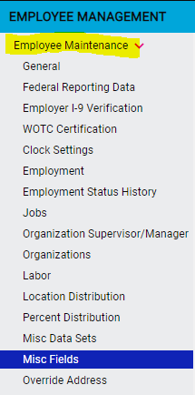
Client Admin Access to Misc Fields
Check and to see if you have access to Misc Fields under Employee Management
Notes:
If you don’t have access to misc fields and would like to, please contact customer service at customerservice@dominionpayroll.com

Slide 21
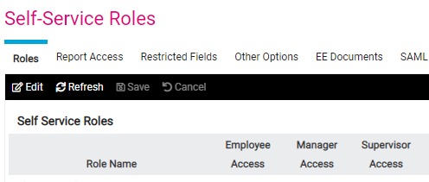
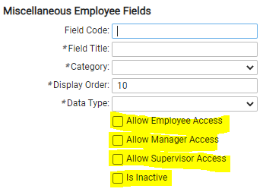
Granting employees and/or managers/supervisors access to misc fields to be able to enter information is a two step process
Screen Access
Field Access
To grant access to the Misc Field Screen please contact customer service at customerservice@dominionpayroll.com to ask for the self-service role of ESS Misc Field FA (full access) be enabled for the employee and/or manager/supervisor to enter info. ESS Misc Fields RO is read only
Notes:
First, we have to give the employee and/or manager access to even view the misc field screen. This is done by contacting customer service and requesting the access that you want. Often it is the employee that will be entering information about themselves – vaccine info, shirt size, license info, etc. Next you have to check off the fields you want them to have access to. If the access box isn’t checked then the field won’t appear on the screen

Slide 22
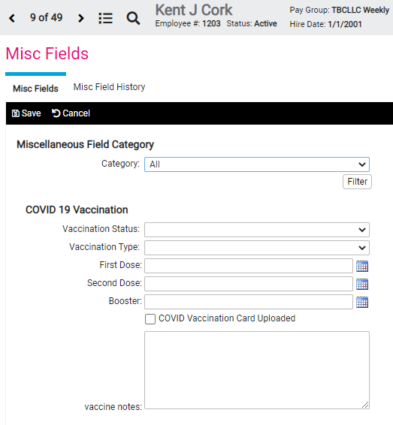
What does the Misc Field Screen look like to those who have access?
Notes:
Clicking the dropdown arrow next to Vaccination Status will show the status choices of Fully vaccinated, Partially vaccinated and Unvaccinated. Vaccination type will show Pfizer, Moderna and Johnson and Johnson. See the calendar next to the Doses and the booster? Then there is a check box to indicate that the vaccine card has been uploaded. Lastly there is a notes box if needed.

Slide 23
Reporting
A custom HR report can be written to capture all the data collected.
Notes:
Run the report in excel. This will allow you to filter for different information such as those with no vaccine card uploaded or those who are unvaccinated so that you can follow up with the mandatory COVID testing set to take affect in January 2022

Slide 24
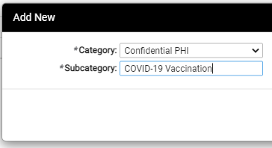
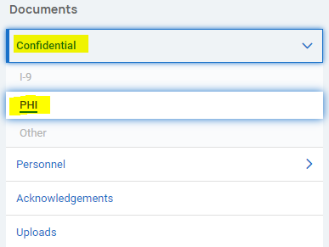
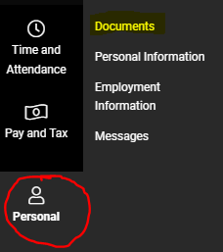
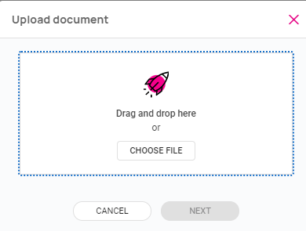
Uploading a COVID-19 Vaccination Card
1. Add a subcategory to Confidential PHI and EE uploads if needed
2. If your employees are using the new UI, they have the ability to upload their vaccination cards under the Confidential PHI. They would navigate to Personal > Documents Confidential > PHI
3. Once they have added their file, they can add a description and determine who has access.
4. If your employees are using the core employee self service, they would navigate to Documents > EE Uploads. An HR admin can change the category of the vaccination doc from EE Upload to Confidential PHI
Notes:
Clicking the dropdown arrow next to Vaccination Status will show the status choices of Fully vaccinated, Partially vaccinated and Unvaccinated. Vaccination type will show Pfizer, Moderna and Johnson and Johnson. See the calendar next to the Doses and the booster? Then there is a check box to indicate that the vaccine card has been uploaded. Lastly there is a notes box if needed.

Slide 25
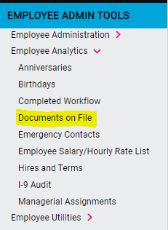
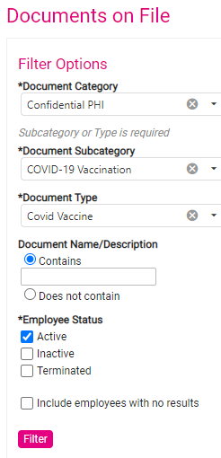
Documents on File Analytics
To quickly see what documents employees have on file, use the documents on File analytic.
Navigate to Employee Admin Tools > Employee Analytics > Documents on File
Use the filters to get the data you need
Notes:
Clicking the dropdown arrow next to Vaccination Status will show the status choices of Fully vaccinated, Partially vaccinated and Unvaccinated. Vaccination type will show Pfizer, Moderna and Johnson and Johnson. See the calendar next to the Doses and the booster? Then there is a check box to indicate that the vaccine card has been uploaded. Lastly there is a notes box if needed.

Slide 26
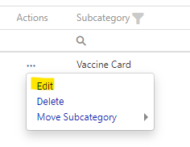
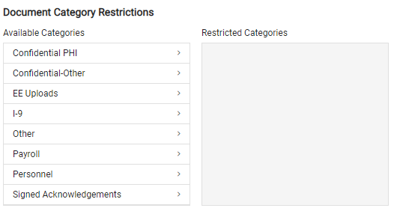
Access to Employee Docs
An HR Admin can edit the parameters regarding an employee upload. They can change the access and the category
However, if you have client users within your organization that you do not want to have access to certain document categories, you can have their access restricted. You will need to contact customer service to have this done.
Employees can determine who has access to their uploaded documents. They do not get to exclude access to a client user.
Notes:
Clicking the dropdown arrow next to Vaccination Status will show the status choices of Fully vaccinated, Partially vaccinated and Unvaccinated. Vaccination type will show Pfizer, Moderna and Johnson and Johnson. See the calendar next to the Doses and the booster? Then there is a check box to indicate that the vaccine card has been uploaded. Lastly there is a notes box if needed.

Slide 27
COVID TEST TRACKING
COVID testing can be tracked under misc data sets

Slide 28
Granting employees and/or managers/supervisors access to Misc Data Sets to be able to enter information is a two step process just like Misc Field
Screen Access
Field Access
To grant access to the Misc Data Set Screen please contact customer service at customerservice@dominionpayroll.com to ask for the self-service role of ESS Misc Data Sets FA (full access) be enabled for the employee and/or manager/supervisor to enter info. ESS Misc Data Sets RO is read only
Notes:
Giving employees access to the individual misc data set field is only one part of the access process. Be sure to call or email customer service to let them know that your employees need access to the misc data set field FA (full service)

Slide 29
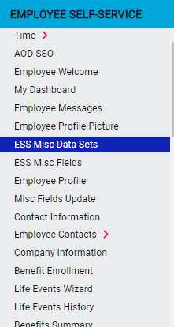
What does the Misc Data Set look like for the employee?
Notes:
As you can see, all the results are listed by date. The employee can go in key in their test date and results.

Slide 30
Email Alerts and Employee Messages
Employee Messages can be set up to help automatically trigger Email Alerts to regularly tested employees.
Under the documents tab in Employee Messages, add a document that regularly tested employees can electronically acknowledge stating that they have uploaded or turned in to Human Resources any required documentation for that week. This document should be marked as “Requires Acknowledgement”
The Email Alerts can be set to go out each day so that it is a constant reminder to the employee to provide the correct documentation. Once the document is acknowledged the email alert will cease for that week.
Notes:
As you can see, all the results are listed by date. The employee can go in key in their test date and results.

Slide 31
Reporting
A custom report can be generated to show compliance

Slide 32
Submit your questions now using the Q&A function on your screen Or submit questions to questions@dominionpayroll.com

