Slide 1
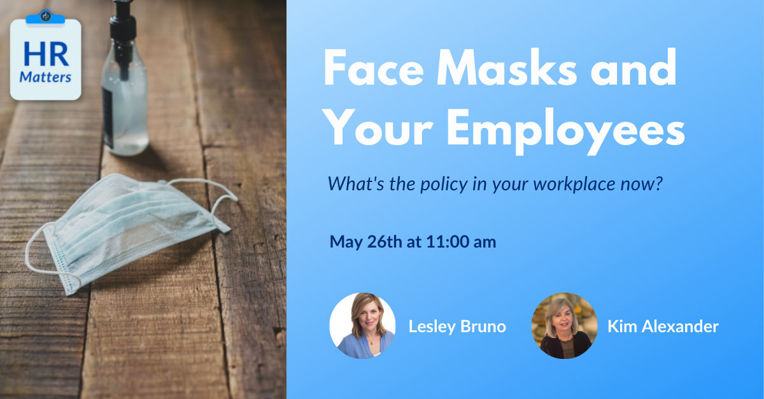
Hold for title slide

Slide 2
Hold for presenter slide

Slide 3
Housekeeping
We will record this webinar and post it on our website by end of day today (COVID-19 resource page)
Please submit questions via the Q&A function, not the Chat
OR submit to questions@dominionpayroll.com

Slide 4
Un-Vaccinated: Masks Vaccinated: No Masks
Now in most states

Slide 5
In Virginia,
for example….
Individuals aged 5 and older should wear a mask in accordance with CDC guidance for mask use and fully vaccinated individuals.
All employees of all businesses must wear masks in accordance with CDC guidelines. Employers must require employees to comply with the face covering guidelines.
Face shields are not a substitute for a mask but specified types of face shields may be worn by someone with a medical condition preventing the person from wearing a mask.
Employers must provide face coverings to employees and require their use.

Slide 6
Meanwhile, over at OSHA…
“The Centers for Disease Control and Prevention has issued new guidance relating to recommended precautions for people who are fully vaccinated, which is applicable to activities outside of healthcare and a few other environments. OSHA is reviewing the recent CDC guidance and will update our materials on this website accordingly. Until those updates are complete, please refer to the CDC for information on measures appropriate to protect fully vaccinated workers.”

Slide 7
And at the EEOC…
“These materials were prepared prior to the CDC’s updated guidance for fully vaccinated individuals issued on May 13, 2021, and any supplements. The EEOC is considering any impact of these developments on COVID-19 technical assistance provided to date.”

Slide 8
Options for workplaces
Require Vaccination
Active Enforcement
Incentivized Enforcement
Honor System

Slide 9
Require Vaccination
Vaccinations are a condition of employment.
Request proof. Document.
Understand that any vaccine-related illness or injury may be subject to worker’s compensation claims.

Slide 10
Active Enforcement
Require proof of full vaccination for those wanting to unmask.
Test/screen.
Document.

Slide 11
Incentivized Enforcement
Incentivize sharing proof of full vaccination for those wanting to unmask (cash, day off, gift card, etc.).
Document.

Slide 12
Honor System
Rely on self-selection.
Remember that you are responsible for protecting your employees from known hazards.
No documentation.

Slide 13
What seems right for your workplace?
Vaccinations Required
Active Enforcement – Require proof of vaccination for those wanting to unmask. Document.
Incentivized Enforcement – Incentivize sharing proof of vaccination for those wanting to unmask (cash, day off, gift card, etc.). Document.
Honor System – Rely on self-selection. Remember that you are responsible for the safety of your employees. No documentation.
I don’t know. Isn’t that why I’m here??

Slide 14
Reminders
If you ask for proof, only ask for bare minimum.
Treat everyone equally. Do not discriminate in either direction.
Enforce your policy.

Slide 15
Submit questions via the Q&A or send to questions@dominionpayroll.com
Stay safe out there!

