Slide 1
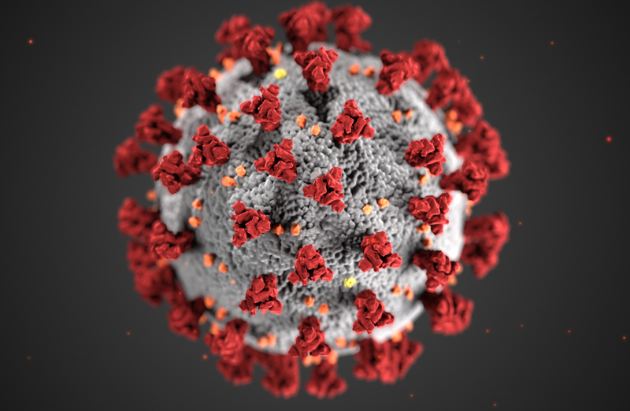
COVID-19 Vaccine Information
Nicole Noren Hooten, Ph.D.
Staff Scientist
Laboratory of Epidemiology and Population Science
National Institute on Aging Intramural Research Program
National Institutes of Health, USA
2/26/2021
@nnhooten

Slide 2
Severe Acute Respiratory Syndrome Coronavirus, SARS-CoV-2, causes the coronavirus disease called COVID-19
Outline for talk
What is messenger RNA?
What are messenger RNA (mRNA) vaccines?
BioNTech/Pfizer vaccine, Moderna vaccine
What are the other vaccines?
Johnson and Johnson (J & J) vaccine, AstraZeneca vaccine
Novavax vaccine
SARS-CoV-2 variants

Slide 3
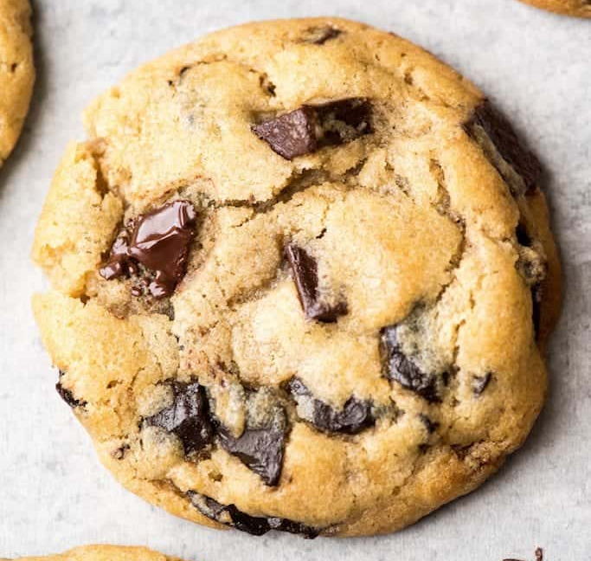
Analogy for DNA and RNA in cells Making Chocolate Chip Cookies
Need a recipe
What ingredients?
How much of each?
What temperature and how long to cook?
Recipes are also used in biology to make up the parts of our body.
The recipe that provides the instructions for all of the different characteristics of our bodies is the Genetic Code.
Our Genetic Code is made up of DNA. It serves as a recipe book for all the different traits like hair color, eye color, and even shapes of our ears.
Different arrangements of our DNA bases tell our cells which proteins to make.
How is this done? Where does mRNA come into play?

Slide 4
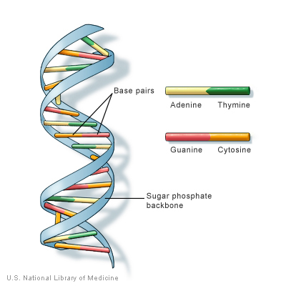
protein
mRNA
Cell
mRNA
transcription
DNA
mRNA
nucleus
translation
protein

Slide 5
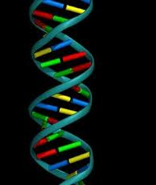
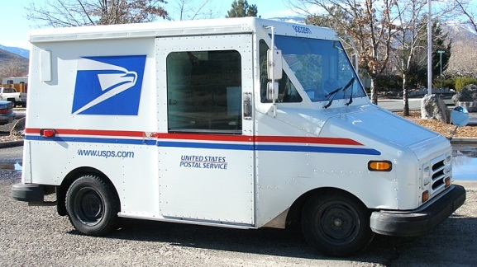
=
“The Instruction manual”
DNA
=
“The messenger”
RNA
=
protein
“The worker”

Slide 6
Trillions of cells in the body
Messenger RNA tells cells which proteins to make
Cells of the human body

Slide 7
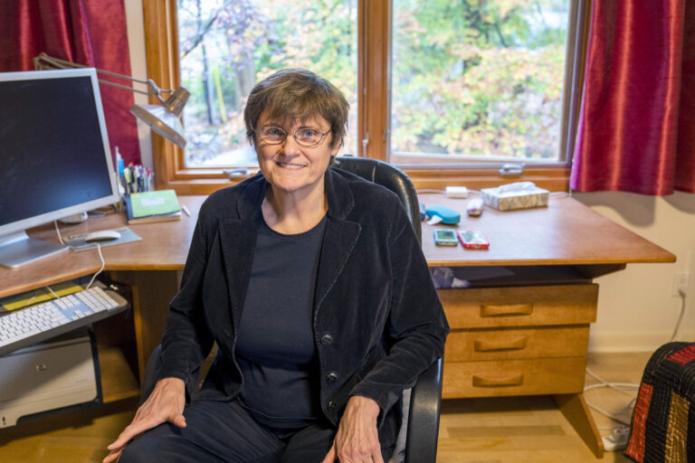
Messenger RNA (mRNA) Technology
Work began to develop messenger RNA as a possible therapy 1990’s in mice
Dr. Kariko wanted to use mRNA to make ‘designer proteins’ that could be targeted to use as a therapeutic modality:
Vaccines
Provide missing proteins in diseases
Initiate tissue repair and regeneration
1995-2005 work devoted to develop mRNA as a safe and effective tool to fight disease
2005 breakthrough on how to use mRNA safely, effectively, as a possible therapeutic
Katalin Karikó, a senior vice president at BioNTech rk,
in JESSICA KOURKOUNIS FOR THE BOSTON GLOBE

Slide 8
COVID-19 mRNA vaccine
mRNA
Creating using BioRender.com

Slide 10
Spike protein
COVID-19 mRNA
vaccine
Spike mRNA
Cell
mRNA
transcription
DNA
mRNA
nucleus
translation
protein

Slide 12
COVID-19 mRNA vaccines from Pfizer/BioNTech and Moderna
mRNA is extremely fragile and if not handled properly it can fall apart. Vaccine storage requires specialized freezers (Pfizer just announced that its vaccine could be stored in a normal freezer for 2 weeks)
Pfizer once thawed must be used in 5 days; Moderna 30 days
Two doses (Pfizer: 3 weeks; Moderna: 28 days)
The most common side effects are injection site pain, fatigue, headache, muscle pain, and joint pain. Some people in the clinical trials have reported fever. Side effects are more common after the second dose; younger adults, who have more robust immune systems, reported more side effects than older adults.
These side effects are a sign of an immune system kicking into gear. They do not signal that the vaccine is unsafe. To date there are no serious, long-term side effects associated with receipt of these vaccines.

Slide 13
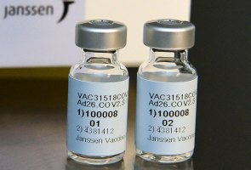
Johnson & Johnson (Janssen’s) COVID-19 Vaccine
Gene for spike protein
Uses an adenovirus—a type of virus that causes the common cold—that cannot replicate (meaning make more of itself).
The modified adenovirus engineered to carry the gene for the coronavirus spike protein. It can then enter your cells, where the modified virus travels to the cell nucleus. The spike protein gene is read by the cell, and it’s then copied into messenger RNA (mRNA).
The mRNA leaves the nucleus and serves instructions to begin making spike proteins. Those are then recognized by your immune system cells, and your body reacts by producing antibodies.
Notes:
Ad26.COV2.S, is a recombinant, replication-incompetent adenovirus serotype 26 (Ad26) vector encoding a full-length and stabilized SARS-CoV-2 spike (S) protein.^{7,8} The vaccine was derived from the first clinical isolate of the Wuhan strain (Wuhan 2019; whole genome sequence, NC_045512).

Slide 14
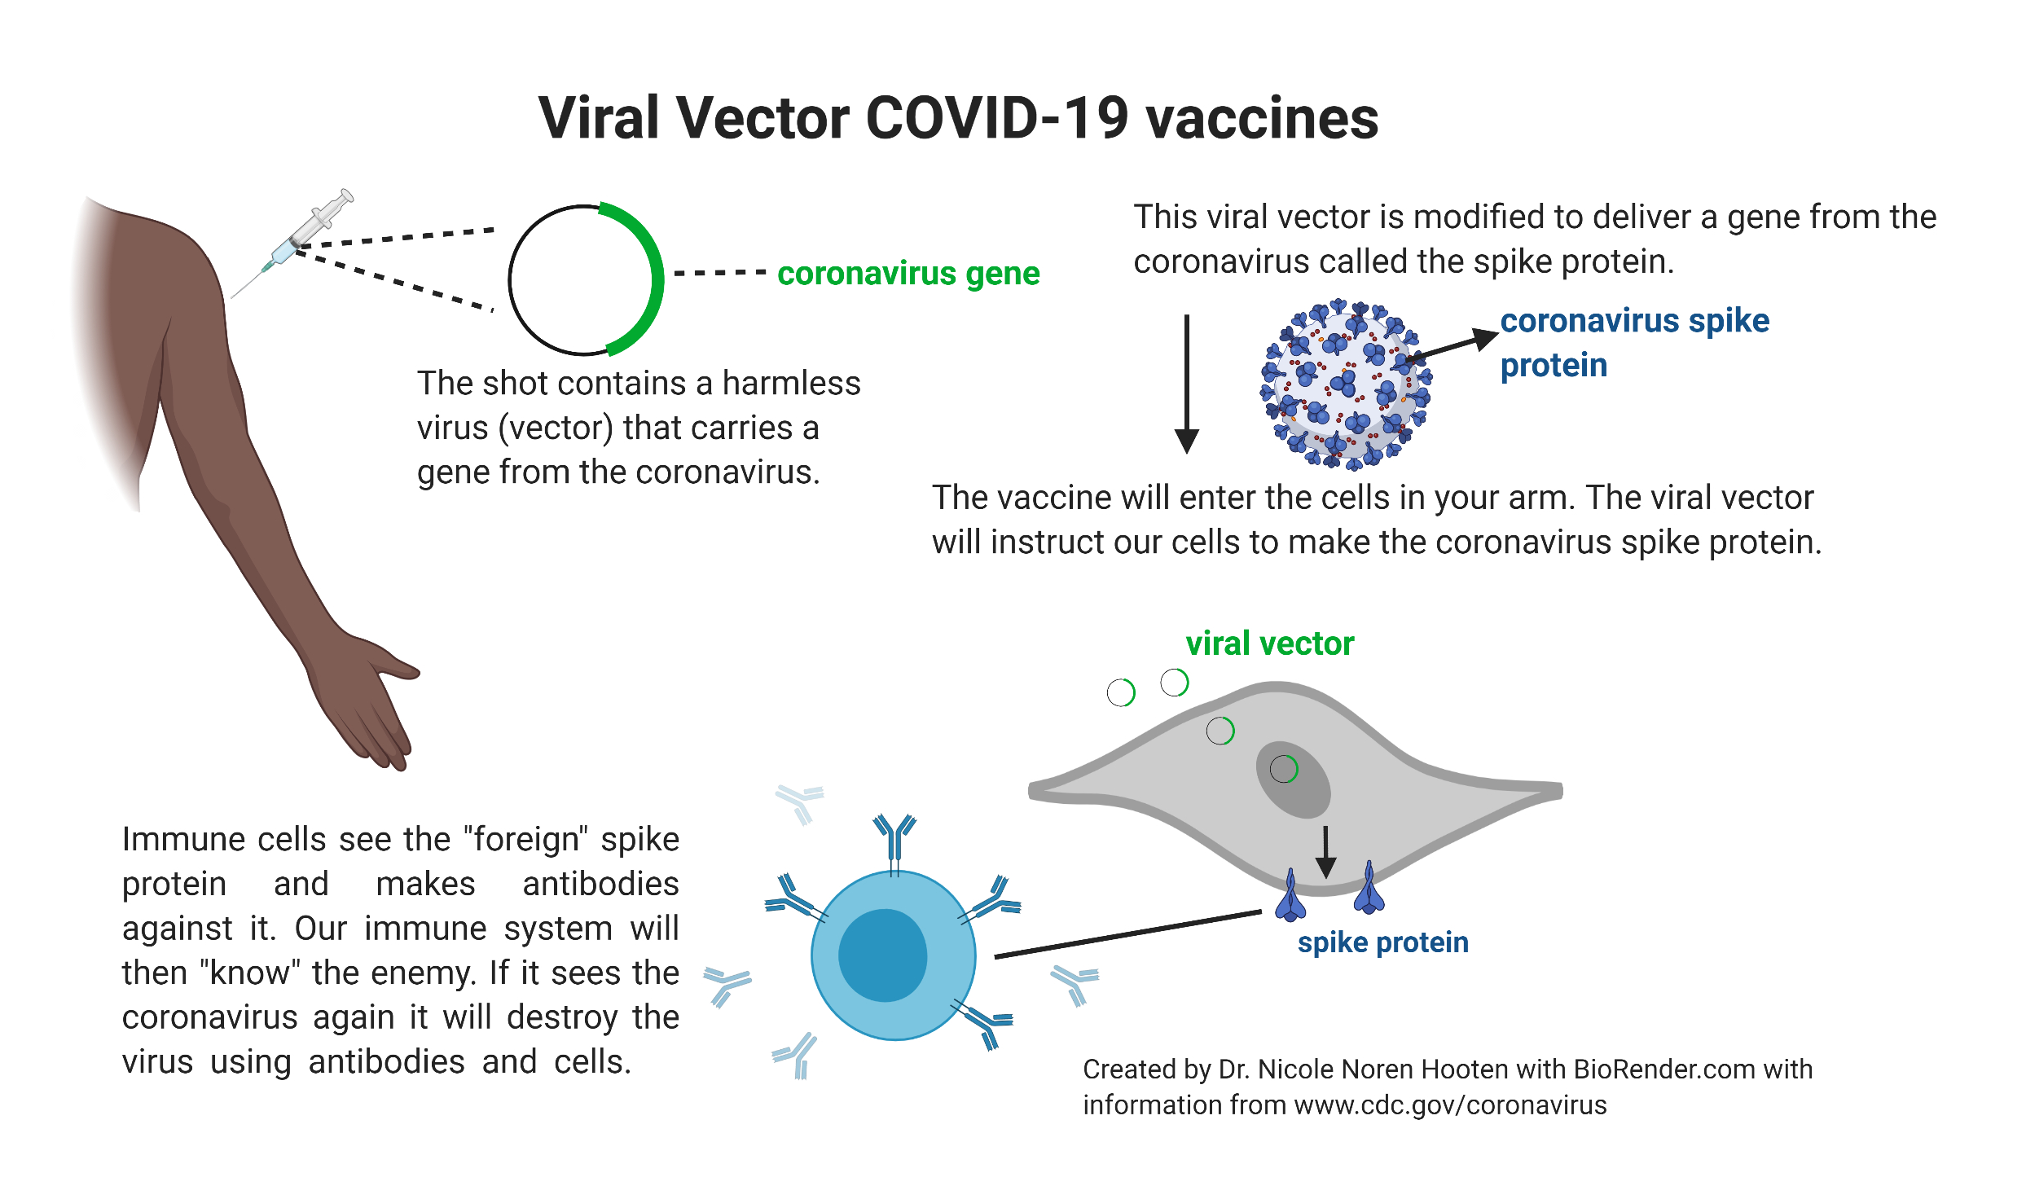

Slide 15
Spike protein
Spike mRNA
Cell
Adenovirus with gene
for spike protein
Spike protein mRNA
DNA
nucleus

Slide 16
AstraZeneca and J & J COVID-19 vaccines use similar technology
Stable in refrigerator and normal freezer temperatures
Single shot
Less expensive to produce and easy to make a lot of quickly
Scientists have been using this technology for decades, but no current vaccines approved in the US use this technology (Ebola vaccine in Europe does)
J & J COVID-19 vaccine was approved by FDA for EUA on 2/27/21
AstraZeneca approved in UK but not (as of 2/21) in US.

Slide 17
Which COVID-19 vaccine should I get? Should I wait for one versus another vaccine?
NO
Take whatever vaccine is offered to you.
Current vaccines were 100% effective in the vaccine trials in stopping hospitalizations and death.
Waiting for a different vaccine is actually worse because of the risk of getting severely ill and dying of COVID-19.
~1% of infected people die from COVID-19.
For older people and those with underlying health problems, the risk of death can be anywhere from 10 to several hundred times higher.

Slide 18
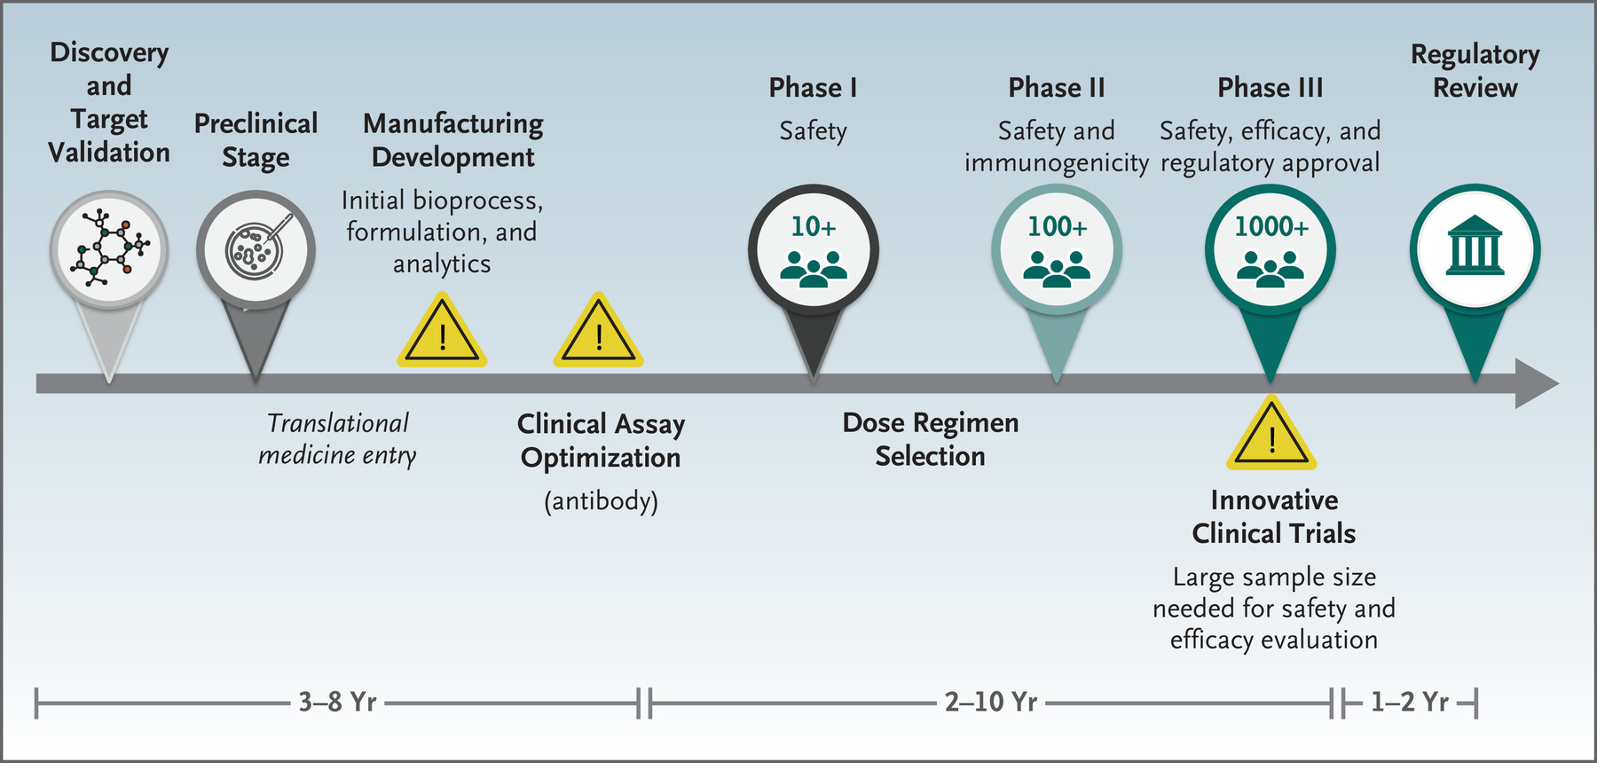
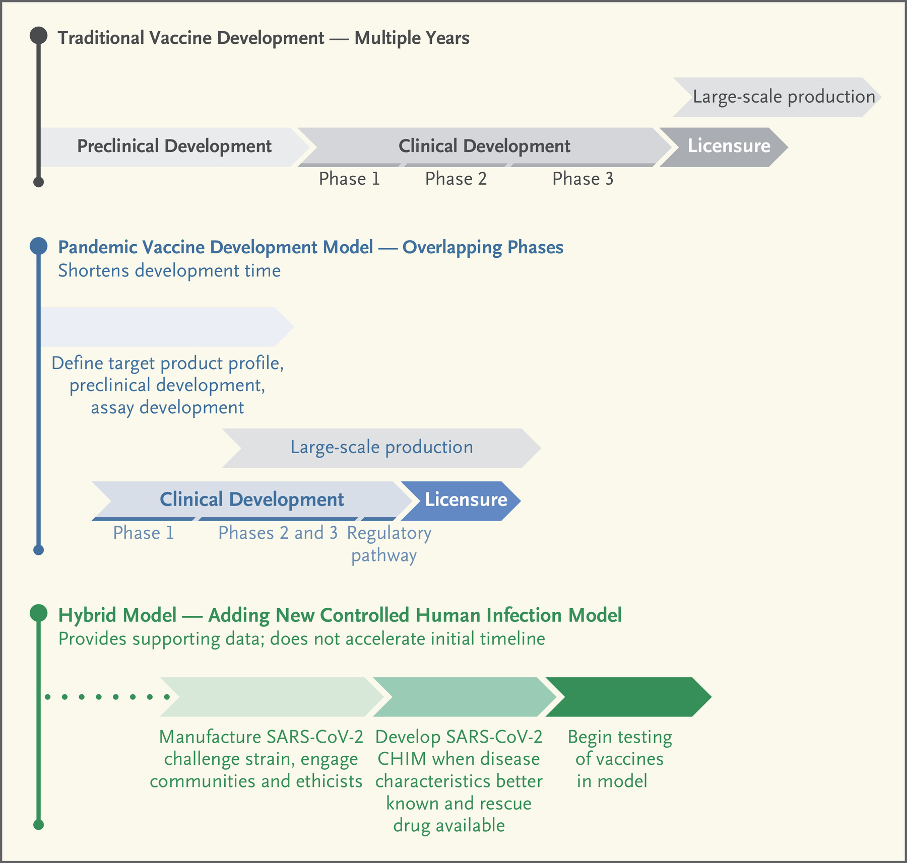
Vaccine timelines
Heaton NEJM 2020
Timeline under
pandemic times
Deming et al.NEJM 2020

Slide 19
Completed Assessment for Vaccination of Children
Pfizer can be administered to those 12 and older
Moderna to those 18 and older
For Children under 16:
Phase 1 and 2A Immunogenicity Studies 2000-3000 children
Age de-escalation study :
16-12 years
12-8 years
8-4 years
Bridging Study to assess safety and induction of immunity in children and then compare that to the Phase 3 data in adults

Slide 20
SARS-CoV-2 binds and enters cells to infect

Slide 21
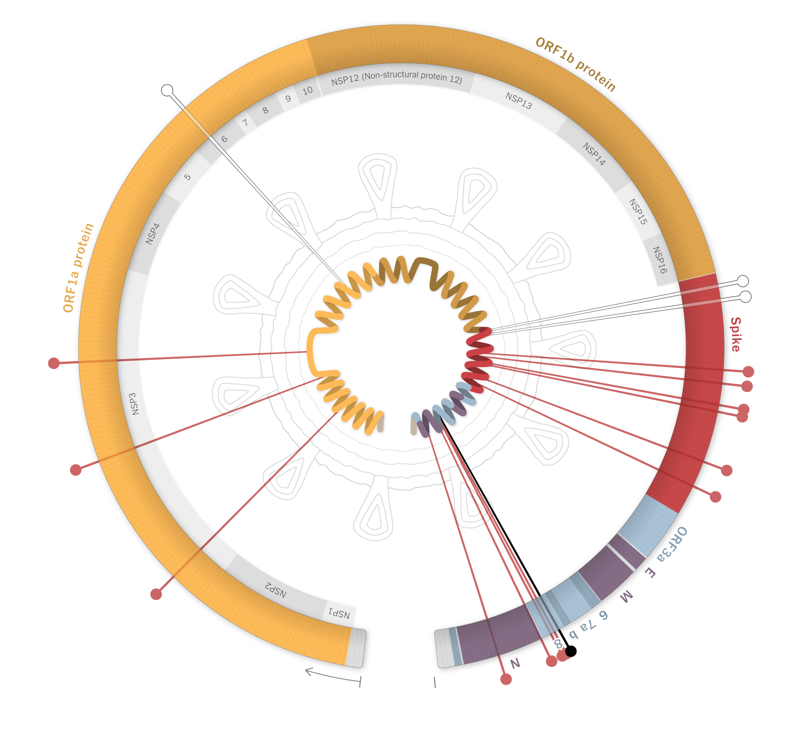
SARS-CoV-2 variants
Original strain that is circulating=wildtype
Mutations can occur called a “variant”.
Mutations can affect the function.
These can be called strains.
COVID-19 is caused by a coronavirus strain known as SARS-CoV-2.
Mutations in the B.1.1.7
variant (UK variant)
More infectious
https://www.nytimes.com/interactive/2021/health/coronavirus-variant-tracker.html?fbclid=IwAR1UdiDeCp-Il5WobEGJlYTOtNwGtCq4-28nHskzcHkIumUJex7SpsHBBjA

Slide 22
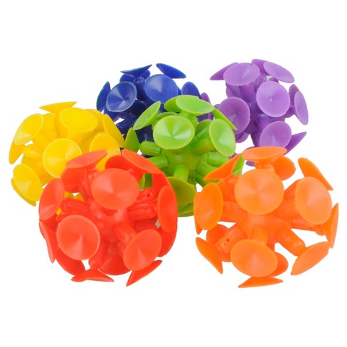
SARS-CoV-2 variants may make the spike protein bind better to our cells

Slide 23
Why are SARS-CoV-2 variants worrisome?
More infectious (ie. Spreads more easily)
For example: B.1.1.7 is ~50% more infectious
Vaccines were made against the “wildtype” virus and may not be an effective
against different variants
B.1.351 in South Africa Moderna vaccine-may be-less effective.
Changes shape of the spike protein
antibodies (made from your immune system against the spike protein) may not bind as well.
https://www.cdc.gov/coronavirus/2019-ncov/cases-updates/variant-surveillance/variant-info.html

Slide 25
Acknowledgements and Disclosures Contact information: norenhootenn@mail.nih.gov
@nnhooten
Dr. Noren Hooten is supported by:
The author declares no competing interests. The views presented are my own and are not represented by the National Institutes of Health or the United States Government.

