Slide 1
Sales Enablement SaaS
Verb Technology Company
NASDAQ: VERB
Profile | June ‘21
with
Live Stream eCommerce
Verb Technology Company, Inc. (NASDAQ: VERB) © 2021

Slide 2
Safe Harbor | Forward-Looking Statements
Certain statements contained in this presentation, including, without limitation, statements containing the words “believes,” “plans,” “expects,” “anticipates,” and words of similar import, constitute “forward-looking statements” within the meaning of the Securities Exchange Act of 1934, as amended, by the Private Securities Litigation Reform Act of 1995. Those statements include statements regarding the intent, belief or current expectations of Verb Technology Company, Inc. (the “Company”), members of its management, and assumptions on which such statements are based. There can be no assurance that such statements will prove to be accurate and there are a number of important factors that could cause actual results to differ materially from those expressed in any forward-looking statements made by the Company, including, but not limited to, plans and objectives of management for future operations or products, the market acceptance or future success of the Company’s products, and the Company’s future financial performance. The Company cautions that these forward-looking statements are further qualified by other factors including, but not limited to, those set forth in the Company's Annual Report on Form 10-K for the fiscal year ended December 31, 2020, and the Company’s Quarterly Report on Form 10-Q for the quarterly period ended March 31, 2021, and other filings with the U. S. Securities and Exchange Commission (available at www.sec.gov). Prospective investors are also cautioned that any such forward-looking statements are not guarantees of future performance and involve known and unknown risks, uncertainties and other factors that may cause the actual results, performance, or achievements of the Company to be materially different from any future results, performance or achievements expressed or implied by such forward-looking statements. Such factors include, among others, the following: general economic and business conditions in those areas in which the Company operates; current and anticipated effects of the COVID-19 pandemic; demographic changes; competition; fluctuations in market interest rates; changes in credit quality; and the Company’s ability to successfully integrate any acquisition it may make. Given these uncertainties, undue reliance should not be placed on such forward-looking statements. The Company disclaims any obligation to update any such factors or to announce publicly the results of any revisions to any of the forward-looking statements contained herein to reflect future events or developments except as required by law. The presentation does not carry any right of publication or disclosure to any other party. No person may treat this presentation as constituting either an offer to sell, or a solicitation of an offer to buy, any interest in, or any investment in the Company. Any offering of securities may be made only pursuant to written offering documents, in compliance with federal and applicable state securities laws. An investment in the Company is available only to qualified individuals or entities, and potential investors should perform their own due diligence regarding any such investment and the tax treatment of any such investment. This presentation may not contain all the details and information necessary for you to make an investment decision or comprehensive evaluation of the Company. The Company takes no responsibility for the accuracy or the completeness of the information contained herein and makes no assurances of such. In addition, selected financial data in this presentation as of March 31, 2021 is based on unaudited financial statements. This presentation is not and does not purport to be an appraisal of the assets, stock or business referenced herein. Neither this presentation nor any of its contents may be used for any other purpose without the prior written consent of the Company. Certain data in this presentation was obtained from various external sources, and neither the Company nor its affiliates, advisers or representatives has verified such data with independent sources. Accordingly, neither the Company nor any of its affiliates, advisers or representatives makes any representation as to the accuracy or completeness of that data or undertakes any obligation to update such data after the date of this presentation. Such data involves risks and uncertainties and is subject to change based on various factors. The trademarks and logos included herein are the property of the owners thereof and are used for reference purposes only. Such use should not be construed as an endorsement of such products or services by the Company.
Verb Technology Company, Inc. (NASDAQ: VERB) © 2021

Slide 3
Our Sales Tools SaaS Platform
TEAMS
LIVE STREAM ECOMMERCE. Combines the best features of popular live-stream webinar and video conference platforms such as Zoom, Facebook-Live, WebEx, with clickable in-video Shopify ecommerce capabilities.
Combines the capabilities of customer relationship management (CRM), lead-generation, and content management, with clickable in-video ecommerce capabilities in an intuitive, powerful tool for large sales-based enterprises.
Powerful content and contact management with great analytics capabilities for solo entrepreneurs and small businesses. Self onboarding available on mobile and desktop with a 1-click sync to Salesforce and verbLIVE is built right in.
A gamified video-based learning management system (LMS) with powerful content management and analytics capabilities used by enterprise for new sales rep training, skill enhancement, and onboarding.
Verb Technology Company, Inc. (NASDAQ: VERB) © 2021

Slide 5
True In-Video LiveStream eCommerce
Now with Verb’s
ATTRIBUTION FEATURE
verbLIVE combines the best features of popular webinar and video conference platforms such as Zoom, Facebook-Live, and WebEx, with Shopify.
users can add interactive in-video ecommerce capabilities – including in-video Shopify carts - to live stream in-video ecommerce webinar broadcasting
allows webinar hosts to select interactive icons that appear on the screens of all viewers, providing in-video click-to-purchase capabilities for products or services featured in the live-stream video broadcast
Live Streaming eCommerce drives revenue through real-time friction-free selling
provides real-time viewer engagement data and interaction analytics
entirely browser-based, works on all devices – no software download required
secured through end-to-end encryption
Verb Technology Company, Inc. (NASDAQ: VERB) © 2021

Slide 6
LIVESTREAM SHOPPING GROWTH IN CHINA
The market has exploded and validates the potential for US livestream shopping
11.11.19
On Singles Day,
Li Jiaqi sells $145M in one livestream ¹
In 2019, livestream shopping accounted for 9% of China’s total ecommerce revenues ²
MARCH 2020
560 million Chinese are watching livestream shopping ²
11.11.20
Viya, China’s top livestream commerce influencer, reached 37M live viewers on a single stream and generated $425M+ in sales ²
Singles Day: $75B+ Sales ³
2020
Taobao live sold to 500M+ livestream shoppers in 2020 and is projected to generate 500B+ transactions over the next three years. ²
Live stream shopping total reaches $136B+ and sees 453% three-year growth rate ²
Li Jiaqi
Streamlabs Report
Singles Day
Verb Technology Company, Inc. (NASDAQ: VERB) © 2021
6

Slide 7
US LIVESTREAM MARKET PRIMED FOR GROWTH
The domestic social and ecommerce trends converge in livestream shopping
2020 eCommerce Inflection Point
1
Due to COVID, 10 years of e-commerce adoption was accelerated into 3 months ¹
Influencers are driving purchase
2
Influencer marketing spend grew to $9.7B in 2020, 91% of survey respondents believe influencer marketing to be an effective form of marketing ²
Livestream usage is taking off
3
Total livestream viewership (non-ecommerce) in the US grew 2x in 2020. 27.9 billion hours streamed in 2020 across the top four platforms.³
Live shopping models are natural to US consumers
4
The behavior is not new: U.S. consumers have a long tradition of “TV shopping” (Market Cap: HSN - $2.2B, QVC - $1.9B) ⁴
And limited-supply “drop” model, which is foundational to live stream shopping’s success in China, is already frequently used by flagship US brands (ex. Supreme).
McKinsey Report
The State of Influencer Marketing 2020: Benchmark Report
StreamLabs
QVC/HSN
Notes:
Link to detailed notes here

Slide 8
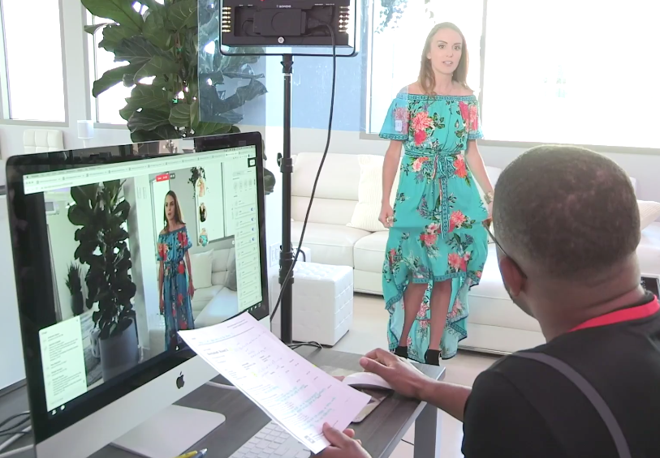
verbLIVE combines the best features of popular webinar and video conference platforms such as Zoom, Facebook-Live, WebEx, and Pexip, with Shopify.
users can add interactive in-video ecommerce capabilities – including in-video Shopify carts - to live stream in-video ecommerce webinar broadcasting
allows webinar hosts to select interactive icons that appear on the screens of all viewers, providing in-video click-to-purchase capabilities for products or services featured in the live stream video broadcast
drives revenue through real-time friction-free selling
provides real-time viewer engagement data and interaction analytics
entirely browser-based, works on all devices – no software download required
secured through end-to-end encryption
Verb Technology Company, Inc. (NASDAQ: VERB) © 2020

Slide 9
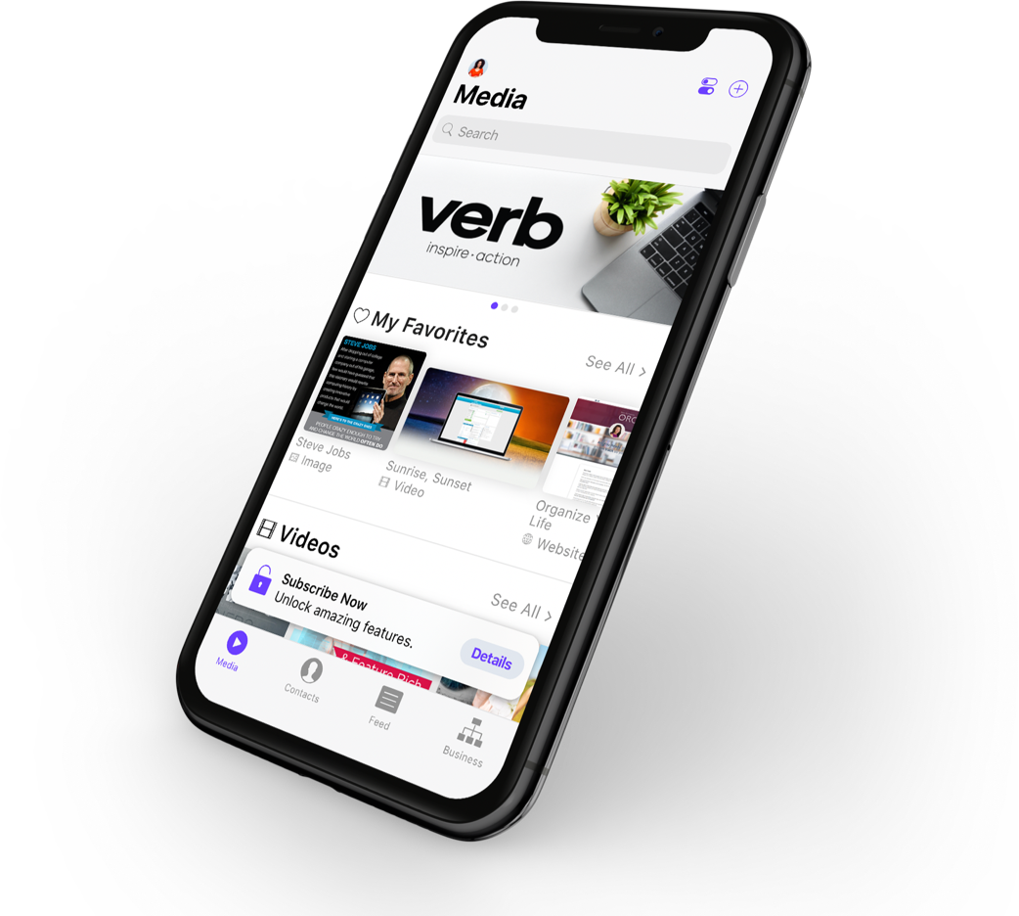
MAIL
OUR INTERACTIVE VIDEO
ECOMMERCE TECHNOLOGY
NOW INTEGRATED INTO . . .
1 BILLION USERS WORLDWIDE TOTAL ADDRESSABLE MARKET
Verb Technology Company, Inc. (NASDAQ: VERB) © 2021

Slide 10
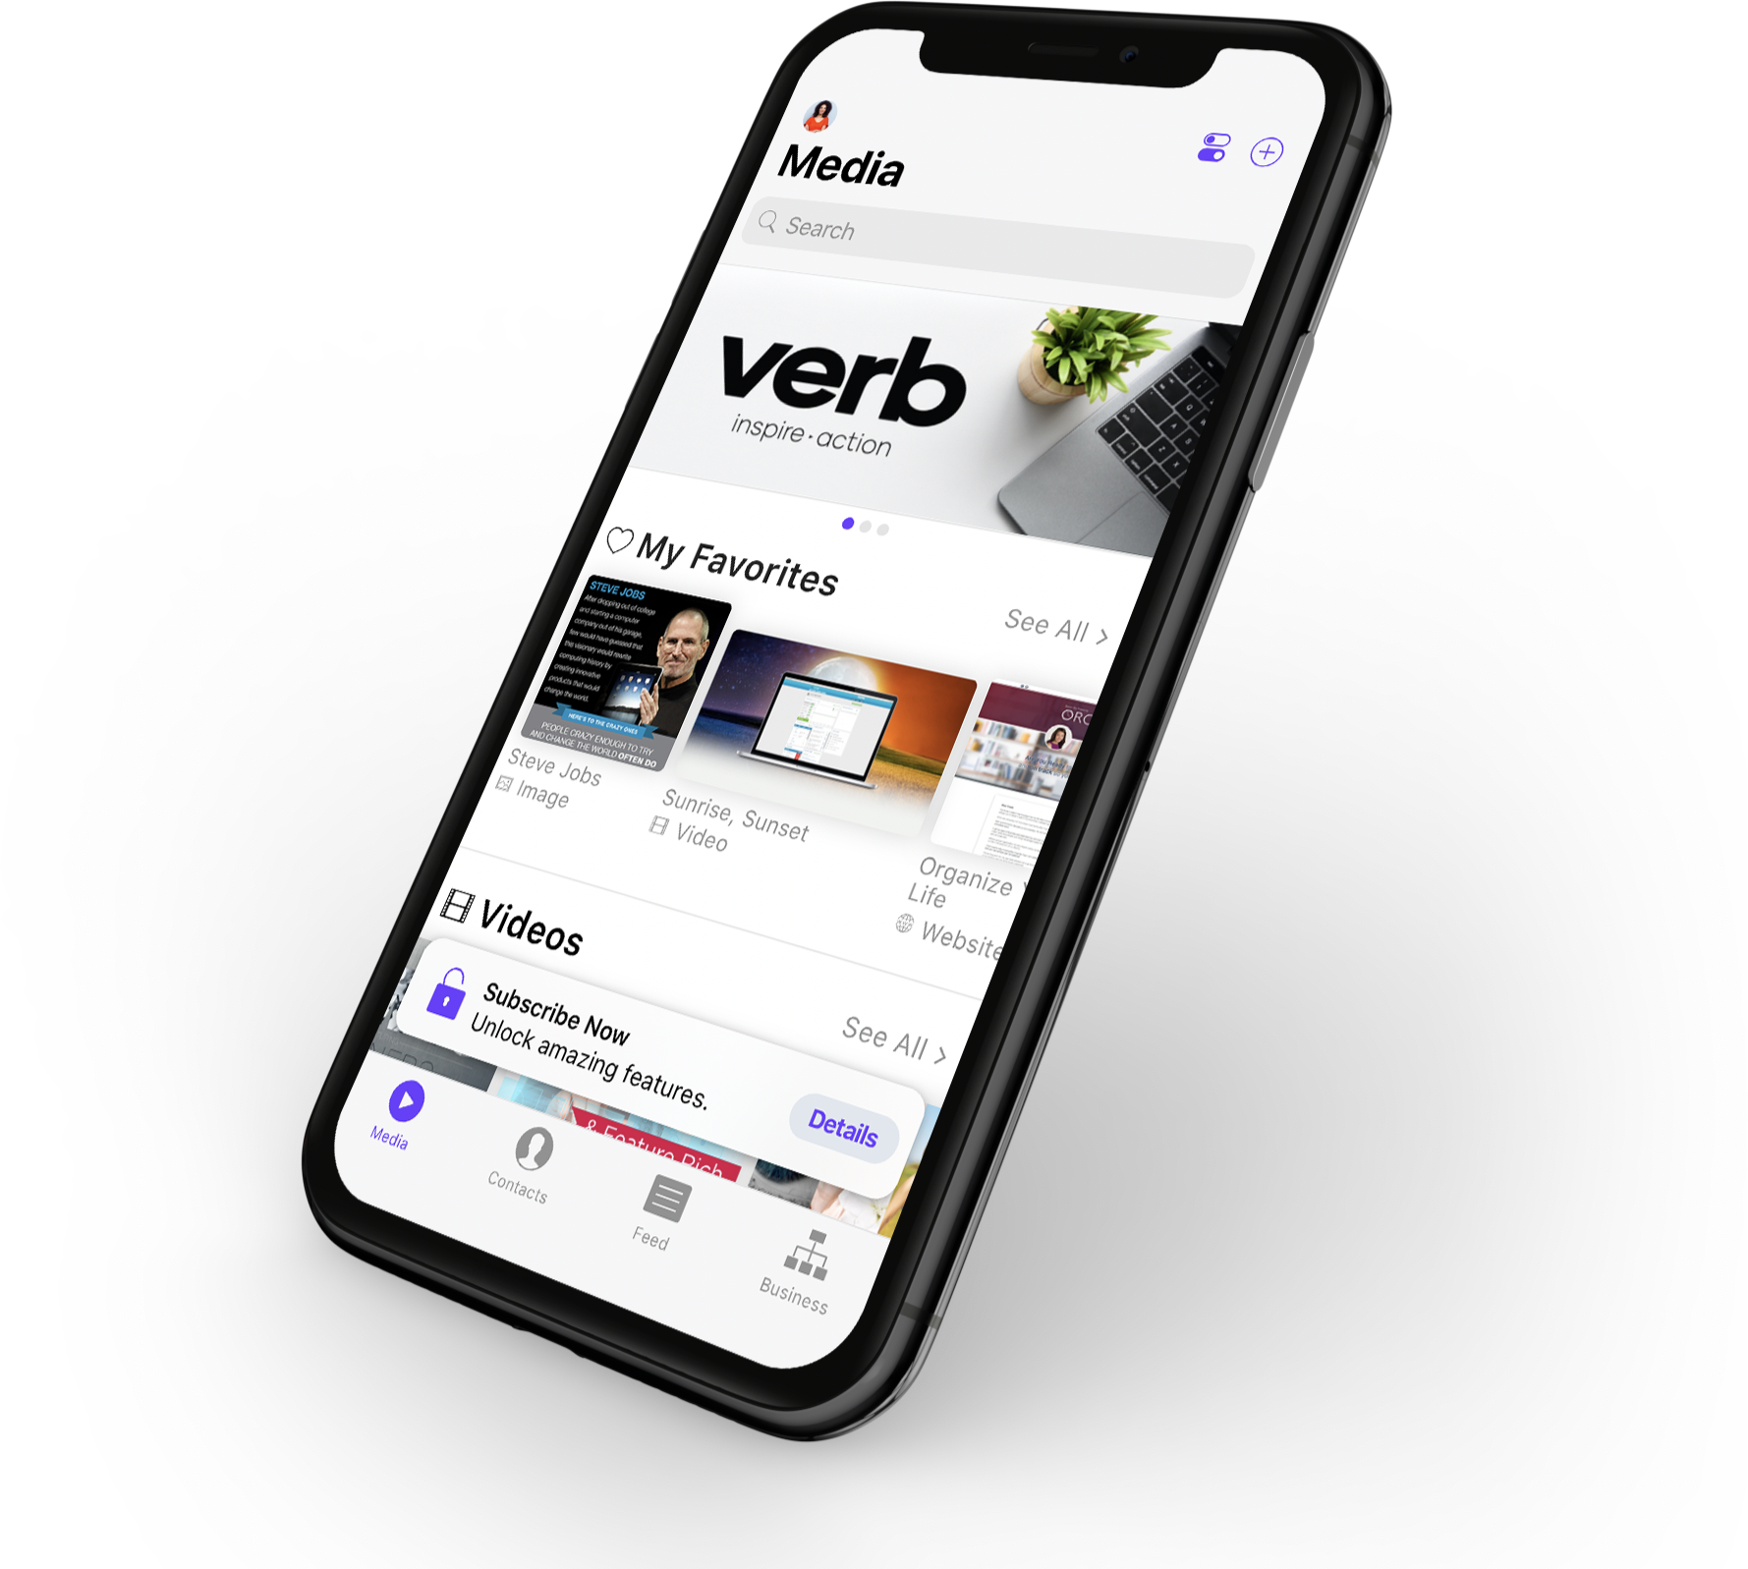
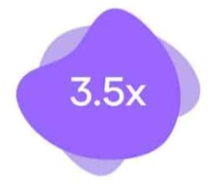
verbCRM combines the capabilities of customer relationship management (CRM), lead-generation, content management, and in-video ecommerce capabilities in an intuitive, powerful tool for both inexperienced as well as highly skilled sales professionals.
quickly and easily create, distribute, and post videos with on-screen clickable icons
prospects or customers can click on a product they see featured in a video and impulse buy it while the video is playing, or click on a calendar icon in the video to make an appointment with a salesperson, among many novel features designed to eliminate friction from the sales process
proprietary data collection and analytics capabilities inform users in real time, when and for how long their prospects have watched a video, how many times they watched it, and what they clicked-on
allows users to focus their time and efforts on ‘hot leads’ or interested prospects
users create their hot lead lists by using familiar, intuitive ‘swipe left/swipe right’ on-screen navigation
increases or more in sales conversion rates*
increases in retention rates*
*as reported by users.
Verb Technology Company, Inc. (NASDAQ: VERB) © 2020

Slide 11
verbCRM combines the capabilities of customer relationship management (CRM), lead-generation, content management, and in-video ecommerce capabilities in an intuitive, powerful tool for both inexperienced as well as highly skilled sales professionals.
quickly and easily create, distribute, and post videos with on-screen clickable icons
prospects or customers click on products featured in videos and impulse buy while the video is playing, or click on a calendar icon in the video to make an appointment eliminating friction from the sales process
proprietary data collection/analytics inform users in real time, when and for how long their prospects have watched a video, how many times they watched it, and what they clicked-on
allows users to focus their time and efforts on ‘hot leads’ or interested prospects
users create their hot lead lists by using familiar, intuitive ‘swipe left/swipe right’ on-screen navigation
increases or more in sales conversion rates*
increases in retention rates*
*as reported by users.
Verb Technology Company, Inc. (NASDAQ: VERB) © 2021

Slide 12
verbCRM combines the capabilities of customer relationship management (CRM), lead-generation, content management, and in-video ecommerce capabilities in an intuitive, powerful tool for both inexperienced as well as highly skilled sales professionals.
quickly and easily create, distribute, and post videos with on-screen clickable icons
prospects or customers can click on a product they see featured in a video and impulse buy it while the video is playing, or click on a calendar icon in the video to make an appointment with a salesperson, among many novel features designed to eliminate friction from the sales process
proprietary data collection and analytics capabilities inform users in real time, when and for how long their prospects have watched a video, how many times they watched it, and what they clicked-on
allows users to focus their time and efforts on ‘hot leads’ or interested prospects
users create their hot lead lists by using familiar, intuitive ‘swipe left/swipe right’ on-screen navigation
increases or more in sales conversion rates*
increases in retention rates*
*as reported by users.
Verb Technology Company, Inc. (NASDAQ: VERB) © 2020

Slide 13
TEAMS
verbTEAMS - Now Offered Bundled with verbLIVE - allows sales and marketing teams to easily share and deliver content to their sales reps, while gaining access to usage metrics. verbTEAMS is available on both mobile and desktop with a 1-click sync to Salesforce making it easy to deliver the right content, to the right people, at the right time.
Share content from a central location, no confusing different versions of material
Upload your training, sales, and product content to verbTEAMS and add your users
Highly scalable with self-sign-up, self-onboarding, and self-configuring. Add your logos and colors to create a custom branded experience for every user and customer to share and view your content
Review user activity and display it in an at-a-glance analytics dashboard
Know exactly how effective each asset is and how to follow up
Verb Technology Company, Inc. (NASDAQ: VERB) © 2021

Slide 14
Verb Technology Company, Inc. (NASDAQ: VERB) © 2020

Slide 15
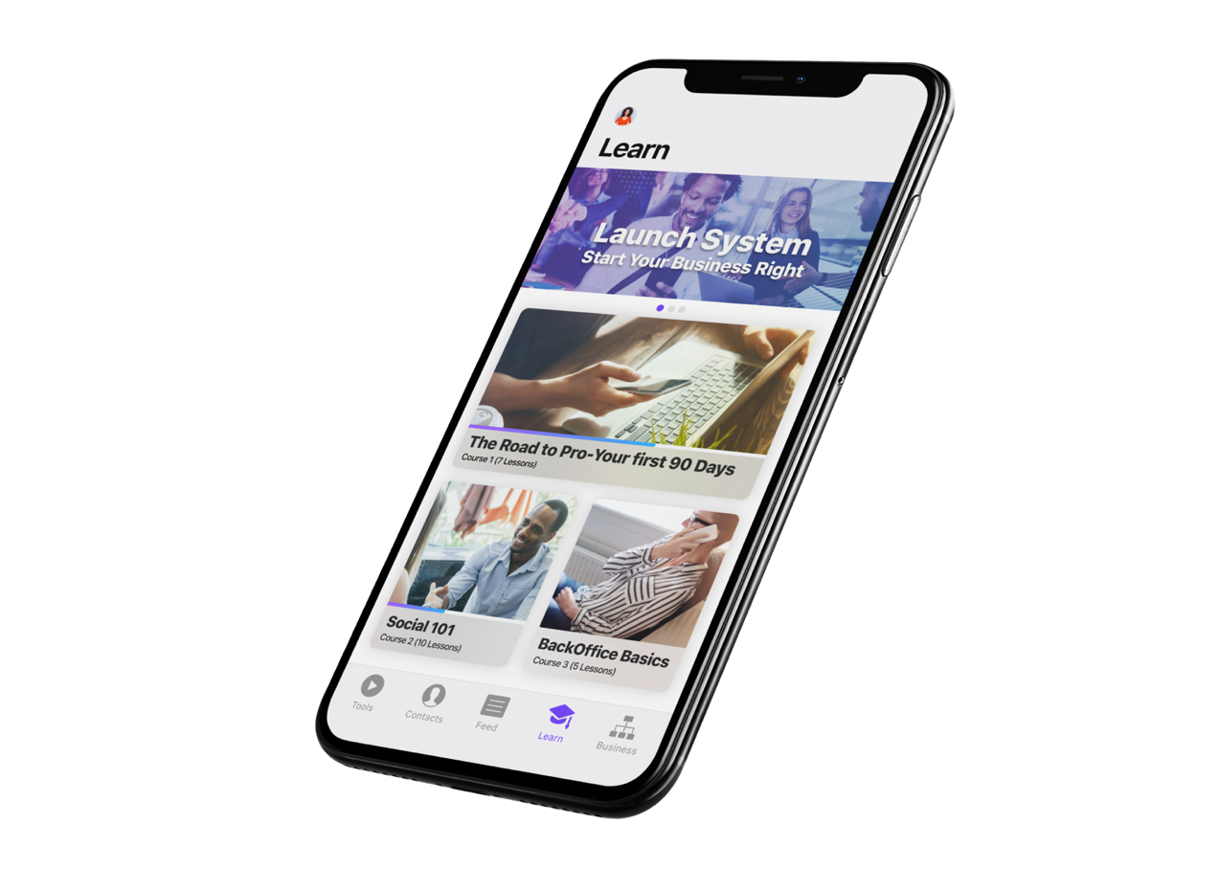
verbLEARN is an interactive, gamified learning management system (LMS) for use by corporate sales managers and educators for training and education.
used by enterprises seeking to educate large sales teams or customer base about new products or elicit in-video feedback about existing products
incorporates Verb’s proprietary data collection and analytics capabilities that inform users in real time, when and for how long the viewers watched the video, how many times they watched it and what they clicked-on
Verb Technology Company, Inc. (NASDAQ: VERB) © 2021

Slide 16
verbLEARN is an interactive video-based learning management system that incorporates all of the clickable in-video technology featured in our verbCRM application, adapted for use by educators for video-based education.
used by enterprises seeking to educate large sales teams or customer base about new products or elicit in-video feedback about existing products
incorporates Verb’s proprietary data collection and analytics capabilities that inform users in real time, when and for how long the viewers watched the video, how many times they watched it, and what they clicked-on
Verb Technology Company, Inc. (NASDAQ: VERB) © 2020

Slide 17
Partnerships & Integrations
We’re integrated our interactive video technology into other popular Enterprise CRMs
Current Integration partners:
Launched Nov 2020
Launched June 2021
Verb Technology Company, Inc. (NASDAQ: VERB) © 2021

Slide 18
Select Enterprise Customers
Global User Base ✦ 60 Countries ✦ 48 Languages
Verb Technology Company, Inc. (NASDAQ: VERB) © 2021

Slide 19
Client Business Sectors
Significant Upside Potential in the Post-COVID Remote Work Economy
Markets
Multi-National Direct Sales Enterprises
Large Professional Associations
CBD Industry
Large & Growing Addressable Markets:
Live Stream eCommerce - $120B in 2020¹
Video Conferencing - $50B by 2026²
CRM - $80B by 2025³
Online eLearning - $375B by 2026⁴
Home Security
Educational Institutions Including School Districts
Insurance
Auto Sales and Auto Leasing
Not-For-Profits
Health Care and Pharmaceutical Sales
1. https://www.cmswire.com/ecommerce/is-live-streaming-ecommerce-the-next-thing
Medical Device and Equipment Sales
2. https://www.gminsights.com/industry-analysis/video-conferencing-market
Real Estate
3. https://www.superoffice.com/blog/crm-software-statistics
4. https://www.gminsights.com/industry-analysis/elearning-market-size
Verb Technology Company, Inc. (NASDAQ: VERB) © 2021

Slide 20
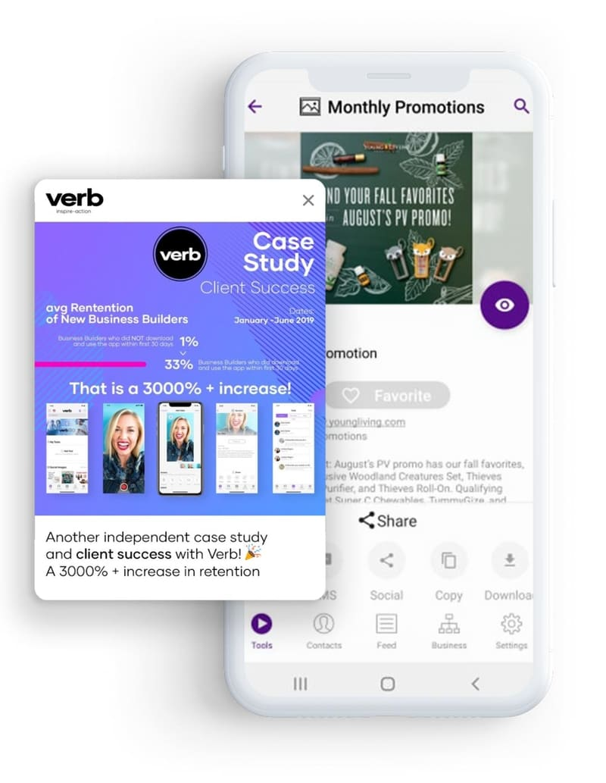
Competitive Analysis
Enterprise
Scalable
Sales
Enablement
Interactive Livestream eCommerce
Interactive Video
CRM
Analytics
Verb Technology Company, Inc. (NASDAQ: VERB) © 2021

Slide 21
Key Performance Metrics
2021 1ST Quarter Highlights - Proven SAAS Revenue Growth
$1.5M SaaS recurring revs - up 12% over Q4 2020 - up 38% over same period last year.
$1.8M Total Digital revs - up 18% over Q4 2020 – up 24% over same period last year.
$2.5M Total Combined revs - up almost 21% over Q4 2020
62 new enterprise client contracts added in 2020 – 16 in Q1 2021
added approx. $900K guaranteed base value in Q1 new contracts.
2M total user downloads – up more than 47% from same period last year.
Microsoft Outlook integration completed and launched
$15M gross proceeds from registered direct closed March 2021 - straight common shares – no warrants priced at $1.60.
Integration of verbLIVE new live stream ecommerce with Salesforce.
VERB added to the Russell Microcap® Index.
Completed another accretive acquisition for rapid expansion into MEDICAL/HEALTH CARE EQUIPMENT AND SUPPLIES SALES
Launched verbTEAMS – new highly scalable sales enablement platform for entrepreneurs and small business – includes verbLIVE and built-in 1-click Salesforce synch
Ranked #1 among sales platforms for direct sales by leading industry publication
More than 140 enterprise clients in 60 countries and 48 languages
More than 25,000 Apple App Store & Google Play Store Ratings - 4.9 Stars Avg.
Verb Technology Company, Inc. (NASDAQ: VERB) © 2021

Slide 22
Proven Management
Rory J. Cutaia
Jeff Clayborne
Mitch Bledsoe
Founder / CEO, Pres & Chairman of the Board of Directors
Chief Financial Officer
Chief Information Officer
Former Founder, Chairman & CEO of Telx - sold for $218M in 2006 then again for $1.9B in 2015. Invested more than $4M to finance Verb.
20 yrs. Fortune 100 Experience. The Walt Disney Company - Universal Music Group - McGladrey & Pullen - KPMG Peat Marwick. CPA - MBA, USC
Senior executive positions at ALLDATA, Assurant, iHeartMedia and First American Corporation, leading large-scale product and infrastructure development efforts.
Verb Technology Company, Inc. (NASDAQ: VERB) © 2021

Slide 23
Distinguished Board of Directors
- Chairman, Rory J. Cutaia
Nancy Heinen
Phil Bond
Judith Hammerschmidt
Jimmy Geiskopf
Ken Cragun
Former Apple General Counsel - Member of Steve Jobs inner circle for 12 years
Former Under Secretary of the U.S. Dept. of Commerce for Technology
Former Exec V. Pres & International Chief Counsel of Herbalife International - Former Special Asst to 2 Attorney Generals of the United States
Verb Lead Director and former Pres and CEO of Budget Rent-a-Car
CFO with 30 yrs. experience leading major financing transactions for listed tech and SaaS software companies, building teams in more than 20 countries
Verb Technology Company, Inc. (NASDAQ: VERB) © 2021

Slide 24
Accomplished Advisory Board
Chuckie Reddy
Erik Nielson
Mory Watkins
J.P. Morgan
Managing Director
Southwest Airlines
Senior Director, Marketing
Private equity fund manager, led successful SaaS company roll-ups
Lewis Jaffe
Sim Farar
Chrm. Commission for Public Diplomacy, reporting to U.S. Pres., Sec. of State, and Congress
“The Godfather of Videoconferencing” created over $1B in shareholder value as CEO, pres. or founder at NASDAQ-listed companies
Jim DuBois
Former Microsoft
Chief Information Officer
Verb Technology Company, Inc. (NASDAQ: VERB) © 2021

Slide 25
Thank you
Verb Technology Company
Verb Technology Company, Inc. (NASDAQ: VERB) © 2021
NASDAQ: VERB
Profile | 6.21

Slide 26
2
2
verb.tech
Newport Beach, CA
American Fork, UT
855.250.2300
Verb Technology Company, Inc. (NASDAQ: VERB) © 2021

