Slide 1
Social Workers in Rural & Small Libraries
Tiffany Russell, lmsw

Slide 2
Before we begin…
Introduction
Exercise

Slide 3
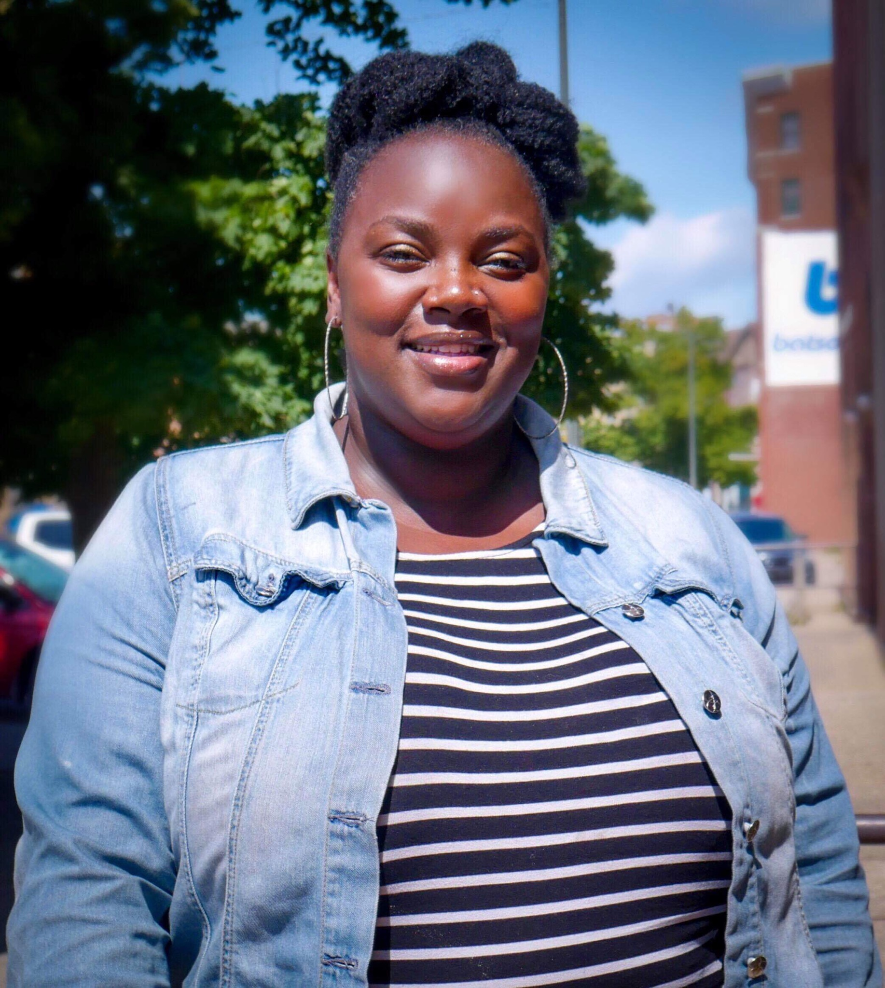
Tiffany Russell, LMSW
Graduate of Western Michigan University
BSW 2002 & MSW 2017
Licensed Clinical Social Worker
Born & Raised in SW Michigan
Medical Social Work and Community Mental Health Experience
Social Service Manager at Niles District Library

Slide 4
Let’s take a moment to…

Slide 5
Today’s Goals
Learn about the emerging field of library social work.
Become more knowledgeable about the interdisciplinary partnership required to develop and sustain library social work.
Recognize similarities & differences between rural & urban library social work.
Learn how libraries can find creative ways to utilize social workers.

Slide 6
You work at the library?
But I thought you were a social worker?

Slide 7
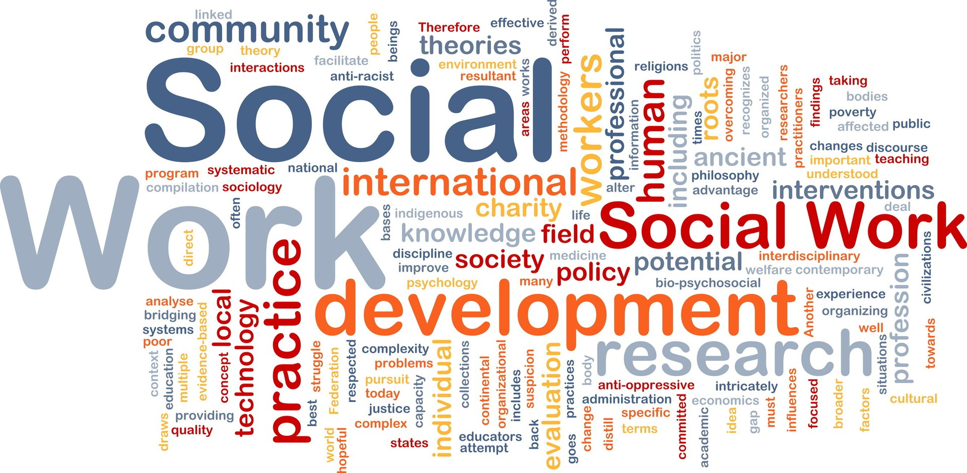
What is library social work?

Slide 8
Library Social Work
Library social work is an emerging field of social work practice where social workers (and more increasingly social work interns) are housed in and work out of public and community libraries.
Library social workers deliver social service-related support and assistance to the public (library patrons and non-patrons) directly out of the library environment.
Library social worker’s efforts are influenced by a library’s unique community needs, and community contexts resulting in a range of activities and services being offered across the spectrum of library social work.

Slide 9
Library Social Work (continued)
Library social workers also serve as social service resource liaisons for library employees, and collateral partners of library-based activities.
Library social work is a result of interdisciplinary cooperation between librarians and social workers, who navigate the common ground in public spaces and places of the library environment.
Library social workers can provide trainings and assistance to staff on various topics.

Slide 10
The Evolution of Library Social Work
2009 – Leah Esguerrra, LMFT hired at San Francisco Library as part of homeless outreach services partnership
Pima County Library, Arizona hired public health nurses for its branch libraries
San Jose Public Library hired a caseworker staffed by volunteer social workers (NASW members) who twice monthly offer 20-minute free referrals.
2011 - Edmonton Public Library, Canada hired a social worker adapted from the San Francisco model

Slide 11
The Evolution of Library Social Work (continued)
2014 - Denver Public Library, Kansas City Library, Washington DC Library, New York Public Library, Sacramento Public Library, Baltimore MD Public Library
2015, 2016, 2017 and 2018 Addison Public Library, the Oak Park Public Library, the Evanston Public Library and the Chicago Public Library added social workers
2017 Kalamazoo Public Library added Peer Support Navigators
2017-18 Niles District Library hosted BSW student intern which expanded in 2018 with 3 yr. grant that funds full-time MSW Social Services Manager plus 3 interns

Slide 12
CORE VALUES OF SOCIAL WORK
Access
Service
Social Justice
Dignity and Worth of the person
Importance of Human Relationships
Integrity
Competence
https://www.socialworkers.org/about/ethics/code-of-ethics/code-of-ethics-english

Slide 13
ETHICAL PRINCIPLES OF SOCIAL WORK
Service
Social Justice
Dignity and Worth of the Person
Importance of Human Relationships
Integrity
Competence
https://www.socialworkers.org/about/ethics/code-of-ethics/code-of-ethics-english

Slide 14
CORE VALUES OF LIBRARIANSHIP
Access
Confidentiality/Privacy
Democracy
Diversity
Education and Lifelong Learning
Intellectual Freedom
http://www.ala.org/advocacy/intfreedom/corevalues

Slide 15
CORE VALUES OF LIBRARIANSHIP (continued)
The Public Good
Preservation
Professionalism
Service
Social Responsibility
Sustainability
http://www.ala.org/advocacy/intfreedom/corevalues

Slide 16
Social Work vs. Librarianship
The Connection
Librarianship Core Values
Access
Confidentiality/Privacy
Democracy
Diversity
Education and Lifelong Learning
Intellectual Freedom
The Public Good
Preservation
Professionalism
Service
Social Responsibility
Sustainability
Social Work Core Values
Service
Social Justice
Dignity and Worth of the Person
Importance of Human Relationships
Integrity
Competence

Slide 17
Rural/Small vs. Urban/Large
Social Work is necessary & beneficial in both settings.

Slide 18
SOCIAL WORK IN URBAN LIBRARIES
Services for homeless and indigent patrons (supplies, resources)
Crisis Response and Intervention (overdose/substance abuse, trauma/PTSD, undiagnosed/untreated mental health issues)
Resource/referral to community resources such as housing, ID access, food, shelter, hygiene, and medical assistance
https://www.tapinto.net/articles/rutgers-social-worker-provides-assistance-at-some

Slide 19
SOCIAL WORK IN URBAN LIBRARIES (continued)
Limited/targeted Case Management Services
Training/education to library staff on mental health, homelessness and substance abuse issues, immigration assistance
Community outreach, engagement and education
Links to education/training and other public services
https://www.socialworker.com/feature-articles/practice/public-libraries-add-social-workers-and-social-programs/

Slide 20
SOCIAL WORK IN RURAL LIBRARIES
Resource/referral to community resources such as
housing, legal, food,
homeless and domestic violence safety shelters,
medicine/prescriptions,
mental health services, transportation,
Pending eviction, unpaid taxes/foreclosure,
child support hearing assistance
Filing or applying for services via online applications
Crisis Response: Substance Abuse, PTSD/Mental Health Crises, Physical Health/Chronic Health Needs
Employment applications, Online filing of grievances, complaints and/or service denial appeals
FAFSA application, Social Security, Unemployment benefits

Slide 21
SOCIAL WORK IN RURAL LIBRARIES (continued)
Accessing support services for incontinence, diabetes supplies, vision/hearing supplies, emergency dental services
Parenting time – supports for non-custodial parents
Family Reunification/Visitation Site
Diversity/Inclusion barriers
Education/Trainings of library staff on mental health, poverty, homelessness, substance abuse
https://www.socialworker.com/feature-articles/practice/public-libraries-add-social-workers-and-social-programs/

Slide 22
How can we help patrons when we don’t have a social worker in our library?

Slide 23
Partnerships & Resources
Get to know your community – Who is out there and what do they do?
Be mindful of patterns in your library – what are common themes of need?
Develop relationships with social service agencies.
Have resources available for patrons – brochures, phone numbers, etc.
Reach out to School of Social Work Departments for interns
Be Creative – is there an agency you can offer a space to offer services?

Slide 24
Key Takeaways
Social Work in libraries is an emerging field – growing rapidly every year.
Librarianship & Social Work have shared values – we are working towards many of the same goals for people we serve.
The role of a social worker varies depending on the location and needs of the community. (Small/Rural vs. Large/Urban)
Social Workers operate under the standard of meeting people where they are – we value libraries!
Relationships matter – developing relationships with organizations, universities, agencies, is essential.

Slide 25
Questions & Discussion

Slide 26
Thank you! Contact Info: Tiffany Russell, LMSW – Clinical tiffanyrussellmsw@gmail.com tiffany.russell@nileslibrary.net

Slide 27
References:
American Library Association. Core Values of Librarianship. Retrieved from http://www.ala.org/advocacy/intfreedom/corevalues
National Association of Social Workers. (2017). NASW code of ethics. Retrieved from https://www.socialworkers.org/About/Ethics/Code-of-Ethics/Code-of-Ethics-English
Social Work Guide. (2019) Retrieved from https://www.socialworkguide.org/careers/#who
Western Michigan University. School of Social Work. (2019) Retrieved from https://wmich.edu/socialwork/about/profession

