Slide 1
Managing through Economic Crisis using Emotional Intelligence
Gary Shaffer, Ph.D.
Director, Glendale (CA) Library, Arts & Culture
Professor, Master of Management in Library & Information Science (MMLIS) Program
Marshall School of Business, University of Southern California
July 22, 2020

Slide 2
Gary Shaffer
16 –year librarian
Ph.D. Simmons University-Boston & MLIS Pratt Institute-New York City
Former
Director, University of Southern California-Marshall MMLIS Program
CEO, Tulsa City-County Library
Director, Communications Sacramento Public Library
Advertising Executive

Slide 3
The Story of EI, 3 Public Directors’ Experience & 2 Other (Academic) EI Studies
A little about Emotional Intelligence (EI)
Share their stories with you
What EI traits did they and other participants use
Which EI traits all the studies’ participants agree upon as their go-to traits
What can we learn from their stories about EI and managing in Recession.
Q/A

Slide 4
The Story of Public Library Directors in Crisis
All faced a major career-defining economic crisis during the last recession.
All used their emotional intelligence (EI) to overcome the crisis.
The study was conducted post recession, and across the U.S.
All participants are considered leaders in the field by outside sources.
Crises ranged from budget cuts/threats, to an anti-tax mayor getting swept into office; all stories included political machinations.
All lived to tell their story.

Slide 5
Emotional Intelligence (EI)
“The ability to monitor one’s own and others’ emotions, to discriminate among them, and to use this information to guide one’s thinking and action” (Salovey & Mayer, 1990, p. 189).
Managerial leaders with a high level of EI try to lower the stress level in the organization (Goleman, Boyatzis, & McKee, 2002), maintain follower trust, and work collectively to achieve the organizational mission despite tumult.
Improves with age and can be learned (Colfax, Rivera, & Perez, 2010).

Slide 6
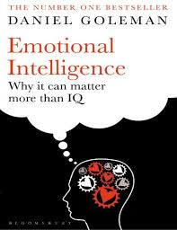
Goleman (‘98-’02) proposes EI Domains
Self-awareness
Self-management
Social awareness
Relationship management

Slide 7
The Four Domains of EI & Assoc. Traits
Each domain has several (96 total) underlying traits. Examples include:
Self-awareness Self-management
Ability to listen and delegate Articulate direction for the library
Sense of humor Ability to compromise
Social-awareness Relationship-management
Accessible to others Ability to function in a political environment
Attracts, builds, and retains talent Ability to gather outside resources

Slide 8
The Story of Just Three Library Directors
#1 Two community members attempt to get a bond measure rescinded based on a purported technical violation.
#2 City budget cuts force branch closures.
#3 Anti-Tax Mayor swept into office on the promise of massive budget cuts.

Slide 9
#1 Community members threaten passed bond measure because of technical violation.
Setting: Midsize urban area
Characters: Library director, newspaper editor, unscrupulous attorney, and library management team
Crisis: Bond measure passes ● Local newspaper editor & attorney note a technical violation related to the measure & affiliated collection of taxes, vs. when vote taken ● Tax protesters sue, locking-up available funding ● Funds will either remain with the library or will need to be repatriated to taxpayers.
Action/Resolution: Library moved forward with its plans due to legal commitments, despite no access to $4.7 million ● Branch closed (long overdue) ● Collection budget cut ● Mgmt. takes voluntary pay cut ● Staff asked to forgo raises ● Director feels Mgmt. Team lost 4 mos. of their "library lives." ●Legal fees exceeded $200K.
Notes:
Crisis: A bond measure passes. A local newspaper editor advises an attorney of a potential technical violation related to the measure and its affiliated collection of taxes, versus when the vote was taken. Tax protesters sue, locking-up available funding. The funds will either remain with the library or will need to be repatriated to taxpayers.
Action/Resolution: The library moved forward with its plans because of legal commitments, despite not having access to $4.7 million locked in escrow. They closed a branch that was long overdue for closing, cut collection budget, management took a voluntary pay cut, while staff was asked to forgo raises. The director feels the management team lost four months of their "library lives." Legal fees exceeded $200K.

Slide 10
#2 City budget cuts force branch closures.
Setting: Large urban area
Characters: Library Director, City Government, Citizen Groups, and impoverished neighborhood residents.
Crisis: City budget cuts force branch closures. Because of state funding, central library escapes cuts.
Action/Resolution: Library management ascertains 1/5th or five-six branches must be closed ● Community meetings held. Issues of race and class emerge ● Data used to identify branches to be closed. ● Wishing to avoid urban blight, city/library lease buildings to other services (e.g. Headstart, Urban League, and Spanish Language programs) ● Building with a nearby library converted to maintenance facility ● 1 converted to Mon-Fri afterschool home-work center ● No staff layoffs occur, but attrition does ● Position/pay freezes are instituted. ● Subsequent bond measure for buildings and collections passes ● Director feels team is successful if library budget not cut disproportionate to other city depts.
Notes:
Action/Resolution: Due to city budget cuts, library management ascertains 1/5th or five-six branches need to be closed. They hold community meetings. Issues of race and class emerge. Library system uses data to identify branches to be closed. Not wanting to contribute to urban blight, the city and library lease buildings to other services (e.g. Headstart, Urban League, and Spanish Language programs), another building with a nearby library is converted to a library maintenance facility, while another is open p.m. hours Mon-Fri, and primarily serves as a homework center. No staff layoffs occur, but attrition does. Position and pay freezes are instituted. A subsequent bond measure for buildings and collections passes funding necessary facility upgrades. The director feels her team is successful if the library budget is not cut disproportionate to other city departments.

Slide 11
#3 Library system devastated by anti-tax politician.
Setting: Large urban area
Characters: Library Director, Anti-tax Mayor, and Library Managers, as well as Staff.
Problem or Scene: Existing Mayor ousted ● Replacement Mayor vows tax-cuts ● Library budget devastated ● 300 Layoffs ensue ● Staff morale lessens.
Action/Resolution: New mayor takes office ● Library director informed library's tax rate will be cut by half ● Budget already 40% less than previous year ● Informed 18 of 49 locations will need to close ● Budget cuts remain intact ● Branches not closed due to public outcry ● Open hours greatly reduced ● Programming cut back ● Preventative maintenance delayed ● Deliveries reduced ● Cleaning crews/Security reduced ● Phone calls go unanswered ● Desks in multi-storied buildings unstaffed ● Book budget cut by 2/3 ● Managers/staff cover multiple locations ● Backroom operations/policies scrutinized ● New service model developed ● Helped City with content creation ● Director chose not to work against mayor-instead working with him in an attempt to get the mayor to adopt the library and some of its programs as his own.
Notes:
Action/Resolution: After the new mayor takes office the library director is informed that the library's tax rate will be cut in half and that he would have to use up all reserves to make up the difference; this in a budget that was close to 40% less than the previous year. Additionally, he was informed by the new mayor that he would need to close 18 of his 49 locations. While the budget cuts remain intact, the branches are not closed due to public outcry. Over 300 staff are let go. The library greatly reduces open hours, cuts back programming, pushes preventative maintenance to the wayside; only emergency repairs are made, deliveries are reduced, cleaning crews and security are also cut back, many phone calls go unanswered, some desks in multi-storied buildings are unstaffed, and the book budget is cut by 2/3. Managers and staff cover multiple locations, backroom operations and policies have been scrutinized. The library is working to define a new service model; looking at aiding in content creation not just supplying information. The director is not working against the mayor, but instead working with him in an attempt to get the mayor to adopt the library and some of its programs as his own.

Slide 12
Findings
Of the 96 EI traits the library directors participating in the study choose from they collectively mentioned 24 as important.
More than half of the directors agreed that the most valuable traits were:
Ability to function in a political environment.
Ability to build a shared vision, articulate it, and rally others around it.
One-third ranked Sense of humor and Ability to gather outside resources as important.

Slide 13
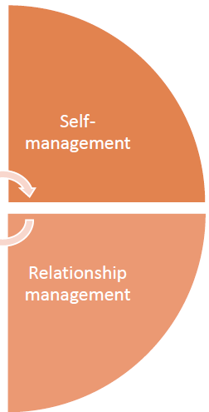
Focus on: Self & Relationship Management
Self-management: Ability to articulate the direction for the library ● Ability to compromise ● Be comfortable with change ● Possess a stable temperament and maintain an emotional balance under constant tensions
Relationship Management: Ability to function in a political environment ● Able to build a shared vision and rally others around it ● Being effective in leading change ● Ability to gather outside resources.

Slide 14
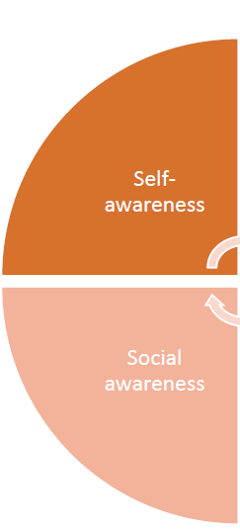
Focus less: Self- & Social Awareness
Self-awareness was the least accessed domain save for: (Sense of humor in my study) ● Realistic understanding of yourself ● Know where you are taking the organization ● Cognitive ability to deal with complex scenarios
Social awareness: Good interpersonal skills ● Good listening skills ● Ability to attract, build and retain talent ● Accessible to others ● Treat people with dignity and respect

Slide 15
In summary
Tapping into your Emotional Intelligence (EI) can help you successfully navigate a crisis.
Being aware that EI, along with its associated domains and traits, exists is a good place to start.
First reflecting on possible scenarios and solutions with your team is highly recommended.
There is a light at the end of the tunnel.

Slide 16
Learning Outside of EI
Don’t waste a crisis!
Just because something is a “sure-thing” does not mean it is.
Stop! Don’t allow someone to get the better of your emotions.
If the budget is going to be cut what services are going to be left behind?

Slide 17
Thank you!
Gary Shaffer
818.937.7812
gshaffer@glendaleca.gov
Book debuted Spring 2020 from Emerald. 30% Discount code: Shaffer30
Includes a chapter on: Challenging Assumptions, Intuition, Resilience, Polarity Management, and Sense of Humor, as well as chapters on Critical Thinking (Decision-making, Problem-solving, Critical Writing, and Creative Thinking).

Slide 18
The End

