Slide 1
The Library Employee Journey
from recruitment to onboarding and life long learning

Slide 2
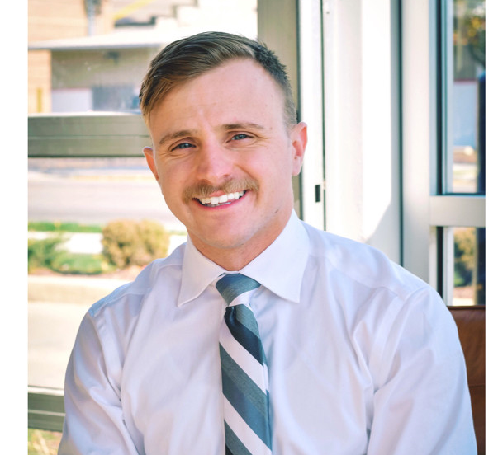
James Ouellette- Training Specialist
Front Office Operations Manager- Prominent Plastics Products
Director Of Corporate Experience- Priority Life Care
Training Specialist- Allen County Public Library

Slide 3
WHY CARE?

Slide 4
The Cost of Bad Training
According to Research conducted at the Middlesex University for Work Based Learning, covering three generations (Baby Boomers, Generation X, and Millennials), over 74% of all participants stated 'lack of training' as the single biggest hurdle in achieving their full potential at work.
87% of Millennials stated access to professional development or career growth opportunities as being very important to their decision of whether to stay or go.
An IBM study revealed that employees who feel they cannot develop in the company and fulfill their career goals are 12 times more likely to leave the company.
Companies that invest $1500 on training per employee can seen an average of 24% more profit than companies that do not.
In a study of more than 3100 US workplaces it was found that a 10 % increase in emotional development produced an 8.6% gain in productivity

Slide 5
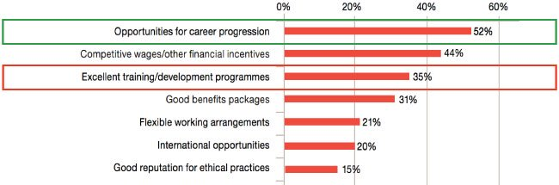
“Which of the following characteristics make an organization compelling to work for?"
-

Slide 6
ACPL Mission: Enriching the community through lifelong learning and discovery.
ACPL Strategic Plan

Slide 7
Training Mission: Enriching the employee experience through lifelong learning and discovery, during their career and beyond

Slide 8
The Employee (Learning) Experience
Hire For Attitude
Train For Skill
Lifelong Learning and Discovery

Slide 9
Hire for Attitude
Employee training begins during the recruitment and hiring process.
Easy access to ACPL history and culture
The hiring manager(s) demonstrates organizational values to the candidate that reflect our culture and attitudes
Once the offer has been made and accepted, the preboarding process begins.

Slide 10
What is preboarding?
Preboarding is the period of time between an employee accepting their job offer and their first day.
Prepare HR paperwork, handbook, benefit packages
Send information about the company
Announce NEW Employee to the team
Register employee for required trainings
Create access logins for payroll ,emails, computer etc…
Stay in contact

Slide 11
TRAIN FOR SKILL
One Day New Employee Orientation
ACPL History and Branches
Ethics, Values, HR and IT practices
Summer learning, Strategic Plan, Genealogy
Meet the Director
Onboarding

Slide 12
Train For Skill
Onboarding and Orientation

Slide 13
100 Day Onboarding
OUR MAP
A standardized onboarding checklist creates an equal opportunity for each employee to achieve success

Slide 14
100 Days of Onboarding
First Day
First 100
First 30
First 60

Slide 15
Youth Service Librarian
First Day
Welcome, clarifications and agenda
Staff introductions and branch tour
Workstation
Online Academy (compliance)
LEU
Shadow and wade (shelving, pick lists)
Culture and organization
Function and purpose
Confidence is built through connection

Slide 16
Youth Service Librarian
First 30
Employee functions
Storytime/Youth Program 3 Visits
Safety trainings are completed
Technical Skills
Wise
Communico
Zoom
Tasks are novel
Confidence is built through trial and support

Slide 17
Youth Service Librarian
First 60
Programs are built with peer/manager support
Safety trainings are completed
Organization connections
ACPL Orientation
Desk time is utilized
Tasks are aligning with departments goals and values
Confidence is built through independence

Slide 18
Youth Service Librarian
First 100
Employee is a part of reoccurring programs
Desk time is utilized
Employee is contributing to the organization
Confidence is built through understanding their purpose in their role

Slide 19
ACPL Orientation
orient verb
ori·​ent | \ ˈȯr-ē-ˌent \
oriented; orienting; orients
Definition of orient
transitive verb
1: to direct toward the interests of a particular group
2 a: to set right by adjusting to facts or principles b: to acquaint with the existing situation or environment
3 a: to set or arrange in any determinate position especially in relation to the points of the compass

Slide 20
ACPL Orientation
Time | Topic | Instructor
8:30am | Welcome and Instructions | James Ouellette
9:00am | History of ACPL | James Ouellette
9:30am | ACPL Family | Mara Honeywell
10:00am | Youth Services | James Ouellette
11:00am | Human Resources | James Ouellette
12:00pm | Lunch | James Ouellette
1:00pm | IT Services | Kevin Wells
2:00pm | The History Of The Genealogy Collection at ACPL | Curt Witcher
3:00pm | Strategic Plan | Denise Davis
4:00pm | Finance Overview and Meeting The Director | David and Greta
5:00pm | Dismissal

Slide 21
Lifelong Learning and Discovery
Monthly safety trainings
Bi-weekly manager/supervisor training and discussion
Public awareness trainings
Coming soon… The Wonderful World of Library Services/Masterclass
Department/career specific training

Slide 23
Viola Davis From Google – Year in Search 2019
“Use your heart, your courage and vision to fix, to heal, to empathize, to connect… Because living life for something bigger than yourself is a hero’s journey.”

