Slide 1
VALCHOICE AND NICHE ACADEMY
Financial Literacy During a Pandemic: Money Smart Week 2021
Insurance Industry Watchdog, ValChoice, produced exclusive content for libraries of all sizes. It covers one of the gaping holes in financial literacy among American’s -- understanding and buying insurance.
February 3, 2021

Slide 2
OVERVIEW
Money Smart Week is Right Around the Corner April 10 - 17
ALA’s Money Smart Week is all about empowering your community with the skills to make better-informed personal finance decisions
The problem: buying insurance is difficult, confusing and expensive
The pandemic changes the needs of many (most?) families
The solution: financial literacy / insurance education
Demonstration – How to access the content and tools

Slide 3
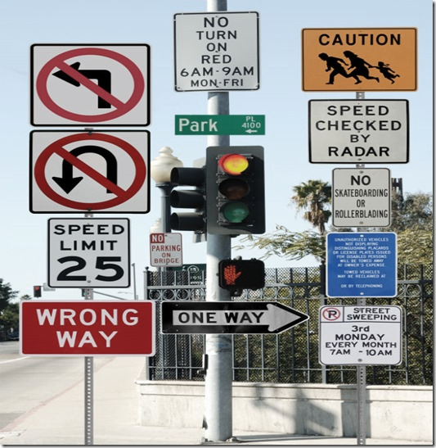
THE PROBLEM FACED BY CONSUMERS
Why is buying insurance so difficult and confusing?
The pandemic changed everything including insurance needs
Prices range widely (10x differences)
No transparency with large claims often not paid
Huge advertising spends can mislead consumers
Online purchases result in poorly insured shoppers
Choosing the wrong insurance is financially catastrophic
UNDER EMBARGO UNTIL JAN. 26, 2016

Slide 4
THE SOLUTION IS FINANCIAL LITERACY
ValChoice Provides Insurance Content That’s Unique and Easy to Understand
No Support Required
What’s Provided
The content can be customized to each city and patron making it more valuable and relevant
Over nearly a decade, ValChoice studied more than 25,000 companies and delivers those findings free of charge to the consumer
Great Benefit to Adult Patrons
Training Options
Everyone from the age of 16 on up needs this kind of education to help them be more informed consumers capable of making better buying decisions
Libraries can choose to deliver the content either via web self service, staff-led events or both

Slide 5
VALCHOICE
#1 Independent Insurance Company Ratings and Analytics
The Carfax for Insurance according to Forbes Magazine

Slide 6
ValChoice
Founder
Silicon Valley CEO, VP Marketing and Sales
Background in math, physics & engineering
Startup to multi-billion-dollar valuation, twice
~ 40-man years of algorithm & software development
Top-tier technology & marketing team
Company founded following a life-altering event

Slide 7
ValChoice BUSINESS MODEL
Sales and marketing tools for agents
Help agents compete against billion $ advertising budgets by differentiating
Enable agents to deliver transparency to consumers

Slide 8
ESSENTIAL TOOLS FOR SMART MONEY WEEK
1 Calculators – Price info tailored to your location
2 Company ratings – On price, value and service
3 Educational videos – By stage of life
4 Worksheets – For individualizing info
5 Agent referrals – For assistance and advice
6 Virtual Programming
7 Book – Injured Money
WWW.DESIGNERSPARADISE.COM

Slide 9
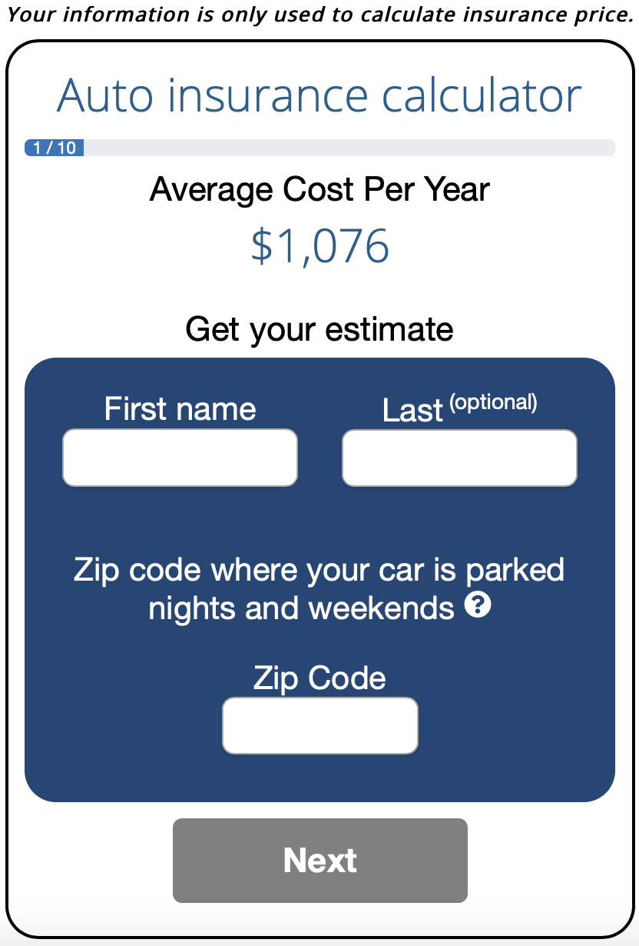
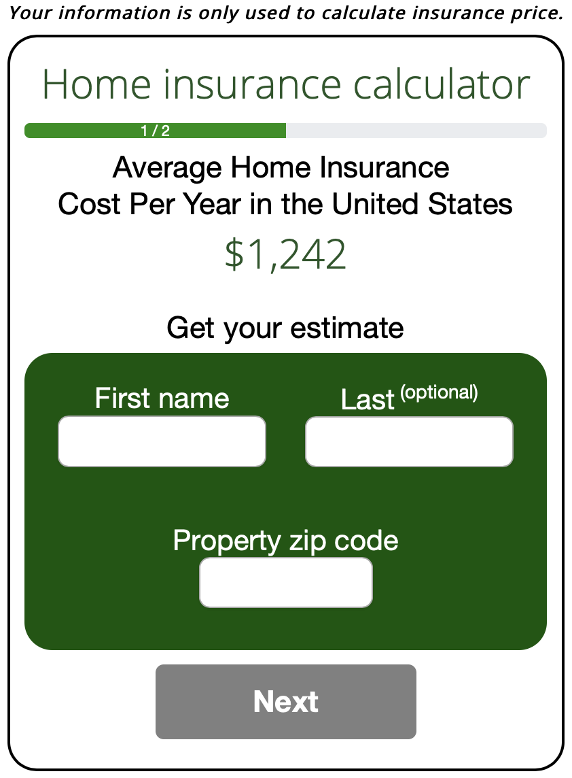
INSURANCE COST CALCULATORS
Find Out What You Should Pay to Get the Most Value from Insurance Coverage
Empowering and informing consumers
Insurance shopping websites don’t provide consumers with the complete picture. ValChoice delivers more information and helps consumers understand what they should pay to get the most value from their insurance dollars when they need it most – when they file a claim.
Completely customizable results that accurately reflect individual location and needs
Thousands of data points and insurance regulatory filings inform the intelligent reports

Slide 10
INSURANCE COMPANY RATINGS
An Independent Measure of Quality and Value
Insurance that doesn’t pay claims is not insurance!
ValChoice measures insurance companies based on three important criteria – price, protection (quality) and service. No other company provides this important independent analysis for consumers
Single company reports are provided to your patrons free of charge
More comprehensive multi-company comparison reports are available from agents on the website

Slide 11
NEW: BEST CARRIERS BY REGION (PRELIMINARY)
ValChoice Compares Carriers on Three Important Criteria – Price, Protection and Service
New England |  |  | Mid-Atlantic |  |  | East North Central |  |  | West North Central
Name | Score |  | Name | Score |  | Name | Score |  | Name | Score
Ohio Mutual | 99 |  | Penn National | 94 |  | Erie Insurance | 98 |  | AAA | 100
MMG Insurance | 82 |  | Nationwide | 89 |  | Madison Mutual | 98 |  | IMT Insurance | 97
Cincinnati Insurance | 79 |  | Cincinnati Insurance | 88 |  | AAA | 93 |  | Country Financial | 95
Amica Mutual | 78 |  | Amica Mutual | 88 |  | Country Financial | 92 |  | Acuity | 86
Nationwide | 75 |  | State Farm | 81 |  | Pekin Insurance | 90 |  | Amica Mutual | 83
South Atlantic |  |  | East South Central |  |  | West South Central |  |  | Mountains |  | California
Name | Score |  | Name | Score |  | Name | Score |  | Name | Score | Name | Score
Central Insurance | 91 |  | Westfield Insurance | 97 |  | AmTrust Financial | 81 |  | Country Financial | 99 | Cincinnati Insurance | 99
Cincinnati Insurance | 89 |  | Amica Mutual | 81 |  | Amica Mutual | 80 |  | Mutual of Enumclaw | 97 | Grange | 91
Donegal Insurance | 87 |  | Cincinnati Insurance | 76 |  | State Farm | 70 |  | Acuity | 97 | Amica Mutual | 87
Erie Insurance | 85 |  | Nationwide | 72 |  | Nationwide | 70 |  | Cincinnati Insurance | 89 | State Farm | 80
Amica Mutual | 84 |  | State Farm | 71 |  |  |  |  | Amica Mutual | 89 | AAA of SoCal | 67

Slide 12
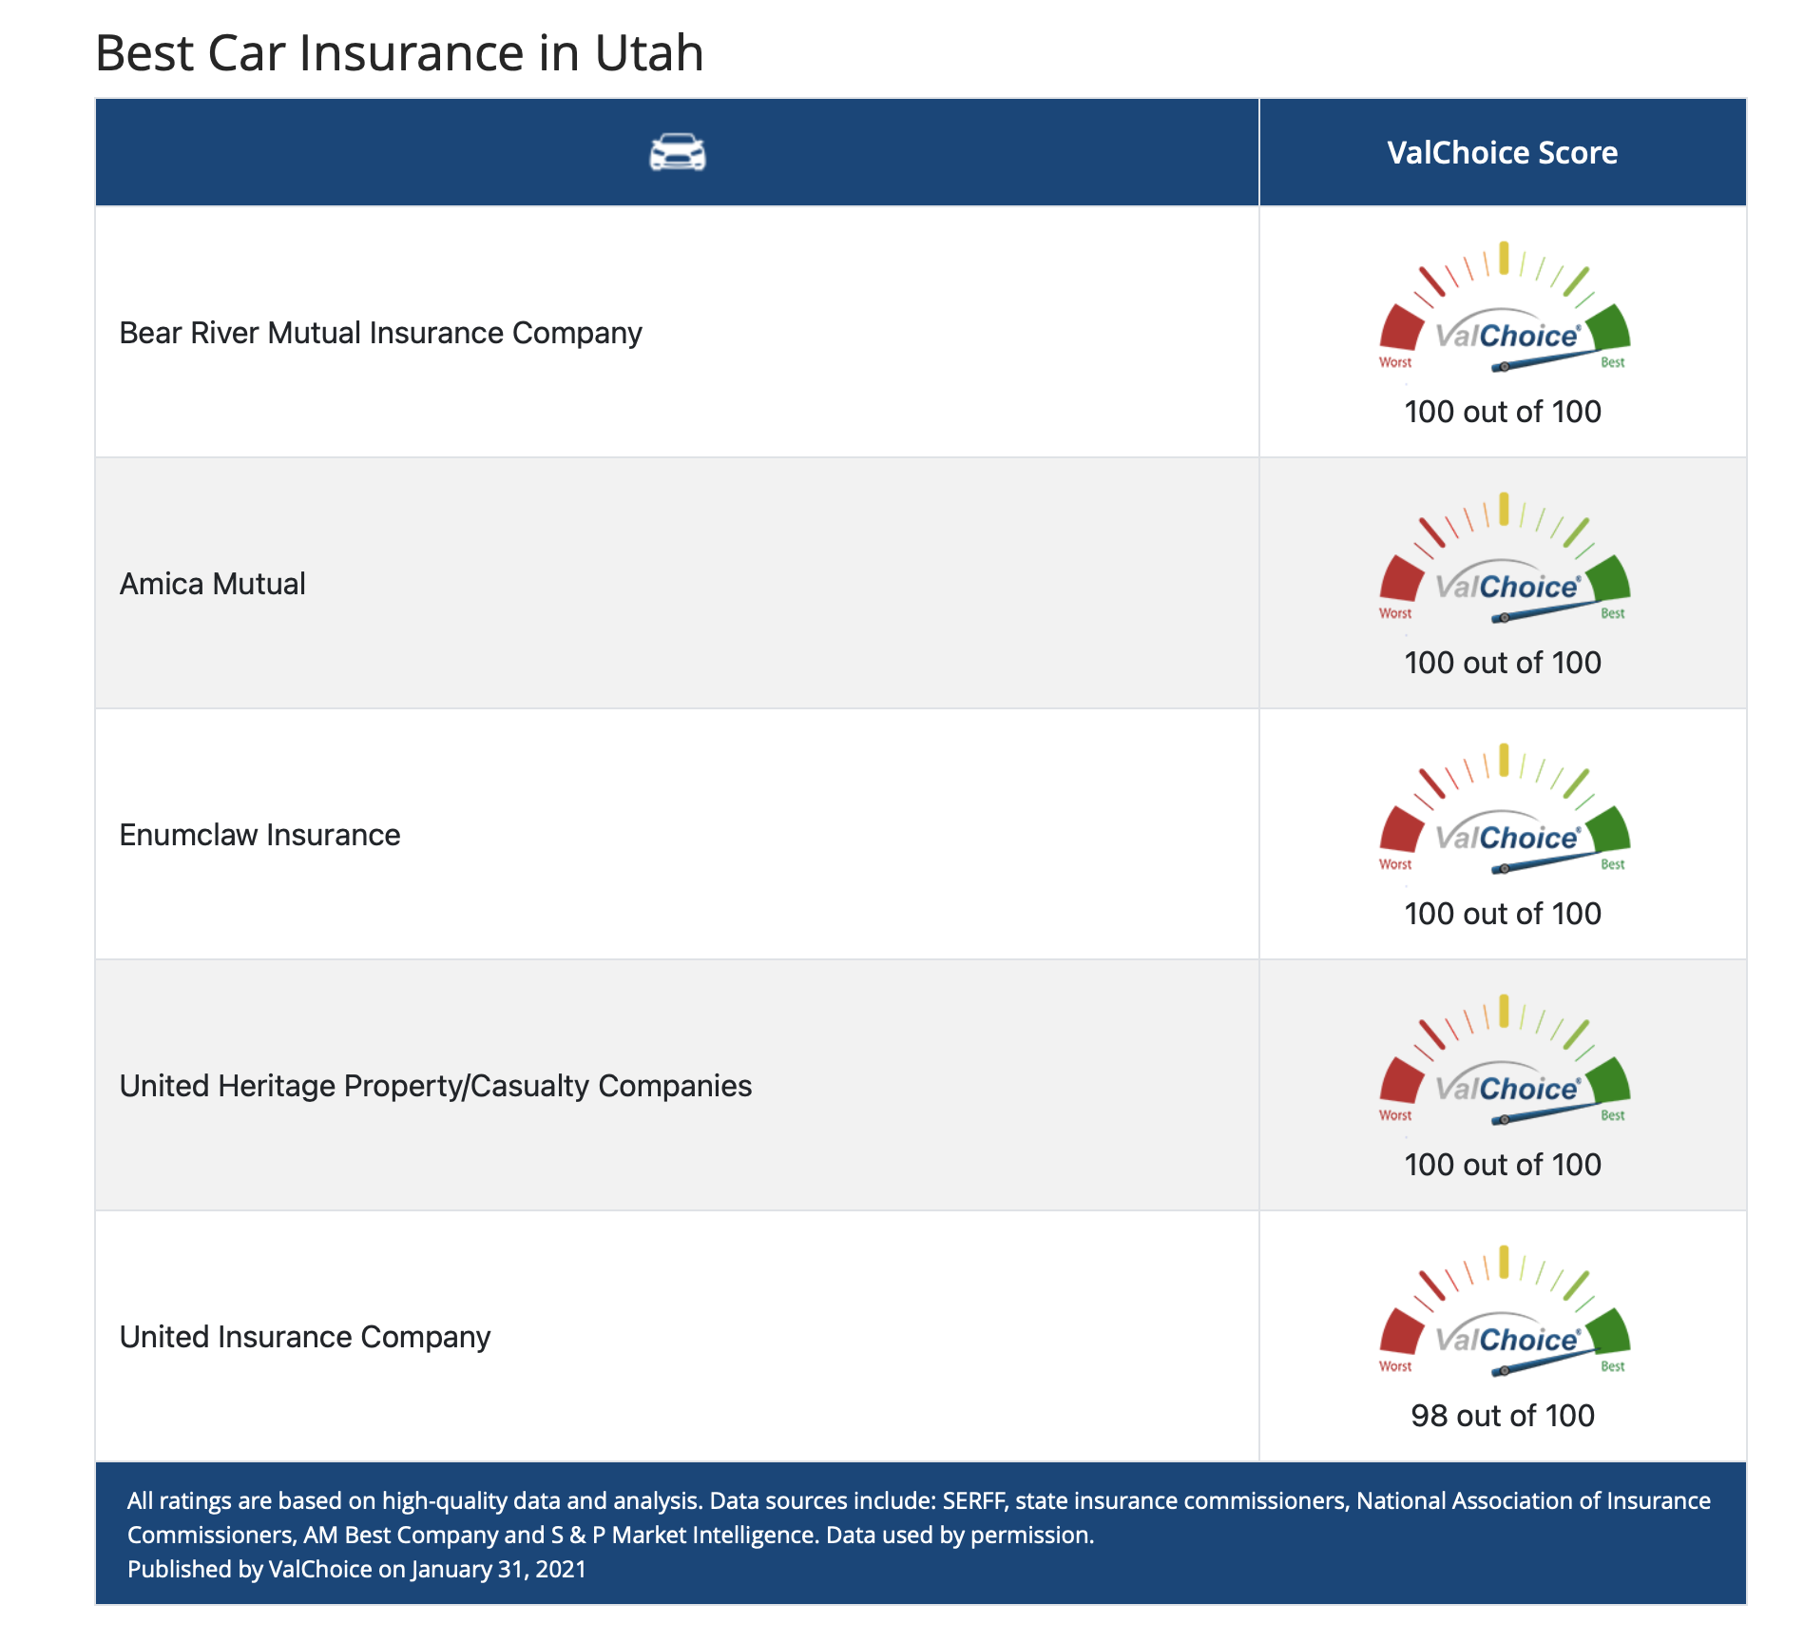
BEST CARRIERS BY STATE
ValChoice grades ~25,000 companies
~12,000 auto insurance
~13,000 home insurance
Best companies shown on pages your library shares
Grades updated annually

Slide 13
VALCHOICE INSURANCE COMPANY REPORTS
Bringing price and claims transparency to the insurance industry
ValChoice is the only company to
Use data collected by state insurance departments
Use data vetted by state insurance departments
Mathematical model of industry by insurance type
No user surveys or web reviews
UNDER EMBARGO UNTIL JAN. 26, 2016

Slide 14
CAR & HOME INSURANCE CHECK-UPS
Free ratings
How good is your insurance company?
Does your insurer delay & deny claims?
Who are the best companies?

Slide 15
EDUCATIONAL VIDEOS
Hands-on Learning with No Train the Trainer Required
16 - 24 Years Old
25 - 54 Years Old
55 and Older
21 frequently asked questions
Seven top tips
Series of six videos
25-minute total run time
25 frequently asked questions
11 top tips
Series of seven videos
30-minute total run time
28 frequently asked questions
12 top tips
Series of seven videos
30-minute total run time

Slide 16
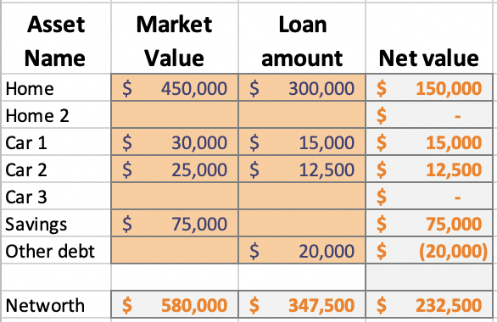
WORKSHEETS
Individualized, hands-on learning
Figure out exactly what you need
Liability insurance coverage
Deductible amount
Coordinated with calculators
Pages (screens) in the web app
Guides individualized decisions

Slide 17
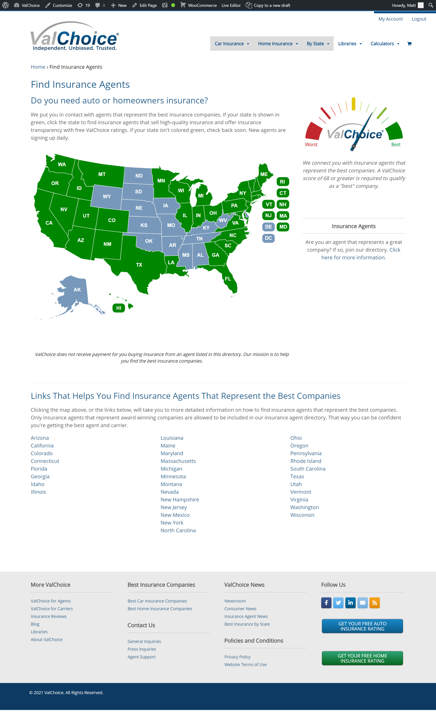
VALCHOICE AGENT REFERRALS
Making it easy to get the help patrons need
ValChoice only rates insurance companies, we also help match patrons with agents in their states
We take the guesswork out of finding a trustworthy advisor who will guide consumers through the purchasing process
These agents represent the top performing carriers

Slide 18
VIRTUAL PROGRAMMING
Helping Patrons Help Themselves
Available during MSW 2021
Sign-up available after registering
Promote through email, newsletters, websites and social media

Slide 19
INJURED MONEY BOOK
“This book is the complete guide for dealing with insurance companies, and the people who work for them. I had read a few "file your own claim" type books, but this is the only one that accurately prepares you for what is going to happen at each step in the process. It also provides a clear explanation of how to handle the situation. This is like a Bible and a Dummies guide rolled into one book. As icing on the cake, it is actually interesting to read.
“Statistically speaking, most of us will never be in a serious car accident in our lives. However, we buy insurance anyway. Injured Money should be part of your insurance purchase, so order a copy now. If you or a loved one are in a serious accident, car or otherwise, you will need to have this book at hand.”
“A very informative book that everyone who has insurance should read.”

Slide 20
PRICING
Calculators – No charge. Register to get links for your location
Ratings – No charge.
Educational Videos – No charge.
Worksheets – Included with educational videos.
Book – Use the above content and we’ll send you a signed copy.

Slide 21
www.valchoice.com/fin-lit

Slide 23
Ordering
STEP #1: ORDERING
Select your state
Click “REGISTER NOW”

Slide 24
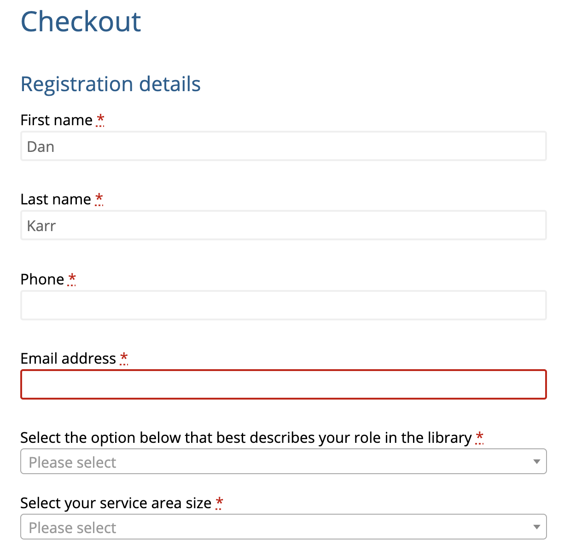
STEP #2: ORDERING
Fill in name
Email
Title
Service area size

Slide 25
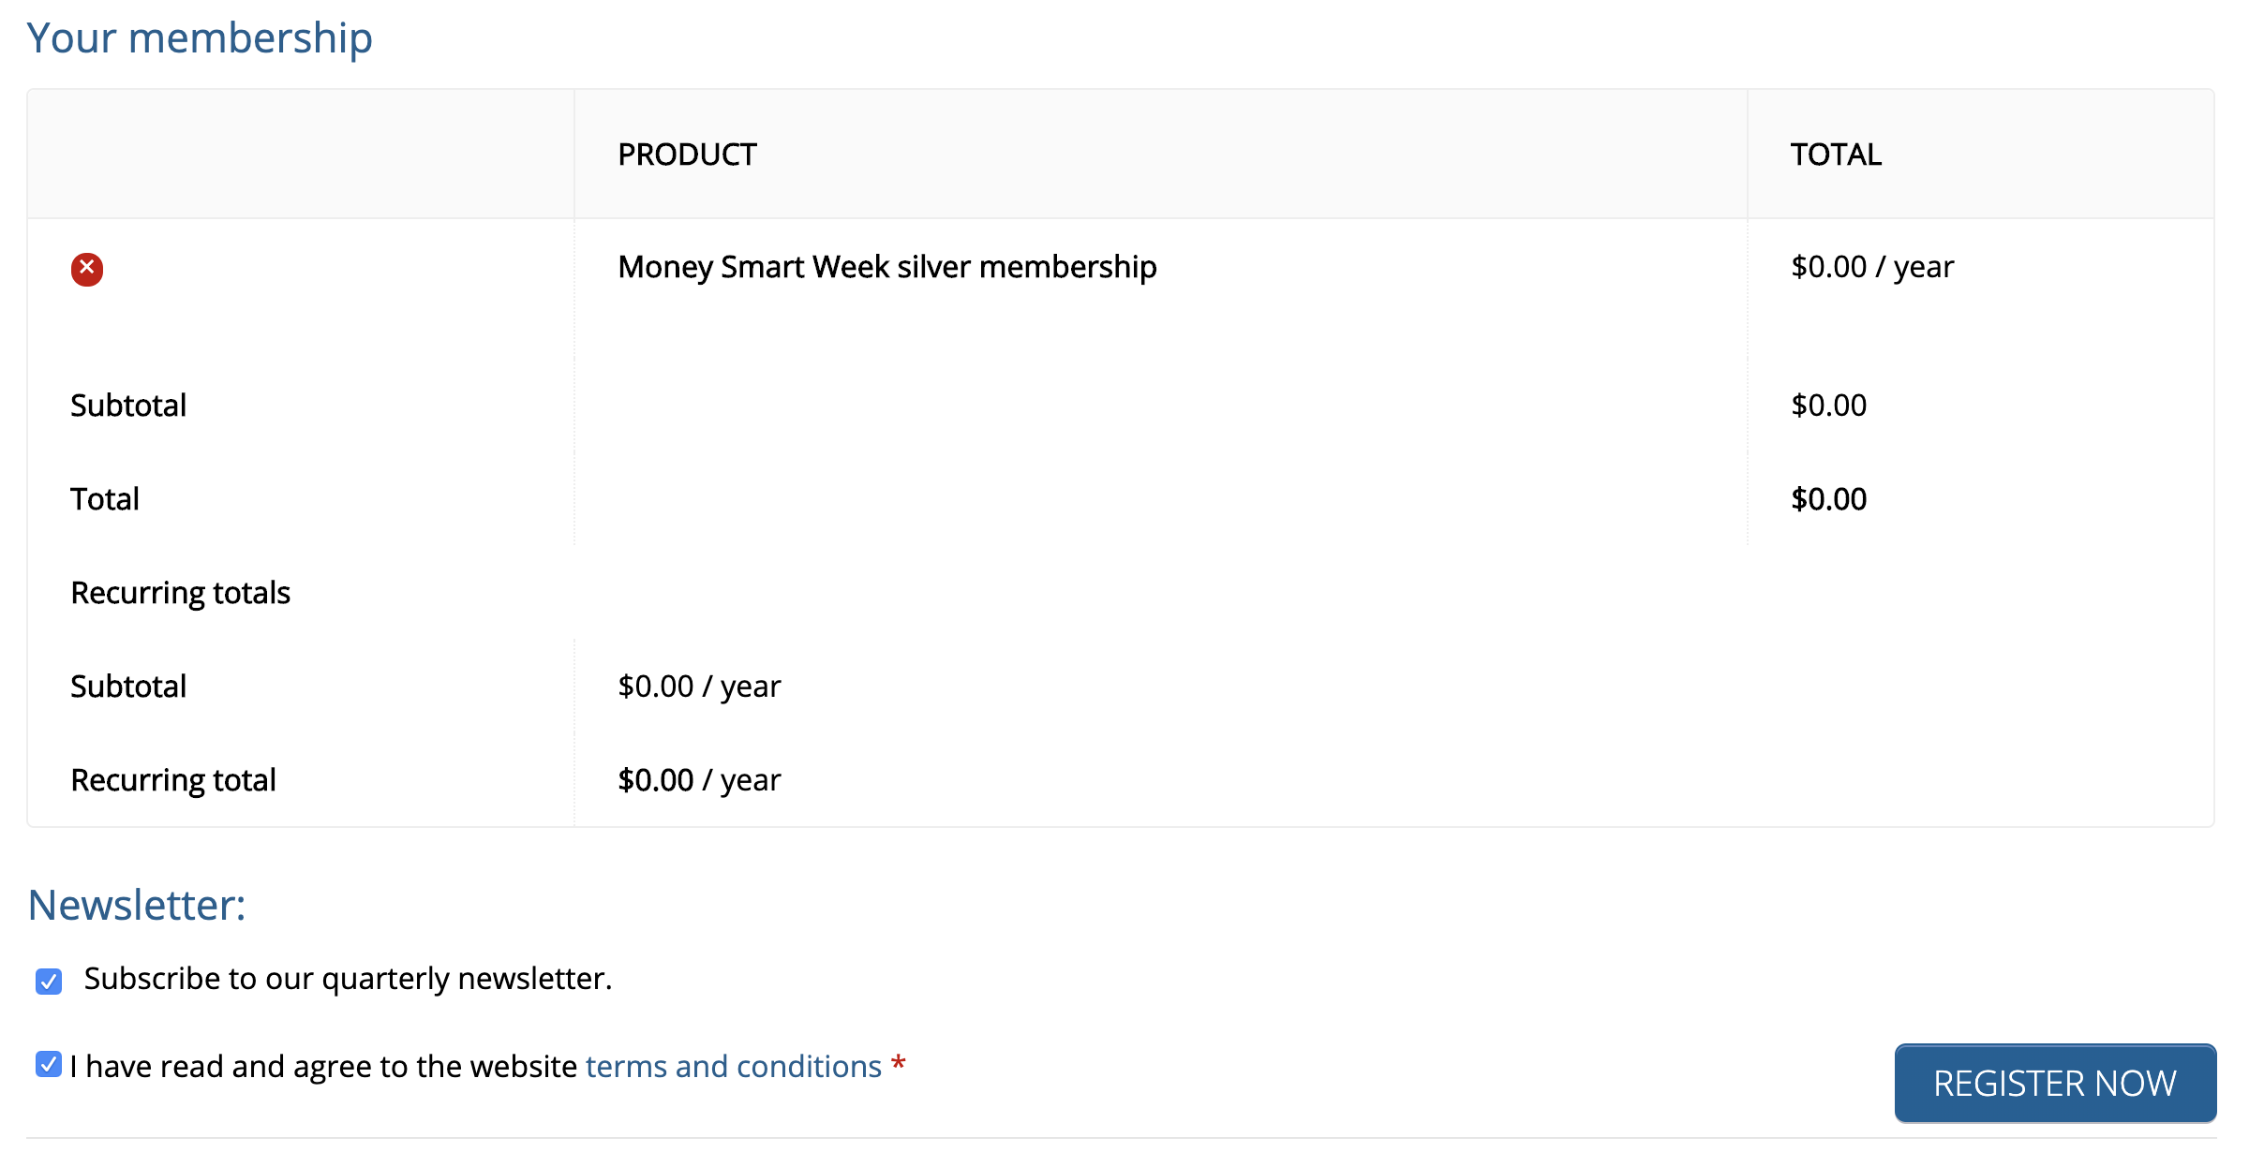
STEP #3: ORDERING
No charge order
No recurring charge
Accept terms
Click ”REGISTER NOW”

Slide 26
STEP #4: ORDERING
Click ”GET CONTENT”

Slide 27
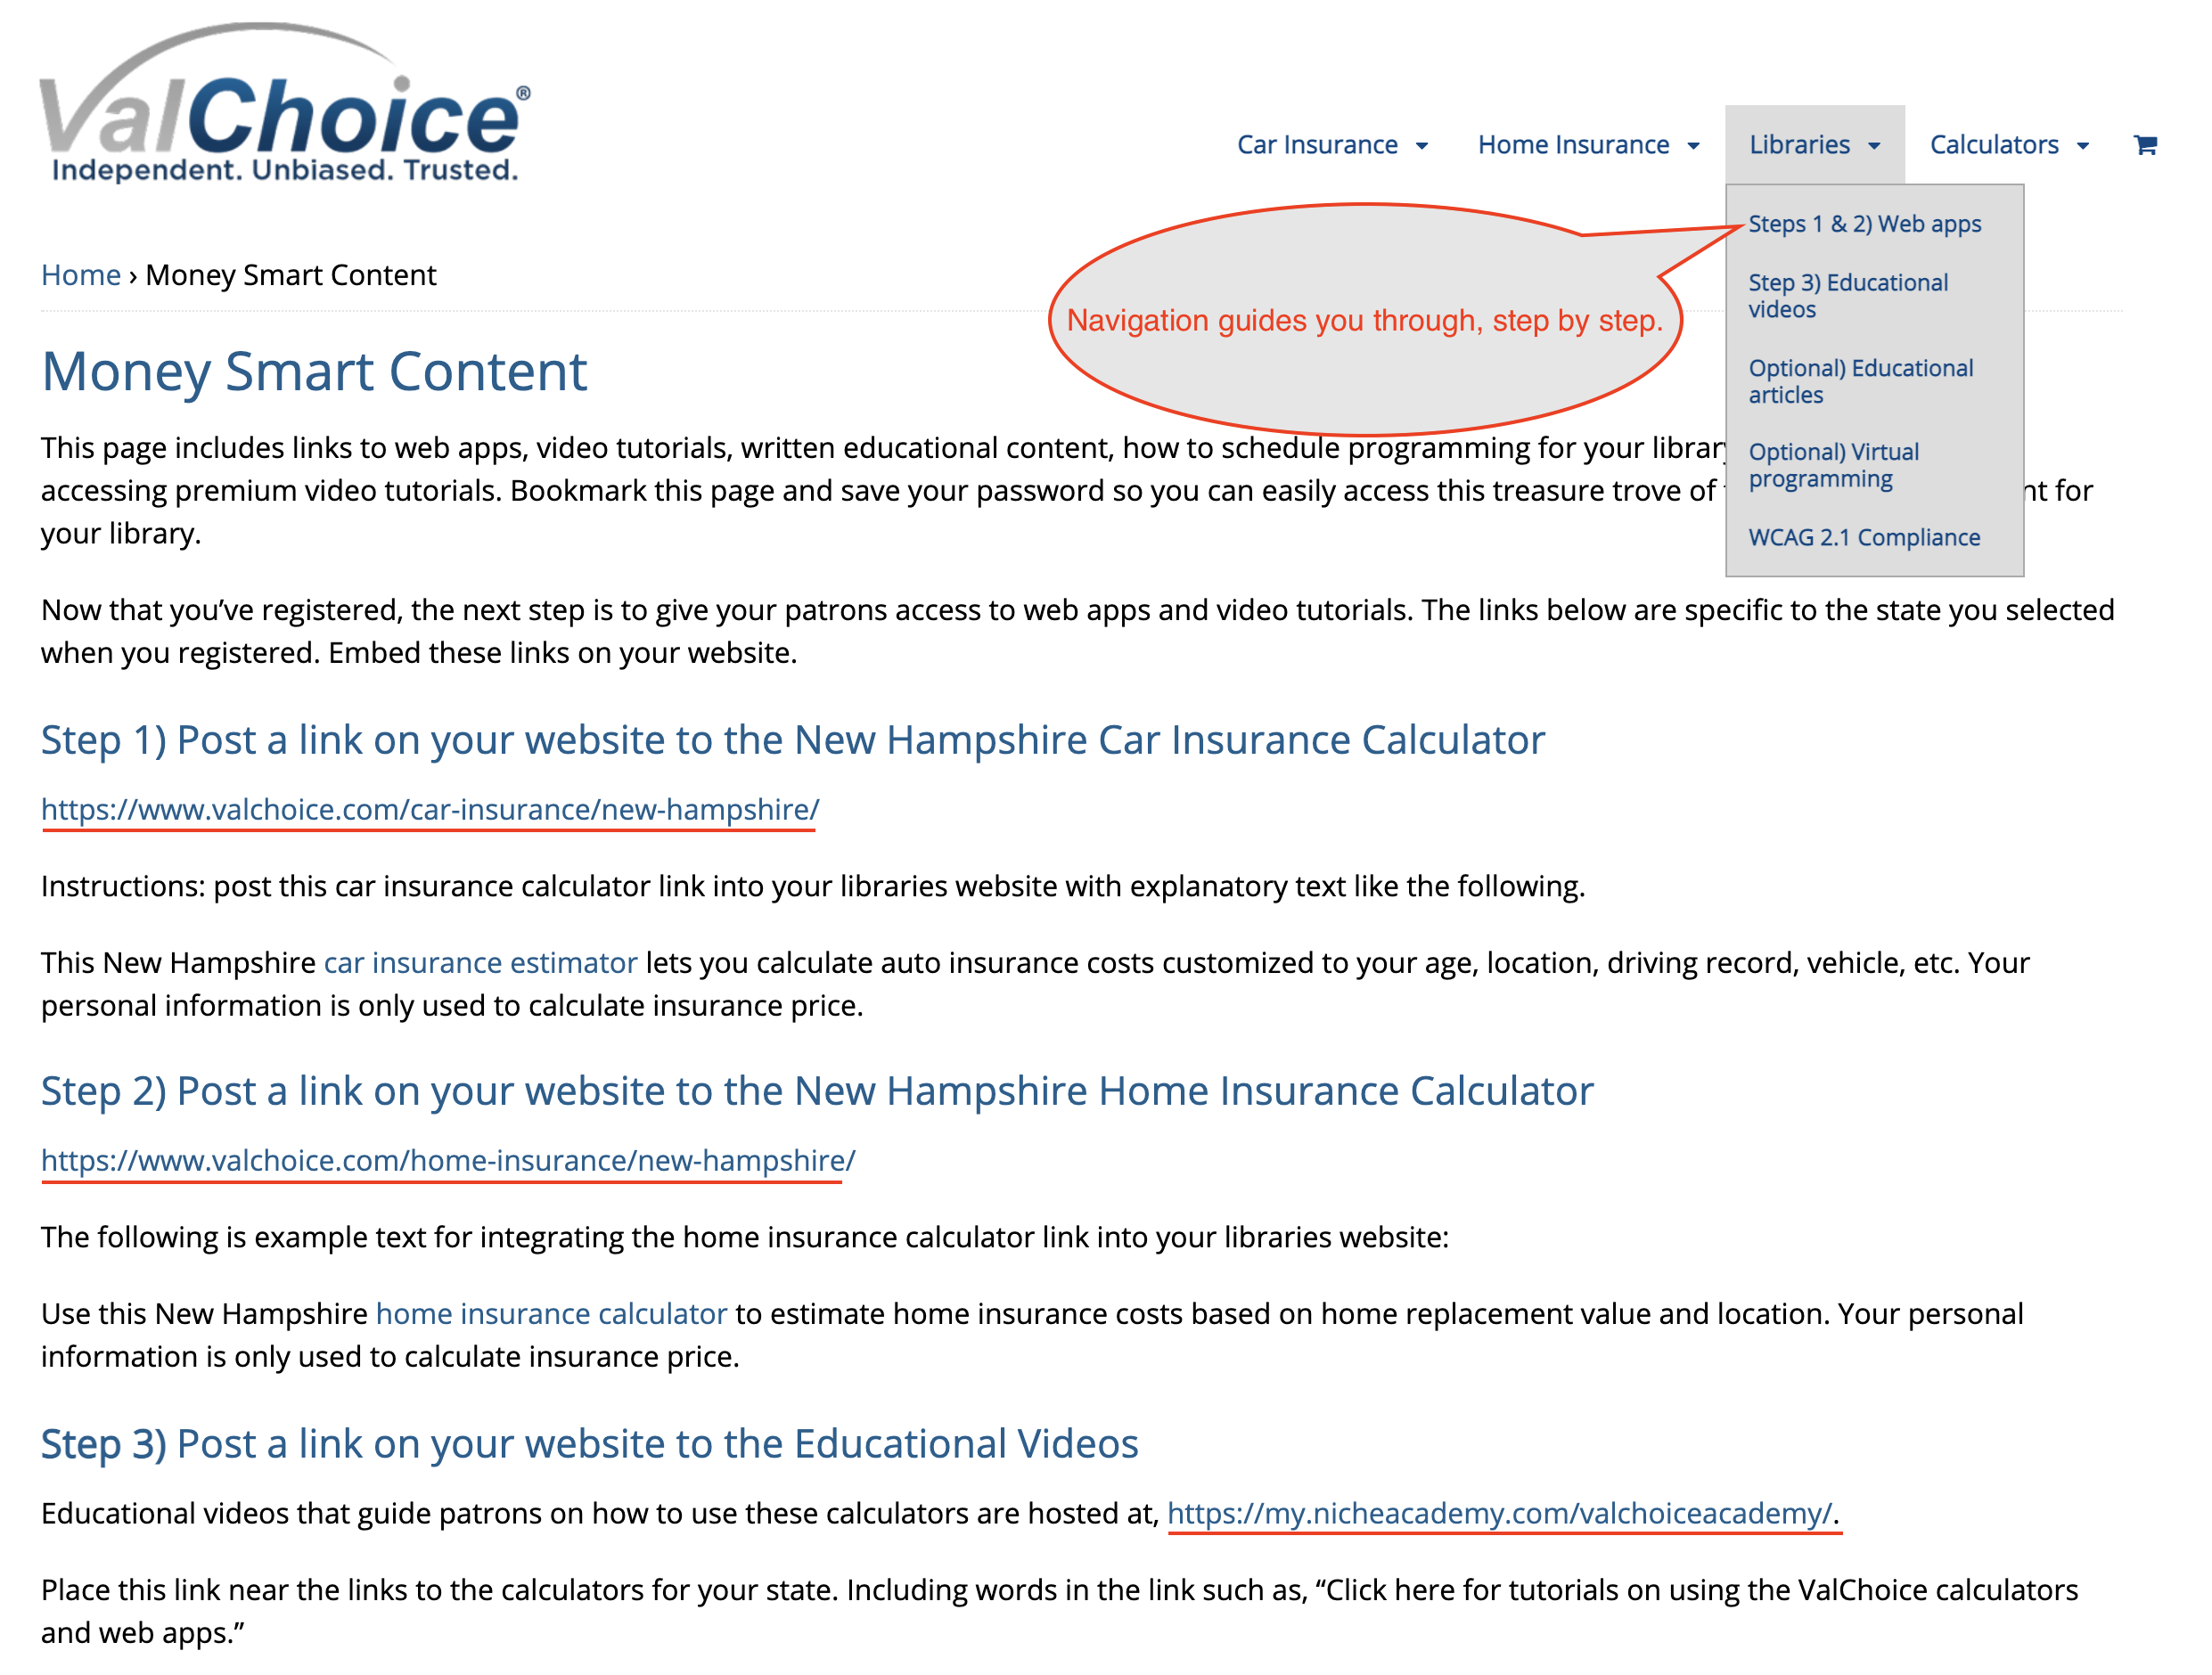
STEP #5: POST ON WEBSITE
Copy your links for pasting into your library’s website

Slide 28
ACCESSING VIDEOS
https://my.nicheacademy.com/valchoiceacademy

Slide 29
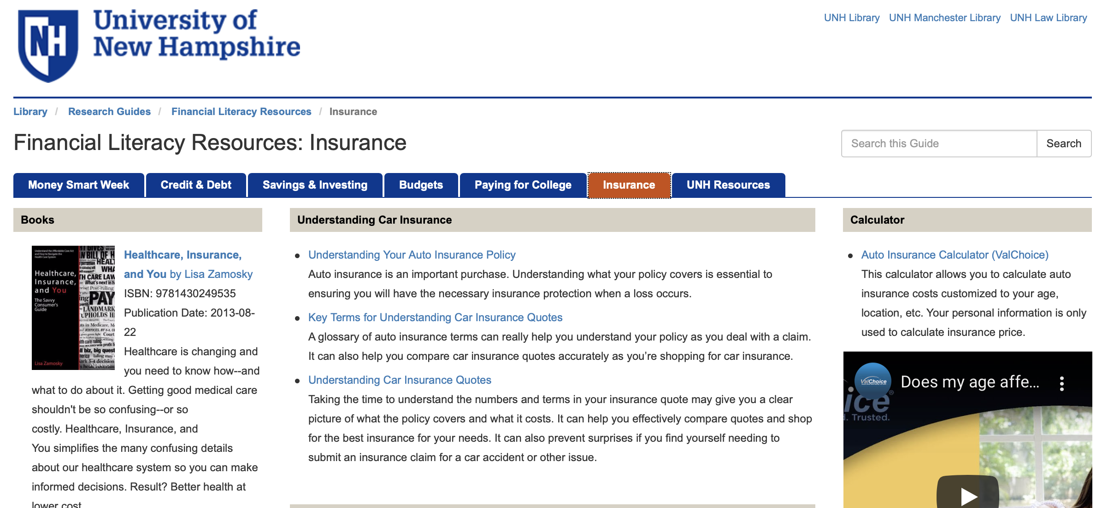
PLACING THE CONTENT

Slide 30
INSURANCE
Virtual programming during MSW
First come, first served

Slide 31
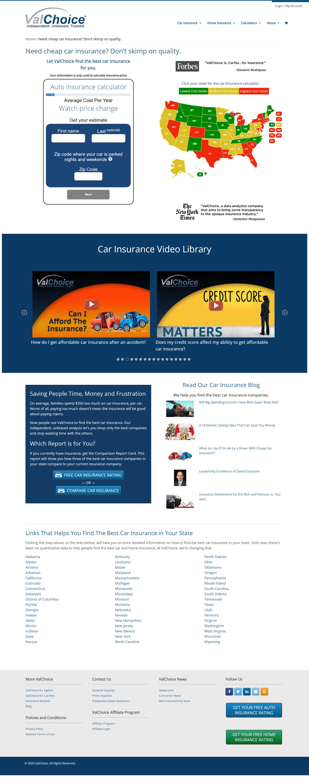
THE VALCHOICE CAR INSURANCE CALCULATOR
Bringing price and claims transparency to buying coverage for automobiles
Find a fair price without pressure to buy
Take control of the coverage and cost through literacy
Select insurance companies based on quality and value
UNDER EMBARGO UNTIL JAN. 26, 2016

Slide 32
THE VALCHOICE CAR INSURANCE CALCULATOR
Bringing price and claims transparency to buying coverage for automobiles
State versions updated as laws and regulations change
Pricing changes with the market
Updates require no support from your organization
No software required on your systems
UNDER EMBARGO UNTIL JAN. 26, 2016

Slide 33
THE VALCHOICE CAR INSURANCE CALCULATOR
Bringing price and claims transparency to buying coverage for automobiles
Customized by location
Educate users on what:
They need
They can influence
Fair
Debunk myths
Much additional info on web page
UNDER EMBARGO UNTIL JAN. 26, 2016

Slide 34
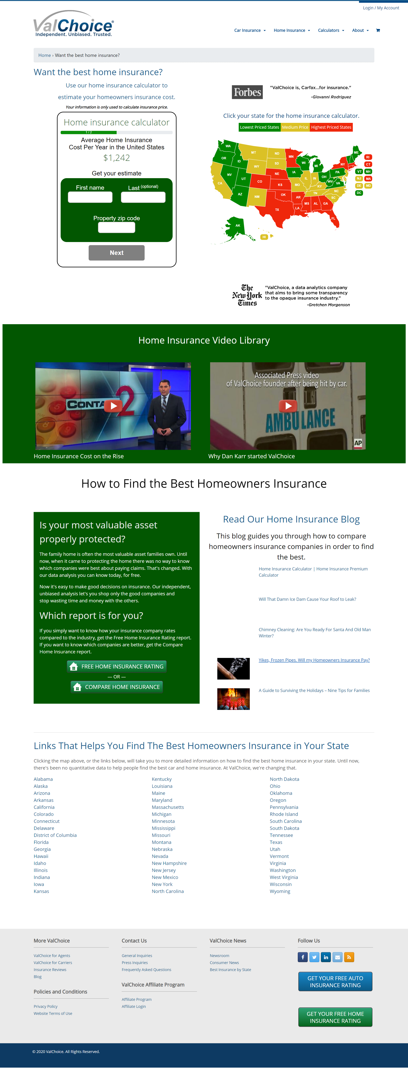
THE VALCHOICE HOME INSURANCE CALCULATOR
Bringing price and claims transparency to buying coverage for consumers most valuable asset
Find a fair price without pressure to buy
Take control of the coverage and cost through literacy
Select insurance companies based on quality and value
UNDER EMBARGO UNTIL JAN. 26, 2016

Slide 35
THE VALCHOICE HOME INSURANCE CALCULATOR
Bringing price and claims transparency to buying coverage for consumers most valuable asset
Updated as prices increase in each state
Updates require no support from your organization
No software required on your systems
UNDER EMBARGO UNTIL JAN. 26, 2016

Slide 36
THE VALCHOICE HOME INSURANCE CALCULATOR
Bringing price and claims transparency to buying coverage for consumers most valuable asset
All info custom, by location
Understand inputs
Debunk myths
Educate users on what’s
They need
They can influence
Fair
Much additional information on page
UNDER EMBARGO UNTIL JAN. 26, 2016

