Slide 1
Half the Victory: Preparing for the Opioid Crisis
Niche Academy
November 3, 2021

Slide 2
"To be prepared is half the victory." Miguel de Cervantes

Slide 3
Warning Signs
Philadelphia Free Library news story
Rise in Incident Reports
Personal addiction history
Notes:
Philadelphia Free Library news story - https://www.npr.org/2017/06/03/531347278/librarians-in-philadelphia-train-to-thwart-drug-overdoses
Rise in Incident Reports
Personal addicition connection

Slide 4
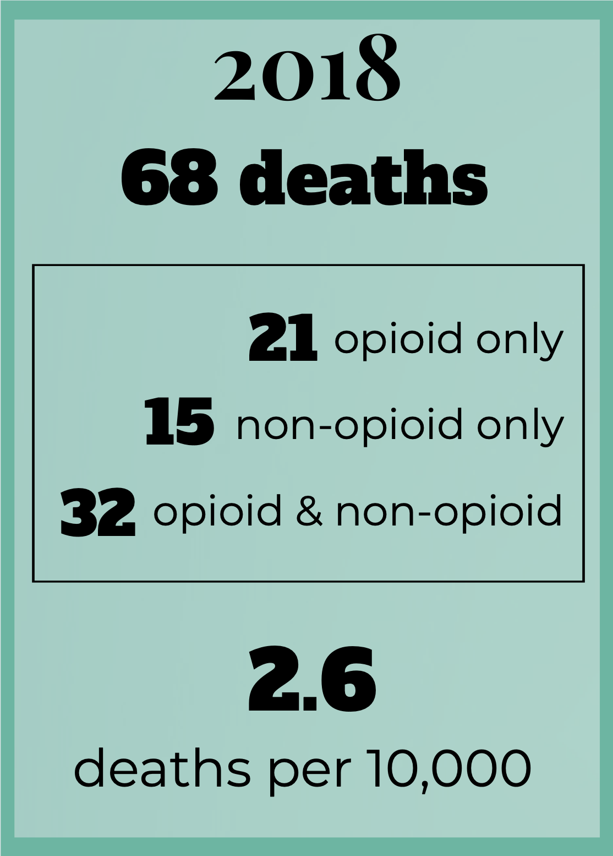
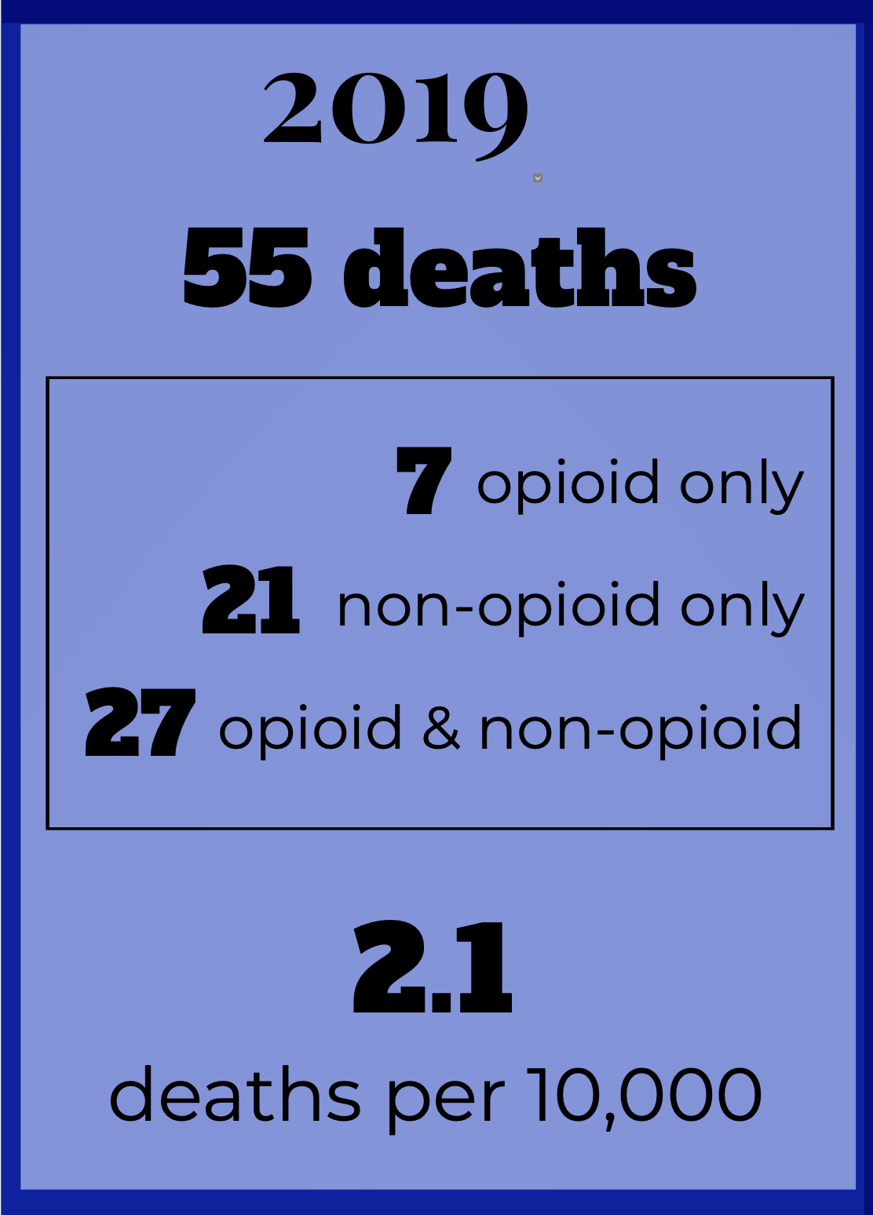
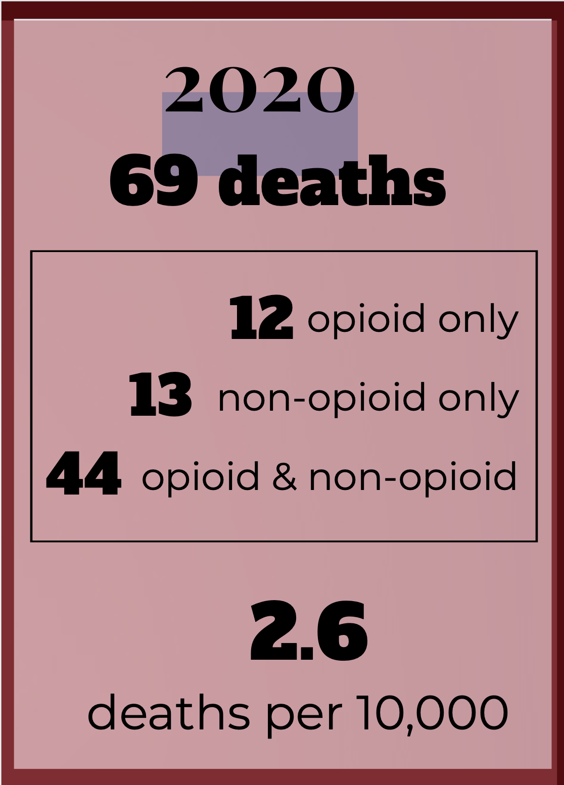
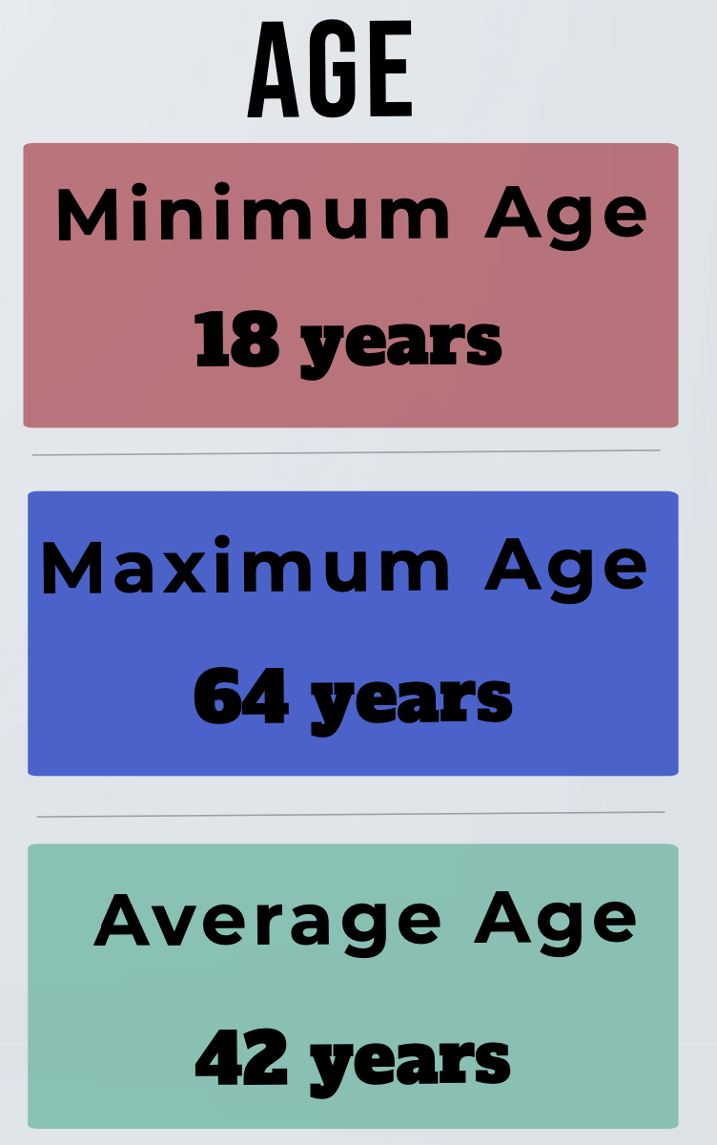
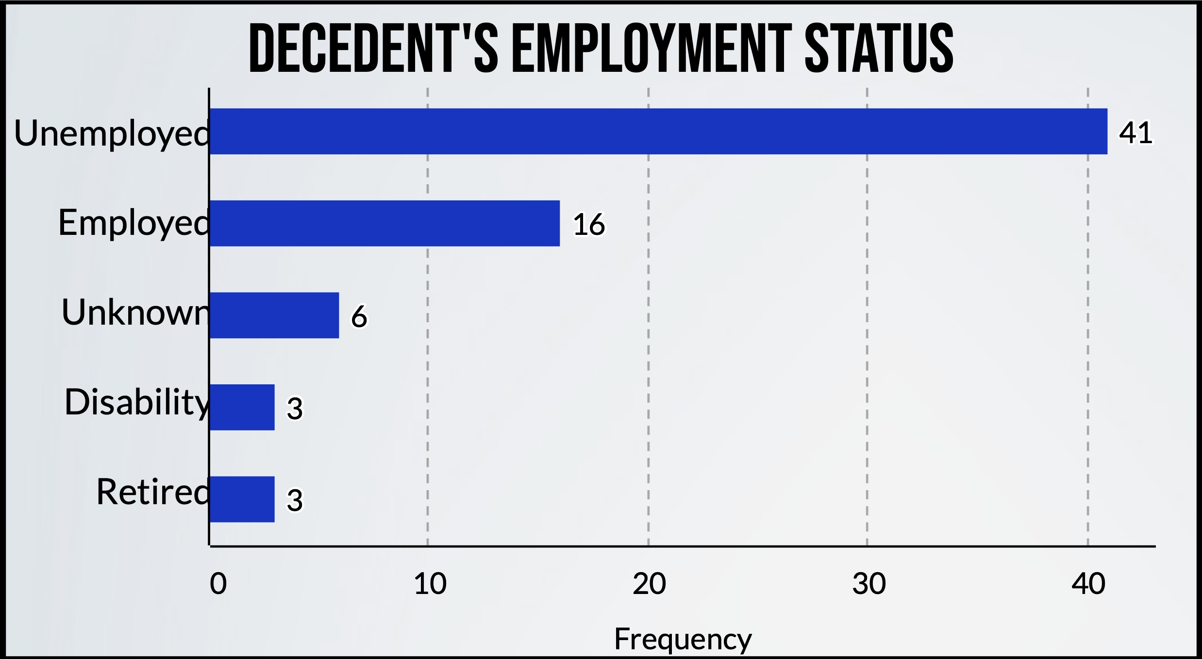
2020 Kalamazoo County Opioid Death Statistics
Notes:
Kalamazoo County Medical Examiner's Report - https://mimedicalexaminer.com/sites/default/files/2021-05/Kalamazoo%20Annual%20DROOD%20Report%202020.pdf
Deaths - % decrease from 18 to 19 = 19%; % increase from 19 to 20 = 25%
40% Depression; 30% Anxiety
23% Suicide ideation; 13% Suicide attempts
7 decendents lived with children at ttime of death; 26% of decendents found by family

Slide 5
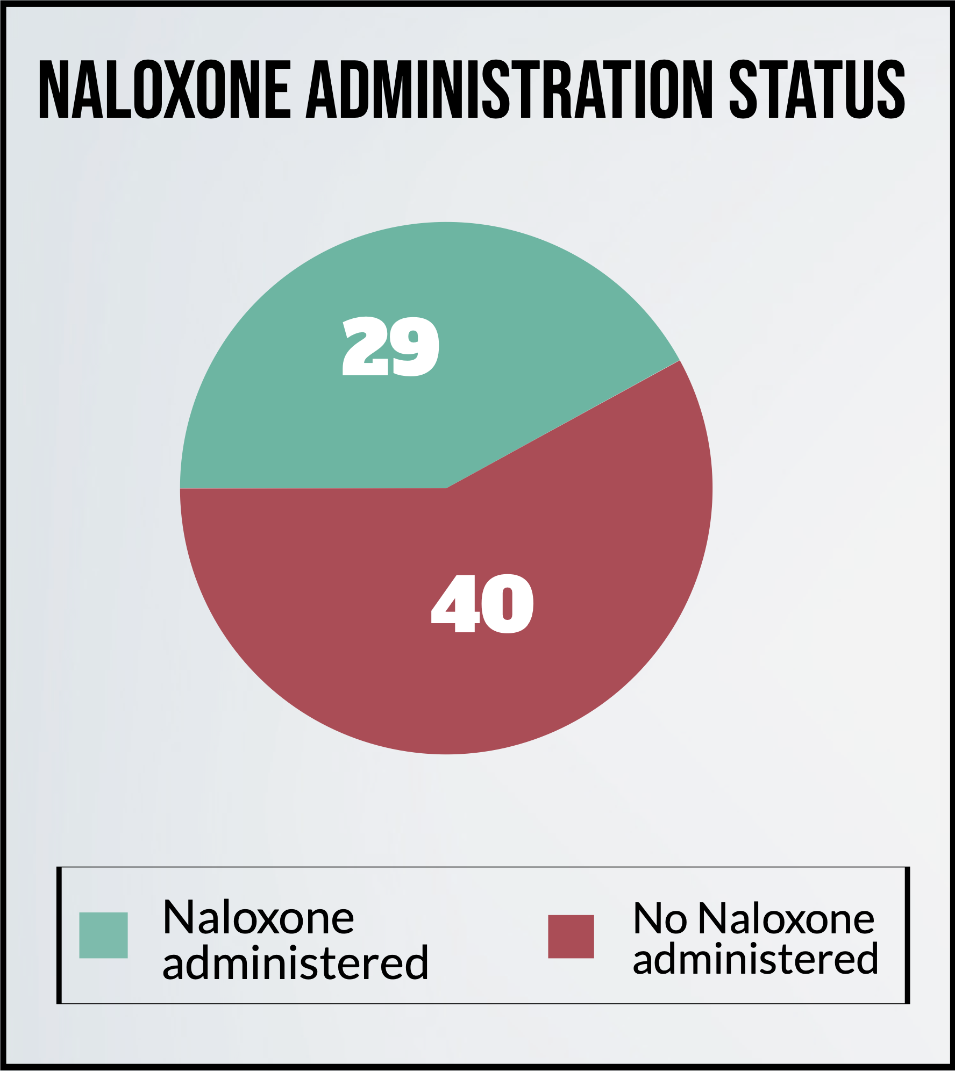
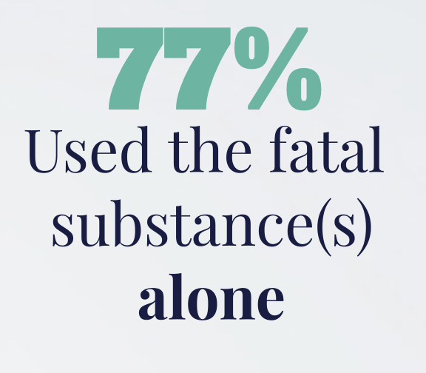
2020 Kalamazoo County Opioid Death Statistics
Notes:
Provisional data from CDC’s National Center for Health Statistics indicate that there were an estimated 93,331 drug overdose deaths in the United States during 2020, an increase of 29.4% from the 72,151 deaths predicted in 2019.
More than 760,000 people have died since 1999 from a drug overdose. Two out of three drug overdose deaths in 2018 involved an opioid. (HHS)
Naloxone is a medication designed to rapidly reverse opioid overdose. The number of prescriptions for naloxone doubled from 2017 to 2018. (HHS)

Slide 6
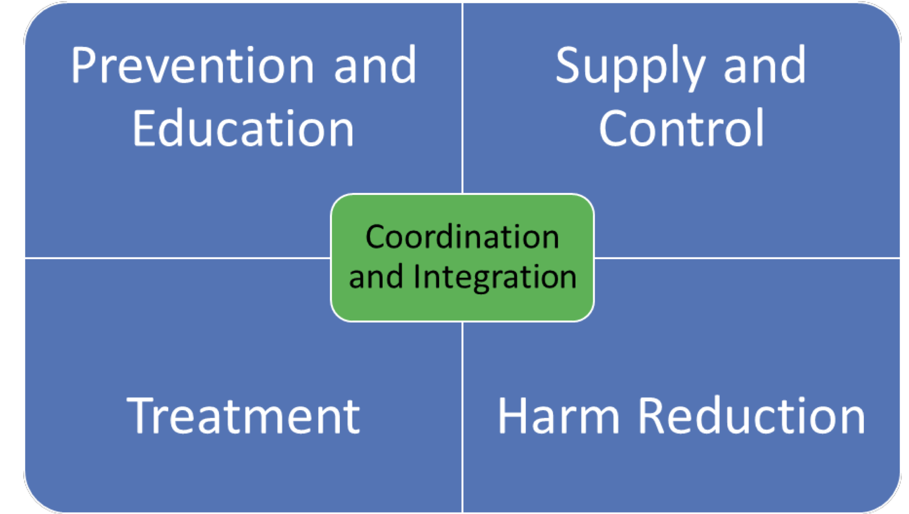
Kalamazoo County Opioid Coalition
Notes:
The Kalamazoo County Opioid Coalition convenes community partners and takes a public health approach to address the opioid epidemic in Kalamazoo County.
Vision - Put opioids in their place.
Mission - Achieving health and wellness for Kalamazoo County through promoting awareness and providing hope to those affected by opioids.
Medical, social services, religious, courts, and law enforcement at the table.
Prevention and Eduction; Supply and Control; Treatment and Recovery; Harm Reduction
KPL - programs, education, and MLA Annual program.
Harm Reduction – methodone, needle exchange, supervised injection sites
https://www.kalcounty.com/hcs/datahub/files/news/Kalamazoo%20County%202019%20Opioid%20Report%20FINAL.PDF

Slide 7
KPL's Proactive Approach
01
02
03
04
Staff Awareness – Overdose and Naloxone Training
Lobby to change Michigan liability laws
Program – Drug Take-Back Day
Peer Navigators

Slide 8
Opioid Awareness and Naloxone Training
Nancy King, COPE Network
75% of staff trained
Offered three times a year
Both online and in-person
Narcan kits
Report usage of Narcan
Notes:
COPE Network
ODs @ KPL

Slide 9
Liability Laws
Library employees were not exempt from liability if using Naloxone (Narcan).
Libraries could not easily purchase Naloxone (Narcan) for staff to use.
Michigan Radio – NPR Station
On 6/26/19, Governor Whitmer signed into law HB 4367 and SB 200.
These laws provide MI public libraries (and all government entities) with the ability to obtain and administer Narcan without fear of liability.
Notes:
The Michigan Library Association led the efforts to change the law.
Eventually included all government entities.
Michigan Radio - https://www.michiganradio.org/health/2018-06-25/libraries-find-themselves-on-the-front-lines-of-michigans-opioid-crisis

Slide 10
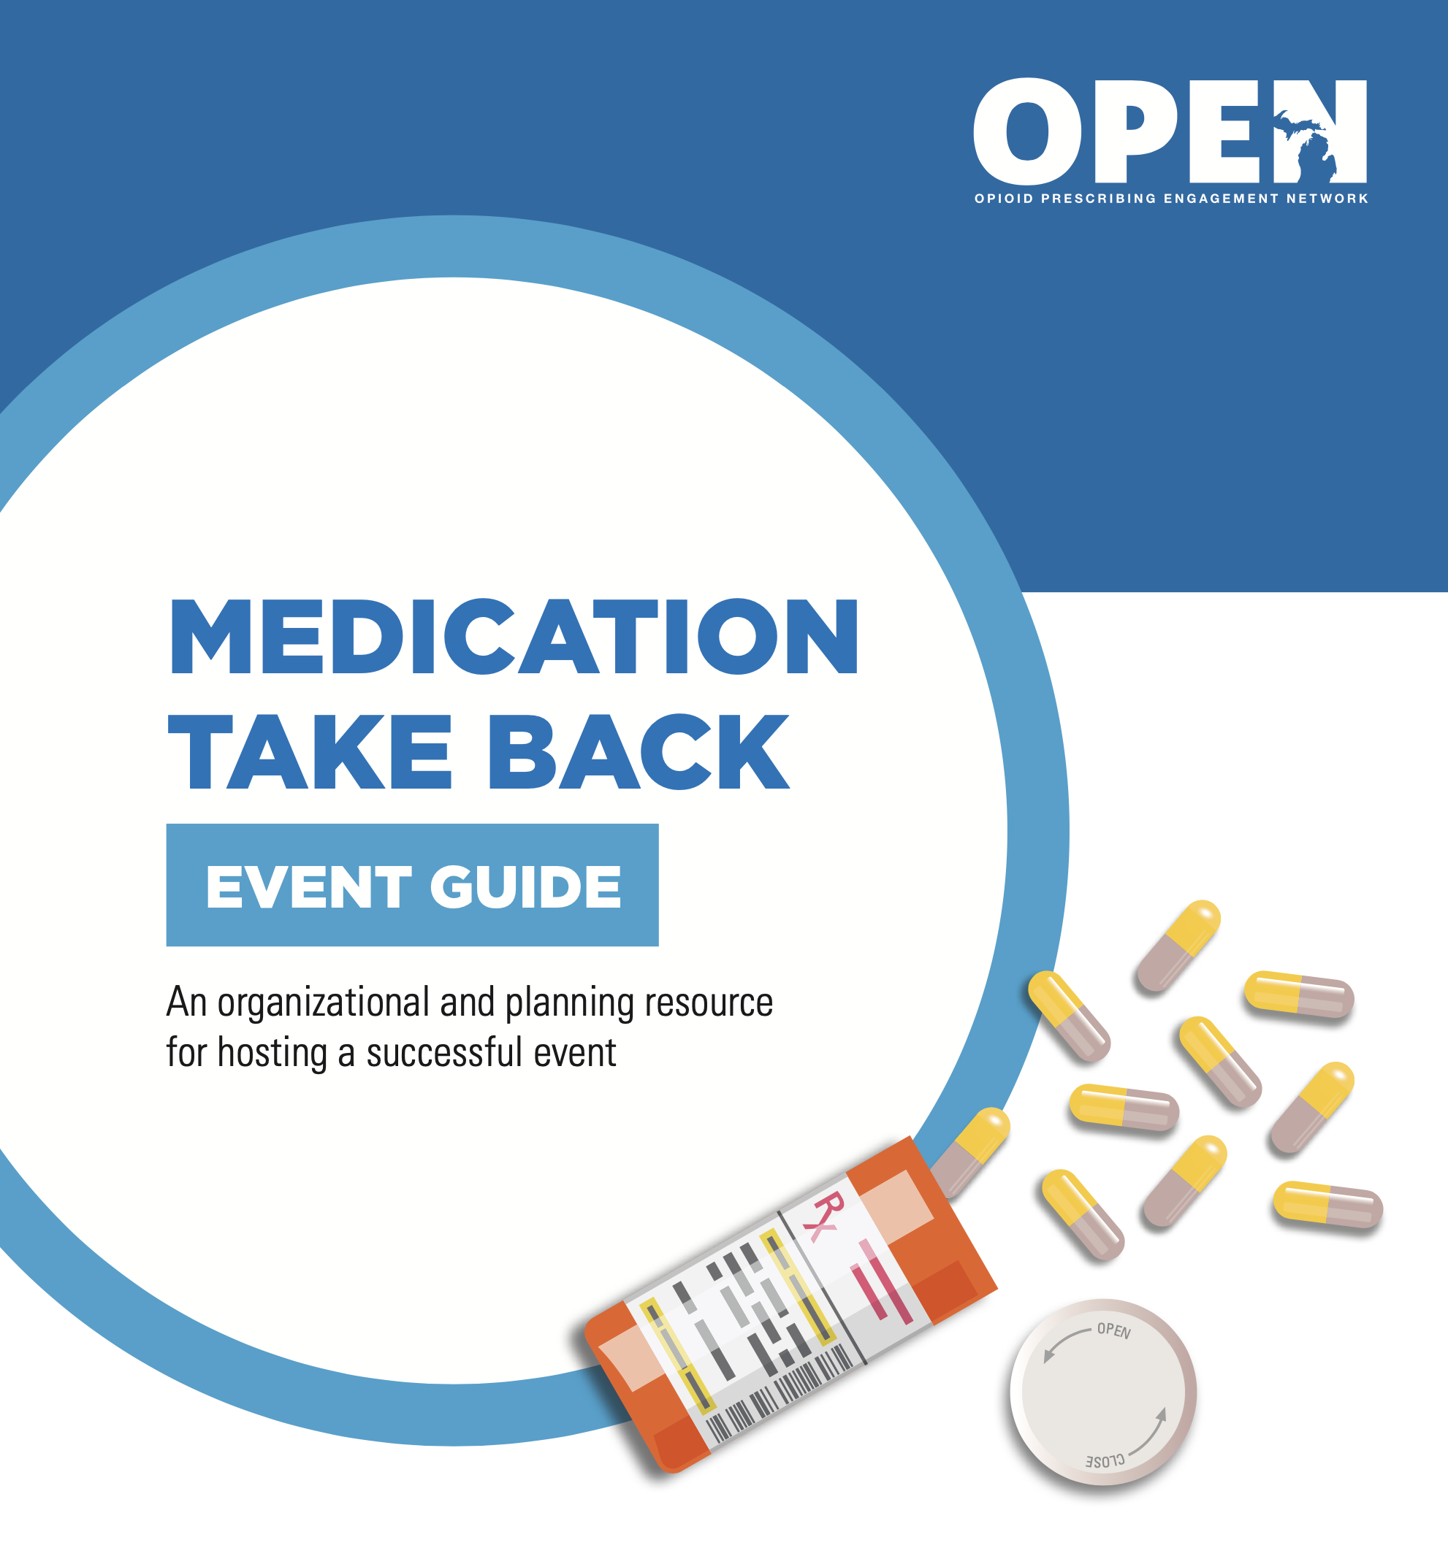
Drug Take Back
Kalamazoo Substance Abuse Task Force
OPEN supplied the supplies to collect, marketing info, food for volunteers, and even paid for local law enforcement to be onsite.
Branch near major road.
Set up a "drive-thru" to make it easier for patrons to dispose of the unused drugs.
Notes:
Michigan OPEN (Opioid Prescribing Engagement Network) - https://michigan-open.org
Prevention Works - https://www.prevention-works.org

Slide 11
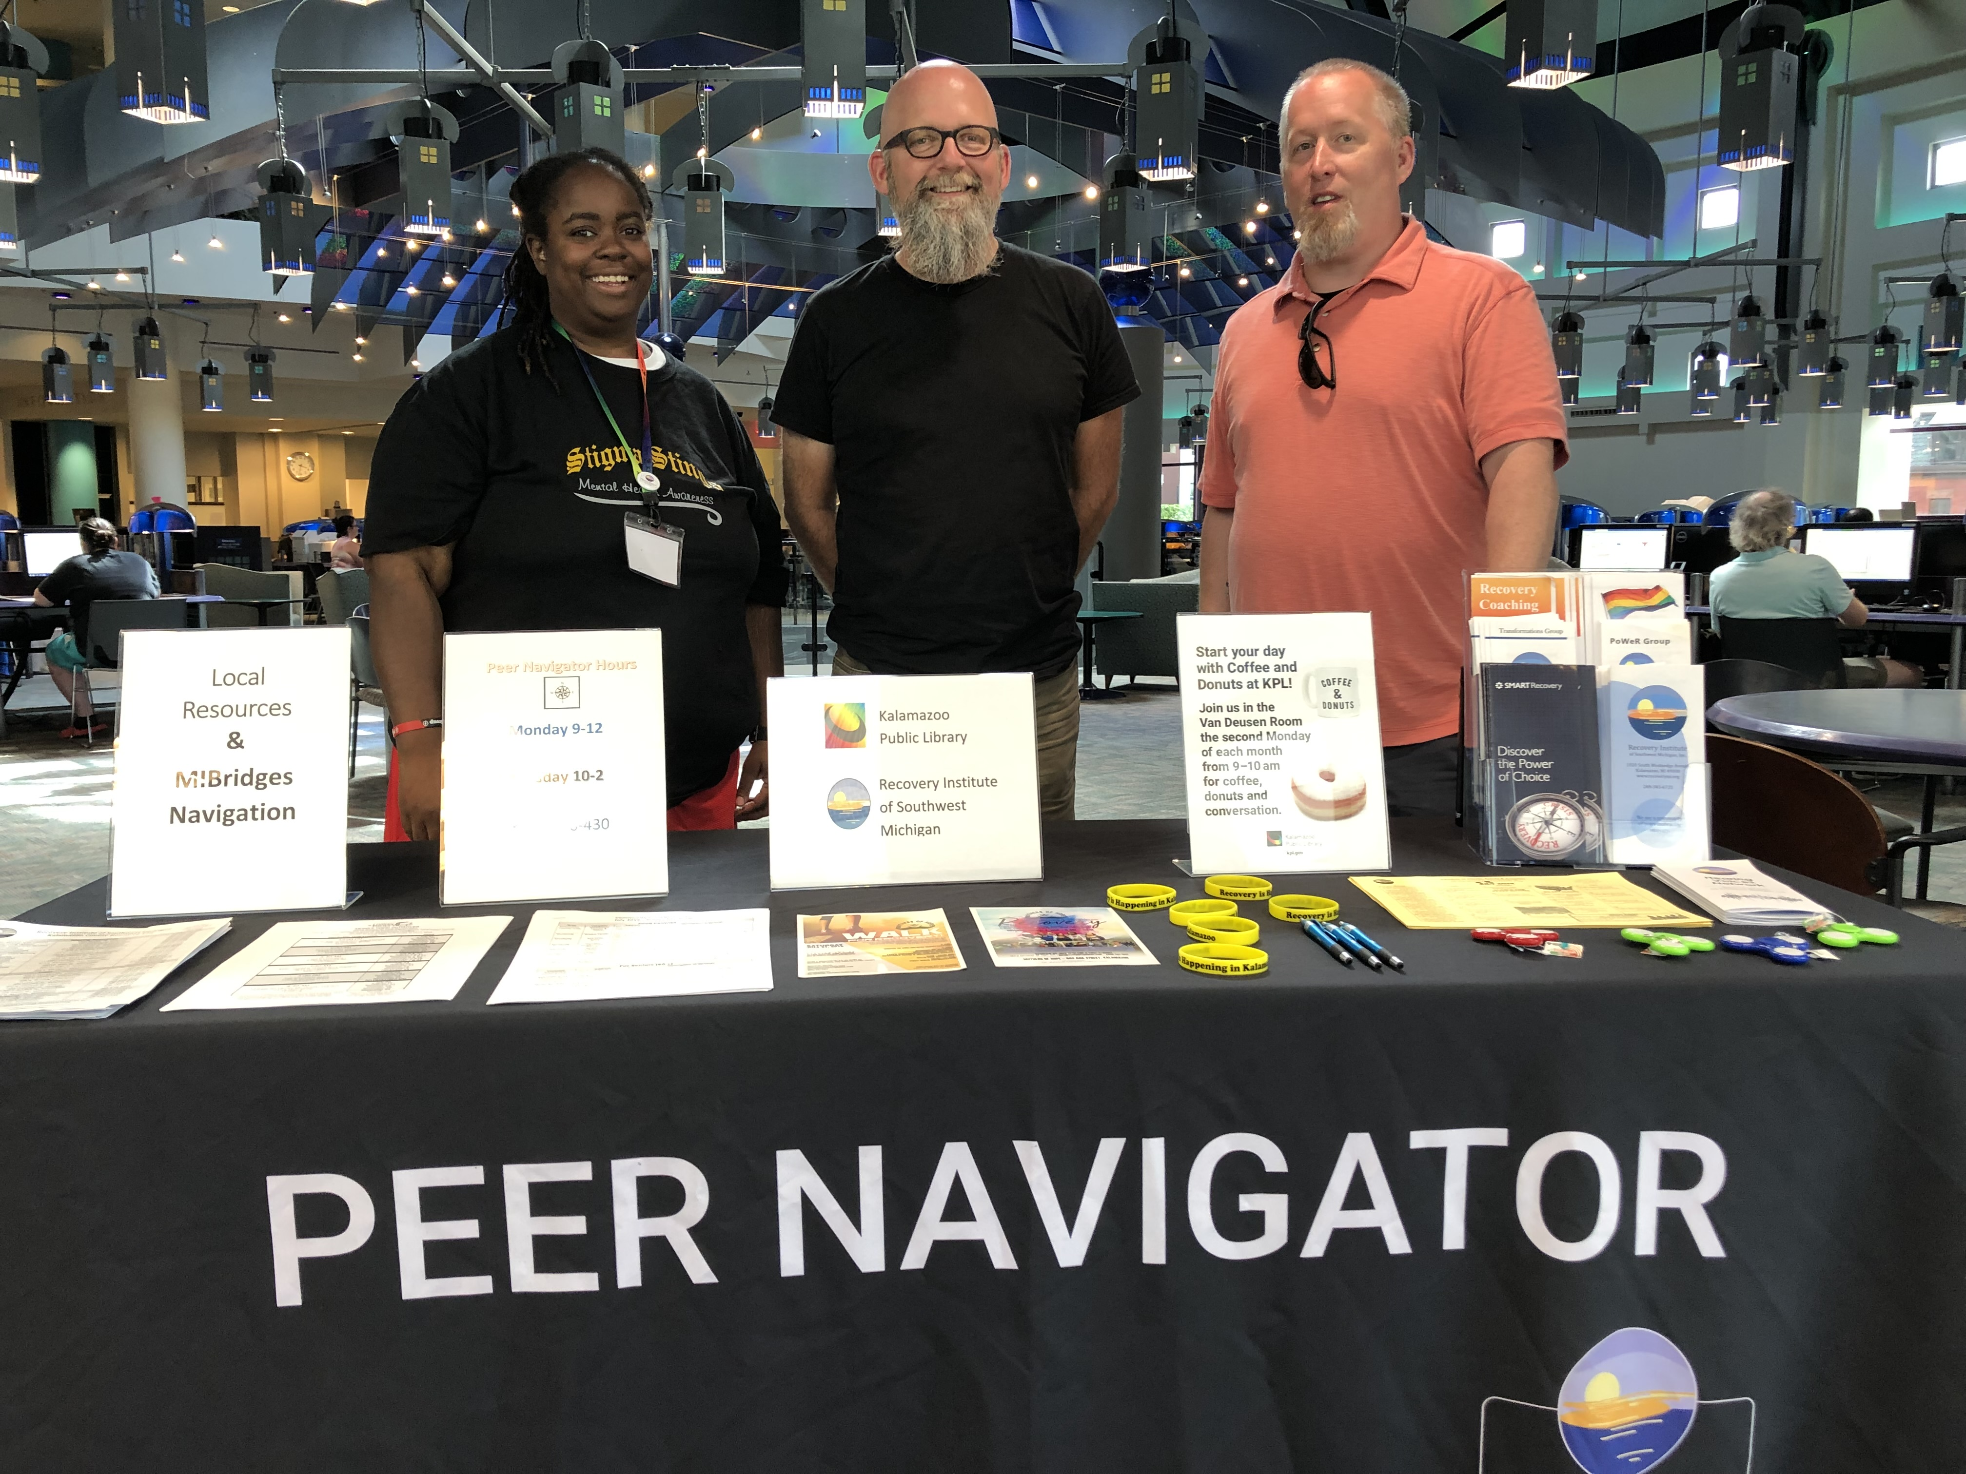
Peer Navigators
Lived experience.
Connect to resources.
Care and meal kits.
"I get to be the help that I needed."

Slide 12
Trauma-Informed Care/ Customer Service
"Trauma-informed care acknowledges the need to understand a patient’s life experiences in order to deliver effective care." (Menschner and Maul)
Fundamental Attribution Error
Reshapes how you interact with all patrons, especially those with substance use disorder.
Notes:
Image - https://pj.news.chass.ncsu.edu/2019/11/04/implementing-trauma-informed-care-in-your-nonprofit/
Key Ingredients for Successful Trauma-Informed Care Implementation By Christopher Menschner and Alexandra Maul, Center for Health Care Strategies - https://www.samhsa.gov/sites/default/files/programs_campaigns/childrens_mental_health/atc-whitepaper-040616.pdf
SAMSHA 's Guide of Trauma and Guidance for a Trauma-Informed Approach - https://ncsacw.samhsa.gov/userfiles/files/SAMHSA_Trauma.pdf

Slide 13
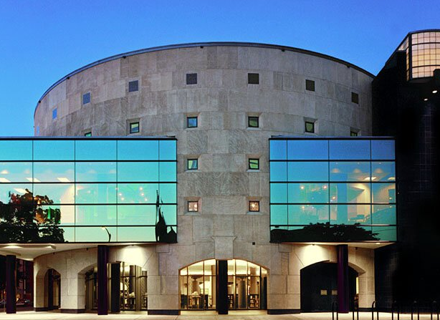
Why Public Libraries?
democratic.
Destigmatizing.
More likely to be discovered if OD.
Trusted.
Supportive community in Kalamazoo.
Notes:
WebJunction

Slide 14
Future
Train and educate.
Programs for National Alcohol and Drug Addiciton Recovery Month 2022.
KCOC programs.
Notes:
Train and educate – all employees, new and old

Slide 15
Questions?
Kevin King
Head of Community Engagement
Kalamazoo Public Library
kevink@kpl.gov
(269) 553-7881

