Slide 1
Library Information Systems
Joseph R. Matthews
and Carson Block

Slide 2
Discount at abc-clio.com

Slide 3
Introductions
Joe Matthews
Carson Block

Slide 4
How did this book come about?

Slide 5
The Integrated Library System is arguably the most important computing system in a library. What exactly is it?

Slide 6
Why is it important to understand the underpinnings of library technology?

Slide 7
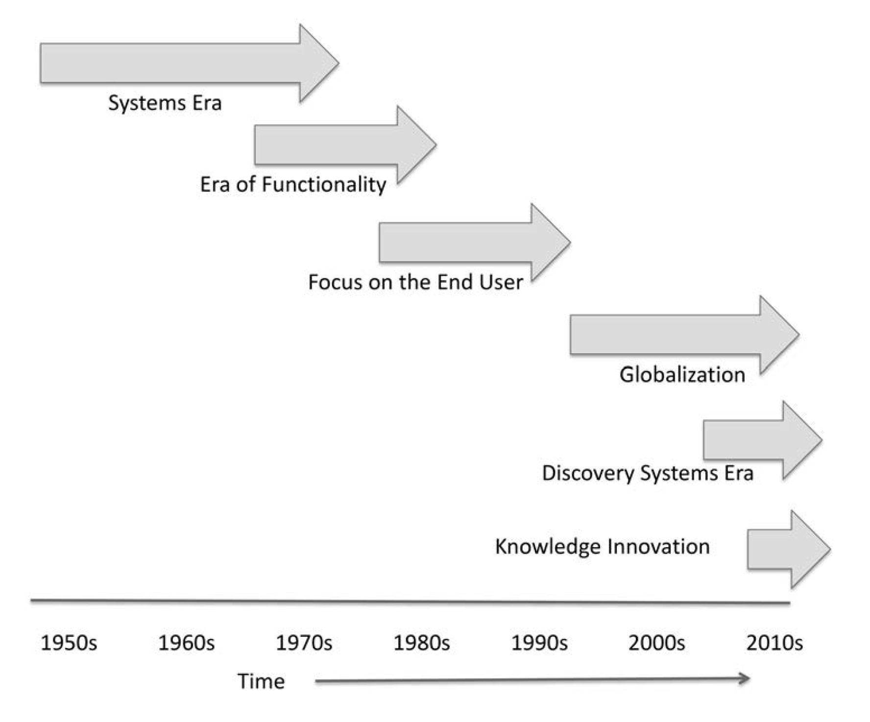
Evolution of Library Information Systems

Slide 8
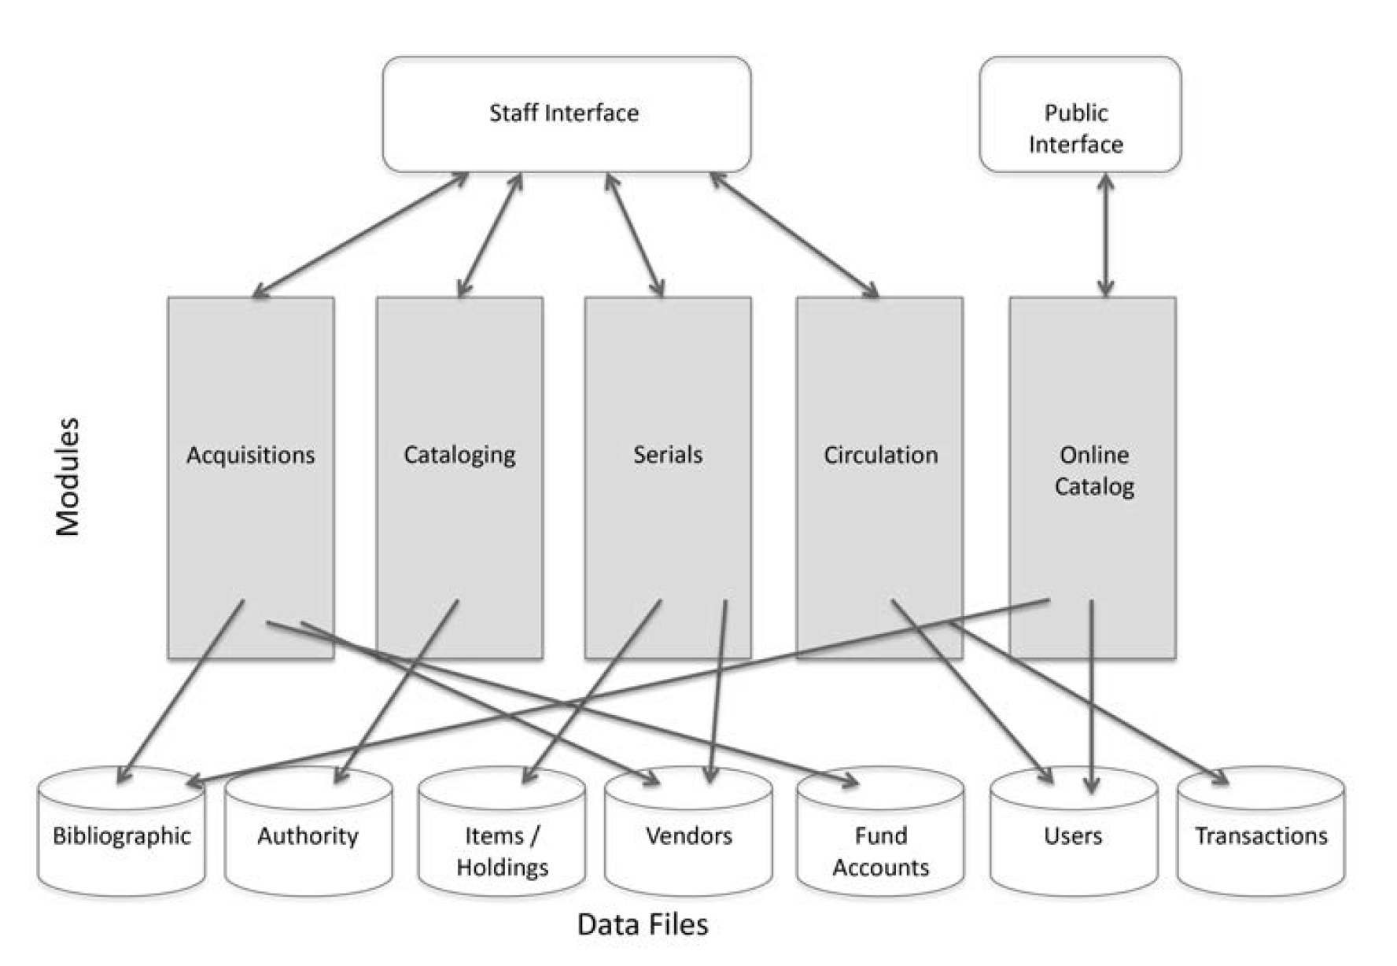
ILS Architecture

Slide 9
What is the role of standards to make all of those things work together?

Slide 10
How does the ILS connect to things like databases and other eResources?

Slide 11
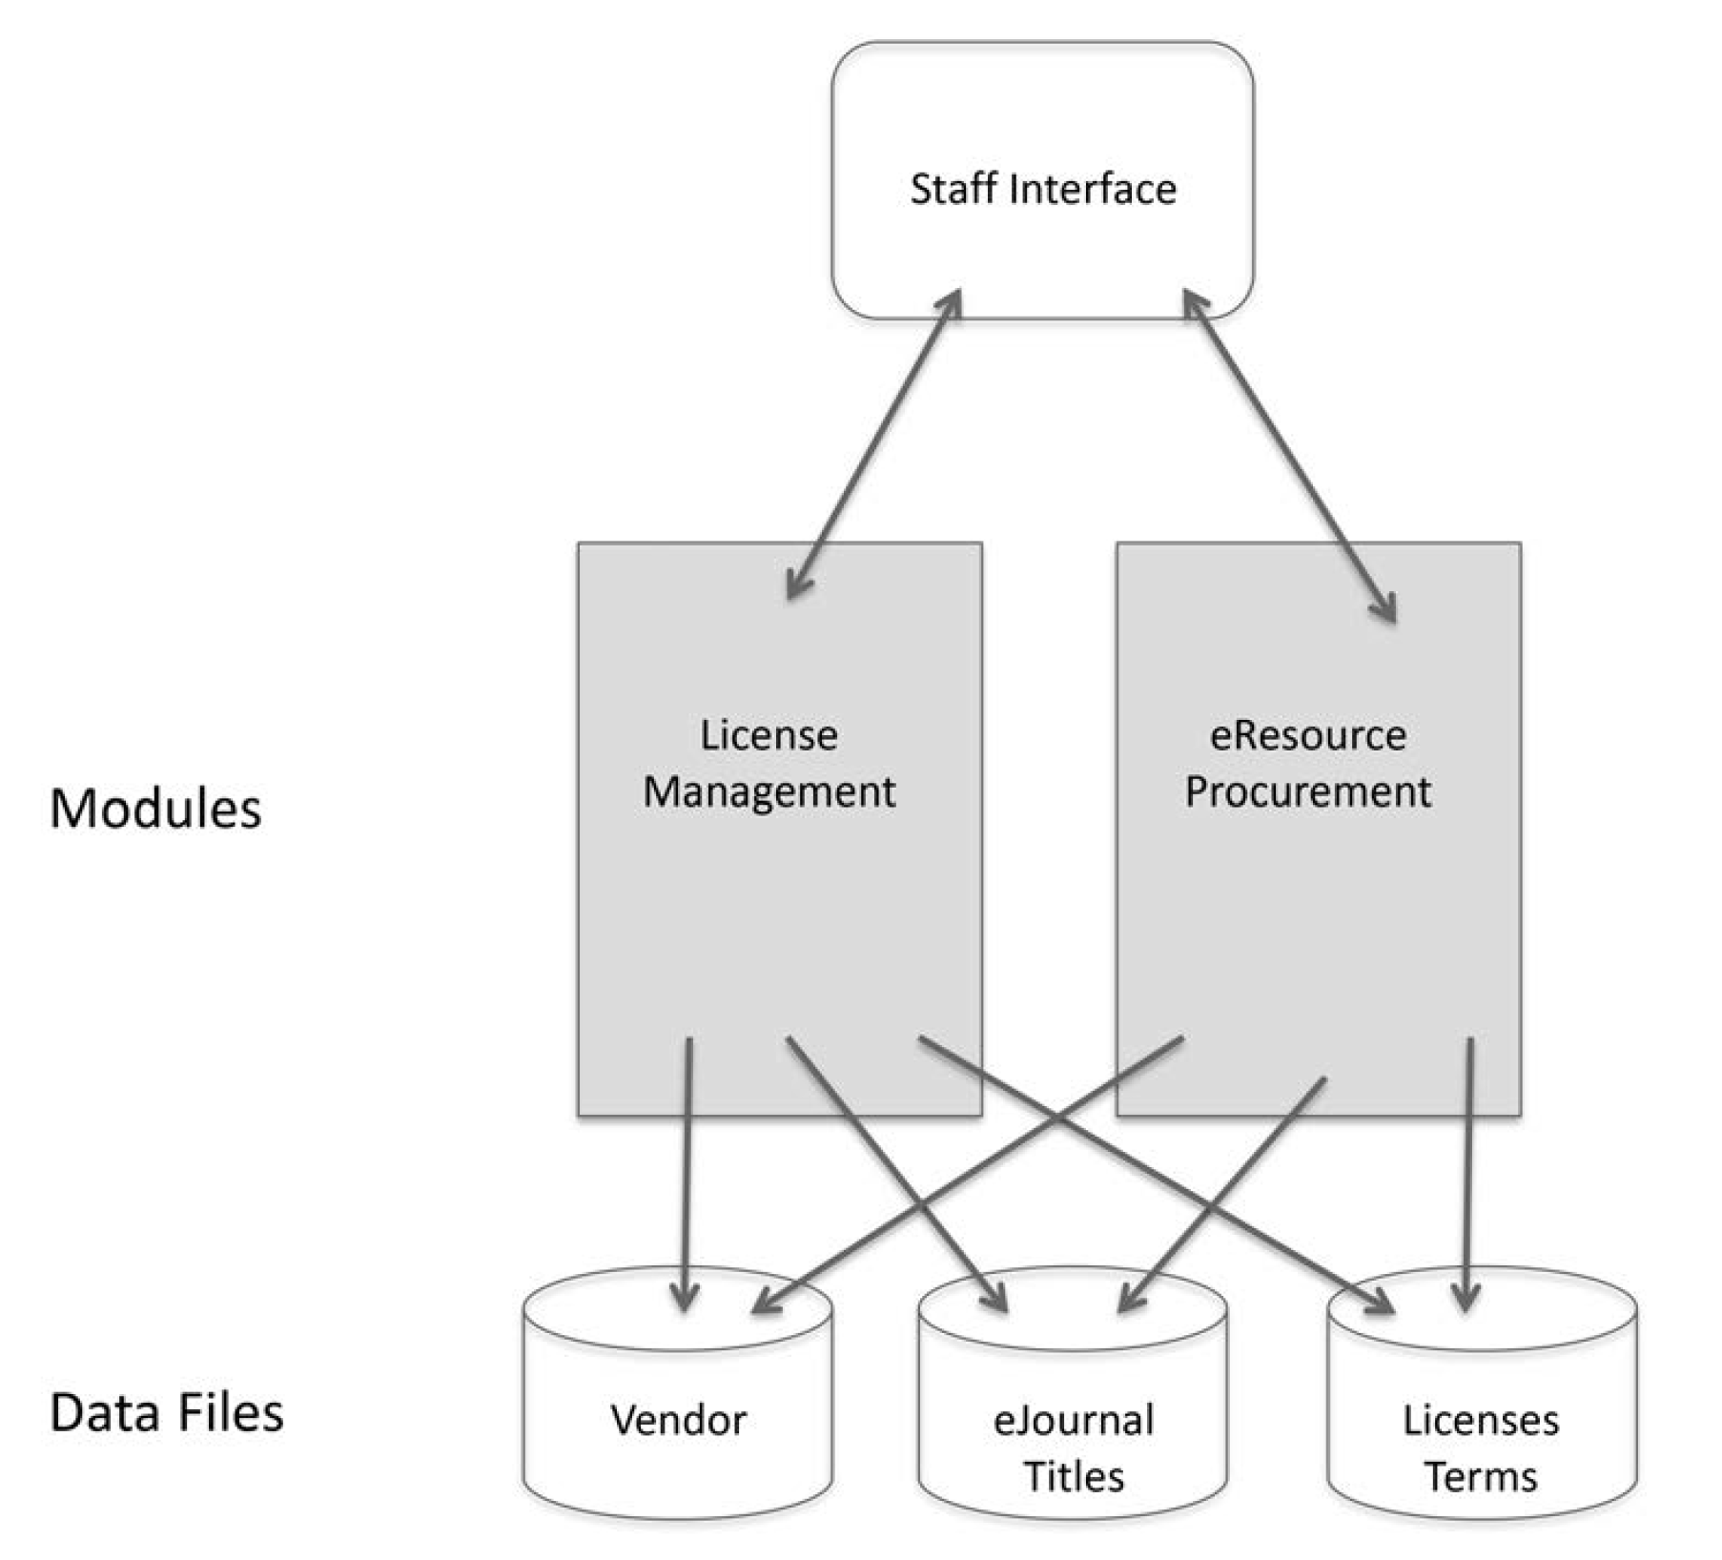
ERMS System Architecture

Slide 12
How does the ILS connect people to things in both the physical and digital worlds?

Slide 13
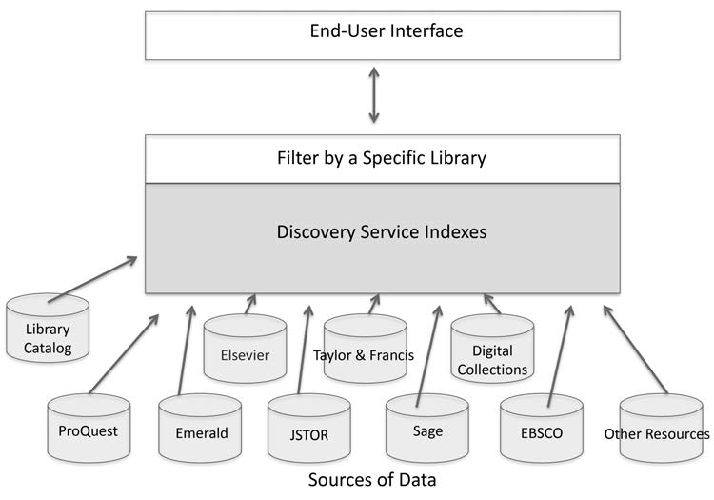
Discovery System Architecture

Slide 14
What we’ve called an ILS is beginning to evolve. What is a Library Services Platform (LSP)?

Slide 15
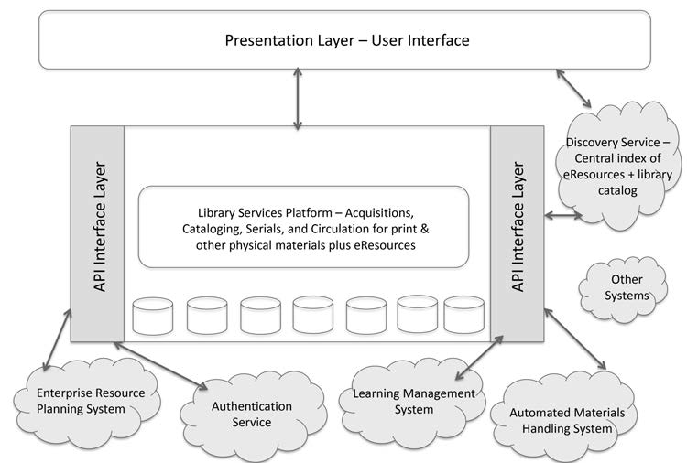
Library Services Platform Architecture

Slide 16
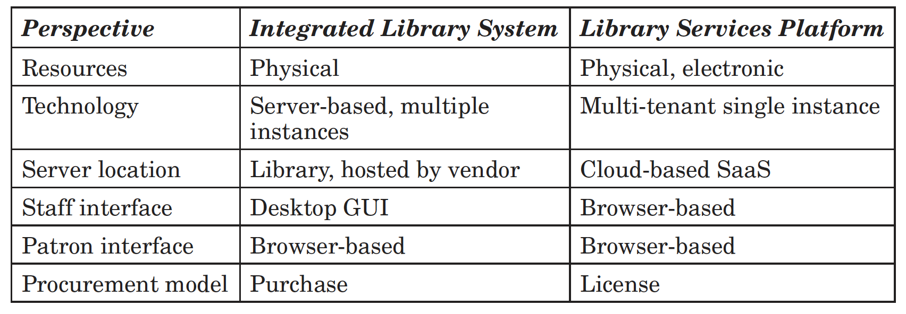
ILS vs LSP

Slide 17
What is open-source software? It’s free, right?

Slide 18
Open Source Software
Free redistribution
Accessible source code
Derived works
Integrity of author’s source code
No discrimination against people or groups
No discrimination against fields of endeavor
Distribution of license
License not specific to a product
License must not contaminate other software

Slide 19
Library Open Source
Evergreen
Koha
FOLIO – Future of Libraries is Open

Slide 20
Let’s talk a little about the nuts and bolts of IT management, starting with data networks…

Slide 21
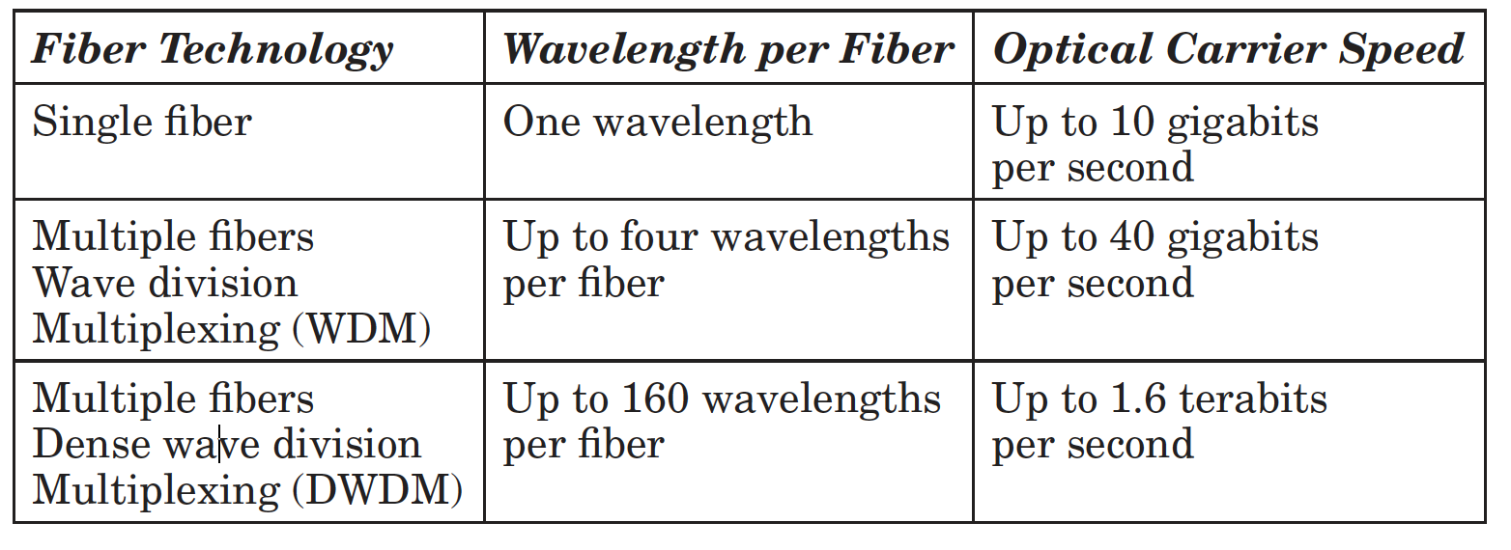
Optical Fiber Network Speeds

Slide 22
Technology Inventory
Network Infrastructure (LAN and WAN)
Computer Hardware (Desktop and Network Level)
Application Software
Technology Support
Staff Skills

Slide 23
Backup Rule of Three (3-2-1)
Always have three digital copies of anything you really care about
Use at least two types of backup media
At least one copy should be stored off- site

Slide 24
Security
Worms
Ransomware
Spam
Fake sites
Viruses
Trojan horse
Rootkits
Phishing
Notes:
Graphic: https://www.vectorhq.com/psd/chain-and-lock-psd-454154.

Slide 25
What things should library people think about when it might be time for a change of the core technology systems?

Slide 26
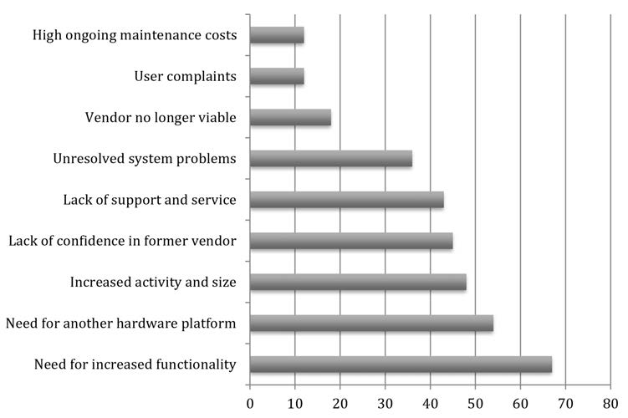
Reasons Libraries Choose to Migrate

Slide 27
Options
In-house
Shared system
Cloud-Based Service

Slide 28
System Migration Topics
• Migration team
• Pre-migration decisions
• What data to migrate
• How to clean up data
• Whether the data should be enhanced
• How much testing should be done
• How to best phase in a migration
• How to train staff
• Why communication is vital
• Security issues

Slide 29
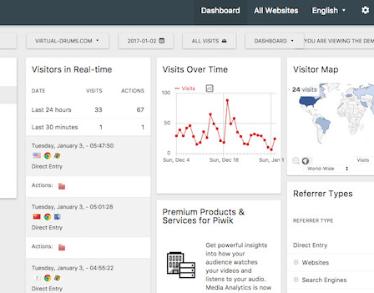
To Google Analytics or ….
Open source analytics— Analog, Fathom, Matomo, Piwik, Simple Analytics, W3Perl, and Wealizer
Notes:
**Please split into 3 slides and find logs for each type**
PIWIK picture from: https://www.cyberciti.biz/open-source/7-awesome-open-source-analytics-weblog-analysis-softwares/

Slide 30
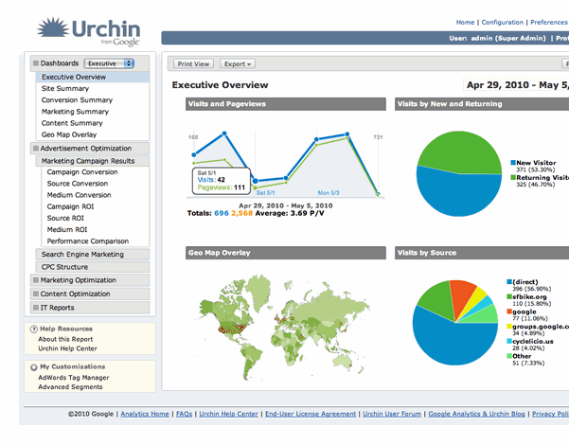
To Google Analytics or ….
Proprietary analytics— Angelfish, Mint, and Urchin
Notes:
**Please split into 3 slides and find logs for each type**

Slide 31
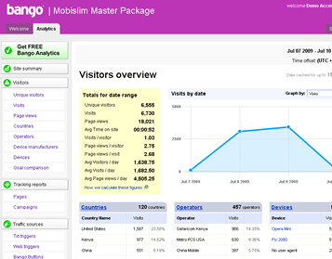
To Google Analytics or ….
Hosted analytics software— Bango Mobile Web Analytics, ClickTale, and Quantcast
Notes:
**Please split into 3 slides and find logs for each type**

Slide 32
What are some useful methods to keep all this straight?

Slide 33
Axioms
Standards Are Critical; Recommended Practices Are Vital
Notes:
Best practices by Bold Yellow from the Noun Project; Creative Commons CCBY

Slide 34
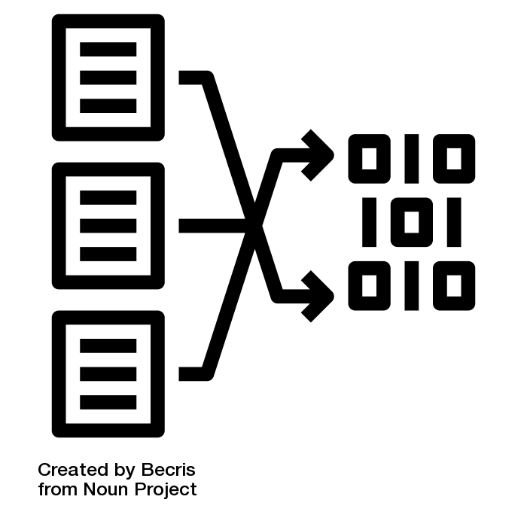
Axioms
The Converted Data Are an Important Asset— If You Make Them Work Hard
Notes:
Data transformation by Becris from the Noun Project; Creative Commons CCBY

Slide 35
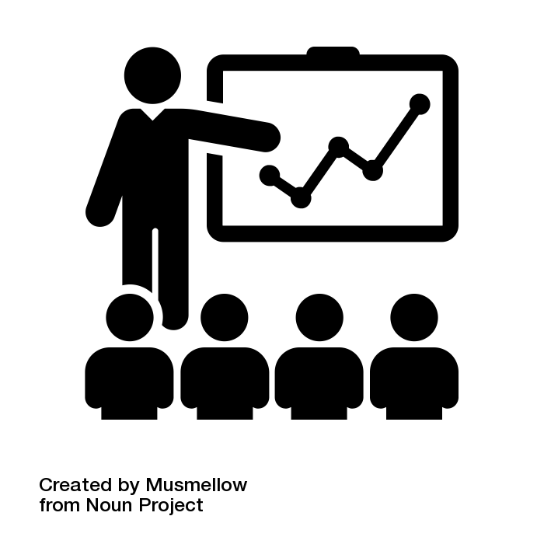
Axioms
Conversion, Maintenance, and Training Are Always Underestimated
Notes:
training by Musmellow from the Noun Project; Creative Commons CCBY

Slide 36
Axioms
Use of Technology Will Grow to Fill the Available Capacity
Notes:
efficiently by priyanka from the Noun Project; Creative Commons CCBY
Technology by Made x Made from the Noun Project; Creative Commons CCBY

Slide 37
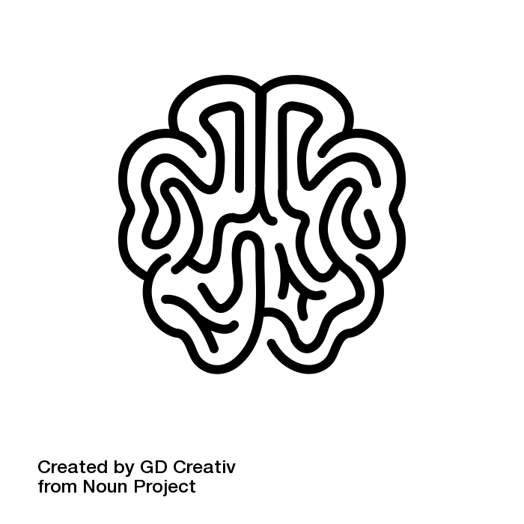
Axioms
Information Technology Is the Central Nervous System of Strategy
Notes:
strategy by GD Creativ from the Noun Project; Creative Commons CCBY

Slide 38
Axioms
You Need Scalable Network Bandwidth
Notes:
Scale by Ben Davis from the Noun Project; Creative Commons CCBY

Slide 39
Axioms
Support Costs for Technology Sources and Services Are a Significant Part of a Library’s Budget, Whether This Is Recognized or Not
Notes:
budget by Chameleon Design from the Noun Project; Creative Commons CCBY

Slide 40
Axioms
APIs Are Playing an Increasingly Important Role as Libraries Move to Embrace Web- Based Services
Notes:
API by mikicon from the Noun Project; Creative Commons CCBY

Slide 41
Axioms
We Live in a Network- Centric World
Notes:
Globe by amanda from the Noun Project; Creative Commons CCBY

Slide 42
Axioms
A Library’s Information Technology Budget Should Be Sizable
Notes:
Pricing by Gregor Cresnar from the Noun Project; Creative Commons CCBY

Slide 43
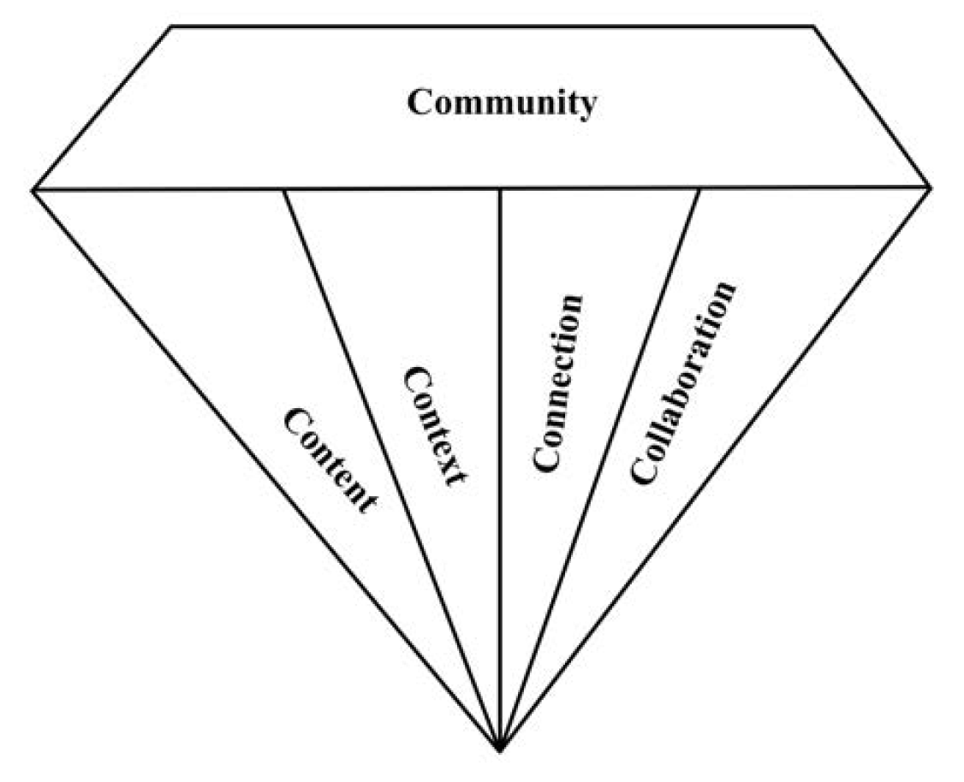
The Adding Value Diamond
Joseph R. Matthews. Adding Value in Libraries, Archives, and Museums: Harnessing the Force That Drives Your Organization’s Future

Slide 44
Questions

Slide 45
Discount at abc-clio.com

