Slide 1
Caring for the Mind providing mental health information at your library
Emily Hamstra (she/her)
Outreach Coordinator
Network of the National Library of Medicine
Pacific Northwest Region
ehamstra@uw.edu | nnlm.gov

Slide 2
Network of the National Library of Medicine
National Institutes of Health
Nation’s research agency
NIH
National Library of Medicine
World’s largest biomedical library
NLM
Network of the National Library of Medicine
Program of the NLM comprised of 7 Regional Libraries (RMLs) and 5 offices
NNLM

Slide 3
NNLM Mission Statement
To advance the progress of medicine and improve the public health by:
Providing all U.S. health professionals with equal access to biomedical information.
Improving the public's access to information to enable them to make informed decisions about their health.

Slide 4
Objectives Caring for the Mind: providing mental health information at your library
1
2
3
Gain awareness of mental health issues
Learn practices for responding to questions for mental health information
Be informed of tools and resources for mental health information

Slide 5
Mental Health Facts

Slide 6
Mental Health Definitions
Mental Health includes our emotional, psychological, and social well-being. It affects how we think, feel, and act as we cope with life. It also helps determine how we handle stress, relate to others, and make choices.
Any mental illness (AMI) is defined as a mental, behavioral, or emotional disorder. AMI can vary in impact, ranging from no impairment to mild, moderate, and even severe impairment (e.g., individuals with serious mental illness as defined below).
Serious mental illness (SMI) is defined as a mental, behavioral, or emotional disorder resulting in serious functional impairment, which substantially interferes with or limits one or more major life activities. The burden of mental illnesses is particularly concentrated among those who experience disability due to SMI.
Definitions from the National Institute of Mental Health and MedlinePlus

Slide 7
Mental Health Literacy
Includes:
Understanding how to obtain and maintain positive mental health
Understanding mental disorders and their treatments
Decreasing stigma related to mental disorders
Enhancing help-seeking efficacy (knowing when and where to seek help and developing abilities to improve one’s mental health care and self-management)
Kutcher S, Wei Y, Coniglio C. Mental Health Literacy: Past, Present, and Future. Can J Psychiatry. 2016;61(3):154–158.

Slide 8
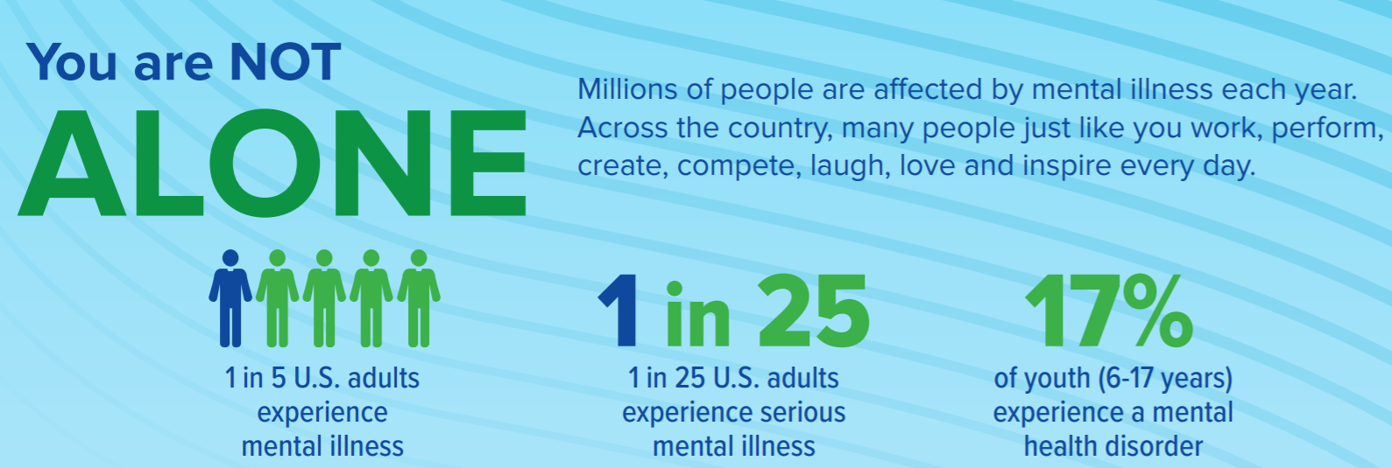
Mental Health Statistics
NAMI Infographics and Factsheets

Slide 9
What Causes Mental Illness?
Genes and family history
Life experiences
Biological factors
Traumatic brain injury
Exposure to viruses or toxic chemicals
Usage of alcohol or recreational drugs
Serious medical condition
Few friends
MedlinePlus

Slide 10
Barriers to Care
Stigma
Cost
Belief that treatment won’t help
Time
Unfamiliarity with services/resources
Navigating insurance
Confidentiality
Medication
Transportation
Access to the internet (telehealth)

Slide 11
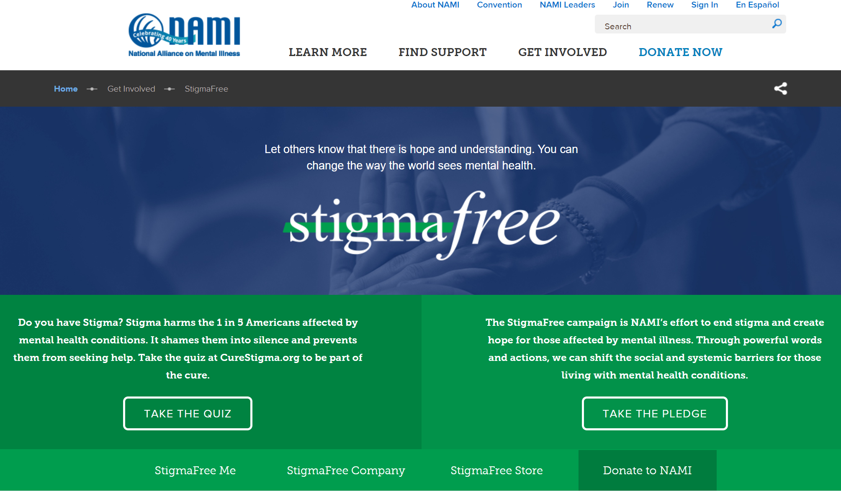
Stigma
Prompts subtle and overt prejudice, discrimination, fear, and stereotyping
Results in avoidance to work, socialize, and live with persons with mental illness
Impedes persons with mental illness to seek help
Fewer opportunities for work, school or social activities or trouble finding housing
Bullying, physical violence or harassment
NAMI, stigmafree

Slide 12
Reflective Activity
1. Reflect on a time that you spoke with or observed someone experiencing a mental health crisis. What happened?
2. Working in public service is emotionally demanding. What actions do you take to care of your mental wellbeing? Or what actions would you like to take?
3. What are possible implications of COVID-19 on mental health? Make a list.
4. Dive into the data from NAMI. What surprises you? https://nami.org/mhstats
Write (or think) for 5 minutes, responding to one of these questions.
We will return to this reflection at the end of the webinar. You will not be asked to share your reflection.

Slide 13
Best Practices for Reference Interviews
Mental Health Facts
Best Practices for Reference Interviews
Responding to challenging questions and behavior
Library policies and guidelines
Caring for your own mental wellbeing
Health Information Resources
Programming
Reflection, Wrap Up

Slide 14
Best Practices for Mental Health Reference
Use the same approach as any other reference interview
Respect Confidentiality
Actively Listen
Be empathetic and patient
Know the difference between providing health information and giving health advice (stay within scope)
Photo by Christina Morillo, Pexels

Slide 15
Ask Open Ended Questions
“What kind of information on …are you looking for?”
“Where have you already looked for information?”
“Would you tell me more about …?”
“When you say…, what do you mean?”
“What do you already know about …?”
Source: Reference Interview Skills 2004: Looking for Questions in all the Right Places InfoPeople by Carol Leita and Sallie Pine

Slide 16
Person-first Language
Avoid expressions like:
“a schizophrenic” or “an alcoholic”
In favor of:
“a person with schizophrenia” or
“an individual with alcohol dependence”
Notes:
Caveat: Deaf community and Autism community – some believe the person can’t be seen or separated without their disability. And that their identity is a sense of pride.

Slide 17
Five tips for nonjudgmental listening
Mental Health First Aid

Slide 18
Communicating with those who have challenging behavior
Be respectful
Don’t assume lack of intelligence
Be honest
Don’t ignore
Don’t mirror patron’s behavior
Under-react
Follow library’s policies
Keep an arm’s length away
Set limits/boundaries
Psychology Today: Strategies for communicating effectively with people with mental illness. Threat Management

Slide 19
NNLM Recorded Webinar
PNR Rendezvous: “Serving Library Patrons with Mental Illness: A Crash Course on Controlling Classes”
Presenter: Mandy Easter, State Library of Iowa
February 17, 2021
YouTube recording

Slide 20
Be prepared
Work with your administrators to have an institutional plan and make sure that EVERYONE, including volunteers, knows what to do if you need to address a situation with someone exhibiting signs of mental illness.

Slide 21
Library Policies
Library policies should follow the American with Disabilities Act (ADA) and other legal requirements. ADA requires that libraries provide services to people with disabilities that are provided for those without disabilities.
Policies to review:
ALA Policies: Library Services for People with Disabilities
ALA Code of Ethics
ADA Regulations title II, subtitle A

Slide 22
Guidelines for Library Services for People with Mental Illnesses
Treat people with mental health issues with the same respect and consideration as other patrons
Avoid making assumptions based on behavior (remember that a patron is just as likely to be on the phone as talking to him-or herself)
Remember that mental illness is not the same as unusual, deviant, or criminal behavior, or a cognitive disability
Respect the privacy of a patron—have a discreet, but safe, place to talk if necessary
ALA ASGCLA Guidelines for Library
Services for People with Mental Illnesses

Slide 23
ASGCLA Guidelines
Allow enough time to meet the needs of patrons with orientation issues
Be aware of the wide range of behaviors associated with mental health issues
Help increase community awareness of mental illness with displays, programs, books, and other materials
Select and recommend titles on health issues based on community needs and requests (do not assume)

Slide 24
ASGCLA Guidelines continued
Do not share your anecdotal stories to demonstrate that you understand; this may convey the wrong message (each situation is different, respect that difference)
From partnerships with agencies, professionals, and self-advocates to assess and meet the needs of people with mental illness
Take care to correct negative stereotypes
Set and enforce standards of tolerance that reflect well on the library and serve as a model for the children and teens in your community

Slide 25
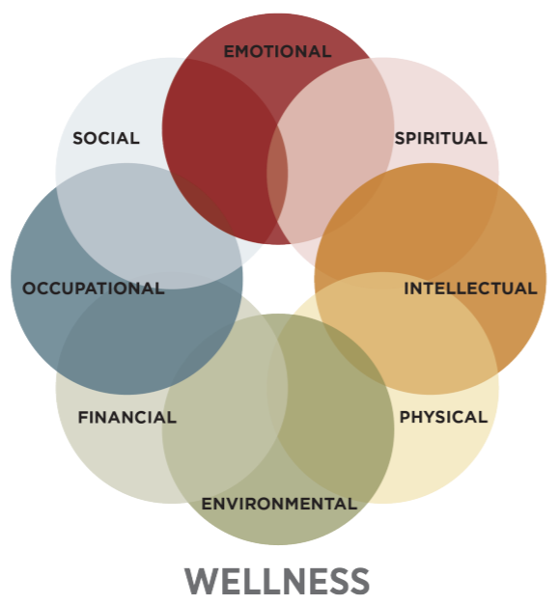
Your Wellbeing: 8 Dimensions of Wellness
Physical
Social
Financial
Environmental
Spiritual
Emotional
Intellectual
Occupational
Image Source: SAMHSA Learn the Eight Dimensions of Wellness

Slide 26
Health Information Resources
Mental Health Facts
Best Practices for Reference Interviews
Health Information Resources
Freely available resources
Programming
Reflection, Wrap Up
Notes:
.

Slide 27
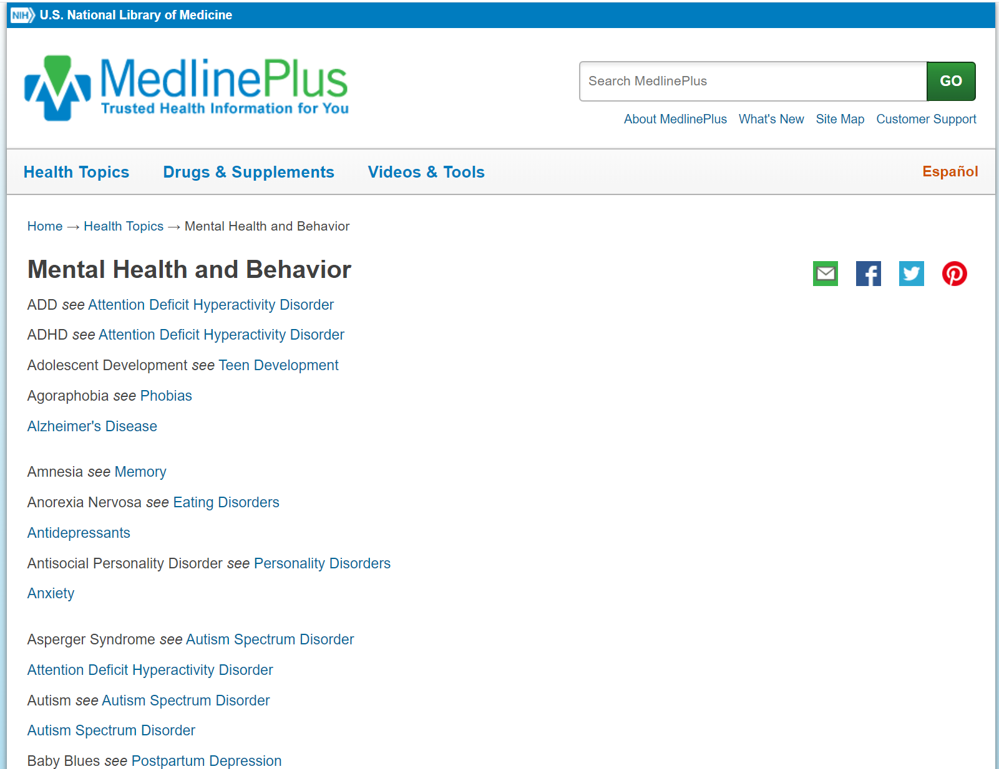
MedlinePlus- Mental Health
Start with the health topics
For basic information, you can use the medical encyclopedia
Find providers and hospitals/facilities in the directories
Find support groups in organizations section
Learn more about drug information
Learn about supplements and interactions

Slide 28
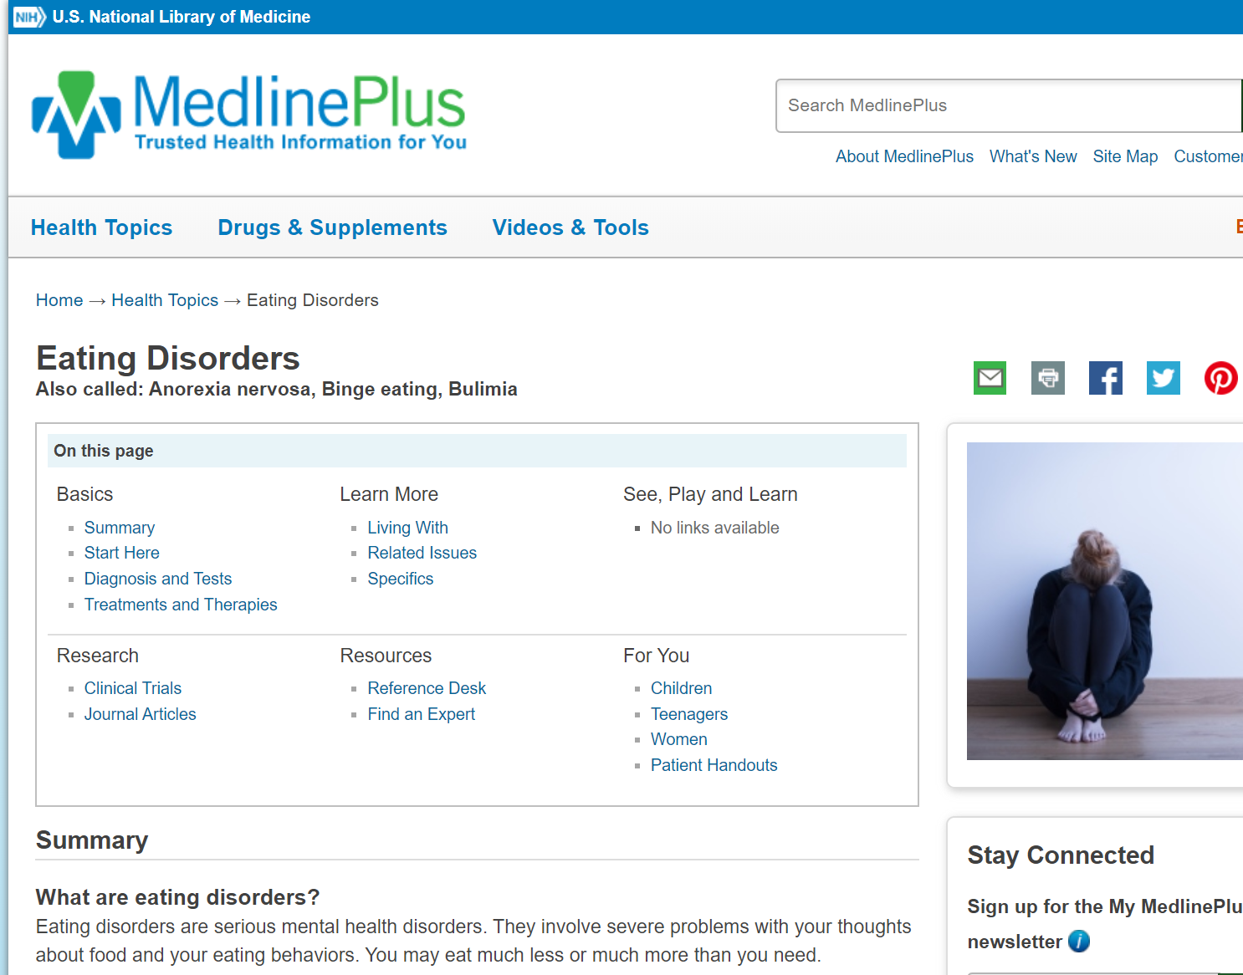
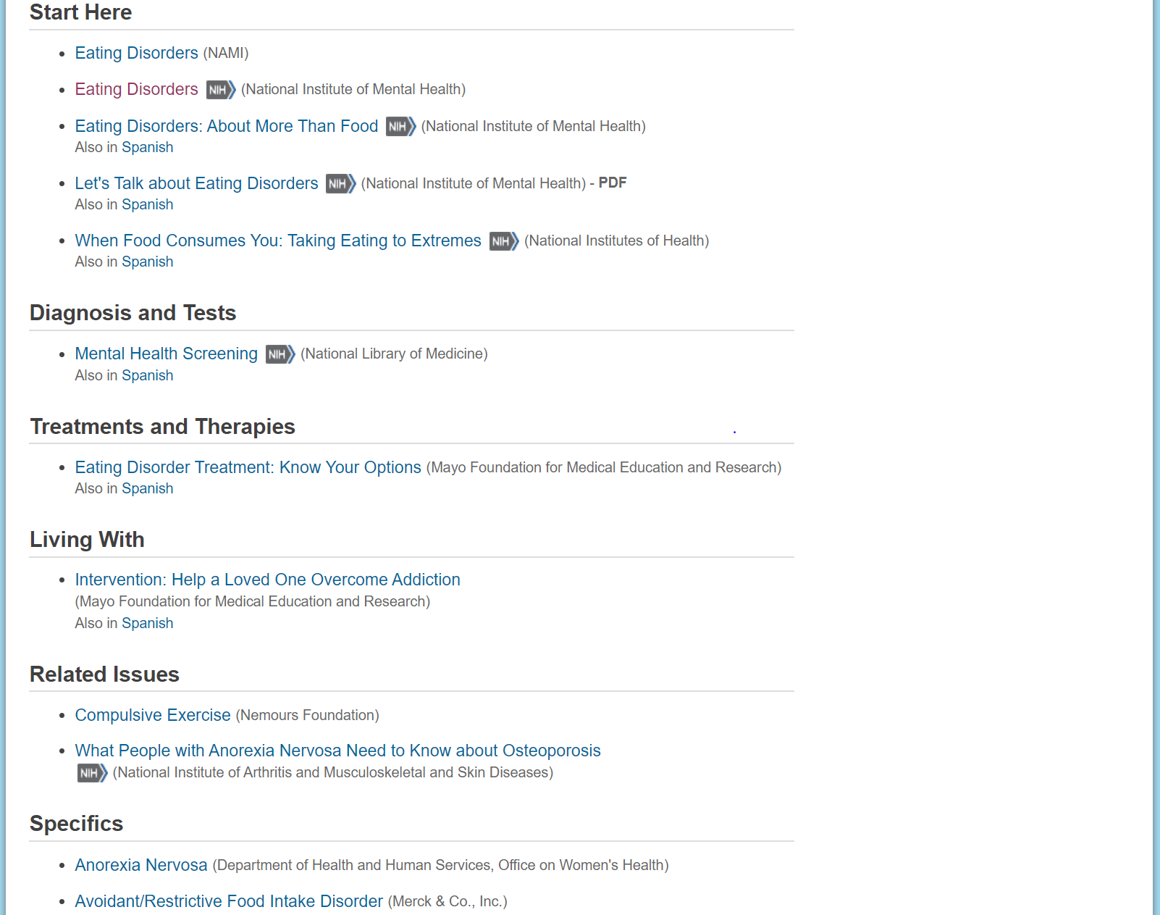
MedlinePlus Health Topics

Slide 29
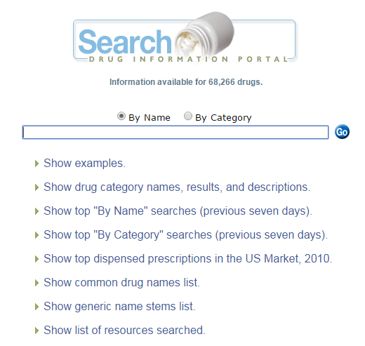
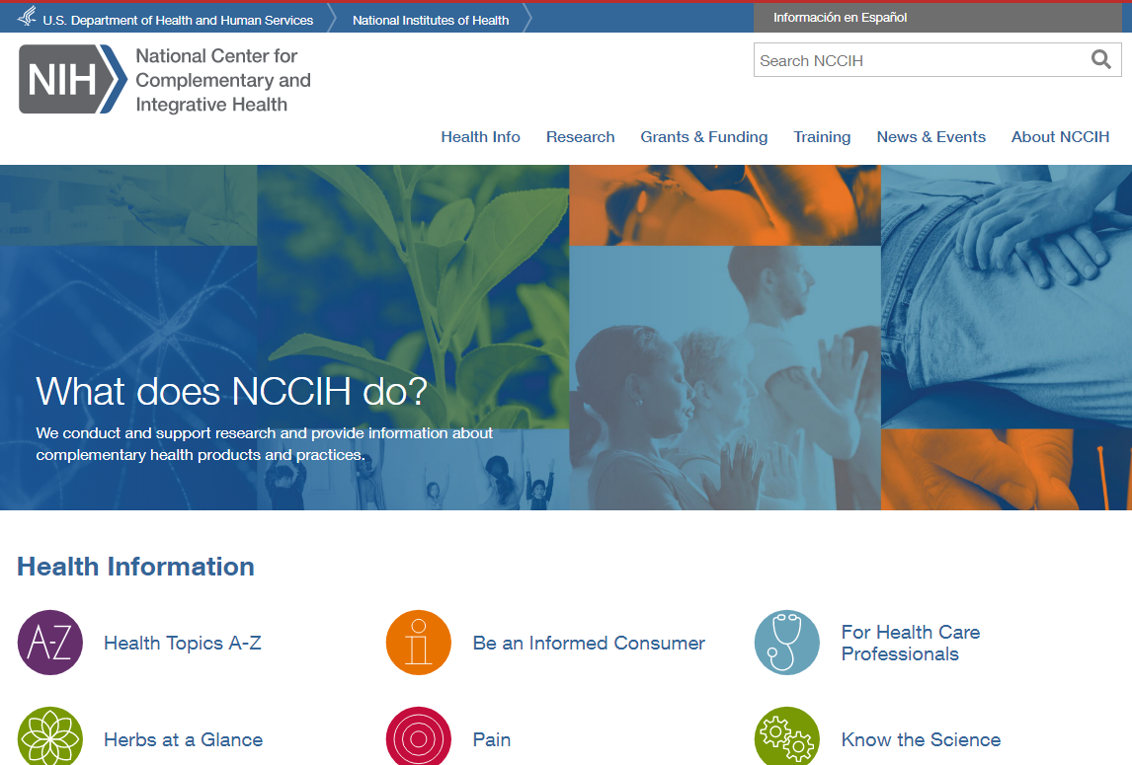
Drug Information
NCCIH
Drug information Portal

Slide 30
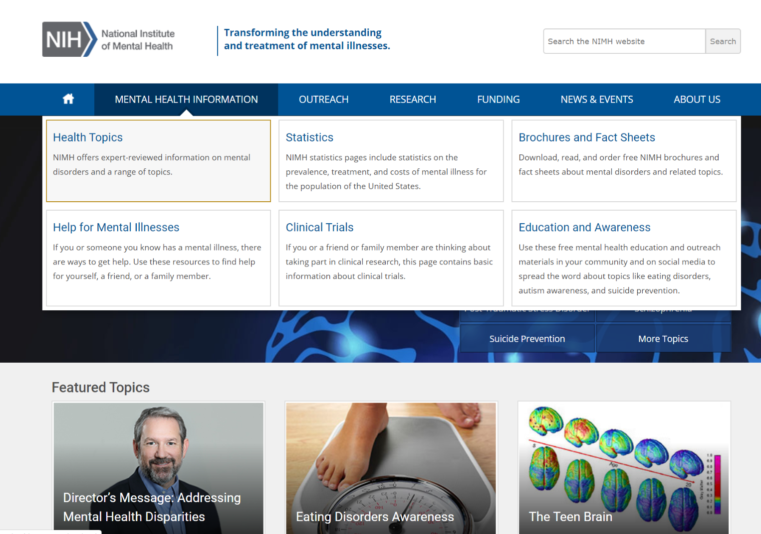
National Institute of Mental Health
Health information
Resources to find help
Free education and outreach materials (including social media)
Free webinars
NIMH: https://www.nimh.nih.gov

Slide 31
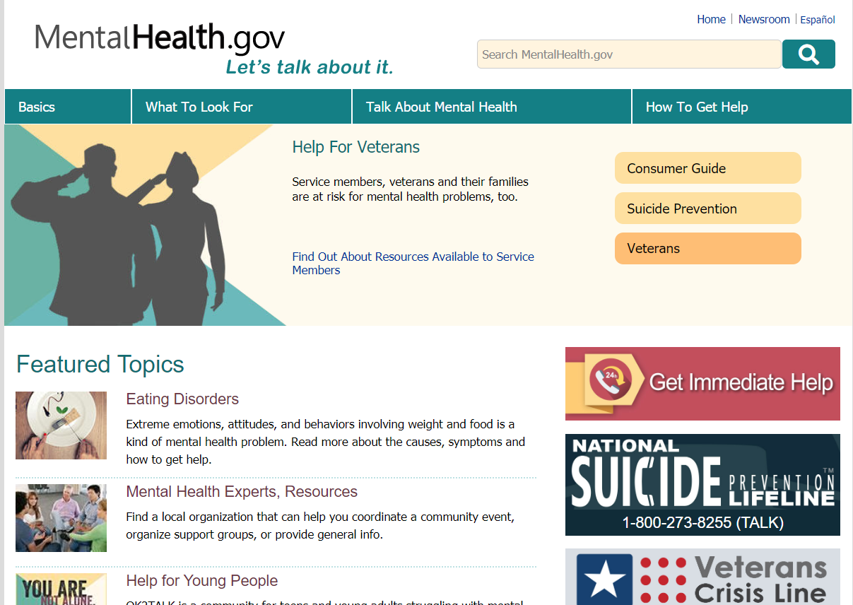
MentalHealth.gov

Slide 32
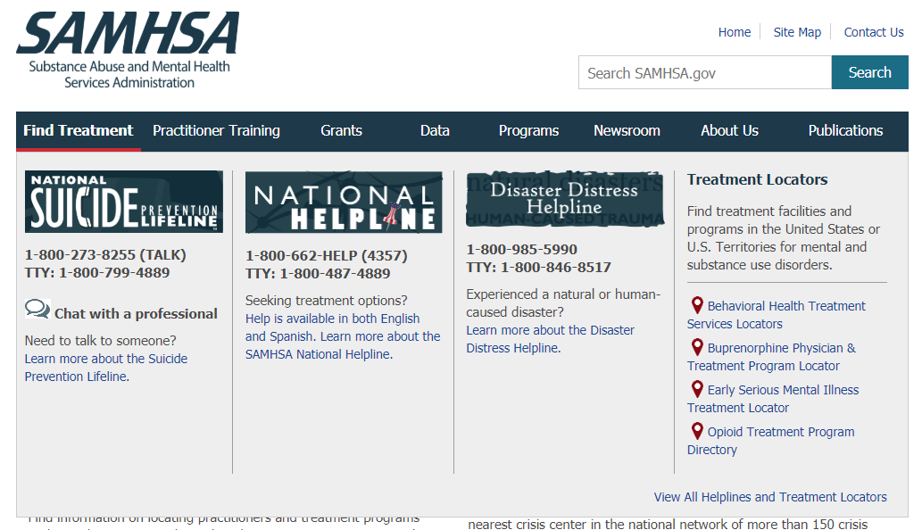
SAMHSA
SAMHSA: https://www.samhsa.gov/

Slide 33
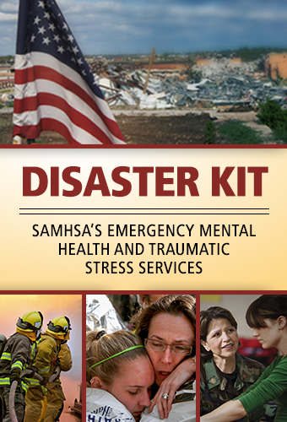
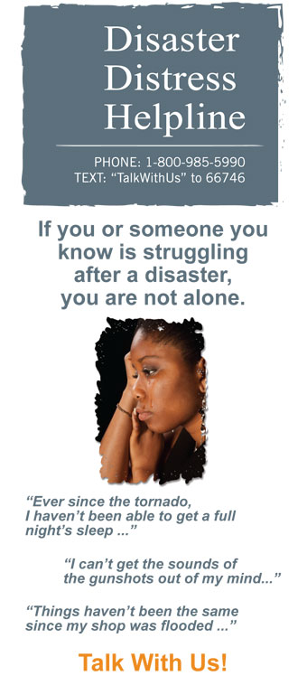
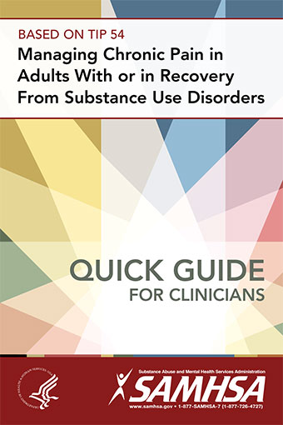
Publications for Professionals and Patients
Notes:
SAMHSA also provides brochures, handouts, and guidelines related to mental health. These are free to download, and in some cases, you can order them in print and offer them in your library.

Slide 34
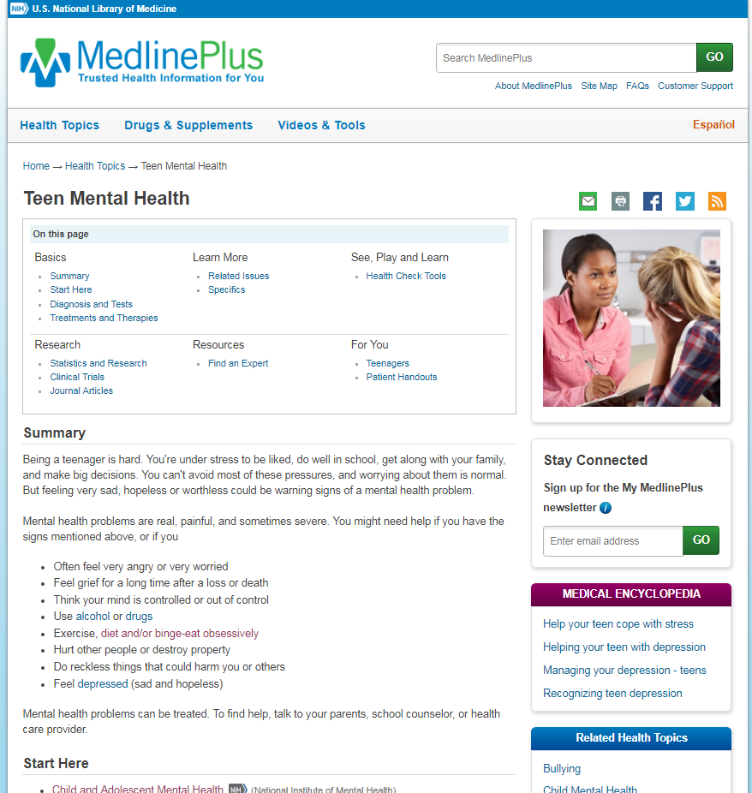
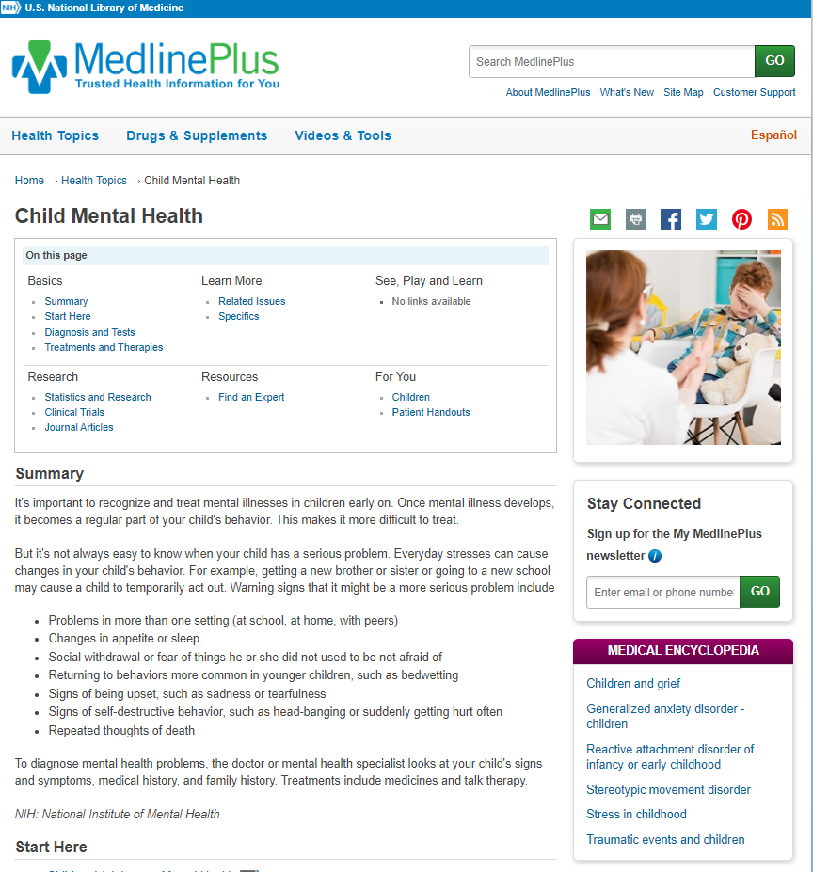
MedlinePlus –Youth Mental Health
MedlinePlus – Teen Mental Health
MedlinePlus – Child Mental Health

Slide 35
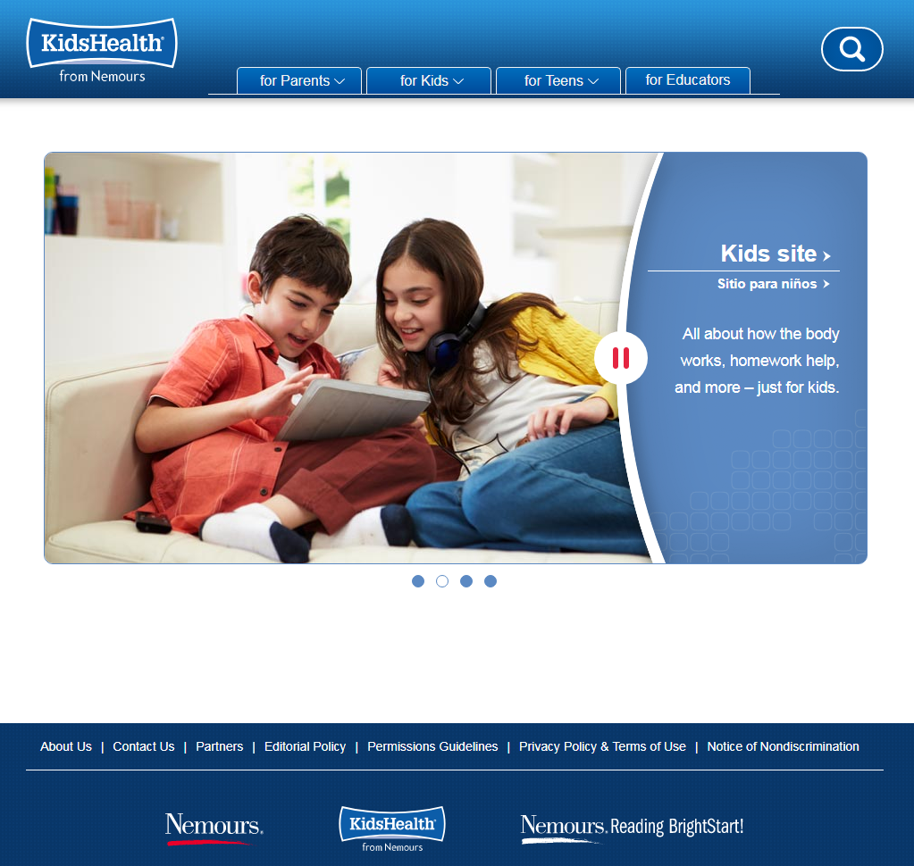
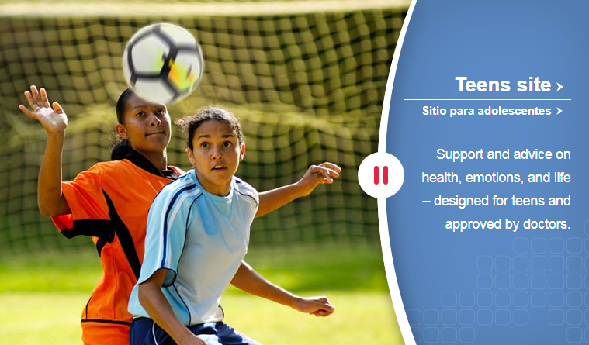
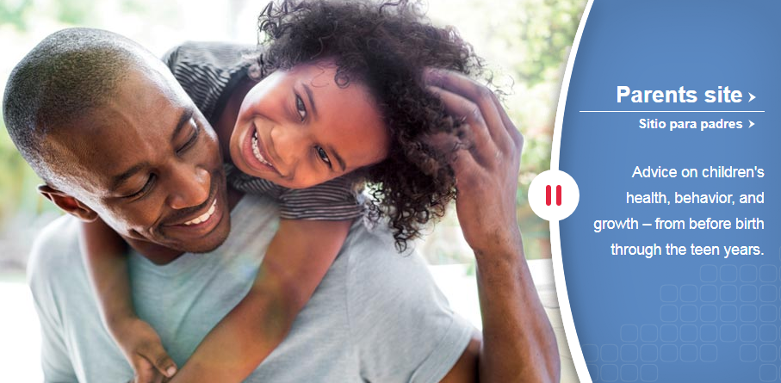
KidsHealth.org
KidsHealth: kidshealth.org
Notes:
.

Slide 36
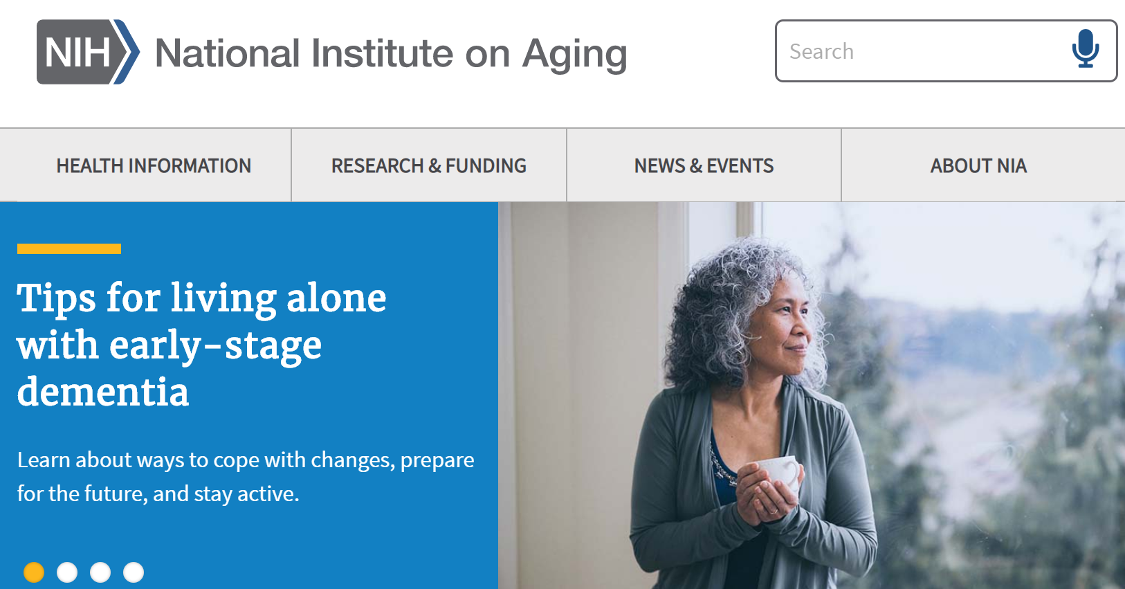
National Institute on Aging
Health information
Dementias
Cognitive health
Depression
Caregiver information
Free print resources
Some information in Spanish
NIA: https://www.nia.nih.gov/

Slide 37
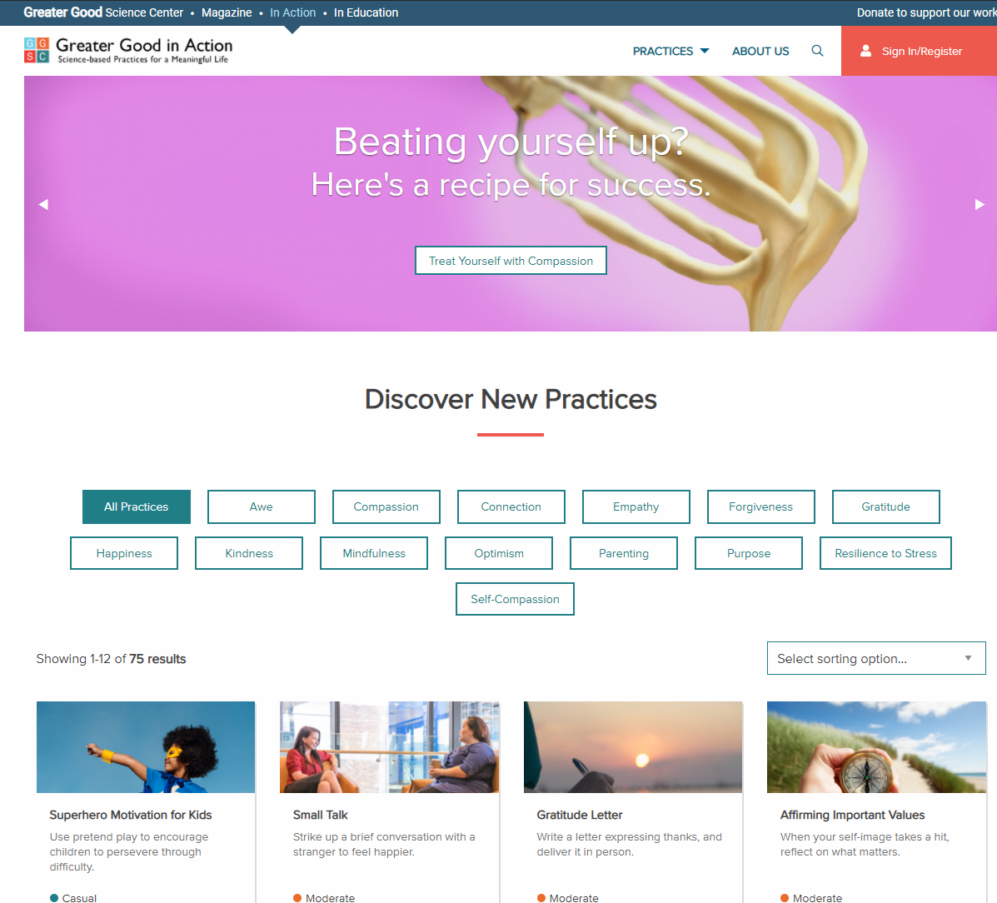
Greater Good in Action
Science-based activities to improve mental wellbeing
How to do the activity
Why to do it, and the science behind it
Greater Good in Action: https://ggia.berkeley.edu/

Slide 38
Resources for Library Staff
NNLM class, Wellness in the Library Workplace
MedlinePlus Health & Wellness
AAMLA, Radical Self Care & Wellness for Information Professionals recorded webinars
ALA-APA Wellness
Mindfulinlis (mindfulness in LIS)
NNLM BLOSSOM symposium recordings
APA- Center for Workplace Mental Health
Greater Good Magazine: Science-Based Insights for a Meaningful Life
Mental Health America – Live B4Stage4
LIS Mental Health

Slide 39
Programming
Mental Health Facts
Best Practices for Reference Interviews
Health Information Resources
Programming
Monthly health observances
NLM Exhibition Program
Reflection, Wrap Up

Slide 40
Mental Health Observances
World Maternal Mental Health Day
National Children’s Mental Health Awareness Day
Suicide Prevention Awareness Month
BIPOC Mental Health Month
National Older Adult Mental Health Awareness Day
Asian American, Native Hawaiian, Pacific Islander (AANHPI) Mental Health Awareness Day
World Teen Mental Wellness Day

Slide 41
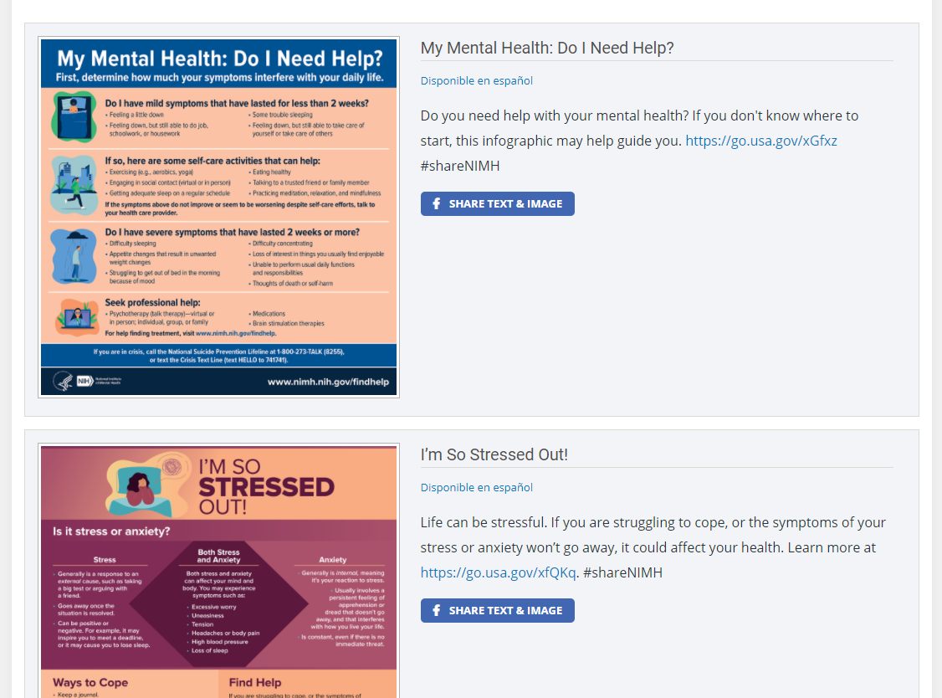
Share Social Media Posts from NIMH https://www.nimh.nih.gov/health/education-awareness

Slide 42
NLM Online (Traveling) Exhibitions
Care & Custody: Past Responses to Mental Health exhibit
NLM Exhibitions
Notes:
See also Care & Custody module for college students: https://www.nlm.nih.gov/exhibition/careandcustody/education-highered1.html

Slide 43
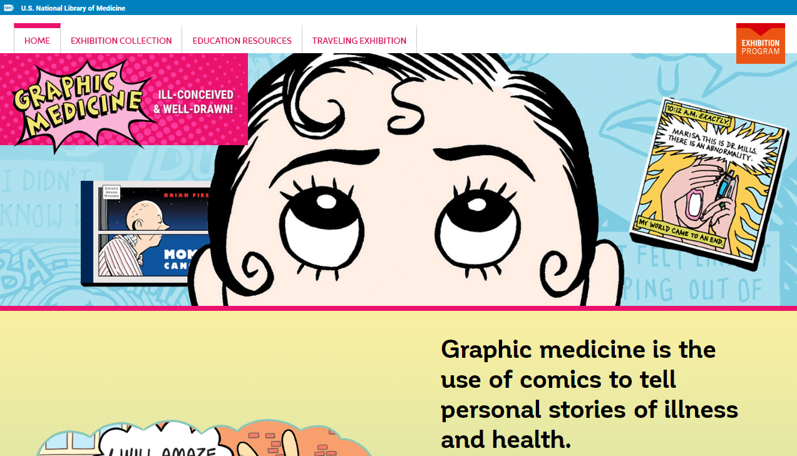
Graphic Medicine
Graphic Medicine https://www.graphicmedicine.org/
NLM exhibit, Graphic Medicine: Ill-Conceived & Well Drawn!

Slide 44
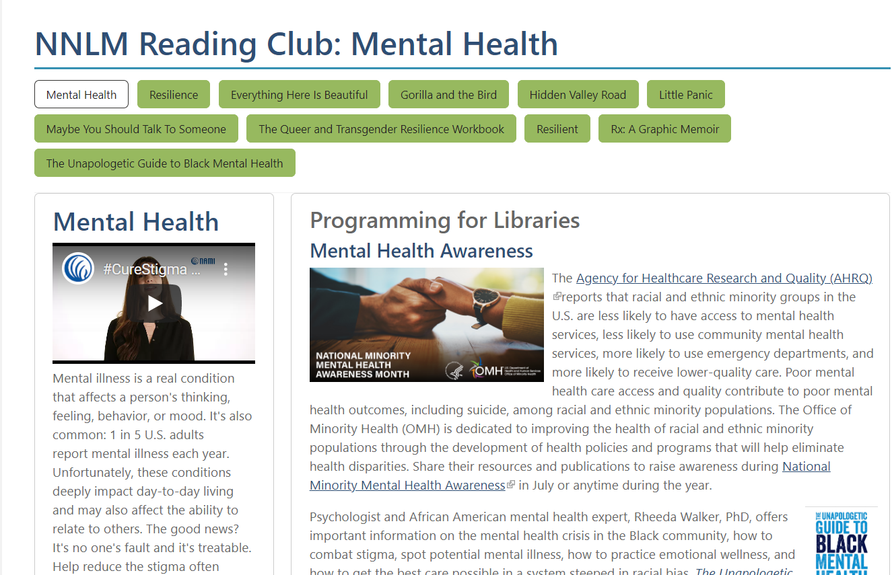
NNLM Reading Club
To find selected books with a health topic
To download discussion guides and promotional materials
To discover health information and program ideas
NNLM Reading Club

Slide 45
Possible Programs and Services
Caregiver information
Support groups
All ages relaxation or low impact yoga
Include downloadable or CDs on meditation or guided imagery
Brochures/handouts from local agencies or national
Social media messages
Wellness journals
Signs in bathrooms and around library
“Did You Know…?” education or tips
Invite experts- diagnosis, drug therapy, counseling, etc.
Pet, art, music, dance therapy

Slide 46
Reflection, Wrap Up
Mental Health Facts
Best Practices for Reference Interviews
Health Information Resources
Programming
Reflection, Wrap Up

Slide 47
Reflective Activity (2 Minutes)
1. Reflect on a time that you spoke with or observed someone experiencing a mental health crisis. What happened?
2. Working in public service is emotionally demanding. What actions do you take to care of your mental wellbeing? Or what actions would you like to take?
3. What are possible implications of COVID-19 on mental health? Make a list.
4. Dive into the data from NAMI. What surprises you? https://nami.org/mhstats
Return the question you reflected on at the beginning of the class. What do you want to add to your original reflection?

Slide 48
Take Home Points
Fight stigma
Cultivate your knowledge of mental health resources (mental health literacy)
Do your very best when assisting those with mental health issues
Make a plan with your team
Be proactive about your mental health

Slide 49
Questions?
Emily Hamstra, MSI (she/her)
Outreach Coordinator
National Network of Libraries of Medicine, Pacific Northwest Region (NNLM PNR)
ehamstra@uw.edu

