Slide 1
Characterizing materials and structures with Digital Image Correlation
Solution presentation
Restricted

Slide 2
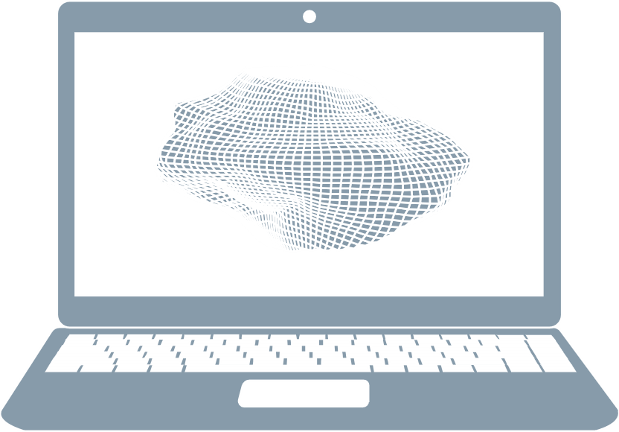
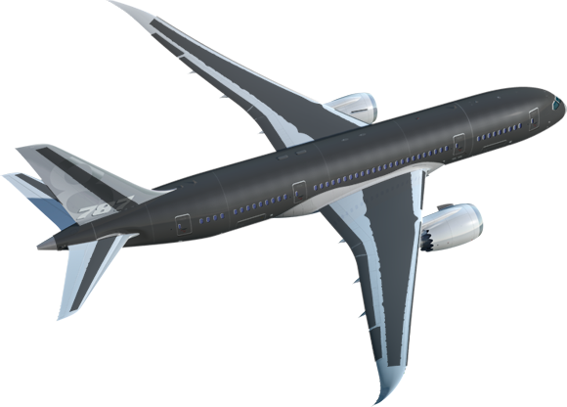
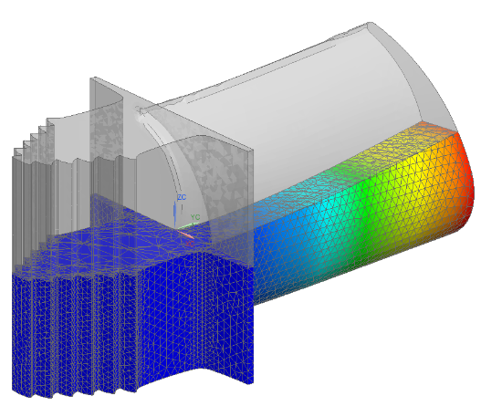
New technologies bring new experimental challenges
Design of innovative materials
Accelerate components and system validation testing
Virtual development
3D
Notes:
While the product we develop evolve, following more demanding customer and more stringent regulation, the role of testing is continuously evolving.
The strive for lighter structure pushes for the development of innovative materials and manufacturing techniques, that needs to be qualified and validated as early as possible so that they can be confidently used in the product design.
Another clear challenge is the need to accelerate components and systems validation testing. The competitive pressure, as well as the variants and customization imposed by the market on the final products, requires all testing activities to happen as fast and reliably as possible.
And finally, we see that more and more development happens more and more virtually, with the ultimate objective of being able to create a full digital twin. This can only be achieved if accurate material and component models are available, which require robust comparison and validation tools to be available

Slide 3
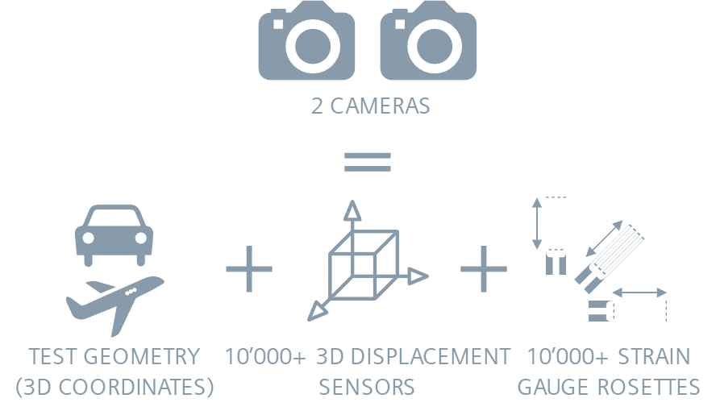
Simcenter Testlab Digital Image Correlation A new paradigm in materials and structural testing
Camera-based acquisition
Digital Image Correlation extracts FULL-FIELD
Geometry / shape
Displacements
Strains
Acc, Vel, Stress, Curvature, …
Notes:
Digital Image Correlation is an innovative testing and analysis method which relies on images of the object acquired with digital cameras during a test to extract full-field data. This means that, on the part of the object being observed, you will get information on thousands of points, with the possibility to accurately capture local behaviors.
Typically, the measurement is performed with two cameras in a stereo configuration, which allows extracting the 3D geometry of the tested area as well as the 3D displacement on all of the points, with a spatial resolution equivalent to that of a Finite Element model. From these quantities, it is then possible to derive velocities, accelerations, strain, stresses and curvatures.

Slide 4
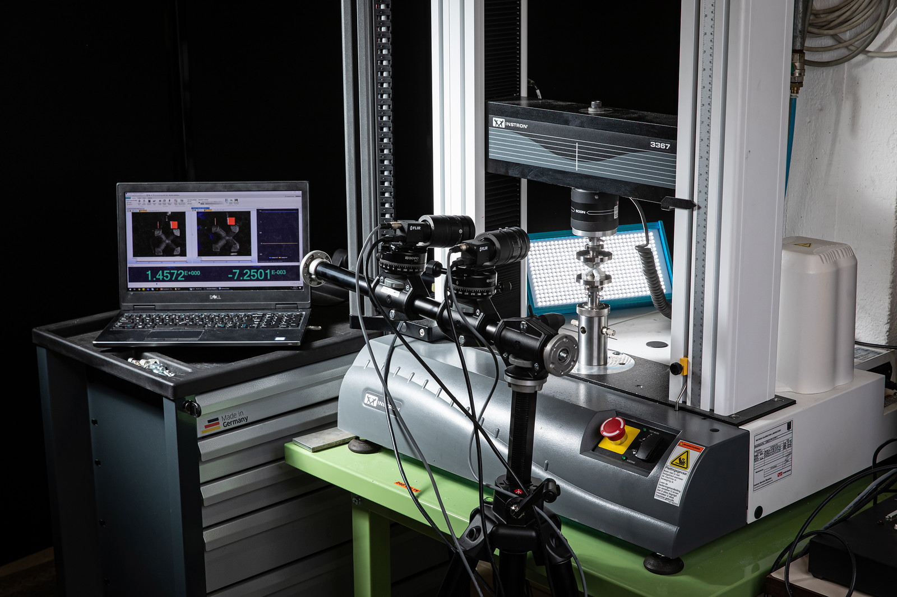
Simcenter Testlab Digital Image Correlation
Contactless measurement solution
Limited instrumentation for faster experiments
Full-field results
Obtain strain and stresses
Cover the whole object with multicam setups
Notes:
DIC offers several advantages over traditional testing techniques. First, as the sensors are the cameras themselves, there is no need to physically attach sensors to the structures. Because of this, it can be used to test lightweight components, very soft materials, but also hot surfaces and rotating components without needed special sensors. Following from this, there is no need for cables connecting the sensors to the data acquisition, which makes the instrumentation less complex, easier to manage and consequently faster and less error-prone. Also, you do not need a lot of stuff: on top of your cameras, you might optionally need a synchronization box (depending on the setup) and some LED light to make sure the scene is properly lit, and this will do the job.
Another advantage over standard techniques is that the delivered results are full field, which means you do not have to choose were to position your sensors with the risk of missing critical information, but you will get data on the complete area of interest. And as we said earlier, it doesn’t stop with position displacements: once the images are processed, you not only can extract the full planar strain fields, but also, upon specifying the material being tested, the resulting stress distribution, which means each “sensor” deliver different information.
Finally, for situation when the object is too big to fit the field of view cameras, or multiple view points are required, a multicamera setup can be created and all data be processed together.

Slide 5
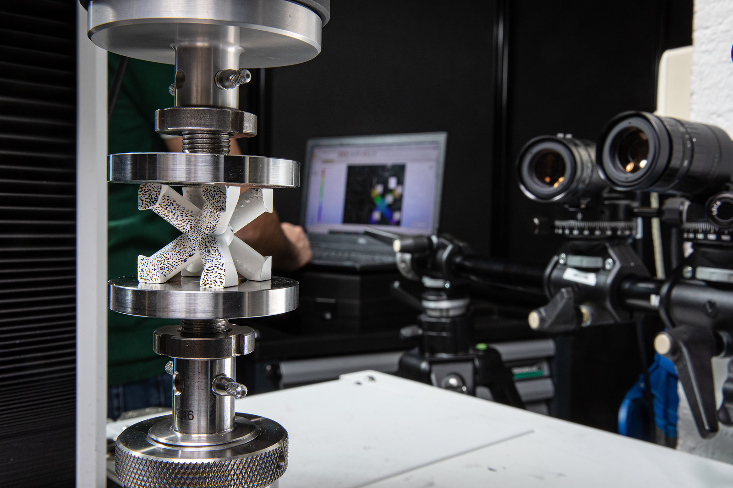
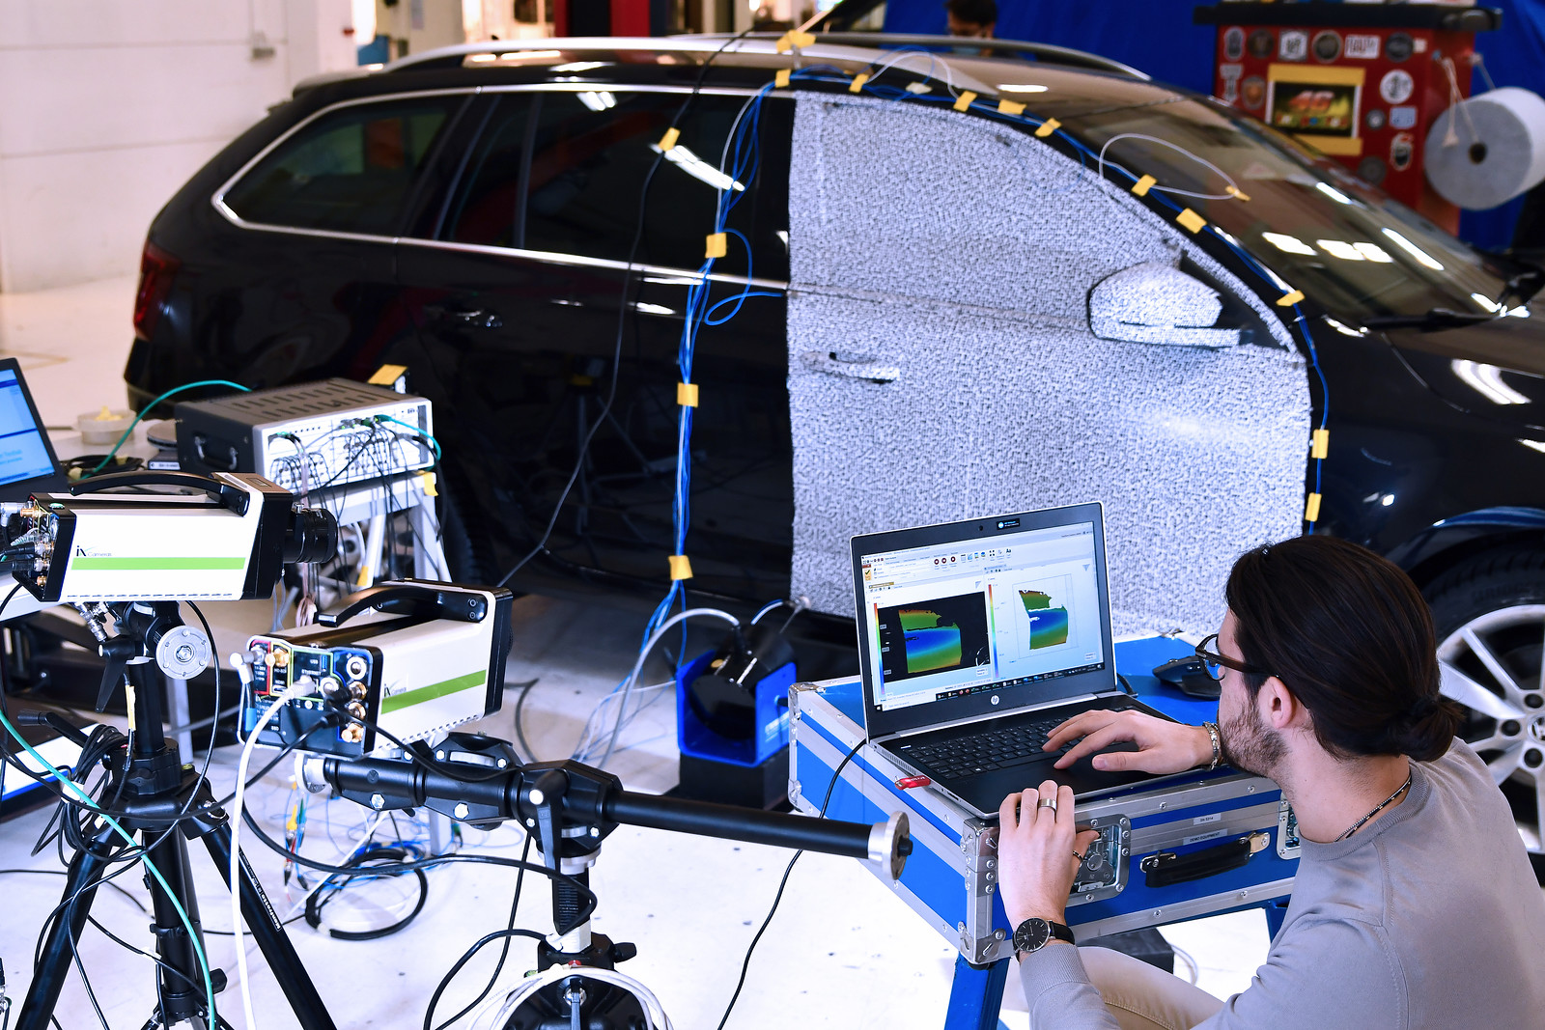
Simcenter Testlab Digital Image Correlation Application domain
Materials testing
Structural testing
Structural dynamics testing
Determine mechanical properties of materials.
Static & quasi-static loading of material samples on dedicated testing machines
Static & quasi-static testing of components and system.
Measure full-field strain field under load
Dynamic testing (Impacts, Crash, Ballistics etc)
Full-field contactless modal analysis
Vibration analysis
Modal testing with low-speed cameras

Slide 6
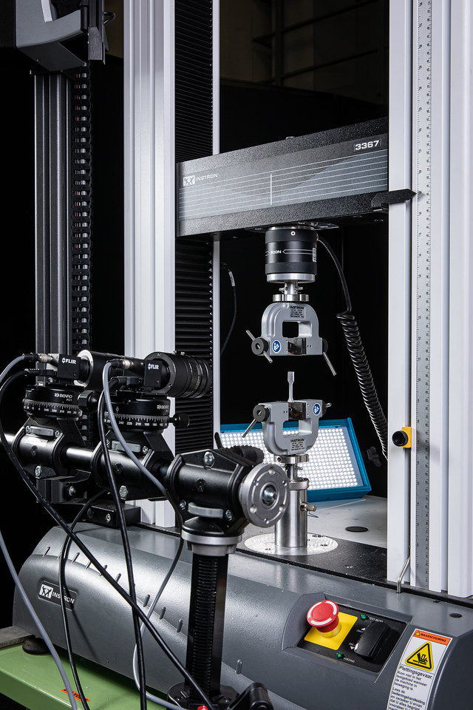
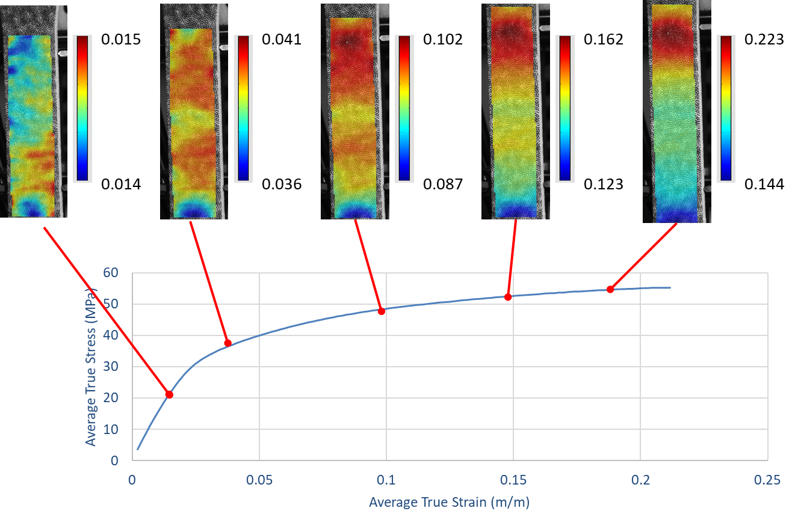
Digital image correlation in practice The evolution of material testing: from single point to full field
Full-field information => no need to decide upfront where to glue the sensor
Resolve parasitic effect typical of tensile testing (Bending, load imperfections, etc)
Detect non-homogeneous behavior
No extension limit
Applicable for all types of materials
Notes:
A typical example of the use of DIC is to test material samples and characterize their mechanical behavior. Historically, materials are tested by creating some standardized samples which are then inserted in tensile, compression or bending testing machine. As the load is increased, the deformation and the strain are measured, up to plasticity and/or failure of the sample.
In the past, regular strain gauges or rosette where used, which provided point information of the deformation of the object. However, SGs could break before the material does, and depending on their location may fail to detect fracture initiations or other local phenomena.Thanks to DIC, the complete strain distribution can be observed, allowing to globally observe the material behavior and detect imperfections. Also, the sample can be streched indefinitely, way beyond the typical limit of strain gauges, and the technique can be applied to any type of material.

Slide 7
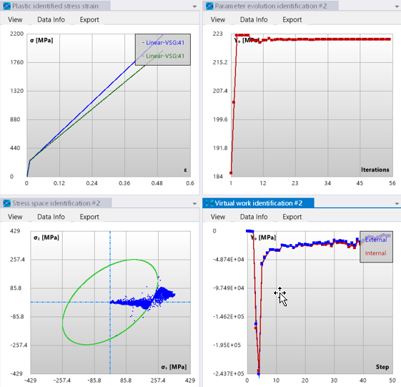
Digital Image Correlation in practice From deformations to material properties identification
Wide range of material models available with possibility to specify your own
Rely on unique implementation of the Virtual Fields Method
More than 10x faster than FE model updating
Allows for more accurate Finite Element modelling
Notes:
A very unique feature of our solution is the possibility to use the data collected while testing the sample and use them to identify the mechanical properties of the material using the Virtual Fields Method. With this method, the user can choose from an extensive library of material models the one that best characterizes the sample and then run an optimization processes, with the measured data as input, to identify the model coefficients, (e.g. the Young Modulus, Poisson Ration, etc). Compared to classical approach, which relies on finite element indirect updating techniques, the VFM method has a much faster convergence, do not requires 100s of model evaluation and makes full use of the full-field information available with DIC. Once the images have been processed, the user specifies the type of material behavior for the sample he/she is analyzing. The software will then run the VFM method and identify the coefficient of the material model that best represent the full field experimental results.
The material properties can then be easily used in Finite Element simulation to better predict the structural behavior of specimens built using the identified material. This is a very unique feature of our solution that no competitor can offer.

Slide 8
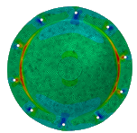
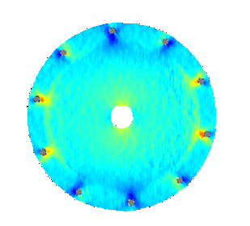
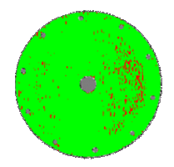
Digital Image Correlation in practice Quantitative model validation using full-field information
FE Simulation
DIC Experiment
Compare FE and DIC
Virtual DIC Images
Classical approaches simply compare the results visually
Risk of confusing processing artifacts with structural differences
SOLUTION: apply DIC to virtual images of the FE model
Full-field correlation map to reliably detect differences in the behavior
Notes:
Another important application of Digital Image Correlation is to validate numerical model prediction, which is a more and more crucial element in the context of the ever increasing digitalization of the design process. One possibility is to simply compare the deformation or strain maps, which is possible because of the high spatial resolution of DIC models. However, just comparing the results could lead to wrong assessment: are the difference due to errors in the models or they are introduced in the DIC phase? DIC is a powerful technique, but is also sensitive to the settings used so a more robust approach is needed to ensure the effects of these parameters on the results are accounted for.
[click] to solve this paradigm, we implemented a unique approach which allows importing the simulation results in our DIC solution, align the FE and DIC models and then apply DIC directly on the FE model after virtual images have been generated. By applying the same calculations to FE and experimental images we can ensure that all highlighted differences can be used to improve the accuracy of the model and are not introduced by data processing artifacts. By substracting the DIC results from the FEA ones, we can obtain a correlation map which immediately show us the regions where these differences are visible and the model needs improvements.

Slide 9
Digital Image Correlation in practice High-speed testing for transient events
Inertial impact
(5M fps)
Pouch drop test
(5k fps)
Analyze images from high-speed cameras
Study highly dynamic events (impacts, blasts, crashes)
Resolve events with fine temporal scale
From 1000s to 1000000s of fps
Notes:
DIC, in combination with high speed cameras, can also help in analyze highly dynamic events, which only last few instant.
This technology is typically used for drop and impact tests, ballistic experiments, blasts and crash test. High speed cameras can easily range from few thousands to millions of frame per seconds, giving the possibility to accurately study extremely fast phenomena. Obviously, this is not just replaying a movie in slow motion, but thanks to DIC you can extract all the quantities of interest like in any other DIC analysis

Slide 10
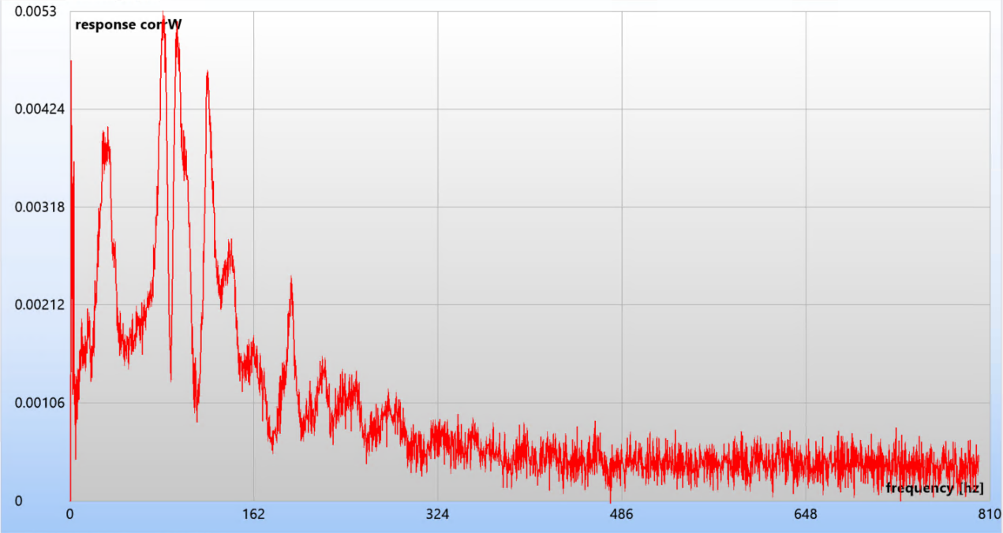
Digital Image Correlation in practice Vibration and modal testing
Measured displacement and strain can be used for frequency analysis
Direct link with Simcenter Testlab for dedicated data processing (OMA, EMA)
Combine DIC with standard measurement equipment and exciters
Dedicated Vibration module for aliased acquisition with low-speed cameras
Notes:
The most recent application of DIC is vibration testing, where the results of DIC are the converted to the frequency domain to analyze their spectral content and visualize vibration shapes. Vibration testing not only require high-speed cameras, but also that the images have a sufficiently high resolution to capture the displacements at high frequency, which are normally extremely small. The big advantage is that, without having to glue any sensor, the user can obtain highly detailed displacement and strain shapes.
A dedicated export functionality makes sure that the geometry and requested data are made available for the other Testlab product to read, giving the option to rely on unique capabilities such as Experimental and Operational modal analysis. Moreover, this gives the opportunity to combine DIC results with more standard data measured with a Simcenter Scadas system, giving the opportunity to combine the advantages of both measurement techniques (very high local spatial resolution together with the accessibility offered by standard sensor to measure on location which are out of sight).
Finally, a special module has been created to allow measuring frequency response with low speed cameras using aliasing as a measurement principle. Thanks to this, the high resolution of low speed camera can be used to reconstruct high frequency signals, which level would bot be detectable with high-speed cameras.

Slide 11
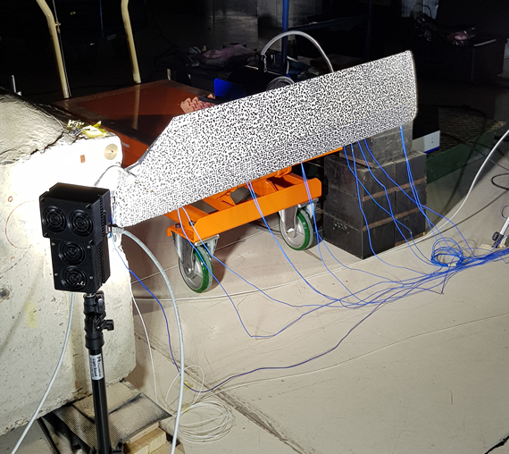
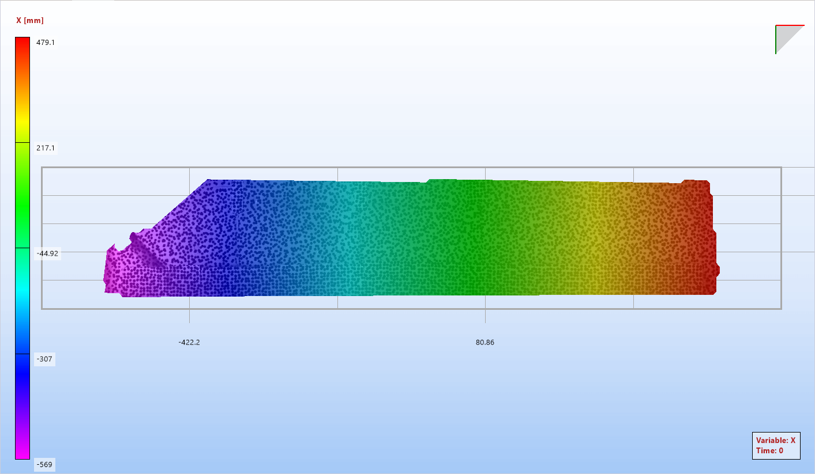
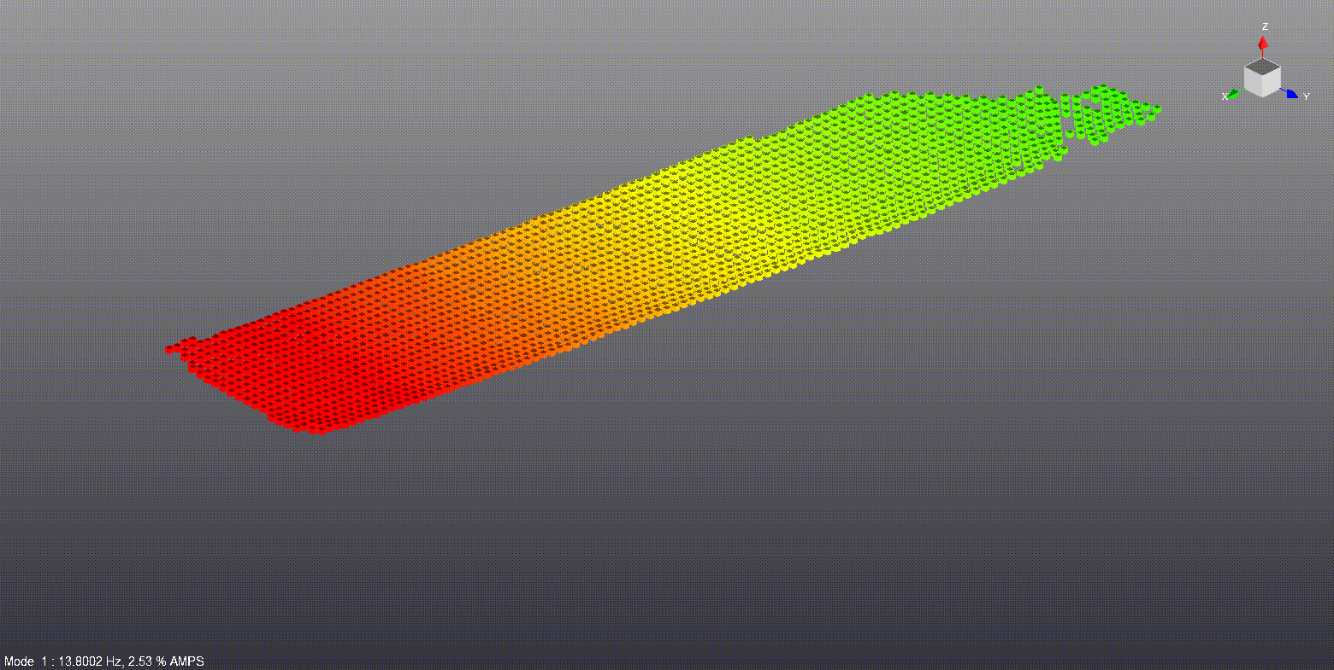
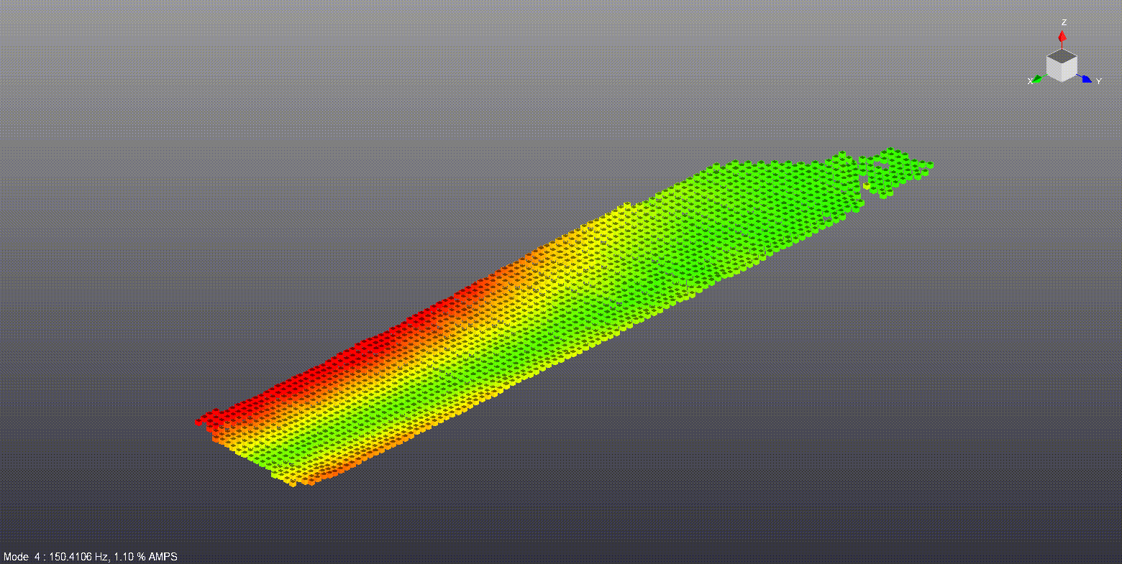
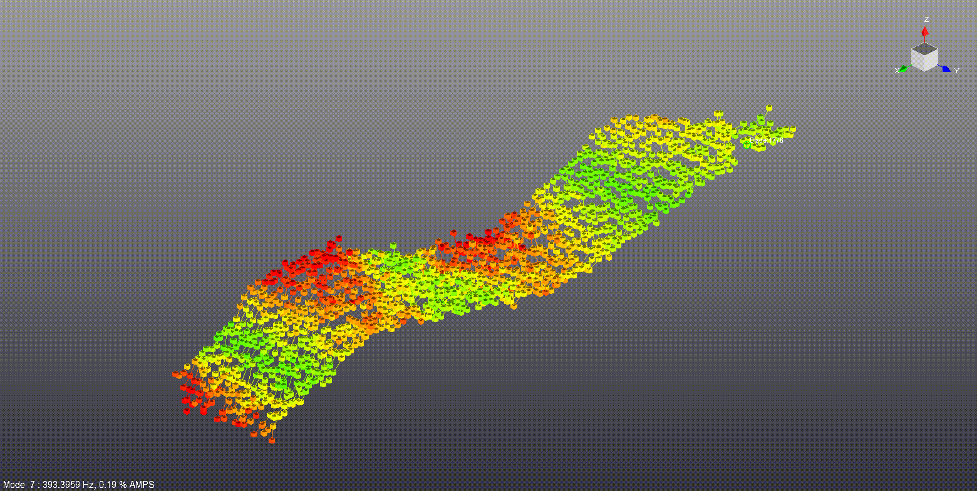
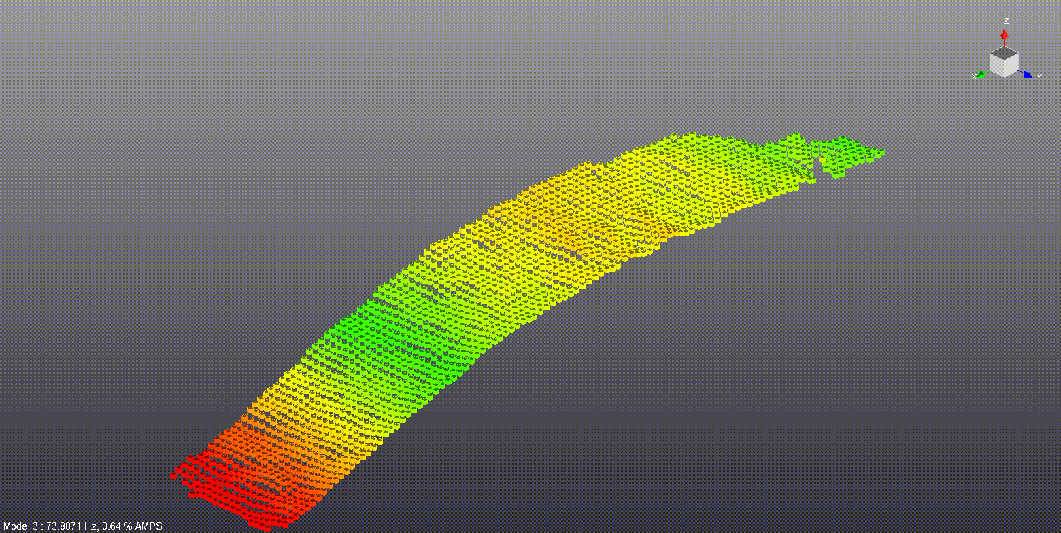
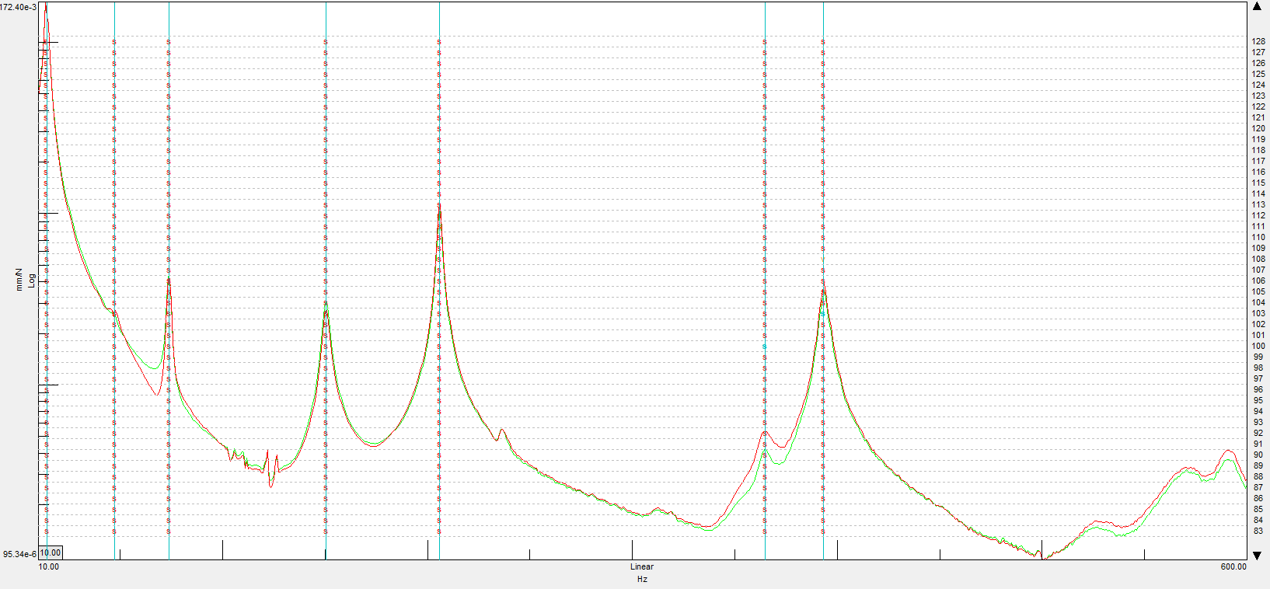
Digital Image Correlation in practice Vibration and modal testing
Measured displacement and strain can be used for frequency analysis
Direct link with Simcenter Testlab for dedicated data processing (OMA, EMA)
Combine DIC with standard measurement equipment and exciters
Dedicated Vibration module for aliased acquisition with low-speed cameras
Notes:
The most recent application of DIC is vibration testing, where the results of DIC are the converted to the frequency domain to analyze their spectral content and visualize vibration shapes. Vibration testing not only require high-speed cameras, but also that the images have a sufficiently high resolution to capture the displacements at high frequency, which are normally extremely small. The big advantage is that, without having to glue any sensor, the user can obtain highly detailed displacement and strain shapes.
A dedicated export functionality makes sure that the geometry and requested data are made available for the other Testlab product to read, giving the option to rely on unique capabilities such as Experimental and Operational modal analysis. Moreover, this gives the opportunity to combine DIC results with more standard data measured with a Simcenter Scadas system, giving the opportunity to combine the advantages of both measurement techniques (very high local spatial resolution together with the accessibility offered by standard sensor to measure on location which are out of sight).
Finally, a special module has been created to allow measuring frequency response with low speed cameras using aliasing as a measurement principle. Thanks to this, the high resolution of low speed camera can be used to reconstruct high frequency signals, which level would bot be detectable with high-speed cameras.

Slide 12
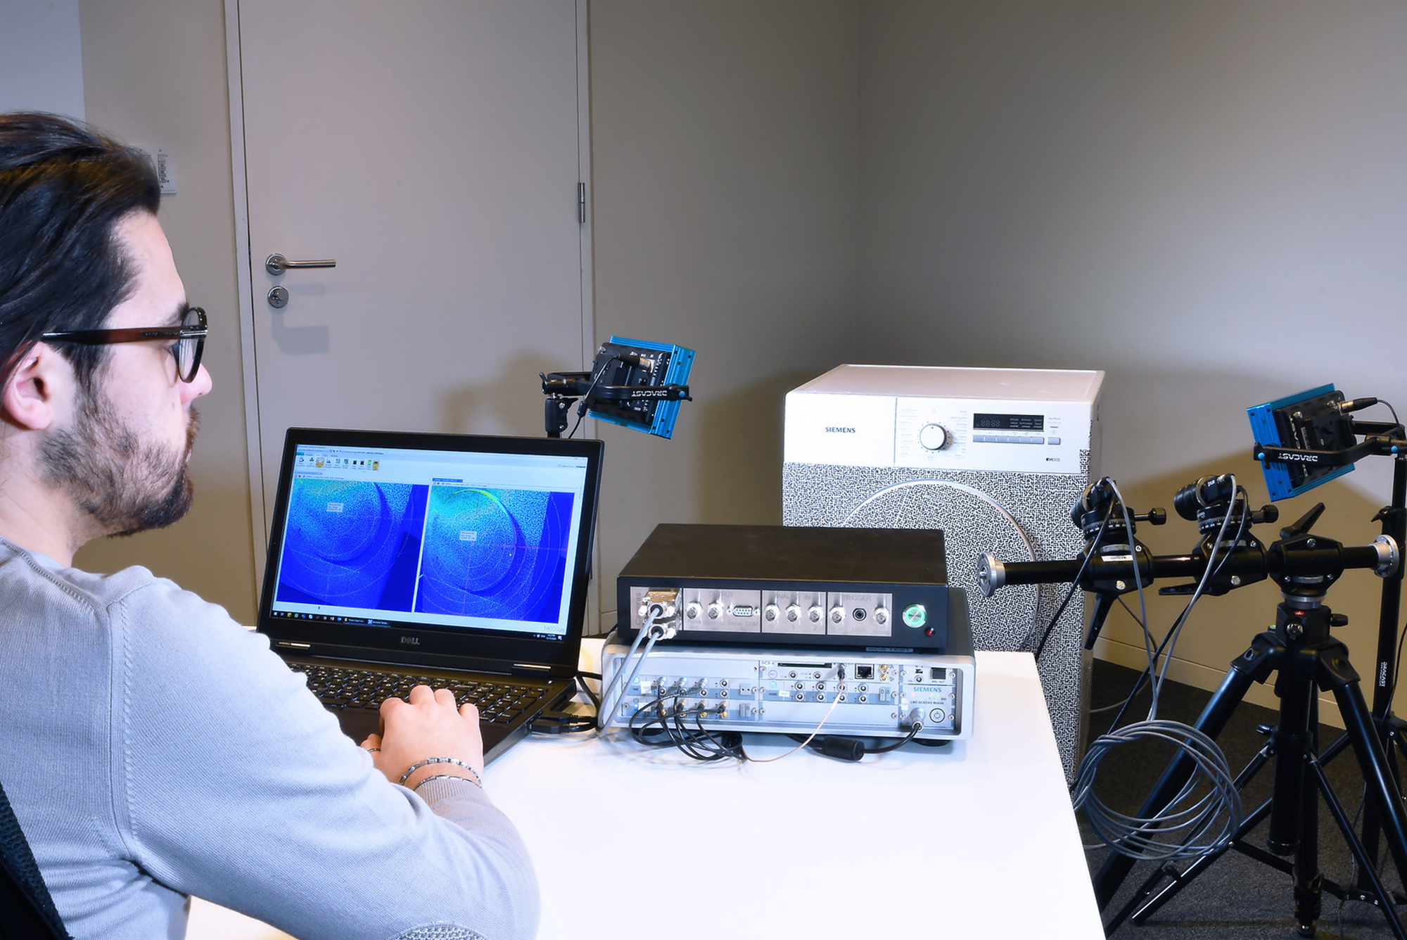
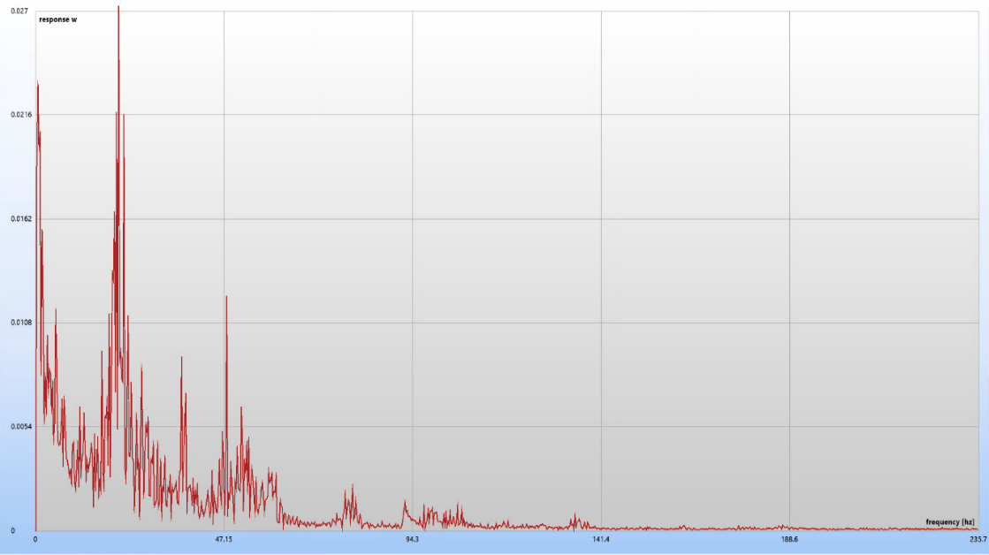
Digital Image Correlation in practice Vibration and modal testing
Measured displacement and strain can be used for frequency analysis
Direct link with Simcenter Testlab for dedicated data processing (OMA, EMA)
Combine DIC with standard measurement equipment and exciters
Dedicated Vibration module for aliased acquisition with low-speed cameras
Notes:
The most recent application of DIC is vibration testing, where the results of DIC are the converted to the frequency domain to analyze their spectral content and visualize vibration shapes. Vibration testing not only require high-speed cameras, but also that the images have a sufficiently high resolution to capture the displacements at high frequency, which are normally extremely small. The big advantage is that, without having to glue any sensor, the user can obtain highly detailed displacement and strain shapes.
A dedicated export functionality makes sure that the geometry and requested data are made available for the other Testlab product to read, giving the option to rely on unique capabilities such as Experimental and Operational modal analysis. Moreover, this gives the opportunity to combine DIC results with more standard data measured with a Simcenter Scadas system, giving the opportunity to combine the advantages of both measurement techniques (very high local spatial resolution together with the accessibility offered by standard sensor to measure on location which are out of sight).
Finally, a special module has been created to allow measuring frequency response with low speed cameras using aliasing as a measurement principle. Thanks to this, the high resolution of low speed camera can be used to reconstruct high frequency signals, which level would bot be detectable with high-speed cameras.

Slide 13
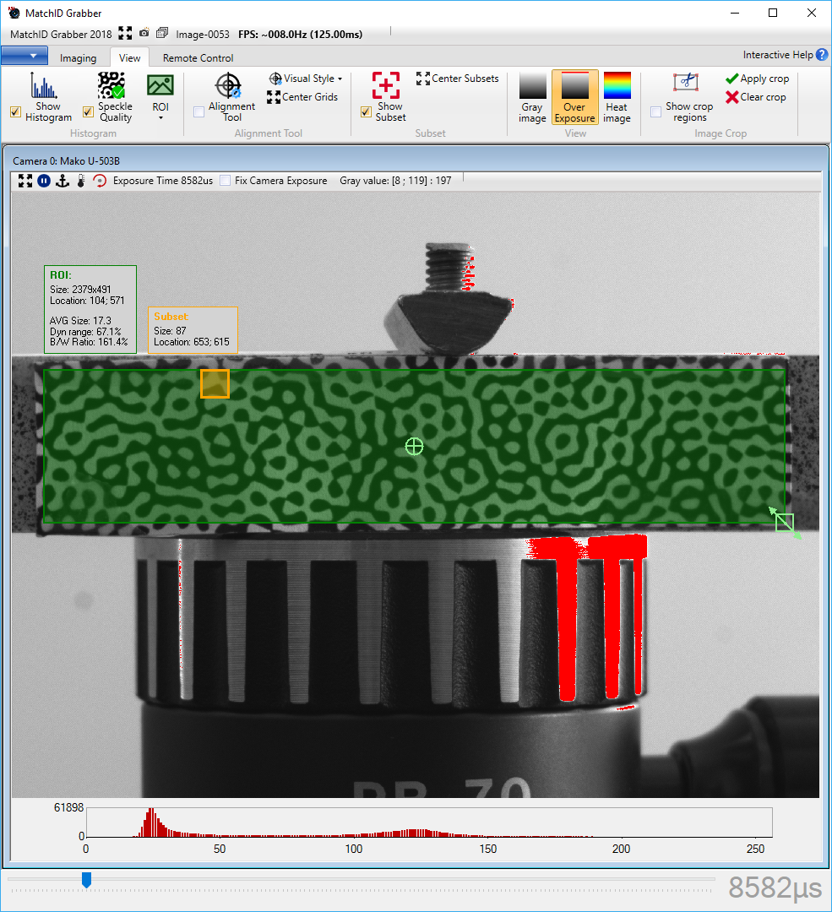
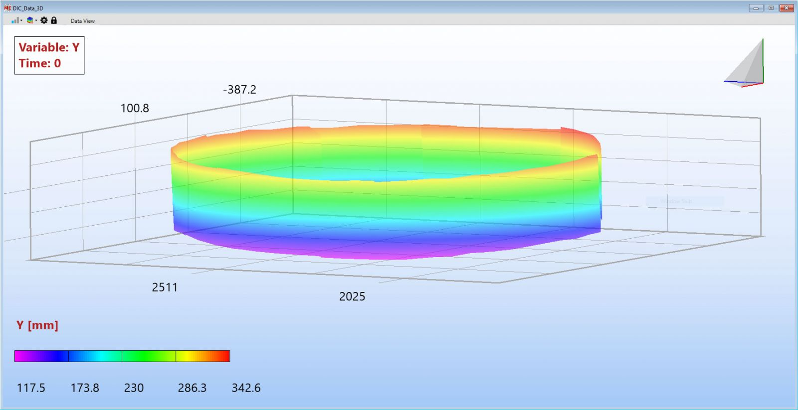
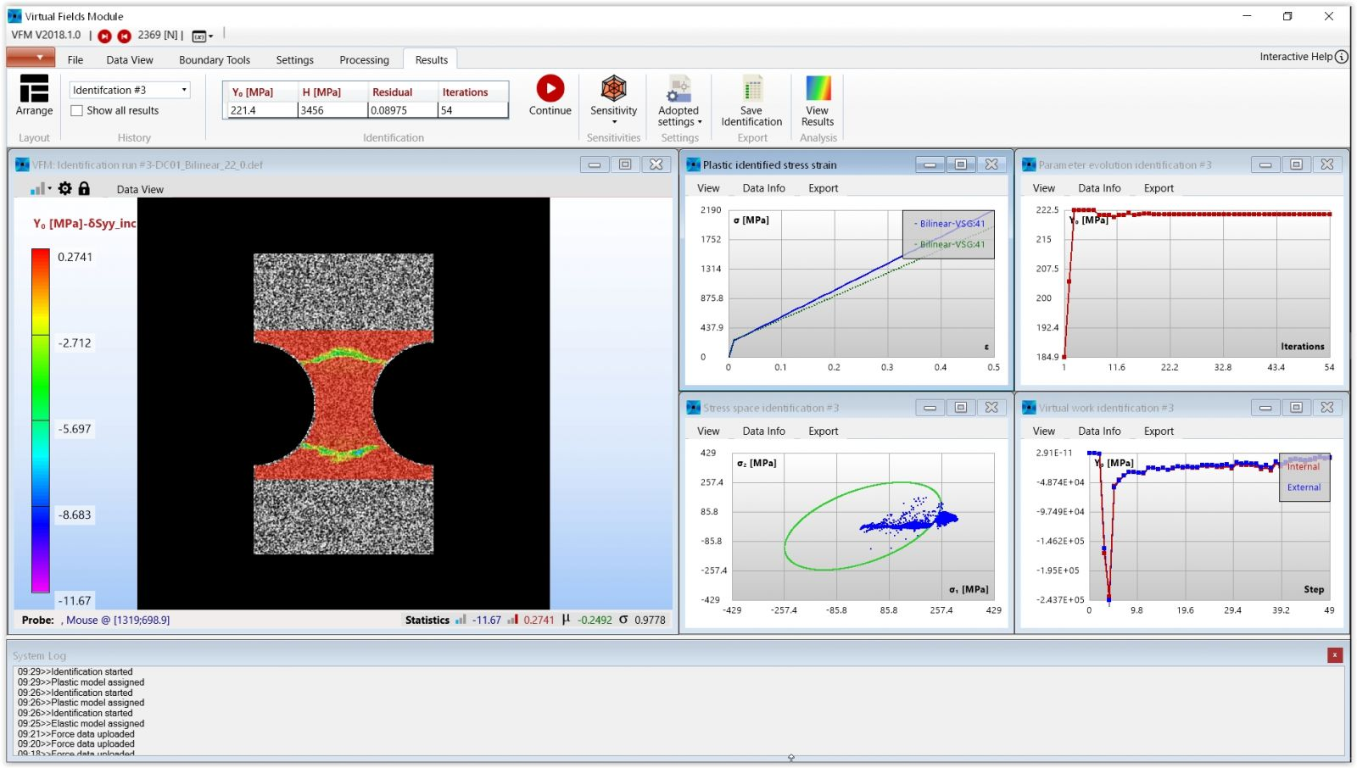
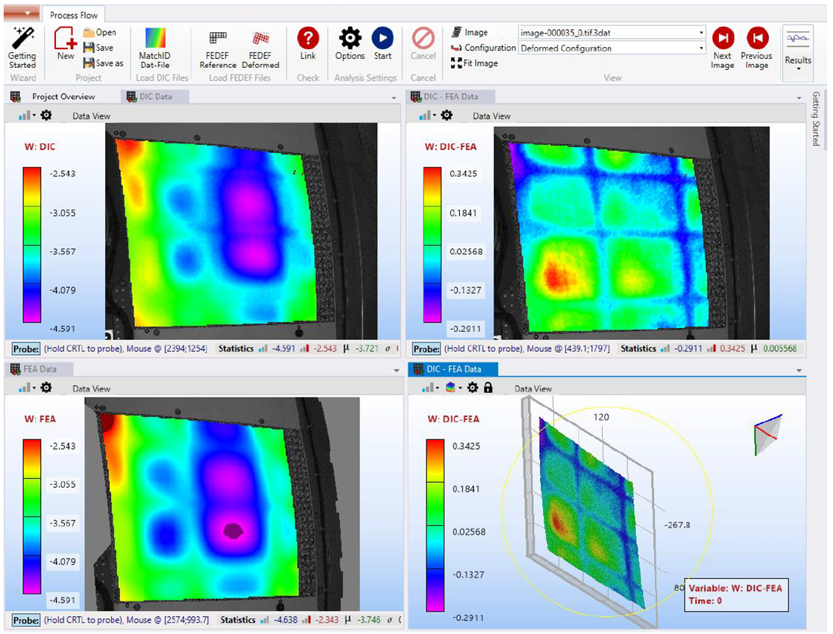
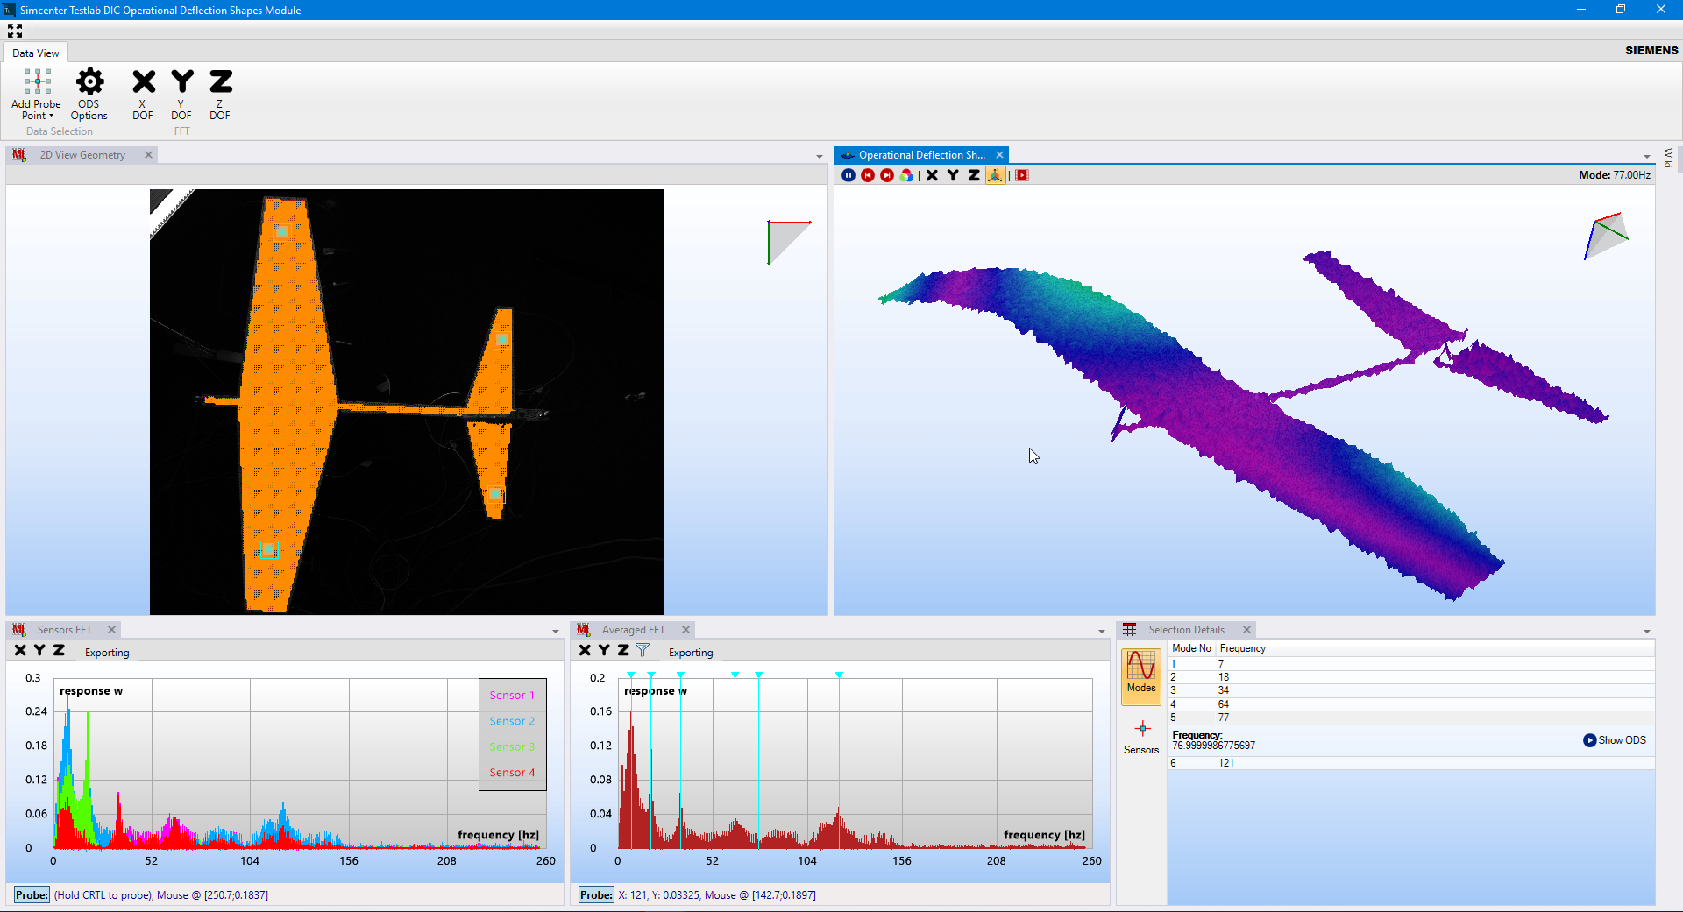
Simcenter Testlab Digital Image Correlation A complete engineering solution for image acquisition and analysis
Simcenter Testlab DIC Acquisition
Configure and synchronize cameras for acquisition
Provide quality indicators on the test setup
Simcenter Testlab DIC Analysis
Core DIC engineering platform for image processing
Extract full-field displacements and strains from images
Includes Calibration, Performance Analysis and other tools
Access results in Simcenter Testlab for advanced processing
Simcenter DIC Analysis – optional extensions:
DIC Multicam
Combine and analyze images from >2 cameras setups
DIC Material Identification
Identify mechanical parameters of most material models
DIC Model Validation
Compare full-field experimental and FE results
DIC Operational Deflection Shapes
Visualize the frequency response of your structure
Notes:
Our Digital Image Correlation solution consists of 5 products, of which (Simcenter Testlab) DIC Acquisition and DIC Analysis are the core ones.
DIC Acquisition manages the calibration of the setup, and the synchronization of the cameras during the acquisition phase. DIC Analysis is the core DIC engineering platform for correlating the acquired images and extracting measurement quantities, such as the complete 3D geometry and the full displacement and strain fields. It’s important to mention that, if the required setup calibration information is available, DIC Analysis is open to process images acquired with others solutions. The DIC Analysis platform is designed to be open, meaning user can easily add their own processing
There are also optional modules to complete the DIC Analysis solution depending on the needs of the customer:
DIC Multicam allows combining and processing images from setups with more than 2 cameras to get a more 3D view of complex objects;
DIC Material Identification relies on the Virtual Fields Methods to identify mechanical parameters of most material models;
DIC Model Validation allows to quantitatively compare FE models with DIC measurement data.
Each of these products is covered by a node-locked license, and at this stage the solution is not tokenable. We are currently working on adding also measurement systems (camera, lenses, lights) to the pricebook to better support deals

Slide 14
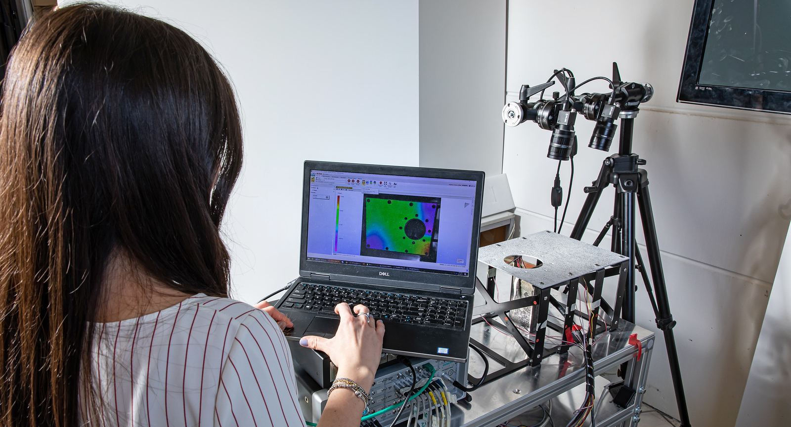
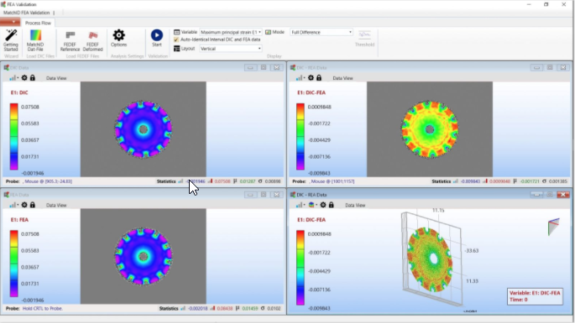
Digital Image Correlation brings new value to materials testing and product engineering
Challenges
Design and engineer
innovative new materials
Accelerate component
and system validation testing
Increase the accuracy
and reliability of simulation
DIC
Value Proposition
Qualify complex material properties
Reduce dependency on testing
Allow true material design iterations
Reduce instrumentation time
Gain more data from single tests
Define problem root cause on the spot
Validate simulation models
Identify model errors & uncertainties
Deploy a robust validation process
Notes:
The new DIC solutions enables to face critical challenges not only in the material testing and product engineering departments, but brings unique benefits to a wide range of engineering applications.
[click] First of all, it allows qualifying complex materials and identify their properties, without the risk of missing critical features that is ineherent on strain-gauges techniques. Moreover, relying on camera, the technique is truly contactless and can be applied to any kind of materials, from concrete, to composites to plastic films.
[click] Second, it can help reducing the complexity and the time spent instrumenting the structure. DIC can easily measure on thousands on location, without any physical sensors or cables being attached to the structure. You not only get geometry and displacements, but also acceleration, velocities and most importantly strains and stress, all of this with just a pair of cameras, allowing to truly observe how your system behaves with the same resolution you would obtain with a numerical simulation. Moreover, the same solution can be used for static, quasi static, fatigue, vibration and dynamic testing, as soon as the proper camera system is selected.
[click] And last but not least, Testlab DIC provides key information on the structural behavior and mechanical properties of materials to bring your numerical model to a next level of accuracy. A dedicated tool allows comparing test and simulation data in a direct way, without the user having to think whether the differences are due to imperfection in the model or to data processing. This can really help identifying area where the model requires improvement, and in particular thanks to experimental results that have the same resolution as the model they are compared to.

Slide 15
Digital Image Correlation (DIC) A new paradigm in materials and structures testing
Camera-based acquisition
Digital Image Correlation extracts FULL-FIELD
Geometry / shape
Displacements
Strains
Acc, Vel, Stress, Curvature, …
Notes:
Digital Image Correlation is an innovative testing and analysis method which relies on images of the object acquired with digital cameras during a test to extract full-field data. This means that, on the part of the object being observed, you will get information on thousands of points, with the possibility to accurately capture local behaviors.
Typically, the measurement is performed with two cameras in a stereo configuration, which allows extracting the 3D geometry of the tested area as well as the 3D displacement on all of the points, with a spatial resolution equivalent to that of a Finite Element model. From these quantities, it is then possible to derive velocities, accelerations, strain, stresses and curvatures.

Slide 16
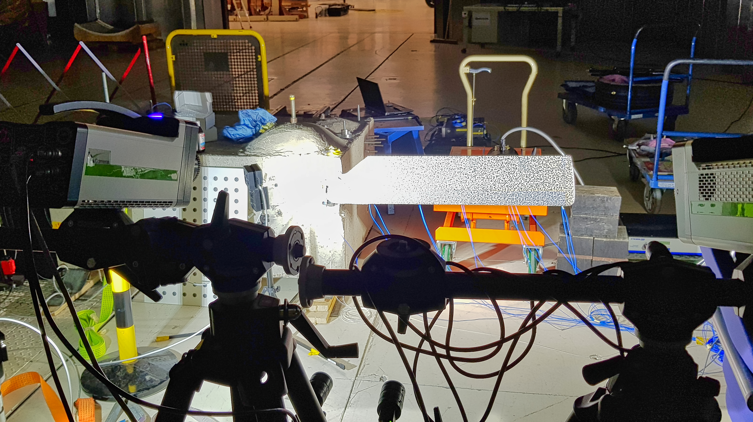
Digital Image Correlation (DIC) A new paradigm in materials and structures testing
Camera-based acquisition
Digital Image Correlation extracts FULL-FIELD
Geometry / shape
Displacements
Strains
Acc, Vel, Stress, Curvature, …
Notes:
Digital Image Correlation is an innovative testing and analysis method which relies on images of the object acquired with digital cameras during a test to extract full-field data. This means that, on the part of the object being observed, you will get information on thousands of points, with the possibility to accurately capture local behaviors.
Typically, the measurement is performed with two cameras in a stereo configuration, which allows extracting the 3D geometry of the tested area as well as the 3D displacement on all of the points, with a spatial resolution equivalent to that of a Finite Element model. From these quantities, it is then possible to derive velocities, accelerations, strain, stresses and curvatures.

Slide 17
Digital Image Correlation (DIC) A new paradigm in materials and structures testing
Camera-based acquisition
Digital Image Correlation extracts FULL-FIELD
Geometry / shape
Displacements
Strains
Acc, Vel, Stress, Curvature, …
Notes:
Digital Image Correlation is an innovative testing and analysis method which relies on images of the object acquired with digital cameras during a test to extract full-field data. This means that, on the part of the object being observed, you will get information on thousands of points, with the possibility to accurately capture local behaviors.
Typically, the measurement is performed with two cameras in a stereo configuration, which allows extracting the 3D geometry of the tested area as well as the 3D displacement on all of the points, with a spatial resolution equivalent to that of a Finite Element model. From these quantities, it is then possible to derive velocities, accelerations, strain, stresses and curvatures.

