Slide 1
Overview
NextGen Technology Services

Slide 2
1
  Introductions: Understanding your Business
2
  Key Differentiators
Agenda
3
  Service Offering Overview
4
  Identifying Opportunities
5
  Case Studies / How to Engage

Slide 3
Understanding Your Business
1
2
3
4
5
What are the core services your business sells today, and do you have a specific customer profile in terms of vertical or employee size?
Are there any specific gaps in your supplier portfolio you are looking to address or services you are looking to learn more about to expand your offerings to your customers?
How much experience do you have selling Security and Managed Services, have you had much success working with other vendors in these areas?
What is your process when engaging a supplier in an opportunity?
Are there specific Master Agents you work through? For future registration purposes its always important to identify if you have multiple options to choose from there.

Slide 4
Why Partners Work with Thrive
Proven playbook on how to help a partner sell Managed IT Solutions when it isn’t their core competency.
One of the largest and fastest growing MSPs and MSSPs in the country with a nationwide reach.
Disruptive next generation services driven by an automation and self-service platform built on ServiceNow.
Suite of services that can manage a customer’s entire IT environment to help you maximize your relationships.
Long history throughout the management team of building businesses through lifelong channel relationships.

Slide 5
Why Customers Work with Thrive
Suite of services that can takeover a customer’s entire IT environment to help you maximize your relationships.
One of the largest and fastest growing MSPs and MSSPs in the country with a nationwide reach.
Thrive is one of the largest and fastest growing MSPs in the U.S. Thrive is a proven technology partner that continuously drives business outcomes, innovation, and overall customer success through its traditional and NextGen managed services.
Disruptive next generation services driven by an automation and self-service platform built on ServiceNow.
Thrive has an Industry leading automated self-service Managed Services Platform back by ServiceNow delivering you the optimal customer experience.

Slide 6
Thrive
Overview

Slide 7
Disaster Recovery
Backup
Managed Detection & Response / SOC
Cloud
Management
Outsourcing Trends
SIEM
SD-WAN
Vulnerability Scanning / Remediation
Global Network Management
Patching
Helpdesk

Slide 8
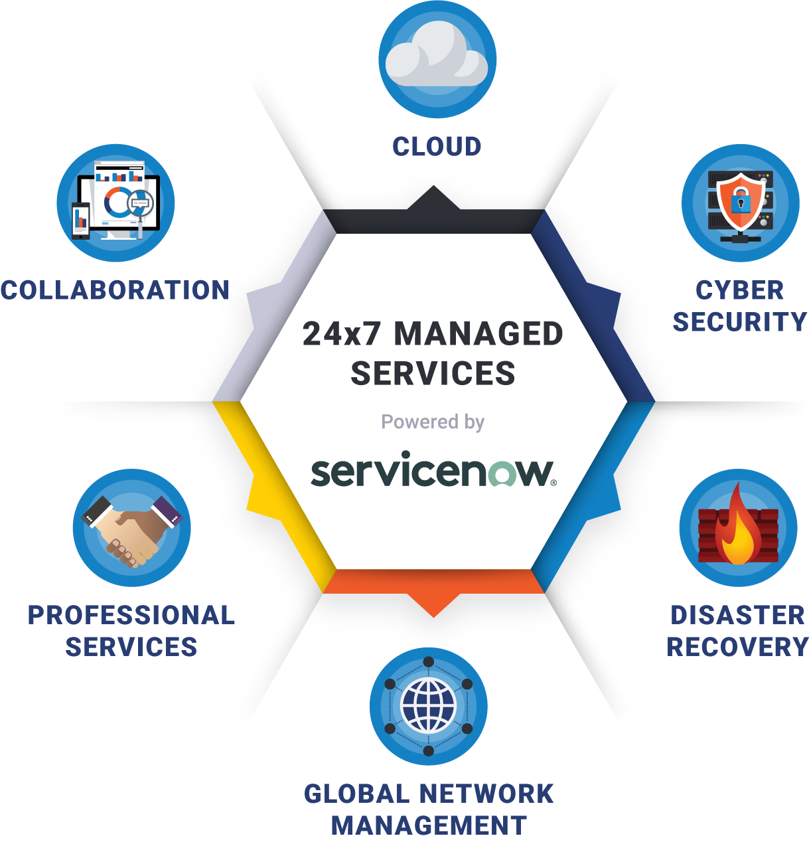
NextGen Managed Services
Thrive’s NextGen managed services platform is designed to optimize business application performance via secure, redundant Cloud-based infrastructure.

Slide 9
Thrive Overview
ABOUT US
Client Base
Services
Key Differentiators
Leadership
1,500+ Customers Worldwide
Servicing SMBs to Enterprises, with a heavy concentration in the Mid-Market (100 to 5,000 employees)
Diverse Customer Base with Focus on:
  Financial Services
  Healthcare
  Legal
  Life Sciences
  Retail
  Manufacturing
Flexible and Powerful Platform that Delivers NextGen Managed Services that Optimize Business Performance, Enable Scalability, and Power Digital Infrastructure Operations
Private, Public & Hybrid Cloud
SOC/Cybersecurity
Backup/Disaster Recovery
Collaboration
Global Network Management
Professional Services
Help Desk & End User Support
Automation and Orchestration Managed Services Platform Built on ServiceNow that Optimizes the Client Experience
NextGen Platform of Products, Services & Technologies
Advanced Cybersecurity Services
Dedicated Technical Service Delivery Team Focused on Your Company and Vertical
Consultative Approach Using the Thrive5 Methodology
Backed By Court Square Capital (New York, NY) and M/C Partners (Boston, MA)
Court Square portfolio companies include Ahead Technologies, DataBlue and Momentum Telecom
M/C Partners portfolio companies Include: Zayo, Lightower, Involta, Denovo and West Monroe
Senior Management Has More than 100 Years of Technology Service Experience
Year Founded: 2000
Headquarters: Foxborough, MA, US
Total Employees: 700+
Technical Engineers: 420+
Technical Certifications: 900+
End-Users: 120,000+
Total Devices: 225,000+
Years of Technical Experience: 2000+
SOC II Type 2 Certified

Slide 10
Cybersecurity

Slide 11
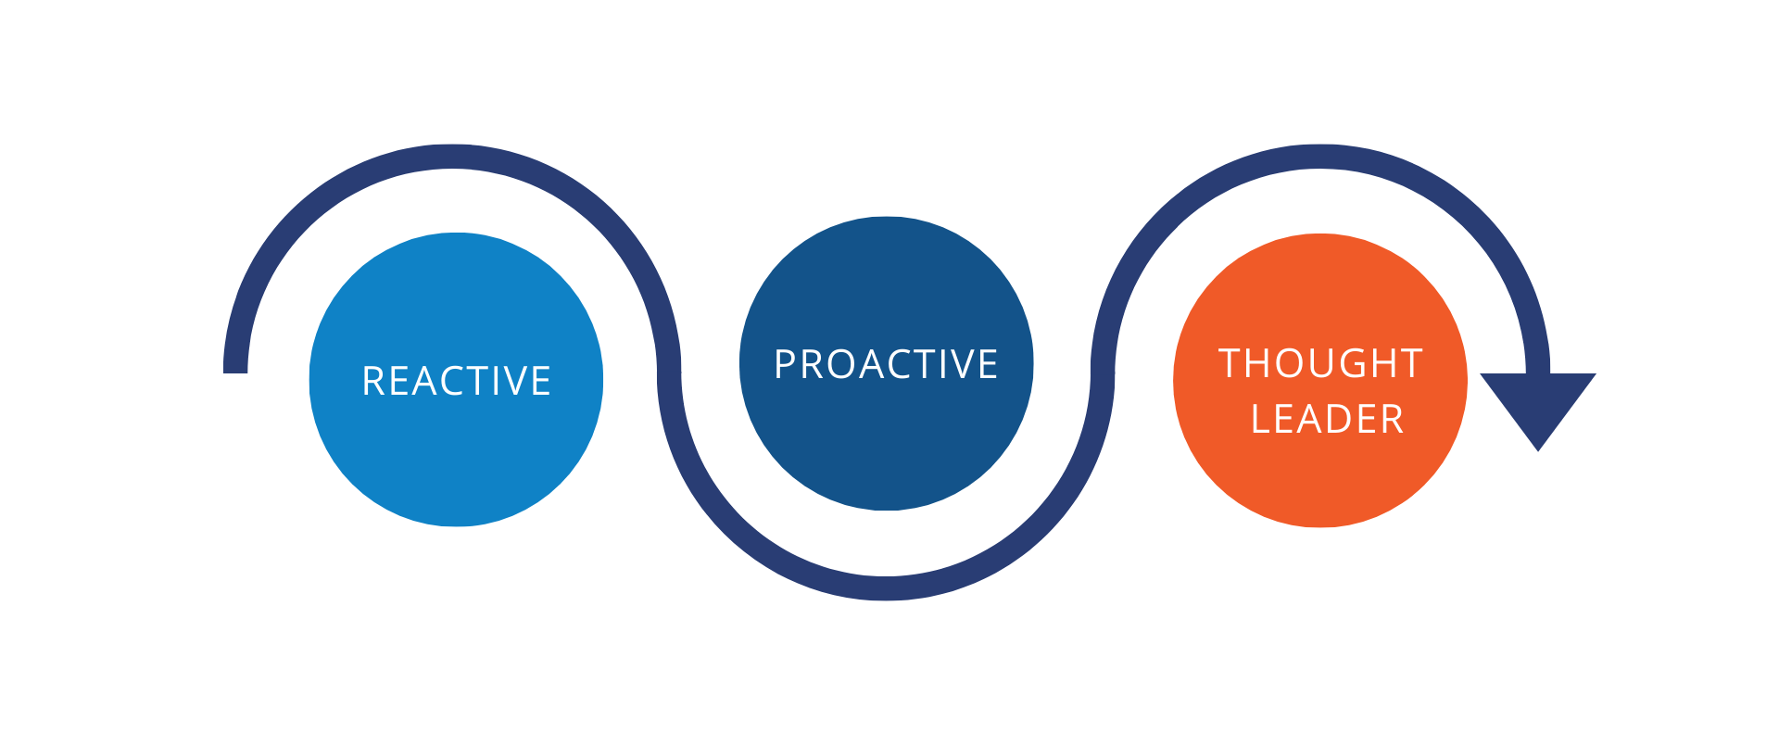
The Cybersecurity Lifecycle of an Agent
Starting to learn about cyber and has begun looking for opportunities with their customer base
Bringing forward cyber opportunities to the partner only when the client asks specifically for the service
Leading with a consultative approach to build a roadmap for the risk within their customer base

Slide 12
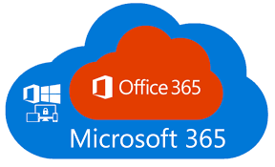





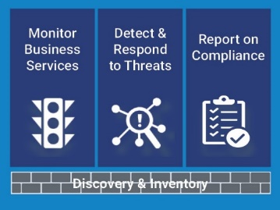


Thrive Security Framework
On-Premises
Data Center
SaaS &
Any Other CSP
Secure Connectivity
3
Vulnerability Management
Web Application Firewall
Data Protection (Encryption\DLP)
vCISO
24 x7 Network & Security Operations
Employees
Security Monitoring (SIEM\SOC)
Security Awareness Training
Single Sign-On
Mobile Device Management
DNS Security
2
Secure Connection
380+ technical engineers
Monitoring, Management, Remediation
Process & Procedures to work with multiple parties(external and 3rd party)
Automation of playbooks & workflows
ServiceNow utilized for service and incident management
Patching – OS & 3rd Party App
Next-Gen Anti-virus & EDR
Advanced Mail Security
Two Factor Authentication
Next Generation Firewall
Backup & Disaster Recovery
Contractor/Customer
1

Slide 13
Recent Assessment Wins
$17K NRC
$18K NRC
$20K NRC
$23K NRC
$25K NRC
Retail
Private School
Software Company
Construction Equipment
Manufacturing
3 weeks
1 month
2 months
9 days
3 weeks
  Security Health Assessment Sales Cycles

Slide 14
Cloud

Slide 15




ThriveCloud
Multi-Tenant
Hybrid
Private Cloud
Disaster Recovery as a Service (DRaaS)
Public Cloud

Slide 16
Best Fit Opportunities & What to Look For

Slide 17
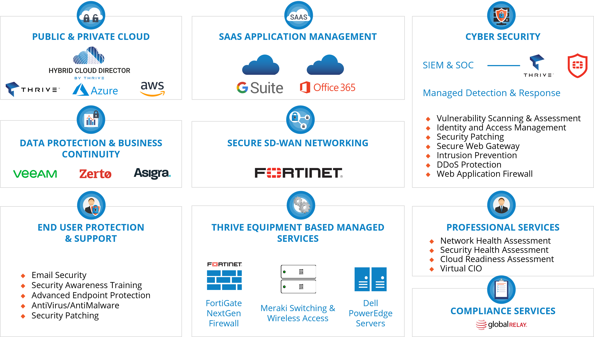
Ideal Customer

Slide 18
Best Fit Opportunities
Prospective Client
100+ employees
Focused Verticals
Financial Services
Looking at
Digital Transformation
Business heavily values security and compliance
IT team of less than 5
Budget for our services is a minimum of $3K MRR- cost not the deciding factor
BioTech
Healthcare
Retail
Hyperscale
Improved Security Posture
Growing business that needs to scale
Multiple locations
Developing and executing both a short and long-term technology roadmap
Addressing issues with existing MSP

Slide 19

Thrive Solutions
Managed Patching
Managed Firewalls with access points at each location and unified threat management
Advanced email security
MDM for Mobile Devices used by sales reps and in store associates
24x7 SIEM & SOC for Advanced Threat Detection and Remediation
Data Center managed backups and DRaaS
Case Study
Multi-Site Retail Company
Situation
86 Locations
Increasing regulatory requirements
State data privacy regulation requirements
New mobile application has increased their data output

Slide 20
5 Things to Listen For
Client mentions any security issues or initiatives.
Has the client discussed moving to the cloud (DRaaS, O365, AWS, Azure, Hyperscale etc.)?
Client mentions compliance and regulatory requirements.
Client is expanding or outgrowing IT team, existing MSP or cloud provider.
Client has had outages, service issues, failed audits or major IT problems
5 Questions to Ask
Have you validated and do you feel comfortable with your current security strategy?
Have you identified where you need to invest when it comes to IT?
How is your current cloud strategy helping you maximize your IT ROI?
Are you getting everything your company needs from how IT is setup in your organization?
Do you have any compliance or regulatory requirements to adhere to?
How to Engage

Slide 21
Do you have a SIEM (Security Incident & Event Management) and / or SOC (Security Operations Center) in place today?
Have you implemented Single Sign On (SSO)?
Who is responding to the alerts? Outsourced SOC or Internal?
Are you currently leveraging any Next Gen AV or Endpoint Detection and Response (EDR) solutions?
How are you currently keeping your servers and endpoints patched?
If not, what are you doing for your endpoints to secure them?
Are you patching 3rd party applications regularly? If so, by what method?
Advanced Security Questions
Do you train your end users for Phishing attempts? What Security Awareness tools do you use?
Do you perform regular vulnerability scans?
Who is analyzing the scans and remediating the findings?
Are your current firewalls being centrally managed and updated to current level of firmware?
If you have workloads in the Cloud, are you providing the same level of security to them as you are in your on-premises workloads?
Have you enabled IDS, IPS and Content Filtering
Have you implemented 2FA (Two Factor Authentication) or MFA (Multi Factor Authentication)?
How are you protecting your users from email born security threats?
What applications are you protecting?
If you have your email in the Cloud (i.e. O365), are you backing it up?

Slide 22
1
GO TO
MARKET
3
ENGAGEMENT
Discuss who and how Thrive engages with the employees, customers and prospects along with rules of engagement set by partner on how to work together and lines of demarcation when working a deal.
Review Partner’s and Thrive’s solutions, identify the overlap, opportunity and prioritize where to focus going forward. Specific market segment, service offering? Understand the org. structure of the partner and understand how to engage.
4
CUSTOMER COMMUNICATION
Next Steps
2
TRAINING
Once the Go to Market has been created, setup both sales and technical training to get the team up to speed on what Thrive’s offering, differentiators and the opportunity. Understand partners business so Thrive can proactively seek out opportunities when possible.
Layout how the partner communicates with their customers (email campaigns, newsletter, webinars, events) and see where we insert Thrive into the process
5
RESOURCES
What resources can Thrive provide to assist Partner in positioning Thrive services both internally and within their account base? Testimonials? Bootcamps? Joining sales calls?

Slide 23
Partner Satisfaction Survey Results
Partner Feedback on Solution Thrive Presented to Customer

Slide 24
Partner Satisfaction Data Overview

Slide 25
Questions

Slide 26
Add Contact Information

