Slide 1
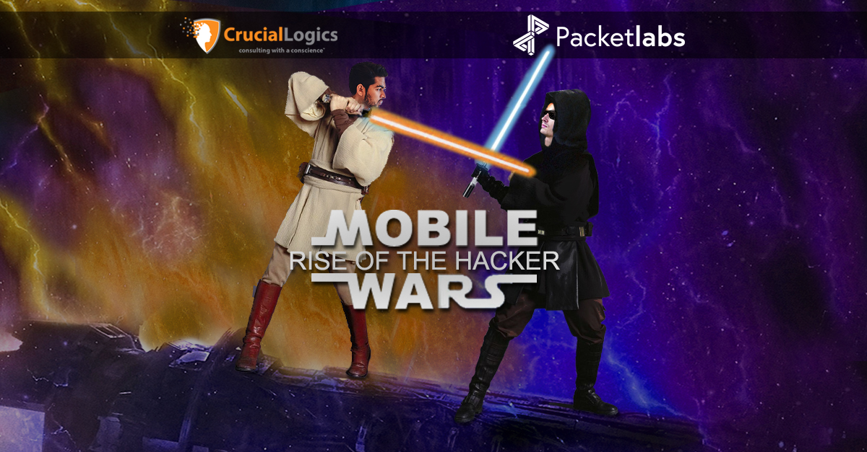

Slide 2

Thank you for joining us today!
This session is being
recorded for replay
Listen-only mode during
the presentation
Ask questions! Please submit questions via the chat

Slide 3

Speaker
Amol Joshi
Partner Enterprise Services, CrucialLogics
v
Amol is a senior security executive with over 16 years of experience in leading and executing complex IT transformations and security programs. He’s a firm believer in achieving security through standardization, avoiding complexity and that security be achieved using native, easy-to-use technologies. Amol approaches business challenges in a detail-oriented way and demonstrates quantifiable results throughout the course of highly technical and complex engagements.

Slide 4
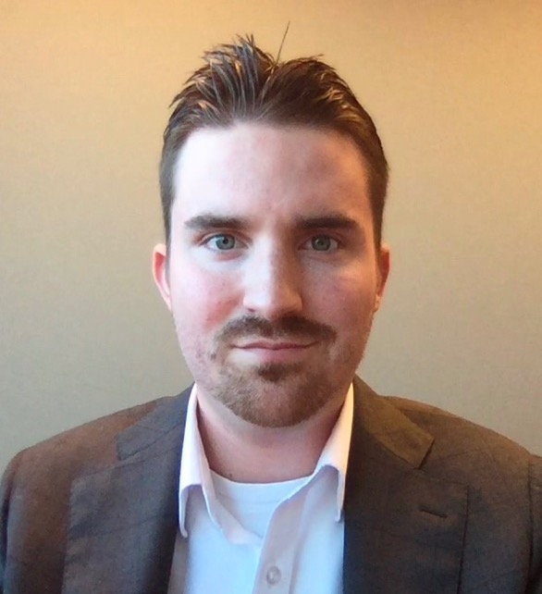
Speaker
Richard Rogerson
Managing Partner, Packetlabs
v
Richard leads a team of ethical hackers who find critical vulnerabilities in client systems before a breach. He has 10+ years of professional consulting experience delivering and leading offensive campaigns. He has several of the most advanced cybersecurity certifications and has been featured in the media several times for his views on cybersecurity breaches including Business E-mail Compromise, Ransomware and Nation-state APTs.

Slide 5

Speaker
Claudio Damaso
Associate Partner, Cloud & Security
AKA – The Most Secure CIO in the World
v
Claudio is a cybersecurity veteran with over 20 years of experience helping organizations identify business risk. Claudio's pragmatic approach to cyber risk focuses on maintaining business systems availability, protecting intellectual property, limiting corporate liability, safeguarding corporate brands, and ultimately ensuring compliance. He has been a speaker at several security events and a panel guest for some of the largest security organizations globally.

Slide 6

Today's Agenda
Data leakage
Spyware
Unsecured WIFI
Broken cryptography
Network spoofing
Improper session handling
Phishing

Slide 7

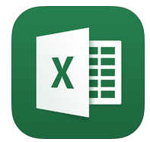




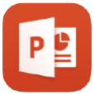





Different Mobile Device Management Scenarios
Multi-identity
Corporate data
Personal data
MAM-WE (Personal) | BYOD (Personal) | CORP (Corporate)
Microsoft Application Management – Without Enrollment | Bring Your Own Device | Company Owned Device
User signs-in to each app and configures them. No personal data is wiped. | User signs-in to Company portal app to auto install and configure Outlook|OneDrive|Teams|etc. apps. No personal data is wiped. | Enrollment: Factory reset of device. All data on device is wiped.
Applications partially managed | Device and applications partially managed | Device and applications fully managed
Identity: App level multi-identity support scenario. MFA support. | Identity: Separate identities (personal and corporate) scenario. MFA support. | Identity: Single identity (corporate) usage scenario. MFA support.
Application protection policies (PIN, don’t copy/paste, jailbroken, etc.) | Application protection policies (PIN, don’t copy/paste, jailbroken, etc.) | Application protection policies (PIN, don’t copy/paste, jailbroken, etc.)
Wipe: App wipe deletes corporate data from app only | Wipe: Work profile wipe deletes all corporate apps and data only | Wipe: Factory reset deletes all apps and data

Slide 8
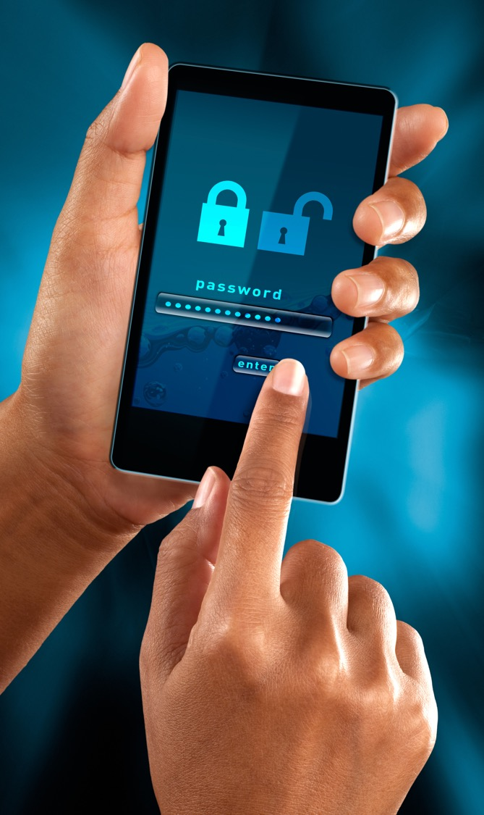
Data Leakage
Data leakage is the unauthorized transmission of data from within an organization to an external destination or recipient. Data Leakage threat vectors for mobile devices can be exploited by apps, visited websites and risky usage.
Areas of data leakage on mobile:
Fidelity of user experiences/security controls (i.e., does the mobile app offer the same
security as the desktop version).
Data loss on mobile (i.e., saving email to personal iCloud/Google drive).
Insecure applications: Application developed without security oversight/requirements
may be caching content (to speed up user experience) but that data may be exposed.
Malware on phones, if the phone is compromised, so is the data.
Avoid Data Leakage:
Extend the Data Loss Prevention and Information Protection policies over to your mobile devices.
Having policies to prevent users and applications from transferring data from corporate-owned apps to personal apps is key. Do not allow copy and paste from corporate to personal.
Disable screenshot options for corporate data.

Slide 9
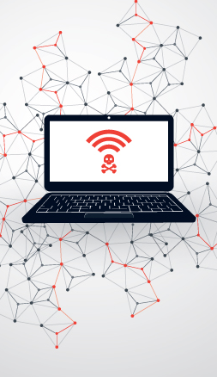
Unsecured WiFi
Public WiFi networks are generally insecure and can expose devices to many issues. As organizations moved to remote work options over the last two years, public WiFi presents a huge risk to all organizations.
The issue:
Canadian data plans are fairly restrictive, and users find WiFi to save data.
Connecting to public WiFi may be intercepted and not all mobile applications validate certificate authorities consistently.
Open wireless networks enable a greater attack surface area on mobile devices.
Secure your WiFi:
On a managed corporate phone you could encrypt traffic by using a VPN service – which is hard to enforce.
Having your sensitive data labeled and encrypted is one way to prevent it from reaching bad actors.
Mobile management policies that allow corporate data to only be accessed and transferred using corporate approved and controlled apps is important.
If you are allowing users to use native applications that you cannot control via policy, then you cannot establish secure communication protocols for these applications to use.

Slide 10
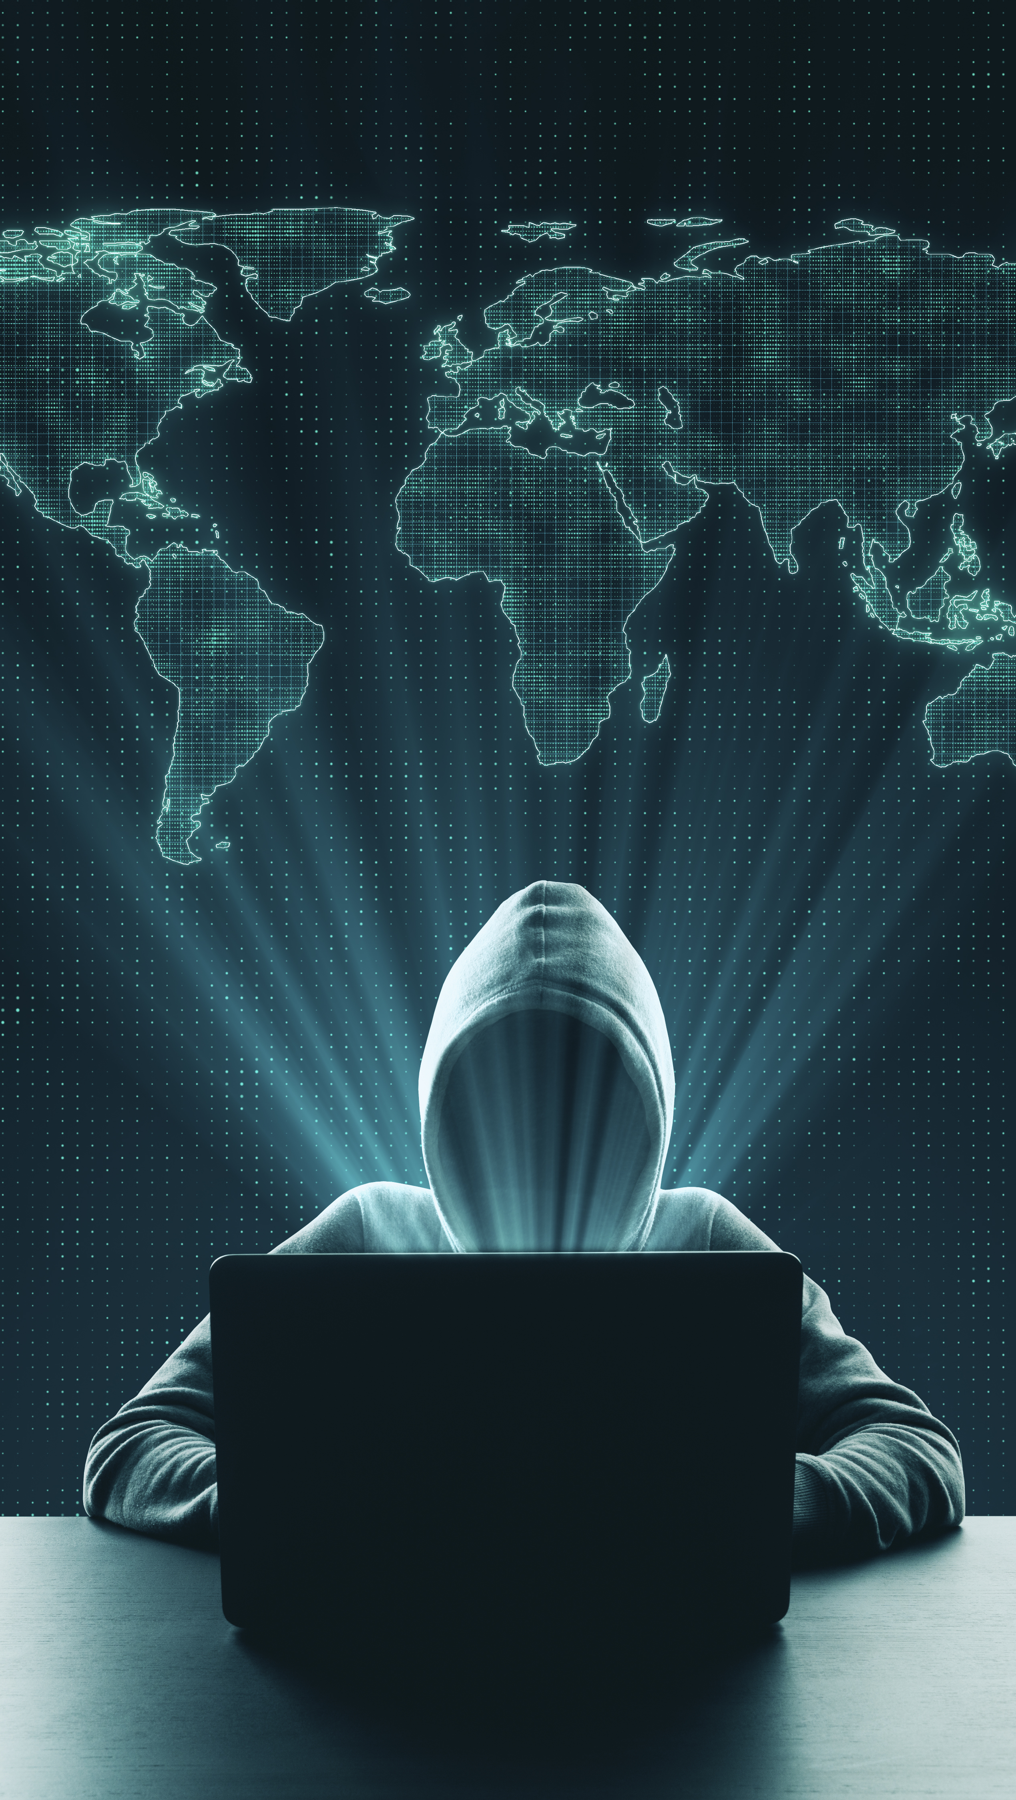
Network Spoofing
A spoofer is an individual who assumes the identity of another person, program or computer to fool other people, devices, and software into believing they are a trusted source. Typical forms of involve email spoofing, IP spoofing and network spoofing.
Don’t get spoofed!
During our engagements, we listen on the wireless radio to determine which SSIDs mobile devices are beaconing out to.
The SSID is captured by bad actors listening on a radio and then will set up an Evil Twin.
Spoofing can happen at many protocols including DHCP, WPAD (windows proxy service) or any other protocols to bait user credentials.
How to Avoid Spoofing
Disable legacy protocols.
Enforce corporate data to be transferred via secure protocols by having proper application policies in place
Per App VPN

Slide 11
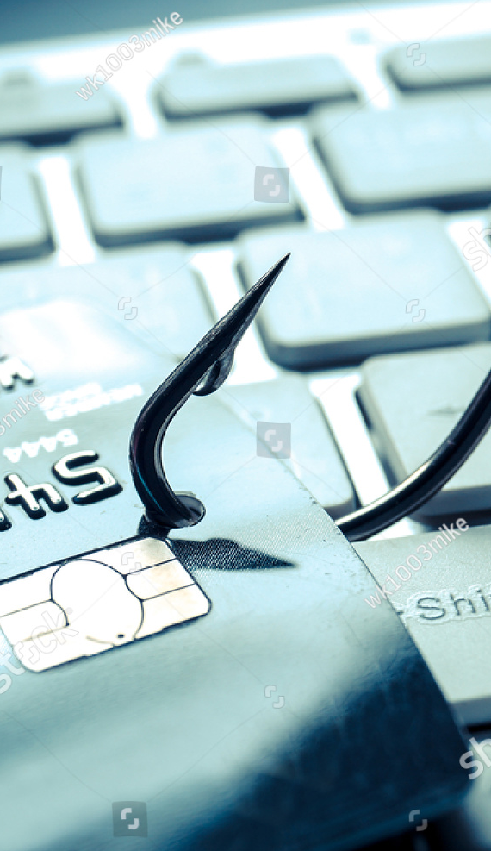
Phishing
Social engineering attacks occur when bad actors send fake emails (phishing attacks) or text messages (smishing attacks) to your employees in an effort to trick them into handing over private information like their passwords or downloading malware onto their devices.
Why Phishing
Surge in after hours work usually happens on our phones.
Bad actors are targeting us early in the morning or late at night.
COVID-19 vaccine booking system breach leveraged smishing.
Avoid Phishing
Having your phishing mechanisms extend to mobile devices is key. Even if a user clicks on a link in an email, the link should be scanned for any malicious activity before allowing the user to proceed further.
Do not allow access from unmanaged devices.
Do not allow access from applications that cannot be controlled by the corporation.

Slide 12
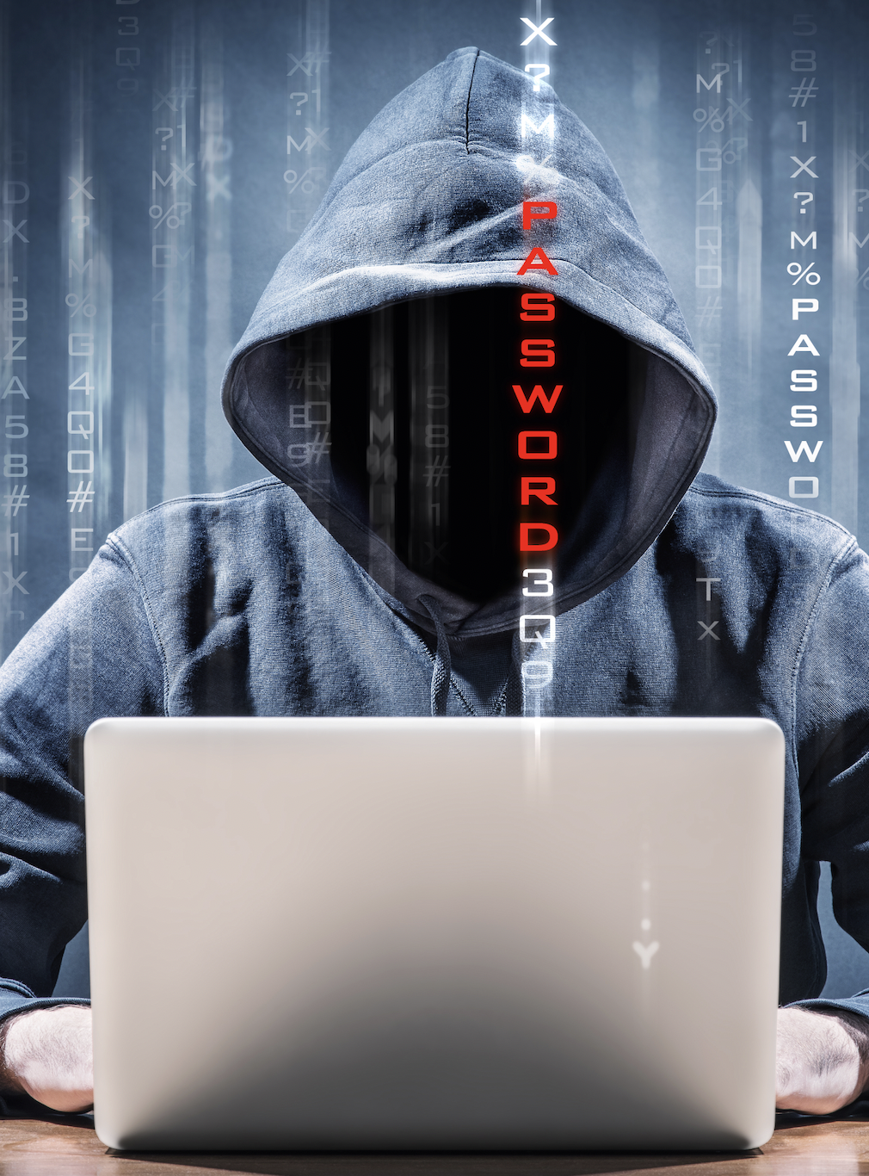
Spyware
Spyware is used to survey or collect data and is most commonly installed on a mobile device when users click on a malicious advertisement (“malvertisement”) or through scams that trick users into downloading it unintentionally.
Spyware is a Problem
Phones are with us every day and contain a mic, camera, accelerometers, GPS, and more.
In 2015, Italy-based HackingTeam was compromised, and promptly went out of business, outlining the tip of the iceberg on surveillance.
Fast-forward to 2021 and Project Pegasus starts to get media coverage for its use in nation-state surveillance.
Hackers all around the world look at our phones as the prime target.
Avoid Spyware
Mobile devices should utilize the same corporate anti-malware strategy that applies to corporate computers.
Advance threat protection mechanisms such as Defender for Endpoint does a good job amalgamating the overall malware strategy.

Slide 13
Broken Cryptography
Sensitive data at rest on a mobile device commonly falls victim to unintended disclosure due to poor, or complete lack of, cryptographic implementations. Developers dealing with tight deadlines or trying to cut corners may use encryption algorithms with existing vulnerabilities or not use any encryption at all.
Why Cryptography is Broken
There are no standardized frameworks for certificate validation and many apps blindly accept all certificates.
The bad actor takes the man-in-the-middle position between the target's mobile application and the back-end API. We've managed to pull clear-text credentials off phones with this technique.
Apps don’t use secure random number generators for any crypto activity and surprisingly we're still finding encoding (base64) used instead of encryption, especially within the mobile filesystem.
Avoid Broken Cryptography
Managed applications.
Managed mobiles.
Only allow corporate approved devices to access corporate data.

Slide 14
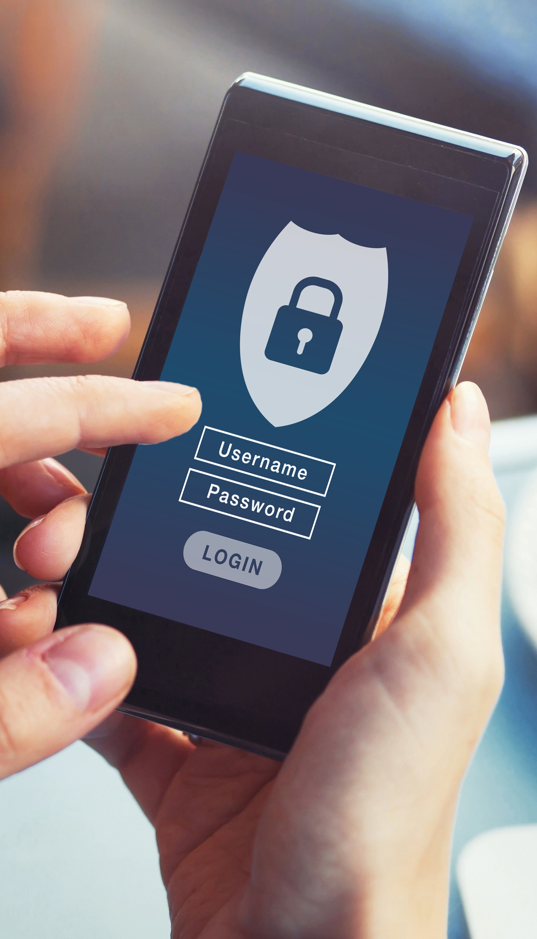
Improper Session Handling
Improper session handling typically results in the same outcomes as poor authentication. Once you are authenticated and given a session, that session allows one access to the mobile application. Mobile app code must protect user sessions just as carefully as its authentication mechanism.
How To Avoid Impression Session Handling
Client-side vs Server-side code is a tough concept for developers that do not have formal cybersecurity training.
We find mobile applications that determine when they're authorized to call certain API endpoints. Now bad actors can call an API endpoint, sometimes without any authentication/session, and exfiltrate sensitive data.
We also see applications that are developed where the login/password are sent with every API request.
Proper Session Handling:
Sessions in HTTP need to be random, and not guessable. This also factors into session management that removes the predictability of sessions.
Managed applications that have undergone vulnerability testing can be allowed.
Delineate between corporate managed applications and non corporate managed applications.

Slide 15
Questions For You
Why are mobile devices treated differently than workstations?
Why can’t the same policies that apply to the workstations be applied to mobile?
Should corporations allow unmanaged mobiles on your network?
What will be your biggest challenge in rolling out a proper MDM solution, especially BYOD?

Slide 16

Questions?
To ask our speakers a question,
type your question into the Chat located in the bottom right portion of the screen.

Slide 17
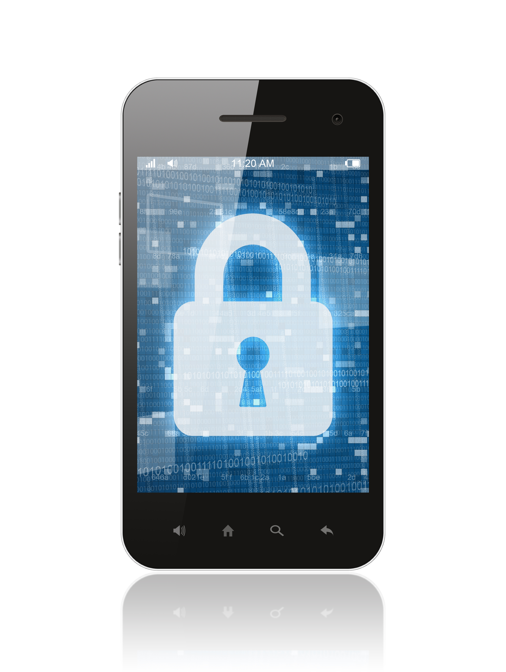
Mobile Application Security Testing
● Continuous Penetration Testing Services
  Infrastructure Pentest
  Authenticated Vulnerability Scans
  E-mail Phishing Simulations
  Active Directory Bloodhound Audit
  Active Directory Password Audit
  Ransomware Assessment
  Web Application Pentests
Mobile Application Security Testing
  Comprehensive testing of custom developed mobile applications on both iOS and Android devices
  Dynamic Application Security Testing (DAST) of back-end API to validate server-side controls
  Critical-flow analysis to review key features through a security lens (network capture, log review, disk activity, and credential exposure).
How To Get Started
  Respond to our webinar follow up email to book your free security advisory session before February15
  Download the additional information and resources in our follow up email

Slide 18
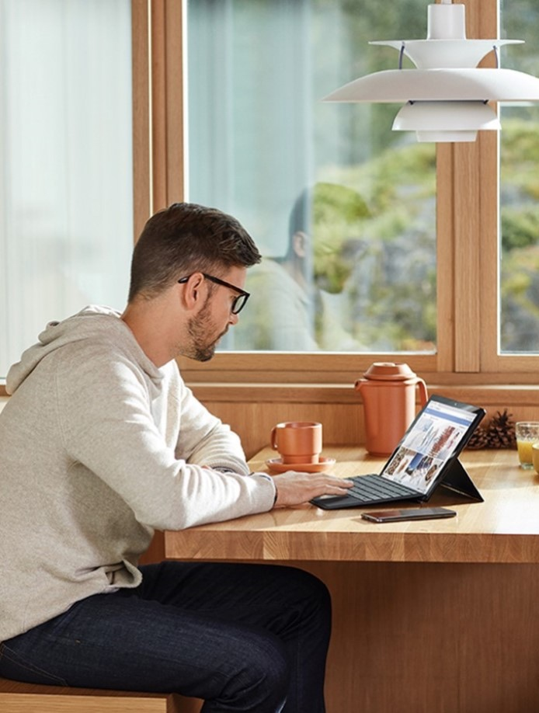
Thank you
for joining us today.
Amol Joshi
CrucialLogics
Amol.Joshi@cruciallogics.com
Richard Rogerson
Packetlabs
Rogerson@packetlabs.net
Claudio Damaso
CrucialLogics
Claudio.Damaso@cruciallogics.com

