Slide 1
Equipment: T&M estimating & Crew Mobile
Cris Poggi & Mike Boeringa

Slide 2
Agenda
System Setup
Application Settings
Routes
Opportunity
Estimating – Services & Items
Crew Mobile
Work Ticket Management

Slide 3
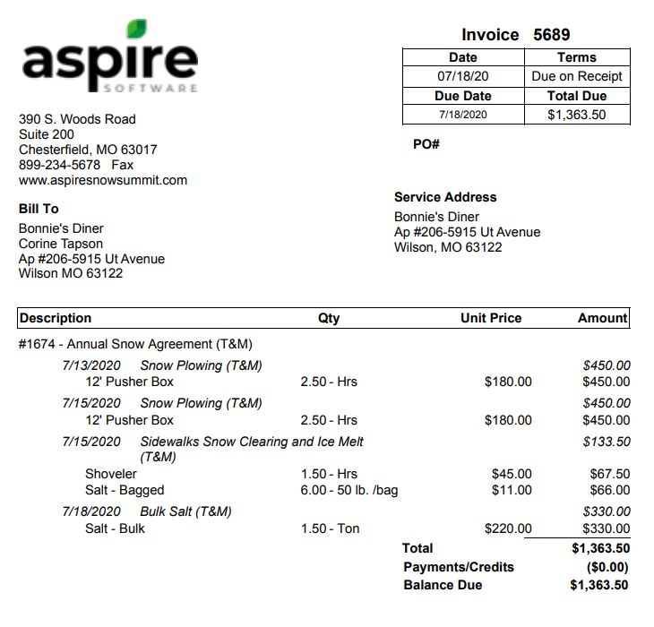

Slide 4
Create equipment items in the item catalog with $0.00 cost
On the equipment item always include “Allocate from mobile” for production to allocate usage in crew mobile
On Route – check off box that allows “Allow equipment time reporting”
Train production employees to select correct equipment when starting time
Determine whether “Include drive time when logging equipment from crew mobile ” applies to total time calculated for billing equipment (application configuration / time reporting tab)

Slide 5
Slips, Trips, and Falls Common Mistakes to Avoid
On equipment items do not check off inventory if allocating equipment from mobile
Confirm that auto expenses are aligned with type of pricing structure for client. Ex. V Plow 8’ per hour – set up with sub expense catalog item V Plow 8’ per hour
On all estimated equipment items override per price to sell price
For equipment to be allocated, it needs to be on the estimate!

