Slide 1
Municipal/Regional Government
Community of Practice
March 29th 2021
1:00 – 2:00 pm ET

Slide 2
Technical Considerations
Visuals: You must be connected through the URL to see today’s visuals
Webcam: If you are able, please turn on your webcams
Audio Options - Please select the appropriate audio setting via your Zoom control panel:
VoIP: You may connect your audio using your computer’s speakers and choose ‘Computer’.
Select “Telephone” Phone: +1 647 558 0588 Meeting ID: 939 5385 1811
Passcode: 664078

Slide 3
Gratitude & Acknowledgement
We begin this workshop by acknowledging that we are meeting on Indigenous land. As settlers, we are grateful for the opportunity to meet and we thank all the generations of Indigenous peoples who have taken care of this land.
As settlers, this recognition of the contributions and historic importance of Indigenous peoples must be clearly and overtly connected to our collective commitment to make the promise and the challenge of Truth and Reconciliation real in our communities.
Where are you calling from?
Guelph - situated on the ancestral homelands of the Anishinaabek Peoples, specifically the traditional territory of the Mississaugas of the Credit First Nation.

Slide 4
Today’s Agenda
Technical Considerations
Check ins
Presentation
Discussion
Closing Announcements
Purpose of the CoP
A platform for poverty reduction roundtables/coalitions working within municipal and regional governments to discuss challenges, explore strategies and successes related to poverty reduction work.

Slide 5
Topic and Check-In
Community Safety and Wellbeing Plans -
informing and interconnecting with Poverty Reduction Strategies
Check-in Question - How does this apply in your context?

Slide 6
Presentation By:
Barb Fedy
Director, Social Services Grey County
Christine MacDonald
Director, Human Services Bruce County
March 29, 2021

Slide 7
Presentation Overview
Brief Summary of CSWBP & Framework
Overview of the Approach by Municipalities of Bruce & Grey
Questions & Discussion
How can poverty reduction plans intersect with community safety and well-being planning?
How can existing poverty work inform new strategies
How can poverty reduction leads partner with Community Safety & Well-Being tables?
What are lessons learned or key takeaways from the Bruce & Grey experience?

Slide 8
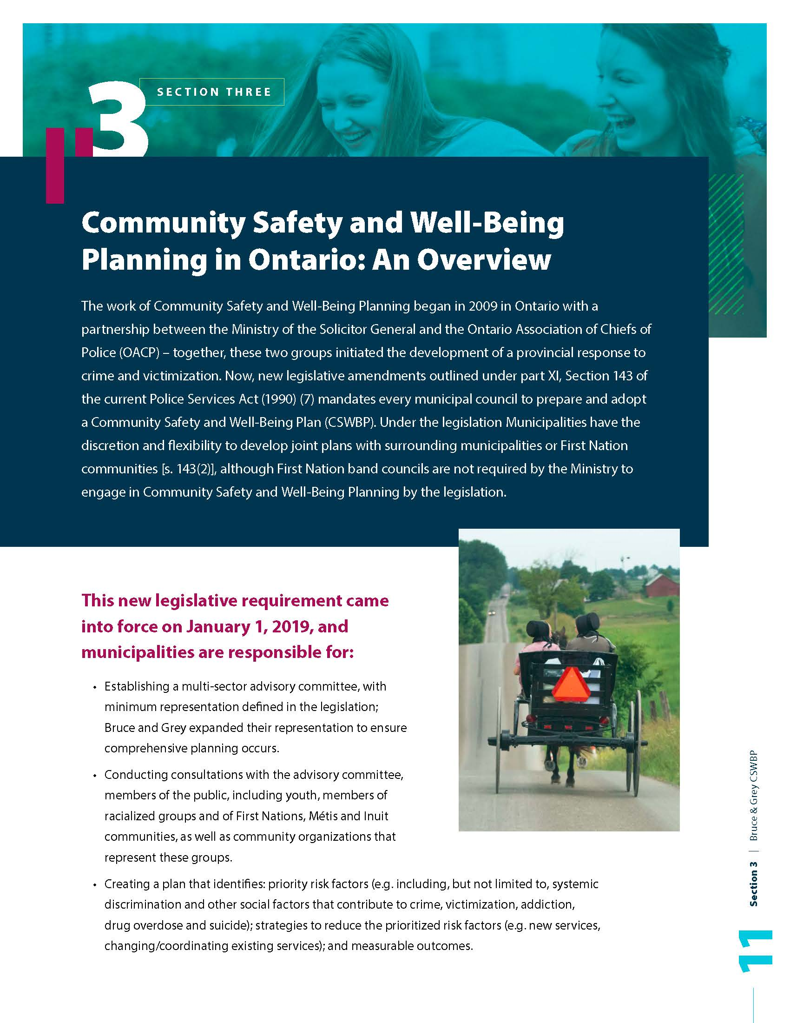
Why CSWBP?
The overarching goal of CSWBP is to achieve sustainable communities where everyone is safe, has a sense of belonging and opportunities to participate, and where individuals and families can meet their needs for education, health care, food, housing, income and social and cultural expression – which will ultimately lead to a reduction in crime across the region.
This process is legislated under the Police Services Act (1990) and the 2 Counties and 16 participating Municipalities entered into an agreement to complete one shared, regional Plan. At this point in time, we believe this is the largest and most unique collaboration in Ontario.

Slide 9
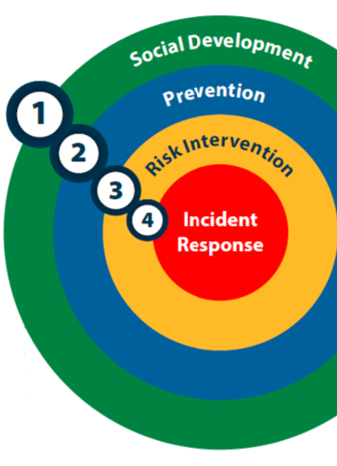
The Ontario CSWBP Framework
1. Social Development: Promoting and maintaining community safety and well-being, where a wide range of sectors, agencies and organizations bring different perspectives and expertise to the table to address complex social issues, like poverty, from every angle, ensuring all community members are aware of services available to them and can access those resources with ease.
2. Prevention: Proactively reducing identified risks and implementing evidence-based situational measures, policies or programs to reduce locally-identified priority risks to community safety and well-being before they result in crime, victimization and/or harm, where people participate more in risk-based programs, feel safe and less fearful, and are more confident in their own abilities to prevent harm.

Slide 10
The Ontario CSWBP Framework _{(cont’d)}
3. Risk Intervention: Mitigating situations of elevated risk, where multiple sectors work together to prevent an incident, whether it is a crime, victimization or harm, from occurring, while reducing the need for, and systemic reliance on, incident response in order to increase access to and confidence in social supports, decreased victimization rates and the number of emergency room visits.
4. Incident Response: Critical and non-critical incident response, or what is traditionally thought of when referring to crime and safety, including service responses such as police, fire, emergency medical services, child welfare organizations removing a child from their home, a person being apprehended under the Mental Health Act, or a school principal expelling a student.

Slide 11
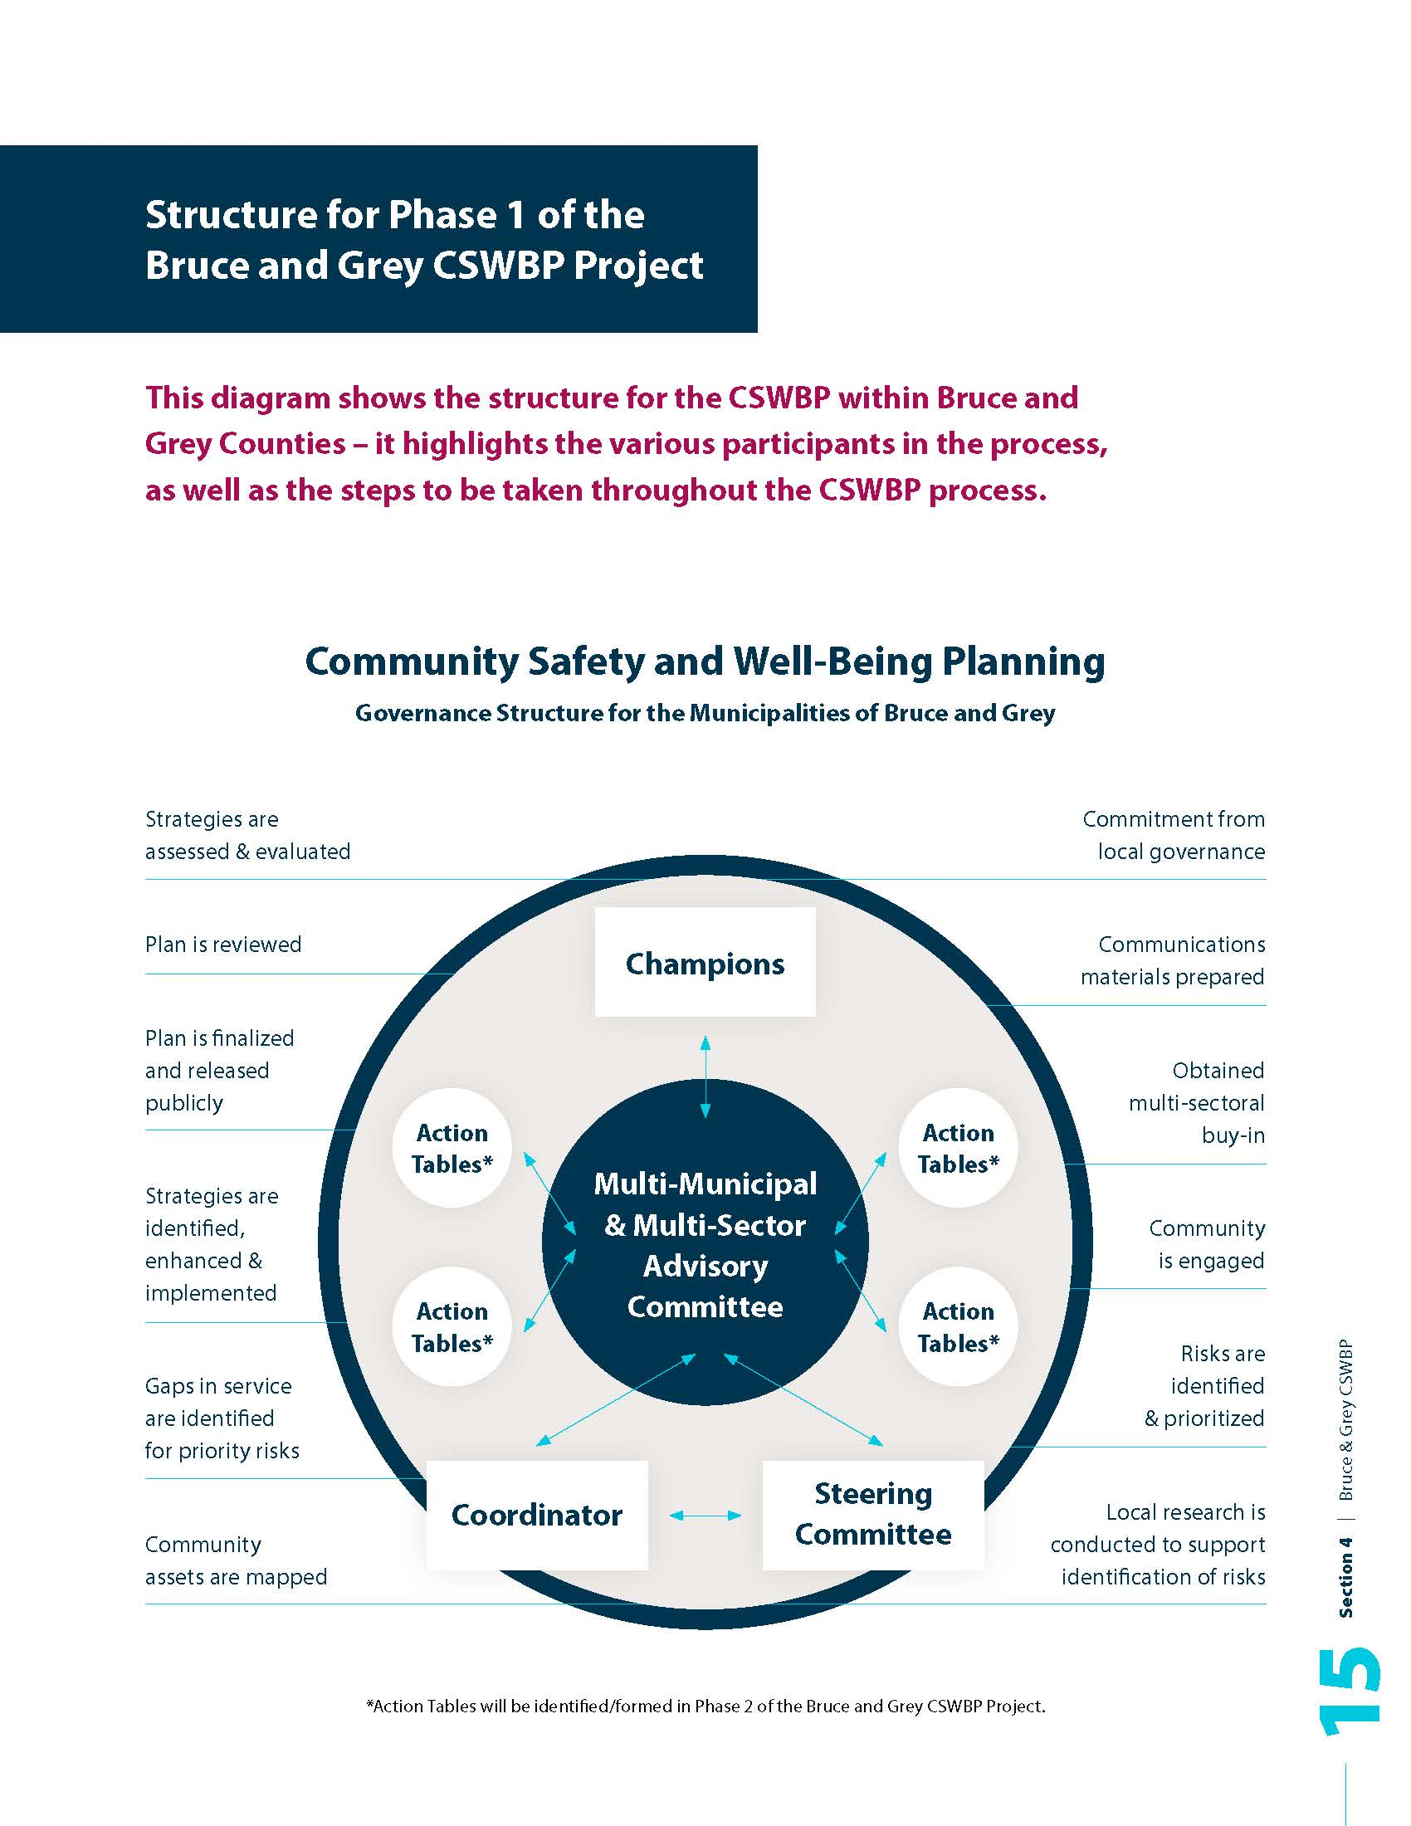
The Bruce and Grey CSWBP Model
Champions – maintain community engagement and awareness;
Multi-Sector Advisory Committee – provides project oversight and support;
Steering Committee – provides Coordinator oversight and ensures work is being completed;
Coordinator – drives the work of CSWBP including implementation, monitoring, evaluation and supports the Committees/ Action Tables; and
Action Tables – Provide content matter expertise for identified Areas of Risk, create/implement action plans, and then evaluate outcomes and impacts (supported by the Coordinator/ Committees/ participating organizations).

Slide 12
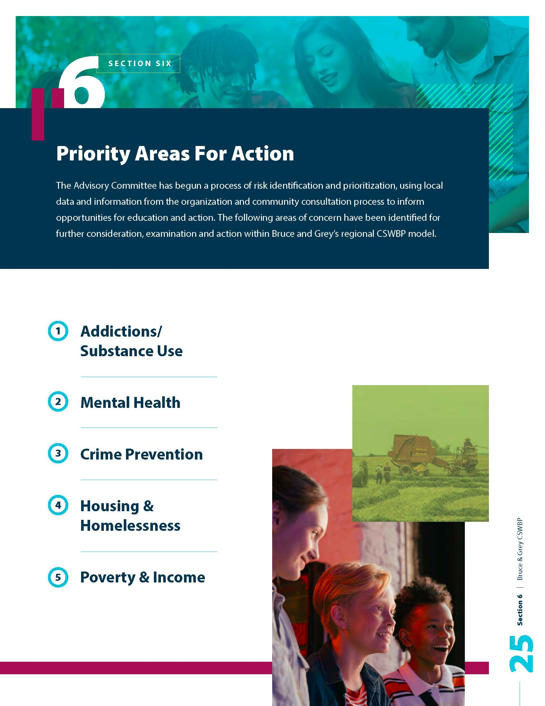
THE BRUCE AND GREY CSWBP PRIORITY AREAS FOR ACTION

Slide 13
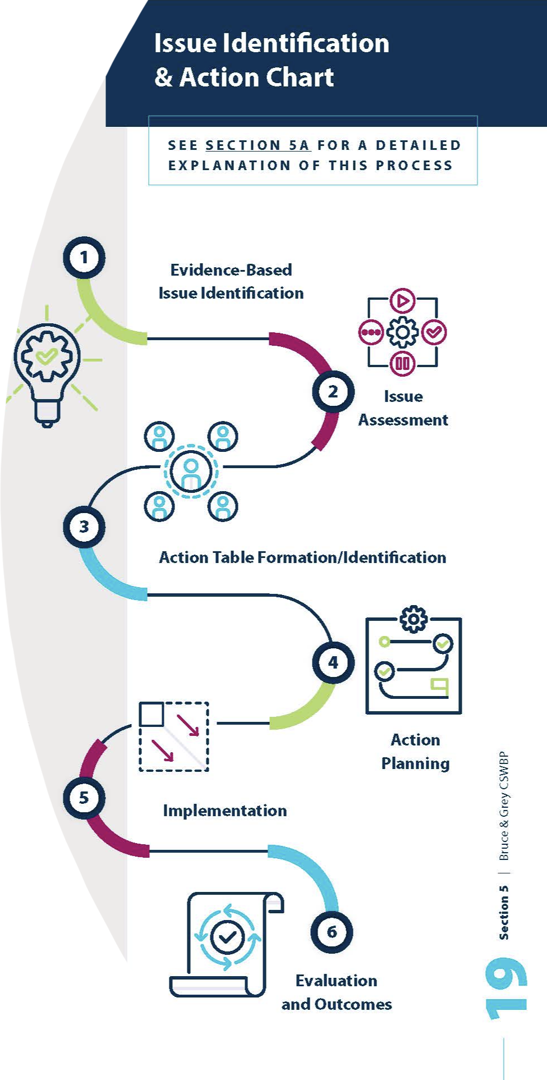
A Focus on Local Solutions & Collective Impact
Collective planning across sectors and between collaborative committees will need to occur in order to ensure that responses and actions are systems-based and are tied to project outcomes that can then be evaluated.
The plan is designed to leverage the good work already being done across Bruce and Grey by enhancing the collaboration and coordination of the various organizations, committees and initiatives.

Slide 14
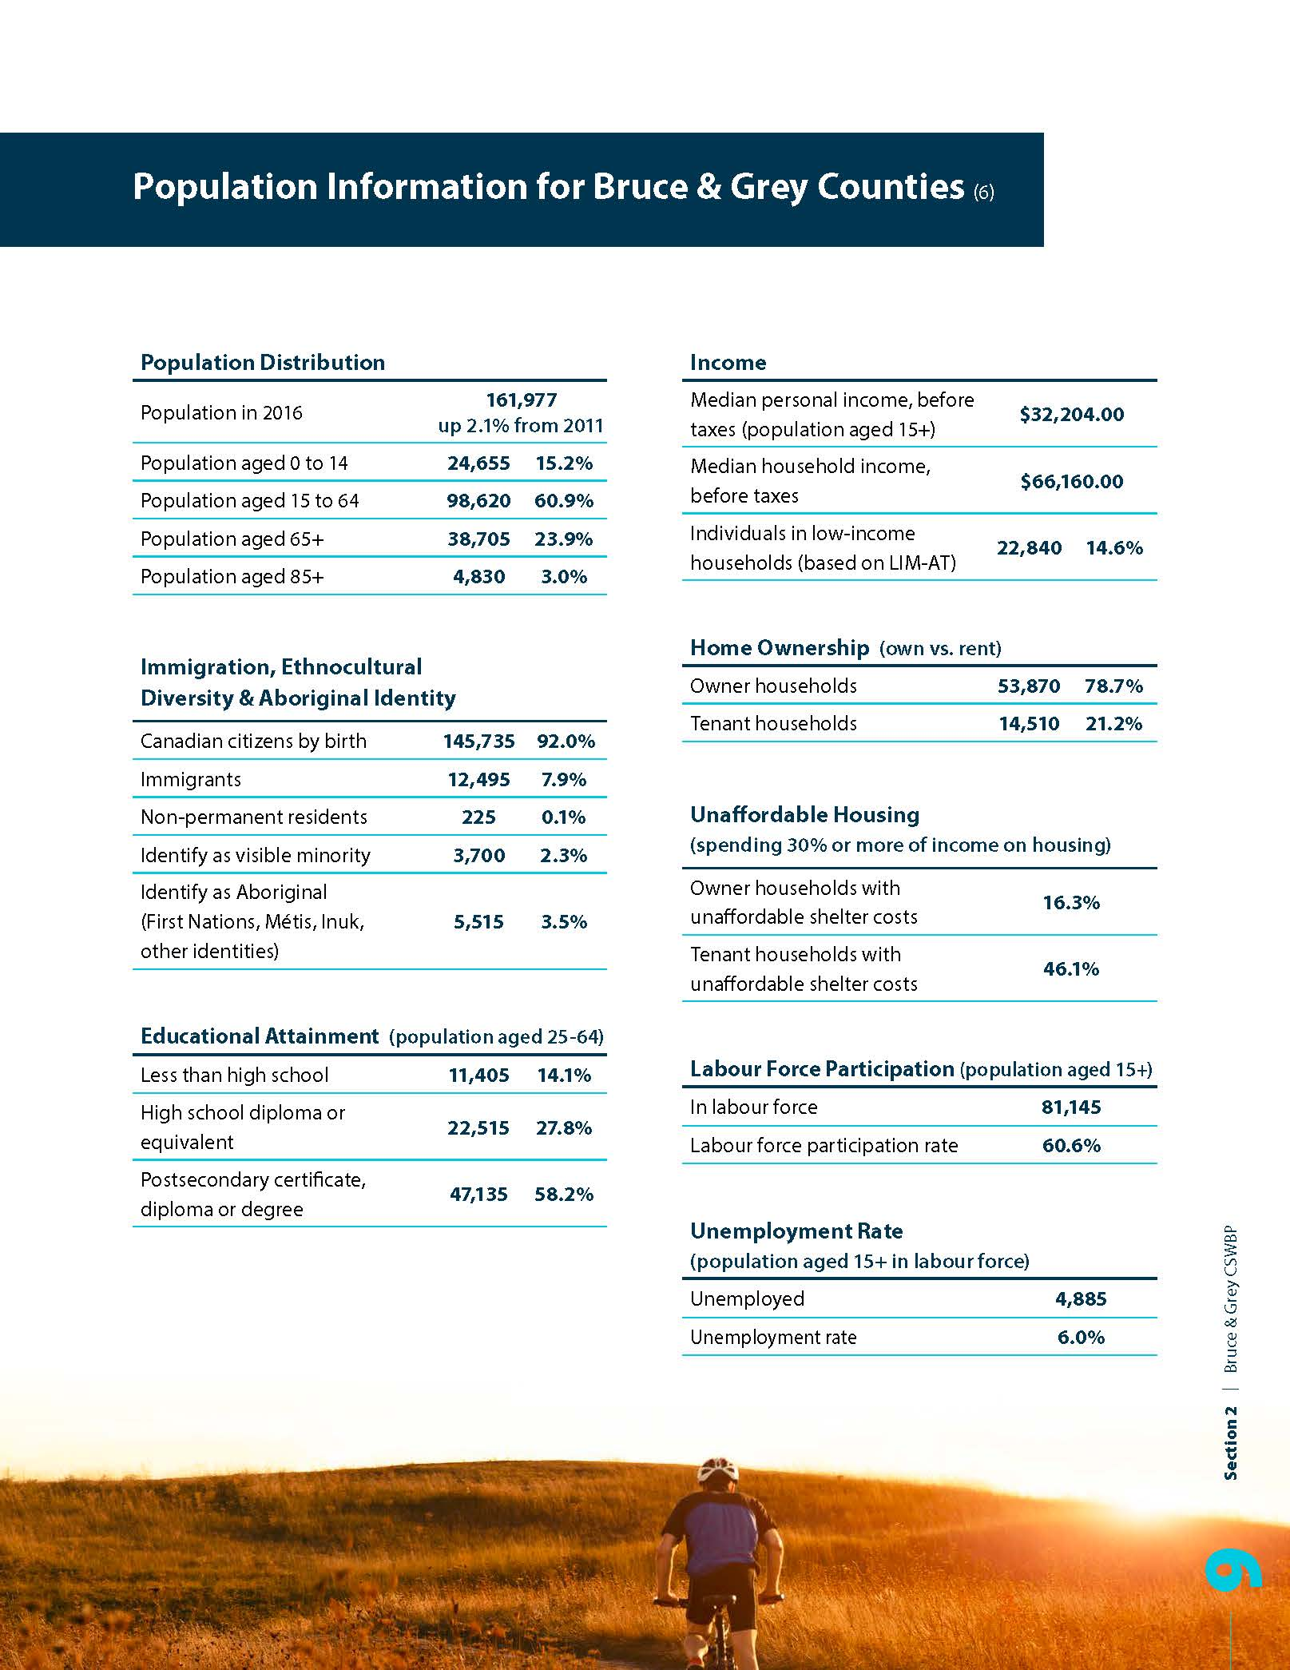
Facilitating Outcome Evaluation
An Indicator Report for the project is currently under development. This Report will explore:
The Municipalities of Bruce and Grey Data/Indicator Framework – a description of the process involved in the identification of priority areas of risk (local data and resident perceptions).
An Overview of Safety and Well-Being in Bruce and Grey – baseline data, a summary of community/resident perceptions, and identification of areas for action.
Ultimately, this Report will facilitate outcome evaluation for CSWBP using locally available data, acting as a resource for the Advisory Committee and Action Tables.

Slide 15
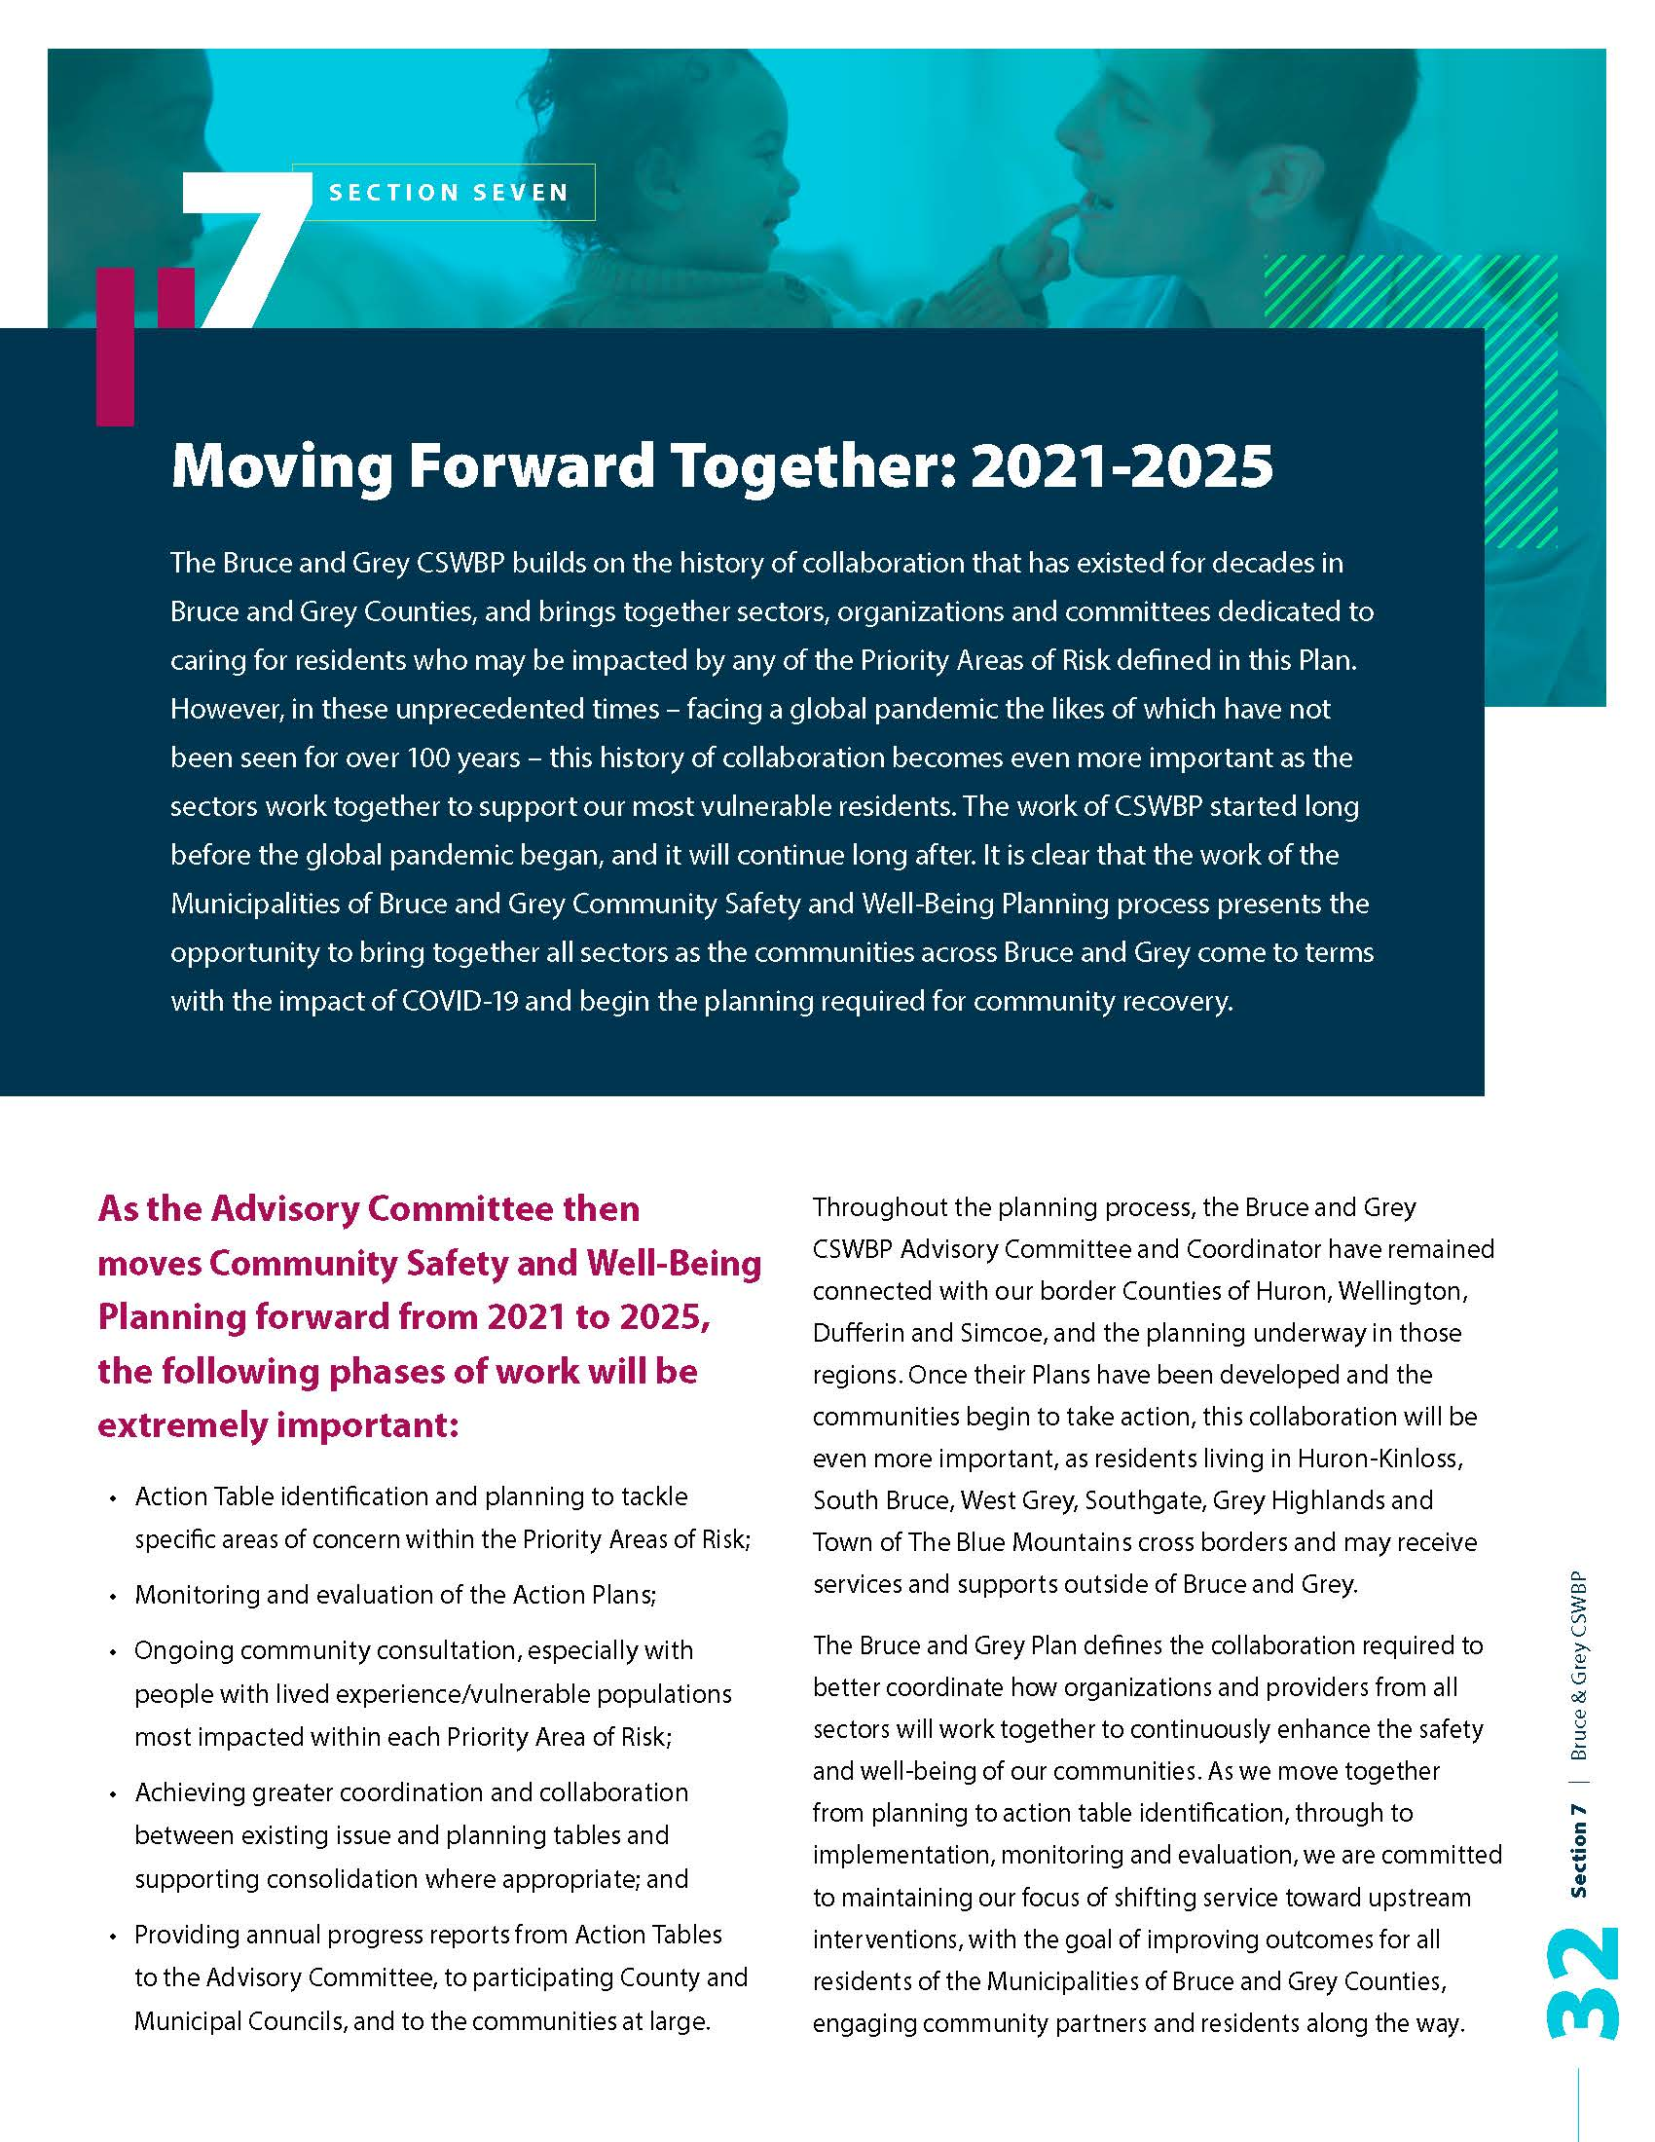
NEXT STEPS FOR THE BRUCE AND GREY CSWBP

Slide 16
Question & Discussion
How can poverty reduction plans intersect with community safety and well-being planning?
How can existing poverty work inform new strategies
How can poverty reduction leads partner with Community Safety & Well-Being tables?
What are lessons learned or key takeaways from the Bruce & Grey experience?

Slide 18
Upcoming Opportunities
All Convenor Call - April 6th
National Advisory Committee on Poverty’s First Report
Private Webinar – April 20th
Decolonizing the City - Vancouver’s Equity Framework
NEXT MEETING: May 24th (TBD)

Slide 19
The End of Poverty Summit
Register Now!
May 5-6th 2021
Celebrating successes in poverty reduction
Co-generating solutions for ending poverty
Inspiring keynote speakers and 14 interactive workshops
Inviting participation from across geographies and sectors
https://events.tamarackcommunity.ca/the-end-of-poverty
Notes:
Get people excited for 2020 Calgary

Slide 20
Webinars
Monitoring Outcomes & Measuring Impact | Lessons from the Opportunity Youth Forum
March 31st
Evaluation for Transformative Change
April 5th
Democracy - A New Idea for Government to Do With Not For
April 7th
Equity, Engagement, and Civic Leadership: How Does Your Community Rate?
April 14th
Culture, Collaboration, and Choice: A Values Approach
April 28th

Slide 21
Thank you
If you have any questions or content for the next call, please contact elle@tamarackcommunity.ca

