Slide 1




Using the
Paycheck Protection Program of the CARES Act
Handout materials are available for download or printing on the HANDOUT TAB on the gotowebinar console. If the tab is not open click on that tab to open it and view the materials.

Slide 2

Using the
Paycheck Protection Program of the CARES Act
Robert S. Keebler, CPA/PFS, MST, AEP (Distinguished)
Martin Shenkman, CPA, MBA, PFS, AEP (Distinguished), JD

Slide 3
General Disclaimer
The information and/or the materials provided as part of this program are intended and provided solely for informational and educational purposes. None of the information and/or materials provided as part of this power point or ancillary materials are intended to be, nor should they be construed to be the basis of any investment, legal, tax or other professional advice. Under no circumstances should the audio, power point or other materials be considered to be, or used as independent legal, tax, investment or other professional advice. The discussions are general in nature and not person specific. Laws vary by state and are subject to constant change. Economic developments could dramatically alter the illustrations or recommendations offered in the program or materials.

Slide 4
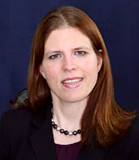



Thank you to our sponsors
InterActive Legal
  Vanessa Kanaga
  (321) 252-0100
  sales@interactivelegal.com

Slide 5


Thank you to our sponsors
Peak Trust Company
  Brandon Cintula
  (888) 544-6775
  bcintula@peaktrust.com

Slide 6
Jane Ransom, Executive Director
jransom@americanbrainfoundation.org
AmericanBrainFoundation.org

Slide 7
Paycheck Protection Program
Background – What is it? JB
The Paycheck Protection Program and loan forgiveness are intended to provide economic relief to small businesses nationwide adversely impacted under the Coronavirus Disease 2019 (COVID-19) Emergency Declaration (COVID-19 Emergency Declaration) issued by President Trump on March 13, 2020. JB
Practitioners should regularly consult FAQs that are to be updated https://home.treasury.gov/system/files/136/Paycheck-Protection-Program-Frequenty-Asked-Questions.pdf MS
Note: Employers should rely on the rules in effect when they filed their application. See FAQ 17. MS
H. R. 748, SEC. 1102
Coronavirus Aid, Relief, and Economic Security Act (CARES Act)
The SBA issued an interim final rule April 2, 2020 [Docket No. SBA-2020-0015]RIN 3245-AH34
FAQs were issued April 6, 2020 and are updated periodically

Slide 8
Paycheck Protection Program
Basic Rules RK
Covered dates: 2/15/20 – 6/30/20
Dollars Allocated to forgivable loans: $349 billion –Caution: The loans are only available until the funds are exhausted so practitioners need to apply early and help clients do the same.
Loan terms are identical for all borrowers
Basic Eligibility:
  Any business concern, non-profit, veterans organization or Tribal business
  Not more than 500 employees; generally (Note: Small business concerns can be eligible borrowers even if they have more than 500 employees, as long as they satisfy the existing statutory and regulatory definition of a “small business concern” under section 3 of the Small Business Act, 15 U.S.C. 632. See FAQ 2).
H. R. 748, SEC. 1102
Coronavirus Aid, Relief, and Economic Security Act (CARES Act)
The SBA issued an interim final rule April 2, 2020 [Docket No. SBA-2020-0015]RIN 3245-AH34

Slide 9
Paycheck Protection Program
Eligibility RK
Eligibility Details:
  Self-employed and independent contractors are eligible
  Special eligibility for restaurants (basically) with not more than 500 employees per physical location, and franchisor is recognized by the SBA
H. R. 748, the CARES ACT, SEC. 1102

Slide 10
Paycheck Protection Program
Definition Small Business MS
Definitions of small business and nonprofit under III.2.a.i of the 4/2/20 interim guidance:
  A. A small business concern as defined in section 3 of the Small Business Act (15 USC 632), and subject to SBA’s affiliation rules under 13 CFR 121.301(f) unless specifically waived in the Act [see next page];
  B. A tax-exempt nonprofit organization described in section 501(c)(3) of the Internal Revenue Code (IRC), a tax-exempt veterans organization described in section 501(c)(19) of the IRC, Tribal business concern described in section 31(b)(2)(C) of the Small Business Act, or any other business;
  See FAQ 3.
H. R. 748, the CARES ACT, SEC. 1102

Slide 11
Paycheck Protection Program
Affiliation Rules RK
Definitions of small business is subject to the affiliation rules.
Borrowers must apply the affiliation rules set forth in SBA’s Interim Final Rule on Affiliation. A borrower must certify on the Borrower Application Form that the borrower is eligible to receive a PPP loan, and that certification means that the borrower is a small business concern as defined in section 3 of the Small Business Act (15 U.S.C. 632), meets the applicable SBA employee-based or revenue-based size standard, or meets the tests in SBA’s alternative size standard, after applying the affiliation rules, if applicable. SBA’s existing affiliation exclusions apply to the PPP, including, for example the exclusions under 13 CFR 121.103(b)(2).
See FAQ 5.
The affiliation rule based on ownership (13 C.F.R. 121.301(f)(1)) states that SBA will deem a minority shareholder in a business to control the business if the shareholder has the right to prevent a quorum or otherwise block action by the board of directors or shareholders. If a minority shareholder in a business irrevocably waives or relinquishes any existing rights specified in 13 C.F.R. 121.301(f)(1), the minority shareholder would no longer be an affiliate of the business (assuming no other relationship that triggers the affiliation rules).
See FAQ 6.
H. R. 748, the CARES ACT, SEC. 1102

Slide 12
Paycheck Protection Program
Eligibility RK
Who is not Eligible:
Businesses that are not eligible for PPP loans are identified in 13 CFR 120.110 and described further in SBA’s Standard Operating Procedure (SOP) 50 10, Subpart B, Chapter 2,
H. R. 748, the CARES ACT, SEC. 1102

Slide 13
Paycheck Protection Program
Eligibility NEW SLIDE JB
§ 120.110 What businesses are ineligible for SBA business loans?
The following types of businesses are ineligible:
(a) Non-profit businesses (for-profit subsidiaries are eligible);
(b) Financial businesses primarily engaged in the business of lending, such as banks, finance companies, and factors (pawn shops, although engaged in lending, may qualify in some circumstances);
(c) Passive businesses owned by developers and landlords that do not actively use or occupy the assets acquired or improved with the loan proceeds (except Eligible Passive Companies under § 120.111);
(d) Life insurance companies;
(e) Businesses located in a foreign country (businesses in the U.S. owned by aliens may qualify);
(f) Pyramid sale distribution plans;
(g) Businesses deriving more than one-third of gross annual revenue from legal gambling activities;
(h) Businesses engaged in any illegal activity;
(i) Private clubs and businesses which limit the number of memberships for reasons other than capacity;
(j) Government-owned entities (except for businesses owned or controlled by a Native American tribe);
(k) Businesses principally engaged in teaching, instructing, counseling or indoctrinating religion or religious beliefs, whether in a religious or secular setting;
(l) [Reserved]
(m) Loan packagers earning more than one third of their gross annual revenue from packaging SBA loans;
(n) Businesses with an Associate who is incarcerated, on probation, on parole, or has been indicted for a felony or a crime of moral turpitude;
(o) Businesses in which the Lender or CDC, or any of its Associates owns an equity interest;
(p) Businesses which:
(1) Present live performances of a prurient sexual nature; or
(2) Derive directly or indirectly more than de minimis gross revenue through the sale of products or services, or the presentation of any depictions or displays, of a prurient sexual nature;
(q) Unless waived by SBA for good cause, businesses that have previously defaulted on a Federal loan or Federally assisted financing, resulting in the Federal government or any of its agencies or Departments sustaining a loss in any of its programs, and businesses owned or controlled by an applicant or any of its Associates which previously owned, operated, or controlled a business which defaulted on a Federal loan (or guaranteed a loan which was defaulted) and caused the Federal government or any of its agencies or Departments to sustain a loss in any of its programs. For purposes of this section, a compromise agreement shall also be considered a loss;
(r) Businesses primarily engaged in political or lobbying activities; and
(s) Speculative businesses (such as oil wildcatting).

Slide 14
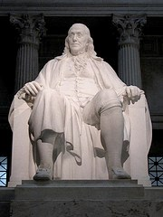
Paycheck Protection Program
Payroll Costs JB
Payroll Costs Include:
  Salary, wages, commissions
  Tips
  Paid leave
  Healthcare payments
  Retirement benefit payments
  Some independent contractors
H. R. 748, the CARES ACT, SEC. 1102
Section III.2.f. of the 4/2/20 interim guidance

Slide 15
Paycheck Protection Program –
What Payroll Includes Details MS
Payroll Costs Include per the 4/2/20 Interim guidance:
  f. What qualifies as “payroll costs?” Payroll costs consist of compensation to employees (whose principal place of residence is the United States) in the form of salary, wages, commissions, or similar compensation; cash tips or the equivalent (based on employer records of past tips or, in the absence of such records, a reasonable, good-faith employer estimate of such tips); payment for vacation, parental, family, medical, or sick leave; allowance for separation or dismissal; payment for the provision of employee benefits consisting of group health care coverage, including insurance premiums, and retirement; payment of state and local taxes assessed on compensation of employees; and for an independent contractor or sole proprietor, wage, commissions, income, or net earnings from self-employment or similar compensation.
H. R. 748, the CARES ACT, SEC. 1102
Section III.2.f. of the 4/2/20 interim guidance

Slide 16
Paycheck Protection Program RK
Payroll Costs Do Not Include:
  Compensation of an individual employee in excess of an annual salary of $100,000 as prorated for the covered period. Note, however, that this exclusion of compensation in excess of $100,000 annually applies only to cash compensation, not to non-cash benefits. See FAQ 7.
  Qualified sick leave wages for which a credit was allowed under section 7001 of the Families First Coronavirus Response Act
  Qualified family leave wages for which a credit was allowed under section 7003 of the Families First Coronavirus Response Act
H. R. 748, the CARES ACT, SEC. 1102

Slide 17
Paycheck Protection Program- What Payroll Excludes Details JB
Payroll Costs Exclude per the 4/2/20 Interim guidance:
  g. Is there anything that is expressly excluded from the definition of payroll costs?
  Yes. The Act expressly excludes the following:
  i. Any compensation of an employee whose principal place of residence is outside of the United States;
  ii. The cash compensation of an individual employee in excess of an annual salary of $100,000, prorated as necessary (other benefits are not limited by the cap);
  iii. Federal employment taxes imposed or withheld do not reduce gross compensation in the calculation. See FAQ 16; and
  iv. Qualified sick and family leave wages for which a credit is allowed under sections 7001 and 7003 of the Families First Coronavirus Response Act (Public Law 116–127).
H. R. 748, the CARES ACT, SEC. 1102
Section III.2.g. of the 4/2/20 interim guidance; See FAQ 7

Slide 18
Paycheck Protection Program – Payments to Independent Contractors Are Not Included MS
Payroll Costs Do Not Include payments to independent contractors in the most recent pronouncement, but it is not certain that is consistent with the statute:
Payroll costs consist of compensation to employees (whose principal place of
residence is the United States) in the form of salary, wages, commissions, or
similar compensation; cash tips or the equivalent (based on employer records of
past tips or, in the absence of such records, a reasonable, good-faith employer
estimate of such tips); payment for vacation, parental, family, medical, or sick
leave; allowance for separation or dismissal; payment for the provision of
employee benefits consisting of group health care coverage, including insurance
premiums, and retirement; payment of state and local taxes assessed on
compensation of employees; and for an independent contractor or sole proprietor, wage, commissions, income, or net earnings from self-employment or similar
compensation.
"and for" may be different from "to
H. R. 748, the CARES ACT, SEC. 1102

Slide 19
Paycheck Protection Program – What About Independent Contractors? MS
Section III.2.a.ii of the 4/2/20 interim guidance provides: “You are also eligible for a PPP loan if you are an individual who operates under a sole proprietorship or as an independent contractor or eligible self- employed individual, you were in operation on February 15, 2020.”
The above might suggest that sole proprietorships and independent contractors submit for their own PPP loans and that those businesses paying a sole proprietorship or independent contractor cannot also count them in their calculations.
This is confirmed in III.2.h. “Do independent contractors count as employees for purposes of PPP loan calculations? No, independent contractors have the ability to apply for a PPP loan on their own so they do not count for purposes of a borrower’s PPP loan calculation.“
Section III.2.p. of the interim guidance provides: “Do independent contractors count as employees for purposes of PPP loan forgiveness? No, independent contractors have the ability to apply for a PPP loan on their own so they do not count for purposes of a borrower’s PPP loan forgiveness.”
H. R. 748, the CARES ACT, SEC. 1102

Slide 20
Paycheck Protection Program – What About Independent Contractors? MS
Section III.2.e.ii of the 4/2/20 interim guidance provides: “Step 2: Subtract any compensation paid to an employee in excess of an annual salary of $100,000 and/or any amounts paid to an independent contractor or sole proprietor in excess of $100,000 per year.
Comment: This is an error and does suggest that independent contractor payments are included as this is inconsistent with the information quoted above from several express provisions in the guidance.
H. R. 748, the CARES ACT, SEC. 1102

Slide 21
Paycheck Protection Program
Calculation Formula RK
  The maximum loan amount is based on the lesser of:
  (1) Average monthly Payroll incurred within the 1 year period before the date on which the loan is made
  X 2.5
  = Loan Cap
  Or (2) $10,000,000
H. R. 748, the CARES ACT, SEC. 1102
Section III.2.e.ii of the 4/2/20 interim guidance

Slide 22
Paycheck Protection Program
What Time Period to Use in Calculation? RK
  Borrowers can calculate their aggregate payroll costs using data either from the previous 12 months or from calendar year 2019.
  For seasonal businesses, the applicant may use average monthly payroll for the period between February 15, 2019, or March 1, 2019, and June 30, 2019.
  An applicant that was not in business from February 15, 2019 to June 30, 2019 may use the average monthly payroll costs for the period January 1, 2020 through February 29, 2020.
  FAQ 14
H. R. 748, the CARES ACT, SEC. 1102
Section III.2.e.ii of the 4/2/20 interim guidance

Slide 23
Paycheck Protection Program
Special Rules RK
  Loan cap computation special rules
    Seasonal employers
      See FAQ 9.
    Those with outstanding loans
    New businesses
H. R. 748, the CARES ACT, SEC. 1102

Slide 24
Paycheck Protection Program
JB then RK
  Allowable use of covered loans:
    Payroll costs
    Group healthcare benefits
    Employee salaries, wages, commissions, or similar
    Payment of interest on any mortgage obligation incurred before 2/15/20
    Rent on a lease in force before 2/15/20
    Utilities for which service began before 2/15/20
    Interest on any debt obligations incurred before the covered period
H. R. 748, the CARES ACT, SEC. 1102
Section III.2.r. of the 4/2/20 interim guidance

Slide 25
Paycheck Protection Program JB
  No requirement that business is not able to obtain credit elsewhere
  Loans are nonrecourse – except if the proceeds are used for an unauthorized purpose
  No personal guarantee required
  No collateral required
The legislation may be internally inconsistent on this point.
H. R. 748, the CARES ACT, SEC. 1102
Section III.4.a. of the 4/2/20 interim guidance

Slide 26
Partnership Loan Basis RK
  In a partnership (or an LLC taxed as a partnership), “debt basis” can only come in two forms:
  Recourse debt
  Qualified non-recourse financing
    Generally includes financing for which no one is personally liable for repayment that is borrowed for use in an activity of holding real property and that is loaned or guaranteed by a federal, state, or local government or borrowed from a “qualified” person
    “Qualified persons” include any persons actively and regularly engaged in the business of lending money, such as a bank or savings and loan association, but generally do not include related parties the seller of the property, or a person who receives a fee for the partnership's investment in the real property

Slide 27
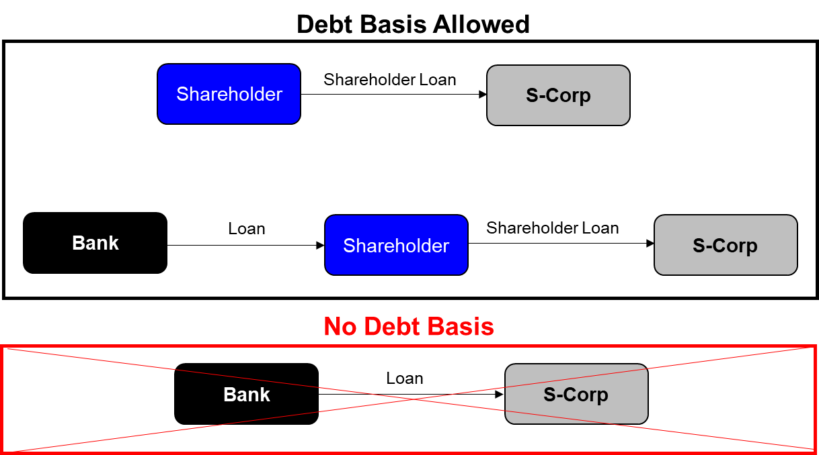
S-Corporation Loan Basis RK
  In an S-Corporation, a shareholder can only have debt basis on loans that shareholder personally makes to the S-Corporation.

Slide 28
Paycheck Protection Program RK
  Good Faith Certification Required
    The current uncertainty makes the loan necessary to support ongoing operations
    The funds will be used to retain workers and maintain payroll or make mortgage payments, lease payments, and utility payments
    No duplicative amounts
H. R. 748, the CARES ACT, SEC. 1102
Section III.2.t. of the 4/2/20 interim guidance

Slide 29

Paycheck Protection Program RK
  Remaining Balance after Forgiveness
    Guaranteed by the SBA
    A PPP loan can be used to refinance a EIDL Loan (see below), but only the amounts eligible for forgiveness under the rules discussed above for PPL loans, will be forgiven.
H. R. 748, the CARES ACT, SEC. 1102

Slide 30
Paycheck Protection Program RK
  General terms
    INTEREST RATE: During the covered period, a covered loan shall bear an interest rate not to exceed 4 percent (by statute). However, in the Treasury Guidance issued 3/31/20 it stated that the rate was to be .5% and is now 1%. See Section III.2.i of the 4/2/20 interim guidance
    PAYMENT DEFERMENT: 6-12 month of deferment including principal, interest and fees (by statute). However, in the Treasury Guidance issued 3/31/20 it stated that the deferral would be only 6 months and that interest would accrue during that period. See Section III.2.n of the 4/2/20 interim guidance
    ORIGINATION FEES: Lender reimbursed by the SBA
    TERM: Maximum maturity of 10-years from the date on which loan forgiveness is applied for (by statute). However, the Treasury Guidance indicates the loans will be due in two years. See Section III.2.j of the 4/2/20 interim guidance
H. R. 748, the CARES ACT, SEC. 1102

Slide 31
Paycheck Protection Program RK
  SBA Disaster Loan Overlap
    Economic injury disaster loans are also available from the SBA – the entire country is a declared disaster area
    A recipient of a disaster loan is generally not barred from participating in the Paycheck Protection Program
    As noted elsewhere you can refinance a EIDL with a PPP loan. See below.
H. R. 748, the CARES ACT, SEC. 1102

Slide 32
Paycheck Protection Program JB
  Loan Forgiveness – Principal forgiven in an amount equal to the following costs incurred during the eight weeks after the loan is originated:
    Payroll costs
    Mortgage interest*
    Rent*
    Utilities*
*Although the statues provide that loan proceeds used for these expenses may be forgiven, Treasury guidance issued 3/3/20 indicates that it is anticipated that not more than 25% of the forgiven amount may be for non-payroll costs.
H. R. 748, the CARES ACT, SEC. 1106
See Section III.2.o of the 4/2/20 interim guidance

Slide 33
Paycheck Protection Program MS
  Banks do not need to do any verification of a borrower’s information on loan forgiveness. Section III.3.c. of the 4/2/20 interim guidance directs banks as to underwriting.
*Providing an accurate calculation of payroll costs is the responsibility of the borrower, and the borrower attests to the accuracy of those calculations on the Borrower Application Form. Lenders are expected to perform a good faith review, in a reasonable time, of the borrower’s calculations and supporting documents concerning average monthly payroll cost. For example, minimal review of calculations based on a payroll report by a recognized third-party payroll processor would be reasonable. In addition, as the PPP Interim Final Rule indicates, lenders may rely on borrower representations, including with respect to amounts required to be excluded from payroll costs. See FAQ-1.
H. R. 748, the CARES ACT, SEC. 1106
See Section III.2.o of the 4/2/20 interim guidance

Slide 34
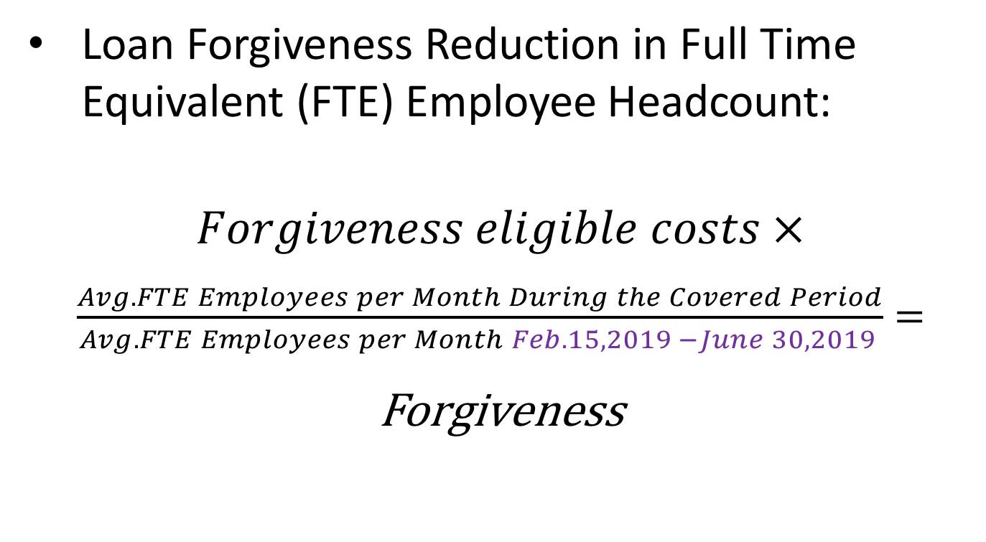
Paycheck Protection Program RK
  Loan Forgiveness Reduction in Full Time Equivalent (FTE) Employee Headcount:
  $Forgiveness eligible costs$ $×$
  $\frac{Avg. FTE Employees per Month During the Covered Period}{Avg. FTE Employees per Month Feb. 15, 2019 −June 30, 2019 }=$
  Forgiveness
H. R. 748, the CARES ACT, SEC. 1106

Slide 35
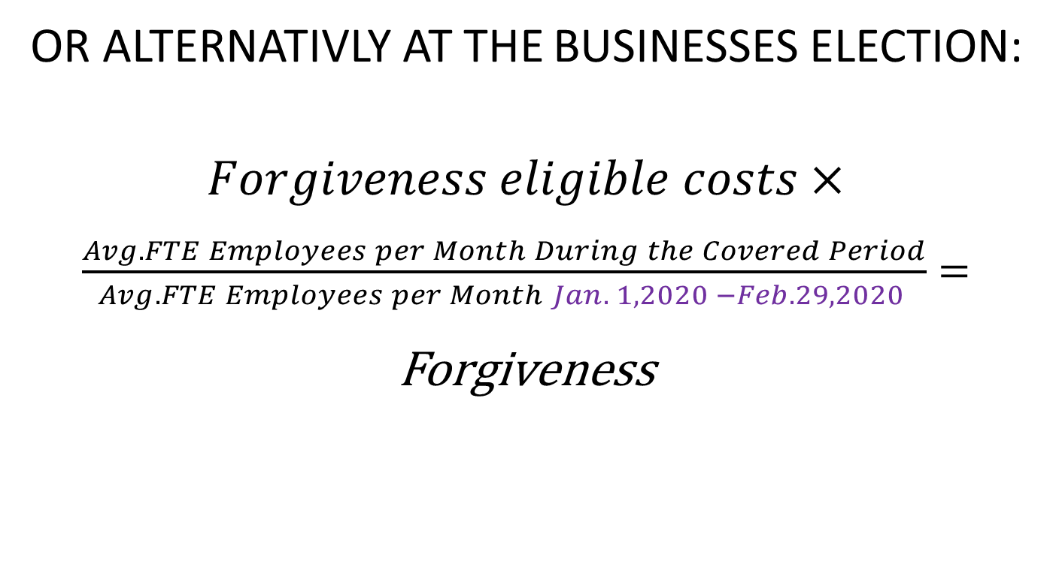
Paycheck Protection Program RK
  OR ALTERNATIVLY AT THE BUSINESSES ELECTION:
  $Forgiveness eligible costs$ $×$
  $\frac{Avg. FTE Employees per Month During the Covered Period}{Avg. FTE Employees per Month Jan. 1, 2020 −Feb. 29, 2020 }=$
  Forgiveness
H. R. 748, the CARES ACT, SEC. 1106

Slide 36
Paycheck Protection Program RK
  Loan Forgiveness Reduction if Salaries & Wages are reduced:
    Forgiveness reduced by the amount of reduction of salaries or wages of any employee that is in excess of 25% during the covered period, compared to the most recent full quarter
    Excludes reductions in compensation for employees with annualized pay greater than $100,000
H. R. 748, the CARES ACT, SEC. 1106

Slide 37
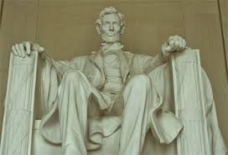
Paycheck Protection Program RK
  Loan Forgiveness Reductions:
    Exemption for those re-hired within 30 days of enactment
      Applies to Full time equivalent (FTE) headcount test
      Applies to salary reduction test
H. R. 748, the CARES ACT, SEC. 1106

Slide 38
Paycheck Protection Program RK
  Loan Forgiveness Taxability
    Any amount forgiven is excluded from gross income
H. R. 748, the CARES ACT, SEC. 1106

Slide 39
Paycheck Protection Program MS
How to Apply
    Where:
      Any SBA approved lender can make the loans.
      You might want to start with your regular bank.
      See www.sba.gov which lists approved lenders.
      Presumably more lenders will sign up.
    When:
      April 3, 2020 - small businesses and sole proprietorships can apply for loans.
      April 10, 2020 - independent contractors and self-employed individuals can apply for loans.
    How:
      Complete the PPP loan application SBA Form 2483 (Paycheck Protection Program Application Form) and submit it with the required documentation, which will include payroll information, to an approved SBA lender.
      The SBA has waived the requirement that you have to first try to obtain a loan elsewhere.

Slide 40
Paycheck Protection Program MS
What you Have to Certify in the Application - 1
    Current economic uncertainty makes the loan necessary to support your ongoing operations.
    The funds will be used to retain workers and maintain payroll or to make mortgage, lease, and utility payments.
    You have not and will not receive another loan under this program.
    You will provide to the lender documentation that verifies the number of full-time equivalent employees on payroll and the dollar amounts of payroll costs, covered mortgage interest payments, covered rent payments, and covered utilities for the eight weeks after getting this loan.
    Loan forgiveness will be provided for the sum of documented payroll costs, covered mortgage interest payments, covered rent payments, and covered utilities.
    All the information you provided in your application and in all supporting documents and forms is true and accurate. Knowingly making a false statement to get a loan under this program is punishable by law.

Slide 41
Paycheck Protection Program MS
What you Have to Certify in the Application - 2
    You acknowledge that the lender will calculate the eligible loan amount using the tax documents you submitted. You affirm that the tax documents are identical to those you submitted to the IRS. And you also understand, acknowledge, and agree that the lender can share the tax information with the SBA’s authorized representatives, including authorized representatives of the SBA Office of Inspector General, for the purpose of compliance with SBA Loan Program Requirements and all SBA reviews.

Slide 42
Paycheck Protection Program MS
What One Lender is Requesting
Start with the application currently posted on the SBA.gov website
Payroll registers for a twelve-month period (ending on your most recent payroll date), showing the following information:
Gross wages for employees, including officers if paid W-2 wages
Paid time off for each employee
Vacation pay for each employee
Family medical leave pay for each employee
State and local taxes assessed on employees compensation
2019 IRS Quarterly 940, 941 or 944 payroll tax reports
1099s for independent contractors for a twelve-month period
Documentation showing all health insurance premiums paid by the company owners under a group health plan -including all employees and owner info
Documentation of all retirement plan funding paid by the company’s owners – do not include funding from employees – include 401K plans, Simple IRA, SEP IRA’s
Financial statements
Business Tax Returns

Slide 43
Paycheck Protection Program MS
What the Interim 4/2/20 Guidance Says about Documentation
Section III.A.2.ii flush language:
“You must also submit such documentation as is necessary to establish eligibility such as payroll processor records, payroll tax filings, or Form 1099- MISC, or income and expenses from a sole proprietorship. For borrowers that do not have any such documentation, the borrower must provide other supporting documentation, such as bank records, sufficient to demonstrate the qualifying payroll amount. [highlights added]”
See comments above from FAQ 1. Lenders do not need to audit submissions: “…Lenders are expected to perform a good faith review, in a reasonable time, of the borrower’s calculations and supporting documents …”

Slide 44
Paycheck Protection Program MS
Are Banks Respecting the Purpose of the Law?
Section III.3.b. of the 4/2/20 interim guidance directs banks as to underwriting.
The SBAs 4/2/20 guidance provides: “The intent of the Act is that SBA provide relief to America’s small businesses expeditiously. This intent, along with the dramatic decrease in economic activity nationwide, provides good cause for SBA to dispense with the 30-day delayed effective date provided in the Administrative Procedure Act. Specifically, small businesses need to be informed on how to apply for a loan and the terms of the loan under section 1102 of the Act as soon as possible because the last day to apply for and receive a loan is June 30, 2020. The immediate effective date of this interim final rule will benefit small businesses so that they can immediately apply for the loan with a full understanding of loan terms and conditions. This interim final rule is effective without advance notice and public comment because section 1114 of the Act authorizes SBA to issue regulations to implement Title 1 of the Act without regard to notice requirements. This rule is being issued to allow for immediate implementation of this program…. The CARES Act was enacted to provide immediate assistance to individuals, families, and businesses affected by the COVID-19 emergency…. The intent of the Act is that SBA provide relief to America’s small businesses expeditiously, which is expressed in the Act by giving all lenders delegated authority and streamlining the requirements of the regular 7(a) loan program. For example, for loans made under the PPP, SBA will not require the lenders to comply with section 120.150 “What are SBA’s lending criteria?.” Lenders must comply with the applicable lender obligations set forth in this interim final rule, but will be held harmless for borrowers’ failure to comply with program criteria; [highlights added].”

Slide 45
Paycheck Protection Program RK
Example
  Consider garden supply store with 27 full time equivalent employees
    Annual payroll is $1,000,000 or $83,333 per month
    None of these employees are paid over $100,000 annually
    The maximum loan is therefore $208,333 ($83,333 x 2.5)
  However, store only kept its 5 key employees on payroll when it was ordered to close who are paid $340,000 in total annually and laid off everyone else

Slide 46
Paycheck Protection Program RK
Example
  A $208,333 loan is originated from the store owner’s favorite bank on April 10th
  The store has the following “unavoidable” expenses over the following 8-weeks:
(See: Section III.2.e.ii of the 4/2/20 interim guidance Examples)

Slide 47
Paycheck Protection Program RK
Example
  However, the store owner thinks that the “shelter-in-place” order will be lifted on April 24:
    She will re-hire half of the hourly employees
    This will cost about $39,600 during the remaining 6-week period of the loan
  Therefore, the total allowable uses for the loan proceeds will be about $169,808 ($130,208 + 39,600) of the $208,333 borrowed

Slide 48
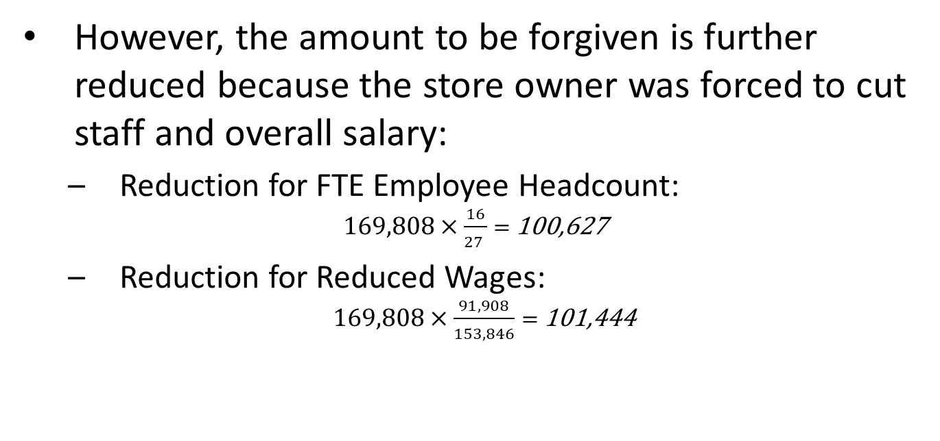
Paycheck Protection Program RK
Example
  However, the amount to be forgiven is further reduced because the store owner was forced to cut staff and overall salary:
    Reduction for FTE Employee Headcount:
  $169,808×\frac{16}{27 }=$ 100,627
    Reduction for Reduced Wages:
  $169,808×\frac{91,908}{153,846}=$ 101,444
The legislation is unclear how exactly to make these computations.

Slide 49
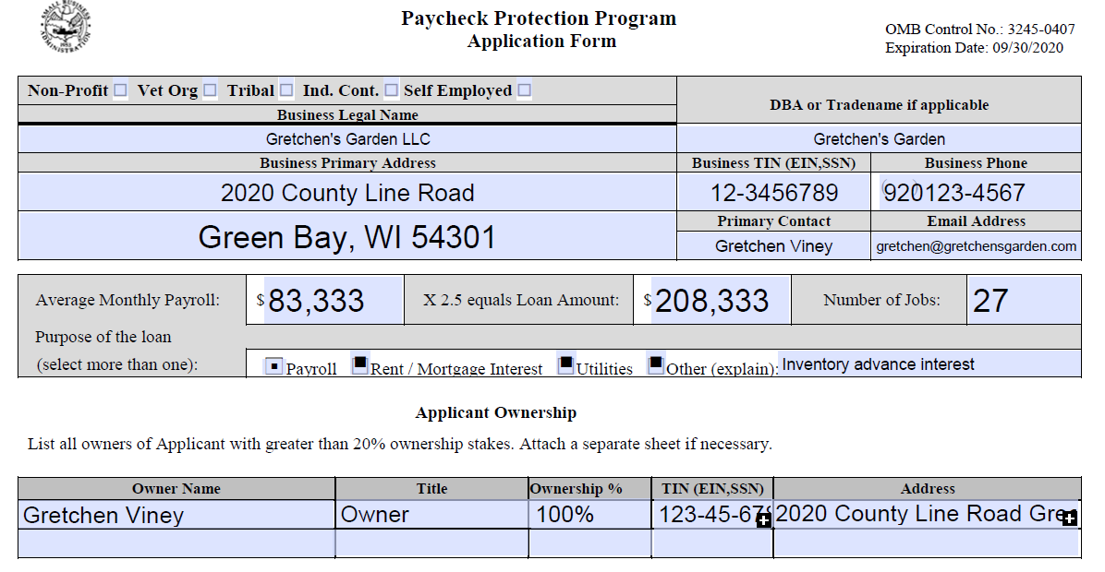
Paycheck Protection Program RK
Example

Slide 50
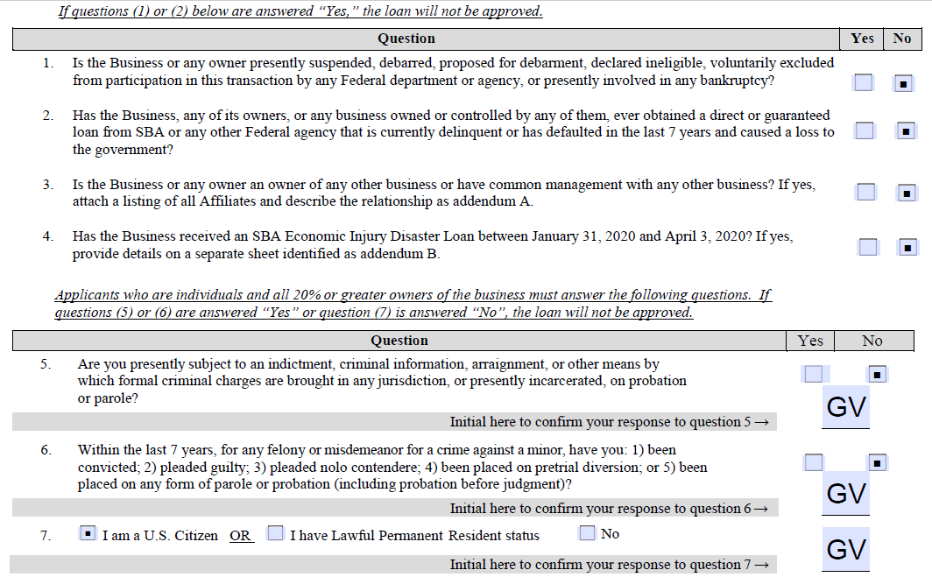
Paycheck Protection Program RK
Example

Slide 51
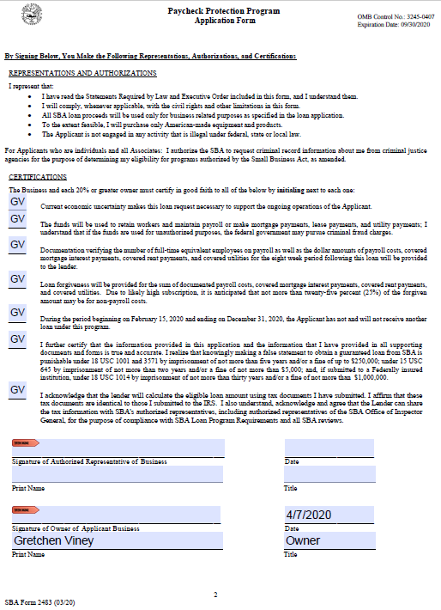
Paycheck Protection Program RK
Example

Slide 52
Economic Injury Disaster Loans RK
Economic Injury Disaster Loans (EIDL)
The Small Business Administration (SBA) provides disaster loans to businesses suffering an economic impact from a disaster. The entire country is now a qualifying "disaster area") because of coronavirus for purposes of an EIDL.
Basic Eligibility:
  Any business concern, non-profit, veterans organization or Tribal business
  Not more than 500 employees; generally
  EIDL loans can be up to $2M per borrower.
  Repayment of SBA loans was deferred for 6 months by the Cares Act.
  Apply on SBA website.
  An EIDL loan taken because of coronavirus can be refinanced by the PPL Loans discussed above (but forgiveness of the loan will be subject to the PPL limitations).

Slide 53
Emergency EIDL Grants RK
If you make an application to the SBA for an Economic Injury Disaster Loan (EIDL), the Cares Act lets you request an emergency advance. The SBA is required to advance those funds within three days. The advance can be used for any allowable EIDL purpose. The advance does not need to be repaid.
The emergency grant advance is an immediate $10,000 tax-free grant from the government to your business.
Self-employed persons, gig workers, and most nonprofit employers are eligible. Employers too large to qualify as a “small business concern” by the SBA are excluded.
A borrower can request an advance of $10,000 to provided within three days of applying
H. R. 748, the CARES ACT, SEC. 1110.

Slide 54
Emergency EIDL Grants RK
The advance can be used for: providing paid sick leave, maintaining payroll to retain employees, meeting increased material costs, making rent or mortgage payments, and repaying obligations which cannot be met due to revenue losses
The advance does not need to be repaid, even if the loan is subsequently denied
“Payroll Protection” loan forgiveness reduced by the EIDL advance
H. R. 748, the CARES ACT, SEC. 1110

Slide 55
Business Tax Relief RK
Employee Retention Credit
  50% of qualified wages up to $10,000 ($5,000 credit)
  Credit against employment taxes and is refundable
  Reduced for credits in Section 7001 and 7003 of the Families First Coronavirus Response Act
  Eligible employers: (1) operations suspended by government (2) significant decline in gross receipts
  Can’t claim this credit and take the forgivable SBA loan – most small employers will opt for the forgivable loan
H. R. 748, the CARES ACT, SEC. 2301

Slide 56
Business Tax Relief RK
Delay of Employer Payroll Taxes
  Payroll tax deposits delayed until the applicable date
  Exception for taxpayers which had indebtedness forgiven by the Paycheck Protection Program in Sec. 1102 & Sec. 1106
  Applicable Date
    12/31/2021: 50% of the amount due
    12/31/2022: the remaining amount due
  Includes 50% of SECA taxes
No interest loan from the IRS for over 20 months!
H. R. 748, the CARES ACT, SEC. 2302

Slide 57
Tax Credits to
Fund Paid Sick Leave RK
Refundable employer FICA tax credit – basics
  Limit if the employee is sick:
    The lessor of wages plus healthcare costs or $511/day
    10 days
    Includes: Employees subject to a government quarantine or isolation order; Employee advised by a healthcare professional to self-quarantine; employee is experiencing symptoms and seeking diagnosis
  Limit for family leave:
    $200/day
    $10,000 maximum
    Includes: taking care of family member ordered or advised to quarantine; taking care of a child following a school closing
  Treasury will set the 15-day period to which these credits are available
  Sick leave pay is not subject the employees portion of the 6.2% FICA tax for Social Security
H.R. 6201 - Families First Coronavirus Response Act

Slide 58
Additional Unemployment Benefits RK
Unemployment compensation.
  Workers with reduced income can now qualify for immediate unemployed compensation under the Cares Act.
  Independent contractors and gig works will now qualify.
  An additional benefit of $600/week will be provide.
  Employer accounts won’t bear these costs.

Slide 59
Health Insurance Coverage Changes RK
The Cares Act enhances health insurance coverage to address costs associates with coronavirus:
  Testing and diagnosis of coronavirus will be without deductibles or co-payments.
  If (hopefully, when) a vaccine is developed that will be provided without deductibles or co-payments.
Telehealth services can be covered under health savings accounts (HSAs) is also permitted.

Slide 60
Employer Disaster Payments to Employees Tax Favored RK
Employers can make payments to employees to address the economic impact of coronavirus
If the payments qualify they won’t be taxed as compensation income to the recipient/employee.
The payments will be fully deductible by the payor/employer.
This treatment is due to the President’s emergency orders making the entire country a disaster area.
See IRC Section 139.

Slide 61
Key Issue Summary RK
Liquidity & Employee Retention
Small Business (<500 employees) | Large Business (>500 employees)
Paid Sick Leave FICA Credits | FICA Tax Credit for Employee Retention
Paycheck Protection Program | FICA Tax Deferral
Disaster Loans

Slide 62
Key Issue Summary RK
Paycheck Protection Program
Payroll expenses considered
to compute monthly average
Period to spend
loan proceeds
Date Loan
Originated
+8 Weeks
-1 Year
Period in which the
loan must be made
2/15/20
6/30/20

Slide 63
Conclusion

Slide 64
Conclusions JB
The Cares Act and other actions and pronouncements provide a range of valuable economic benefits for many clients.
The information has been issued rapidly and is complex and the interplay of different provisions sometimes confusing.
Practitioners have a tremendous opportunity to help clients take advantage of the PPP and other programs.
A key first step is educating clients as to these opportunities.
Practitioners should not be the barefoot shoemakers. Many practitioners and firms may also benefit from these opportunities.
No one has any idea how long and how deep the impact of Coronavirus may be. Every firm and client that can take advantage of these programs should do so.

Slide 65
For more information or to ask questions
Robert Keebler: Robert.Keebler@keeblerandassociates.com
Martin Shenkman: shenkman@shenkmanlaw.com
Jonathan Blattmachr: jblattmachr@hotmail.com

Slide 66
CLE Credits
For more information about earning CLE credit for this program or other Martin Shenkman programs please contact Simcha Dornbush at NACLE. 212-776-4943 Ext. 110 or email sdornbush@nacle.com

