Slide 2
NAIFA’s
Membership
Promise

Slide 3
Advocate.
The protective advisor.

Slide 4
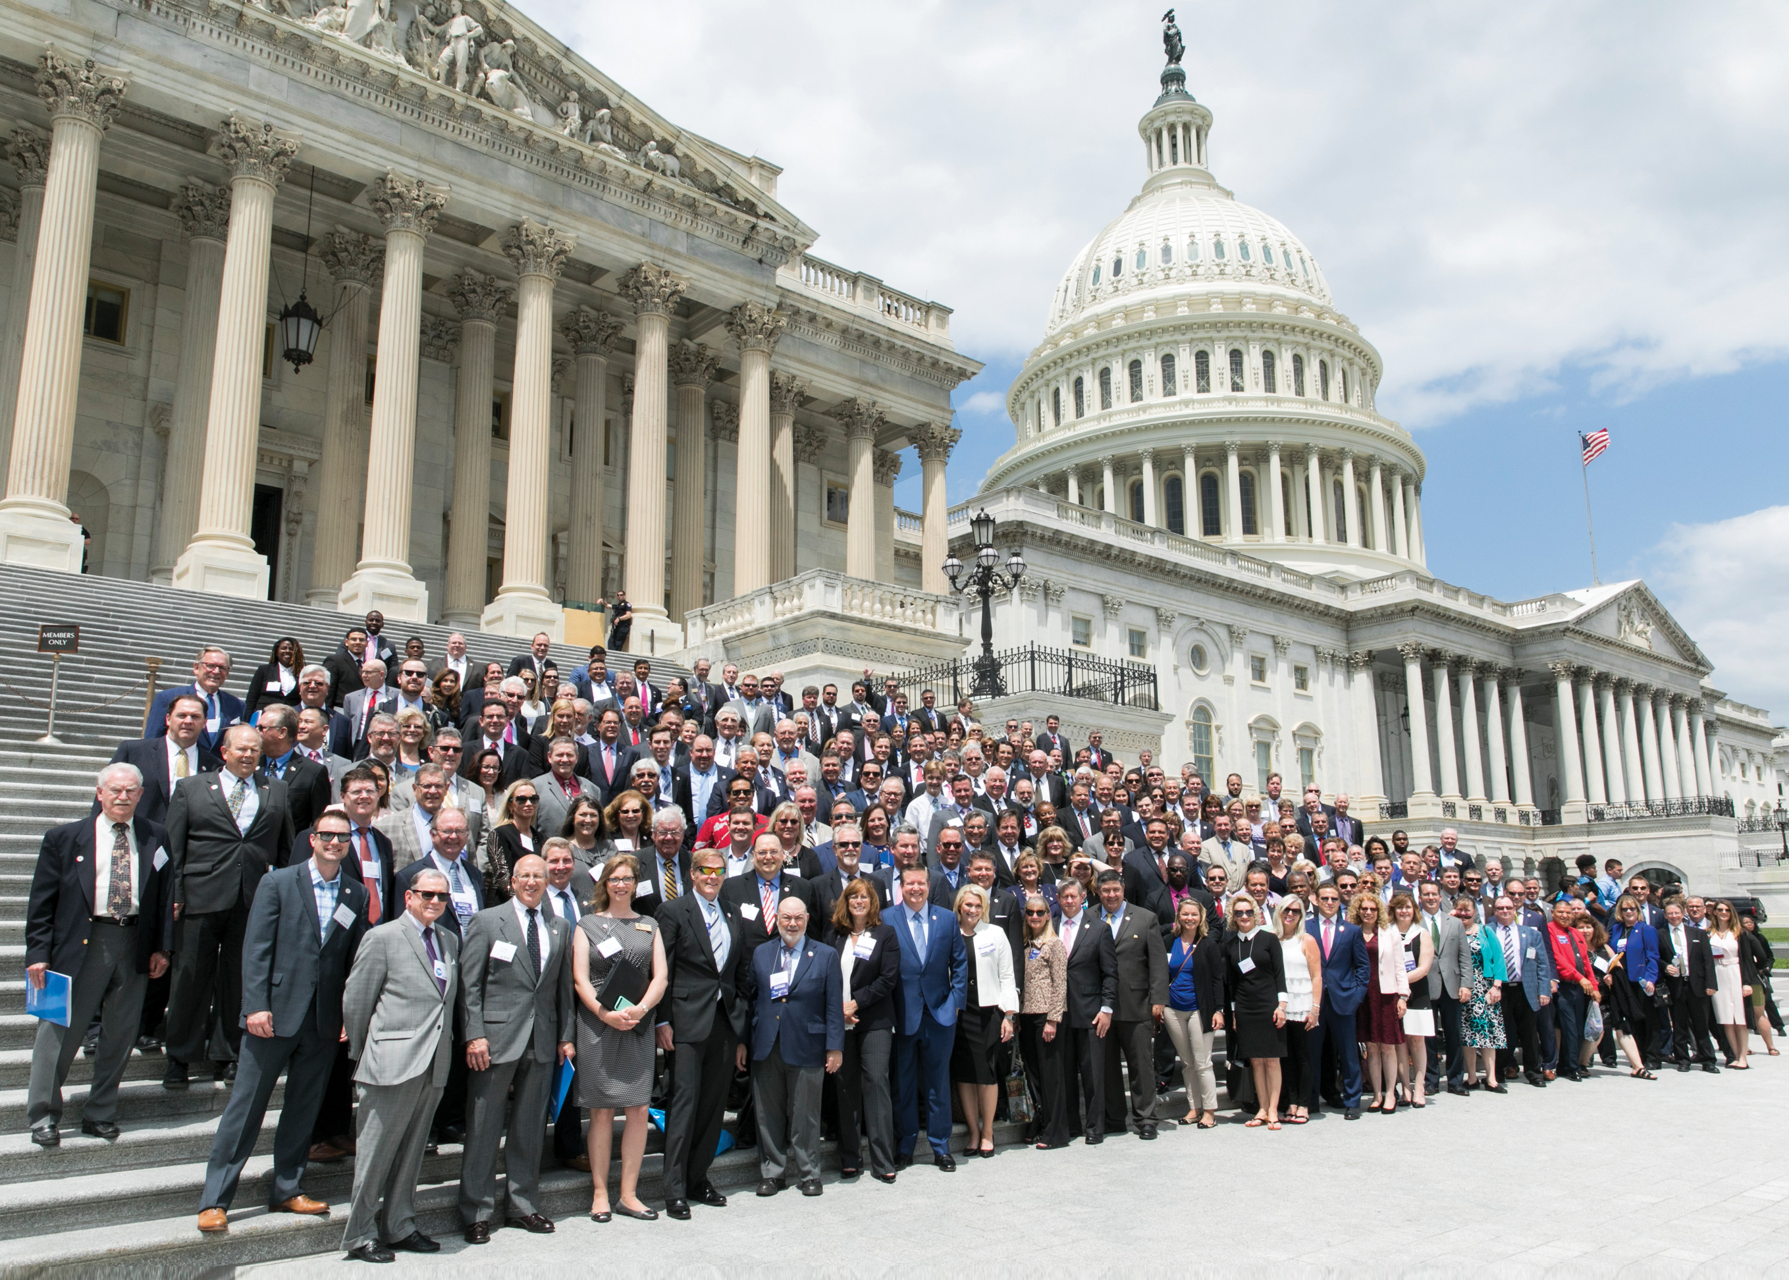
A NAIFA Member In Every Congressional District
Federal Level
The Power of You.
The Power of Us.

Slide 5
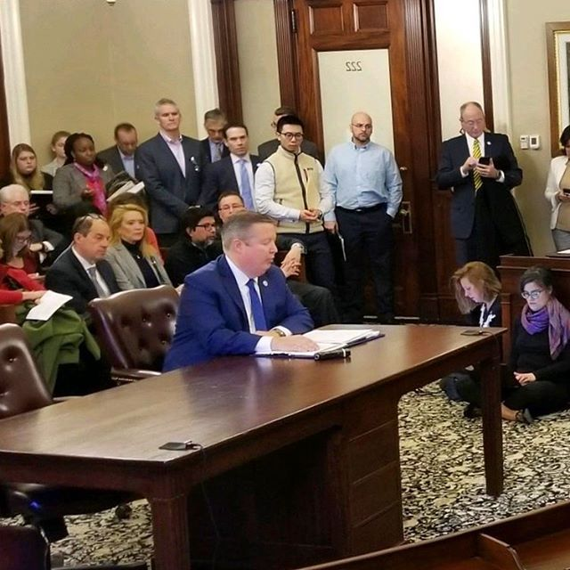
State Advocacy
Interstate Level
In Every State Capital
Political & Day on Hill Events
Division of Securities
NAIFA-MA & Kevin Mayeux, CEO

Slide 6
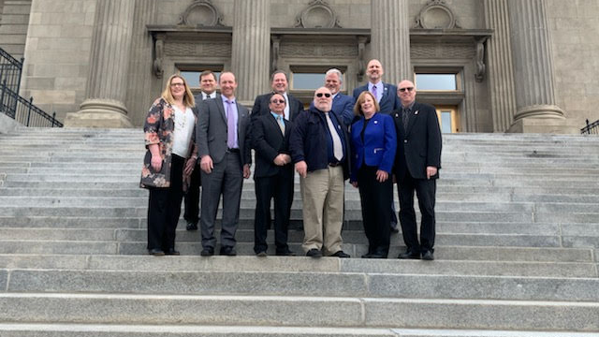
State Level
In Every State Capital
Political & Day on Hill Events

Slide 9
Educate.
The thinking advisor.

Slide 10
Watch Virtually or at a Watch Party (when possible again)
One National Meeting per Month with Top Speakers
Pledge of Allegiance to Unite Us All for Serving MainStreetUSA

Slide 17
October 6-8, 2020 | Virtual

Slide 18
Differentiate.
The trusted advisor.

Slide 19
The NAIFA
Code of Ethics

Slide 20
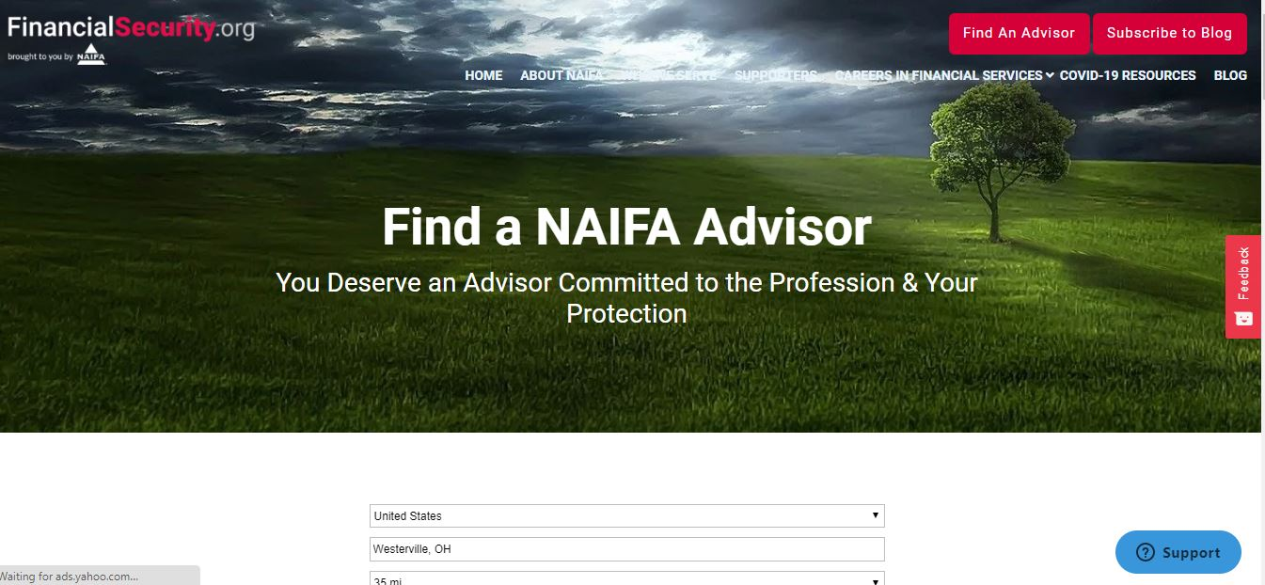

Slide 21
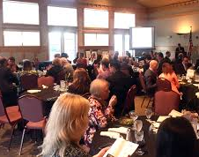
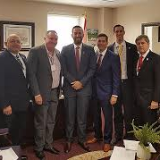
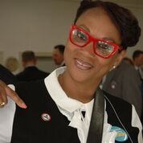
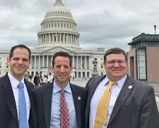
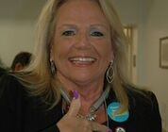
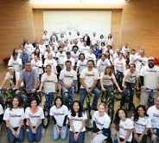
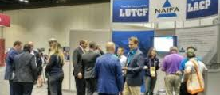
Connected Community for Life

Slide 23
POWER OF THE PIN Delivering on NAIFA’s Membership Promise
Notes:
[

Slide 26
www.belong.naifa.org/fees

