Slide 2
Income Protection Solutions Rick Cordaro, DIA, DIF, LUTCF
For financial professional use only. Not for use with consumers or the public.

Slide 3
Agenda
What is income protection?
Why is it important?
How does it work?
How about some examples?
Income Protection for Key Employees
Salary Continuation Plans
Executive Bonus Plans
For financial professional use only. Not for use with consumers or the public.

Slide 4
What is income protection?
For financial professional use only. Not for use with consumers or the public.

Slide 5
Income protection: Better known as disability insurance, helps clients insure their most important asset, their income.
For financial professional use only. Not for use with consumers or the public.

Slide 6
It helps people…
Maintain current lifestyle without draining savings or business profits
Continue saving for retirement and future dreams
Provide for his/her family
For financial professional use only. Not for use with consumers or the public.

Slide 7
Key features of a typical policy
Stays with your client even if they change jobs
Can’t be canceled, unless your client stops paying for coverage
Guarantees the cost for coverage will not change until age 65
Can be designed to meet a client’s budget and needs
Works well on its own or with other solutions your client may have in place, such as disability coverage from their employer
For financial professional use only. Not for use with consumers or the public.

Slide 8
Why is Income Protection important?
For financial professional use only. Not for use with consumers or the public.

Slide 9
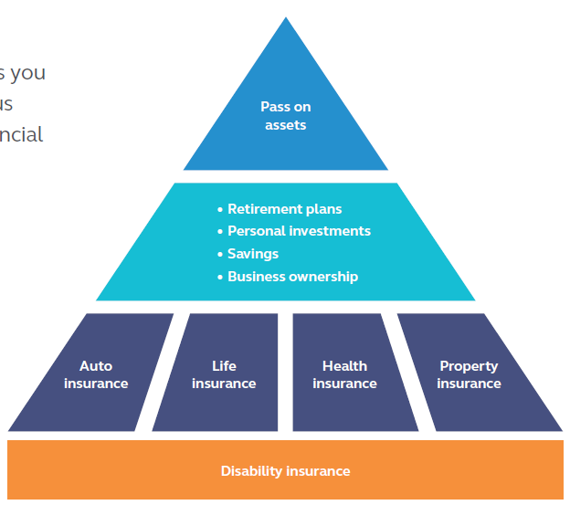
It’s the foundation to everything life brings…
For financial professional use only. Not for use with consumers or the public.

Slide 10
Life’s twists and turns are often unexpected
Over 1 in 4 of today’s 20 year-olds will become disabled before reaching retirement.¹
Every 7 seconds, a working-age American suffers a disabling injury or illness.²
Over 53 million American adults live with a disability.³
1-Social Security Administration, The Facts About Social Security’s Disability Program, 2016.
2-”The Disability Disconnect.” The Council for Disability Awareness. (n.d.) http://www.disabilitycanhappen.org/research/pdfs/CDA_Infographic.pdf, viewed 09/15
3- “CDC: 53 million adults in the US live with a disability.” Centers for Disease Control and Prevention. (July 2015) http://www.cdc.gov/media/releases/2015/p0730-us-disability.html, viewed 09/15
For financial professional use only. Not for use with consumers or the public.

Slide 11
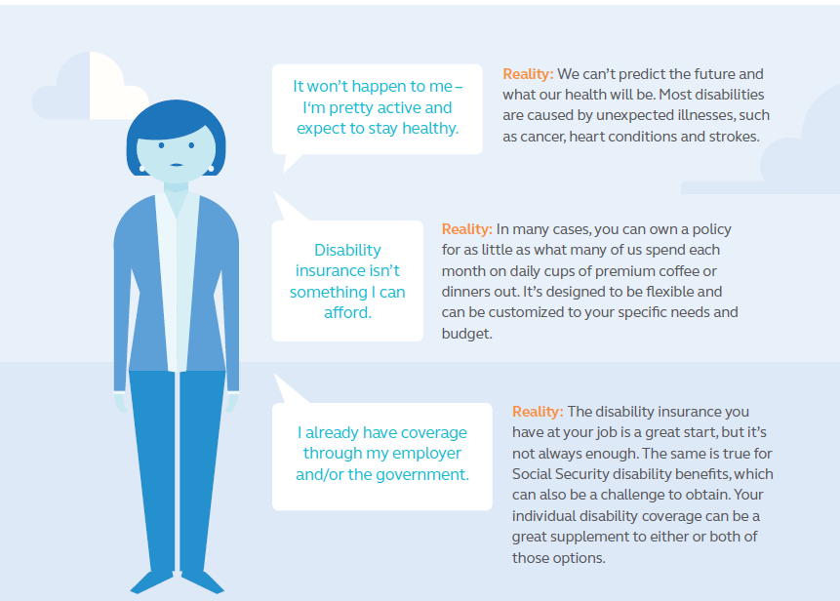
Common Misconceptions
For financial professional use only. Not for use with consumers or the public.

Slide 12
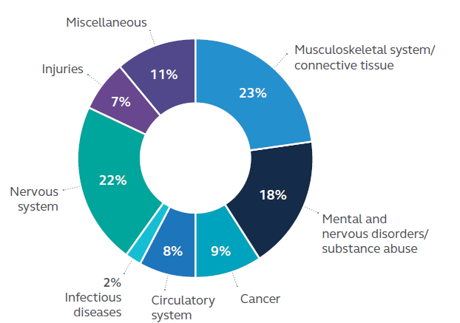
Disabilities play no favorites
Source: Active Principal Disability claims payments as of 8/31/15. The above is for illustrative purposes only and is not intended as a comprehensive representation of circumstances surrounding the claims displayed, an inclusive representation of all claims, or a promise to pay specific claims.
For financial professional use only. Not for use with consumers or the public.

Slide 13
When a disability strikes, expenses increase
For financial professional use only. Not for use with consumers or the public.

Slide 14
So, there’s a lot at stake for your clients…
Future earnings
Retirement savings and other assets
Current standard of living
Future insurability
Income protection is one way for your client to better prepare for life’s twist and turns.
For financial professional use only. Not for use with consumers or the public.
For financial professional use only. Not for use with consumers or the public.

Slide 15
How does income protection work?
For financial professional use only. Not for use with consumers or the public.

Slide 16
Here’s how it works
If you can’t earn your income because of an illness or injury, you receive benefit payments, that work like a “paycheck,” to help pay everyday living expenses – car payments, housing, groceries…whatever bills you face.
For financial professional use only. Not for use with consumers or the public.

Slide 17
Key terms to know:
Elimination Period
Often called the “waiting period,” it’s the number of days a disabled insured has to wait before benefit payments start to accrue. (Example: 90 days)
Benefit Period
After the elimination period, this is the amount of time the insured can receive monthly benefits while their too sick or hurt to work. (Example: To age 65)
Benefit Amount
The money the insured receives each month, like a “paycheck”, to help replace a portion of their lost income.
Occupation Class
Risk classification based on job duties. Determines how much coverage the insured is eligible for and at what price.
For financial professional use only. Not for use with consumers or the public.

Slide 18
Supplementing existing coverage
Supplement group benefits to help protect more of your client’s income.
Sample – Annual Gross Income: $60,000
62% income replacement (post-tax)
100%
$5,000
80%
42% income replacement
$3,500
$1,000
60%
$3,000
40%
$2,100
$2,100
20%
0%
Monthly Income before taxes
Monthly Income after taxes
Group LTD Benefit (before taxes)
Group LTD Benefit (after taxes)
Group LTD benefit + Individual DI policy
Group LTD benefits of 60% up to $10,000/month, a $1,000 IDI benefit, and assuming a 30% tax bracket for Federal, State and FICA.

Slide 19
How about some examples?
For financial professional use only. Not for use with consumers or the public.

Slide 20
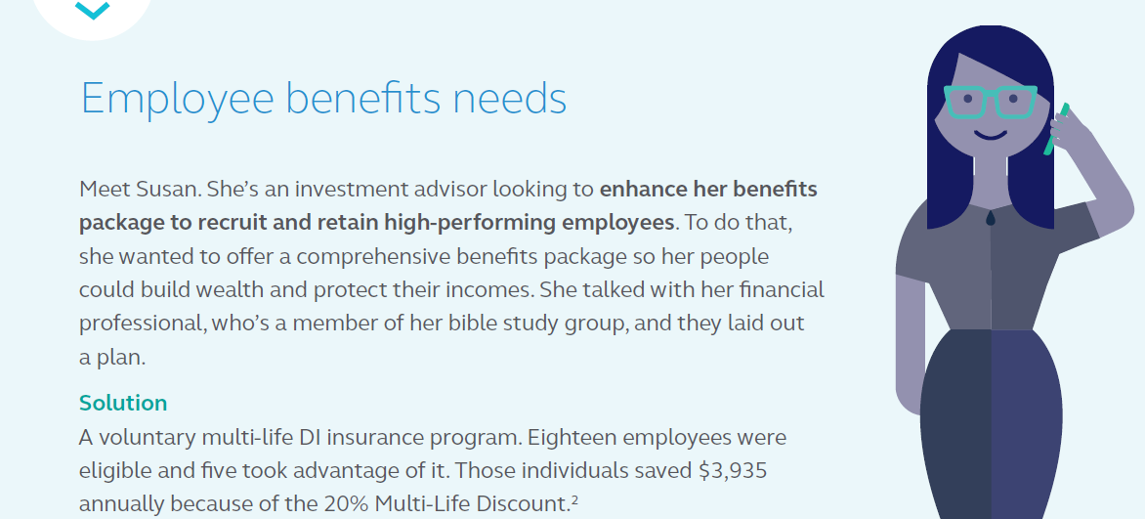
² Based on gender neutral rates.
For financial professional use only. Not for use with consumers or the public.

Slide 21
For financial professional use only. Not for use with consumers or the public.

Slide 22
Income protection solutions for key employees
For financial professional use only. Not for use with consumers or the public.

Slide 23
Understand the risk of a business owner’s disability
Average age | Number of people in a group
 | 1 | 2 | 3 | 4 | 5 | 6
25 | 58% | 82% | 92% | 97% | 99% | 99%
30 | 54% | 79% | 90% | 96% | 98% | 99%
35 | 50% | 75% | 88% | 94% | 97% | 98%
40 | 45% | 70% | 84% | 91% | 95% | 97%
45 | 40% | 64% | 78% | 87% | 92% | 95%
50 | 33% | 55% | 70% | 80% | 86% | 91%
55 | 25% | 43% | 57% | 68% | 70% | 82%
60 | 14% | 26% | 37% | 46% | 53% | 60%

Slide 24
Identify the opportunities
Key employees can be anyone critical to the business – especially those with specialized skills.
For the employer:
Recruit, reward and retain employees
For the key employees:
Protect their income and their ability to save for retirement even if they couldn’t work due to an illness or injury.

Slide 25
Salary continuation program
For financial professional use only. Not for use with consumers or the public.

Slide 26
Salary continuation overview
Also known as qualified sick-pay, wage continuation or Section 105 program
A formal, qualified plan that describes, in writing, how the employer will continue paying all or part of key employees’ salary if they become disabled.
Covers entire classes of employees – does not allow for selectivity within a class.
Commonly funded by Individual Disability Income (DI) insurance and/or Group Long Term Disability
Ideal for C-Corporations (owners can also be covered)

Slide 27
Guidelines salary continuation
In writing, the program must state:
Who is covered
How much to pay
In order to gain tax advantages, the program must show intent to fulfill a promise of benefits and be:
supported by a written agreement
communicated to all covered employees
established prior to a disability
When payments begin
How long payments continue

Slide 28
Benefits of having salary continuation
To the business:
Helps attract and retain talent
Reinforces positive employer-employee relationships
Helps manage the financial risk of loosing a key employee due to an illness or injury
Uses business resources for a tax-favored basis
To key employees:
Protects their income
Helps cover the extra expenses often associated with disability
Provides disability coverage at little or no cost to them

Slide 29
Today – key employee is healthy and working
Employer
Employee
The business receives a tax deduction for salary payments.
The business pays the employee a salary.
The employee pays taxes on their income.

Slide 30
If a key employee is too sick or hurt to work
– without a salary continuation program
Employer
Employee
The business rules the employee’s payments as dividends and not as a salary.
The business pays the disabled employee a dividend.
The employee pays taxes on the dividend.
The result: Double taxation. Once for both the business and the employee.

Slide 31
How salary continuation can help
Employer
Policy
Employee
Cost of coverage:
(Taxable) Benefits:
Employer pays insurance premiums, (deductible as a fringe benefit expense.) Premiums are not-taxable to the employee.
Ins Co. pays taxable benefits directly to employee.

Slide 32
Executive Bonus Program
For financial professional use only. Not for use with consumers or the public.

Slide 33
Executive bonus overview
Informal, nonqualified program allows employer to pay extra salary to executives, who use that money to purchase DI insurance.
Allows flexibility to only cover select employees
Ideal for partners/members of LLCs and S-Corporation owners
Helps attract and retain key employees

Slide 34
Benefits of executive bonus
To the business:
Simplicity and selectivity
No “formal” plan put in place (no paperwork)
Premiums are deductible as normal compensation
Inexpensive and simple to understand, implement and administer
To key employees:
Disability income payments are received income tax-free
Supplements their existing Group LTD coverage
Policy is portable

Slide 35
How executive bonus works
Employer
Employee
Policy
Taxable bonus:
Cost of coverage:
Employer offers bonus cash to employee to purchase policy.
Employee pays the insurance premiums.
Benefits:
Ins Co. pays income tax-free benefits directly to the employee.

Slide 36
Compare the options
For financial professional use only. Not for use with consumers or the public.

Slide 37
Understand the differences and similarities
Differences between the options
 | Who pays DI premiums | DI Benefit to Employee
Salary continuation | Tax-free | Taxable
Executive bonus | Taxable | Tax-free
Both salary continuation and executive bonus:
The employer pays the premium.
The premium is tax deductible for the employer.

Slide 38
Help employers find the best solution for them
Salary continuation program:
Cover a broad range of employees
Tax-free premiums, taxed benefit payments
Requires a formal plan
Executive bonus program:
Cover only select employees
Taxed premiums and tax-free benefit payments,
Less formal documentation

Slide 39
Available Solutions
For financial professional use only. Not for use with consumers or the public.

Slide 40
Individual Disability Income (DI)
Employee receives monthly payments if they becomes too sick or hurt to work. DI helps supplement group coverage.
Your client may be eligible for the multi-life discount.
Start the conversation by asking employers:
Could you continue to pay a disabled employee’s salary from your business?
How long could you afford to pay a salary to a key employee who is too sick or hurt to work?
Would the payments you pay be deductible to your business?

Slide 41
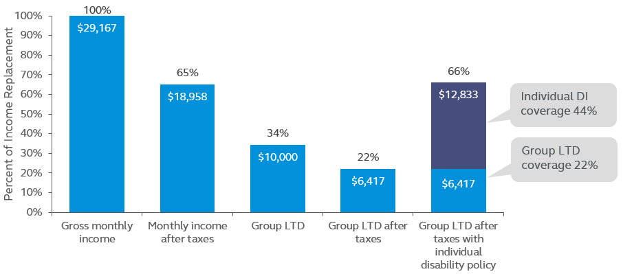
Combining group coverage with DI

Slide 42
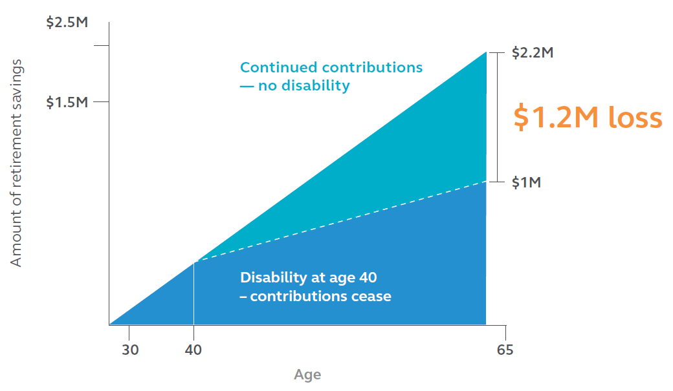
Impact of a disability on retirement

Slide 43
DI Retirement Security
Employee
Carrier
Client pays premiums.
Irrevocable trust
Client accesses the trust later as retirement income.
Ins Co. makes monthly deposits that are invested on the client’s behalf.

Slide 44
How it works:
Sick pay,
vacation
Individual Disability Income
DI retirement security
Short-Term Disability
Long-Term Disability
Funds
depleted
Days: 0
90
To age 65

Slide 45
Questions?
For financial professional use only. Not for use with consumers or the public.

