Slide 1


Cracking the Retirement Income Code
CURTIS V. CLOKE, CLTC, LUTCF, RICP®
CEO and Founder

Slide 2



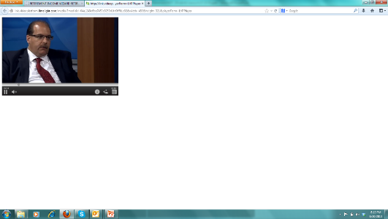





Retirement Income Expert
Adjunct Instructor
2009 Top 5 Finalist for Advisor of the Year
Senior Markets Advisor Magazine
Member of:
NAIFA 29 Year
MDRT 19 Year
  12 X Top of the Table
  3 X Court of the Table
Society of Financial Services Professionals
Forum 400 (International Forum)
Featured on TV program (Moving America Forward)
….William Shatner
Curtis V. Cloke, CLTC, LUTCF, RICP®
Curtis V. Cloke, CLTC, LUTCF
CEO & Founder
Thrive Income Distribution System, LLC.
Retirement NextGen® – Thrive University®
www.curtiscloke.com
For Financial Professional Use Only
`
Copyright 2009 – 2018 Thrive Income Distribution System®
Notes:
Introduction and bio slide
READ Slide

Slide 3

For Financial Professional Use Only
`
Copyright 2009 – 2018 Thrive Income Distribution System®

Slide 4


Perspective Principles – Retirement Planning
Perspective of what we know frames the limitations of what we perceive to be true
What is true, is always true regardless if we know or believe the real truth
Principles of truth are truths that work every time and are timeless
  Example: Gravity
For Financial Professional Use Only
`
Copyright 2009 – 2018 Thrive Income Distribution System®

Slide 5
Session Perspectives
Liquidity: Understanding the “Illusion of Control”…FOMO
Safe Income: Luck vs. Skill (Predictable vs Unpredictable)
Discussing the “top five risks” to mitigate in retirement
Agnostic Approach: The “Basket of Products” approach
The power of annuity guarantees when building an income floor
How to “Buy Income and Invest the Difference®”
Consider Housing Wealth
Framing solutions with visual vs. numerical data
For Financial Professional Use Only
`
Copyright 2009 – 2018 Thrive Income Distribution System®

Slide 6


Changing Retirement Landscape
The Choluteca Bridge in Honduras
    Medicare is facing unfunded liabilities +38 trillion dollars over the next 75 years.
    Less than 10% of Companies today offer Pensions.
    US State Pensions are unfunded by more than 1 Trillion Dollars.
    Life expectance for 65 year olds now even longer!
    Men 86.6 Women 88.8
    Source: Changes in life expectancy for 65-year olds in the us 2010 vs 2014 Wall Street-Journal 10/28/2014
For Financial Professional Use Only
`
Copyright 2009 – 2018 Thrive Income Distribution System®

Slide 7



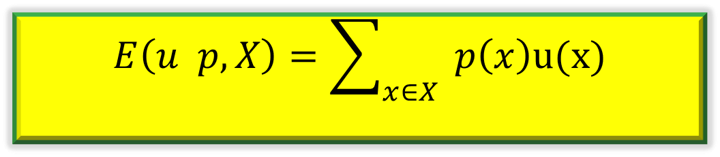
Bernoulli’s Formula – Math & Science
Dutch Polymath Daniel Bernoulli (1738)
$$E\left(u p,X\right)=\sum_{x∈X}{ }p\left(x\right)u(x)$$
Expected Value = (odds of gain) x (value of gain)
For Financial Professional Use Only
`
Copyright 2009 – 2018 Thrive Income Distribution System®

Slide 8
De-Risk the Solution
Skill vs. Luck
Flow vs. Grow
For Financial Professional Use Only
`
Copyright 2009 – 2018 Thrive Income Distribution System®
Notes:
Granted we knew to avoid being over exposed in the market during the the danger zone… the 5 to 10 years before and after retirement.

Slide 9
Cycle of Decision
No Urgency
Become Aware of Urgent Need
Contrast Solutions
Decision to Implement Now
Aware of Situation
“Hello to Close” with Confidence
For Financial Professional Use Only
`
Copyright 2009 – 2018 Thrive Income Distribution System®
Notes:
Granted we knew to avoid being over exposed in the market during the the danger zone… the 5 to 10 years before and after retirement.

Slide 10
How to Avoid Procrastination and Shorten the Sales Cycle of Profitability?
For Financial Professional Use Only
`
Copyright 2009 – 2018 Thrive Income Distribution System®
Notes:
Granted we knew to avoid being over exposed in the market during the the danger zone… the 5 to 10 years before and after retirement.

Slide 11
Nothing hides inefficiency
in an advisory firm better than..
SUCCESS.
-Charles Hollander, Jr. -
For Financial Professional Use Only
`
Copyright 2009 – 2018 Thrive Income Distribution System®
Notes:
Hers what we know at Red Flag to be true

Slide 12

Getting Your Timing Right
The close is made here!!!
Vs.
Timing
10%
90%
90%
10%
For Financial Professional Use Only
`
Copyright 2009 – 2018 Thrive Income Distribution System®
Notes:
Diagnosis Trumps Presentation

Slide 13
Key Elements of Retirement
Knowing What Retirees Want
Taking Key Risks Off the Table
Divide and Conquer Approach
Buy Income and Invest the Difference®
The 4 L’s of Retirement
Core Measurements of Safe vs. Unsafe
For Financial Professional Use Only
`
Copyright 2009 – 2018 Thrive Income Distribution System®

Slide 14
Key Elements of Retirement
Meeting One:
Knowing What Retirees Want
For Financial Professional Use Only
`
Copyright 2009 – 2018 Thrive Income Distribution System®

Slide 15

Get to the Heart of the Matter
For Financial Professional Use Only
`
Copyright 2009 – 2018 Thrive Income Distribution System®

Slide 16

Get to the Heart of the Matter
Where are you from and what was it like growing up?
What did you learn about money growing up?
What is the hardest lesson you’ve had regarding $?
What is the best experience you’ve had regarding $?
What would you do with your time if no one paid you?
Is there something important about your $ I wouldn't know if I didn’t ask?
In retirement, how much of your income is OK at risk ?
In retirement, how much of your assets is OK at risk?
For Financial Professional Use Only
`
Copyright 2009 – 2018 Thrive Income Distribution System®

Slide 17
Top Five Fears
    Outliving
    Control
For Financial Professional Use Only
`
Copyright 2009 – 2018 Thrive Income Distribution System®

Slide 18

Investments- Liquidity
For Financial Professional Use Only
`
Copyright 2009 – 2018 Thrive Income Distribution System®

Slide 19
Top Five Fears
    Outliving
    Control
    Inflation
    Legacy
    Investment Mistake
For Financial Professional Use Only
`
Copyright 2009 – 2018 Thrive Income Distribution System®

Slide 20
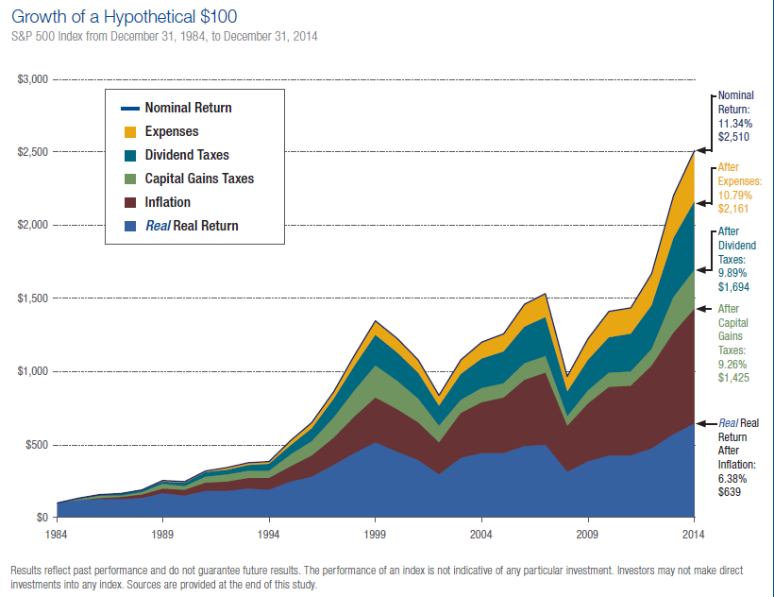
Real Real Returns
Source: Thornburg Investments
Source: Thornburg Investments
For Financial Professional Use Only
`
Copyright 2009 – 2018 Thrive Income Distribution System®

Slide 21
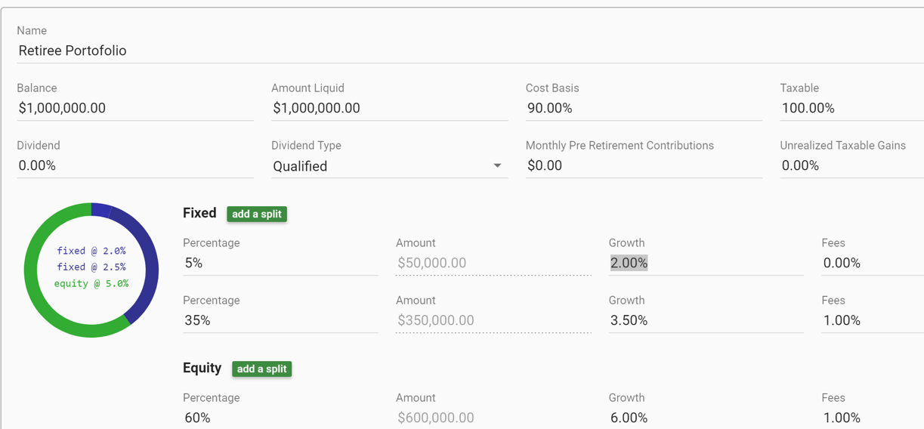
Projecting Average Portfolio Returns
35%
60%
5%
Cash
Bonds
Equities
This hypothetical example is for educational purposes only and is not a guarantee of returns.
Notes:
This slide is an example of how composite returns work in a hypothetical calculation to demonstrate how compsite returns are quite different from what retirees actually think.

Slide 22

Emotion Commotion™
Point of Maximum Financial Risk
Euphoria
Thrill
Anxiety
Excitement
Denial
Greed
Fear
Optimism
Optimism
Desperation
Relief
Panic
Capitulation
Hope
Despondency
Depression
Point of Maximum Financial Opportunity
For Financial Professional Use Only
`
Copyright 2009 – 2018 Thrive Income Distribution System®

Slide 23
Key Elements of Retirement
Meeting One:
Knowing What Retirees Want
Taking Key Risks Off the Table
For Financial Professional Use Only
`
Copyright 2009 – 2018 Thrive Income Distribution System®

Slide 24

Defining 18 Risks of Retirement.
As defined by The American College RICP™
For Financial Professional Use Only
`
Copyright 2009 – 2018 Thrive Income Distribution System®

Slide 25
Top Five Risks
    Longevity
    Health
    Inflation
    Sequence of Returns
    Market Volatility
For Financial Professional Use Only
`
Copyright 2009 – 2018 Thrive Income Distribution System®

Slide 26
What a Difference a Year Makes
80%/20% Mix
65 year old with $1 million portfolio
Invested in 80% equities, 20% fixed income
Withdrawing 5% each year
Increase withdrawals by 3% for inflation
Comparing 30-year rolling time-frames
Will assets last 30 years?
For Financial Professional Use Only
`
Copyright 2009 – 2018 Thrive Income Distribution System®

Slide 27

What a Difference a Year Makes
80% / 20% Mix
Income lasted LESS than 30 years
Income lasted MORE than 30 years
95+
90
85
80
75
70
65
The age at which money expires
Chance of Running Out of Money
0% by 75
32% by 85
59% by 95
’26 ‘28 ‘30 ‘32 ‘34 ‘36 ‘38 ‘40 ‘42 ‘44 ‘46 ‘48 ‘50 ‘52 ’54 ‘56 ‘58 ‘60 ‘62 ‘64 66 ‘68 ‘70 ‘72 ‘74 ‘76 ‘78 ’80 ‘82 ‘84
The year that your retirement starts
Source: Calculations by Retirementoptimizer.com Inc.; the equity proxy is S&P 500 Index since 1926, using currently prevailing dividend rates of 2%^. Total annual portfolio cost is 2.5% of the portfolio value, including management fees and all trading costs. Fixed income net returns (after all expenses) are historical 6-month CD rate plus 1%. Currently prevailing dividend rates apply to today’s (2014) average dividend rate (about 2.0%). Historical 6-month CD rates are basically the interest rate for short-term deposits. The longer-term return of the fixed-income portfolio(excluding the capital gains/losses in the short term) is approximated by using this historical 6-month CD rate plus a premium. The S&P 500 Index is an unmanaged index of 500 stocks that is generally representative of the performance of larger companies in the US.S. An investor cannot invest directly in an index. Unmanaged index returns do not reflect any fees, expenses or sales charges. Past performance is no guarantee of future results.
The above chart is based on Jim Otar’s methodology, which uses historical market returns instead of random returns and compares the results The above example is hypothetical, based upon historical data, and provided for illustrative purpose only. The example does not represent any Lee Mason product or service. Individual investor results would have differed from those illustrated above.
For Financial Professional Use Only
`
Copyright 2009 – 2018 Thrive Income Distribution System®
Notes:
Now what you have seen is a hypothetical situation. Let’s now look at some real numbers using the S&P 500. This was a study done by Legg Mason. In this study the retiree has 1 million dollars and they are invested 80% in stocks and 20% in bonds. In this study, $50,000 is withdrawn a year and that number increases at the actual historical inflation rate. This chart is going to show the results of retiring in a particular year and looking 30 years into the future. Did you have enough money to last your 30 years in retirement.
The blue columns are years that you did have enough. The way this charts works is that if you retired in 1984 you would still have money based on the returns of the actual bond and stock market by the 2014 (30 years into the future). The red lines you didn’t have enough. You can see the year you retire makes a huge difference in your retirement lifestyle but there is no way to be able to plan for this. You can see that the longer you live the greater the odds of running out of money. This shows that longevity is a big issue. As you can see, if you never lived past 76 you never ran out of money. But even living to 85 with this set of parameters, you have a 32% percent chance of running out of money. There has to be a better way than to plan your financial future based on luck.

Slide 28

Retirement Planning
Analytics & Advice
Implementation of Income, Growth & Legacy Allocations
Planning Fees
Management Fees & Commissions
+
Fees Create Credibility
Client Remains Engaged
Additional Revenue Source
Shortens the sales process to close
Takes pressure off of product sale
Discussion of multiple planning topics
For Financial Professional Use Only
`
Copyright 2009 – 2018 Thrive Income Distribution System®

Slide 29



Three Basic Retirement Income Strategies
Systematic Withdrawal Income Plan
Buckets/Laddered
Retirement Income Floor
“Assume & Consume”
“Progressive Time Segments of Money”
Promised Based
For Financial Professional Use Only
`
Copyright 2009 – 2018 Thrive Income Distribution System®
Notes:
(Curtis) Let me frame the Three basic retirement income strategies.
SWIP = Systematic Withdrawal Income Plan
Bucket = Progressive Time-Segmentation strategies. These ladders of assets segment assets into various ladders for phased income and risk – reward performance based on individual risk tolerance.
Flooring Strategies create a floor of Promised Based income that traditional replaces a portion of the fixed asset allocation. The floor can be to cover essential income needs or lifestyle income needs. Essential expenses are basic required expenses and lifestyle expenses include vacations, golf fees and other non-essential income desires that are discretionary and not basic requirements. The decision to establish an essential income floor vs a lifestyle income floor depends on how many assets the pre-retiree has vs the percentage of income drag on the portfolio and how much of the portfolio the pre-retire is willing to apply to Promised Based vs Risk Based income allocation.

Slide 30
SWIP Strategy
Maximizing Income using a minimum sum of assets to accomplish a variety of investment techniques. Each solution is dependent on client’s needs, desires and available assets classes.
Assumptions – Client is 60, Retires at 65, Accepts income risk in retirement
Systematic Withdrawal Income Plan (SWIP)
Starting Assets
$
FRA
Assume and Consume
Assume and Consume
$
$
$
$
$
$
$
60 65 70 75 80 85 90 95
Assets
Income Need
For Financial Professional Use Only
`
Copyright 2009 – 2018 Thrive Income Distribution System®
Notes:
(Curtis) This is a picture of a SWIP strategy we call affectionately call, an assume and consume strategy. It usually requires many assumptions that are risk based with a retirement that starts consuming assets and we we hope they last a lifetime. We use money-Carlo simulations to determine a projected reliability of success or failure.

Slide 31
Bucket Strategy
Maximizing Income using a minimum sum of assets for
each time-segment of retirement. Solution varies based on client’s needs, desires and available assets classes.
Assumptions – Client is 60, Retires at 65, Accepts income risk during retirement
*Now – Soon – Later Buckets founded by Clarity 2 Prosperity
*LATER
*SOON
*NOW
Starting Assets
LT Growth Assets
60 65 70 75 80 85 90 95
Assets
Income Need
For Financial Professional Use Only
`
Copyright 2009 – 2018 Thrive Income Distribution System®
Notes:
(Curtis) This is a picture of a time-segmented portfolio strategy using a no, soon and later segmentation also known as Go-Go, Slow-Go and No-Go.

Slide 32
Flooring Strategy
Flooring strategy used in combination with GLWB
Assumptions:
Client is 60, Retires at age 65, Desires minimal retirement income risk
LT Growth Assets
Floor built with secure life time income
SPIA-DIA-VA-FIA
Discretionary Income
Starting Assets
$
Essential Income
Secure, Inflation-Adjusted
Lifetime Income
60 65 70 75 80 85 90 95
Assets
Income Need
For Financial Professional Use Only
`
Copyright 2009 – 2018 Thrive Income Distribution System®
Notes:
(Curtis) This is a picture of a flooring strategy with the darker green section representing the essential income needs and the lighter green representing the discretionary income goal. Notice that inflation is built-in and long-term growth assets in the background are also part of the flooring plan.

Slide 33
Hybrid Floor – Bucket Strategies
Maximizing Income using minimum sum of assets to accomplish income goals. Each solution is dependent on the client’s needs, desires and available asset classes.
Assumptions – Client is 60, Retire at 65, Desires blend of retirement income risk during retirement
Flooring with Laddered Bucket Approach
LT Growth Assets
Later
Starting Assets
Systematic Withdrawal
Income Plan (SWIP)
$
Soon
Now
Essential Income
Secure, Inflation-Adjusted
Lifetime Income
60 65 70 75 80 85 90 95
Assets
Income Need
For Financial Professional Use Only
`
Copyright 2009 – 2018 Thrive Income Distribution System®
Notes:
(Curtis) This is a picture of a Hybrid strategy of utilizing a retirement income floor of promised based inflation-adjusted income allocation, with a laddered time-segment strategy for discretionary income and growth allocations. And finally an allocation of long-term growth assets that may either grow or provide a 1% to 3% income source as needed to maintain the lifestyle goals of the retiree plan. Often times this hybrid method is the most efficient method to mitigating risk and providing other goals such as liquidity, legacy and maximizing control of assets and outcome while mitigating risk.

Slide 34
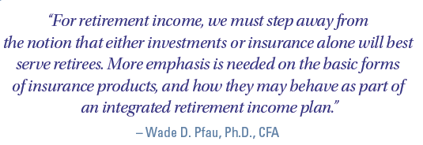
Basket of Products Approach
For Financial Professional Use Only
`
Copyright 2009 – 2018 Thrive Income Distribution System®
Notes:
The DIA is a deferred income annuity. A delayed SPIA if you will that starts income flow more than 13 months after the money is deposited. The longer the insurance company has your money… the more they are going to be willing to pay out in a contractual arrangement.

Slide 35



Basket of Products Approach
To: Financial Professional
From:
Annuities
Life Insurance
Mutual Funds
Health Ins. - LTC
Stocks - Bonds
For Financial Professional Use Only
`
Copyright 2009 – 2018 Thrive Income Distribution System®
Notes:
Granted we knew to avoid being over exposed in the market during the the danger zone… the 5 to 10 years before and after retirement.

Slide 36
Product Allocation to Align Risks
Annuities
Variable, Fixed & SPIA/DIA
Cash/Bonds/Alt.
Risk Management
Equities
Performance & Growth
Insurance
Life, LTC & Liability
Longevity Risk
Essential Inflation
Market Downside
Protect Behavior Reliability of Inc. Seq. of Returns
Short-Term Risk
Moderate Upside
Balance
Tax Free Inc. (Roth)
Liquidity
Tax Managed
Manage Hyper- Infl.
Market Upside
Tax-Harvesting
Long-Term Risk
Deflation Risk
Tax Free Growth & Legacy (Roth)
Long Term Care
Life Ins. – DB
Tax-Free Inc.
(Life CV)
Disability Ins.
Liability Ins.
Health Ins.
THRIVE® Product Glide Path™
For Financial Professional Use Only
`
Copyright 2009 – 2018 Thrive Income Distribution System®

Slide 37
Key Elements of Retirement
Meeting One:
Knowing What Retirees Want
Taking Key Risks Off the Table
Divide and Conquer Approach
For Financial Professional Use Only
`
Copyright 2009 – 2018 Thrive Income Distribution System®

Slide 38






THRIVE® Retirement Process
Divide and Conquer
Defensive
Offensive
PROMISED BASED INCOME ASSETS
MARKET BASED INC & GWTH ASSETS
+
PayCheck
PlayCheck
Income
Value of assets needed to create a stream of annually increasing retirement income with precision
Growth
Value of assets not needed for income is used to provide liquidity, discretionary income, growth, and legacy
Copyright 2017– Thrive Income Distribution System®
Must be reliable and predictable
Managed risk is acceptable
For Financial Professional Use Only
`
Copyright 2009 – 2018 Thrive Income Distribution System®
Notes:
The THRIVE philosophy is to Divide and Conquer. By that I mean we take someone’s assets and determine how many are needed to guarantee an inflation adjusted income, guaranteed for life so they can continue living their desired lifestyle. The rest we would use for our growth and Extra income. The income would be our paycheck and the growth would be our Play Check. This is our Buy Income and Invest the Difference® approach. It has been proven to generate more guaranteed income as well as provide more remaining assets than using traditional strategies because we don’t have to keep our growth assets hostage for income. The assets designated for income need to be guaranteed and without risk as opposed to the growth assets that can experience whatever level of risk someone is willing to take. Another way of looking at this dividing of assets is the income portion is defensive and the growth portion is offensive. Much like sports you need both to have a successful team.

Slide 39
PROMISED BASED INCOME
ROI
Reliability of Income
RISKED BASED ASSETS
Discretionary Income
Growth Assets
Free Spending Liquidity
Legacy and LTC Goals
For Financial Professional Use Only
`
Copyright 2009 – 2018 Thrive Income Distribution System®

Slide 40


THRIVE® Income Process
Many goals to achieve
Reliable Income
Leave Legacy
Maximize Returns
Beat Inflation
Minimize Taxes
Minimize
Risk
… Meets emotional and financial needs for a lifetime
For Financial Professional Use Only
For Agent Use Only
`
Copyright 2009 – 2018 Thrive Income Distribution System®
Notes:
* Lets face it…. Creating a retirement income plan is a complex undertaking
After all There are so many diverse goals and issues to consider.
I have found that most clients want to accomplish the following in their retirement plan – kind of a wish list if you will – probably what heads the list is a guaranteed income for life that adjusts for inflation, Then of course there is the issue of taxes – everyone wants to pay as few of taxes as possible… legally of course.
and everyone wants to get the best returns on their investments as possible
but they don’t want to lose any money.
and most people, after they have made sure they have taken care of themselves, wouldn’t mind leaving a legacy of some sort for their children or their favorite charities.
How do we coordinate and solve all of these issues? Booming Income is the answer. The software system that helps clients get more with less by coordinating income streams and maximizing assets. And when the Booming Income plan is implemented – we not only meet the financial needs of a client but many of their emotional ones as well.

Slide 41
Income Guarantees REQUIRE Insurance
GLWB
SPIA
DIA
QLAC
Guaranteed Lifetime Withdrawal Benefit Rider to Deferred Annuity
Single Premium Immediate Annuity
Single Premium Deferred Income Annuity
Single Premium Deferred Income Annuity
Income Rider Withdrawals
Annuitized Payments
Annuitized Payments
Annuitized Payments
*Guarantees are based upon the claims-paying ability of the issuing insurance company.
For Financial Professional Use Only
For Agent Use Only
`
Copyright 2009 – 2018 Thrive Income Distribution System®
Notes:
The creative and flexible use of Income annuities. These are the primary ones – The guaranteed lifetime withdrawal benefit that is usually associated with a fixed indexed annuity, the SPIA and the DIA

Slide 42
Key Elements of SPIAs & DIAs
Fee Drag
1. Eliminates the FEE-DRAG
All future income, including inflation increase,
can be fully guaranteed.
INFLATION
$
$
$
$
$
3. Tax Benefits with non-qualified assets
FIBO®
25% GAIN
Tax-Exclusion Ratio
4. Mortality Credits
75% PRINCIPAL
$6,000
First In…
$5,000
$4,000
$3,000
Payout
…Blend Out
$2,000
$1,000
$ 500
$0
65
66
67
68
69
70
71
72
73
74
75
76
77
78
79
80
81
82
83
84
85
86
87
88
89
90
91
92
93
94
95
96
97
98
99
100
Age
For Financial Professional Use Only
`
Copyright 2009 – 2018 Thrive Income Distribution System®

Slide 43
Key Elements of Retirement
Meeting One:
Knowing What Retirees Want
Taking Key Risks Off the Table
Divide and Conquer Approach
Buy Income and Invest the Difference®
For Financial Professional Use Only
`
Copyright 2009 – 2018 Thrive Income Distribution System®

Slide 44


How to Make the Impossible…POSSIBLE!
FIBO®
Maximize Tax Efficiency
NO Ongoing Fee - Drag
RMD Compression®
The Most For the Least
Inflation - Adjusted Lifetime Income
Buy Income & Invest the Difference®
Guarantees are subject to claims paying ability of issuing company
For Financial Professional Use Only
`
Copyright 2009 – 2018 Thrive Income Distribution System®

Slide 45
Key Elements of Retirement
Meeting One:
Knowing What Retirees Want
Taking Key Risks Off the Table
Divide and Conquer Approach
Buy Income and Invest the Difference®
The 4L’s of Retirement
For Financial Professional Use Only
`
Copyright 2009 – 2018 Thrive Income Distribution System®

Slide 46




4 L’s of Retirement
Longevity
  Will income last a Lifetime?
Lifestyle
  Safe withdrawal rate?
  Fixed vs. Variable withdrawal?
Legacy
  Promised based vs. Risk based?
  Protecting the surviving Spouse
Liquidity
  Discretionary spending?
For Financial Professional Use Only
`
Copyright 2009 – 2018 Thrive Income Distribution System®

Slide 47
Key Elements of Retirement
Meeting One:
Knowing What Retirees Want
Taking Key Risks Off the Table
Divide and Conquer Approach
Buy Income and Invest the Difference®
The 4L’s of Retirement
Core Measurements of Safe vs. Unsafe
For Financial Professional Use Only
`
Copyright 2009 – 2018 Thrive Income Distribution System®

Slide 48

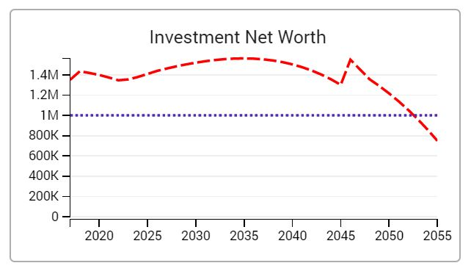
  Investment Net Worth
For Financial Professional Use Only
`
Copyright 2009 – 2018 Thrive Income Distribution System®

Slide 49

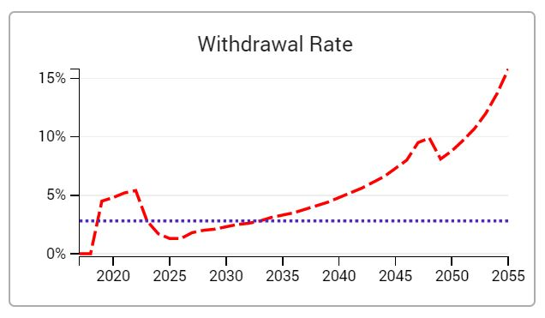
  Withdrawal Rates
3%
For Financial Professional Use Only
`
Copyright 2009 – 2018 Thrive Income Distribution System®

Slide 50

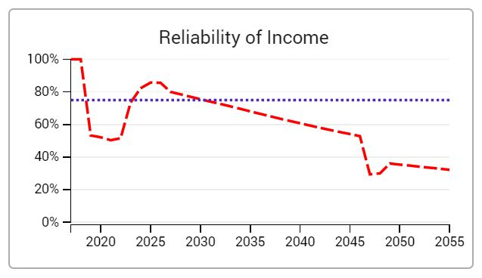
  Reliability of Income
For Financial Professional Use Only
`
Copyright 2009 – 2018 Thrive Income Distribution System®

Slide 51
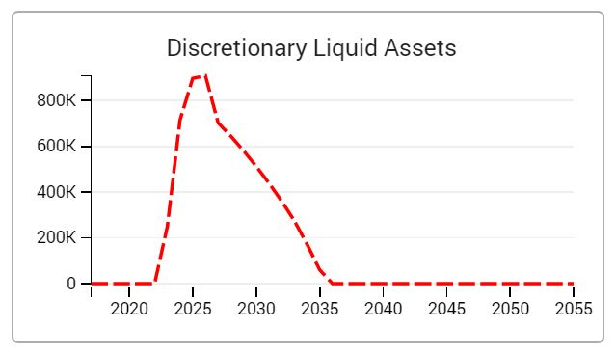
Liquidity
  Discretionary spending?
  Discretionary Liquidity
For Financial Professional Use Only
`
Copyright 2009 – 2018 Thrive Income Distribution System®

Slide 52
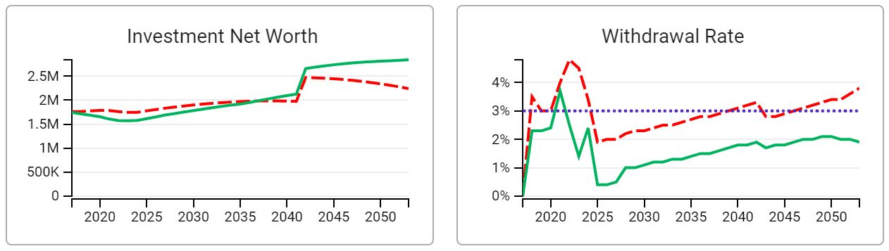
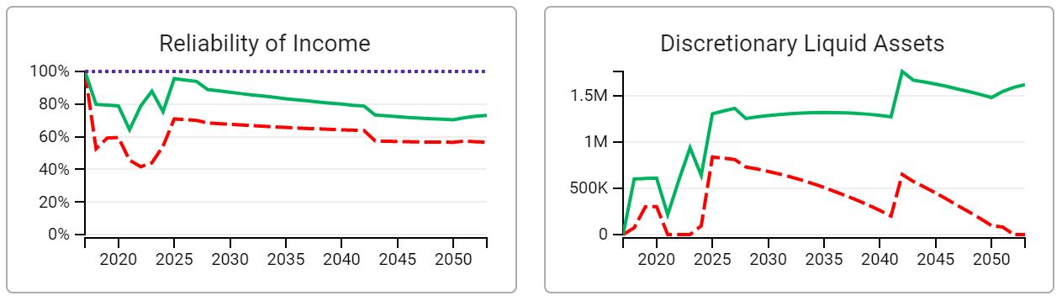
Retirement Income Dashboard
  4 Key Quantitative and Qualitative Measurements
  Investment Net Worth
  Withdrawal Rates
  Reliability of Income
  Discretionary Liquidity
www.retirementnextgen.com
For Financial Professional Use Only
`
Copyright 2009 – 2018 Thrive Income Distribution System®

Slide 53

 | Mr. | Mrs.
Current Ages | 61 | 57
Target Longevity Age Mr/Mrs. | 90 | 95
Social Security | $30,600 | $28,140
Pension | $43,620
Annual Net Desired Income (Today's $'s) | $103,200
Target Inflation Rate (non-medical/ medical) | 2.50% / 5.0%
NQ Assets | $335,580
Qualified Assets | $541,542 | $430,500
Home Wealth | $300,000
Total Assets | 1,607,622
Case Study #1 Sales
For Financial Professional Use Only
`
Copyright 2009 – 2018 Thrive Income Distribution System®

Slide 54
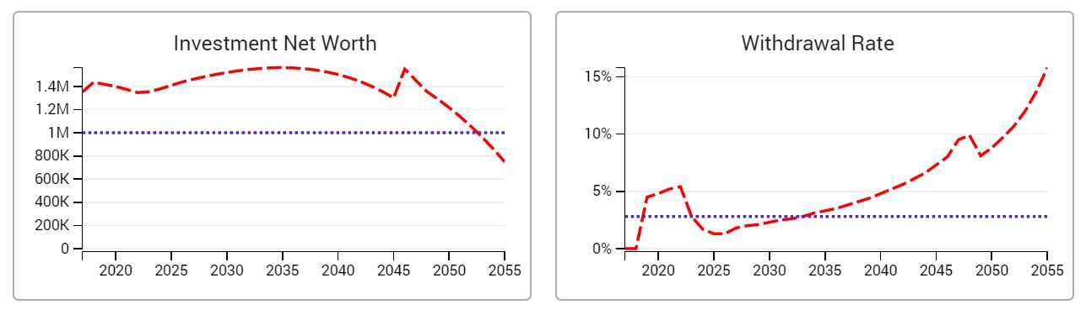
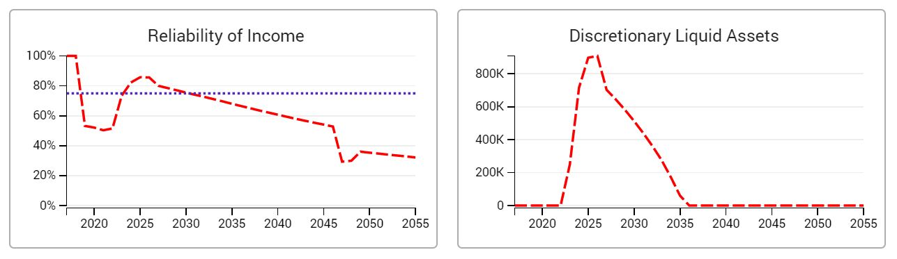
Key Core Measurements
Baseline – Traditional Solution of Low Promised Based Income Guarantees
For Financial Professional Use Only
`
Copyright 2009 – 2018 Thrive Income Distribution System®

Slide 55
Consider Basket of Products Approach That Also Test Fixed Insurance Solutions
RETIREMENT INCOME
Delay SS w/ Bridge
Optimize SS delay options and solve income needs with “Period Certain” SPIAs & DIAs to provide an engineered cash flow bridge
Essential Income Floor
Allocation to SPIA/DIA/FIA for the essential income floor, after coordinating income sources of Social Security & Pension optons
QLAC
Control early RMD’s and solve higher distribution rates and longevity risk in later phase of retirement with a QLAC
Bracket-Bump Roth Conversions*
Utilizing tax-efficient cash flow streams prior to age 70 ½ & during the SS bridge period can provide opportunity to convert qual. assets
Life Insurance – LTC Enhancements
Coordinating life insurance for income, death benefit, & stand alone, plus an asset based life insurance LTC to de-risk portfolio
For Financial Professional Use Only
`
Copyright 2009 – 2018 Thrive Income Distribution System®

Slide 56
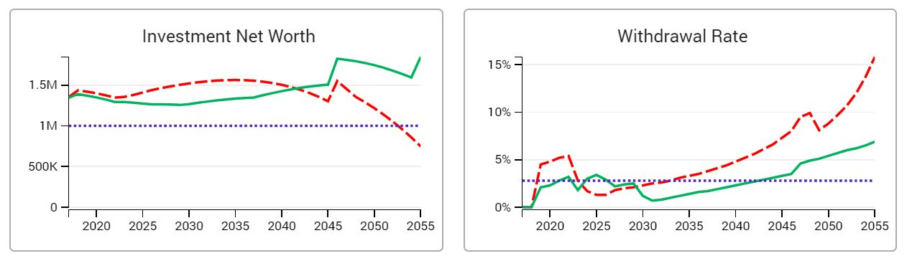
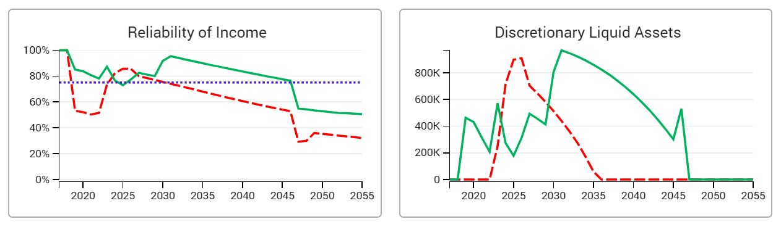
Key Core Measurements
Retirement Solution - Blend of Product Allocation - FOMO
Case Study #1 Sales
For Financial Professional Use Only
`
Copyright 2009 – 2018 Thrive Income Distribution System®

Slide 57
 | Mr. | Mrs.
Current Ages | 63 | 53
Target Longevity Age Mr/Mrs. | 89 | 97
Social Security | $30,900 | $16,020
Pension | $0
Annual Net Desired Income (Today's $'s) | $156,000
Target Inflation Rate (non-medical/ medical) | 3.0% / 5.0%
NQ Assets | $1.225 million
Qualified Assets | $4.94 million
Home Wealth | $610,000
Total Assets | $ 6.775 million
Case Study # 2 Sales
For Financial Professional Use Only
`
Copyright 2009 – 2018 Thrive Income Distribution System®

Slide 58
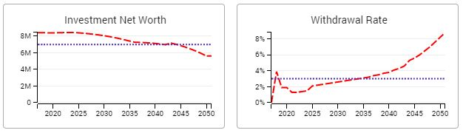
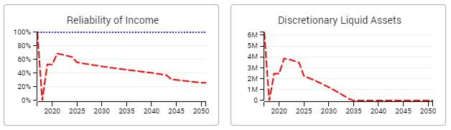
Key Core Measurements
Baseline – Traditional Solution of Low Promised Based Income Guarantees
`
Copyright 2009 – 2016 Thrive Income Distribution System®

Slide 59
Consider Basket of Products Approach That Also Test Fixed Insurance Solutions
RETIREMENT INCOME
Delay SS w/ Bridge
Optimize SS delay options and solve income needs with “Period Certain” SPIAs & DIAs to provide an engineered cash flow bridge
Essential Income Floor
Allocation to SPIA/DIA/FIA for the essential income floor, after coordinating income sources of Social Security & Pension optons
Chase Equities for Growth
Now that the essential income is purchased, the remaining assets can be used to chase equities for more growth
QLAC
Control early RMD’s and solve higher distribution rates and longevity risk in later phase of retirement with a QLAC
Bracket-Bump Roth Conversions*
Utilizing tax-efficient cash flow streams prior to age 70 ½ & during the SS bridge period can provide opportunity to convert qual. assets
Life Insurance
Coordinating life insurance for income and life insurance for death benefit

Slide 60
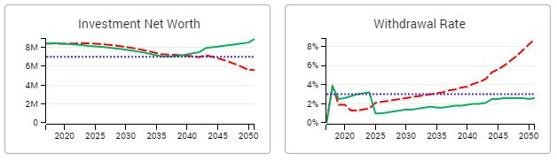
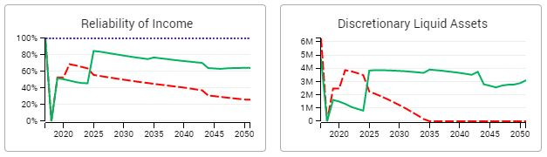
Key Core Measurements
Retirement Solution - Blend of Product Allocation - FOMO
Case Study # 2 Sales
`
Copyright 2009 – 2016 Thrive Income Distribution System®

Slide 61

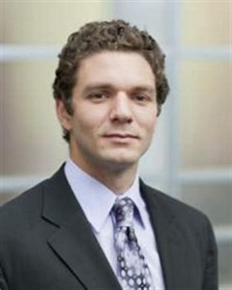

“Let me preface this by pleading with you to continue to read and not give in to your urge to skip the discussion of reverse mortgages because you have heard negative things about them,” Hopkins writes in “Rewirement: Rewiring the Way You Think About Retirement.”
“While there are risks with utilizing a reverse mortgage, if properly used, it can be one of the best features of your retirement income plan.”
https://www.marketwatch.com/story/what-to-know-about-the-new-jumbo-reverse-mortgages-2019-02-13?mod=hp_minor_pos19
`
Copyright 2009 – 2016 Thrive Income Distribution System®

Slide 62
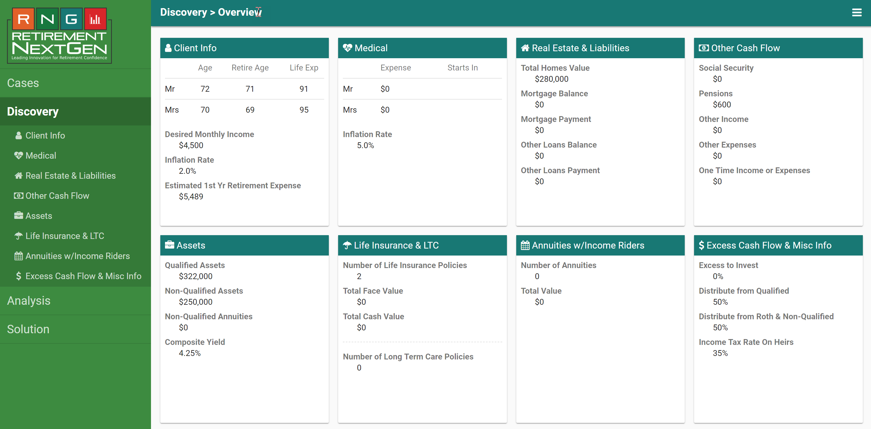
HECM Case Study

Slide 63
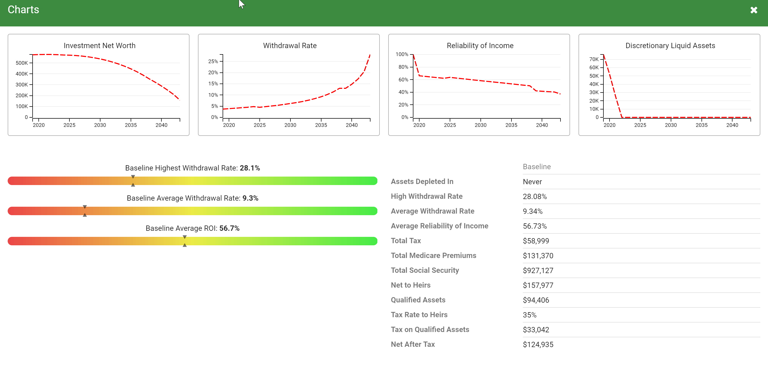

Linear Baseline

Slide 64
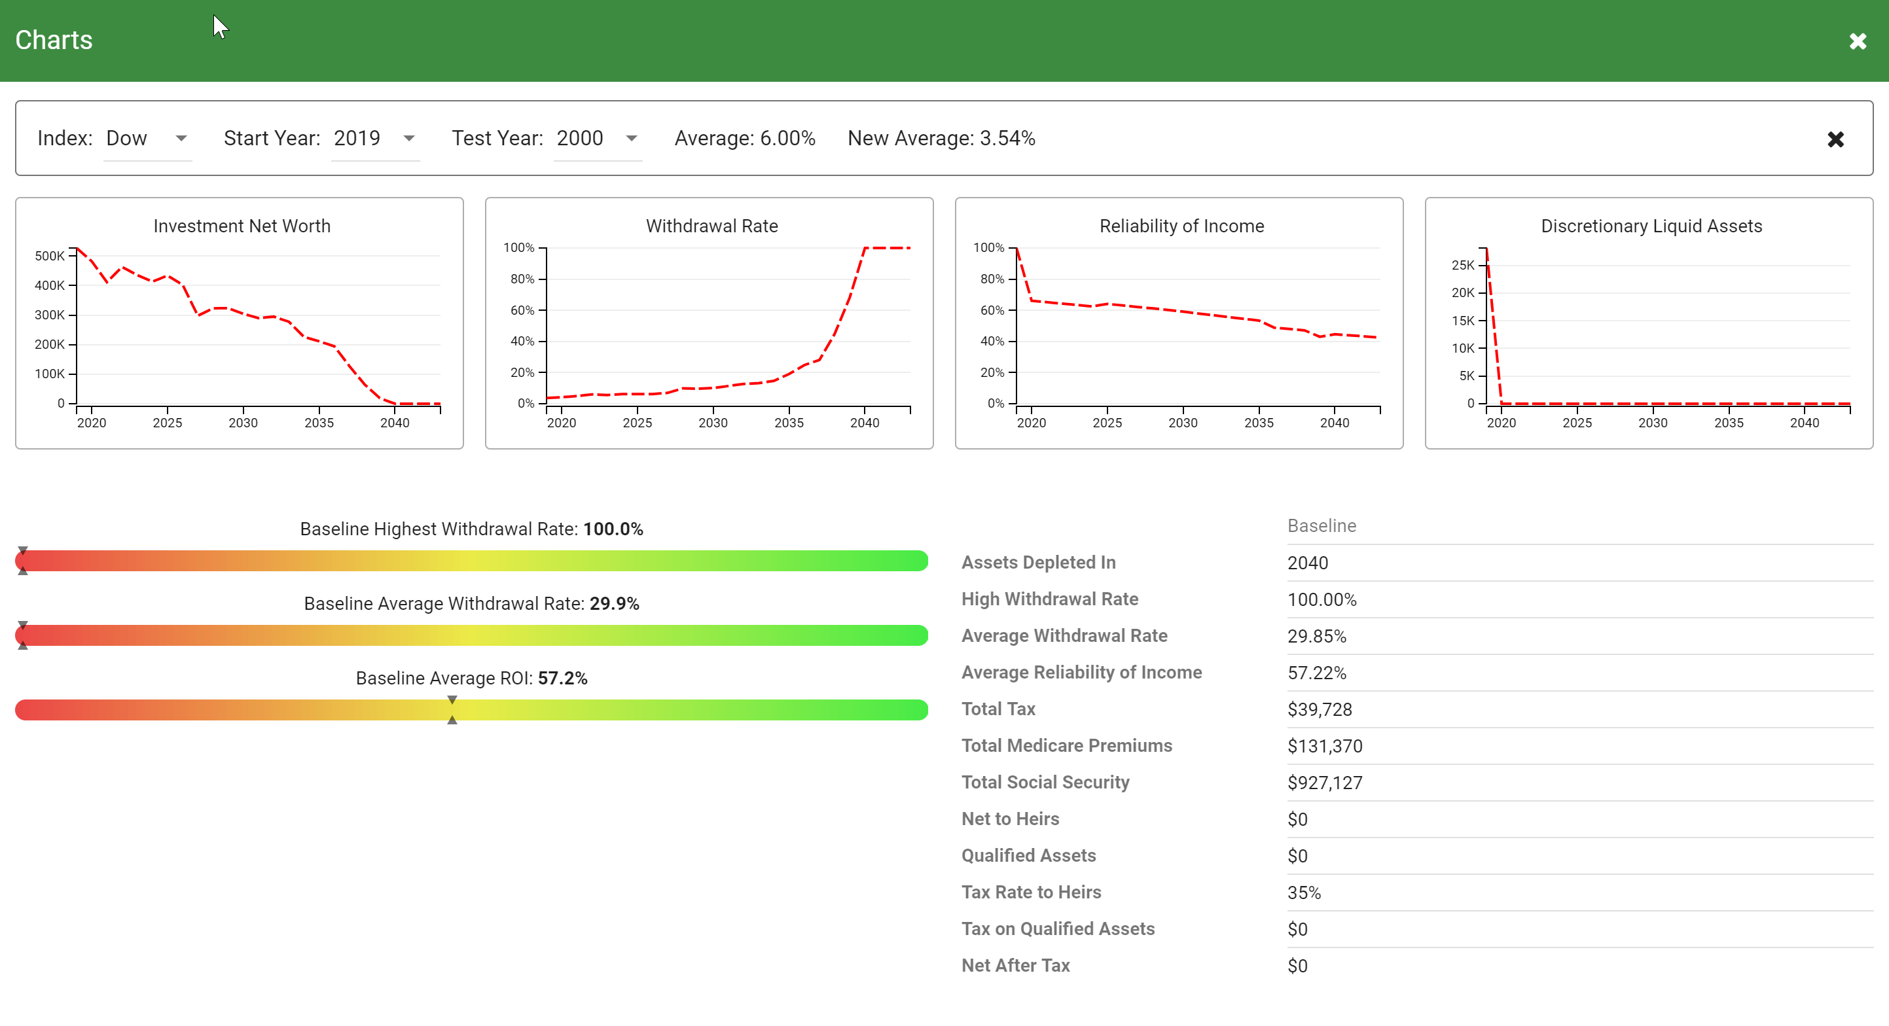
Market Stress Tested Baseline

Slide 65
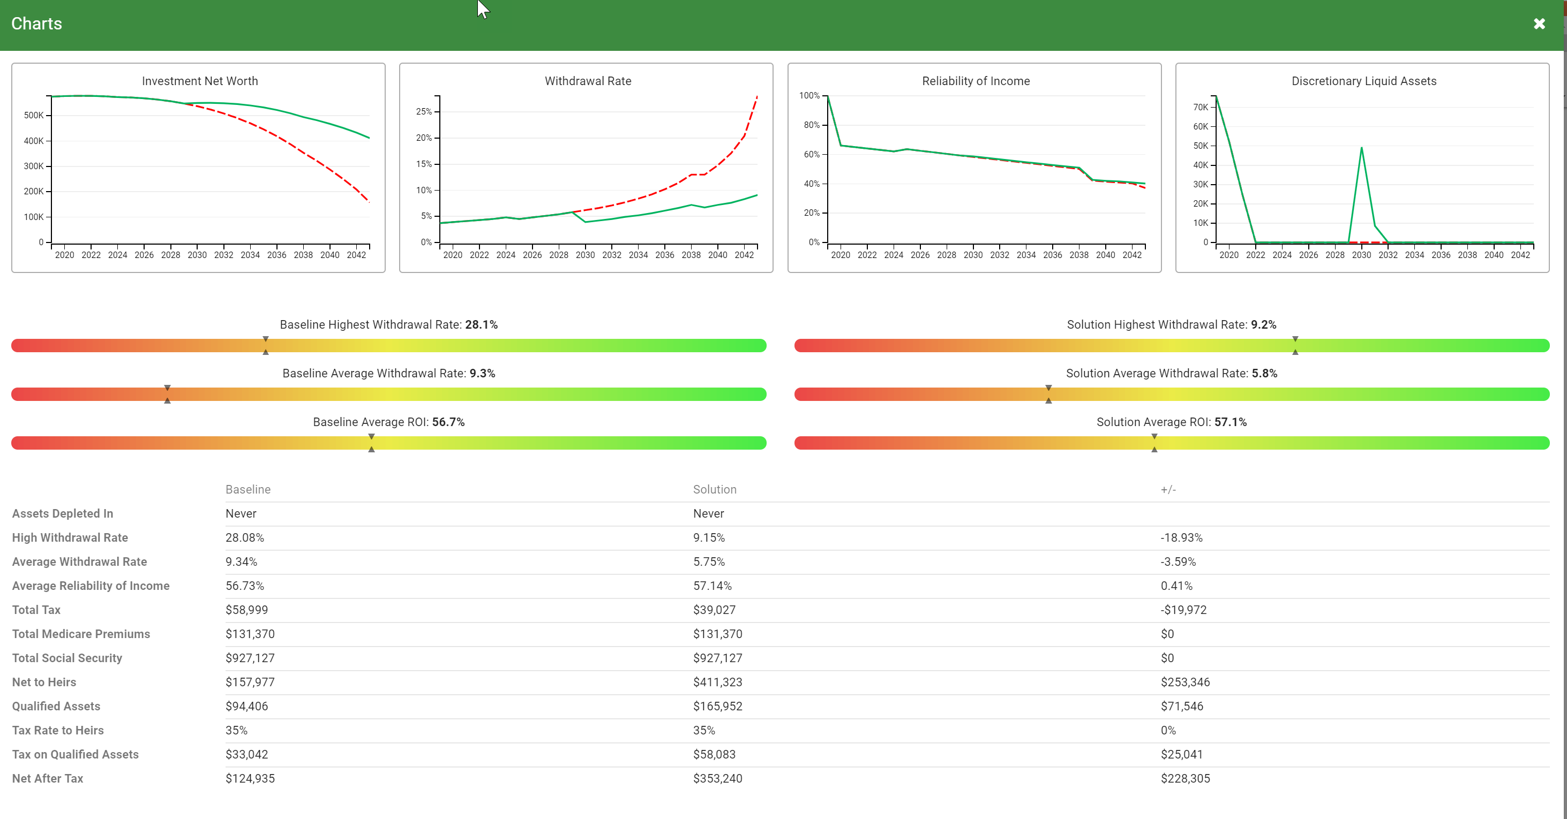
HECM Line of Credit Income Draw - Baseline

Slide 66
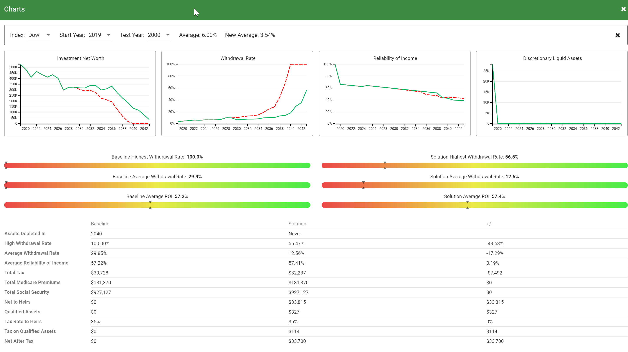
HECM Line of Credit Income Draw - Baseline

Slide 67


Buy Income and Invest the Difference®
Buy Income…
Promised Based Income Assets
Invest the Difference… Risked Based Growth Assets
`
Copyright 2009 – 2016 Thrive Income Distribution System®

Slide 68


Tom Hegna on Thrive University
Text: THRIVEU to 66866

Slide 69





THRIVE University Online
Text: THRIVEU
To #: 66866
http://thrive.mentored.com

Slide 70

THRIVE® University Two-Day Bootcamp
Newport Beach, CA
August 7- 8, 2019
To Register: www.thriveulive.com
(Scroll down and click on Thrive University August 2019)
Click Here
For more info. Call Michele Gebhardt 515-298-4748

Slide 71
THRIVE® University – 5 Fears 5 Risk Planning Process
  From: Ron Braun <rbraun@upstreamip.com>
  Date: 3/28/19 5:42 PM (GMT-06:00)
  To: ccloke@thriveincome.com
  Subject: Three in a row
  Just closed the third prospect interview in a row just by playing your video of 5 Fears and Five Risks.
  Sent from my iPhone
  Securities offered through Sigma Financial Corporation, member FINRA/SIPC.

Slide 72

THRIVE® University – 5 Fears 5 Risk Planning Process
  From: Ron Braun <rbraun@upstreamip.com>
  Sent: Friday, March 29, 2019 1:53 PM
  To: ccloke@thriveincome.com
  Subject: testimonial
  Recently I start my 1st meeting by asking the “Getting to the Heart of the Matter” questions myself and then simply playing the online video of Curtis going through the “5 Fears 5 Risk” presentation with my “Taxes in Retirement” seminar prospects. After having less than optimal success closing the planning, my first three prospects committed to my planning fee and the fourth is a hopeful maybe after using this approach. This presentation, taught at Thrive University as a 3-meeting process, is making a difference in my initial impact of emotionally reaching the client, creating value by framing their problem in the Retirement Income Dashboard (RNG) and helping my prospective clients see the value of the planning process we use.
  Ronald C. Braun, CFP®, AIF®
  Senior Wealth Manager
  UPSTREAM Investment Partners, LLC
  7125 Orchard Lake Rd.
  Suite 304
  West Bloomfield, MI 48322
Thrive Store
www.curtiscloke.com

Slide 73



THRIVE® University – RNG Retirement NextGen®
  What does Dave Allison of C2P have to say about Thrive U and RNG?
  "I have tested so many planning software programs and struggled to find something that connected the art of creating the need, developing sales opportunities, and actually performing comprehensive financial planning all in one, without being so complex that advisors don't want to use it and clients can't understand it. RNG has solved that issue and for any advisors that want to use the power of analytics to motivate their clients to say yes, I highly recommend Retirement NextGen (RNG), the retirement planning software powered by Thrive Income Distribution System, LLC.“
  Dave Alison, CFPR
  President | Founding Partner
  Clarity 2 Prosperity
RNG Launched by C2P as the Retirement Planning Software of Choice December 2018
www.retirementnextgen.com

Slide 74
Key Takeaways
Know your client – Getting to the Heart of the Matter
Client-Driven Process
Understanding Fears vs. Risk
Separate Analytics (Fee) from Implementation (Product)
Overcoming the FOMO Factor
Embrace the “Basket of Products” approach
Divide and Conquer
Understanding the 4 L’s of Retirement
Frame the contrast of the Before and After with Pictures
For Financial Professional Use Only
`
Copyright 2009 – 2017 Thrive Income Distribution System®

Slide 75

Re-Firement for a Life of Significance

Slide 76

Utility of the Joy of Living
Live & Give on purpose for purpose
Contentment - Purpose - Meaning
`
Copyright 2009 – 2016 Thrive Income Distribution System®

Slide 77
www.thriveu.net
Thank You
For Financial Professional Use Only
`
Copyright 2009 – 2017 Thrive Income Distribution System®

