Slide 1
How to turn your successful practice into a balanced life
NAIFA 2019 P+P
Danny O’Connell

Slide 2
Why do we do it?
Notes:
I don’t have all the answers, Im just a guy who asked “what if”
I am willing to bet just about every one of you in this room and joining us live has experienced some issue, some tragedy, something that really tested your resolve. Something you wish you never would have had to deal with.
In no way am I going to try and compare or get into a “who had it worst” contest, thank God my circumstances were not health related. That being said, as I reflected and got ready for this session it dawned on me, while I wish I never would have had to go through it, I am stronger because of it.
Welcome to this session: How to Turn your Successful Practice into a Balanced Personal Life

Slide 3
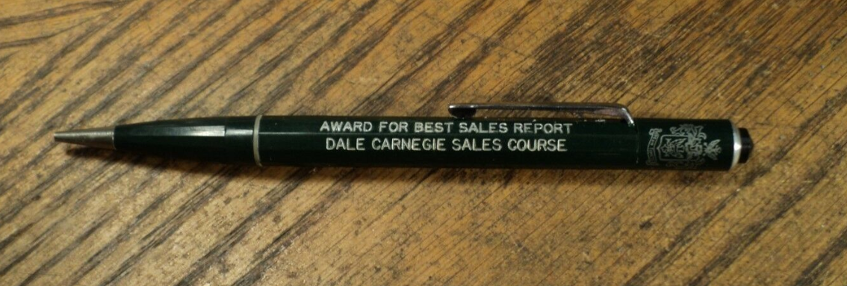
Sales Training 101

Slide 4
What if ?
What if we applied the things we were taught getting into this industry?
What if we applied the books we read, the speakers we listen to, and the goals we set to our personal lives?
Can these same principals carry over?
At the end of the day what is it we truly seek?

Slide 5
Is balance what we truly seek?

Slide 6
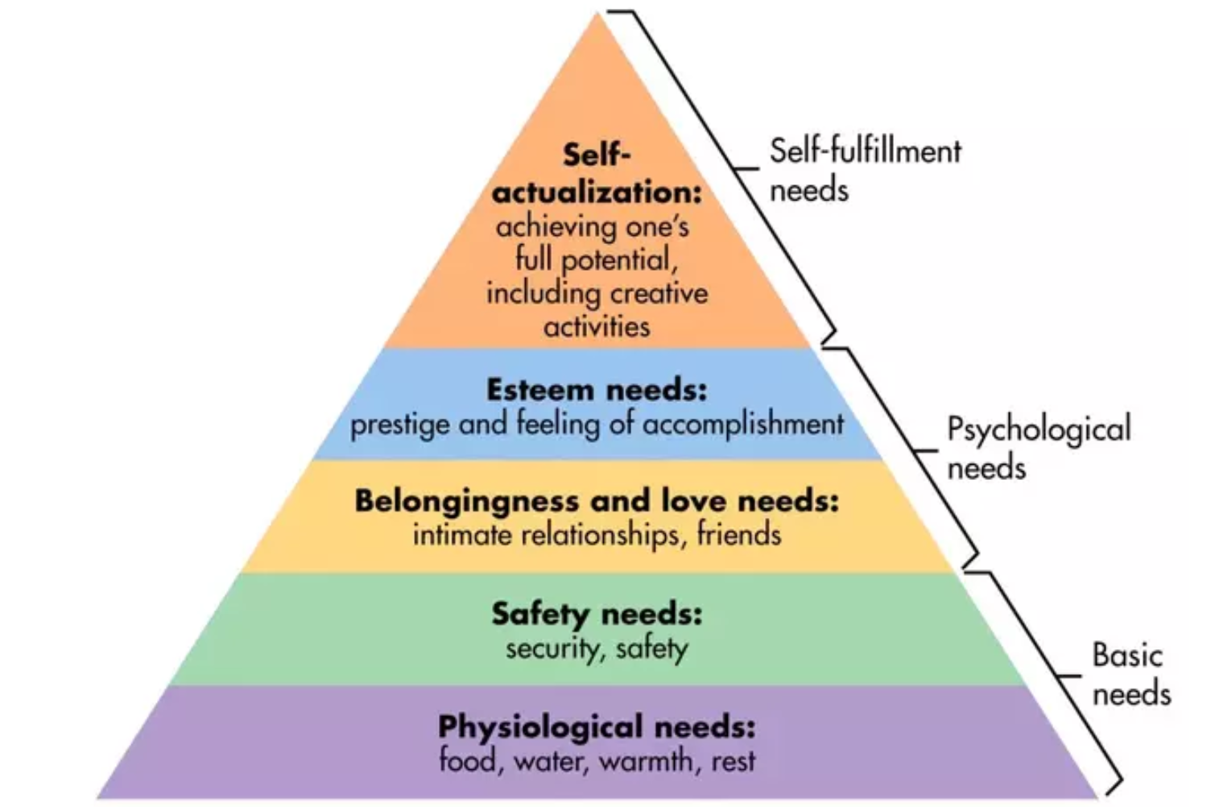
Maslow's Hierarchy of Needs

Slide 7
true personal success is in making deep meaningful impacts on the world, including those people we will never meet.
Crater Lake National Park, OR

Slide 8
Beginning the Journey

Slide 9
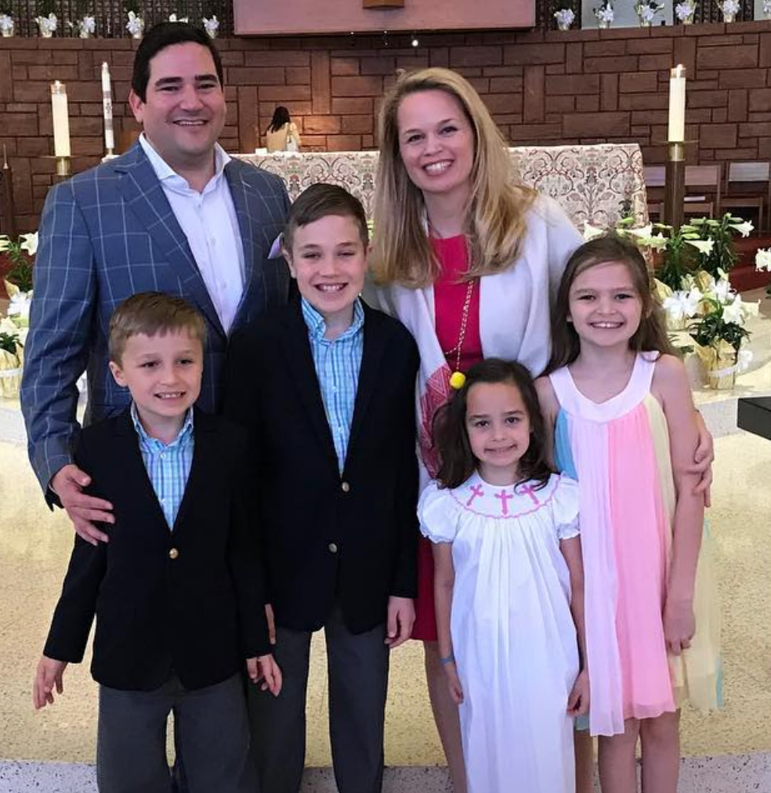
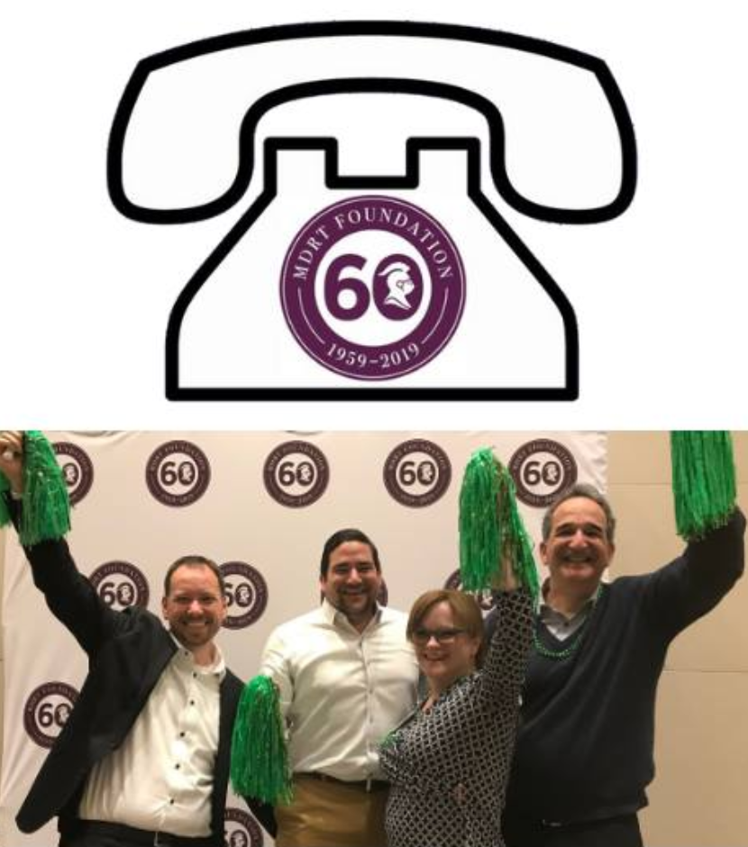
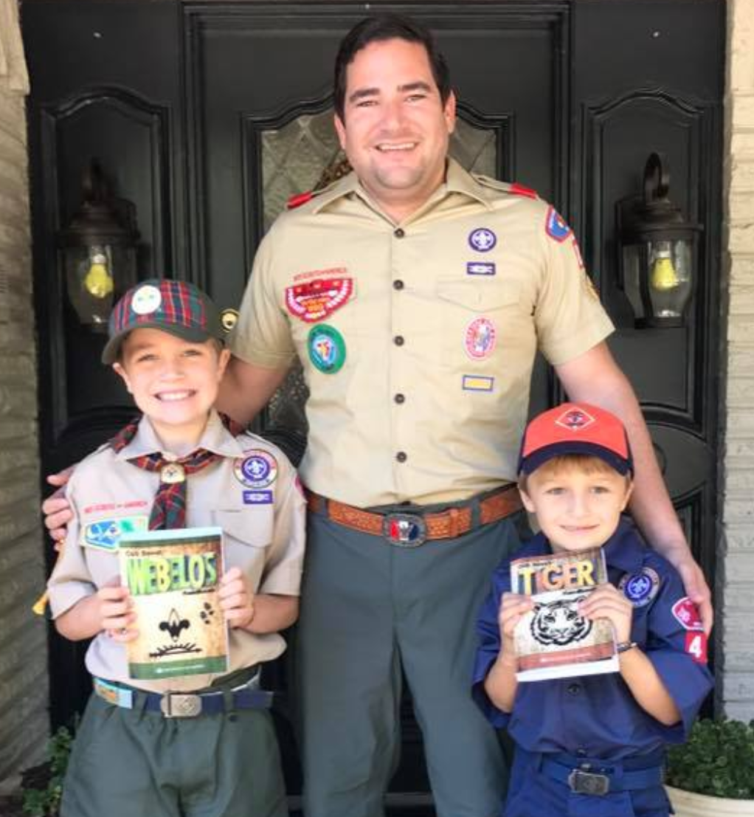
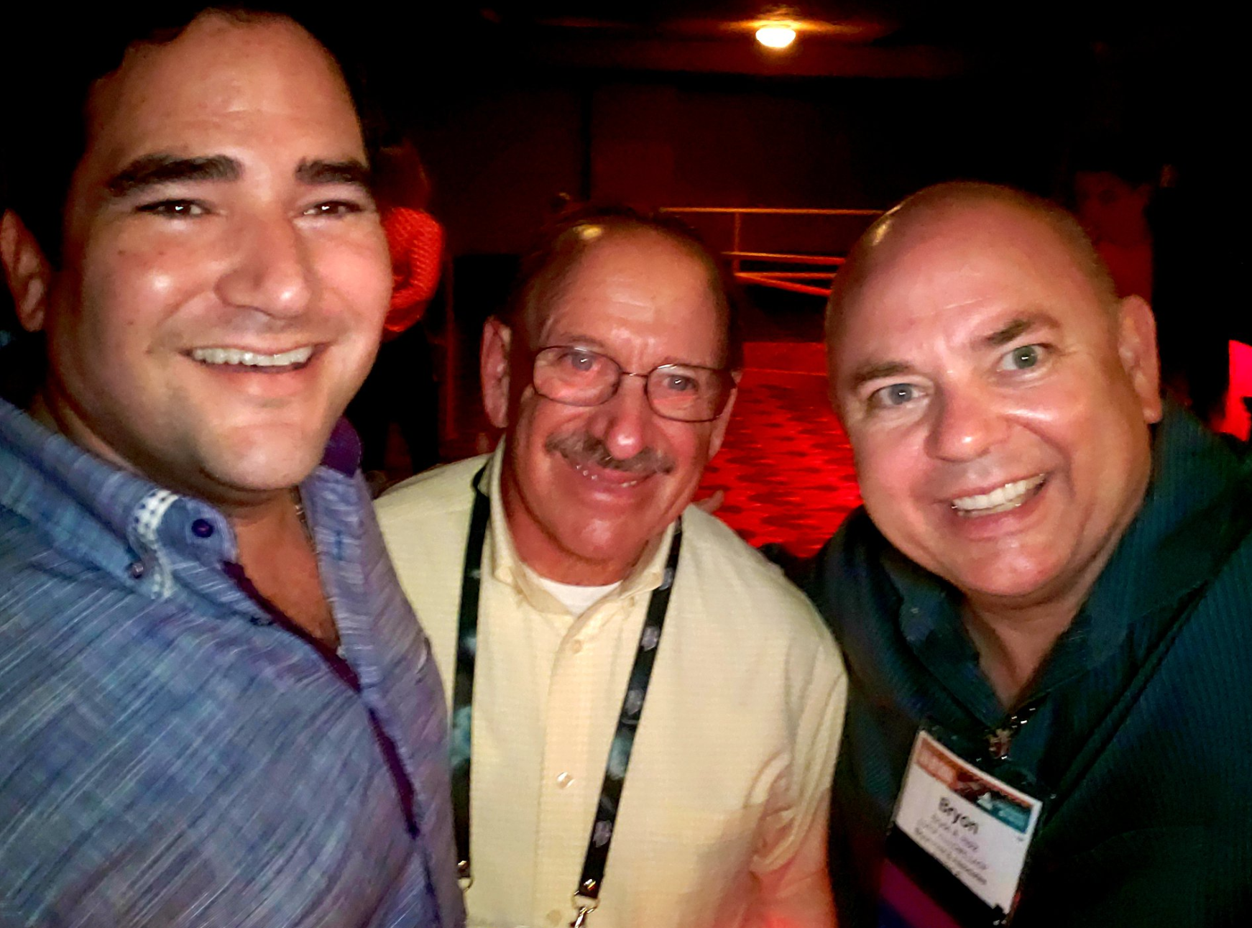
Identifying those we serve

Slide 10
My roles
Spiritual beliefs – God / mediation
Husband: my spouse
Family: my parents, siblings, my children
Boss: my staff
Sales Person: my clients
Professional associations: NAIFA, NAHU, MDRT
Other leadership roles: Cub Scouts, Boy Scouts, Rotary, CASA
Personal Health: Me

Slide 11
Self Reflection
Does this bring me joy?
Does it allow me to make a difference?
Is it something I care about?
Is this a positive & healthy influence in my life?

Slide 12
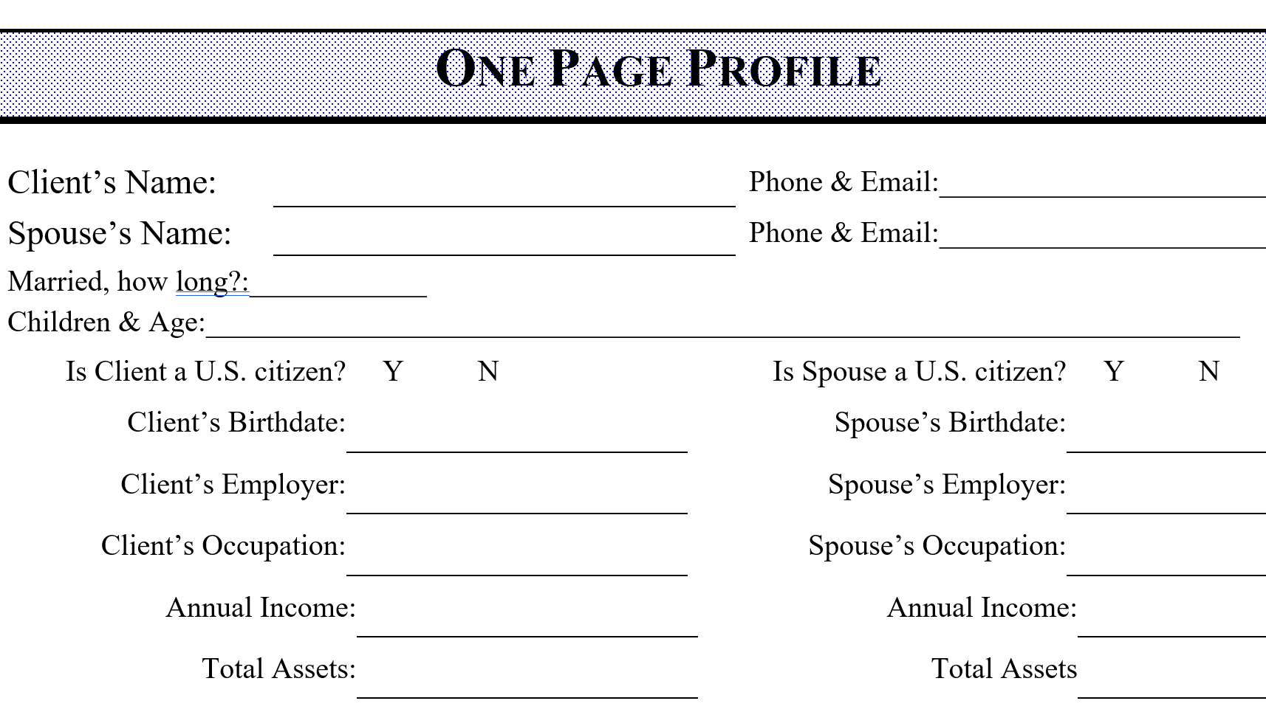
Business Fact Finders

Slide 13
Personal Fact Finder

Slide 14
My Action Items
Spiritual – pray with my kids, be the example for them, forgive others
Father – play catch, teach us things, build legos, have family dinners
Husband – be present, travel together, listen
Boss – align employees in best place to succeed
Sales person – make sales
Volunteer – plan out events, be on calls, be at in person meetings
Personal – workout 2-3 times a week, eat better, do more cardio

Slide 15
Working the plan
12 week year concept by Brian Moran
Why are we so productive in Q4? - FOCUS
What if we applied that focus all year?
Write down your goals
Share them with those who matter
We all know goals work when you don’t
review them right?

Slide 16
Review the plan
How did my life change?
Expected Changes?
What worked & what didn’t
What do I need to give move energy to?
What do I not want to have in my life?
What did I totally forget about?

Slide 17
One Page Business Plan
When is the last time you did one?
When is the last time you reviewed it?
When is the last time you sat down with your staff and had them complete one?
When is the last time they reviewed it?
When is the last time you did one for yourself?

Slide 18
Balance no longer looks like this

Slide 19
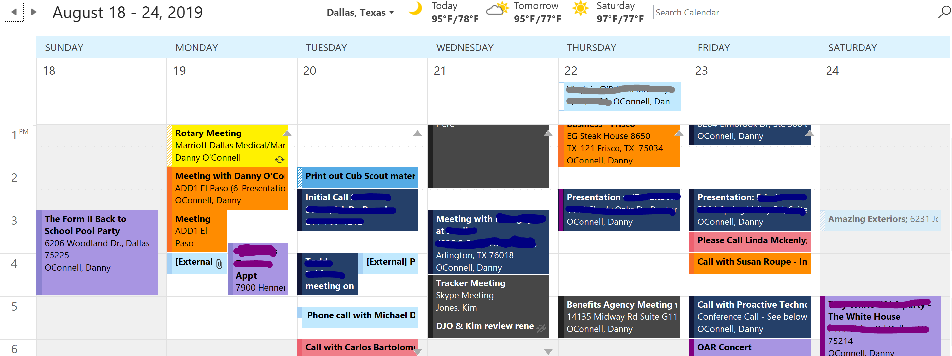
Instead it begins to resemble this

Slide 20
Where is your inspiration?
Who do you read?
Maxwell, Who Moved My Cheese, Oh Shift
Who & what do you listen to?
Steve Harvey
What do you follow on social media?
Jay Shetty, Power of Positivity
What music do you listen to and when?
How do you continue to grow?
Engage your staff!

Slide 21
The outcome
Know where I spend my time
See schedule & “balance” for weeks
Wake up happy!
The final outcome: for me, true happiness

Slide 22
Summary
You have everything you need to get there
Look no further then the tools you use in your business
Rethink what balance looks like
Identify those who rely on you
Understand their expectations & needs
Set goals realistic goals based on feedback
Work toward 2-3 per quarter
Review

Slide 23
Finally
Enjoy a more meaningful, fulfilling, life which makes an impact on those who mean the most to you.

