Slide 1
Monthly All Leader Briefing
Wednesday, July 1st @ Noon

Slide 2
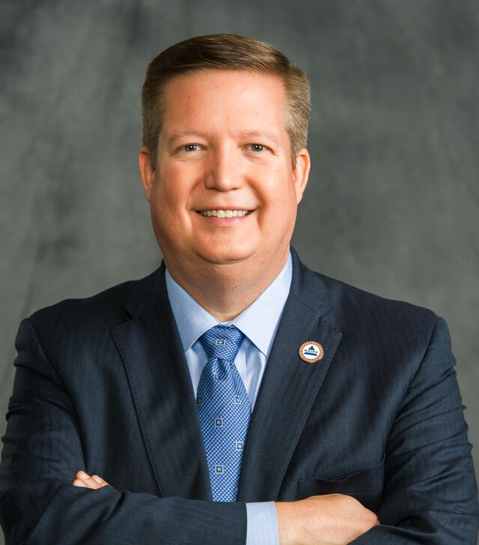
CEO Update
Kevin Mayeux, CAE

Slide 3
Marketing & Communications Update
Suzanne Carawan

Slide 4
Member & Chapter Services Update
Corey G. Mathews, CAE

Slide 5
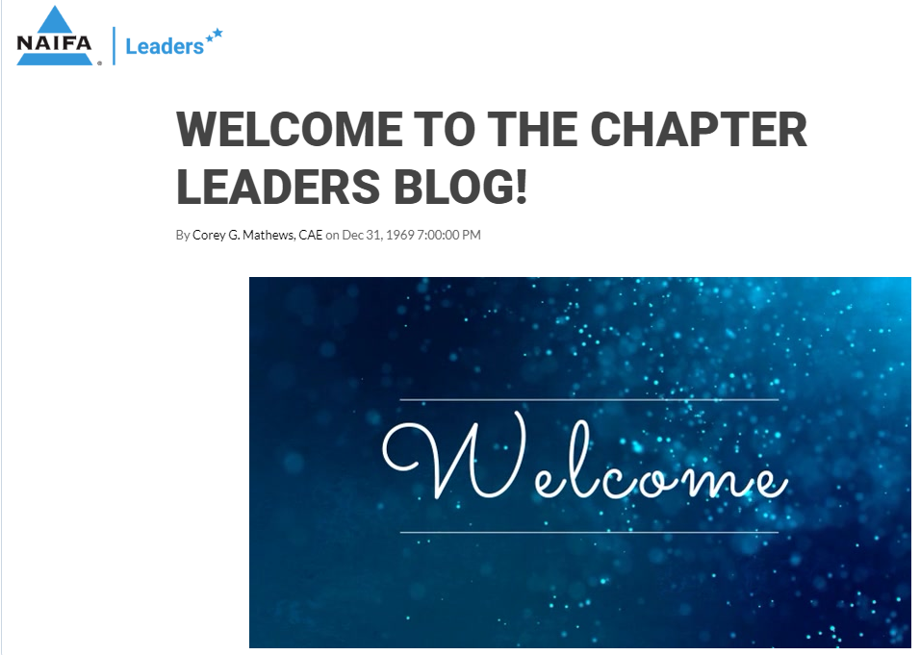
Chapter Communications
Blogs (Leaders/Staff)
Monthly Meetings (Leaders/Presidents/Staff)
Chapter Experience Team
FLEX Team

Slide 6
Chapter Websites
Now Available!
ca.naifa.org
Sites will be developed on a first-come, first serve basis.
Contact: jfolladori@naifa.org

Slide 7
Chapter Playbook Online
Chapter Services Team Info
Operating a Chapter
Chapter Leader Resources
Chapter Exec Resources
Membership Resources
And More…
Coming Soon…

Slide 8
The NAIFA Blueprint Chapter Leadership Training
Governance
Finance
Membership
Advocacy
Programs
Communications
Chapter Playbook

Slide 9
Membership Development
Member Onboarding
New Member Outreach
Member Survey
Care Calls

Slide 10
Reminders
Chapter Leaders Meetings – 1st Fridays @ Noon ET
Chapter President Meetings – 2nd Fridays @ 1 p.m. ET
Chapter Staff Meetings – 3rd Fridays @ Noon ET
Membership Chair Meetings – 4th Thursdays @ 3 p.m. ET
We will notify you of exceptions, which will occur.

Slide 11
We’re Here for You!
Questions?
What do you need?
What are you hearing?

