Slide 1
For producer use only. Not for use with the general public.
ADV 2653 05-2021 21-0300

Slide 2



F&G Dynamic
Accumulator℠ 10
Fixed Indexed Annuity
Featuring the all-new structured fixed indexed annuity (FIA) account
For producer use only. Not for use with the general public.
2

Slide 3
Agenda
Current environment
A novel approach to pursue upside
How our innovative solution works
For producer use only. Not for use with the general public.
3
Notes:
Thanks for joining us. Our focus for today’s discussion is so exciting, an innovative new fixed indexed annuity from F&G. Before we tell you what it’s all about though, we first want to dig into the challenges we’re all facing in this rate environment. We’ll explore our novel approach to deliver upside potential for your clients. And then we’ll get into the finer points of exactly how our new product aims to help meet your clients’ needs.

Slide 4
What clients are up against
Historically low interest rates
Traditional CD returns have plummeted
Bond ladders aren’t what they used to be
Wild swings of market volatility
Housing market bubble continuing to grow
Potential recession looming
For producer use only. Not for use with the general public.
4
Notes:
It seems like some of the challenges we face today have been with us for a decade. Others, we’ve seen made worse in recent years by increasingly volatile markets, growing concerns about a possible recession, and more recently a global pandemic, and all its nasty economic side effects. Add it all up, and it’s meant a steep uphill climb for anyone seeking growth potential without being willing to take on significant risk.

Slide 5

For producer use only. Not for use with the general public.
5
Notes:
Our objective is building this new product was to discover and build a new way for F&G clients to dial in growth. We wanted to offer them choices. We wanted to provide them a level of control that you just can’t find in traditional FIAs. We want to bring something to the market that would potentially be in category all its own.

Slide 6
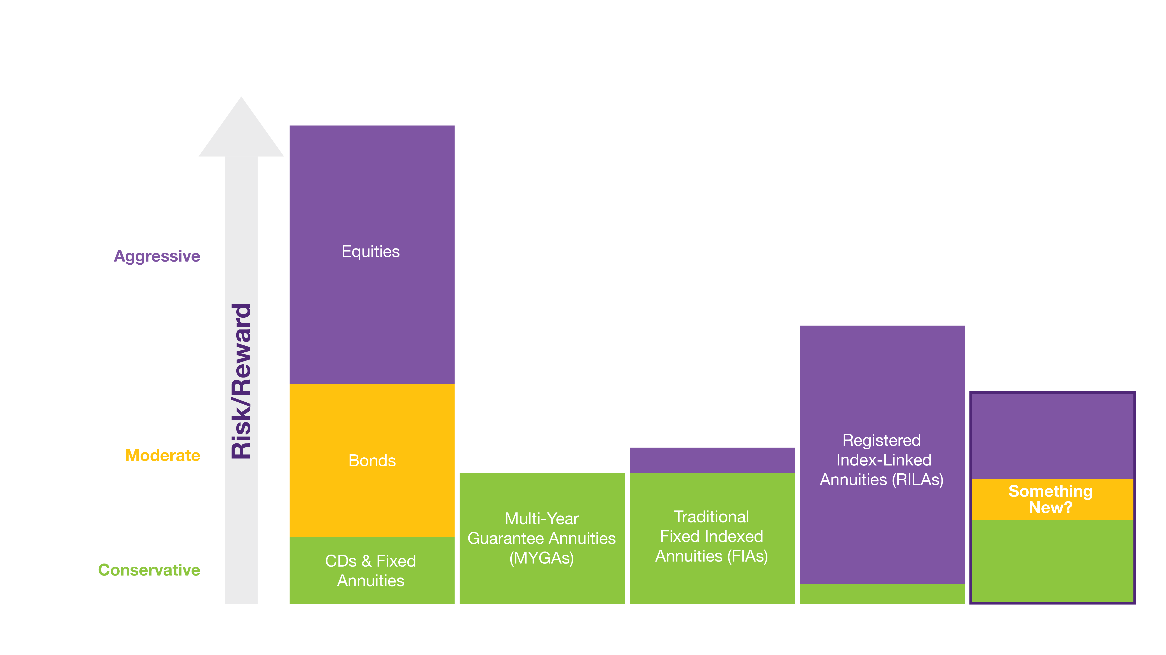
Places to turn for upside potential
For producer use only. Not for use with the general public.
6
Notes:
We started by looking at all the places at a consumer’s disposal today:
The basics up and down the risk spectrum
Offerings like MYGAs and FIAs that F&G also offers
RILAs, this relatively new hybrid product that’s been all the rage the last few years
And we thought, there’s room for something truly original here.

Slide 7


Introducing
F&G Dynamic Accumulator℠ 10
Fixed Indexed Annuity
featuring the all-new
structured FIA account
For producer use only. Not for use with the general public.
7
Notes:
<Read slide>

Slide 8
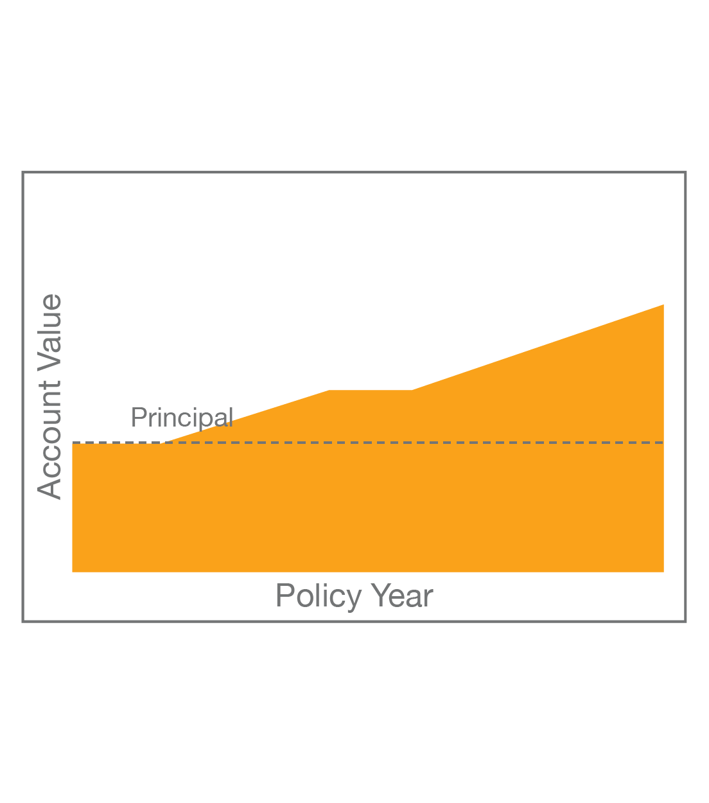
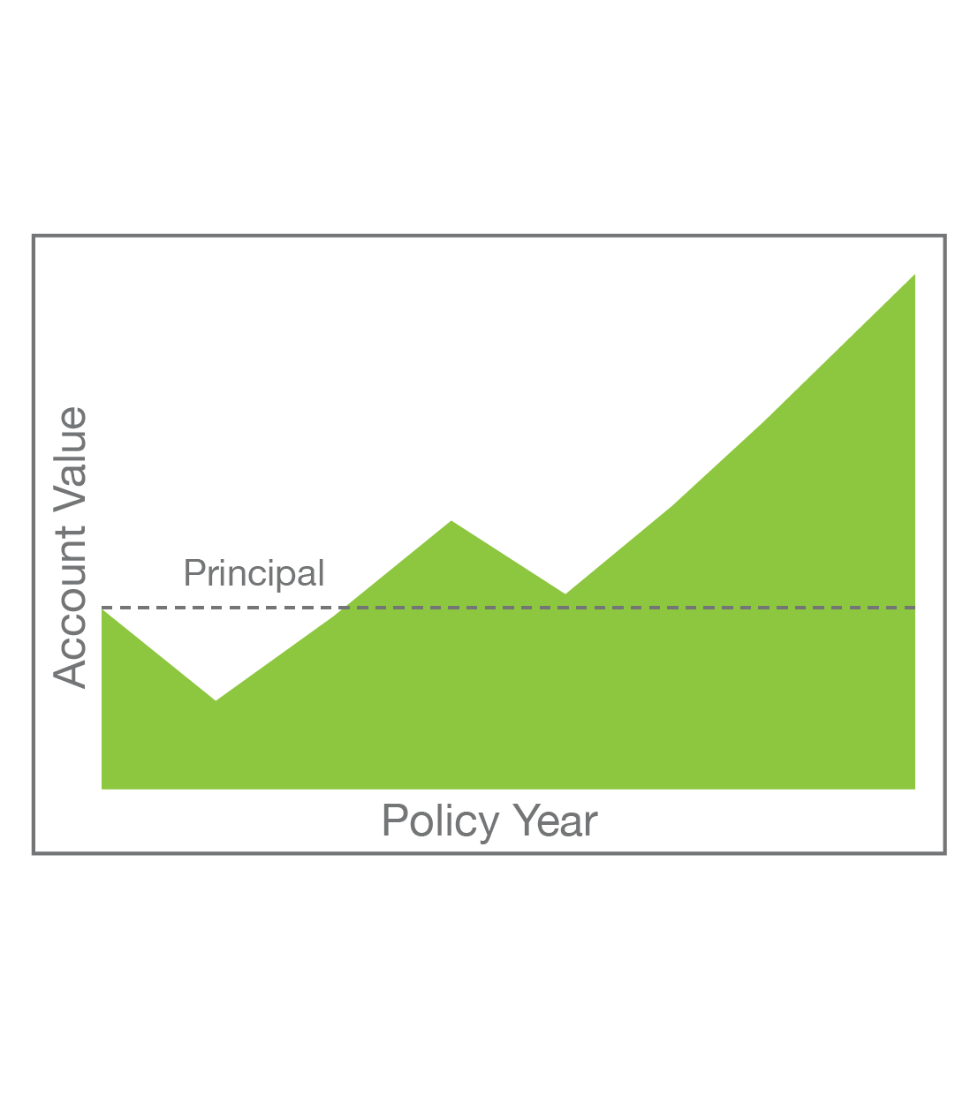
Until recently, clients had to make a big leap to find upside
Product | FIA | RILA
Principal protection |  | —
Earned index credits protection |  | —
Upside potential | Least | Most
Product registration | Non-registered | Registered
Market size | $75B | $17B
Growth | +7% | +55%
For producer use only. Not for use with the general public.
9
Notes:
As rates have dropped and upside has been harder to find in the fixed and fixed indexed annuity space, we have found a way to offer more upside than products like those along with a much greater degree of protection than a RILA.
In bad times, Dynamic Accumulator acts like an FIA. In fact, clients’ premium will be 100% protected from market losses. And in good times, Dynamic Accumulator will act more like a RILA by allowing clients to put a portion of previous gains at risk.
<Highlight key differences in table>

Slide 9
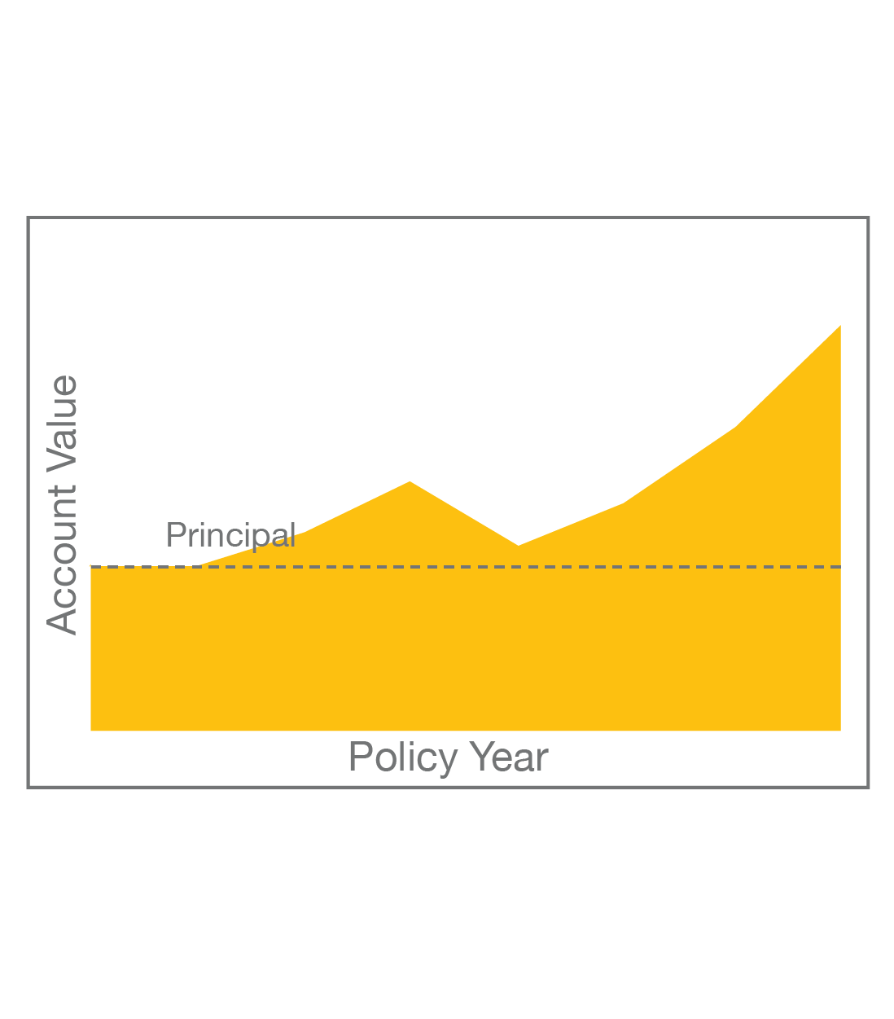
F&G Dynamic Accumulator offers more upside with 100% premium protection
Product | FIA | RILA | F&G Dynamic Accumulator
Principal protection |  | —
Earned index credits protection |  | — | Client chooses to dial up protection or potential
Upside potential | Least | Most | Flexible
Product registration | Non-registered | Registered | Non-registered
Market size | $75B | $17B | $0B
Growth | +7% | +55% | TBD
For Dynamic Accumulator, while premium is 100% protected, gains put at risk in the structured FIA account may be lost down to the risk floor selected by the client.
For producer use only. Not for use with the general public.
9
Notes:
As rates have dropped and upside has been harder to find in the fixed and fixed indexed annuity space, we have found a way to offer more upside than products like those along with a much greater degree of protection than a RILA.
In bad times, Dynamic Accumulator acts like an FIA. In fact, clients’ premium will be 100% protected from market losses. And in good times, Dynamic Accumulator will act more like a RILA by allowing clients to put a portion of previous gains at risk.
<Highlight key differences in table>

Slide 10


Like an FIA in down years, like a RILA in up years
Protection like an FIA
Potential like a RILA
Premium is 100% protected from losses due to market downturn
Far greater downside protection than a RILA where initial investment is mostly
at risk
No-fee design
Can be sold by insurance-licensed agents
Unlike an FIA and more like a RILA, gains can be leveraged for greater
upside potential
Unlike a RILA, clients control how much of their growth is risked each year and how much is protected
RILAs can only be sold by Registered Reps
While premium is 100% protected, gains put at risk in the structured FIA account may be lost down to the risk floor selected by the client.
For producer use only. Not for use with the general public.
10
Notes:
Let’s take a closer look at how Dynamic Accumulator will bridge that gap between FIAs and RILAs.
<Read slide>

Slide 11
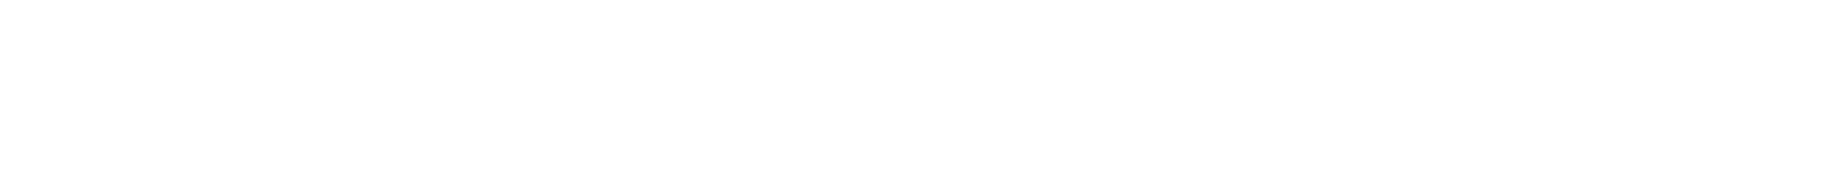
Greater upside potential by leveraging gains
Traditional FIA
Dynamic Accumulator
The above examples are hypothetical, non-guaranteed and not an indication of past or future performance. Assumes $100,000 initial premium. Returns are based on actual S&P 500® performance on December 31 of years 2010-2020. Policy issued Dec. 31, 2010. Caps are 4%, 5.25%, 7.5%, and 10% for floors of 0%, -2.5%, -5%, and -10% respectively. Assumes policy is held for the duration of the surrender charge period and no withdrawals or surrenders. Caps and floors are for demonstrations purposes only and may be different for new policies issued. Assumes -10% track is elected at issue and policyholder remains in -10% track for duration. All rates are subject to change at the sole discretion of F&G.
For producer use only. Not for use with the general public.
11
Notes:
These next several slides are going to examine the hypothetical performance of Dynamic Accumulator compared to traditional FIAs, and we’re also going to use this time to introduce you to some new terminology that is unique to Dynamic Accumulator.
The first of these terms is tracking value. Like a traditional FIA, interest is credited at the end of each crediting period. Because Dynamic Accumulator’s structured FIA account is a long-dated strategy, that crediting period is 10 years. In between, there is an annual value that calculates on a point-to-point basis, but in the structured FIA account Vesting Point to Point strategy, we call it a tracking value. A client’s tracking value is what they can put at risk after gains reach a certain threshold. As more gains are established, more can be risked – up to 10% - in exchange for better rates.
Here, on the left, you see the performance of a traditional FIA over the last 10 years indexed to the S&P 500.
On the right, you see the relative upside potential realized by putting earlier gains at risk. Premium always remains 100% protected, but with an increasing amount of their gains at risk (maxing out at 10%), this client was able to achieve over 25% more growth from the same underlying index performance.

Slide 12
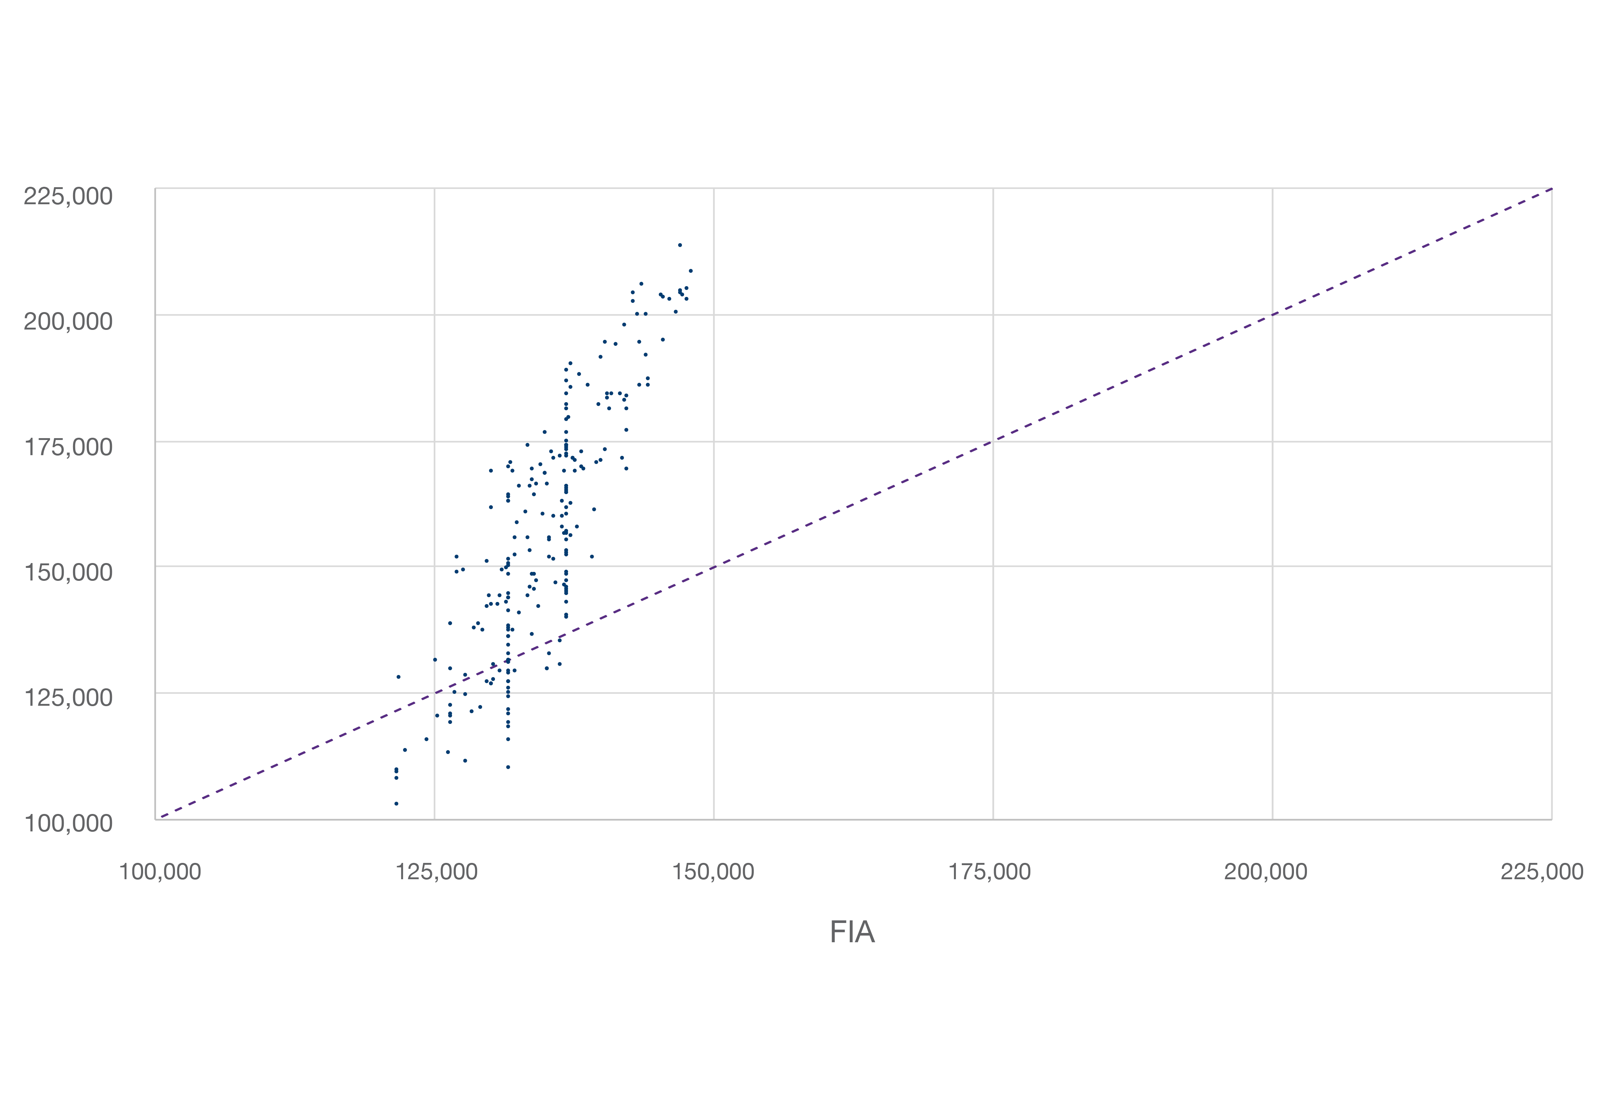
Account value growth comparison
Account value at the end of year 10
In 80% of the scenarios, the structured FIA account performs better than the traditional FIA annual point-to-point crediting option, providing higher upside potential.
Dynamic Accumulator
In 20% of the scenarios, the traditional FIA crediting option performed better, due to the downside exposure.
The above example is hypothetical, non-guaranteed and not an indication of past or future performance. Based on 1,000 simulated scenarios using -10% floor/10% cap track and randomly selected historical 10-year S&P 500® periods from Jan. 1, 1980, to Dec. 31, 2020. Caps and floors are for demonstrations purposes only and may be different for new policies issued. Assumes -10% track is elected at issue and policyholder remains in -10% track for duration. All rates are subject to change at the sole discretion of F&G.
For producer use only. Not for use with the general public.
12
Notes:
Now, you might be saying… Of course, those were mostly great years. An unprecedented bull run with very few blips along the way, sure you’d time travel back and risk more to get a greater return. But that’s just one scenario.
We ran 1,000 simulations – ranging from long periods of growth like the last 10 years saw, to the more typical ups and downs, to sustained stretches of bad returns – all real, randomized 10-year historical periods going back to Jan. 1, 1980. Here’s what our analysis showed.
Not only would Dynamic Accumulator have outperformed a traditional FIA in the last 10 years, but it would have done so in 80% of the scenarios we tested. Every one of those dots above the line is point in favor of Dynamic Accumulator.

Slide 13
F&G Dynamic Accumulator’s structured FIA account at issue
Initial client choices
Initial rates, effective at launch
Step 1: Owner chooses premium allocation
(in structured FIA account, can choose par or cap, not both)
Step 2: Owner elects track (maximum risk appetite)
Strategy | Floor | Initial par | Min par
Vesting point-to-point with par | 0.0% | 26.0% | 5.0%
 | -2.5% | 37.0% | 10.0%
 | -5.0% | 47.0% | 15.0%
 | -10.0% | 65.0% | 20.0%
Strategy | Allocation %
Vesting point-to-point with par | X%
Vesting point-to-point with cap | Y%
Fixed strategy | Z%
Strategy | Floor | Initial cap | Min cap
Vesting point-to-point with cap | 0.0% | 3.50% | 1.0%
 | -2.5% | 5.50% | 2.0%
 | -5.0% | 7.25% | 3.0%
 | -10.0% | 11.50% | 4.0%
Track options
0% | -2.5% | -5% | -10%
Strategy | Initial rate | Min rate
Fixed | 1.0% | 0.5%
In year 1, all policies will be in 0% floor, regardless of track.
All rates are subject to change at the sole discretion of F&G.
For producer use only. Not for use with the general public.
13
Notes:
Assuming your client chooses to use the structured FIA account, they’ll have a few more choices to make at issue com pared to a traditional FIA. You’ll also notice the rate structure is a little different.
Here’s how simple the process is for the client:
Choose how much premium to allocate to each strategy, and for any premium allocated to the structured FIA account, select whether they’ll use a participation rate or cap rate, just like a traditional FIA.
Then, for that structured FIA account premium, there’s one more decision to make. You’ll help them dial in the maximum risk they’re willing to accept. All clients will start in Year 1 with zero risk and can build their way up to their max risk tolerance automatically as adequate gains are established in the tracking value.

Slide 14

Then, each contract anniversary, the client is in control
To leave everything as is (no action required)
Or adjust their crediting option within the structured FIA account
S&P 500® one-year tracking period point-to-point with cap
S&P 500® one-year tracking period point-to-point with par rate
And the track they’ll use for the protection/reward they seek
Based on their age and changing circumstances, reevaluate their risk tolerance
Assess market conditions and decide how confident they are in how the selected index might perform
Dial up or down their track accordingly
For producer use only. Not for use with the general public.
14
Notes:
Those initial choices can last the life of the contract. It’s possible to set it and forget it, in other words. Risk exposure dials up automatically to the max risk appetite selected as gains are available to risk. It may also dial back down if losses bring the tracking value back below the minimum thresholds.
But the client is always in control. If someone you work with is more actively engaged in managing their allocations, they may find a product like Dynamic Accumulator appealing. They can judge for themselves the kind of year ahead and change this risk setting accordingly each contract anniversary. At that time, they can also change indexes or shift between the par and cap strategies. Although it isn’t likely since the product was built around the structured FIA account, they are able to take the risk entirely out of the structured FIA account once in the 10-year crediting period.

Slide 15
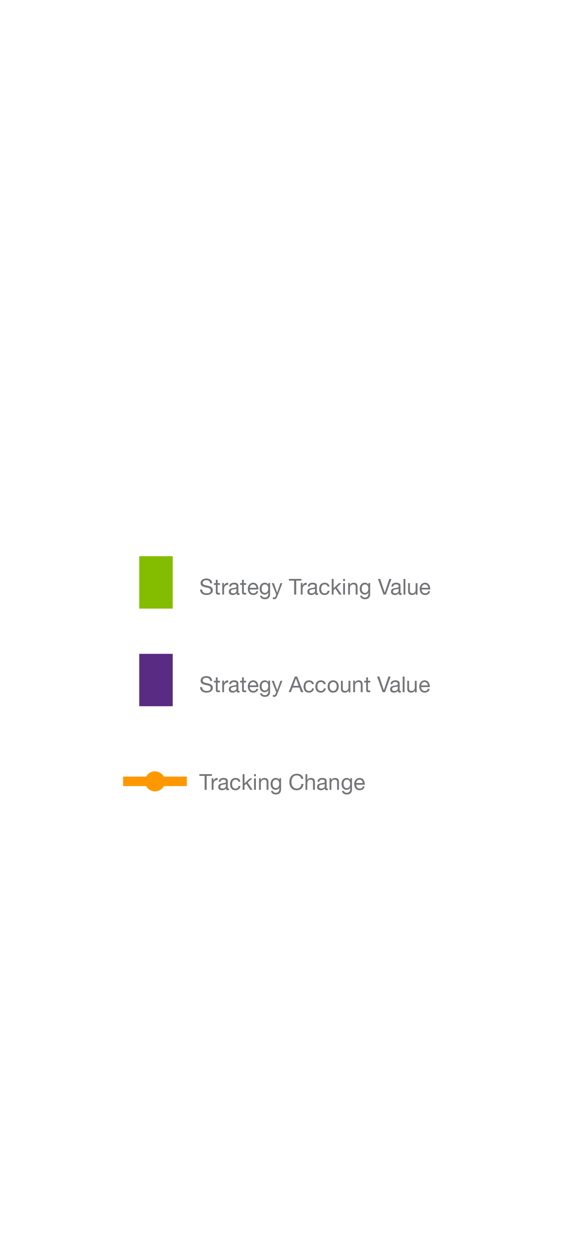
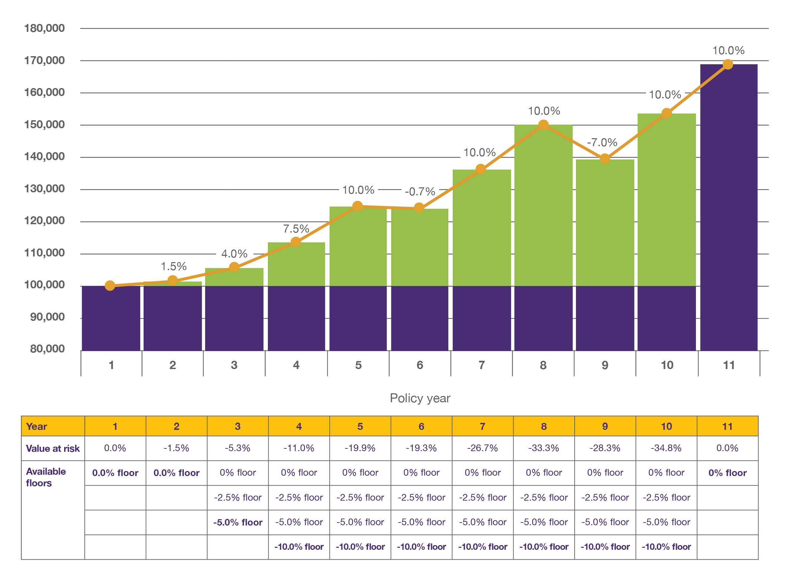
How F&G Dynamic Accumulator’s structured FIA account works
This example is hypothetical, non-guaranteed and not an indication of past or future performance. Assumes $100,000 initial premium. Returns are based on actual S&P 500® performance on December 31 of years 2010-2020. Contract issued December 31, 2010. Caps are 4%, 5.25%, 7.5%, and 10% for floors of 0%, -2.5%, -5%, and -10% respectively. Assumes contract is held for the duration of the surrender charge period and no withdrawals or surrenders. Caps and floors are for demonstrations purposes only and may be different for new contracts issued. Assumes -10% track is elected at issue and policyholder remains in -10% track for duration. All rates are subject to change at the sole discretion of F&G.
For producer use only. Not for use with the general public.
15
Notes:
This graph walks us through a 10-year progression of product performance. The purple is easy enough to monitor. That’s account value, the initial premium that is 100% protected, and it’s unchanged for 10 years. The green is the structured FIA account’s tracking value. As you can see, it can go up or down, unlike a traditional FIA.
At the bottom of the slide, in the table, you can see that as the tracking value goes up or down, the value at risk can go up or down as well. In this case, the client accepted the maximum risk possible, but it took until Year 5 to establish enough gains to stair-step their way up to that 10% risk floor.
After Year 10, any gains to the structured FIA account’s tracking value are credited to the account value, and the 10-year period resets with that new balance 100% protected.

Slide 16
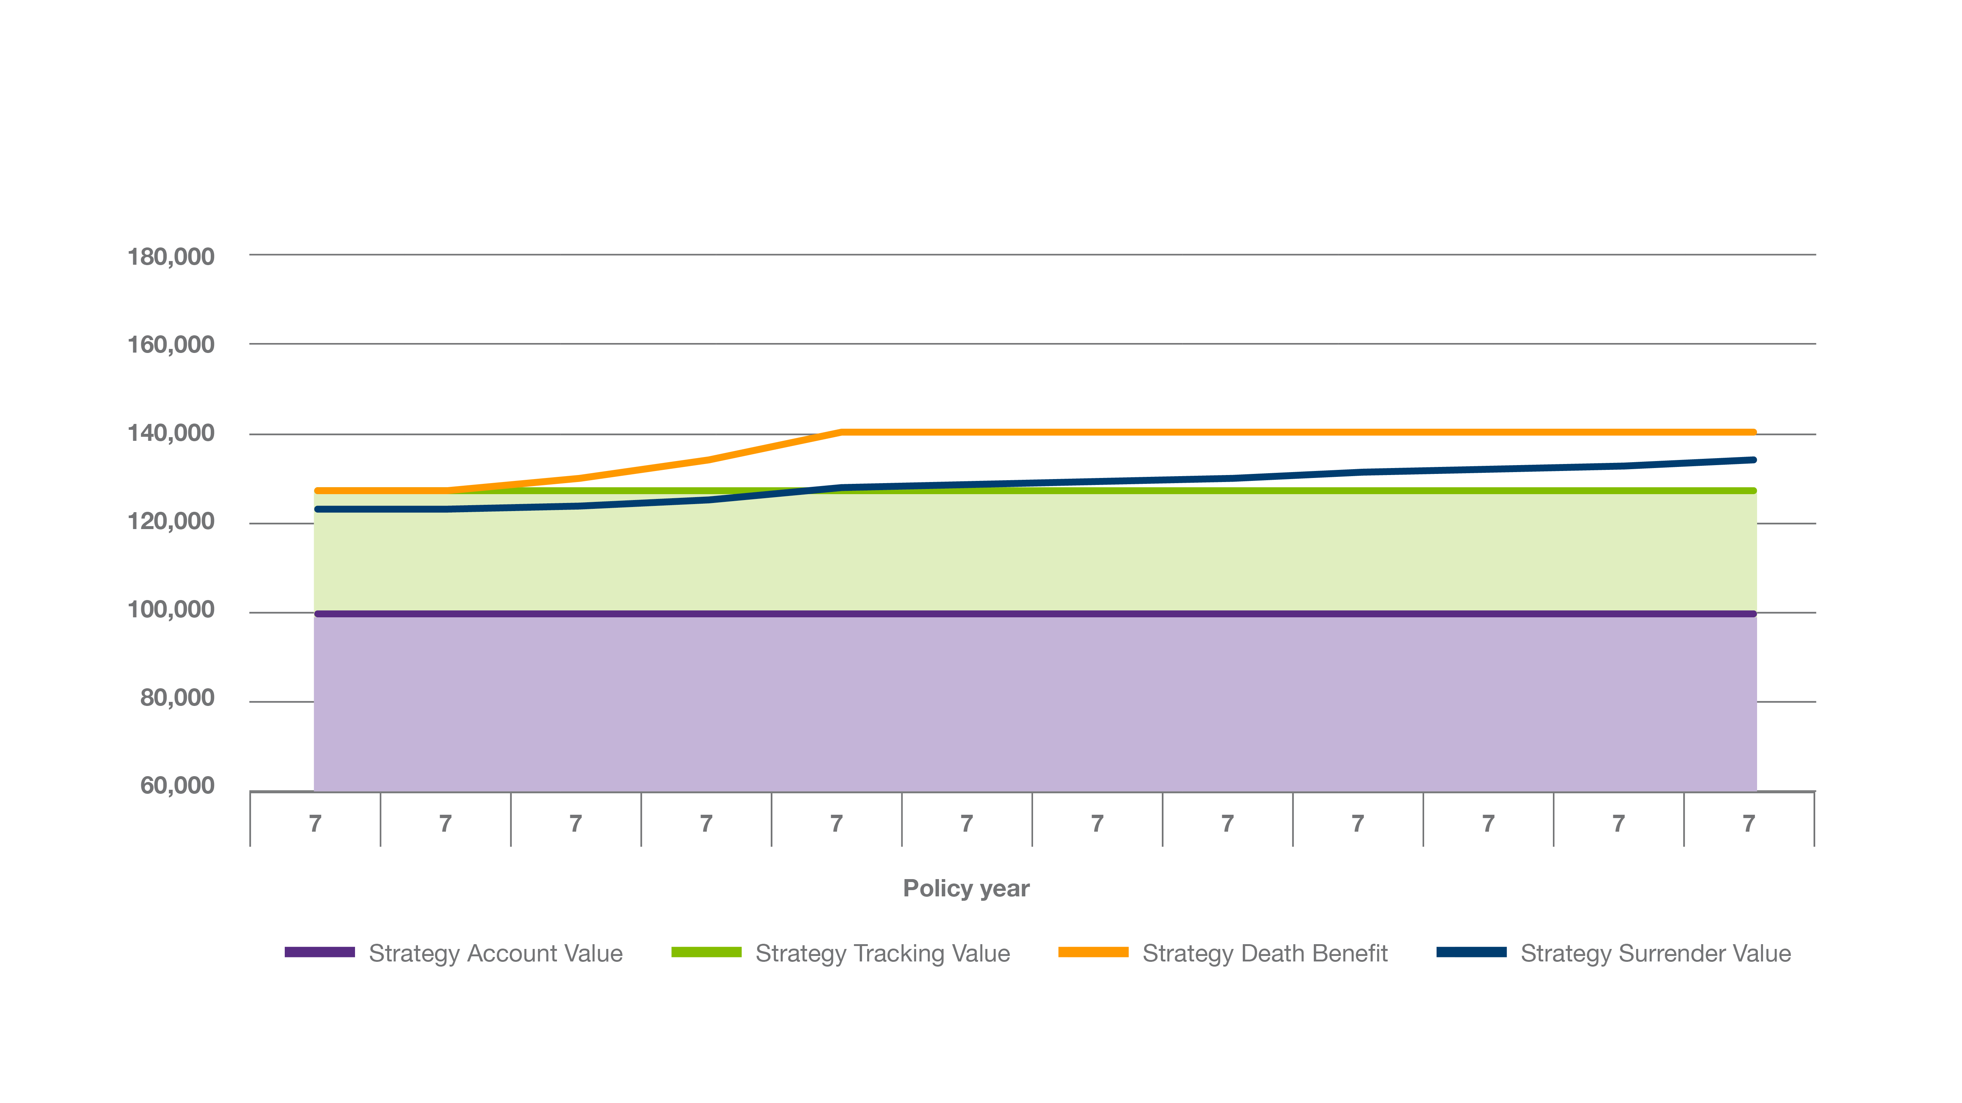
Contract values within a single year
Strategy tracking value
(what’s at risk)
Protected premium
This example is hypothetical, non-guaranteed and not an indication of past or future performance. Assumes $100,000 initial premium. Assumes contract is held for the duration of the surrender charge period and no withdrawals or surrenders. Assumes -10% track is elected at issue and policyholder remains in -10% track for duration. Caps and floors are for demonstrations purposes only and may be different for new contracts issued. All rates are subject to change at the sole discretion of F&G.
For producer use only. Not for use with the general public.
16
Notes:
Now, let’s zoom in and look at 12 months of one year to see how the various values that apply to the contract move mid-year.
As you saw before, the account value is steady. In this year, the tracking value happened to be pretty stable, too. Over the course of the year, though, the surrender value and death benefit – based in part on the tracking value of the structured FIA account – fluctuated a bit. Mid-year, if a client were to take an excess withdrawal or to pass away before the 10-year crediting period is up, the payout could includesome adjustments unique to Dynamic Accumulator. A Mid-year Strategy Value Adjustment, much like a Market Value Adjustment, could be positive or negative. Also, upon death, a Mid-year Strategy Death Credit, which can be positive or zero but never negative, would also apply.
Compensation for Dynamic Accumulator is based in part on the tracking value.

Slide 17
An opportunity for something different, from F&G
Potential – Building on an emerging market
Potential – A novel approach to pursue upside
Getting in on the ground floor of the RILA-like FIA market
Similar registered products saw $17.4 billion in sales (55% growth) in 2019
First-of-its-kind, structured FIA account,
“dial-in” design puts client in control
Par and cap rates up to 2.5 times higher
Double down on gains, client chooses how to dial in exposure and go after much larger potential returns
Potential – Set it and forget it or dial in track each year
Client has an opportunity to recalibrate annually – choosing
more upside or more protection – never locked in
Annual touch base may uncover new sales opportunities
Get in front of younger clients and stay there
All rates are subject to change at the sole discretion of F&G. While premium is 100% protected, gains put at risk in the structured FIA account may be lost down to the risk floor selected by the client.
For producer use only. Not for use with the general public.
17
Notes:
We think you’ll agree that Dynamic Accumulator represents potential, potential, potential.
<Read slide>

Slide 18
A story of choice and control
100% guaranteed premium protection
Leverage prior gains for greater upside potential
Annual flexibility to dial in your preferred track
1
2
3
For producer use only. Not for use with the general public.
18
While premium is 100% protected, gains put at risk in the structured FIA account may be lost down to the risk floor selected by the client.
Notes:
For all that sets Dynamic Accumulator apart and makes it unique, at the end of the day, the story you can share with clients couldn’t be simpler. It’s a familiar fixed index annuity story with protection and growth potential, of course. But beyond that, it’s story of choice and control.
Here are the talking points.
<Read slide>

Slide 19

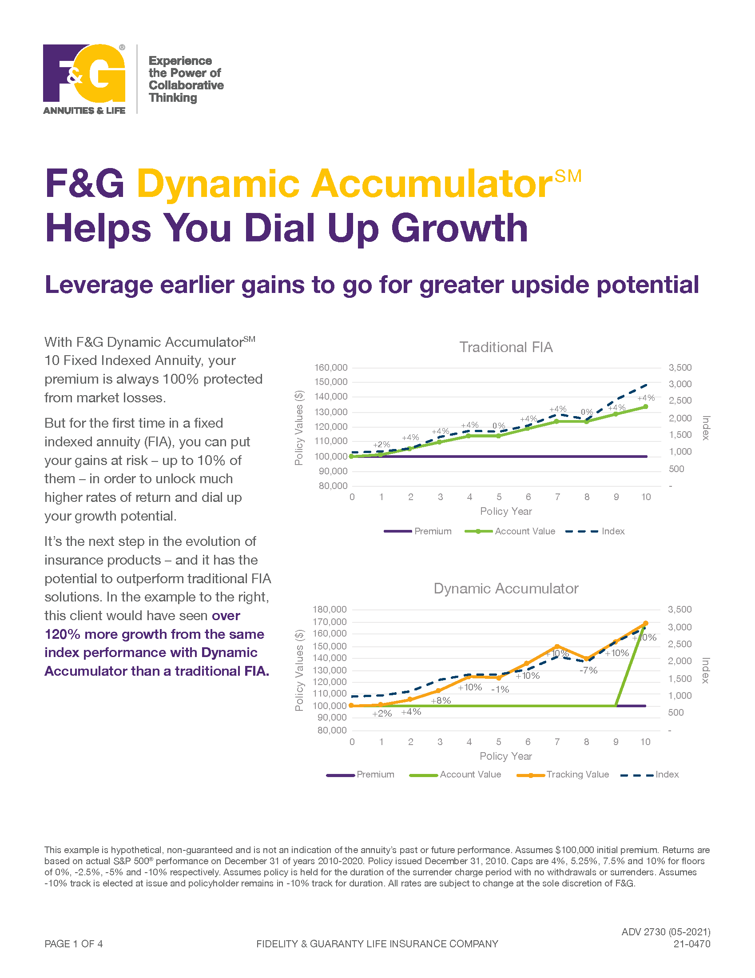
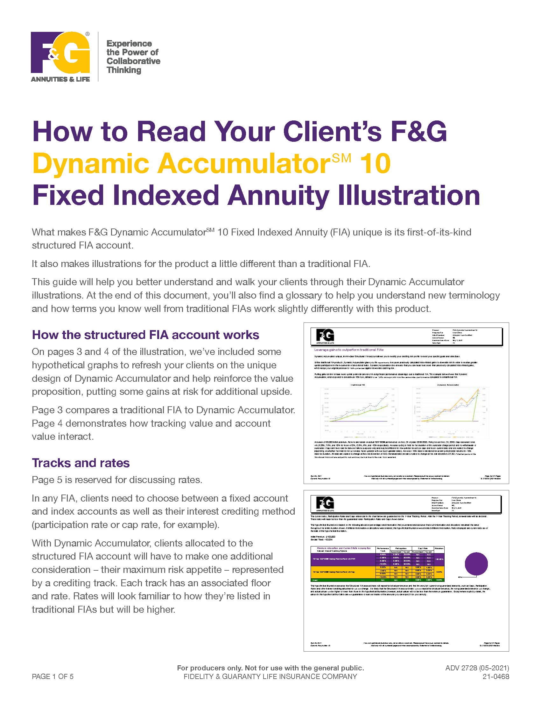
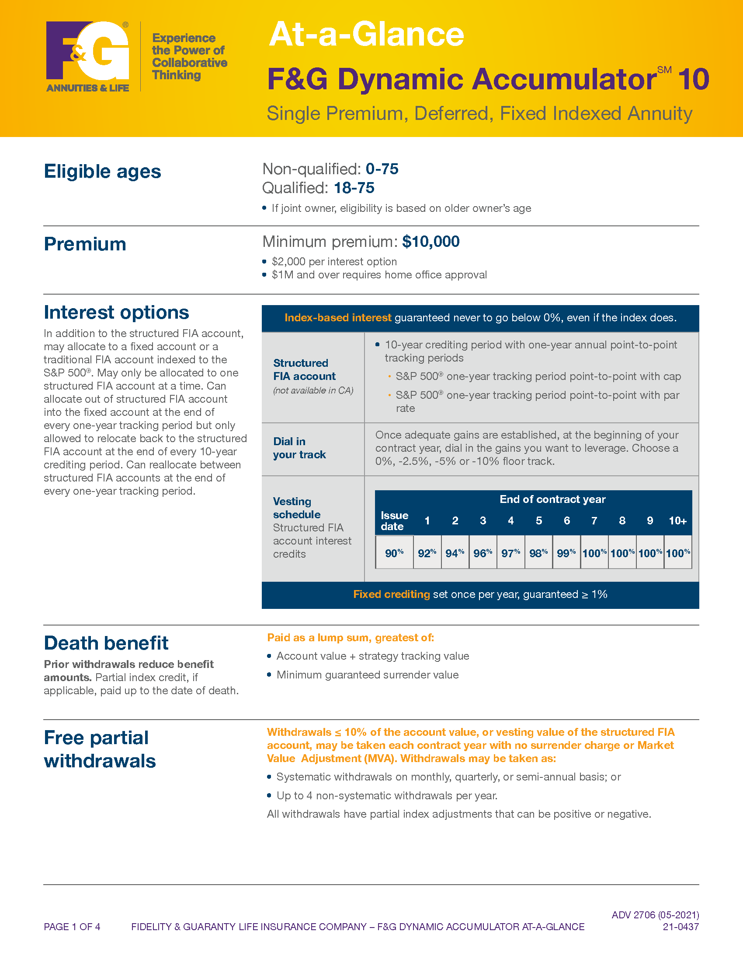
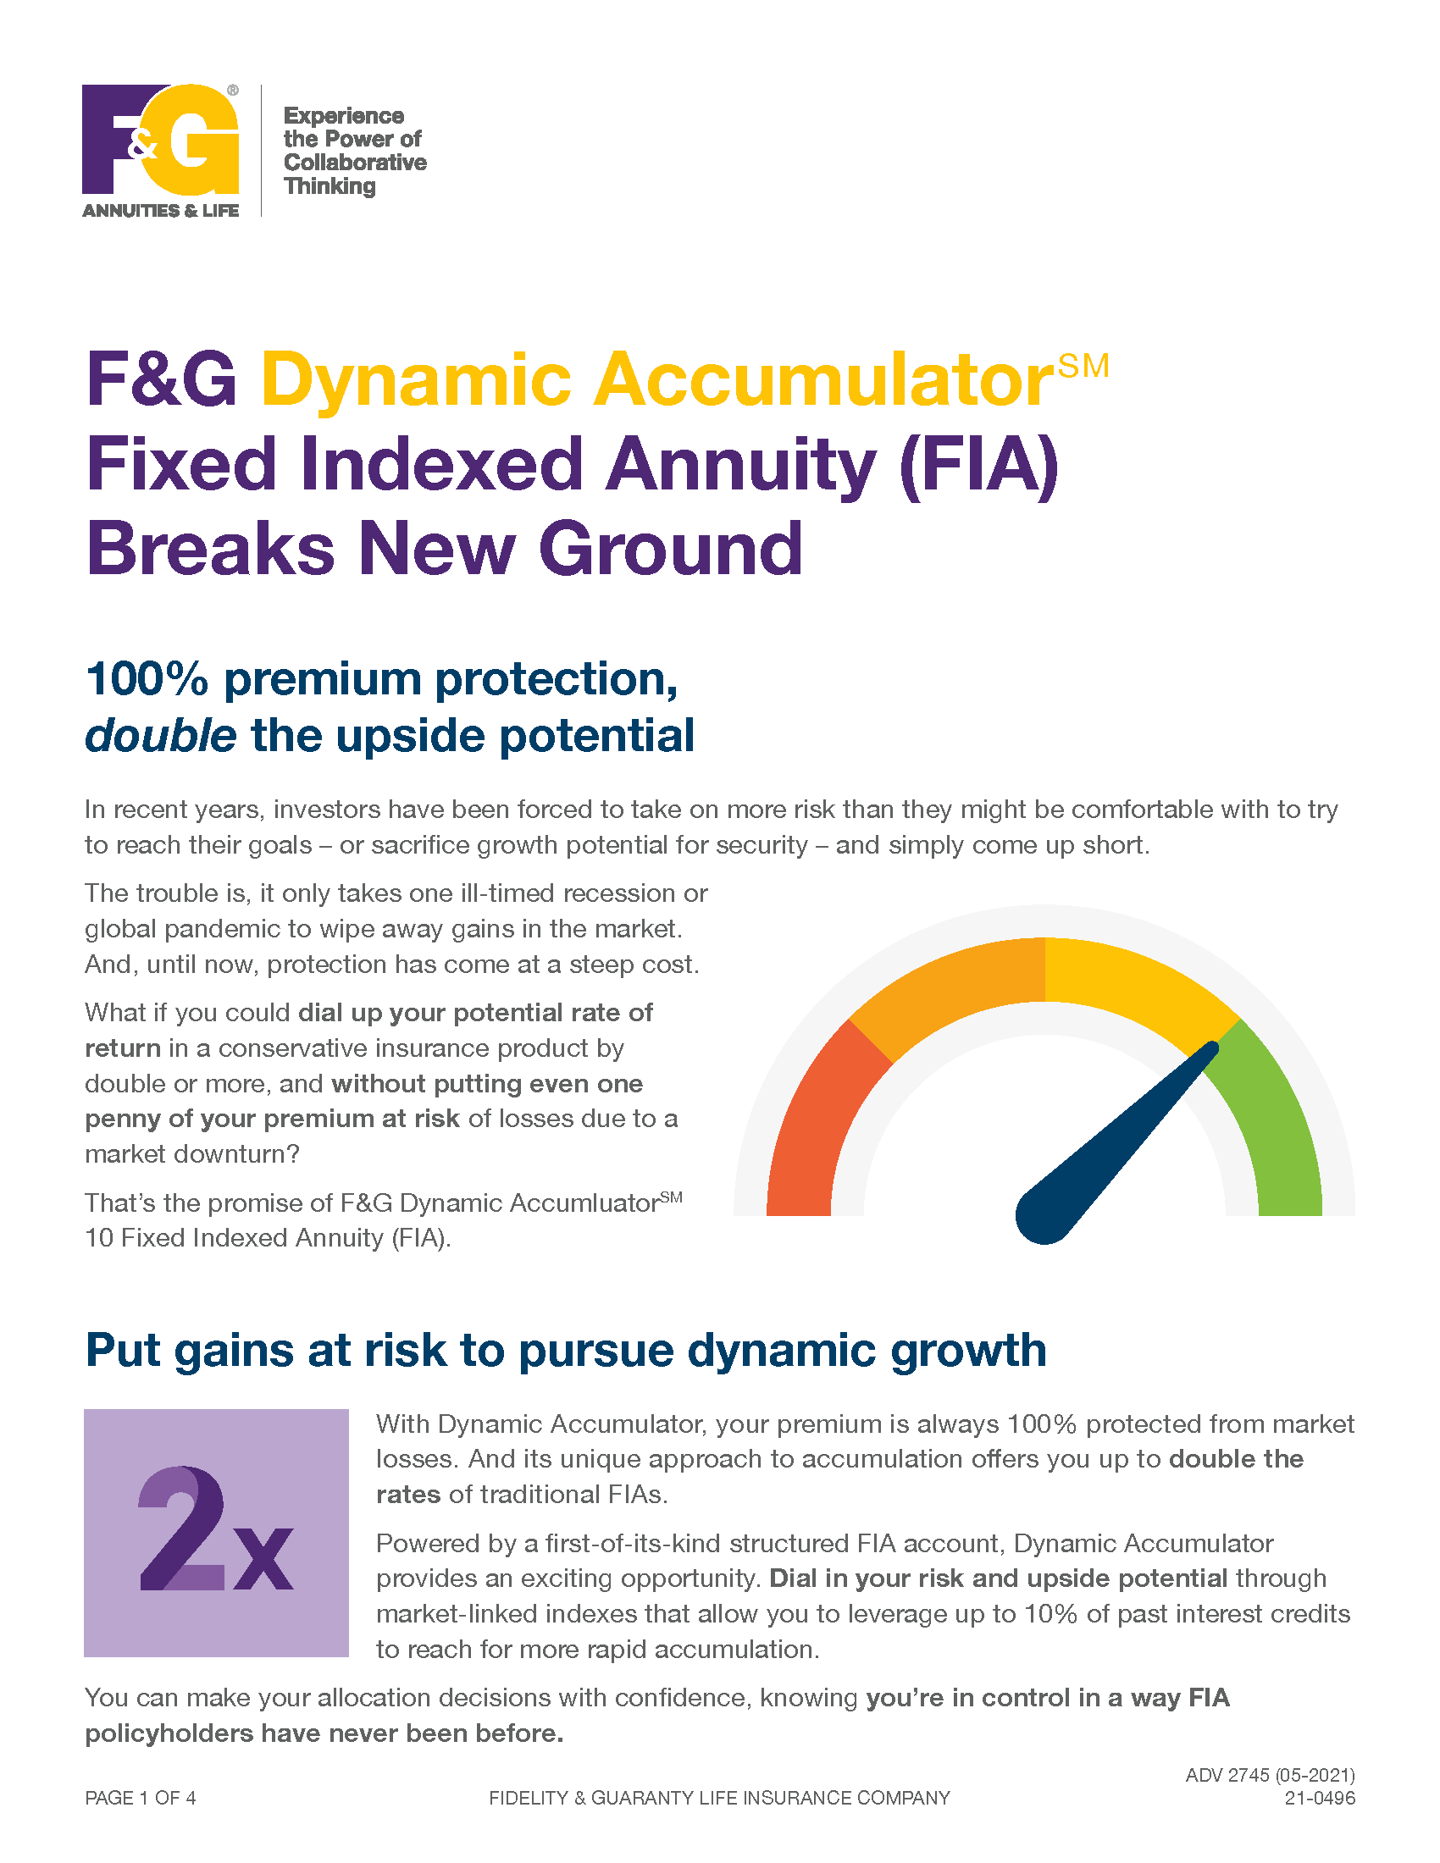
Resources
https://success.fglife.com/dynamic-accumulator
For producer use only. Not for use with the general public.
19

Slide 20
Dynamic Accumulator
Featuring the structured FIA account
Fixed Indexed Annuity
Eligible ages | Non-qualified: 0-75 Qualified: 18-75 If joint owner, eligibility is based on older owner’s age
Single premium | Minimum single premium: $10,000 $2,000 per interest option $1M and over requires home office approval
Interest options In addition to the structured FIA account, may allocate to a fixed account or a traditional FIA account indexed to the S&P 500®. May only be allocated to one structured FIA account at a time. Can allocate out of structured FIA account into the fixed account at the end of every one-year tracking period but only allowed to relocate back to the structured FIA account at the end of every 10-year crediting period. Can reallocate between structured FIA accounts at the end of every one-year tracking period.
Death benefit Prior withdrawals reduce benefit amounts. Partial index credit, if applicable, paid up to the date of death. | Paid as a lump sum, greater of: Strategy Account Value of Fixed Account + Strategy Tracking Value of Vesting Point-to-Point + Mid-Year Strategy Death Credit Minimum Guaranteed Surrender Value
Free partial withdrawals | Withdrawals ≤ 10% of the account value or vesting value of the structured FIA account may be taken each contract year with no surrender charge or Market Value Adjustment (MVA). Withdrawals may be taken as: Systematic withdrawals on monthly, quarterly, or semi-annual basis; or Up to four non-systematic withdrawals per year. All withdrawals have partial index adjustments that can be positive or negative.
Index-based interest guaranteed never to go below 0%, even if the index decreases
Structured FIA account | 10-year crediting period with one-year annual point-to-point tracking periods S&P 500® one-year tracking period point-to-point with cap or par rate
Dial in your track | Once adequate gains are established, at the beginning of your contract year, dial in the gains you want to leverage. Choose a 0%, -2.5%, -5% or -10% floor track.
Vesting schedule Structured FIA account interest credits
Fixed crediting set once per year, guaranteed ≥ 0.5%
 | End of contract year
Issue date | 1 | 2 | 3 | 4 | 5 | 6 | 7 | 8 | 9 | 10+
90% | 92% | 94% | 96% | 97% | 98% | 99% | 100% | 100% | 100% | 100%
For producer use only. Not for use with the general public.
20
Notes:
Let’s get into the product specs.
<Read slides>

Slide 21
Dynamic Accumulator
Featuring the structured FIA account
Fixed Indexed Annuity
Surrender charge percentages— for withdrawals > 10.00% | All withdrawals are subject to partial index credits, which may be positive or negative. Any time a withdrawal incurs a surrender charge, a Market Value Adjustment (MVA) will be applied. The MVA is based on a formula that takes into account changes in rates since contract issuance. Generally, if rates have risen, the MVA will decrease surrender value; if rates have fallen, it will increase surrender value. State variations apply.
Required Minimum Distribution (RMD) friendly | RMD free amount may be withdrawn without a surrender charge or MVA The RMD amount is reduced for all prior withdrawals taken in the contract year
For unexpected health care costs — access to account value with no surrender charge or MVA | Nursing Home Care (in a licensed nursing home) Confinement must begin at least one year after contract effective date Must be confined to nursing home for at least 60 days | Terminal Illness Diagnosis must be made at least one year after contract effective date and certified by a licensed physician Life expectancy must be less than one year
Years into Guarantee Period | 1 | 2 | 3 | 4 | 5 | 6 | 7 | 8 | 9 | 10 | 11+
 | 10% | 9% | 8% | 7% | 6% | 5% | 4% | 3% | 2% | 1% | 0%
Applies to all states where approved (see state approval chart)
State variations and conditions apply.
For producer use only. Not for use with the general public.
21

Slide 22
50- to 75-year-olds seeking more upside potential with principal protection
Clients considering RILA but with a desire for more downside protection
Clients considering FIA but with a desire to have more upside potential
DIY clients who want the flexibility to adjust their downside exposure on an annual basis
Clients seeking flexibility to modify risk and return crediting profile
Clients 59 ½ and up in 401(k) plans with partial withdrawal plan provision
Fee-sensitive clients
Top client types
Build on an emerging market
For producer use only. Not for use with the general public.
22
Notes:
Before we wrap up today, I want you to start thinking through your book of business and the prospects you have coming in for a visit the next few weeks. Think about who might be a fit for Dynamic Accumulator.
<Read slide>

Slide 23
“How much of your 401(k) plan can you afford to lose between now and retirement?”
Client conversation starter
77%
Plans that allow age
59½ in-service withdrawals
Source: Profit Sharing Council of America
forbes.com/sites/financialfinesse/2017/03/16/the-401k-distribution-opportunity-you-need-to-think-twice-about
For producer use only. Not for use with the general public.
23
Notes:
For any of those clients with money still in their employer-based retirement plan, the question is simple: How much of your 401(k) can you afford to lose between now and retirement?
Let’s hear from the group. What do you think the most common answer is going to be? <Pause> Of course, it’s zero.
Up to 77% of companies offering a 401(k) plan allow in-service withdrawals, according to the Profit Sharing Council of America. It’s not just 401(k) plans. Any type of retirement plan will work including 403(b)s, 457’s and pensions, too.

Slide 24
“Would you be interested in an option for your retirement money that:
Provides 100% premium protection
Allows you to dial in your upside potential and downside risk each year?”
Client conversation starter
Segue to:
Discussion on pros and cons of each option
Offer to run personalized illustration
Source: Profit Sharing Council of America
forbes.com/sites/financialfinesse/2017/03/16/the-401k-distribution-opportunity-you-need-to-think-twice-about
For producer use only. Not for use with the general public.
24
Notes:
That’s your opportunity to come through in a big way. You can help protect that nest egg from Day 1, and with Dynamic Accumulator, retain as much of the upside potential as possible within a fixed indexed annuity. You can also help by walking your client through the rollover process to ensure there are no client taxes due to the transaction.

Slide 25
F&G has built a growing business
based on partnership, innovation,
and a disciplined investment approach
SIGNIFICANT
STRONG
STRATEGIC
1959
Established
700,000
People protected
430+
Employees and growing
Corporate headquarters: Des Moines, IA
For producer use only. Not for use with the general public.
25
Notes:
F&G is strong, significant, and strategic; read slide

Slide 26
The meaning behind “FIDELITY” & “GUARANTY”
FIDELITY (noun): Faithfulness to a person, cause, or belief, demonstrated by continuing loyalty and support
GUARANTY (noun):
A formal promise or assurance (typically in writing) that certain conditions will be fulfilled
For producer use only. Not for use with the general public.
26
Notes:
F&G stands for Fidelity and Guaranty.
<Read slide>

Slide 27

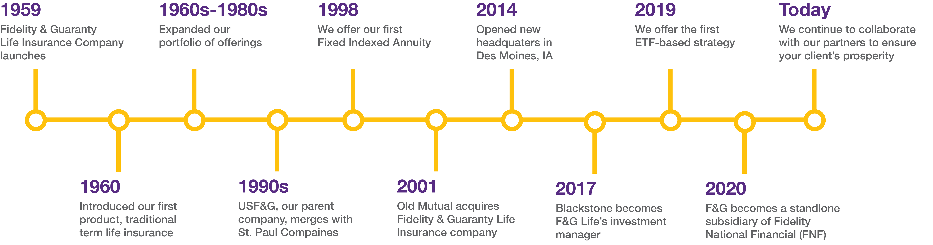
Our history of innovation and collaboration
60 YEARS
F&G has built a growing business based on partnership, innovation and a disciplined investment approach
For producer use only. Not for use with the general public.
27
Notes:
Read slide, highlighting major news of last few years – working with Blackstone (2017) and being acquired by FNF (2020).

Slide 28
A stronger and more significant F&G
June 2020 acquisition by Fidelity National Financial, Inc. (FNF) elevated F&G to triple A- rating¹ from three major ratings agencies
Our partnership with Blackstone is a competitive advantage – enabling F&G to offer stable and competitive rates
¹ A.M. Best Financial Strength Rating: A- (“Excellent”), 4th highest out of 16 ratings for financial strength. Rating as of December 4, 2020. Financial strength rating for Fidelity & Guaranty Life Insurance Company for S&P is A-, 3rd highest out of 11 ratings for financial strength. Rating as of October 8, 2020. Financial strength rating for Fidelity & Guaranty Life Insurance Company for Fitch is A-, 3rd highest out of 11 ratings for financial strength. Rating as of September 30, 2020. Financial strength rating for Fidelity & Guaranty Life Insurance Company for Moody’s is Baa1, 4th highest out of
9 ratings for financial strength. Rating as of June 1, 2020.
For producer use only. Not for use with the general public.
28

Slide 29
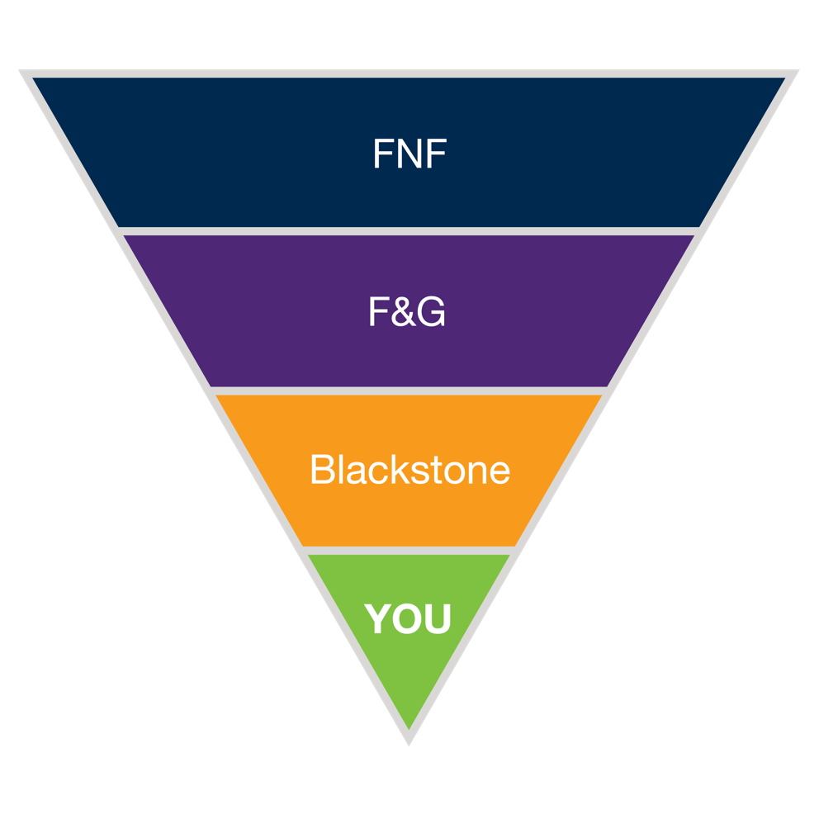
Driving value to our partners
Fidelity National Financial, F&G’s parent company with capital resources and a complimentary business model providing F&G a strong and stable owner
F&G is a subsidiary of FNF and operates independently; We remain headquartered in Des Moines, Iowa, and under the leadership of President & CEO Chris Blunt
Blackstone Insurance Solutions will continue to manage the General Account assets under the direction of F&G – our competitive edge to deliver consistent and competitive products
All with a focus on providing stable, dependable product to our distribution partners
For producer use only. Not for use with the general public.
29
Notes:
Here’s how it comes together to enhance the value we can extend to you and your clients.

Slide 30


F&G’s Investment Management Partnership with Blackstone
Established in 1959
700,000 people protected
Named one of the fastest growing annuity issuers of 2018, according to NAIC data
Investment manager of F&G’s general account
A leading investment firm and largest in Fixed Income
$619 billion in assets under management¹
The Blackstone Group Inc. and its affiliates do not issue, provide any guarantee of, or have any obligations under, the life insurance and annuities issued by Fidelity & Guaranty Life Insurance Company.
¹ As of December 31, 2020.
For producer use only. Not for use with the general public.
30

Slide 31
Ratings
RATED A- by A.M. Best Outlook Stable
Rapidly climbing into the FIA Top 10 and expanding into new channels
Insurance Operating Subsidiaries |  | Outlook
S&P Global | A- | Stable
Fitch | A- | Stable
Moody’s | Baa1 | Stable
A.M. Best Financial Strength Rating: A- (“Excellent”), 4th highest out of 16 ratings for financial strength. Rating as of December 4, 2020. Financial strength rating for Fidelity & Guaranty Life Insurance Company for S&P is A-, 3rd highest out of 11 ratings for financial strength. Rating as of October 8, 2020. Financial strength rating for Fidelity & Guaranty Life Insurance Company for Fitch is A-, 3rd highest out of 11 ratings for financial strength. Rating as of September 30, 2020. Financial strength rating for Fidelity & Guaranty Life Insurance Company for Moody’s is Baa1, 4th highest out of
9 ratings for financial strength. Rating as of June 1, 2020.
For producer use only. Not for use with the general public.
31

Slide 32
Disclosures
“F&G” is the marketing name for Fidelity & Guaranty Life Insurance Company issuing insurance in the United States outside of New York. Life insurance and annuities issued by Fidelity & Guaranty Life Insurance Company, Des Moines, IA. Guarantees are based on the claims paying ability of the issuing insurer, Fidelity & Guaranty Life Insurance Company, Des Moines, IA.
The Blackstone Group Inc. and its affiliates do not issue, provide any guarantee of, or have any obligations under, the life insurance and annuities issued by Fidelity & Guaranty Life Insurance Company.
The provisions, riders and optional additional features of this product have limitations and restrictions, and may have additional charges. Contracts are subject to state availability, and certain restrictions may apply.
Information provided regarding tax or estate planning should not be considered tax or legal advice. Consult your own tax professional or attorney regarding your client’s unique situation.
Surrender charges and market value adjustment may apply to partial and full surrenders. Surrenders may be taxable and may be subject to penalties prior to age 59 ½.
Past performance does not guarantee future result.
Rates subject to change at insurer’s discretion and are effective annual rates.
The “S&P 500 Index” is a product of S&P Dow Jones Indices LLC, a division of S&P Global, or its affiliates (“SPDJI”) and has been licensed for use by Fidelity & Guaranty Life Insurance Company. Standard & Poor’s® and S&P® are registered trademarks of Standard & Poor’s Financial Services LLC, a division of S&P Global (“S&P”); Dow Jones® is a registered trademark of Dow Jones Trademark Holdings LLC (“Dow Jones”); These trademarks have been licensed for use by SPDJI and sublicensed for certain purposes by Fidelity & Guaranty Life Insurance Company. These annuity products are not sponsored, endorsed, sold or promoted by SPDJI, Dow Jones, S&P, their respective affiliates, and none of such parties make any representation regarding the advisability of investing in such product(s) nor do they have any liability for any errors, omissions, or interruptions of the S&P 500 Index.
For producer use only. Not for use with the general public.
32

Slide 33
Thank you
Notes:
Add client and agent collateral thumb nails and landing page

