Slide 1
Intro to FlowJo version 10 … for version 9 users John Quinn Ph.D. Director of Science and Product Development BDB Informatics (FlowJo) john.flowjo@bd.com

Slide 2
Outline
Commonalities between v9 and v10
Features missing from v10
Additions to v10
Opening v9 files in v10
Walk through of v10
BD and FlowJo are one! Supporting you and your research from design to discovery.

Slide 3
Commonalities
Basic operation is the same:
Drag and drop to apply / organize
Double-click to Edit
Workflow
Workspace, Comp Wizard, Table Editor, Layout Editor
Batching controls
Very customizable
BD and FlowJo are one! Supporting you and your research from design to discovery.

Slide 4
Missing from v10
Tether gates
LDA / PCA dimensionality reduction
Poly-variate plots
Clone gates
Bi-variate difference gating
Comparative stats in TE
Ability to set default stat in TE
Sci-Book
BD and FlowJo are one! Supporting you and your research from design to discovery.

Slide 5
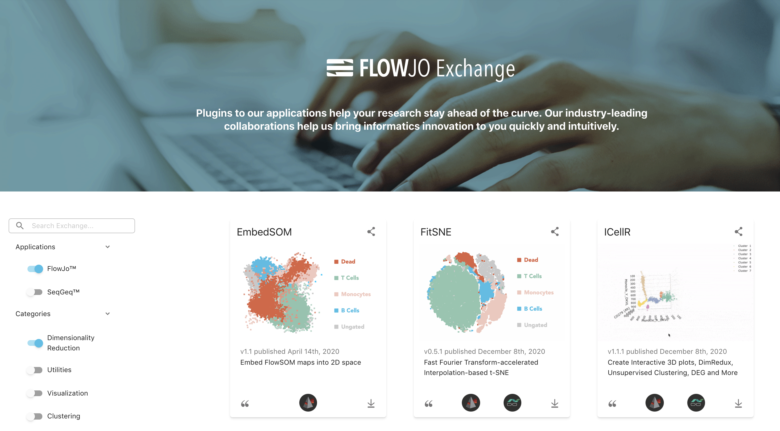
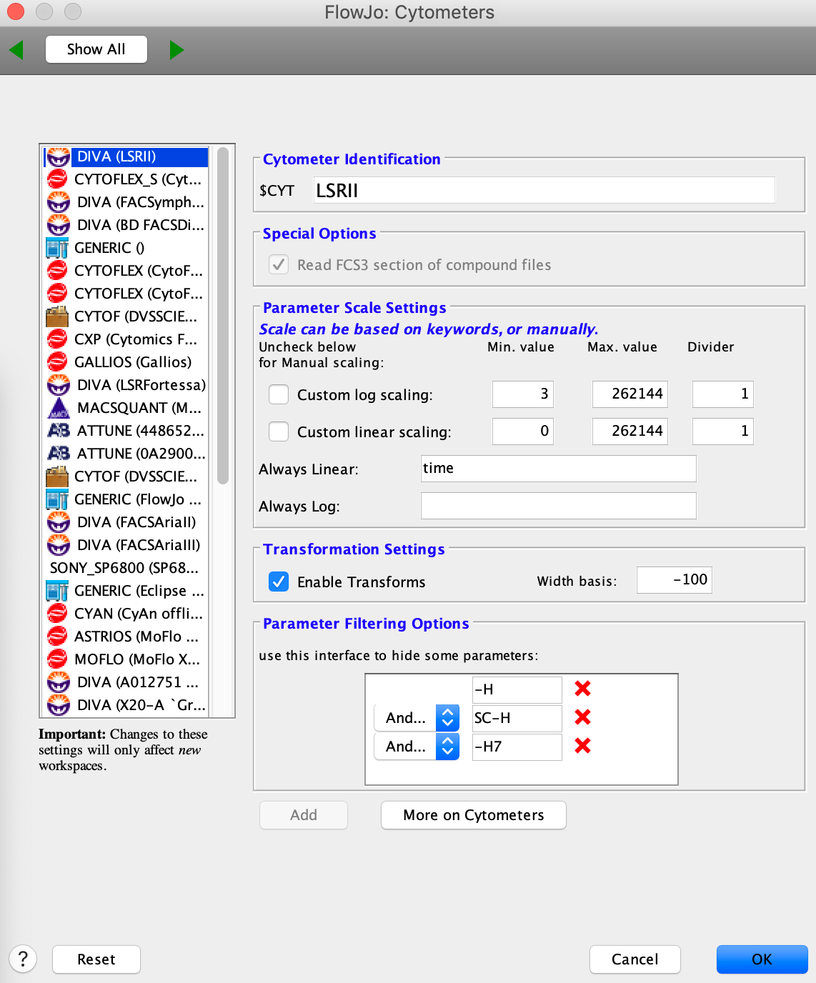
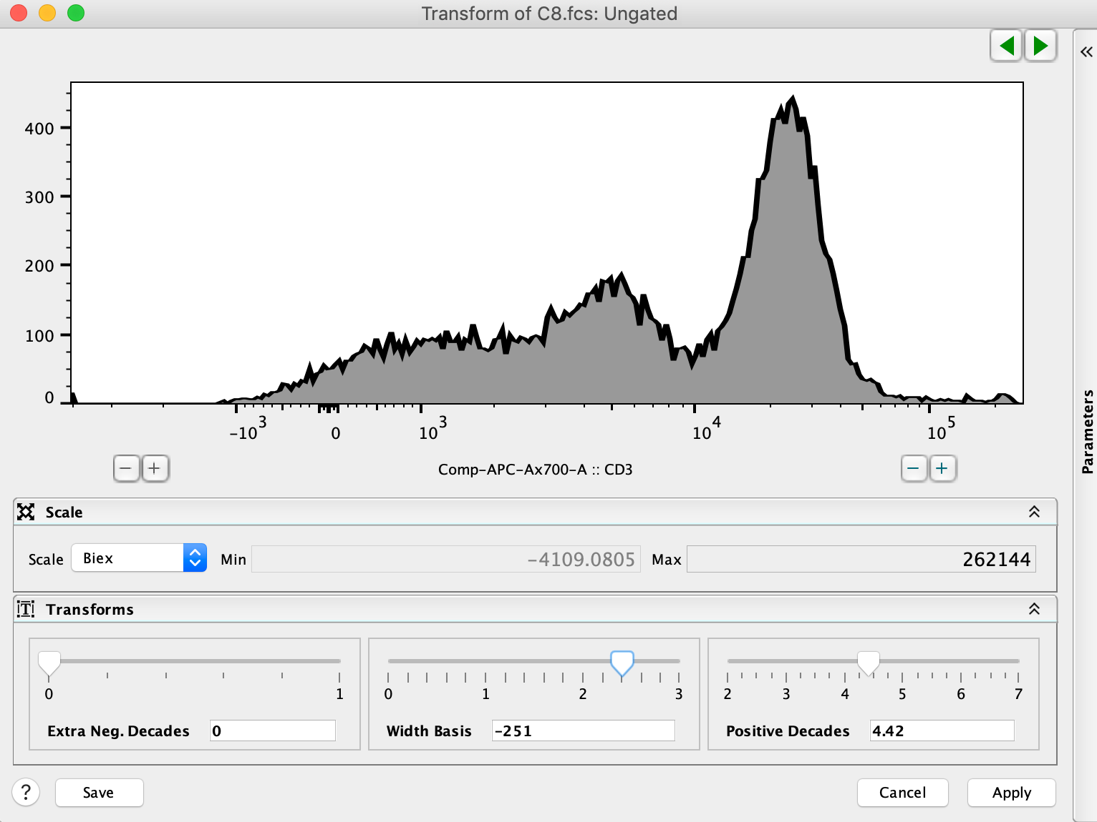
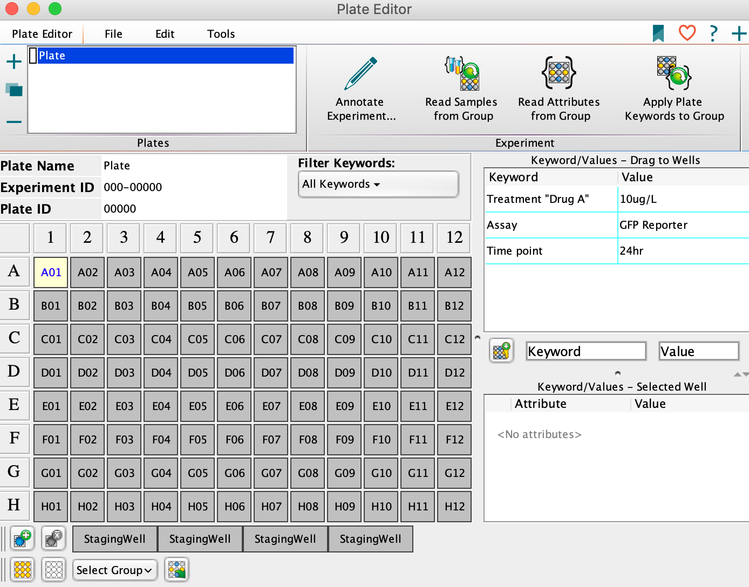
Additional in v10
Plugin architecture with 30+ Plugins
Customizable ribbon format
Improved transformation tools
Improved data reading / scaling support
ACS file output
AutoSpill, TSM, and other compensation innovations
Plate tools
OS flexibility
BD and FlowJo are one! Supporting you and your research from design to discovery.

Slide 6
Additional in v10
Plugin architecture with 30+ Plugins
Customizable ribbon format
Improved transformation tools
Improved data reading / scaling support
ACS file output
AutoSpill, TSM, and other compensation innovations
Plate tools
OS flexibility
BD and FlowJo are one! Supporting you and your research from design to discovery.

Slide 7
Additional in v10
Plugin architecture with 30+ Plugins
Customizable ribbon format
Improved transformation tools
Improved data reading / scaling support
ACS file output
AutoSpill, TSM, and other compensation innovations
Plate tools
OS flexibility
BD and FlowJo are one! Supporting you and your research from design to discovery.

Slide 8
Additional in v10
Plugin architecture with 30+ Plugins
Customizable ribbon format
Improved transformation tools
Improved data reading / scaling support
ACS file output
AutoSpill, TSM, and other compensation innovations
Plate tools
OS flexibility
BD and FlowJo are one! Supporting you and your research from design to discovery.

Slide 9
Additional in v10
Plugin architecture with 30+ Plugins
Customizable ribbon format
Improved transformation tools
Improved data reading / scaling support
ACS file output
AutoSpill, TSM, and other compensation innovations
Plate tools
OS flexibility
BD and FlowJo are one! Supporting you and your research from design to discovery.

Slide 10
Additional in v10
Plugin architecture with 30+ Plugins
Customizable ribbon format
Improved transformation tools
Improved data reading / scaling support
ACS file output
AutoSpill, TSM, and other compensation innovations
Plate tools
OS flexibility
BD and FlowJo are one! Supporting you and your research from design to discovery.

Slide 11
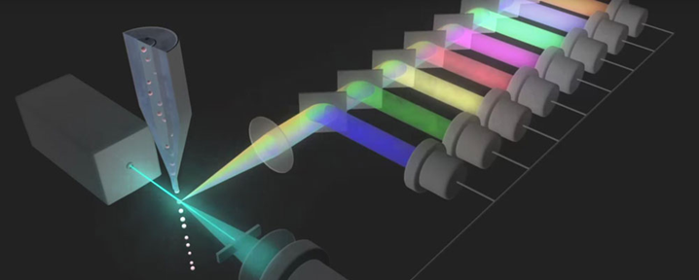
Demo time

