Slide 1
Digital Rights Management Demystified
Common Issues and Solutions
Johannes Jauch, CTO, Axinom
Pieter-Jan Speelmans, CTO, THEO Technologies

Slide 2
Johannes Jauch
Pieter-Jan Speelmans
CTO, Axinom
CTO, THEO Technologies
As the leader of the technology team, Johannes is responsible for defining the technological trail Axinom blazes.
He works to empower organizations in understanding and leveraging Axinom products and solutions to solve real-world issues such as content piracy, revenue protection, scalability of services, and much more.
Pieter-Jan is the Founder and the head of the technical team at THEO Technologies. He is the brain behind THEOplayer, HESP and EMSS.
With a mission to 'Make Streaming Video Better Than Broadcast', he is innovating the way video is delivered online from playback all the way to ultra-low latency streaming. Pieter-Jan is committed to enable media companies to easily offer exceptional video experience across any device.

Slide 3
1.
Adhering to the requirements of content owners.
How to implement different keys and configurations for different stream qualities?

Slide 4
A typical requirement from a content owner
Audio, SD, and HD tracks must use separate encryption keys.
Hardware-backed DRM is mandatory for resolutions of 1080p and above.
When video is displayed on an external screen the system must enforce the use of the HDCP protocol version 2.2 or above.
In any case video display on external screens must be prevented for resolutions of 1080p and above.

Slide 5
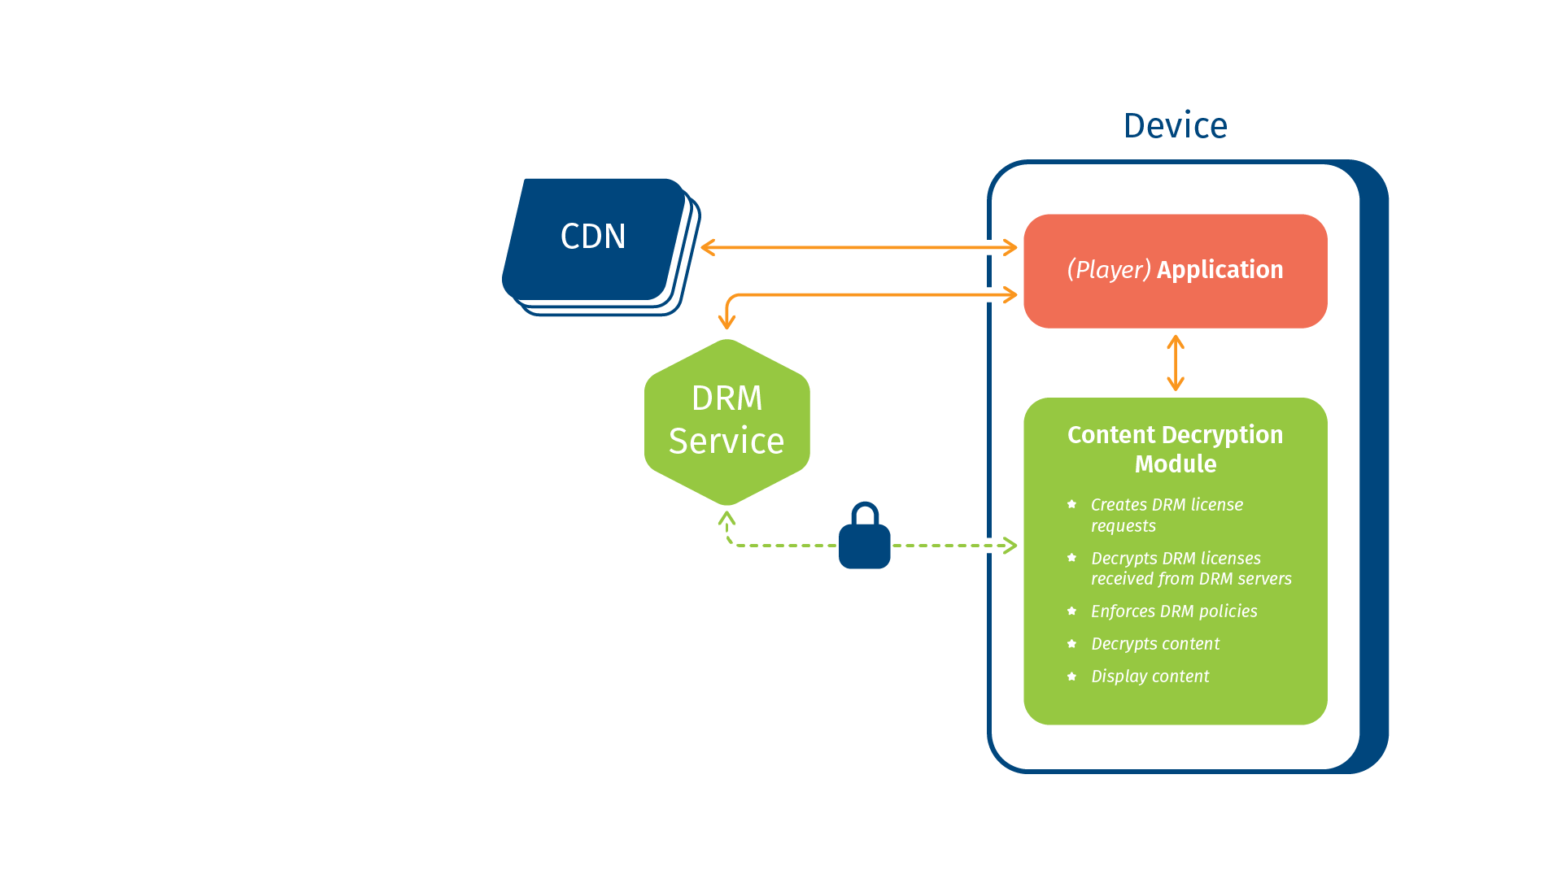
Why encrypt
with multiple
keys?
Notes:
Content owners do not trust anything except DRM technology.
Two essential pieces: The DRM service, the DRM client aka Content Decryption Module (CDM)
All devices capable of playing DRM protected content have a CDM, be it Widevine, FairPlay, or PlayReady.

Slide 6
Content Decryption Module flavors
Hardware-backed:
Purely software:
Widevine Security Level 1
PlayReady Security Level 3000
Widevine Security Level 3
PlayReady Security Level 2000
Notes:
The CDMs come in two flavors: software-only and hardware-backed
Hardware-backed DRM enjoy higher trust by content owners.
Apple devices all come with hardware-backed DRM
Widevine and PlayReady have both kinds of CDMs in the field:
WV: Security Level 1 and Security Level 3
PR: Security Level 3000 and Security Level 2000

Slide 7
Why encrypt with multiple keys?
Content owners want flexibility
A sample use case:
Provide HD/UHD or HDR content only to clients with hardware-backed DRM
Reach the broadest audience by providing content in lower resolutions to as many devices as possible
Solution:
Use different encryption keys for encrypting different tracks in ABR assets
Authorize devices based on their capabilities
Notes:
One content owner put it like this „UHD / HDR“ content are our „crown jewels. We want maximum protection for them. We also have long tail content that has different protection needs“.

Slide 8
Sample Asset
Sample MPEG-DASH asset
Representation | Resolution | Encryption key
Audio | - | Key 1
Video | 480p | Key 2
Video | 640p | Key 2
Video | 720p | Key 3
Video | 1080p | Key 3
Video | 2160p | Key 4

Slide 9
But wait..can‘t I just keep two versions, each encrypted with just one key?

Slide 10
Notes:
There are other reasons that go against this
One
Rarely so simple as presented in webinars

Slide 11
How to achieve multi-key encryption end-to-end?
Components in the delivery chain that need to support multi-key assets:
The encoder/packager
The DRM key service
The DRM license service
The player
Axinom and THEOplayer have you covered.

Slide 12
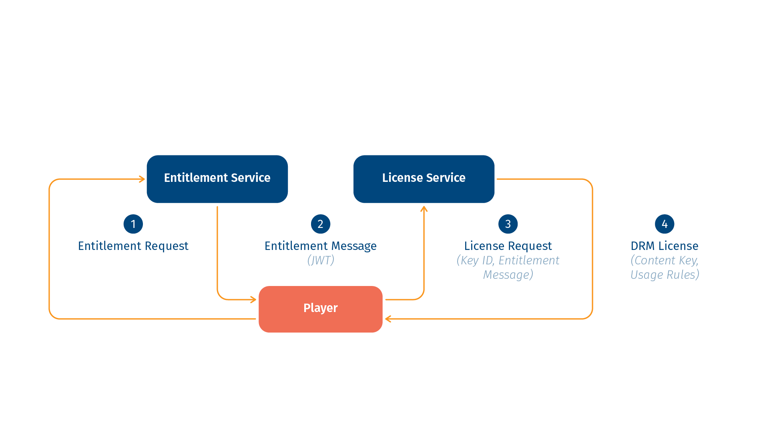
Authorizing playback at runtime
JWT – JSON Web Token is a widely supported standard

Slide 13
Contents of an Entitlement Message (represented as JWT)
...
"content_keys_source": {
"inline": [
{
"id": ”c39ad9e7-0ab3-4534-9e9f-9853615e26f6",
"usage_policy": "Audio"
},
{
"id": ”6d329dff-db5e-48ef-b096-3ef347b16c7f",
"usage_policy": "SD"
},
{
"id": "29f05e8f-a1ae-46e4-80e9-22dcd44cd7a1",
"usage_policy": "HD"
}
]
},
"content_key_usage_policies": [
{
"name": "Audio”
},
{
"name": "SD",
"widevine": {
"device_security_level": "SW_SECURE_CRYPTO",
"hdcp": "2.2"
},
"playready": {
"min_device_security_level": 2000,
"uncompressed_digital_video_opl": 300
}
},
{
"name": "HD",
"widevine": {
"device_security_level": "HW_SECURE_ALL",
"hdcp": "NO_DIGITAL_OUTPUT"
},
"playready": {
"min_device_security_level": 3000,
"uncompressed_digital_video_opl": 400
}
}
]
}

Slide 14
What about the player side?
Notes:
So what about the player side, that’s a good question!

Slide 15
What about the player side?
License
Server
Player
CDM
Notes:
As mentioned by Johannes, DRM is mostly a story written between trusted components in the DRM server and as close as possible to the client hardware, in the CDM.
At a glance, the player is just a component in the middle, having to pass through the relevant data, right?
Well, not really. The player actually has a large impact

Slide 16
What about the player side?
License
Server
Media
Server
Player
CDM
Notes:
While the raw license data has to be passed to the CDM, there is a major integration point: the streaming protocols
There are of course many, HLS and DASH being the most popular today.

Slide 17
Thou shalt not stall
Notes:
The first and foremost important role of the player is to ensure smooth playback.
This means making sure your buffer is full. It means ABR, adapting to the right quality for your network, switching between HLS Variant Streams and DASH Representations.
This is where doing multi-key has a huge impact. So why? What does a player need to do when switching qualities?
Let’s have a look at what the flow is of a quality switch.

Slide 18
An unaware player’s approach to quality switching
Step 1: Determine which stream to switch to
Step 2: (Optionally download an updated playlist or manifest.)
Step 3: (Optionally download a map or initializer file & append it to the buffer.)
Step 4: Download the media data & append it to the buffer.
Step 5: Play
Notes:
Switching qualities for a simple player isn’t that hard. You download the playlist, you download the initializer and media data and add it to the buffer.
There are however a few gaps.

Slide 19
An unaware player’s approach to quality switching
Step 1: Determine which stream to switch to
Step 2: (Optionally download an updated playlist or manifest.)
Step 3: (Optionally download a map or initializer file & append it to the buffer.)
Optionally a license request
Step 4: Download the media data & append it to the buffer.
Optionally a license request
Step 5: Play
Notes:
After step 3 or 4, you’ll get a license request from the CDM.

Slide 20
An unaware player’s approach to quality switching
Step 1: Determine which stream to switch to
Step 2: (Optionally download an updated playlist or manifest.)
Step 3: (Optionally download a map or initializer file & append it to the buffer.)
Optionally a license request
Step 4: Download the media data & append it to the buffer.
Optionally a license request
Step 4b: Issue a license request and pass the response to the CDM.
Step 5: Play
Notes:
As a result, you’ll need to get that license and append it. Here, it might go wrong. Imagine if you can’t get that license. Or the device your viewer is using might not satisfy the restrictions. That’s a problem, and the switch will need to be aborted. This all takes time. As a result, the buffer will be drained, and the player will stall.

Slide 21
Thou shalt not stall
Notes:
We’re breaking the rules here. So what should a proper player do?

Slide 22
An unaware player’s approach to quality switching
Step 1: Determine which stream to switch to
and identify if another key is needed
Step 2: (Optionally download an updated playlist or manifest.)
Step 3: (Optionally download a map or initializer file & append it to the buffer.)
Step 4: Download the media data & append it to the buffer.
Step 5: Play
Notes:
First mistake: a player should be aware if another key is needed. This can in some cases be seen in the manifest. If this information is available, it must be used. If the key ID is known, the player can even ask the CDM if that key is still valid. As a result, you can ensure you won’t end up with an invalid license. So what else?

Slide 23
An unaware player’s approach to quality switching
Step 1: Determine which stream to switch to
and identify if another key is needed
Step 2: (Optionally download an updated playlist or manifest.)
identify the PSSH and use it to do an early request for the license
Step 3: (Optionally download a map or initializer file & append it to the buffer.)
Step 4: Download the media data & append it to the buffer.
Step 5: Play
Notes:
Another step, is to identify the PSSH from the manifest or playlist as soon as possible and ensure there is a license. This also provides a second clue if a different key is being used, in case you couldn’t observe it earlier.
Of course things could still go wrong. So an important other thing is…

Slide 24
An unaware player’s approach to quality switching
Step 1: Determine which stream to switch to
and identify if another key is needed
and decide if you will really want to make the switch, and have the buffer to do this
Step 2: (Optionally download an updated playlist or manifest.)
identify the PSSH and use it to do an early request for the license
Step 3: (Optionally download a map or initializer file & append it to the buffer.)
Step 4: Download the media data & append it to the buffer.
Step 5: Play
Notes:
Make sure you can make that switch, without running out of buffer, even if things still go wrong.
Often, switching down is OK: requirements are lower for lower qualities and bitrates. But switching up, it’s important to keep in mind there might be a catch. In fact, if you have the PSSH, it doesn’t hurt to test if you can make that switch while still downloading the media data of the previous quality.
And there’s a last step.

Slide 25
An aware player’s approach to quality switching
Step 0: Ensure your CDM is set up to handle the most strict restrictions (if possible).
Step 1: Determine which stream to switch to
and identify if another key is needed
and decide if you will really want to make the switch, and have the buffer to do this
Step 2: (Optionally download an updated playlist or manifest.)
identify the PSSH and use it to do an early request for the license
Step 3: (Optionally download a map or initializer file & append it to the buffer.)
Step 4: Download the media data & append it to the buffer.
Step 5: Play
Notes:
Or better said: a first.
Make sure you try to apply the rule of strictest requirements. If available on your platform: request Hardware DRM from the start, even if the license turns out to only enforce software-based DRM. It doesn’t come at a cost to do this, but it can bring big advantages down the line.
All of these things are important to keep in mind. It’s not common for all players to do this today, so make sure you have a player which is capable of handling this setup when you decide to reconfigure your DRM setup.
By performing these steps, we can ensure all of the stated requirements requirements are checked, and we can actually adhere to the content owners’ requirements.

Slide 26
2.
Why is protecting live/linear streaming so hard?

Slide 27
Scenario 2: Protecting linear streaming
Content owner:
“Linear streams must rotate encryption keys every 2 hours.”
Notes:
- It’s a misconception that rotating keys increases security
Better reason: two shows within a linear stream need separate authorization, because of different sets of resolutions or content owners require different output protection

Slide 28
Scenario 2: Protecting linear streaming
Naive approach
Announce a new <Period> when keys must rotate. Let end user devices find out and send license requests.

Slide 29
Notes:
Probably the quickest way to create your very own sophisiticated DDOS attack.
So as you can see, without mitigation such a simple requirement like rotating encryption keys causes the perfect “license request storm”.

Slide 30
Scenario 2: Protecting linear streaming
Let‘s do some math:
Audience: 1 million
Latency ~30 seconds
Notes:
Audience: 1 mln. concurrent streams
→ 1 million clients, each sending a DRM license request within a 30 second timeframe

Slide 31
Scenario 2: Protecting linear streaming
>30.000 rps
Notes:
And that‘s on average.
It‘s a common goal to reduce latency. In this naive approach bringing latency down works against the DRM service‘ stability.

Slide 32
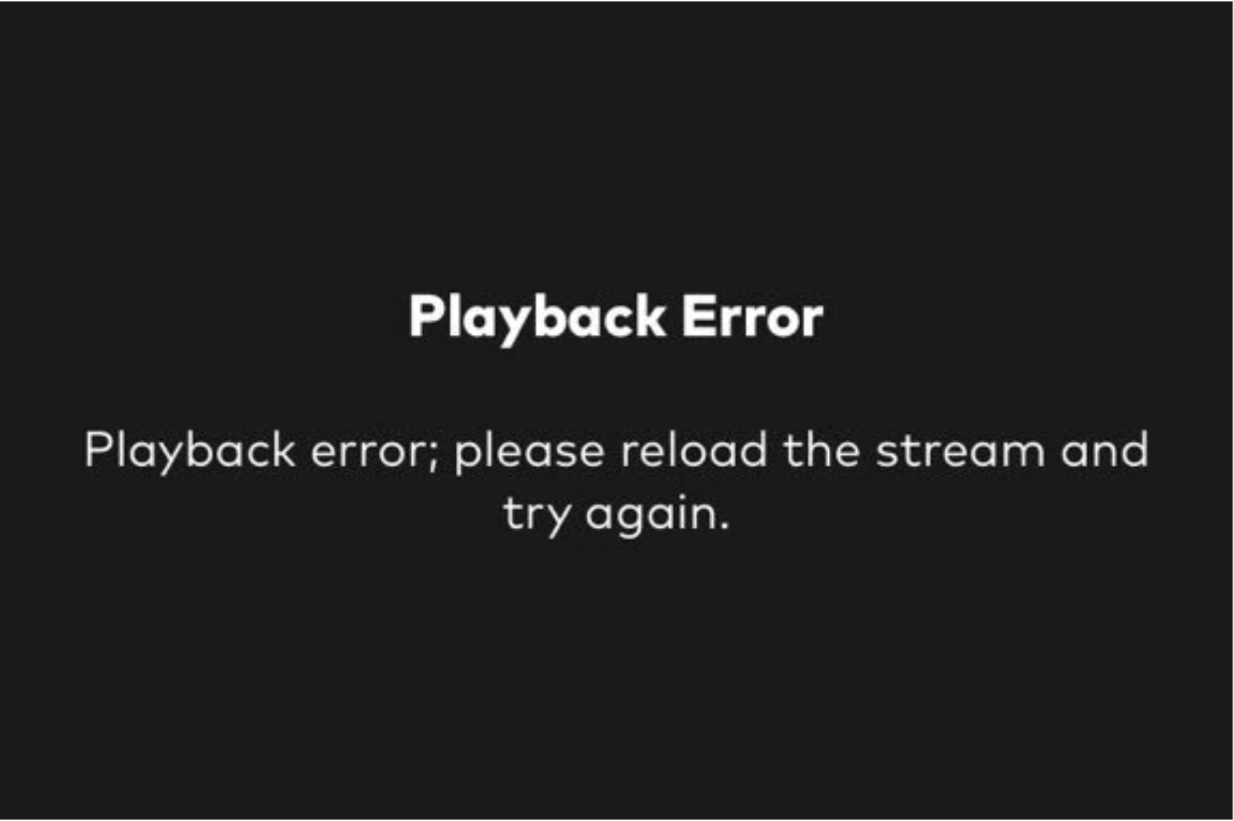
Scenario 2: Protecting linear streaming

Slide 33
Scenario 2: Protecting linear streaming
Mitigation strategies:
Increase service capacity
Distribute license acquisition over time
Notes:
More about the second option later
We have come across all sorts of “interesting” ideas. A mitigation strategy that does NOT work: trying to ”pre-produce” and cache DRM licenses in a CDN. Every DRM license response is unique and it depends on the client device. There is no way around performing a license request transaction with the DRM service.
Axinom offers customers to choose their own “guaranteed capacity”.

Slide 34
Scenario 2: Protecting linear streaming
Live events – when stretching over time is NOT possible:
A (potentially) large audience tunes in at the very same time
Everyone needs a license NOW.
Notes:
Do start your/some stream BEFORE the event in order to make everyone request a DRM license immediately. In other words: do not make everyone wait in the few minutes before the event stream starts without the possibility to send a license request. And then open the flood gates (bad idea!)

Slide 35
Scenario 2: Protecting linear streaming
Have a big audience? When working with a DRM service vendor verify that
Your capacity needs can be met (with some margin)
In the geography of your expected audience
Test it
Notes:
Axinom offers:
Guaranteed capacity. This means the service is guaranteed to be able to deliver x (you name it) licenses every second for an extended period of time.
Axinom has license servers in many data centers around the world: North and South America, Europe, Asia (several DCs in India), and Australia
Least latency routing makes sure that your clients are served from the closest DRM license server available

Slide 36
Scenario 2: Protecting linear streaming
Wait a minute.
Does the multi-key topic have any impact on this?
Notes:
Widevine supports multiple keys in one license response
PlayReady supports multiple licenses in one response (since 2015)
FairPlay returns one key per license request
Having high service capacity is nice and that’s all good. But there was second mitigation strategy which I think there’s more to it. Back to you Pieter-Jan

Slide 37
Spread the !
Notes:
So the question is, what else can you do to make this all run smooth? Well, you can spread the love. Or better phrased, the load.
How to do this? Well, you can make your player smarter.
Think about the case which Johannes mentioned: 1M viewers which all need a license in 30 seconds. That's a lot. But what happens if you only have a 2s latency?

Slide 38
Spreading the load
500.000 rps
Notes:
That's 500 thousand requests per second. This is massive. You need a lot infrastructure to tackle this. But the worst thing about this...

Slide 39
Spreading the load
500.000 rps
for 2s, then nothing...
Notes:
Is that the remainder of the time, this infrastructure is close to idle. If you rotate every 2 hours, that's 7198 idle seconds, and 2s of work. When rounding up, that's 0.03% of the time. That's not a lot.
If you could however spread that load, and 1M requests come in over the full 2 hours, that would mean only 140 requests per second. You don't need big infrastructure for this. So how can we make this happen?

Slide 40
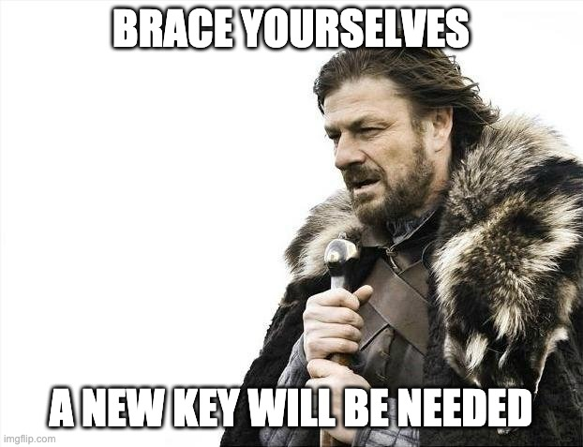
Notes:
It's simple: make sure the player knows.
For example, when you announce your new DASH period: add in the PSSH with the updated key.
You'll be quick to spot this only solves part of the problem: you won't be announcing your period that much up front. Problem? Not solved. So what else should we do?

Slide 41
How about using multiple keys in one license?
Notes:
The answer can be quite simple: use multiple keys in one license. In your PSSH, you can add in multiple key ids. You could use this for multiple keys across representations and renditions, but also across time.

Slide 42
Hi Mr Server, could I get the key for KID 1?
Sure, here you go. And take the key for KID 2 as well!
Notes:
When a client needs a key, you can in that same license provide the key for the next period as well. That way, when the player sees a new PSSH for the new period, a smart player can identify it already has that key.

Slide 43
But this just delays the problem...
Notes:
But this just delays the problem, right? When the next key is used as well, and a next one is needed, you'll once again have clients in need of a license. It will be half the clients, but that's still a lot.
This is true. There's more to it. You'll need to get your client to update its license during the period to also fetch the next key.
Also, note that the license doesn't have to be delivered any more within the time of the buffer. If it is delivered at a later point in time, that's fine: playback of the next period can already start. But it can be done in an even better way.
While improving on this is not something which can be done with any run-of-the-mill kind of setup, you'll need some specific integration here.
There are some options...

Slide 44
But this just delays the problem...
Not really, a smart player can handle this
Notes:
For example, players can identify if keys are valid or not, and can see from PSSH boxes which keys will be requested in a license.
I'm not saying it's trivial, but it is possible. And if you do this right, you can spread out the load evenly, and avoid these license request storms.
Even if you use a mixed player solution, or some platforms don't allow multiple keys in one license, every platform you can remove from the license storm, means an improvement.
With the right DRM partner, you can scale to any number of license requests per second. With the right player partner, you can bring this number of requests per second down, and spread it out.

Slide 45
3.
Integrating DRM in your content supply chain.
How to get started with DRM implementation?

Slide 46
https://portal.axinom.com

Slide 48
Get started now! Visit:
axinom.com/drm
theoplayer.com
Notes:
So as you can see, it’s very easy to add DRM to your flow! There’s no reason not to do it.
I hope you all enjoyed this webinar.

