Slide 1
Unity Storage Array Profile
^{Unity_Sample_325}
^{Project:}
^{Project ID:}
^{Sample}
^{Prepared For:}
^{Sample, sample@test.com}
^{Prepared By:}
,
^{Created:}
^{10/14/2020}
Copyright © 2020 Dell Inc.
PPTX 2018.08.14

Slide 2
Common Summary: Inventory, Capacity and Workload
Inventory and Capacity Summary
Workload Peak (Maximum) Measurements
Workload Summary 95th Percentile Measurements
Serial No. | Sample
Model No. | Unity 300
Software Level | 5.0.1
Configuration File Date | 9/23/2020 2:16:51 PM
Performance Start | 9/23/2020 10:00:10 AM
Performance End | 9/23/2020 12:59:50 PM
Performance Interval | 10 sec
Cache | 24.0
Fast Cache | 0.0
Total No. Drives | 38
No. Flash Drives | 8
No. Spinning Drives | 30
Flash Usable (TB) | 2.5
Spinning Disk Usable (TB) | 30.5
Used Capacity (TB) | 1.4
Usable TB | 24.0
LUN Skew – Avg IO | 100.00%
LUN Skew – 95th IO | 100.00%
Peak IOPS: Date Time | 2020-09-23 11:30:00
Peak IOPS: IOPS | 1835
Peak IOPS: Read % | 0
Peak IOPS: Avg. Read Size (KB) | 0.0
Peak IOPS: Avg. Write Size (KB) | 511.97
Peak IOPS: MB/s | 917.8
Peak IOPS: Latency (ms) | 7.85
Peak MB/s: Date Time | 2020-09-23 11:30:00
Peak MB/s: IOPS | 1835
Peak MB/s: Read % | 0
Peak MB/s: Avg. Read Size (KB) | 0.0
Peak MB/s: Avg. Write Size (KB) | 511.97
Peak MB/s: MB/s | 917.8
Peak MB/s: Latency (ms) | 7.85
95th IOPS: Date Time | 2020-09-23 10:39:00
95th IOPS: IOPS | 1783.2
95th IOPS: Read % | 0
95th IOPS: Avg. Read Size (KB) | 0.0
95th IOPS: Avg. Write Size (KB) | 512.06
95th IOPS: MB/s | 891.7
95th IOPS: Latency (ms) | 8.1
95th MB/s: Date Time | 2020-09-23 10:33:00
95th MB/s: IOPS | 1783.4
95th MB/s: Read % | 0
95th MB/s: Avg. Read Size (KB) | 0.0
95th MB/s: Avg. Write Size (KB) | 512.0
95th MB/s: MB/s | 891.7
95th MB/s: Latency (ms) | 8
95th SPA Utilization | 0%
95th Sample Utilization | 52.43%
Copyright © 2020 Dell Inc.
PPTX 2018.08.14

Slide 3
Summary - Unity300-Sample
Hardware Overview
Software Features
Serial No. | Sample
Model No. | Unity 300
Software Level | 5.0.1
Memory (GB) | 24
No. DPEs & DPAs | 2
Active Drives | 31
Inactive Drives | 7
Empty Slots | 2
All Inclusive
Input Data
Emulations
Connectivity
Configuration File Date | 9/23/2020 2:16:51 PM
Performance Start | 9/23/2020 10:00:10 AM
Performance End | 9/23/2020 12:59:50 PM
Performance Interval | 10 sec
Archive File Quantity | 3
Block | This Live Optics report shows block usage only. File usage is not reported.
FC 4GB | 0
FC 8GB | 0
FC 16GB | 1
1 GigE | 2
10 GigE | 2
25 GigE | 0
Copyright © 2020 Dell Inc.
PPTX 2018.08.14

Slide 4
Capacity Summary by Drive Type
Name | Model | Disk (TB) | SSD (TB) | Usable (TB) | Used (TB) | Utilization (%)
Unity300-Sample | Unity 300 | 30.5 | 2.5 | 24.0 | 1.4 | 5
Drive Type | Size (GB) | Usable Size (GB) | Number of Drives | % of IOPS | Capacity (TB) | Capacity (%)
HDD | 1834 | 1834 | 14 | 100.0 | 25.07 | 76.1
HDD | 550 | 550 | 10 | 0.0 | 5.37 | 16.3
SSD | 366 | 366 | 7 | 0.0 | 2.5 | 7.6
Total Capacity (TB) | Total Capacity (%)
32.9 | 100
Copyright © 2020 Dell Inc.
PPTX 2018.08.14

Slide 5
Array Profile Details

Slide 6
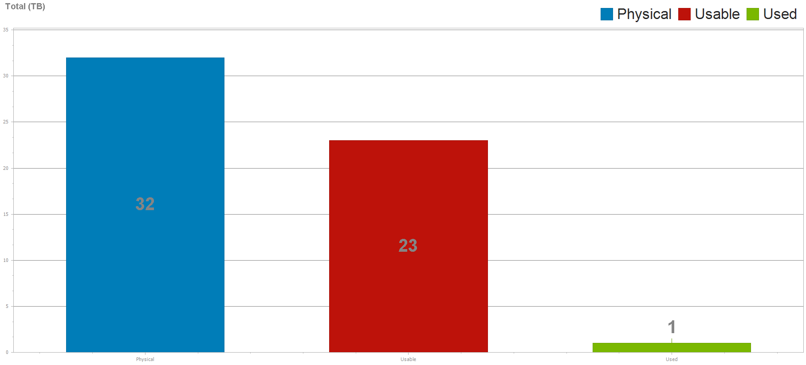
Array Summary
Copyright © 2020 Dell Inc.
PPTX 2018.08.14

Slide 7
Fibre Channel Ports - Unity300-Sample
Name | Speed (Gbit/sec) | Read MB/sec 95th | Write MB/sec 95th | Read MB/sec Peak | Write MB/sec Peak | Read MB/sec Avg | Write MB/sec Avg
Sample_iom_1_fc0 | 16 | 0 | 891 | 0 | 917 | 0 | 851
Copyright © 2020 Dell Inc.
PPTX 2018.08.14

Slide 8
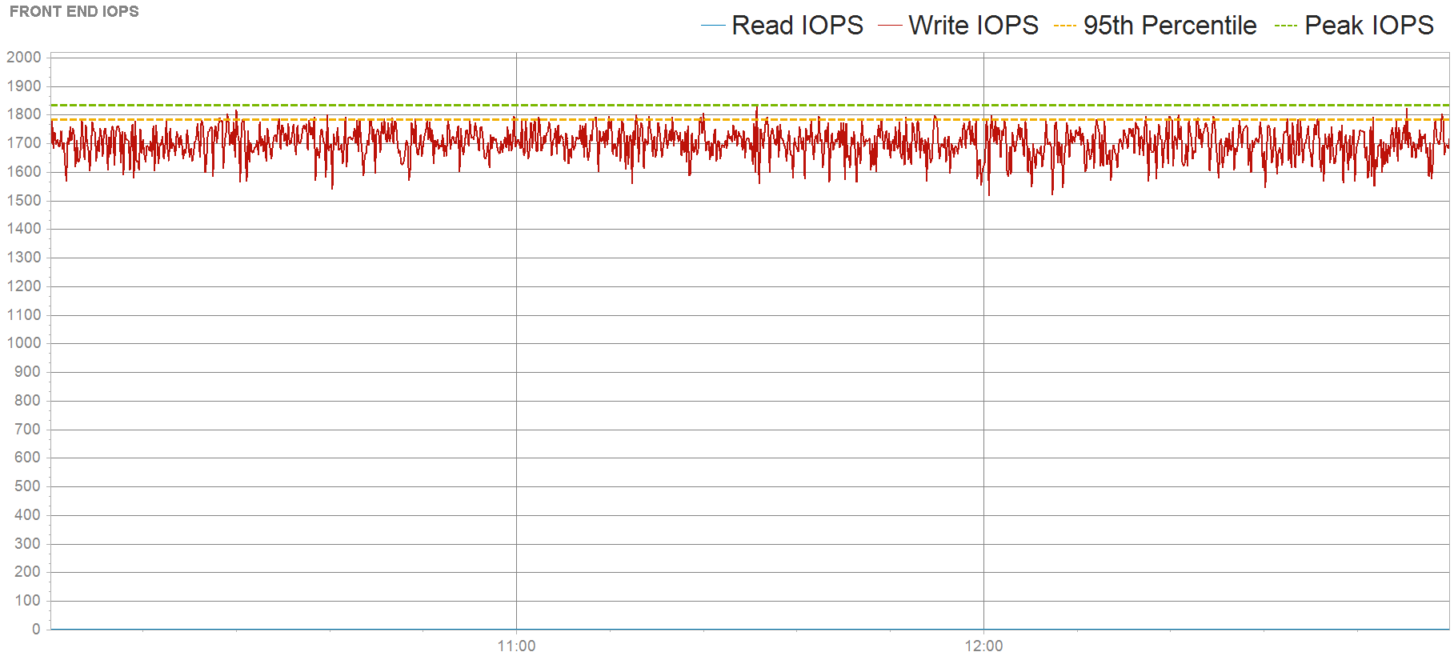
Front End IOPS - Unity300-Sample
Copyright © 2020 Dell Inc.
PPTX 2018.08.14

Slide 9
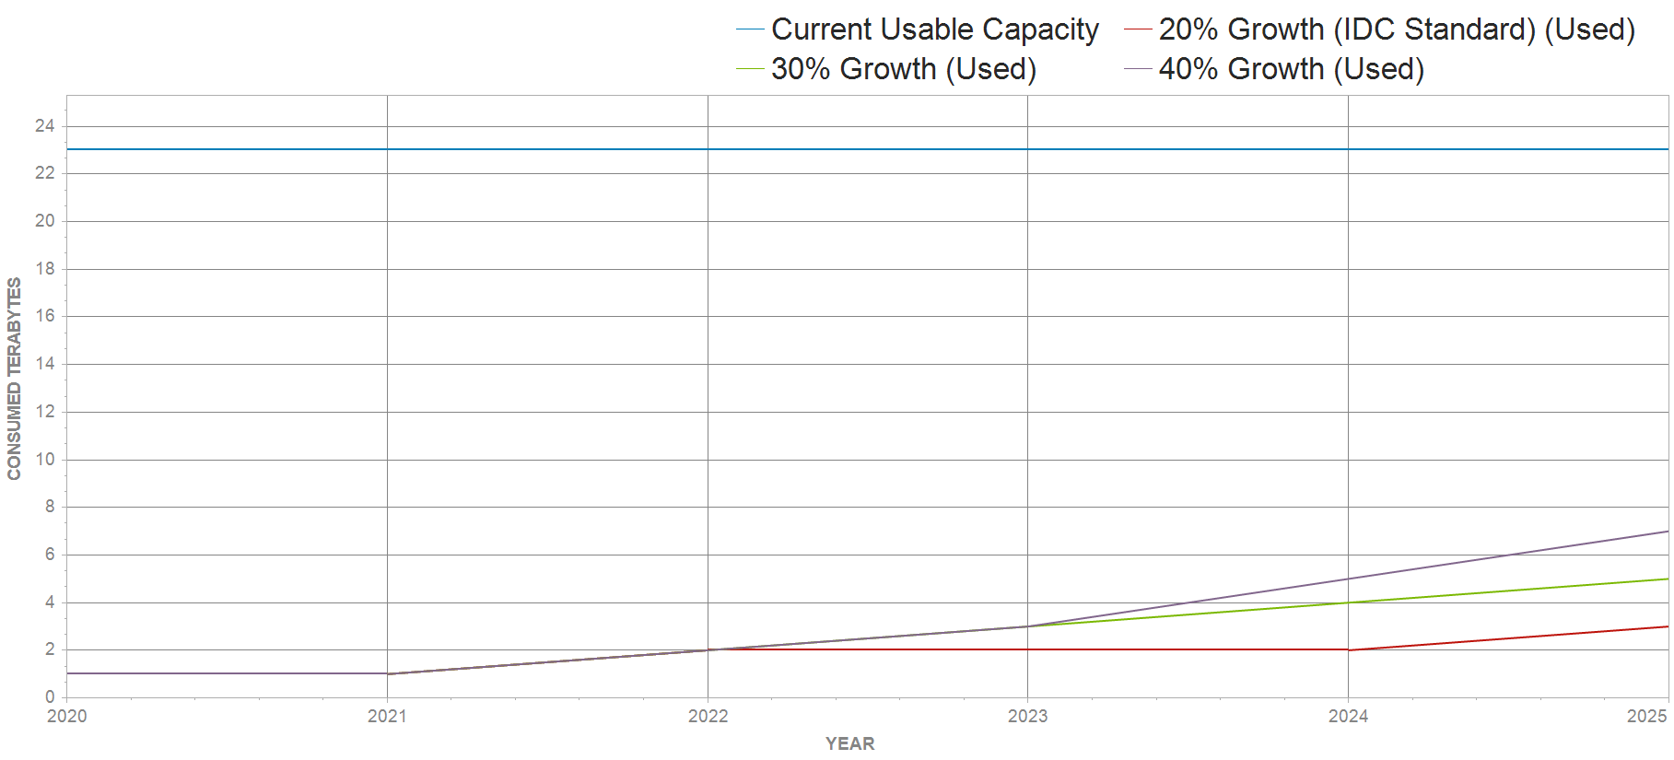
5 Year Growth projection
At 20% growth, usable capacity will not be exceeded within 5 year(s).
Copyright © 2020 Dell Inc.
PPTX 2018.08.14

Slide 10
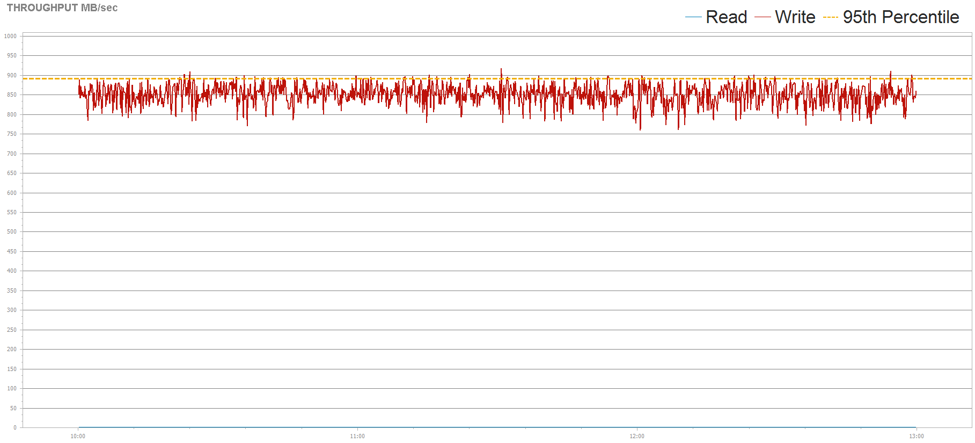
Front End MB/s - Unity300-Sample
Copyright © 2020 Dell Inc.
PPTX 2018.08.14

Slide 11
Top 5 Clients by IOPS
Copyright © 2020 Dell Inc.
PPTX 2018.08.14

Slide 12
Top 5 Clients by IOPS
Client | #LUNs | Used (TB) | Peak IOPS | Response Time (ms) | Front End MB/sec | Read % | Avg IO Size (KB)
r300Sample147 | 4 | 0.76 | 1835.70 | 8.48 | 917.80 | 0.00 | 512.00
c220Sample166 | 3 | 0.65 | 0.00 | 0.00 | 0.00 | 0.00 | 0.00
svtesx166149.svt.Sample.emc.com | 1 | 0.65 | 0.00 | 0.00 | 0.00 | 0.00 | 0.00
r300Sample149 | 4 | 0.65 | 0.00 | 0.00 | 0.00 | 0.00 | 0.00
Test_JP_Host_1 | 3 | 0.65 | 0.00 | 0.00 | 0.00 | 0.00 | 0.00
Copyright © 2020 Dell Inc.
PPTX 2018.08.14

Slide 13
Front End IOPS vs Back End IOPS
Copyright © 2020 Dell Inc.
PPTX 2018.08.14

Slide 14
IO Size & Read Percent - Unity300-Sample
Copyright © 2020 Dell Inc.
PPTX 2018.08.14

Slide 15
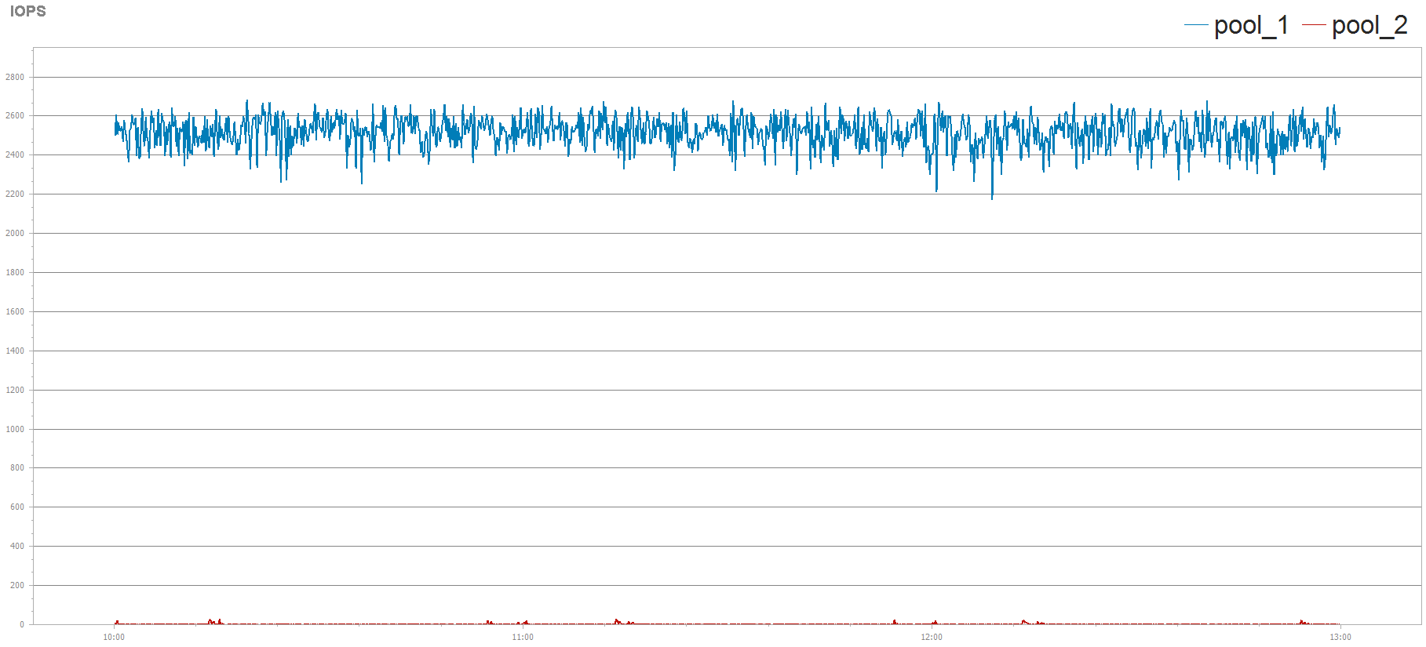
Back End Activity by Pool - Unity300-Sample
Copyright © 2020 Dell Inc.
PPTX 2018.08.14

Slide 16
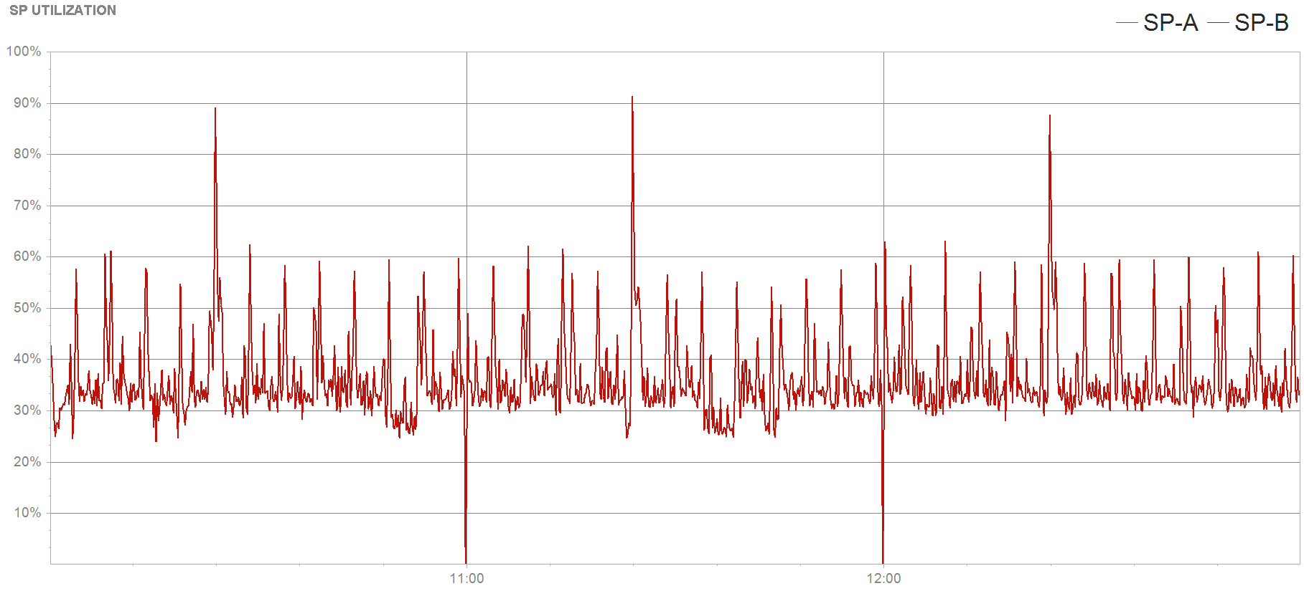
Storage Processor Utilization
Copyright © 2020 Dell Inc.
PPTX 2018.08.14

Slide 17
Front End Ports: Peak Composite
Copyright © 2020 Dell Inc.

Slide 18
Peak/Average Ports Utilization
Peak Utilization
Average Utilization
Copyright © 2020 Dell Inc.
Notes:
FE Port Utilization – Avg/Peak

Slide 19
Cache Utilization
Copyright © 2020 Dell Inc.
PPTX 2018.08.14

Slide 20
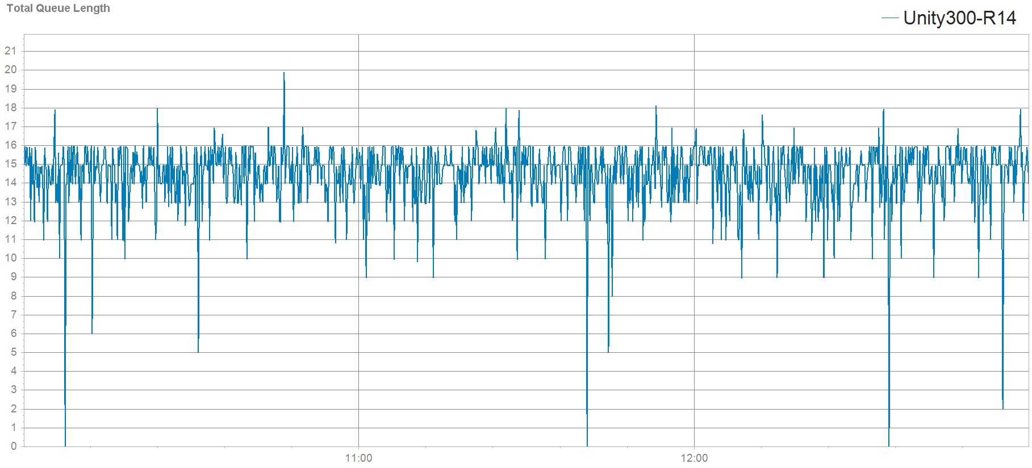
Total Average Busy Queue Length
Shows the total average busy queue length across both SPs.
Copyright © 2020 Dell Inc.
PPTX 2018.08.14

Slide 21
Top Clients and LUNs

Slide 22
Top 15 LUNs by IOPS - Unity300-Sample
LUN | Front End IOPS - max | Front End MB/sec - max | Avg IO Size (KB) | Latency (ms) - max | Latency (ms) - avg | Avg Queue Length - max | Read % - avg
Test21 | 1835.70 | 917.80 | 512.00 | 9.58 | 8.48 | 19.92 | 0.00
flag | 0.00 | 0.00 | 0.00 | 0.00 | 0.00 | 0.00 | 0.00
HikariDS | 0.00 | 0.00 | 0.00 | 0.00 | 0.00 | 0.00 | 0.00
DR_test | 0.00 | 0.00 | 0.00 | 0.00 | 0.00 | 0.00 | 0.00
LR01_Sampleahm9-lun00 | 0.00 | 0.00 | 0.00 | 0.00 | 0.00 | 0.00 | 0.00
s | 0.00 | 0.00 | 0.00 | 0.00 | 0.00 | 0.00 | 0.00
ss lun2 | 0.00 | 0.00 | 0.00 | 0.00 | 0.00 | 0.00 | 0.00
CG-lun-1 | 0.00 | 0.00 | 0.00 | 0.00 | 0.00 | 0.00 | 0.00
JJ-450F | 0.00 | 0.00 | 0.00 | 0.00 | 0.00 | 0.00 | 0.00
Asama1 | 0.00 | 0.00 | 0.00 | 0.00 | 0.00 | 0.00 | 0.00
Copyright © 2020 Dell Inc.
PPTX 2018.08.14
Notes:
This shows the top 15 LUNS by IOPS

Slide 23
Top 15 LUNs by IOPS - Unity300-Sample
LUN | Front End IOPS - max | Front End MB/sec - max | Avg IO Size (KB) | Latency (ms) - max | Latency (ms) - avg | Avg Queue Length - max | Read % - avg
Clone02-Sampleahm9-lun00 | 0.00 | 0.00 | 0.00 | 0.00 | 0.00 | 0.00 | 0.00
RR01_Sampleahm9-lun-clone | 0.00 | 0.00 | 0.00 | 0.00 | 0.00 | 0.00 | 0.00
flag2 | 0.00 | 0.00 | 0.00 | 0.00 | 0.00 | 0.00 | 0.00
Sampleahm9-lun00 | 0.00 | 0.00 | 0.00 | 0.00 | 0.00 | 0.00 | 0.00
flag3 | 0.00 | 0.00 | 0.00 | 0.00 | 0.00 | 0.00 | 0.00
Copyright © 2020 Dell Inc.
PPTX 2018.08.14
Notes:
This shows the top 15 LUNS by IOPS

Slide 24
Top 15 LUNs by MB/s - Unity300-Sample
LUN | Front End IOPS - max | Front End MB/sec - max | Avg IO Size (KB) | Latency (ms) - max | Latency (ms) - avg | Avg Queue Length - max | Read % - avg
Test21 | 1835.70 | 917.80 | 512.00 | 9.58 | 8.48 | 19.92 | 0.00
flag | 0.00 | 0.00 | 0.00 | 0.00 | 0.00 | 0.00 | 0.00
HikariDS | 0.00 | 0.00 | 0.00 | 0.00 | 0.00 | 0.00 | 0.00
DR_test | 0.00 | 0.00 | 0.00 | 0.00 | 0.00 | 0.00 | 0.00
LR01_Sampleahm9-lun00 | 0.00 | 0.00 | 0.00 | 0.00 | 0.00 | 0.00 | 0.00
s | 0.00 | 0.00 | 0.00 | 0.00 | 0.00 | 0.00 | 0.00
ss lun2 | 0.00 | 0.00 | 0.00 | 0.00 | 0.00 | 0.00 | 0.00
CG-lun-1 | 0.00 | 0.00 | 0.00 | 0.00 | 0.00 | 0.00 | 0.00
JJ-450F | 0.00 | 0.00 | 0.00 | 0.00 | 0.00 | 0.00 | 0.00
Asama1 | 0.00 | 0.00 | 0.00 | 0.00 | 0.00 | 0.00 | 0.00
Copyright © 2020 Dell Inc.
PPTX 2018.08.14
Notes:
This shows the top 15 LUNS by IOPS

Slide 25
Top 15 LUNs by MB/s - Unity300-Sample
LUN | Front End IOPS - max | Front End MB/sec - max | Avg IO Size (KB) | Latency (ms) - max | Latency (ms) - avg | Avg Queue Length - max | Read % - avg
Clone02-Sampleahm9-lun00 | 0.00 | 0.00 | 0.00 | 0.00 | 0.00 | 0.00 | 0.00
RR01_Sampleahm9-lun-clone | 0.00 | 0.00 | 0.00 | 0.00 | 0.00 | 0.00 | 0.00
flag2 | 0.00 | 0.00 | 0.00 | 0.00 | 0.00 | 0.00 | 0.00
Sampleahm9-lun00 | 0.00 | 0.00 | 0.00 | 0.00 | 0.00 | 0.00 | 0.00
flag3 | 0.00 | 0.00 | 0.00 | 0.00 | 0.00 | 0.00 | 0.00
Copyright © 2020 Dell Inc.
PPTX 2018.08.14
Notes:
This shows the top 15 LUNS by IOPS

